Slide 1
Virtualization
An Introduction to Virtualization

Slide 2
INTRODUCTION
Virtualization is a technique for hiding the physical characteristics of computing resources from the way in which other systems, applications, or end users interact with those resources.
Virtualization allows you, virtually and cost-effectively, to have two or more computers, running two or more completely different environments, on one piece of hardware.

Slide 3
Why do we need Virtualization
To install Client OS over Client OS.
To install Server OS over Client OS.
To install Client OS over Server OS.
To install Server OS over Server OS.
To resolve compatibility issues.
To have multiple OS on single machine without physically partitioning the hard drive.
To maximize resource utilization.

Slide 4
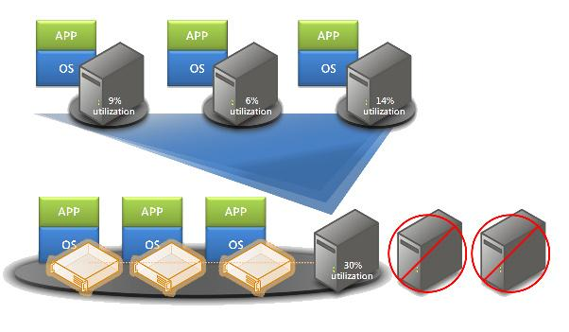
An example of Virtualization

Slide 5
TYPES OF VIRTUALIZATION
Operating System Virtualization
  Desktop virtualization
  Server virtualization
Application Virtualization
Storage Virtualization
Database Virtualization
Network Virtualization

Slide 6
Operating System Virtualization
Operating system virtualization refers to the use of software to allow system hardware to run multiple instances of different operating systems concurrently, allowing you to run different applications requiring different operating systems on one computer system.

Slide 7
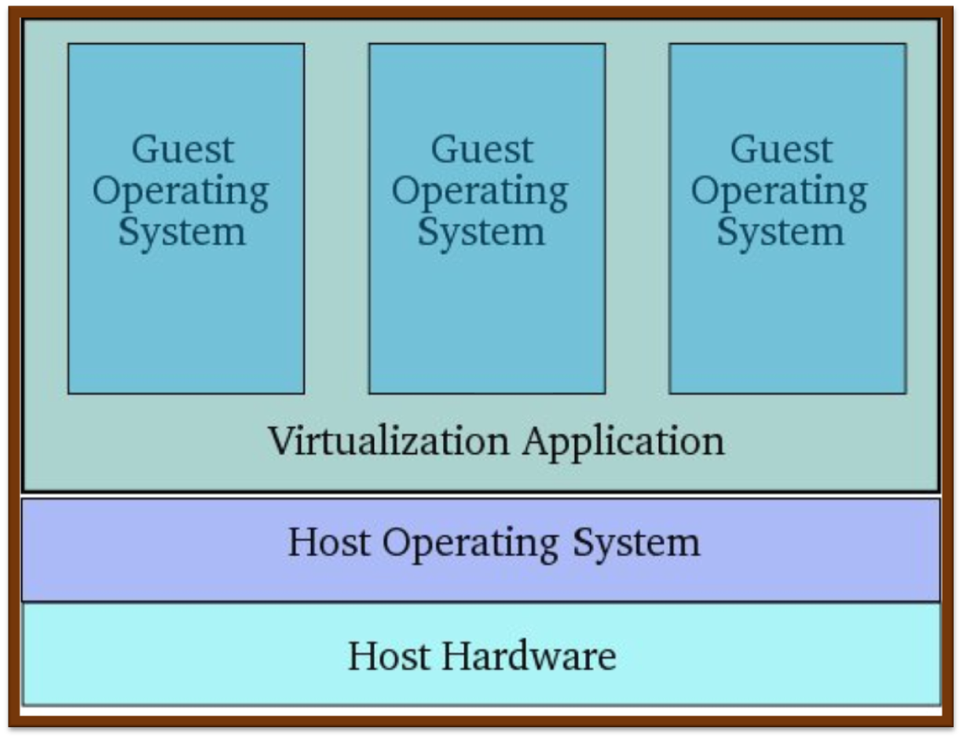
Figure: Operating System Virtualization

Slide 8
  Desktop virtualization
  Desktop Virtualization creates a separate OS environment on the desktop, allowing a non-compatible legacy application to operate within a more current desktop operating system.
  Server virtualization
  Server Virtualization creates a separate OS environment that is logically isolated from the host server. This allows greater density of resource use (hardware, utilities, space) while providing operational isolation and security.

Slide 9
Application Virtualization
While most of the prevalent virtualization strategies focus on hardware infrastructure, an important and often overlooked method is application virtualization.
With application virtualization end-user software is "packaged," stored, and distributed in an on-demand fashion across a network.
Virtualized applications use a common abstraction layer, which defines a protocol, allowing them to communicate with one another in a standard messaging format.

Slide 10
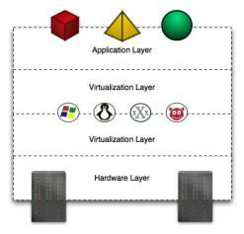
Figure : Operating System Virtualization and Application Virtualization

Slide 11
Storage Virtualization
Perhaps the most widely deployed and highly regarded virtualization practice, storage virtualization allows separate storage devices to be combined into a perceived single unit. Storage virtualization attempts to maximize the efficiency of storage devices in information architecture.

Slide 12
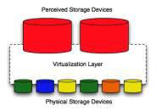
Figure: Storage Virtualization

Slide 13
Database Virtualization
Database virtualization allows the use of multiple instances of a DBMS, or different DBMS platforms, simultaneously and in a transparent fashion regardless of their physical location. These practices are often employed in data mining and data warehousing systems.

Slide 14
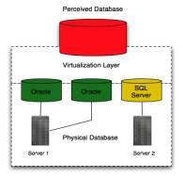
Figure : Database Virtualization

Slide 15
Network Virtualization
By virtualization a network, multiple networks can be combined into a single network, or a single network can be separated logically into multiple parts. A common practice it to create virtual LANs, or VLANs, in order to more effectively manage a network.

Slide 16
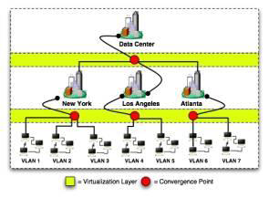
Figure : Network Virtualization

Slide 17
TYPES OF VIRTUALIZATION
(IN TERMS OF CLOUD)
P2V(Physical to Virtual)
V2P(Virtual to Physical)
V2V(Virtual to Virtual)
P2P(Physical to Physical)

Slide 18
P2V(Physical to Virtual)
Physical to virtual (P2V) is a term that refers to the migration of an operating system (OS), application programs and data from a computer's main harddisk to a virtual machine or a disk partition

Slide 19
V2V(Virtual to Virtual)
Virtual to virtual (V2V) is a term that refers to the migration of an operating system (OS), application programs and data from a virtual machine or disk partition to another virtual machine or disk partition

Slide 20
V2P(Virtual to Physical)
Virtual to physical (V2P) is a term that refers to the migration of an operating system (OS), application programs and data from a virtual machine or disk partition to a computer's main harddisk.

Slide 21
P2P(Physical to Physical)
Physical to Physical (P2P) is a term that refers to the migration of an operating system (OS), application programs and data from a computer's main hard disk to a new disk partition

Slide 22
Load Balancing
One characteristic of cloud computing is virtualized network access to a service. No matter where you access the service, you are directed to the available resources. The technology used to distribute service requests to resources is referred to as load balancing.

Slide 23
Advance Load Balancing
The more sophisticated load balancers are work load managers. They determine the current utilization of the resources in their pool, the response time, the work queue length, connection latency and capacity, and other factors in order to assign tasks to each resource.

Slide 24
Understand hypervisor
A low-level program is required to provide system resource access to virtual machines, and this program is referred to as the hypervisor or Virtual Machine Monitor(VMM).

Slide 25
Types of hypervisor
Native Hypervisor
Embedded Hypervisor
Hosted Hypervisor

Slide 26
Native Hypervisor
Native(or Type I) hypervisors, which sit directly on the hardware platform are most likely used to gain better performance for individual users.

Slide 27
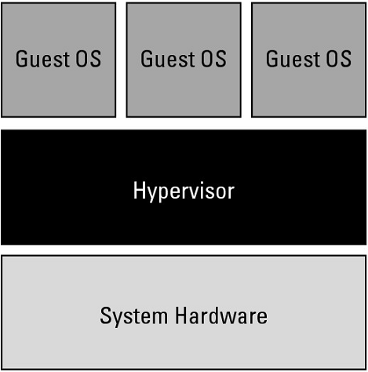
Type 1 hypervisor

Slide 28
Embedded Hypervisor
Embedded hypervisors are integrated into a processor on a separate chip. Using this type of hypervisor is how a service provider gains performance improvements.

Slide 29
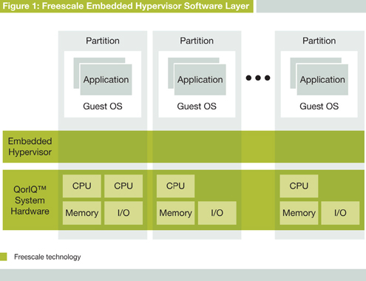
Embedded Hypervisor

Slide 30
Hosted Hypervisor
Hosted(or Type 2) hypervisors run as a distinct software layer above both the hardware and the OS. This type of hypervisor is useful both in private and public clouds to gain performance improvements

Slide 31
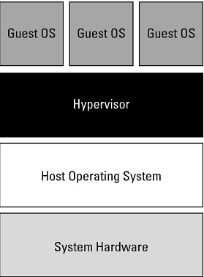
Type 2 hypervisor

Slide 32
High Level Abstraction
Emulation
Para Virtualization
Full Virtualization

Slide 33
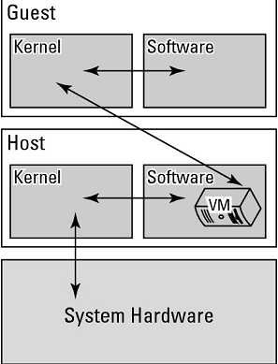
Emulation

Slide 34
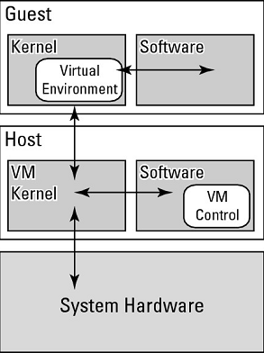
Para Virtualization

Slide 35
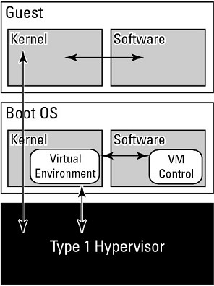
Full Virtualization

Slide 36
Static vs. Dynamic Virtualization
There are two types of virtualization:
Static Virtualization
Dynamic Virtualization

Slide 37
Static Virtualization
With the static architecture, each user always connects to the same virtual machine (VM) that exists and is maintained between sessions. This means for every user, you need a VM, which obviously requires a large amount of storage for all the VMs.

Slide 38
Dynamic Virtualization
With a dynamic architecture, the VMs are not persistent and when a user connects, a new VM is created based on a master template, the user personality is placed onto the new VM and applications are made available through application virtualization, giving very fast availability of the session.

Slide 39
Why Virtualization &
Benefits Of Virtualization
Virtualization support Green Computing.
Virtual machines can be used to consolidate the workloads of several under-utilized servers to fewer machines, perhaps a single machine (server consolidation).
Virtualization can enable existing operating systems to run on shared memory multiprocessors.
Virtual machines make software easier to migrate, thus aiding application and system mobility.
Virtualization provide a base to cloud computing.

Slide 40
Virtualization Software
Virtualization software is available for a variety of needs, ranging from free or no-cost software for desktop users to six-figure packages for data-center operators. The package you choose will depend on what you need to accomplish with the technology.
Commercial Virtualization Software
Free and Open-Source Virtualization Software

Slide 41
Commercial Virtualization Software :
VMWare:-
  VMWare products run on both Windows and Unix/Linux variants, as well as on Mac.
Microsoft Virtual Server and Virtual PC:-
Microsoft Virtual Server and Microsoft Virtual PC offer a growing user base, freely available online documentation, and allow you to run as many guests as your hardware can support.
Parallels:-
    The first commercial virtualization product that could run on Mac OS hosts ― Parallels also offers products that run on Windows and Linux hosts.

Slide 42
Free and Open-Source Virtualization Software:
As with many other software technologies, there are free and open-source alternatives to commercial virtualization software. Options in this arena include Qemu and FreeVPS.

Slide 43
BUSINESS VALUE IN VIRTUALIZATION
Hardware and Software Costs
  Server Costs
  VMware Costs
  Operations Costs
  Energy Costs
  Data Center Space Costs
  Installation Costs

Slide 44
Foundational issues
License Management
Service Levels
Network Management
Workload Administration
Capacity Planning

Slide 45
License Management
Many license agreements tie license fees to physical servers rather than to virtual servers. Resolve these licenses before using the associated software in a virtual environment. The constraints of such licenses may become an obstacle to efficiency.

Slide 46
Service Levels
Measuring, managing, and maintaining service levels can become more complicated simply because the environment itself is more complex.

Slide 47
Network Management
The real target of network management becomes the virtual network, which may be harder to manage than the physical network.

Slide 48
Workload Administration
Set policies to determine how new resources can be provisioned, and under what circumstances. Before a new resource can be introduced, it needs to be approved by management.
Also, the administrator has to be sure that the right security policies are included.

Slide 49
Capacity Planning
Although it’s convenient to think that all servers deliver roughly the same capacity, they don’t. With virtualization, you have more control of hardware purchases and can plan network resources accordingly.

Slide 50
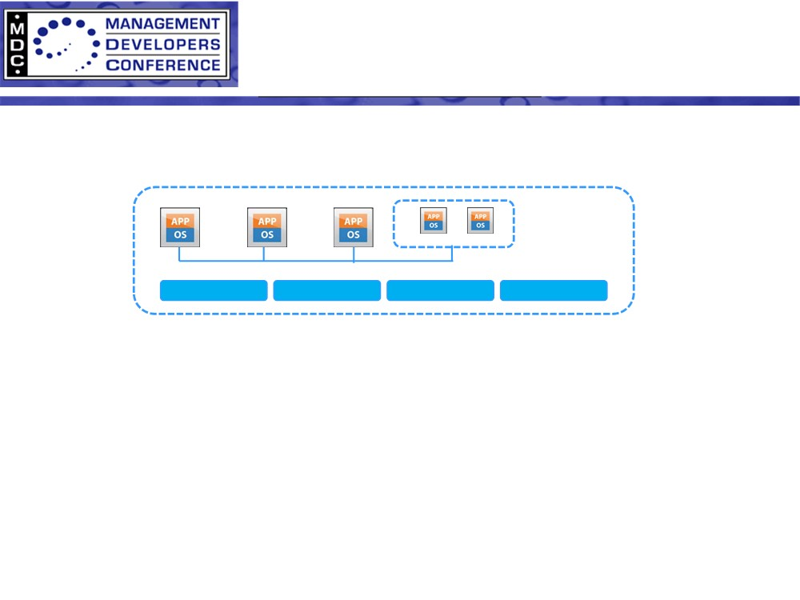

Open Virtualization Format
• A distribution format for virtual appliances
- Provides a complete description of a single VM or complex multi-VM software
solution package
Virtual HW desc
Licensing
Properties
Other meta-data
• Vendor and platform independent
- Interoperable across virtualization platforms
• Extensible
- Facilitate value-added features by DMTF or third-parties
• DMTF specification
- Version 0.9 technology submission September 2007
- Version 1.0 preliminary September 2008
- Version 1.0 final February 2009
- Version 1.1 in approval process, work-in-progress available
- Version 2.0 work has started
Source: OVF Overview presentation of DMTF SVPC WG at MDC Conference 2009

Slide 51
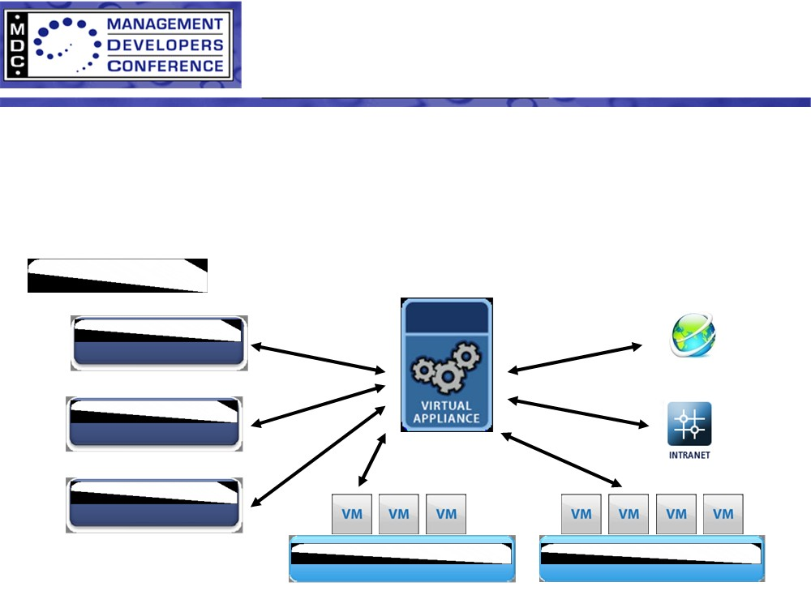
Large Scale VM distribution
• Provisioning is a critical function
- How do different products and vendors exchange VMs?
- How do different products interoperate on meta-data?
- Suitability of data for distribution?
Authoring Tools
Backup Tools
Analysis Tools
Source: OVF Overview presentation of DMTF SVPC WG at MDC Conference 2009

Slide 52
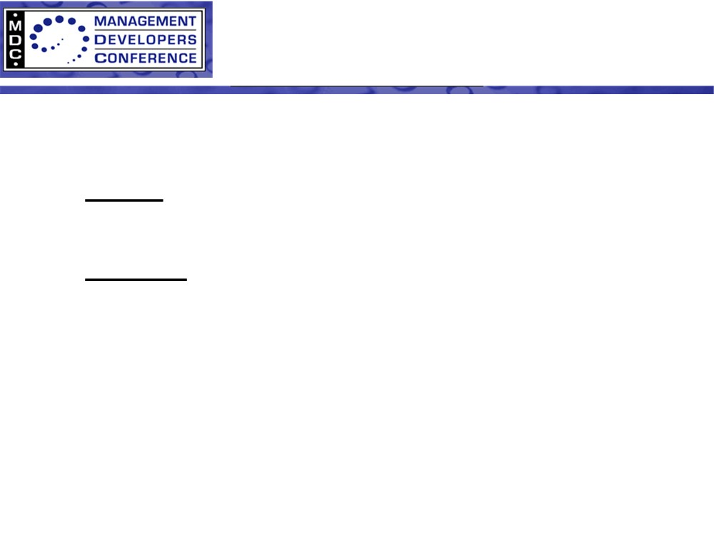
OVF Workflow
Author→ Distribute → Deploy
• Author Role: To create a complete software package
that makes life simple for the deployer
• Deployer Role: Deploy and customize the package
for a particular instance
• Author must express and deployer must understand:
- Compatibility and optimization requirements
- Resource requirements
- Entitlements requirements
- Customization options
- Package integrity
Source: OVF Overview presentation of DMTF SVPC WG at MDC Conference 2009

Slide 53
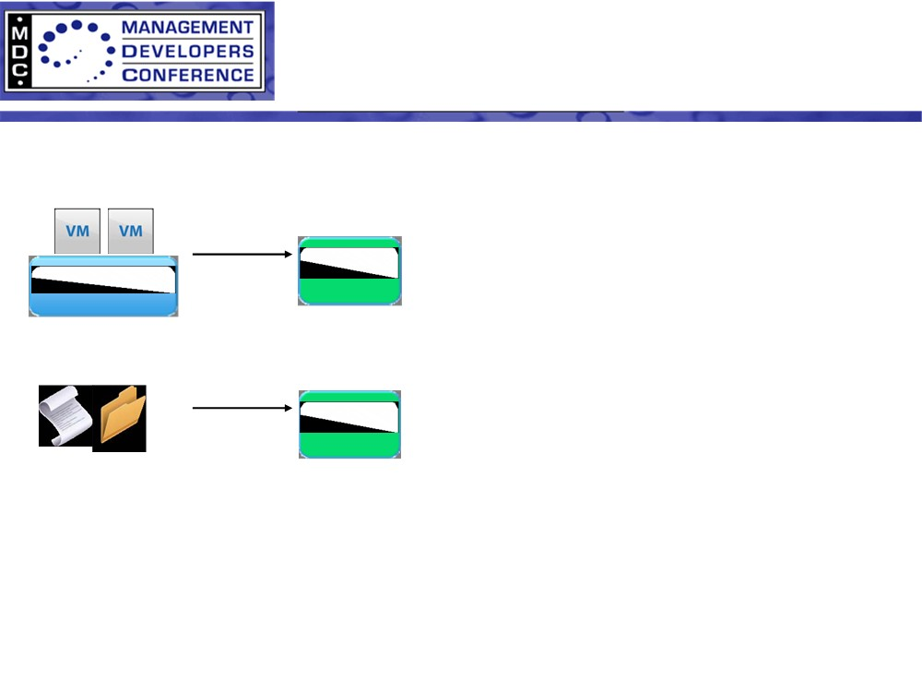
OVF Authoring
• A virtual machine can be exported
into OVF or built from source
export
• The author can describe “portable
hardware” for maximum
interoperability or optimum
performance
build
• The virtual machine images can be
compressed to facilitate distribution
Source
• The author can sign the package to
guarantee its integrity
Source: OVF Overview presentation of DMTF SVPC WG at MDC Conference 2009

Slide 54
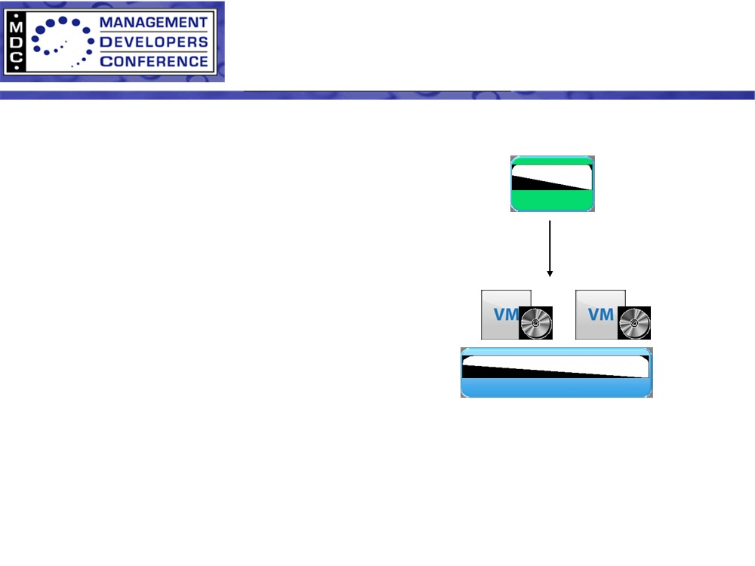
OVF Deployment
• Validation
- Verify licensing, security, integrity
- Resource requirements and
placement
- Application properties (such as IP
addresses and passwords)
import
• Conversion
OVF
environment
- Convert virtual disks to run-time
format
• Installation
- Provide runtime environment for
application (customization and
localization)
Source: OVF Overview presentation of DMTF SVPC WG at MDC Conference 2009

Slide 55
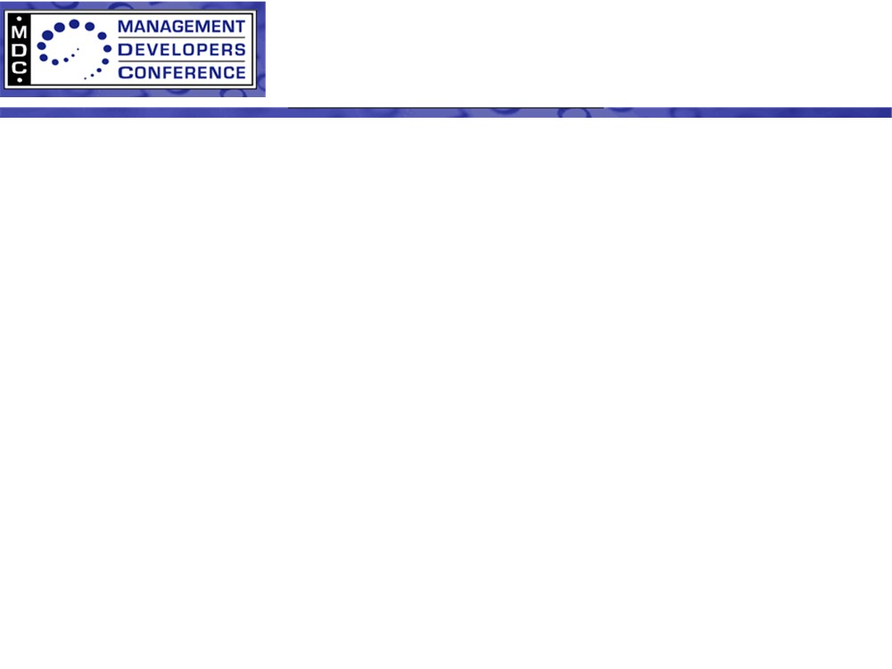
Open Virtualization Format
• Complete description of Virtual Machine
Supports multiple disk formats and virtual hardware platforms.
• Supports single VM and multi-VM configurations
Models multi-tier services consisting of multiple VMs, including
composed services.
• Optimized for distribution
Supports verification, signing, versioning, and handling of licensing
terms.
• Optimized for simple, automated user experience
Supports validation of entire package, provides descriptive information
to user, and includes application level meta-data.
• Vendor and platform independent
Does not rely on specific host platform, virtualization platform, or guest
operating system properties.
Source: OVF Overview presentation of DMTF SVPC WG at MDC Conference 2009

Slide 56
Open Virtualization Format
• Extensible
Allows vendor specific meta-data and provides an extensible hardware
description model supporting future advances in virtualization
technology.
• Localizable
Supports user visible descriptions in multiple locales.
• Open standard
A collaboration of key vendors
Source: OVF Overview presentation of DMTF SVPC WG at MDC Conference 2009
3

Slide 57
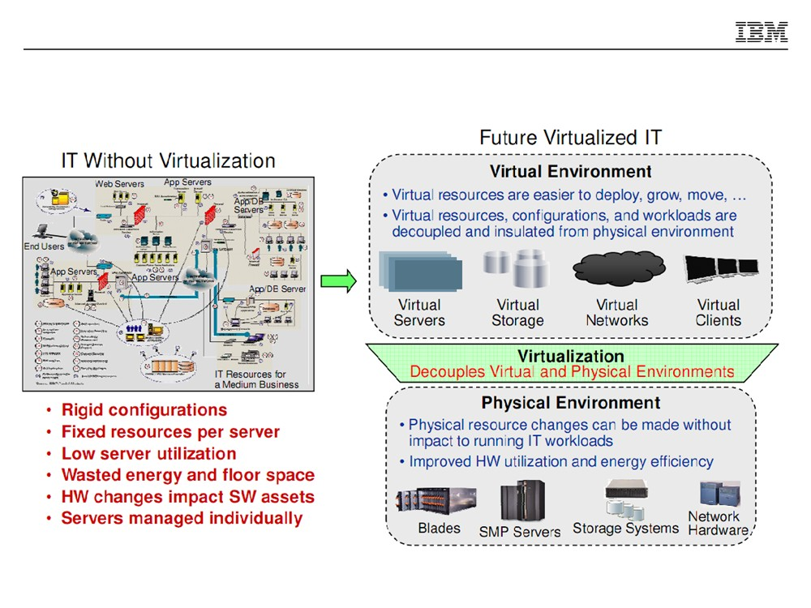

Slide 58
Conclusion
Virtualization technology brings benefit to a wide variety of usage scenarios. It provides many different techniques to enhance system impregnability through isolation, configuration independence and thereby software interoperability, better system utilization, and accountable and predictable performance.
Although an impressive set of technologies, virtualization exposes the cracks disguised by the enterprise operational models of the past two decades.

Slide 59
Any Query???

Slide 60
Thanks!!!

