Slide 1

Tic- tac- toe
Made by:
Tanya Gupta
04214803114
5I123

Slide 2
Android Overview
2003
Android Inc
2005
Google
2007
Open Handset Alliance
Google, HTC, Intel, LG, Motorola, Nvidia, Samsung, T-Mobile...
Goal: Develop open standards for mobile devices
Android is
a software platform and operating system for mobile devices
based on the Linux kernel
developed by Google / the Open Handset Alliance.
Android Apps are
managed code in the Java* language
controlling the device via Google-developed Java libraries.

Slide 3
Tic Tac Toe Board
Tic-Tac-Toe game can be played by two players where the square block (3 x 3) can be filled with a cross (X) or a circle (O). The game will toggle between the players by giving the chance for each player to mark their move. When one of the players make a combination of 3 same markers in a horizontal, vertical or diagonal line the program will display which player has won, whether X or O.

Slide 4
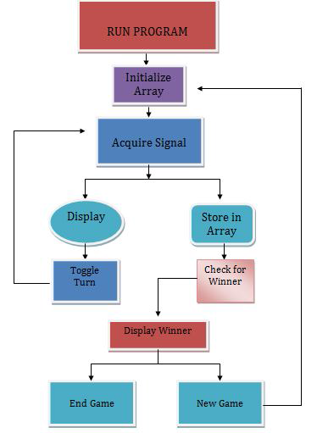
Tic-tac-toe program flow chart

Slide 5
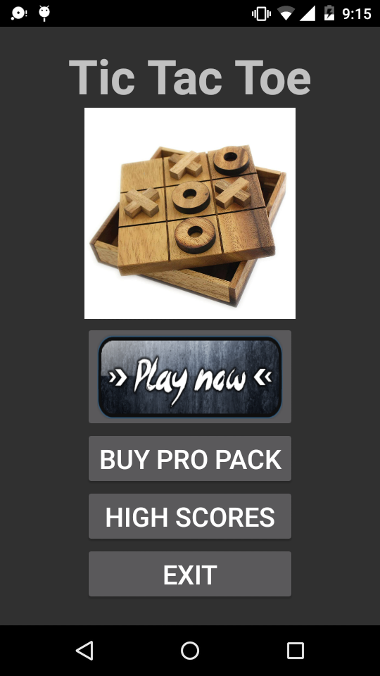
USER INTERFACE
Main Menu
Main menu provides user ability to choose any of the following options:-
Play Now
Buy Pro Pack
High Scores
Exit

Slide 6
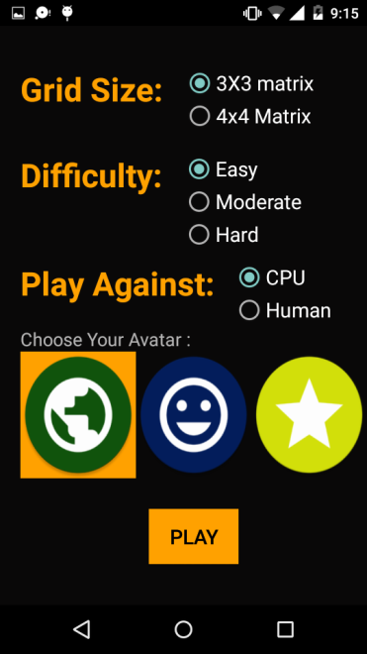
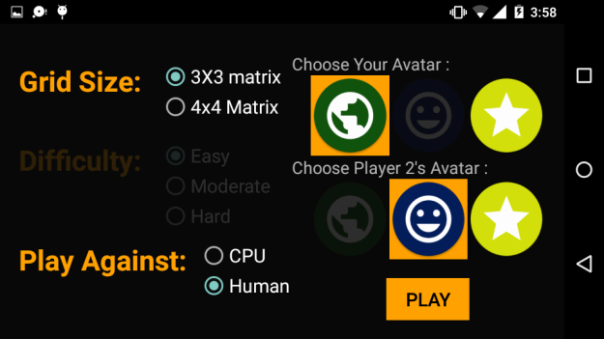
2. Play Now Option
When the user clicks on play now then it provides user ability to change:-
Grid Size
Difficulty level
Number of players

Slide 7
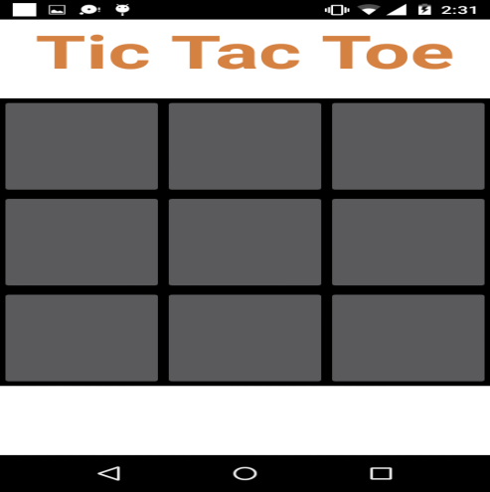
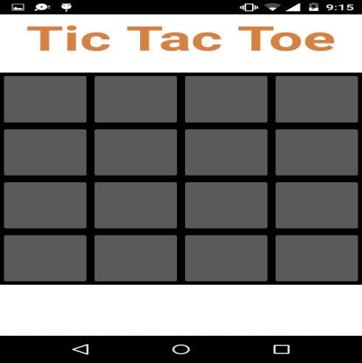
GRID SIZE
Grid Size(3 X 3)
Grid Size(4 X 4)

Slide 8
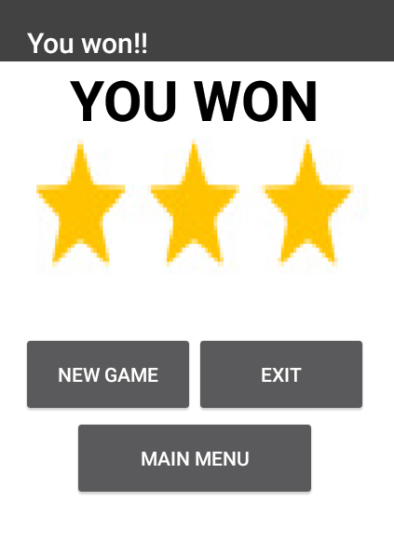
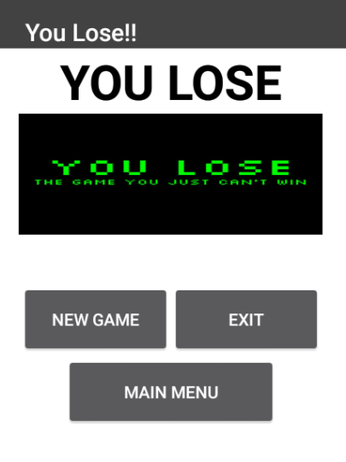
DIFFICULTY LEVEL
Easy– In this level it is very easy to win, even a person playing for the first time can win.
Hard - In this level it is very hard to win, unless you are master of this game.

Slide 9
NO. OF PLAYERS
Single Player - Playing against CPU
It contains difficulty levels.
And single symbol needs to be selected.
Multiple Player - Playing against human
It does not have any sort of difficulty level.
And two symbols need to be selected for each player.

Slide 10
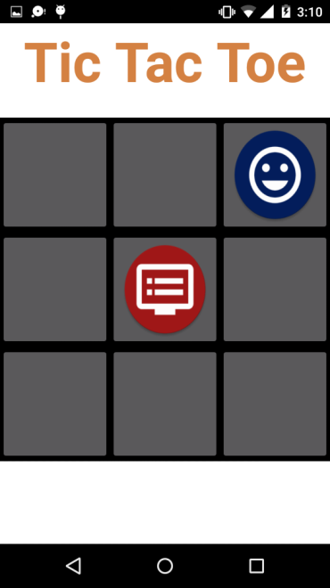
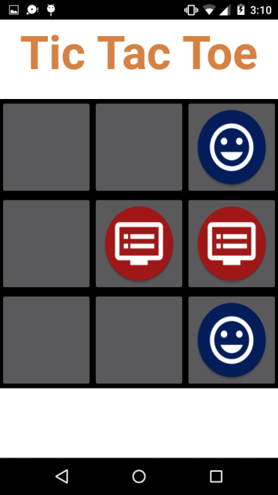
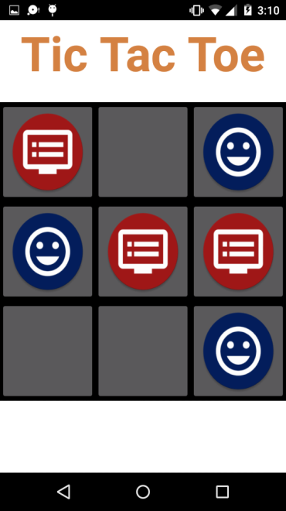
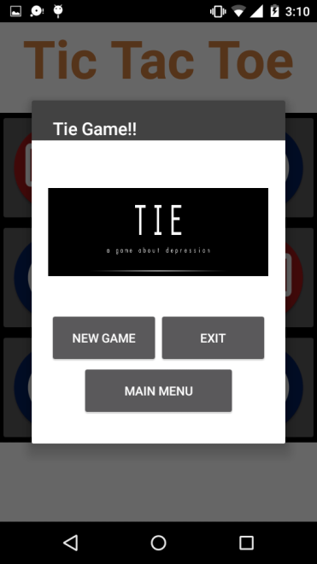
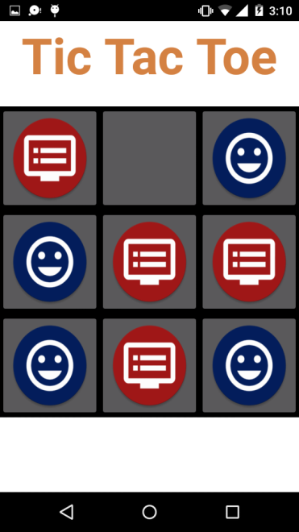
• Playing against CPU

Slide 11
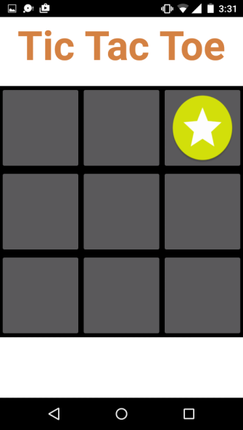
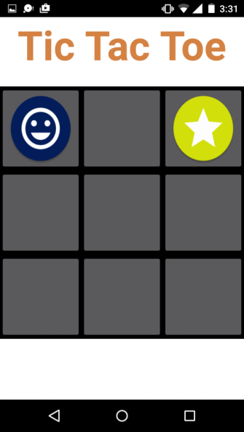
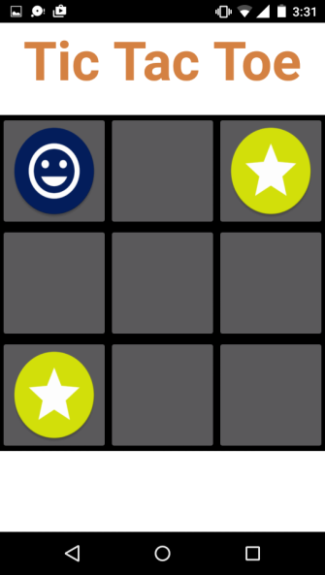
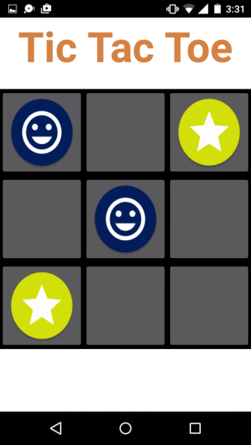
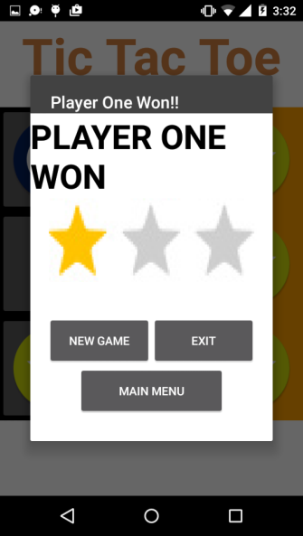
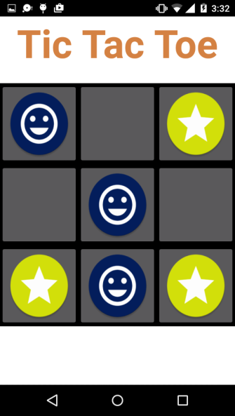
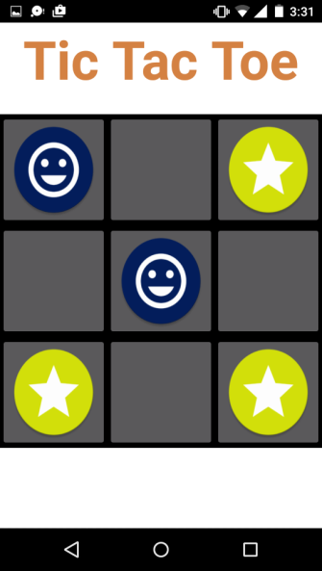
• Playing against Human

Slide 12
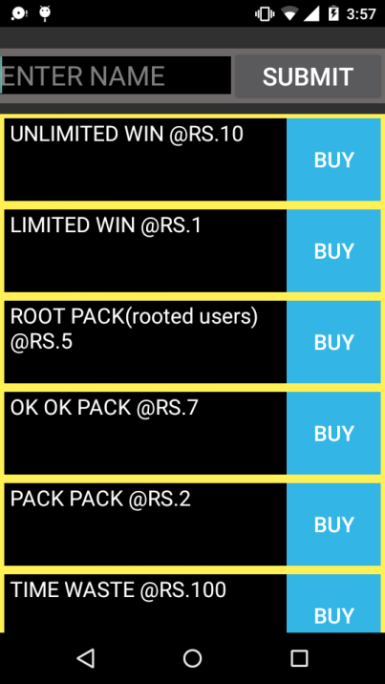
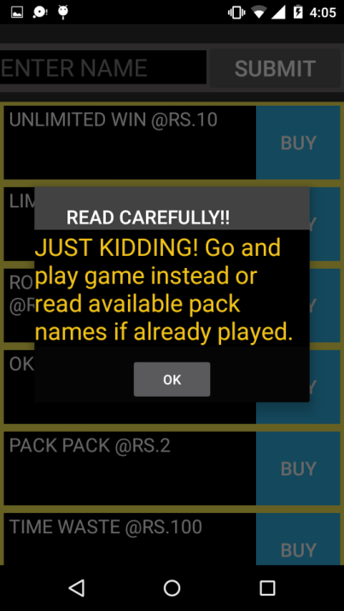
3 Buy Pro Pack
When the user clicks on BUY PRO PACK option then it shows the list of Pro Packs:-

Slide 13
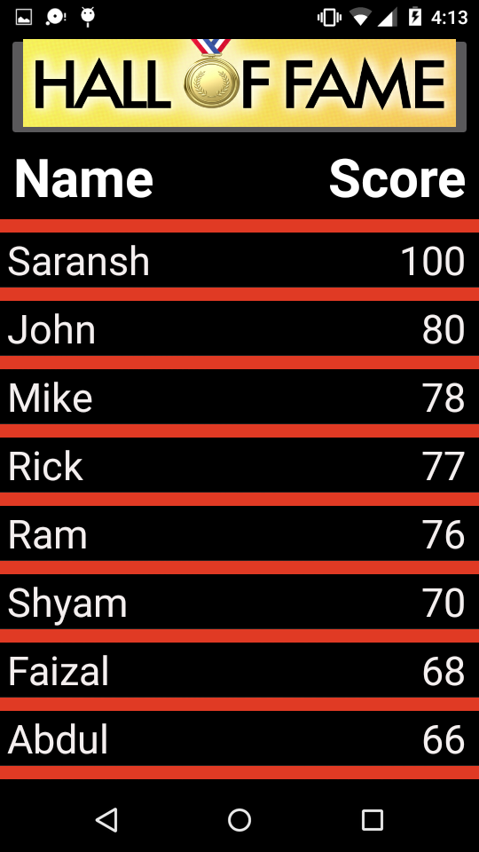
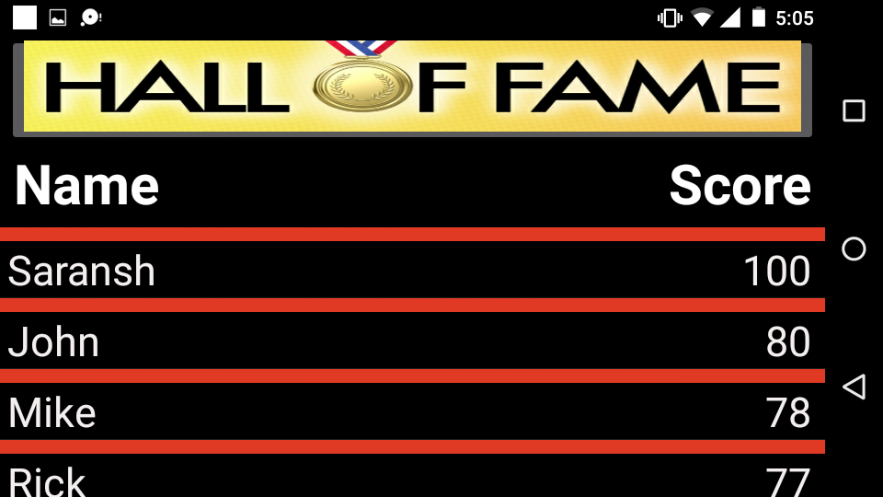
4 High Score
When the user clicks on High Score option then it shows the list of Scores:-

Slide 14
What did we learn?
Technically
we learned also how to use a lot of the components in Android Studio such as the debugger.
I also learned a new language that is XML, a language I didn't know at all earlier.
logic development and logic programming skills.
Using 3rd party API’s and libraries in app.
Loaders
Content Providers for in-app database

Slide 15
Future Aspects
Providing Game Sounds: The game must also provide background sounds. The user also has the facility to mute the sounds whenever he/she pleases.
Providing Instructions to play the Game: For players who are new to the game, instructions are given, so that they too can play.
Providing Hints: Hints are to be given whenever the player requests hints.
Adding Animations: Animations can be implements in the application which will improve the working and presentation of the application.

Slide 16
CONCLUSIONS
We develop and implement tic-tac-toe game in android studio using the platform of the Android SDK. In this system, we create a 3x3 and 4x4 tic-tac-toe game in android. The system is designed so that a single or two players can play a game of tic-tac-toe using this application. The program will contain a display function and a select function to place the symbol as well as toggle between the symbols allowing each player a turn to play the game. The program will update after each player makes their move and will check for the conditions of the game as it goes on.

Slide 17


Slide 18


