Slide 1
TOKYO OLYMPICS 2021
Presented By:
Aastha Deogharia - 202118025
Tanya Jagyasi - 202118039

Slide 2
INTRODUCTION
In this project we were using Tokyo Olympic 2021 database With this project we try to analyze how the Olympics have evolved over time, including questions about the participation and performance of women/men, the variation in athletic build by sport and by nation, and the nature of olympic dominance by nation, which is demonstrated by number of medals received.

Slide 3
DATASET
This dataset is in comma separated format. Which contains 5 tables namely.
• Athlete.csv— Contains details about the participated athletes
• Coaches.csv — Contains details about the coaches (country, discipline, event)
• EntierGender.csv— Entries by Discipline and number of female and male athletes taking part in it
• Medal.csv— Number of gold, silver and bronze medals won by each country
• Team.csv— Contains the details of all the Teams(Country, event, Discipline, Event)

Slide 4
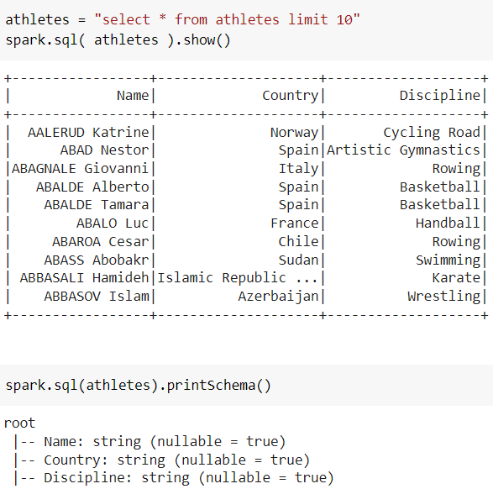
The Athletes

Slide 5
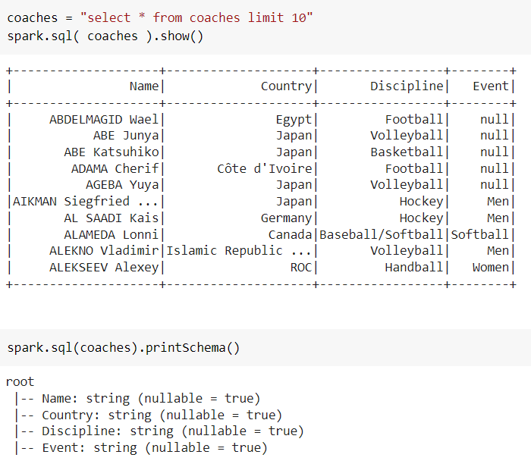
The Coaches

Slide 6
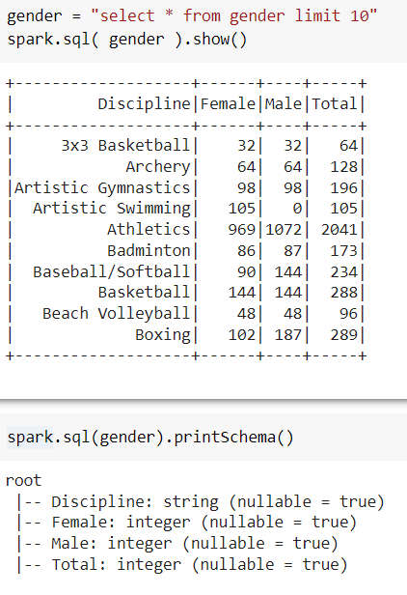
The Genders

Slide 7
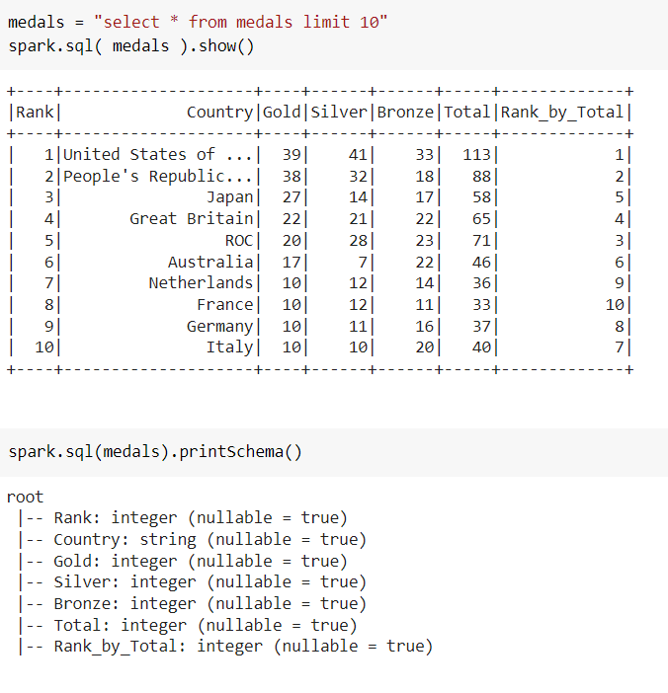
The Medals

Slide 8
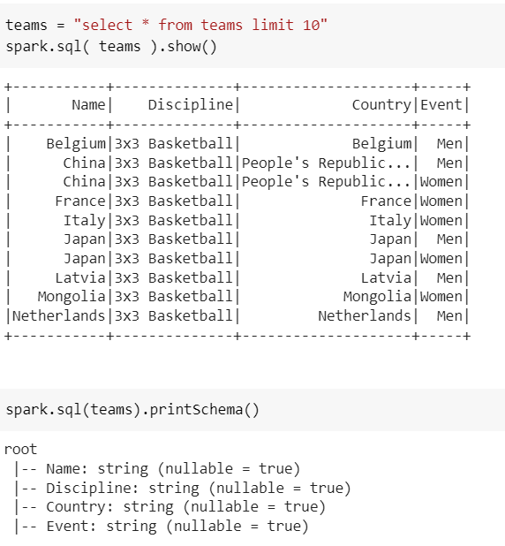
The Team

Slide 9
DATA PREPROCESSING
We have created a function to convert CSV to Tables , it contains the name of the csv and name of the table to which we converted the csv.
We have shown 10 elements of all the tables.

Slide 10
OLAP
Online Analytical Processing (OLAP) is a category of software that allows users to analyze information from multiple database systems at the same time.

Slide 11
ROLAP
ROLAP, or relational OLAP, is multidimensional data analysis that operates directly on data on relational tables, without first reorganizing the data into a cube.

Slide 12
ANALYZING THE DATA USING OLAP:
By using OLAP and Aggregation operations we answered the followings questions:

Slide 13
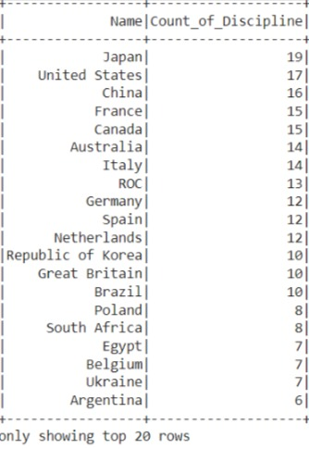
1.How many participation each country have in Tokyo Olympics.

Slide 14
2. What is the total number of Gold Silver and Bronze Medals given in Tokyo Olympic 2021

Slide 15
3. List of the top ten Countries with most Medals

Slide 16
4. How many athletes participated in the different Games .

Slide 17
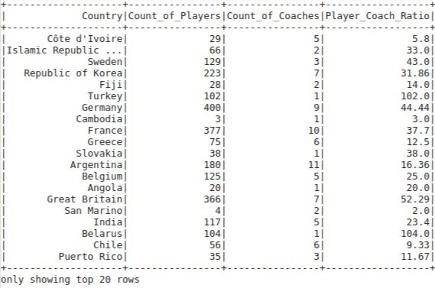
5. How many coaches were assigned to which number of players.

Slide 18
6. Total number of Medals won by “India” .

Slide 19
Conclusion
Most athletes in the Olympics reside from countries like the United States of America, Japan and Australia. The USA has the highest number of gold, silver and bronze medals and this shows how successful the US is. The biggest reason could be wealth; more investment on athletes and their respective disciplines. Having better coaches and facilities does help create better and improved athletes so wealth could probably be why the US does so much better than other countries.

Slide 20
THANK YOU

