Slide 1
Laptop Price
Prediction

Slide 2
Table of Contents
01
04
02
05
03
06
About The Project
Exploratory Data Analysis
Data Description
Models Applied
Data Pre-processing
Conclusion

Slide 3
About the Project
Laptops are portable computer that encompasses a microprocessor, rechargeable battery, fold-down screen, keyboard and mouse.
There are numerous companies in the market that produce a variety of laptops from budget friendly and low quality to premium high quality laptops for different purposes like academic use, office use or gaming.

Slide 4
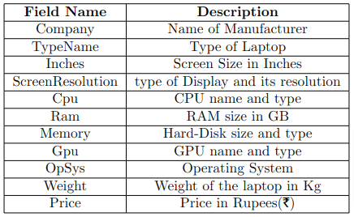
Data Description
Our dataset consists of around 1300 rows and 12 columns.
This is a raw dataset with minimum specifications of the given specific laptops.
After studying some other works on this topic we found that there are a few more features required for predictions

Slide 5

Data Pre-Processing
Finding null values (using ‘isnull( )’)
Checking for duplicate values (using ‘duplicate( )’)
Changing data type of columns from String to Integer or Float (using ‘str.replace( )’)
These functions are present in the pandas library.

Slide 6
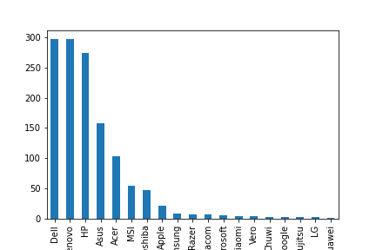
Exploratory Data Analysis
Here we performed some basic EDA on our data and found the following outcomes:
Laptop manufacturers and their frequency in the dataset.

Slide 7
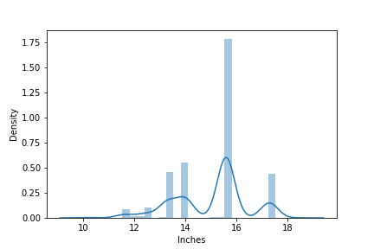
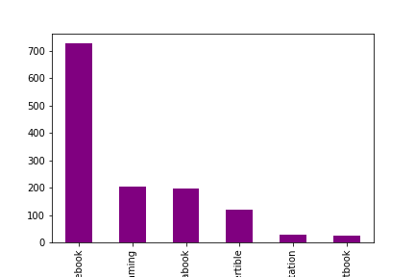
Screen Size of Laptops and their distribution in the dataset.
Distribution of Laptop Types in the dataset.

Slide 8
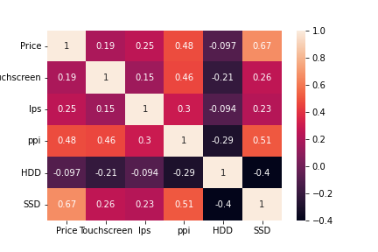
Correlation

Slide 9
Models
Linear Regression
Decision Tree Regressor
Estimates the relationship between one independent variable and one dependent variable
Models in the form of a tree structure. It breaks down a dataset into smaller and smaller subsets while at the same time an associated decision tree is incrementally developed
Ridge and Lasso Regression
Random Forest Regressor
Powerful techniques generally used for creating parsimonious models in presence of a ‘large’ number of features. regression uses two different penalty functions for regularisation
A Random Forest is an ensemble technique capable of performing both regression and classification tasks with the use of multiple decision trees and a technique called Bootstrap and Aggregation, commonly known as bagging.

Slide 10
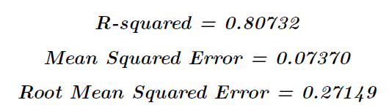
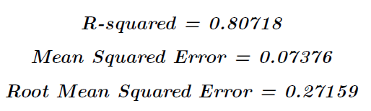
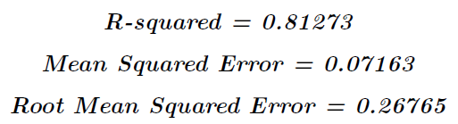
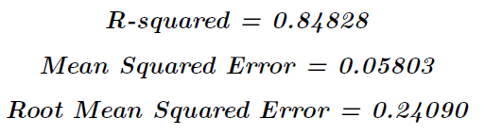
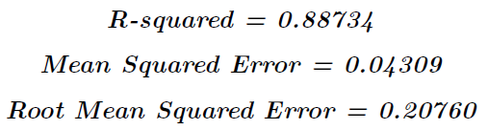
Results
Linear Regression
Lasso Regression
Ridge Regression
Decision Tree
Random Forest

Slide 11
Conclusion
We found out that Random Forest is the best regression model for this problem.
Reason being that, it randomly generates numerous Decision Trees and takes their average result to give the final prediction, and this process reduces variance in the datapoints.

Slide 12
Thank You!

