Slide 1
Current Screening Workflow
Brainner
Claude AI
Live Report
Ashby
Pulls and scores candidates based on keywords
Pulls candidates from Brainner (highest to lowest) Screens based on reasoning
HTML dashboard
auto-refreshes + Data is stored locally and removed
Using API - Archives 1s & 2s
automatically
>
>
>
Result: 500 candidates screened in ~30 minutes for ~$10-$20

Slide 2
What You Need Before Starting
TOOLS & ACCESS
COST BREAKDOWN
1
API Keys
Claude API (per 100 resumes)
~$3–4
Claude - Contact IT (Neha / Lucas) for Anthropic API
Brainner - Lucas Ashby - DIY: Ashby Settings → API Keys
Claude API (per 500 resumes)
~$15–20
2
Node.js
Free download at nodejs.org — version 18+ recommended
Claude API (per 1,000 resumes)
~$30–35
3
Claude Desktop Version
Cowork for Automagic resume screening
Brainner API
FREE (included in subscription)
4
The screener scripts
Ashby API
FREE (included in subscription)
Shared folder on the recruiting drive
Node.js
FREE

Slide 3
Step 1 — Write & Calibrate Your Criteria
HOW TO BUILD YOUR CRITERIA
EXAMPLE: 4-GATE STRUCTURE
1. Start with the JD
Gate 1: Company/Industry
Pull the must-haves and nice-to-haves. Write them as gates — things the candidate must pass, not just have. Describe areas that are gray
Is the candidate from a tech or tech-adjacent company? Filters out manufacturing, government, legacy enterprise.
2. Rate real candidates first
Before running the script, manually score 5–10 candidates with the HM. Note what passed and what didn't.
Gate 2: AI Requirement
Any hands-on AI signal in their work — not just 'AI' in the skills section. Must appear in a role description.
3. Add calibration examples
Add 3–5 real scored candidates into your criteria as examples (resume, why they passed or failed).
Gate 3: Strategic Level
4. Define score 1–4 clearly
Do they own programs and influence senior leaders? Analysts and coordinators are a hard no.
1 = hard no. 2 = no (archive). 3 = borderline / probe. 4 = strong yes. Be specific about what earns each score.
Gate 4: Ops Type
5. Iterate after each run
Is their ops experience product/engineering ops — not IT, finance/AP, or compliance ops?
Review where Claude got it wrong. Update the criteria. 2 - 3 rounds of calibration usually locks it in.

Slide 4
Step 2 — Prompt your Script
Folder with Prompts
Screener will pull from Brainner > Sort by Score > Assess based on Claude Criteria > Result in a Score
Sample Criteria Prompt Structure
You are an expert recruiter screening candidates for [ROLE] at [COMPANY]. Score each candidate 1-4 based on:
Gate 1: [Must-have requirement] • Gate 2: [Domain requirement] • Gate 3: [Seniority/impact requirement] • Gate 4: [Role-specific requirement]
How to Run It
Open Terminal and navigate to your screener folder, then run the script for your role:
cd ~/Desktop/ashby-screener
node screen-[role].js
Pro tip: Run count-tpm-scores.js first to see the Brainner score distribution before committing to a full run.

Slide 5
The Scoring System
You determine the scoring scale.
HM uses a weighted scale with percentages • I use 1–4 reflective of Ashby scoring (depends on role / resume quantity)
Score 1 Hard no — do not move forward
Score 2 No — archive in Ashby after the run
Score 3 Maybe / borderline — human review needed
Score 4 Strong yes — shortlist for phone screen

Slide 6
Step 3 — Run the Screener
Terminal
WHAT HAPPENS
$ cd ~/Desktop/ashby-screener
$
node screen-sr-tpm.js
Loaded cache: 196 already screened
Fetching candidates… Page 1: 200
[1/500] John Smith (Brainner: 95) score: 4
[2/500] Jane Lee (Brainner: 92) score: 3
Fetches all candidates from Brainner across paginated pages
Skips anyone already in cache (no re-screening)
Sorts by Brainner score, takes your TOP_N
Sends each resume + criteria to Claude API
Saves score + summary to cache and CSV instantly
Writes live HTML report after every candidate
THE CACHE — YOUR BEST FRIEND
Every screened candidate is saved to a local JSON cache file (e.g. sr-tpm-cache.json). On every subsequent run, the script checks the cache first and skips anyone already screened — so you never pay twice for the same candidate, and batches always pick up exactly where you left off. Run it 5 times and it screens 5 fresh batches with zero overlap.

Slide 7
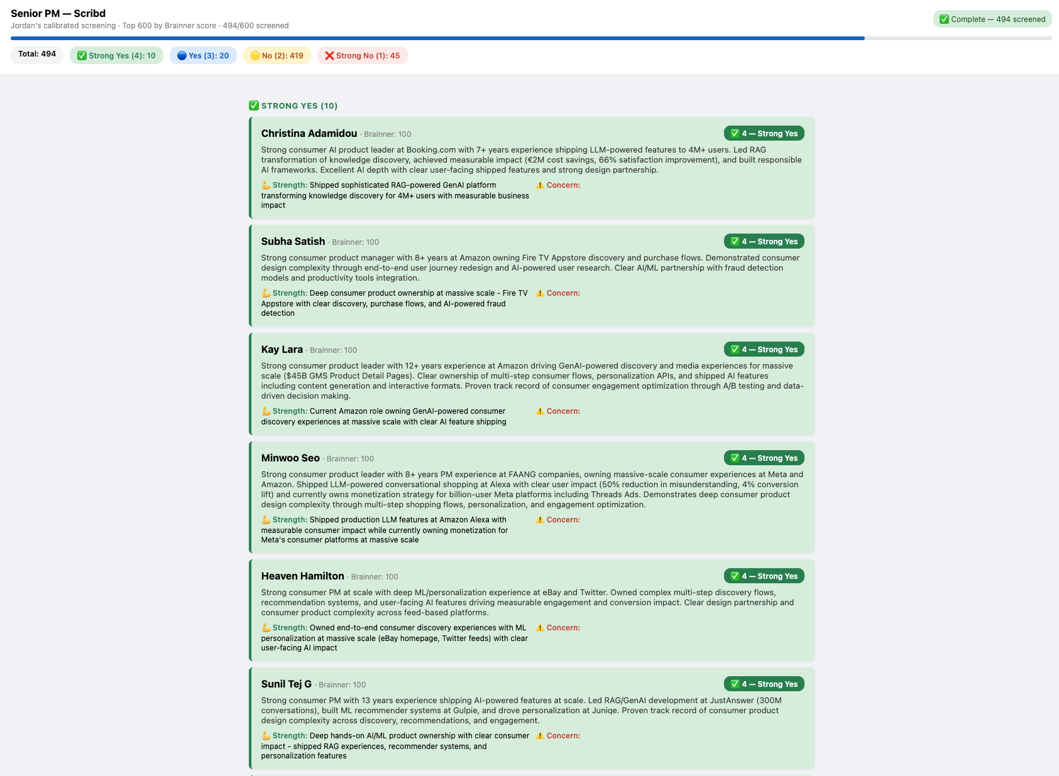
Step 4 — The Live HTML Report (Demo)

Slide 8
Step 5 — Archive in Ashby
After the screener finishes, run the archive script. It reads your cache and moves every score 1 and 2 candidate in Ashby — but only if they're currently in Application Review.
Only "Application Review"
The script checks each candidate's current Ashby stage before moving them. If they've already been moved to Phone Screen, Shortlisted, or any other stage — they are skipped entirely. No accidental moves.
Only scores 1 and 2
Scores 3 and 4 are never touched. The archive script only reads candidates with ourScore === 1 or ourScore === 2 from the local cache file.
Fully automated
One command. The script paginates through all Ashby applications, matches by email, checks stage, moves, and prints a full summary. ~150ms per candidate to respect API rate limits.
Why this matters: We had a candidate nearly archived who was already in a Phone Screen stage. This rule prevents that.

Slide 9
Pro Tips for Getting the Most Out of This
01
Calibrate before you screen at scale
02
Always read the score 3s yourself
Run calibration with the hiring manager. Then update the criteria before sending it through 500 people.
Claude is conservative on 3s — it flags the concern but leaves the call to you. Read the Top Concern for every score 3 and make a human judgment.
03
Keep the criteria tight
04
Use the Brainner score as a pre-filter
Longer criteria isn't better. If the HM keeps changing their mind about what matters, the criteria will drift and your scores will be inconsistent.
Don't start at the bottom of the Brainner ranked list. Screen the top 500 by Brainner score first. You'll find all your 4s and most of your 3s there.
05
Add calibration examples as you go
06
Batch your archiving after each run
Every time a candidate comes back from a screen and you learn something, add them as a calibration example. The criteria gets sharper over time.
Don't archive mid-screen. Run the full screener first, review the results, then run the archive script once. Gives you a chance to catch any surprises.

