Slide 1
IETF Hackathon -YANG Data Model for Network Inventory (IVY)
IETF 125
14–15 March 2026
Shenzhen, China

Slide 2
IVY YANG Model Interop Test
China Unicom
Ciena
Most likely testbed configuration:
A controller from one vendor plays the role of inventory system (inventory role)
Several controllers from different vendors are plays the role of inventory controller (controller role)
Each controller role provides a view of network elements and their physical inventory
If a vendor has an inventory system, this can take the inventory role
Inventory role
Inventory role
ivy model
Controller role
Huawei
Network may be:
An image in the controller
A simulation
Real hardware
Network
Ideally network elements would be a mix of IP, Ethernet, OTN and optical where there were various NEs of different mixes of capabilities. This should have no impact on the ivy interface capability.

Slide 3
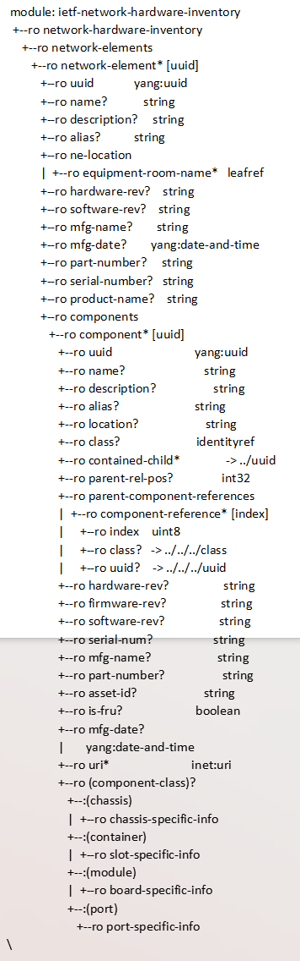
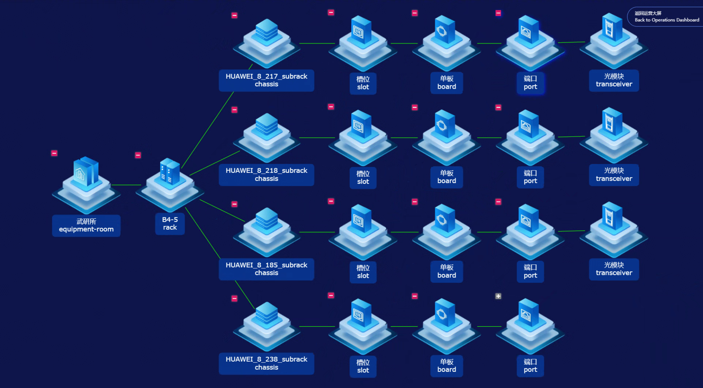
Ivy model
<What draft were involved?>
draft-ietf-ccamp-network-inventory-yang-02

Slide 4
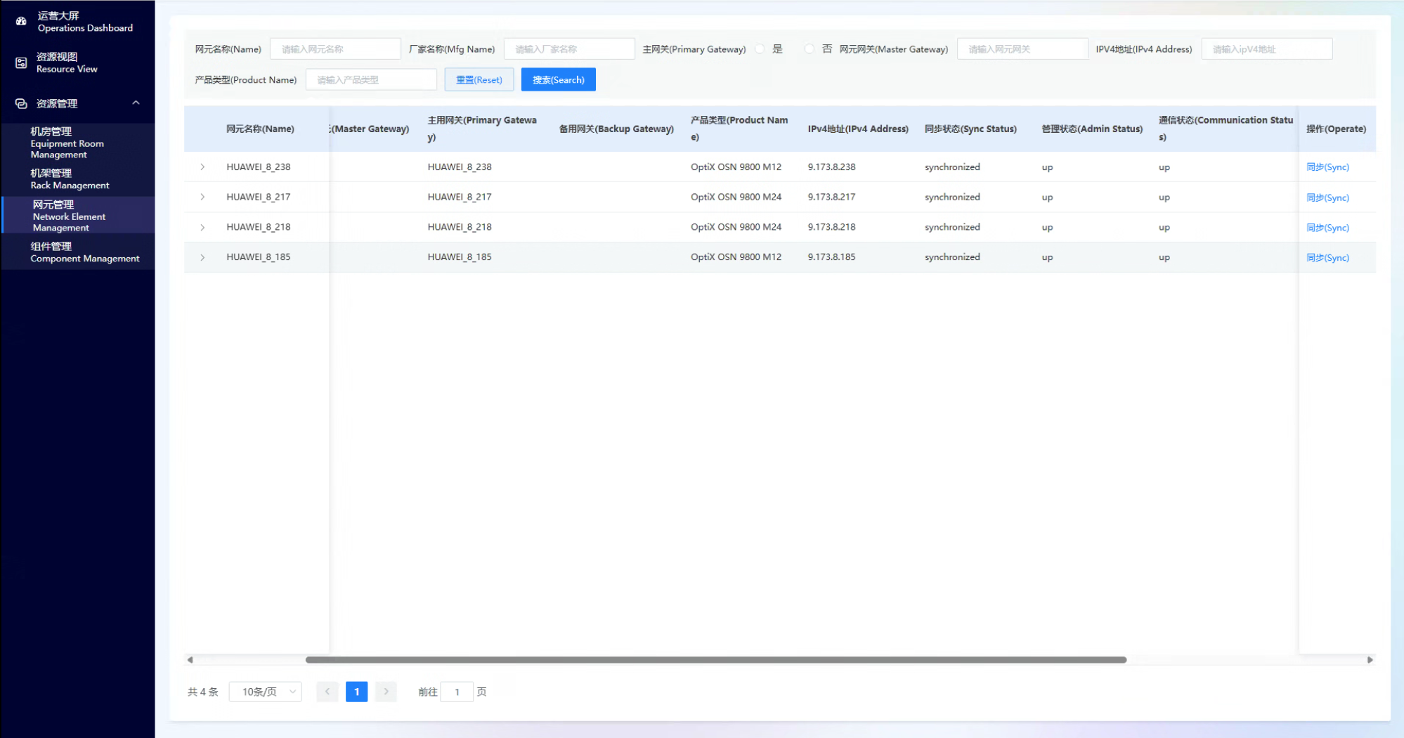
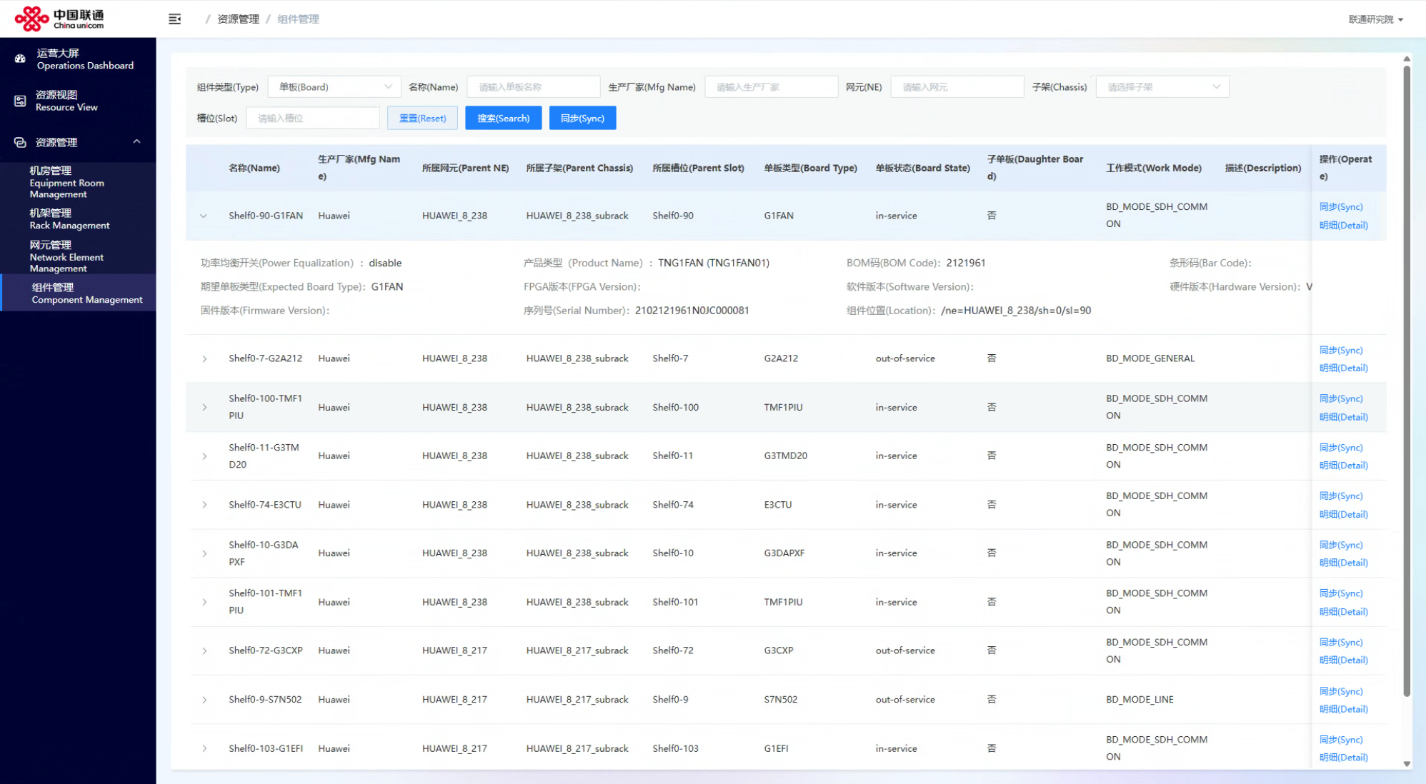
Ivy system(China Unicom Orchestrator)

Slide 5
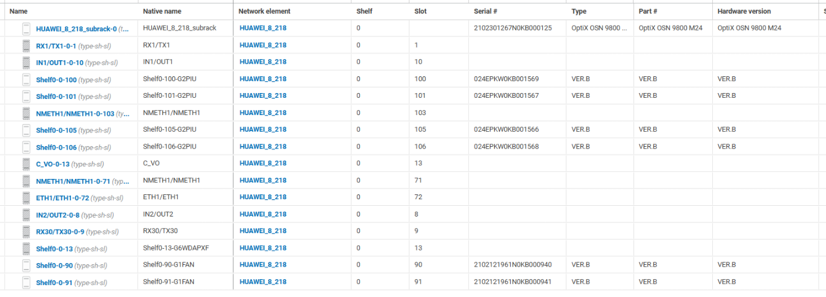
Ciena Results
We received ivy conformant JSON in a file from the Hackathon
We were able to take that and use our ivy mediation component (with a few refinements as we are using a different draft version) to extract the NE and equipment data and display it on the Navigator UI
The following screenshot snips show that data
This has been a very productive preparation for the planned hackathon in IETF 126

Slide 6
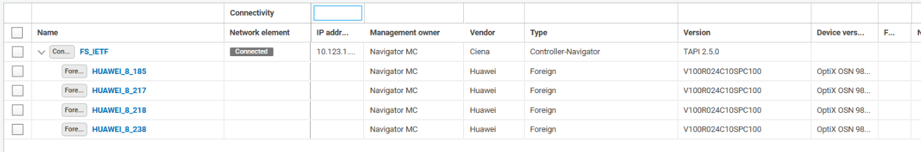
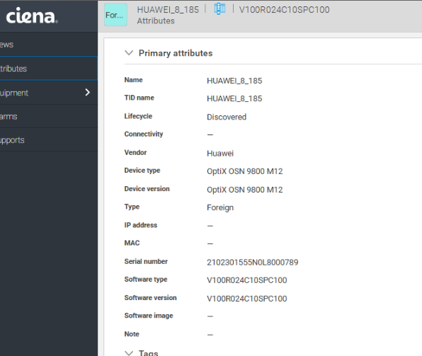
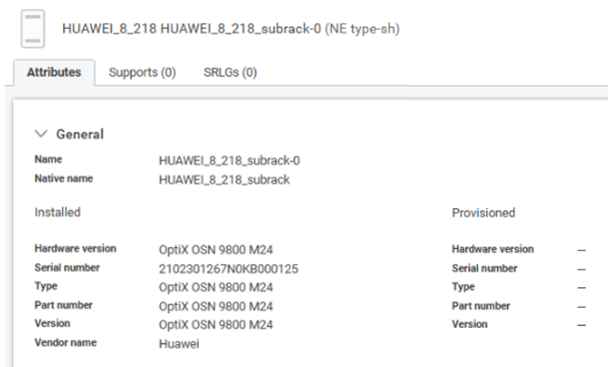

Slide 7
Wrap Up
Team members:
Yanxia Tan(Chinaunicom) Haomian Zheng(Huawei)
Italo Busi(Huawei) Henry Yu(Huawei)
Xiao Li(Huawei) Nigel Davis(Ciena)
Navin Purohit(Ciena) Abhay Sombanshi(Ciena)
Yanlei Zheng(Chinaunicom) Chaode Yu(Huawei)
Aihua Guo(Futurewei)
First timers @ Hackathon:
Yanxia Tan
Xiao Li
Yanlei Zheng
Italo Busi
On our github we have: https://github.com/tanyanxia/IETF125-Hackathon-ivy-project
Full Video clip (7min)
JSON code
This presentation
Plan in Vienna (Hackathon IETF126)
Continue implementing the model from other vendors (interests collected)

