Slide 1
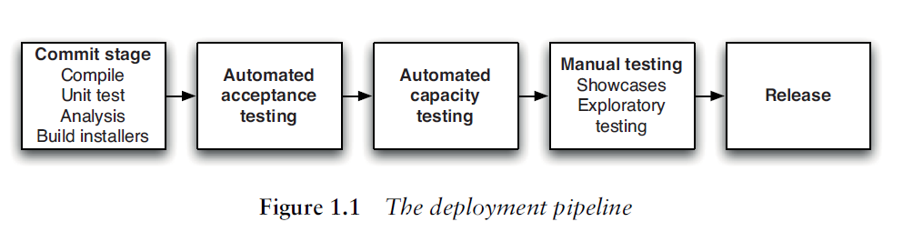
How does deployement pipeline works?

Slide 2
Problems in deploying software manually
Error will occur every time
Not repetable or reliable
Time consuming and expensive
Needs lots of documentation with steps
That are misinterpreted, and untested in a production-like environment
Many corrections during a release
Manual testing to confirm deployment
Releases take hours instead of minute
Frequent roll-backsLate nights

Slide 3
Instead
Integrate testing , deployement and release activity into devlopment.
Automate deployments as much as possible
Scripts equal up-to-date documentation, encourage cooperation and sharing
Encapsulate expertise and are version-controlled like any other source code
Automation makes processes repeatable, testable, less boring and fast.

Slide 4
AP: First to production-like after Dev finished
Testers have only tested in a development environment
Production deployers have never done deployment before
All kinds of infrastructure-related problems pop up after the PL said that development was done
Lots of fighting between operations and development
Notes:
Deploying to production-like environment fort the first time only after development is finished

Slide 5
Instead...
Start deploying to a production-like environment (staging) as soon as you start developing
Integrate testing, deployment and release into a standard part of your development process
If you already have good Continuous Integration, this means: add deployment/release to it (correctly)

Slide 6
AP: Manual Configuration of Prod Env
Configuration of an environment is a lot
Deployments to production fails after succesful deployments to other environments
Differences between nodes in production
Cannot roll back your environment
Different versions of packages
Basically: No overview, no control

Slide 7
Instead...
Set up your entire environment using an automated process that is stored in version control
Specifically any and all configuration - of your OS, of OS tools and middleware, and of your application
Your production environment is key - it must be reproducible in your staging and dev environments

Slide 8
The Deployment Pipeline
Describes your process of getting software from version control into the hands of users.
Similar on for most projects on a high level
Each step in the pipeline produces output which is taken up (pulled) by the next step when ready
Notes:
Value Stream Maps - Lean Software Development: An Agile Toolkit. Mary and Tom Poppendieck
http://en.wikipedia.org/wiki/Value_stream_mapping
See page 106 of the Continuous Delivery Book

Slide 9
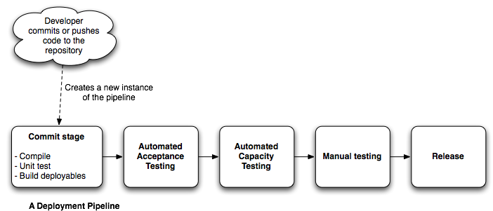
A Deployment Pipeline
Also known as Continuous Integration Pipeline, build pipeline, etc.

Slide 10
Continuous Delivery
Timely delivery
Good Quality Software

Slide 11
How to Achieve Goal of continuous delivery
Automated
Frequent Releases
Feedback

Slide 12
3 Criteria for Feedback
Every Change Should Trigger the Feedback Process
The Feedback Must Be Received as Soon as Possible
The Delivery Team Must Receive Feedback and Then Act on It

Slide 13
Principles of Software Delivery
Create a Repeatable, Reliable Process for Releasing Software
Automate Almost Everything
Keep Everything in Version Control
If It Hurts, Do It More Frequently, and Bring the Pain Forward
Build Quality In
Continuous Improvement

Slide 14
If you have a good configuration management strategy, you should be able to answer “yes” to all of the following questions:
Can I exactly reproduce
Product environment
version of the operating system
its patch level
the network configuration
the software stack
the applications deployed into it & their configuration
Can I easily make an incremental change in
Any of the features of product
And deploy it in all my environment
Can I easily see each change and trace it back
what the change was
who made it
When they made it

Slide 15
Last but not the least,
Information should be easily available to each member
Frequent check in
Automatically benefits
Efficient delivery
Increased cycle time
Reduced feedback

Slide 16
Points we just discussed can be achieved by following practice
Using Version Control
Check In Regularly to Trunk
Use Meaningful Commit Messages
Managing Dependencies
External libraries
External components
Software configuration

Slide 17
Why Version Control is Important
Helps to reproduce a particular state of the software’s binaries and configuration
What was done when, by whom
allows you to recover an exact snapshot of the state of the entire system, from development environment to production environment, at any point in the project’s history
store binary images of their application servers, compilers, virtual machines

Slide 18
Continuous integration
An extremely strange and serious problem with many software projects is that-
For “long periods of time during the development” process the application is not in a working state
Problems faced-
Significant time software is unusable
Nobody is interested in trying to run the whole application until it is finished
Software is not compatible at the time of delivery
Hell lot of problems during build

Slide 19
Prerequisites of continuous integration
Version Control
An Automated Build
Agreement of team
Create a Comprehensive Automated Test Suite
Keep the Build and Test Process Short
Managing Your Development Workspace

Slide 20
Essential Practices In Continuous Integration
Don’t Check In on a Broken Build
Always Be Prepared to Revert to the Previous Revision
Don’t Comment Out Failing Tests
Test-Driven Development
Failing the Build for Slow Tests

Slide 21
Why Testing Strategy is necessary?
functional aspects of the system
Increase confidence
reduced support costs
Capacity, security,
and other nonfunctional requirements are established early on, and automated
test suites are written to enforce them.

Slide 22
Types Of Test
Business-Facing Tests That Support the Development Process
Technology-Facing Tests That Support the Development Process
Business-Facing Tests That Critique the Project
Technology-Facing Tests That Critique the Project

Slide 23
Automating Acceptance test
They make feedback loop faster
Reduce Workload on Testers
Free testers to concentrate on exploratory testing and high value activities
Autogenerate Requirements Documentation from your tests

Slide 24
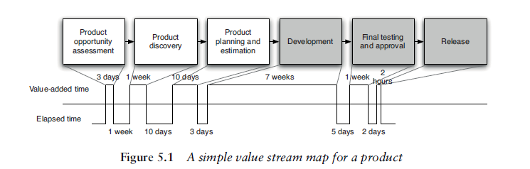
What is Deployement Pipeline
a deployment pipeline is an automated manifestation of your process for getting software from version control into the hands of your users.

Slide 25
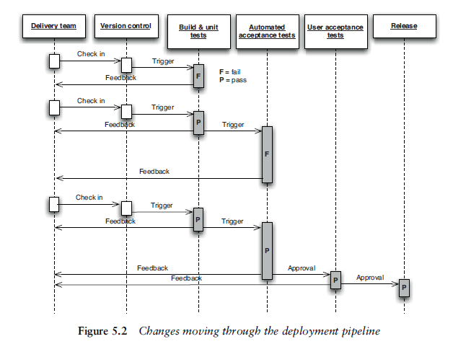

Slide 26
Deployment Pipeline Practices
Only Build Your Binaries Once
Deploy the Same Way to Every Environment
Smoke-Test Your Deployments
Deploy into a Copy of Production
Each Change Should Propagate through the Pipeline Instantly
If Any Part of the Pipeline Fails, Stop the Line

Slide 27
Commit Stage
Compile the code (if necessary).
Run a set of commit tests
Create binaries for use by later stages.
Perform analysis of the code to check its health.
Prepare artifacts, such as test databases, for use by later stages.

Slide 28
Automated Acceptance Test Gate
system delivers the value the customer is expecting
verifying that no bugs are introduced into existing behavior by new changes

Slide 29
Preparing To Release
Have a release plan
Minimize the effect of people making mistakes by automating as much of the process as possible
Rehearse the procedure often in production-like environments
Have the ability to back out a release if things don’t go according to plan
Have a strategy for migrating configuration and production data as part of the upgrade and rollback processes

