Slide 1

MALLA REDDY TECHNICAL CAMPUS​
A constituent Unit of MALLA REDDY VISHWAVIDYAPEETH Deemed to be University Approved by UGC & AICTE New Delhi Maisammaguda , Medchal (Dist), Hyderabad – 500100, Telangana
CAMPUS
CARE
Campus Complaint
Management System
STUDENT SERVICES
SMARTER CAMPUS SUPPORT
A simple digital platform to report campus issues,
track progress, and improve student services.
TEAM 1
PROJECT: CAMPUSCARE
B Sindhu-25MVCSMR0016
CH Harika-25MVCSMR0023
Tanya Kumari-25MVCSMR0081
T Hasini-25MVCSMR0084

Slide 2
1. Problem Statement
Campus issues need a clear, reliable way to reach the right team.
Scattered reporting
Limited visibility
Follow-up challenges
Students may report issues verbally, by phone, or through different channels.
It can be difficult to know whether a complaint was received or reviewed.
Staff may struggle to organize, prioritize, and track open issues.
Project goal: make complaint submission, assignment, and status tracking simple and transparent.

Slide 3
2. Proposed Solution
CampusCare brings the complaint journey into one organized portal.
01
02
03
04
→
→
→
Submit
Review
Track
Resolve
Student enters the issue, category, and location.
Campus team reviews the complaint and assigns it.
Student checks the latest status at any time.
Staff records the action taken and closes the issue.
Expected value: fewer missed reports • better accountability • clearer communication

Slide 4
3. Key Features
Complaint form
Status tracking
Search & filters
Report an issue with category, location, and description.
View Submitted, In Progress, and Resolved complaints.
Find reports by keyword, category, or status.
Dashboard summary
Staff review
Refreshable list
See total complaints and counts by status.
Review reports and update progress as work continues.
Reload recent complaints to view the latest available data.

Slide 5
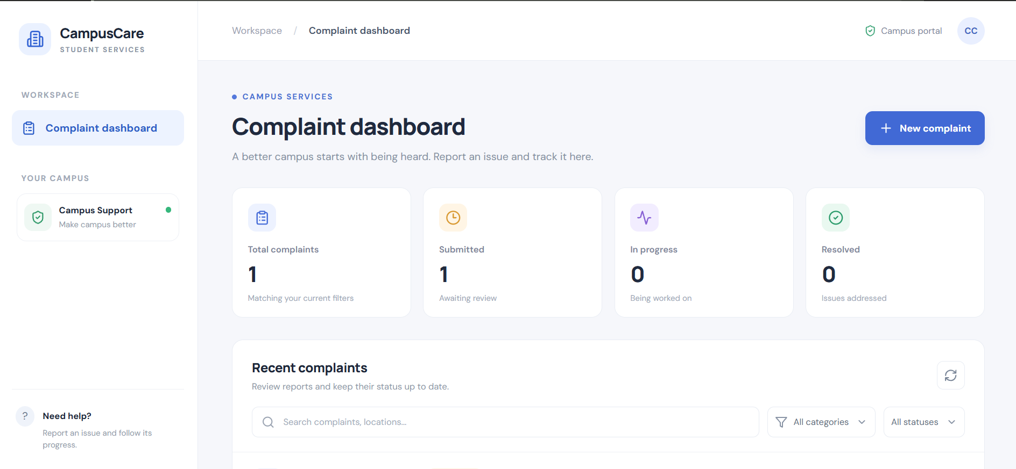
4. Prototype Walkthrough
The current interface focuses on quick overview and easy navigation.
What the demo shows
Complaint totals at a glance
Status summary cards
Search and category filters
Recent complaints list
New complaint action

Slide 6
5. Technology & Working
Suggested technology stack
Basic system workflow
Frontend
HTML, CSS, JavaScript / React
Student submits complaint
↓
Backend
Node.js with Express (if API is enabled)
System stores the report
↓
Authorized staff reviews it
Database
MongoDB (for persistent complaint records)
↓
Status is updated
Interface
Dashboard, form, search, status filters
↓
Student checks progress

Slide 7
6. Impact, Future Scope & Conclusion
Expected impact
Future enhancements
A single place to report campus issues
Better visibility into complaint status
Easier prioritization for campus teams
A more responsive student-support process
Student and staff login with role-based access
Email or in-app status notifications
Photo attachments and complaint priority
Analytics on resolution time and recurring issues
CampusCare aims to turn campus complaints into trackable actions — helping build a better campus for everyone.

Slide 8
ThankYou!!

