Slide 1

Data Analysis & Machine Learning Using Python
Predicting the price of old car.
Presented By:
Swapnil Gupta

Slide 2

Outline:
Problem Statement
Objective
Motivation
Dataset Description
Data Preprocessing
Data Visualization
Regression Analysis
GUI
Conclusion

Slide 3

Problem Statement :
The prices of new cars in the industry is fixed by the manufacturer with some
additional costs incurred by the Government in the form of taxes. So, customers
buying a new car can be assured of the money they invest to be worthy.
But due to the increased price of new cars and the incapability of customers to buy
new cars due the lack of funds, used cars sales are on a global increase. There is a
need for a used car price prediction system to effectively determine the worthiness
of the car using a variety of features. It is important to know their actual market
value while both buying and selling.

Slide 4

Objective:
. The objective of our project is to predict the price of the old cars using various attributes and
features. Some of the expected factors are model name, manufacturer, year of
manufacturing, number of cylinders and fuel type .
Additionally, the model will provide recommendation for related vehicles with a lower miles, lower price, and one that is slightly more expensive.
We will model the price of cars with the available variables so that it can be used by the management to understand how exactly the prices vary. They can accordingly manipulate the design of the cars, the business strategy etc.

Slide 5

Motivation :
With the growing economic conditions, the sale of used cars has been increased thus their is a need to design a model.
Deciding whether a used car is worth the posted price when you see listings online can be difficult, as value of used cars depends on factors like model, manufacturer, mileage, fuel type.
From the perspective of a seller, it is also a dilemma to price a used car appropriately. Based on existing data, the aim is to develop model for predicting used car prices efficiently.

Slide 6
Dataset Description :
1. The dataset is drawn from -
“https://www.kaggle.com/avikasliwal/used-cars-price-prediction?select=train-data.csv”
2. We require a meticulous details about the car in order to build a algorithm to predict it’s reusability .
The dataset consists of 6019 entries with each entry associated with 15 different attributes.

Slide 7
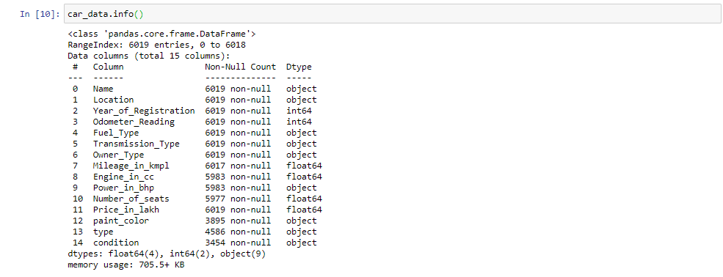
Know about the data :

Slide 8
Attributes Description :
Name - Name of the car
location – the location or city where the car is currently in.
Year_of_registration - At what year the car was first registered - the age of the car..
Odometer_Reading - the total distance travelled by the car since it was first registered.
Fuel_type - compressed natural gas(CNG), diesel, petrol, LPG, electric
Transmission_Type – automatic or manual.
Owner_Type – first , second, third or above.
Mileage_in_kmpl - mileage of the car in kilometre per litre
Engine_in_cc - Cylinder capacity or the cubic centimeters capacity of the combustion cylinder.
Power_in_bhp - Car Engine Power in brake horse power.
Seats - describes the number of seats in the car.
Price - the price in Rs on the advertisement to sell the car.
Paint_color - Represents the color variants available of the car.
Type – car body type – suv, wegan, sedan, truck, convertible, other etc.
Condition – specify the condition whether it is new, excellent, good, fair etc.

Slide 9
Data Preprocessing:
Why Data Preprocessing is required?
When it comes to creating a Machine Learning model, data preprocessing is the first step marking the initiation of the process. Typically, real-world data is incomplete, inconsistent, inaccurate (contains errors or outliers), and often lacks specific attribute values/trends. This is where data preprocessing enters the scenario – it helps to clean, format, and organize the raw data, thereby making it ready-to-go for Machine Learning models.

Slide 10
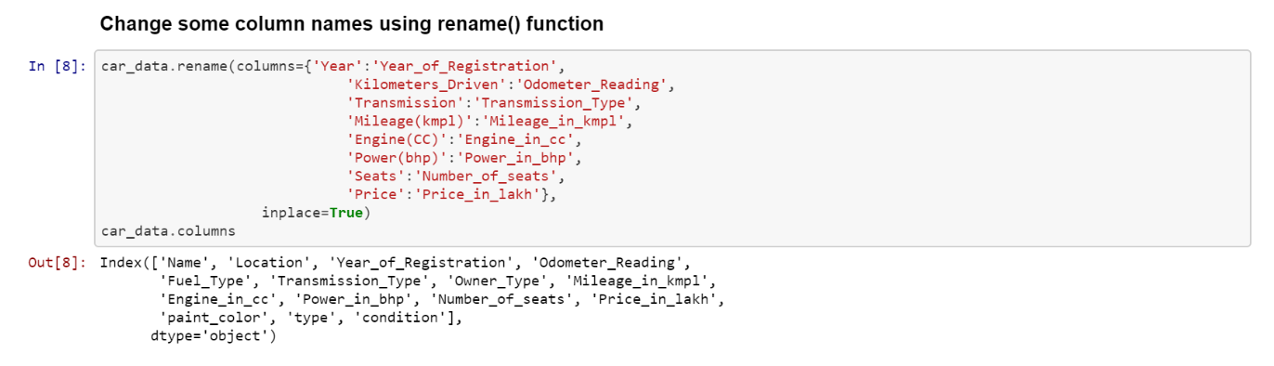
Steps in Data Preprocessing:
Acquring ,importing and reading of dataset.
Changing the Data Attributes Name:
If it is required to change the names of the attribute if they are inappropriate then we need to change the names of our attributes.

Slide 11
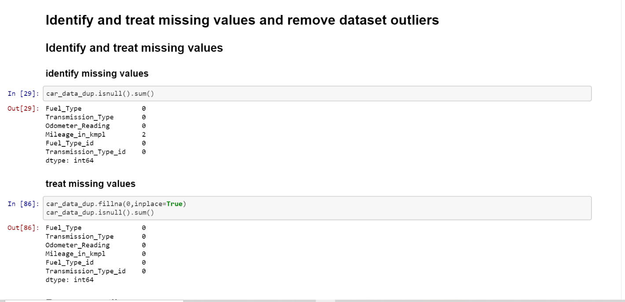
Identifying and handling missing values : In data preprocessing, it is pivotal to identify and correctly handle the missing values, failing to do this, you might draw inaccurate and faulty conclusions and inferences from the data.

Slide 12
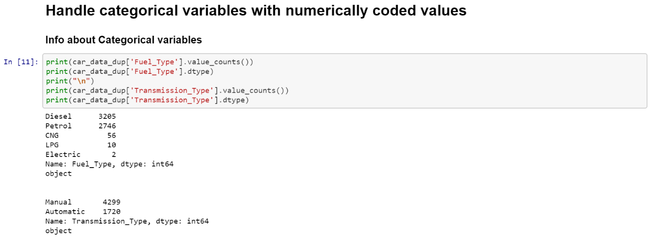
Encoding the categorical data:. Categorical data refers to the information that has specific categories within the dataset.

Slide 13
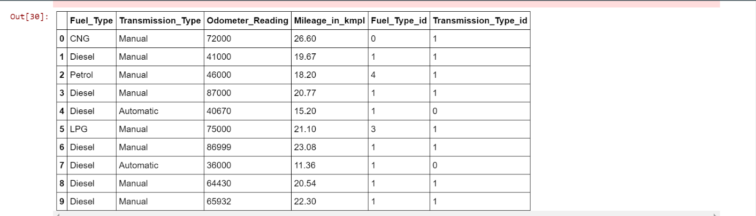
For Fuel_Type, create new column "Fuel_Type_id" which handles categorical data as numerical data.
0 <- CNG 1 <- Diesel 2 <- Electric 3 <- LPG 4 <- Petrol
2. For Transmission_Type, create new column "Transmission_Type_id" which handles categorical data as numerical data.
0 <- Automatic 1 <- Manual

Slide 14
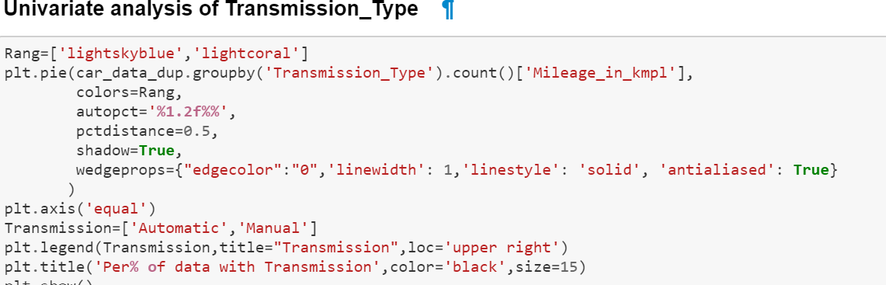
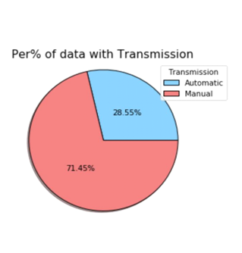
Data Visualisation: Data visualization refers to the techniques used to communicate data or information by encoding it as visual objects (e.g., points, lines or bars) contained in graphics. Few of the observation we made are listed below
As we can see from figure, in our dataset, in attributes Transmission most of car are manual. It implies people do not prefer automatic cars.
Here we are performing the univariate analysis on Transmission Type

Slide 15
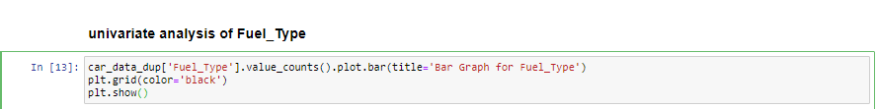
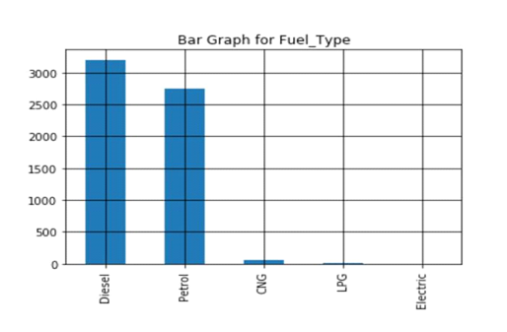
Univariate analysis of Fuel_Type
. In attributes Fuel_Type we can see that diesel car is most preferred type followed closely by petrol cars.

Slide 16
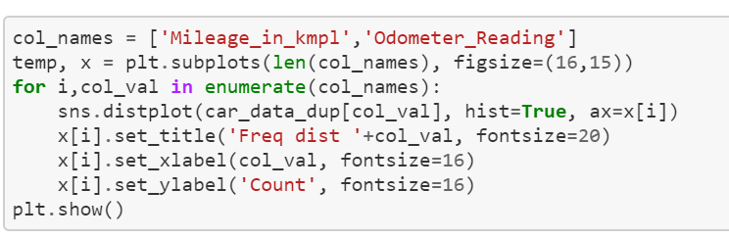
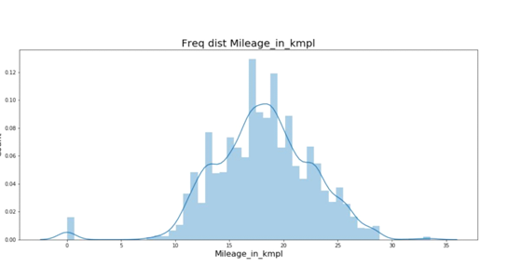
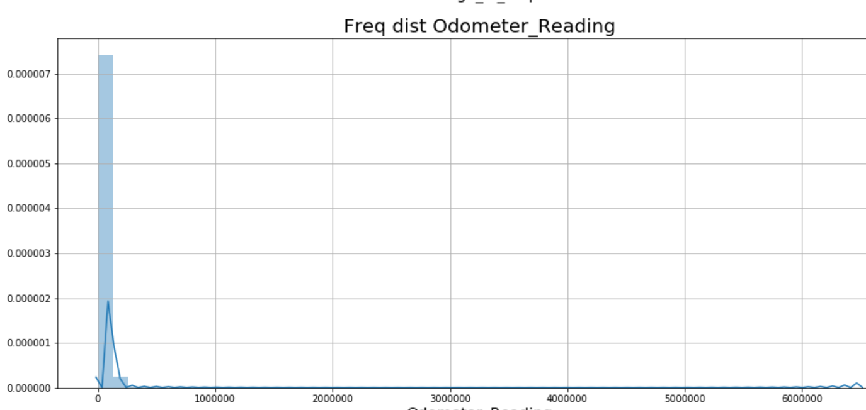
Univariate Analysis of odometer reading and mileage in kmpl:
Car milage ranges from 7 to 28.
Maximum cars have milage of
17-19

Slide 17
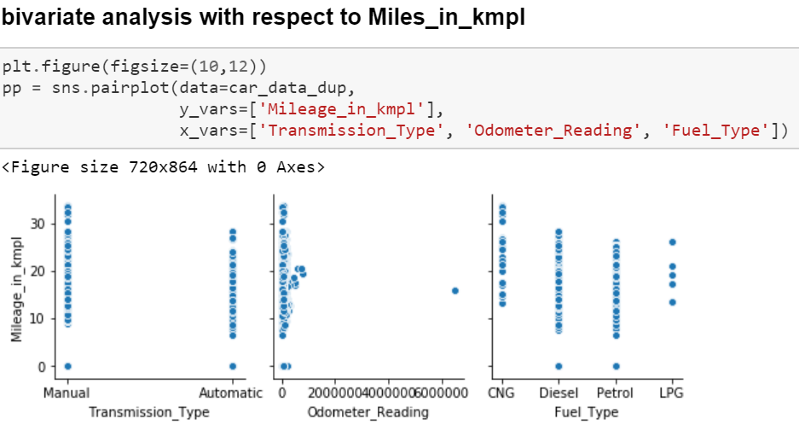
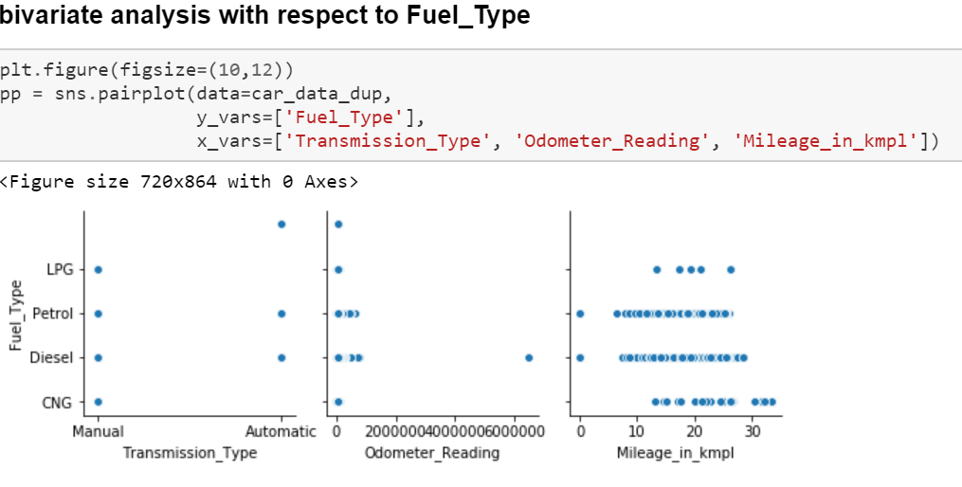
Bivariate Analysis with respect o miles in kmpl.
Bivariate Analysis with respect to Fuel_Type.
In this graph automatic transmission type doesn’t have fuel_type as CNG.
In this graph for manual it ranges from 10 to 30 and for automatic transmission type it ranges from 10 but is more than 20 but less than 30

Slide 18
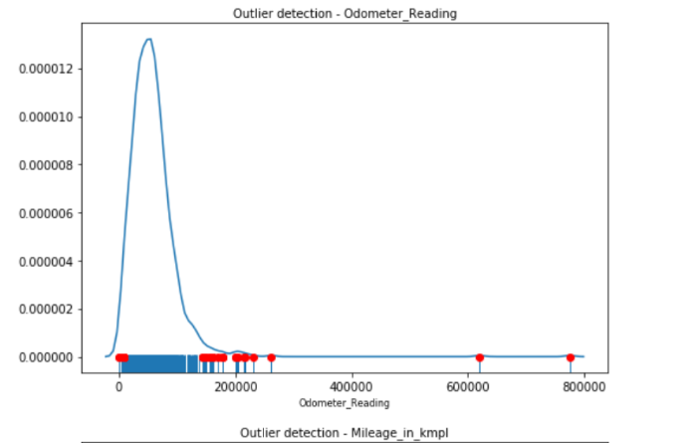
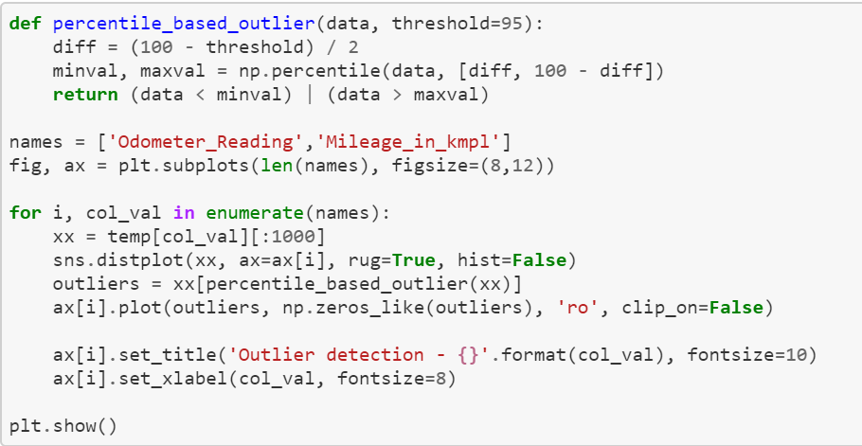
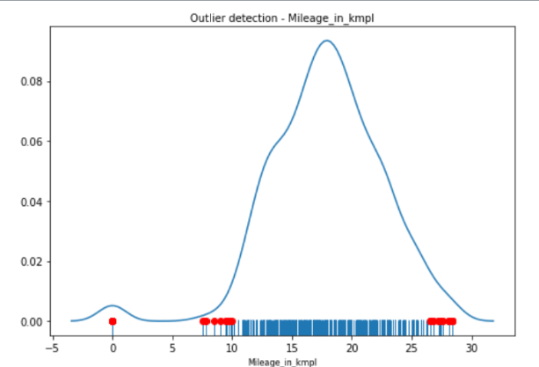
Percentile based outliers detection :
Red points highlights the outliners.

Slide 19
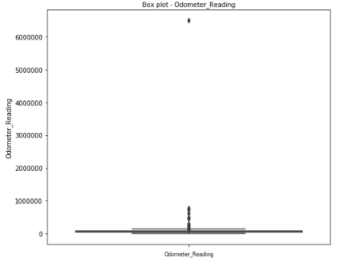
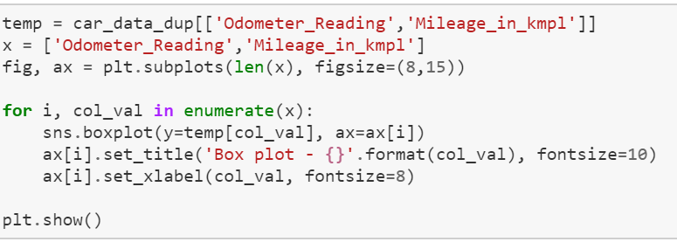
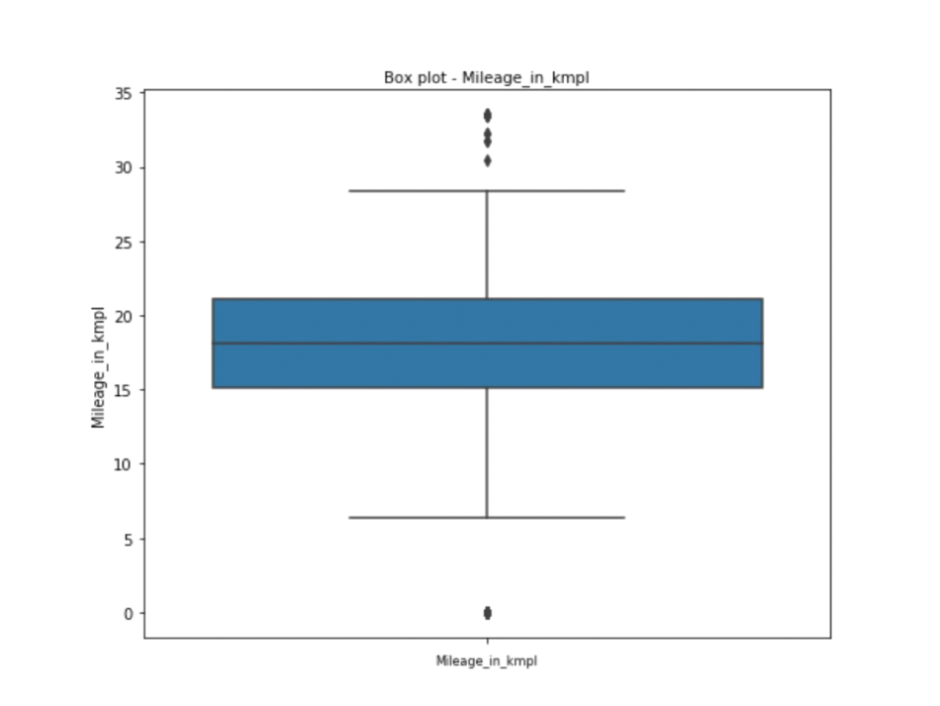
Outliners detection using boxplot :
It is based on outlier detection analysis.
From this box plot we come to know that outliers are in range 30 to 35.

Slide 20
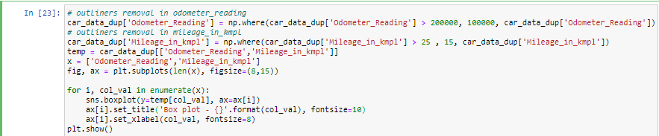
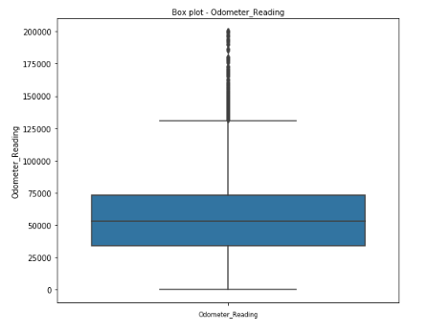
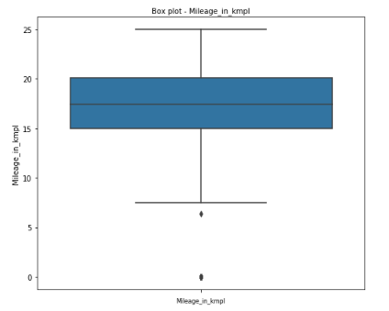
Removal of outliers :

Slide 21
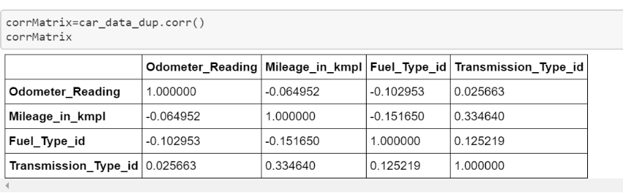
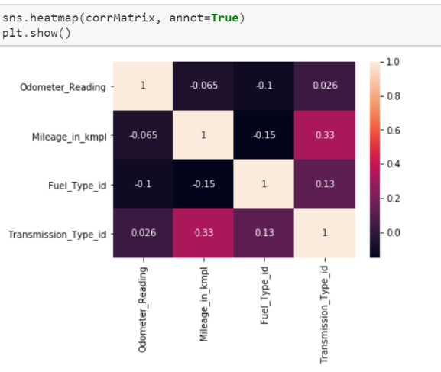
Building a correlation matrix and correlation graph:
Figure below tells the overall distribution of every attribute with respect to that of another.
The lighter the color, the larger the correlation magnitude.
The below heatmap shows dependency between Mileage_in_kmpl and Transmission_Type_id and the correlation value is approximate to 0.33

Slide 22
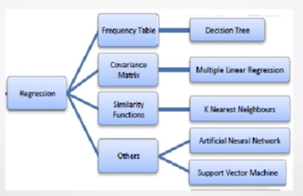
Regression Analysis:
Regression analysis is a form of predictive modelling technique which investigates the relationship between a dependent (target) and independent variable (s) (predictor).
This technique is used for forecasting, time series modelling and finding the causal effect relationship between the variables.
Here in our model we are using four types of regression models:
Multiple Linear Regression
Decision Tree Regression
Random Forest Algorithm

Slide 23
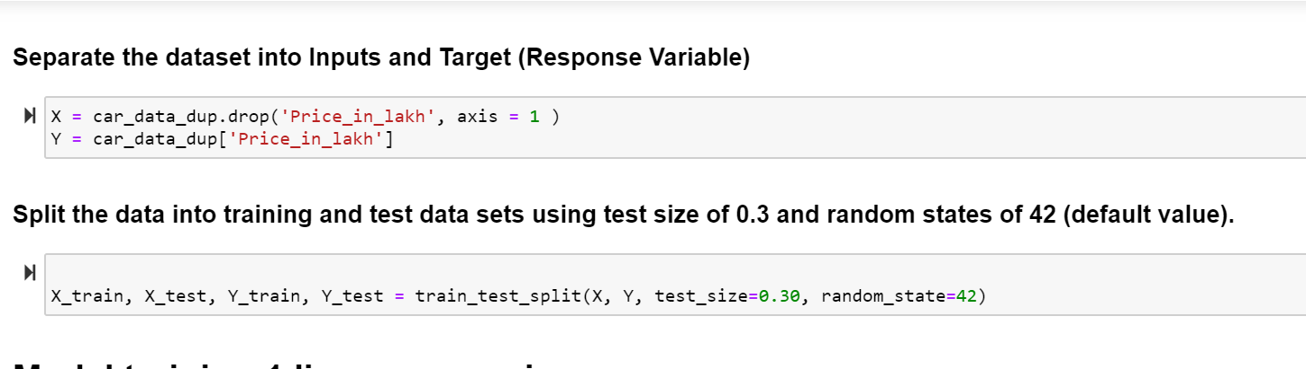
To perform regression analysis we first need to separate the dataset into input and target variables.
Split the dataset into test and train.
In our model we have splitted them into test size of 0.3 and random state of 42.

Slide 24
Description of Multiple Linear Regression:
Multiple Linear Regression is the most common form of linear regression analysis.
As a predictive analysis, the multiple linear regression is used to explain the relationship between one continuous dependent variable and two or more independent variables.
The independent variables can be continuous or categorical (dummy coded as appropriate).

Slide 25
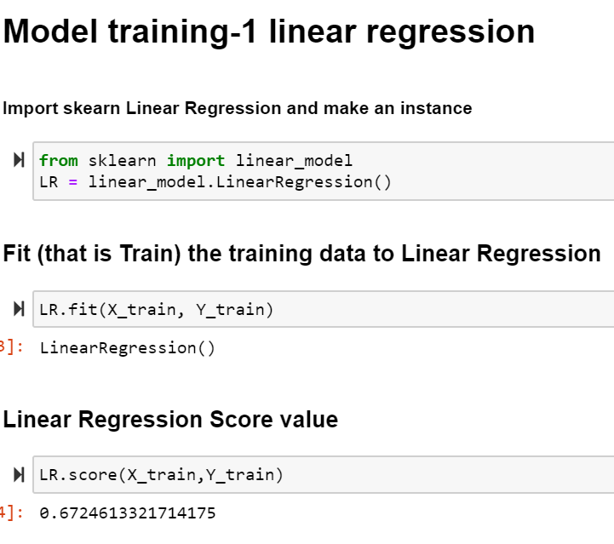
Multiple Linear Regression:
Separate the dataset into input and target variables.
Split the dataset into test and train.
Apply Linear regression model.
Fit the Regression Model
After fitting the regression model we obtained 67% accuracy.
R square value of multiple linear regression is 0.67

Slide 26
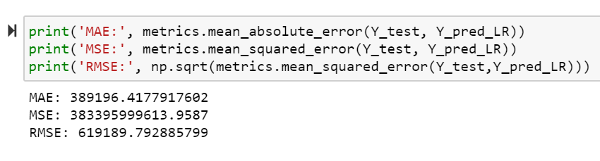
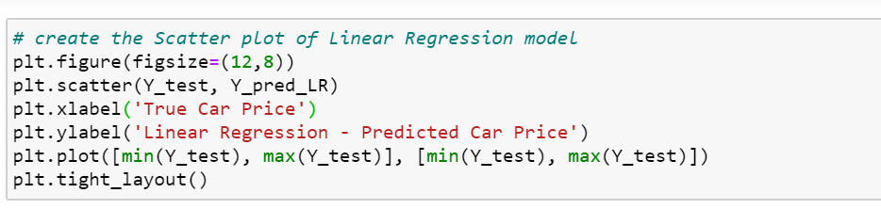
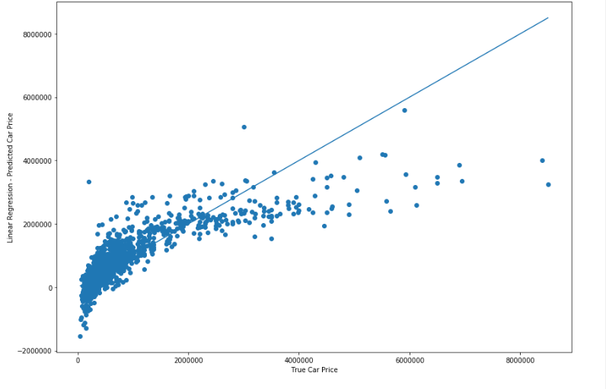
Values obtained:
Mean absolute error- : 3.891964177917602
Mean squared error- 3.833959996139587
Root mean squared error-6.19189792885799
Most of the graph is scatered in the region from 0 to 2000000.

Slide 27
Description of Decision Tree:
Decision tree builds classification or regression models in the form of a tree structure.
It breaks down a data set into smaller and smaller subsets while at the same time an associated decision tree is incrementally developed.
The final result is a tree with decision nodes and leaf nodes. A decision node has two or more branches. Leaf node represents a classification or decision. The topmost decision node in a tree which corresponds to the best predictor called root node
Decision trees can handle both categorical and numerical data.

Slide 28
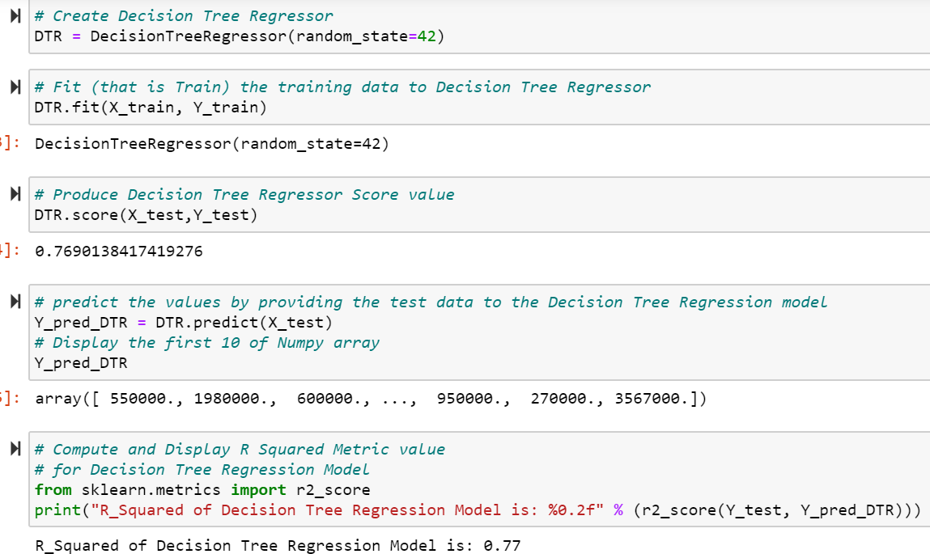
Decision Tree Model:
Import Decision Tree Regressor
Apply Decision Tree Regressor model
Fit the model.
After fitting the model score obtained is 0.76.. i.e., 76% accuracy
Predict the values providing the test data to Regression Model
R_Square value is 0.77

Slide 29
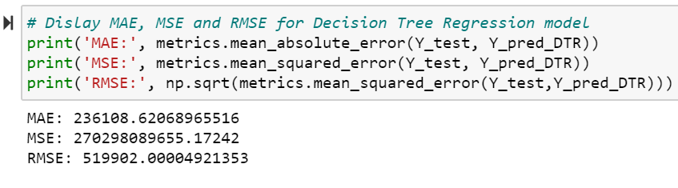
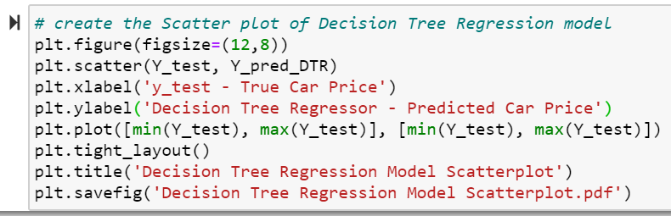
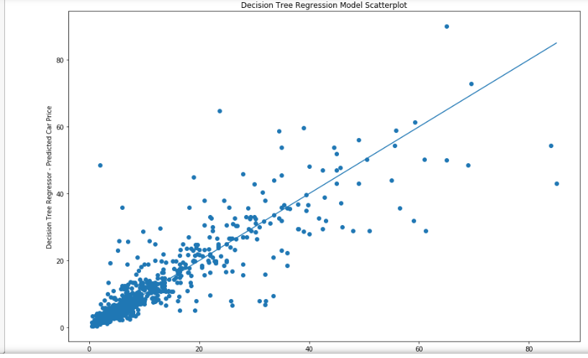
Values Obtained:
Mean absolute error- 2.317905172413793
Mean squared error- 1.7949274999999998
Root mean squared error-4.273482708540924

Slide 30
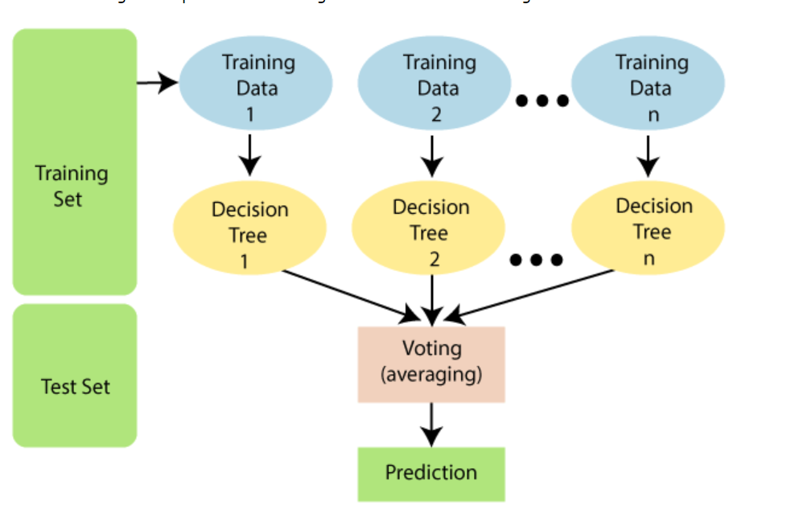
Description of Random Forest Algorithm:
It is based on the concept of ensemble learning, which is a process of combining multiple classifiers to solve a complex problem and to improve the performance of the model.
As the name suggests, "Random Forest is a classifier that contains a number of decision trees on various subsets of the given dataset and takes the average to improve the predictive accuracy of that dataset." Instead of relying on one decision tree, the random forest takes the prediction from each tree and based on the majority votes of predictions, and it predicts the final output.
The greater number of trees in the forest leads to higher accuracy and prevents the problem of overfitting.

Slide 31
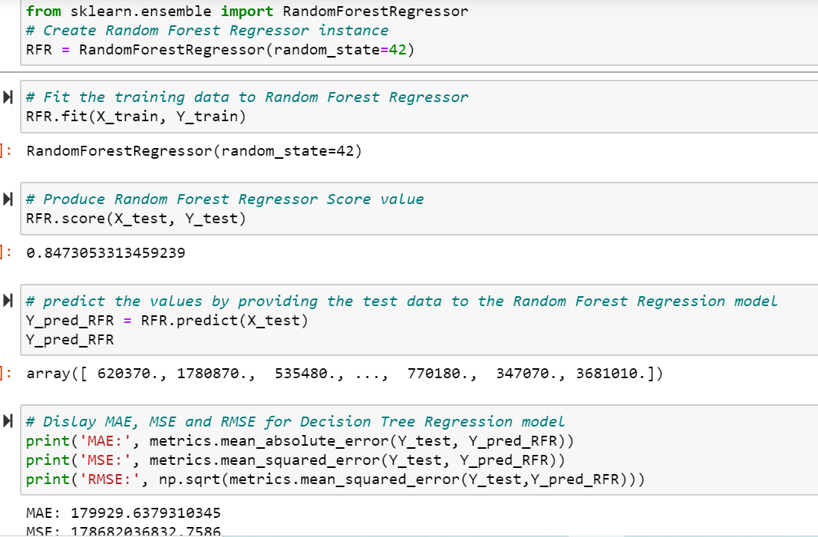
Random Forest Algorithm:
Importing the Random Forest Regressor.
Applying Random Forest Regression.
Fit the model
After fitting the model score obtained is 0.847..i.e., accuracy of 84%.
Predict the test data to Random Forest Regressor model.
Values Obtained:
Mean absolute error-1.7949274999999998
Mean squared error- 1.7949274999999998
Root mean squared error-4.273482708540924

Slide 32
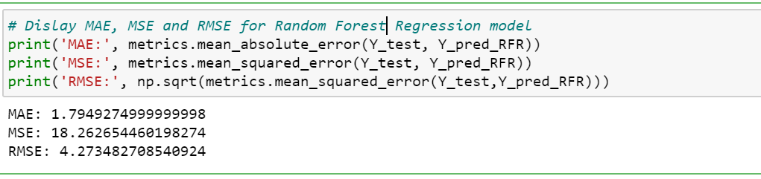
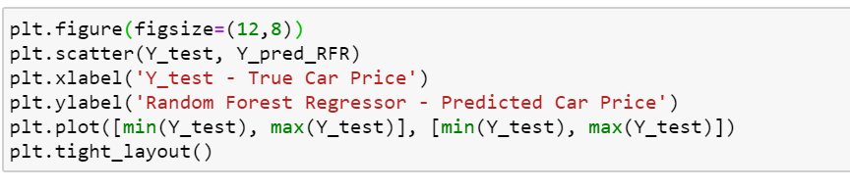
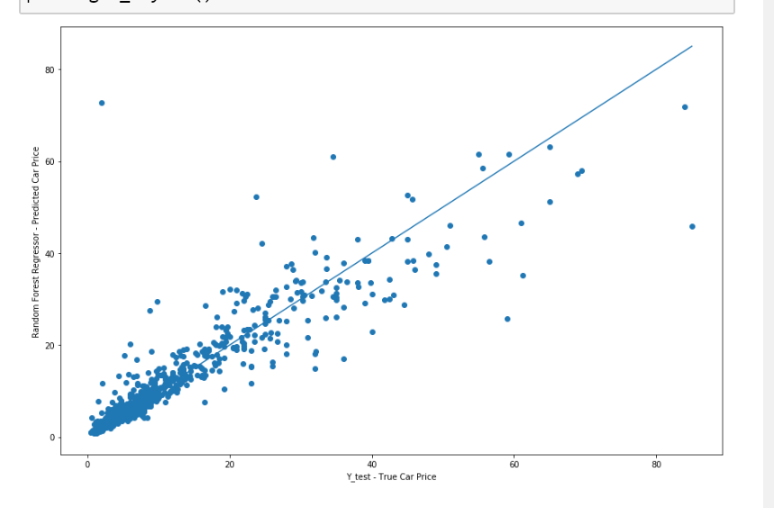
Values Obtained:
Mean absolute error-1.7949274999999998
Mean squared error- 1.7949274999999998
Root mean squared error-4.273482708540924

Slide 33
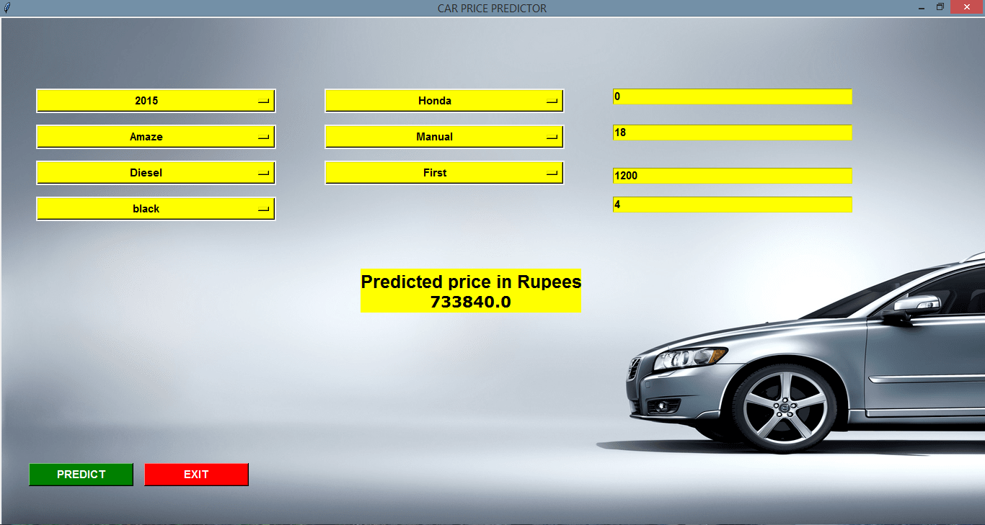
GUI:

Slide 34
Features of GUI:
All the drop down lists in our GUI are arranged in sorted manner.
Only the most required entries are asked by the user in which 6 are of categorical type and 5 are of numerical type.
Our GUI takes all the entries and return us the predicted price of the car.

Slide 35
Conclusion:
In our project after importing the data set and performing data preprocessing and data visualisation we obtained our first conclusion that Fuel_Type , Transmission_Type,Paint_color,Owner_Type,type,condition are categorical data which are replaced by numerically coded values.
Second , In transmmission we come to the conclusion that people prefer more manual cars in comparison to automatic cars,simiilarly we come to know in terms of fuel type diesel cars are preferred more over petrol cars.
Third, most of the outliers were contained in Odometer_Reading and Mileage_in_kmpl.
Fourth, mileage_in_kmpl and Transmission_type_id are correlated with an approximate value of 0.33
Fifth, On performing multiple linear regression we obtained an accuracy of 67%
Sixth,On performing Decision Tree Regression we obtained an accuracy of 79%
Seventh,On performing Random Forest Algorithm we obtained an accuracy of 84%

Slide 36


