Slide 1
INSTRUCTIONS
Use Font size 22 to 28 and Font Style Times New Roman (body)
Do not change the Template: Heading / Title of the slides
Do not change font style or colours
Do not copy paste paragraphs: use only Bullet Points
Maximum slide Limit is 20 only
As per the number of supervisor allotted adopt slide-2 or slide-3
Please display the required meaningful Content or images or tables
Change the footer accordingly using insert tab then click on header & footer tab and edit it
Save the PPT with Register No, Dept and Review no, example: 23xxxxxxxxx_CSE

Slide 2

Title:Efficient and Structured Approach to Library Resource Administration
Student Name: B.Tanya Sri
Student ID: 2520030112
Cluster:2
Section: 8
Under the Guidance
of
Supervisor Name: Dr.Jayaram Boga
Assistant Professor
Department of CSE

Slide 3
OUTLINE
Abstract
Existing System
Proposed System
System Architecture
Project Modules
Objectives
Co’s Attainments - FWD
Co1
Co2 …….. 5. Co5
Co’s Attainments - DSA
Co1
Co2 …….. 5. Co5
Screen Shots for FWD & DSA
Conclusion
Geo-Tagged Photos

Slide 4
Abstract
Library Resource Administration System is a web-based platform for managing library resources.
Helps administrators store, organize, and manage books efficiently.
Users can register, login, borrow, and return books through the system.
Authentication is improved using OTP verification and CAPTCHA validation..
Developed using HTML, CSS, JavaScript for frontend interface.
Backend implemented using Java programming and data structures.
Data structures like ArrayList and HashMap are used for efficient data management.
Improves speed, security, and accessibility in library operations.
Provides a user-friendly and interactive system for digital library management.

Slide 5
Existing System
Library records are usually maintained using manual registers or spreadsheets.
Searching for books is time-consuming and inefficient.
Difficult to track borrowed and returned books accurately.
No proper system for user authentication or access control.
Book recommendations are not available in traditional systems.
Managing large numbers of books becomes complex and error-prone.
Limited ability to organize books by category or rating.
Users depend on librarians for checking book availability.
Lack of automation leads to slow library operations.
Manual systems increase chances of data loss or record mistakes.

Slide 6
Proposed System
Introduces a digital library management platform.
Administrators can add, update, and remove books from the system.
Users can register and login securely using OTP and CAPTCHA.
Implements book recommendation using sorting algorithms.
Provides interactive web interface using HTML, CSS, and JavaScript.
Stores and manages users using HashMap data structure.
Ensures secure authentication and password management.
Provides faster book search and resource management.
Improves efficiency and organization of library services.

Slide 7
System Architecture
Library Management System is a web-based application.
Developed using HTML, CSS, JavaScript, and Java.
Users access the system through a web browser.
Users can register, login, borrow, and return books.
Admin can add and manage library books.
User Interface Layer
Built using HTML and CSS.
Provides forms and dashboards.
Application Logic Layer
Implemented using JavaScript and Java.
Handles authentication, book management, and recommendations.
Data Layer
Stores data using ArrayList and HashMap.
Provides secure and efficient library management.

Slide 8
Project Modules
User Authentication Module: Allows users to register, log in, and manage their accounts securely using OTP and CAPTCHA verification.
Book Management Module: Enables administrators to add, update, and delete books from the library system.
Book Borrow & Return Module: Users can borrow available books and return them after use.
Book Recommendation Module: Suggests books to users based on topic, genre, and rating using sorting algorithms.
User Management Module: Stores and manages user information such as username, email, and phone number.
Password Reset Module: Allows users to reset their password securely using OTP verification.

Slide 9
Objectives
To create a system where users can easily access library books.
To provide a centralized platform for managing library resources.
To allow users to borrow and return books through the system.
To enable administrators to add, update, and manage book records.
To provide a simple and user-friendly interface for library users.
To implement secure user authentication using OTP and CAPTCHA verification.
To apply data structures and algorithms for efficient book search and
recommendation.

Slide 10
Co’s Attainments - FWD
CO1 – Apply Internet Fundamentals, HTML & Introductory CSS Styling The project uses HTML for page structure such as login forms, registration forms, and dashboards, and CSS for styling and layout, demonstrating understanding of basic web development concepts.
CO2 – Apply HTML Forms, Semantic Tags & Comprehensive CSS Layouts The system includes login and registration forms, uses semantic HTML elements, and implements responsive layouts using CSS (Flexbox and modern styling).
CO3 – Apply JavaScript Programming Essentials JavaScript is used for handling user input, managing book data, and implementing application logic such as borrow and return operations.
CO4 – Apply JavaScript Interactivity & DOM The project uses DOM manipulation and event handling to dynamically display books, update availability status, and manage user interactions.
CO5 – Apply Advanced Web Development & Deployment The system integrates features like OTP verification, CAPTCHA validation, book search, and interactive UI, demonstrating advanced web development concepts.

Slide 11
Co’s Attainments - DSA
CO1: Implemented sorting techniques to find books based on topic and genre.
CO2: Used ArrayList (List ADT) to store and manage book records.
CO3: Applied sorting algorithm to recommend books based on rating.
CO4: Used HashMap (hashing) to store and manage user accounts efficiently.
CO5: Developed a practical library management application using linear data structures.
CO6: Built a menu-driven Java application integrating authentication, book management, and recommendation features.

Slide 12
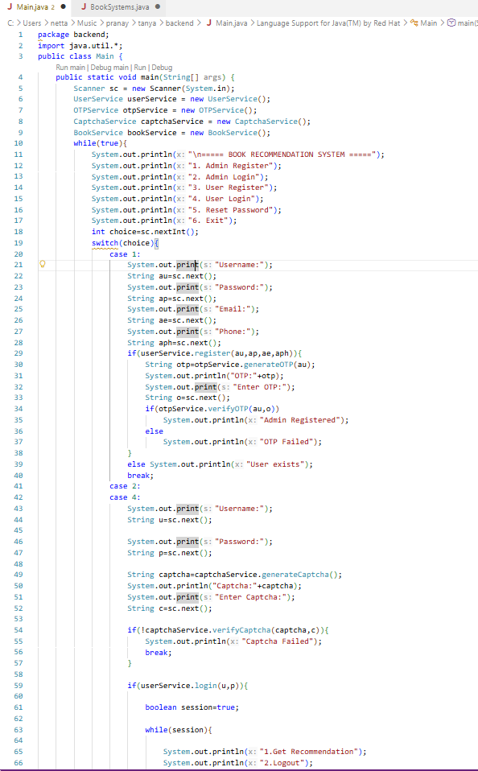
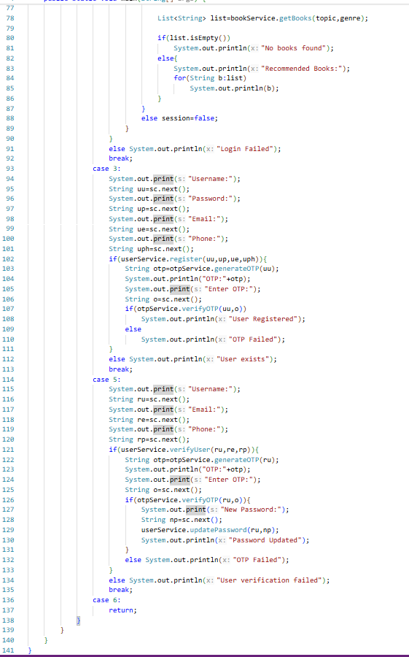
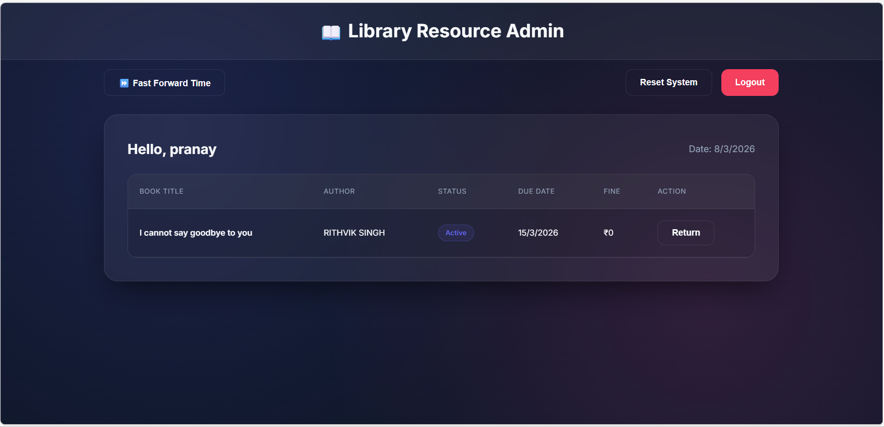
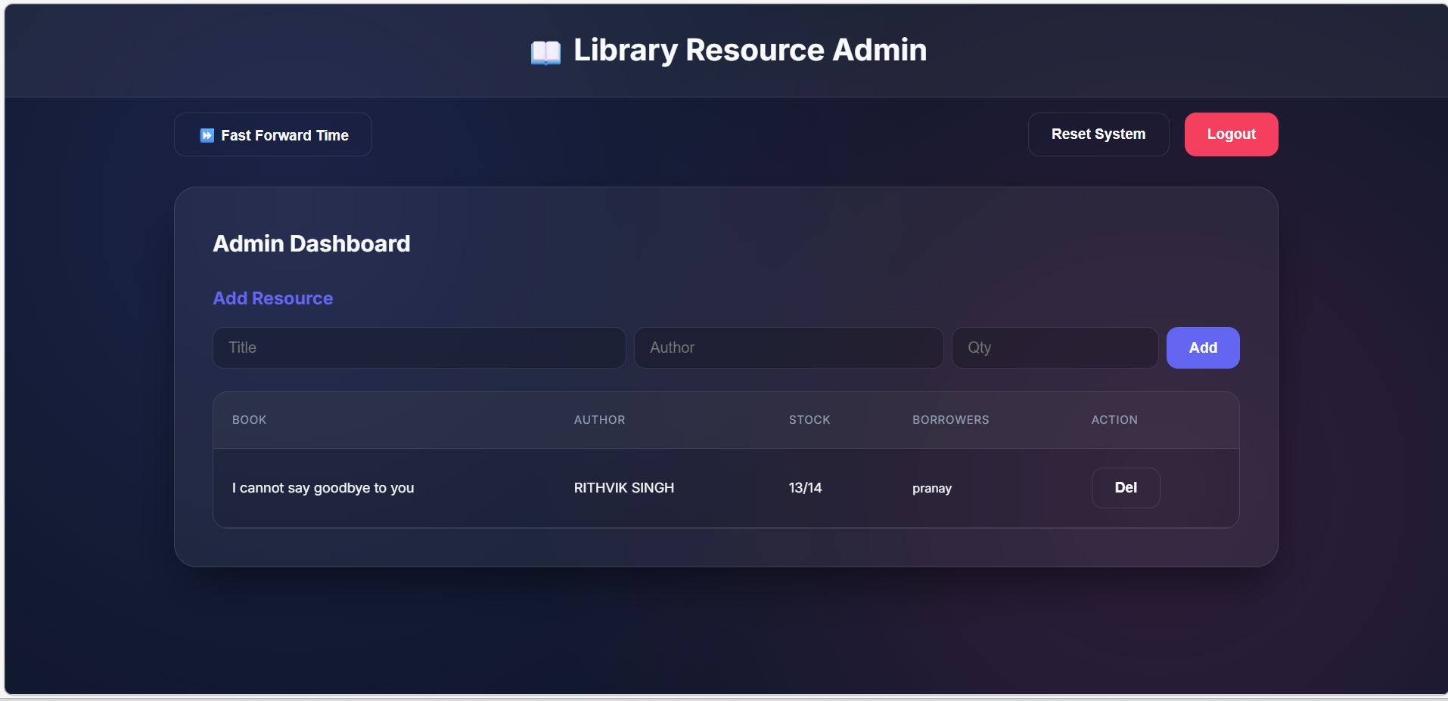
Screenshots for FWD & DSA

Slide 13
Conclusion
The Library Resource Administration System demonstrates the practical implementation of data structures and web technologies.
The system uses ArrayList and HashMap to manage book and user data efficiently.
Features such as user authentication, OTP verification, and CAPTCHA validation improve system security.
The application provides book management and recommendation features.
Overall, the project shows how technology can be used to build a simple and efficient digital library management system.

Slide 14
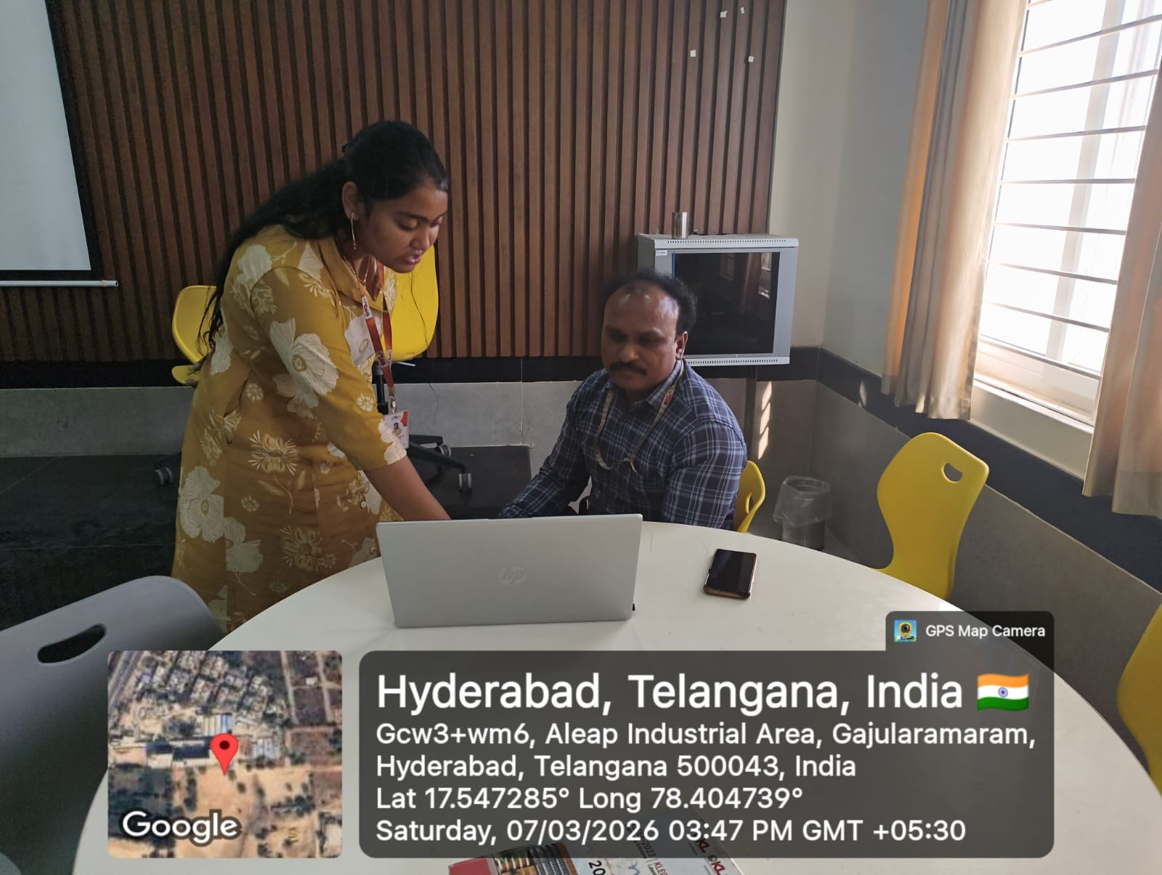
Geo- Tag Photos

Slide 15
THANK YOU

