Slide 1
EXPLORATORY DATA ANALYSIS ON TERRORISM GLOBAL DATASET
TASK SUBMISSION FOR INTERNSHIP UNDER THE SPARKS FOUNDATION GRIP PROGRAM JULY 2021
BY TANYA TANDON

Slide 2
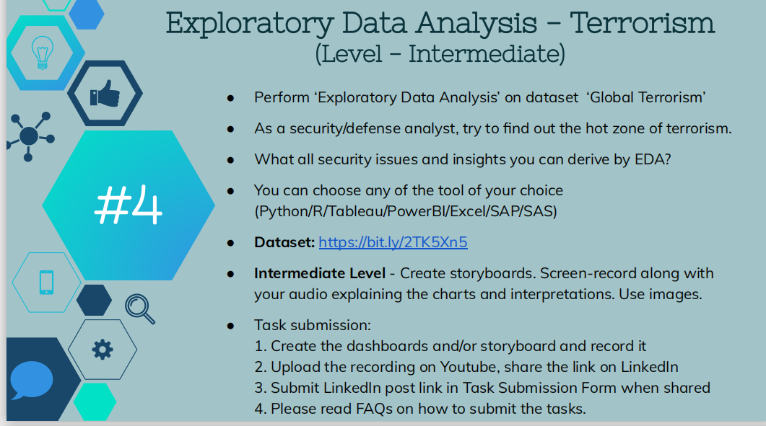

Slide 3
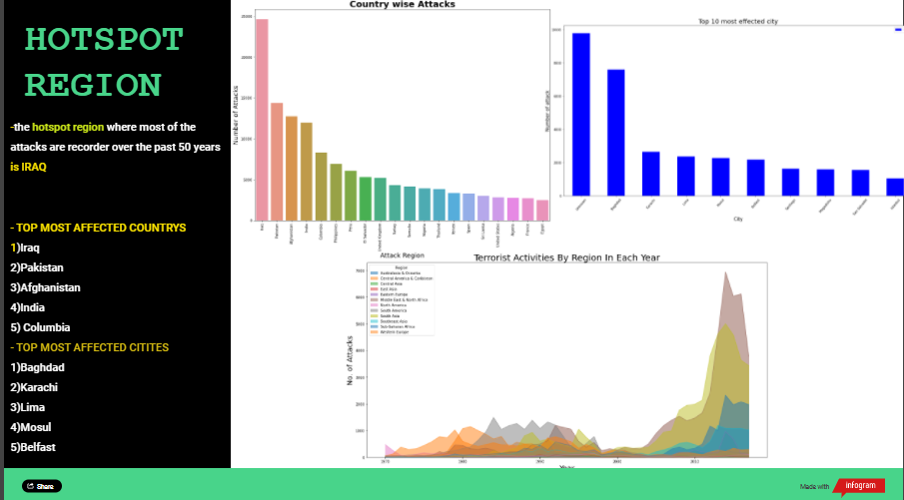

Slide 4
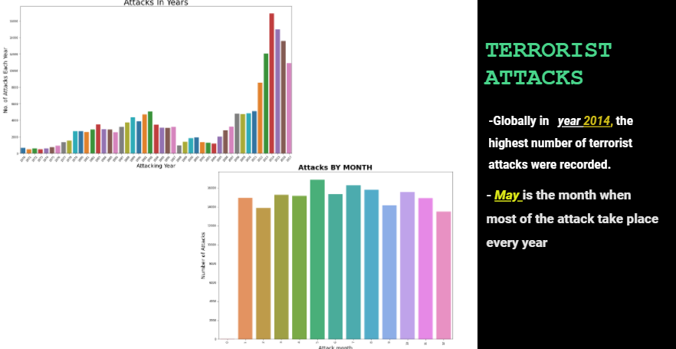

Slide 5
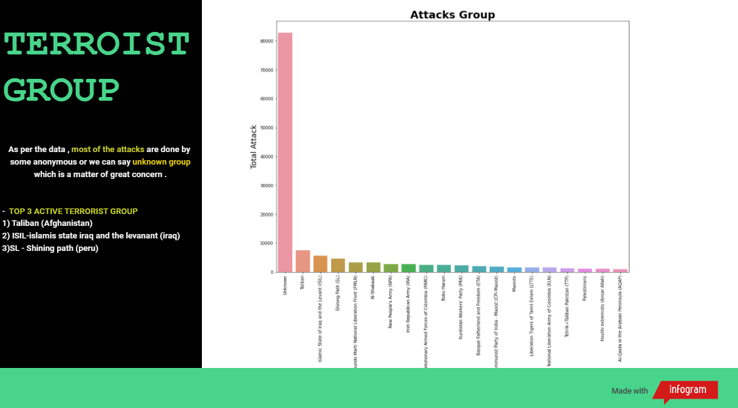

Slide 6
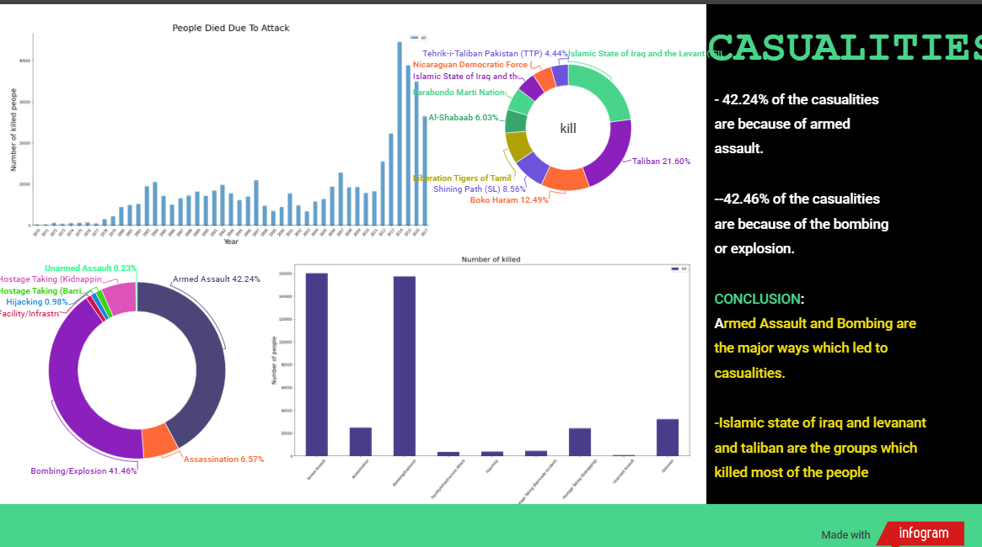

Slide 7
