Slide 1
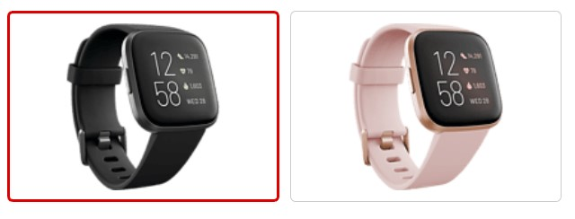
FitBit Fitness Tracker Data
Research done by Tanya Zanina
MidBootcamp Project with IronHack
04.11.2022

Slide 2
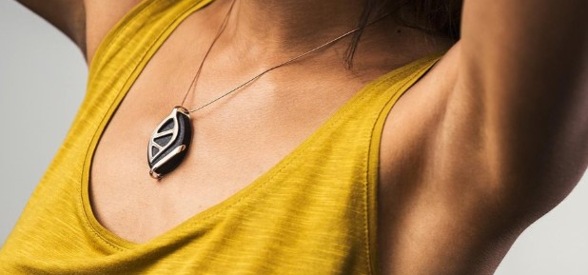

BellaBeat. Business task.
BellaBeat is high-tech company that manufactures health-focused smart devices.
Task: analyze smart device usage in order to get insights and trends.
Data was found: https://www.kaggle.com/datasets/arashnic/fitbit/code?resource=download
33 participants
Usage from 12 April 2016 till 12 May 2016

Slide 3

Guiding questions
What are some trends in smart device usage?
How could these trends apply to Bellabeat customers?
How could these trends help inﬂuence Bellabeat marketing strategy?

Slide 4
Approach taken
Examine the customer data
Clean the data
Breakdown questions into smaller pieces
Develop approaches to answer each sub-question
Analyse the data & draw conclusions

Slide 5
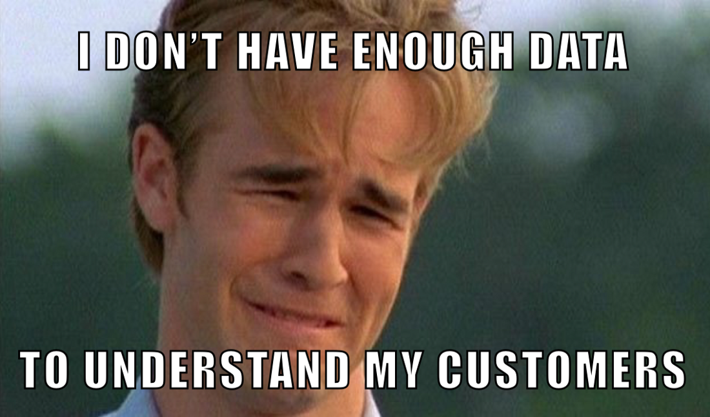
Problems of the data set
Only 33 participants and not all 33 for every variable.
No information about age, gender, height, geolocation
Weight was also presented for very small group
Some customers didn’t use devise during the sleep.

Slide 6
What did I have
Data contained 18 files, quite clean data
I decided to work with 7 of them:
Daily activity
Heart rate
Intensity
Steps
Sleep
Weight
Calories.
Checking for NaN values and duplicates.

Slide 7
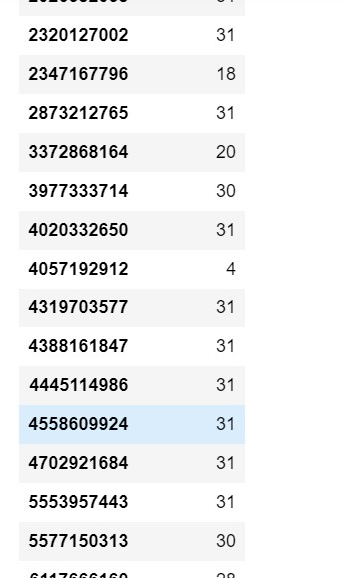
Removing some rows
I was removing the customers, who were representing the data with only few days out of 30.
I did it for every file.
Sleeping file had a lot of missing days. Probably people take off device during the nights.

Slide 8
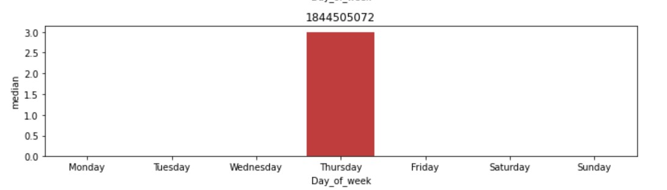
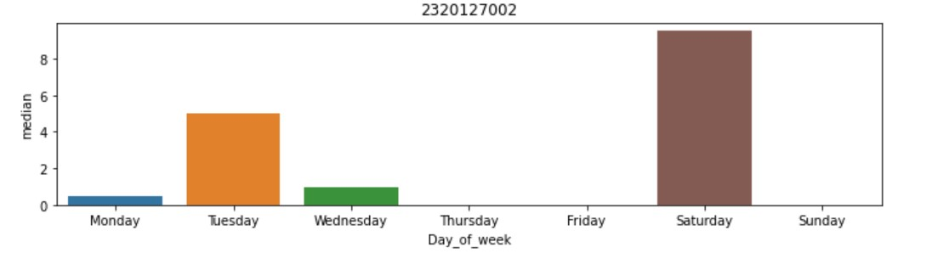
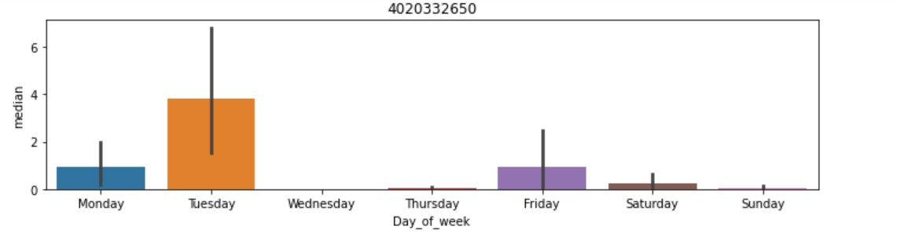
Example of insufficient data – Intensity (active minutes)

Slide 9
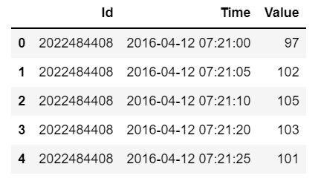
Example of large data sets – Heart Rate
Table with heart rate has data for 14 people
Every 5-10 seconds
2.5 million rows

Slide 10
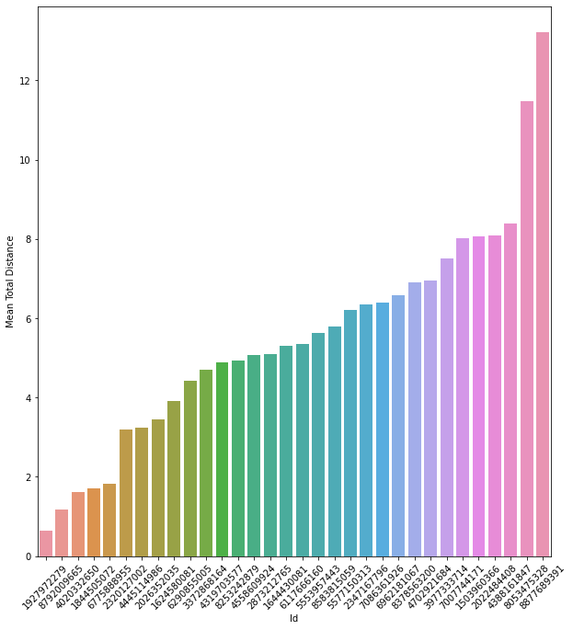
Exploring data. Finding correlations. Mean Total Distance per customer

Slide 11
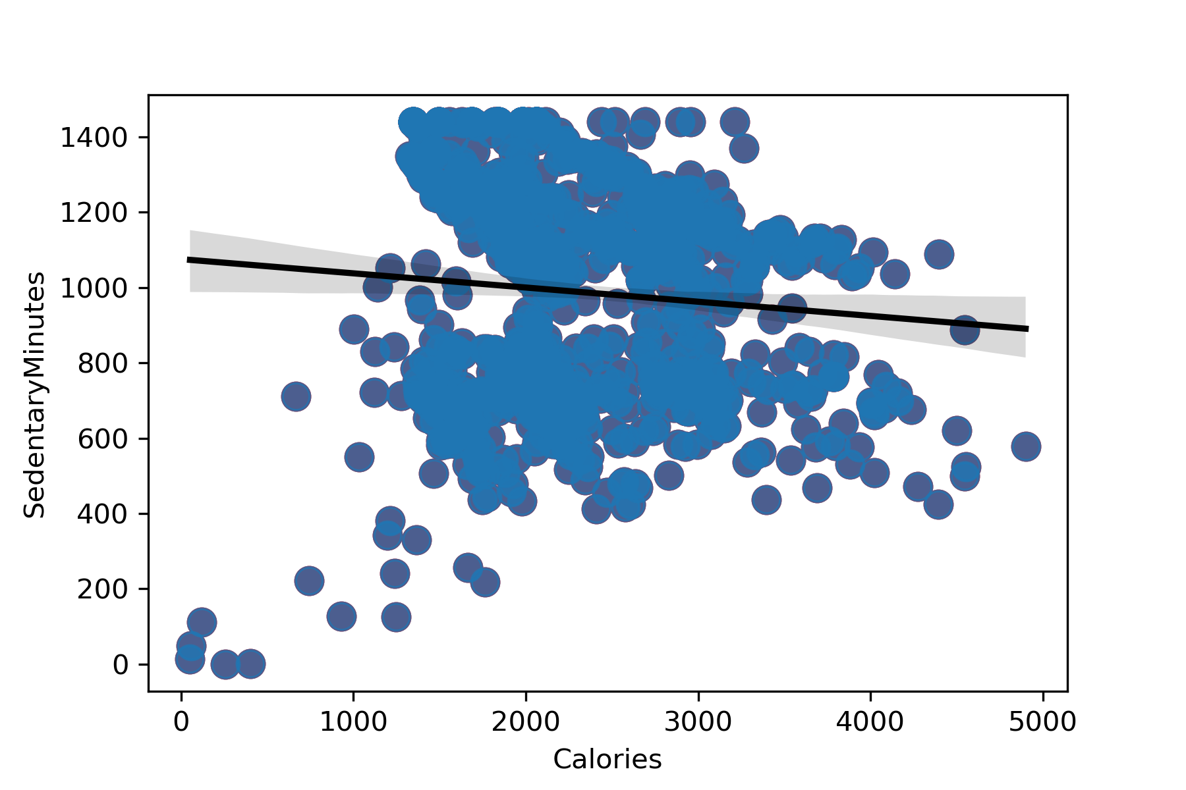
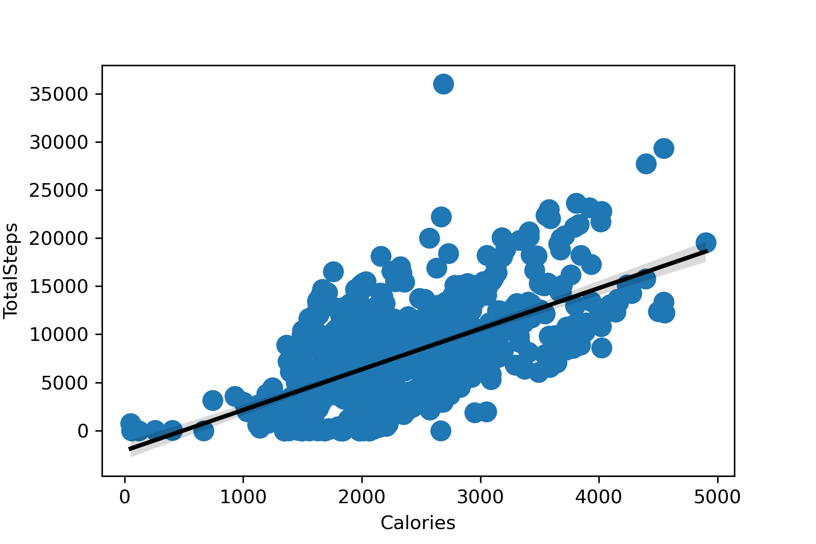
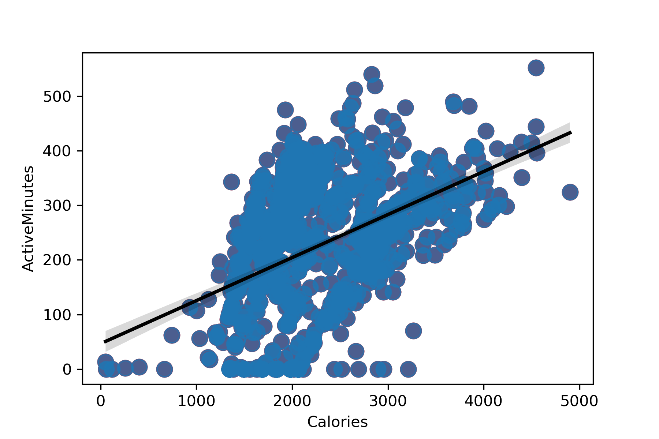
Calories and Sedentary Minutes
Calories and Total Steps
Calories and Active Minutes
There is a correlation between calories and total steps.
As well between calories and active minutes.
And there is NO correlation between sedentary minutes and calories.

Slide 12
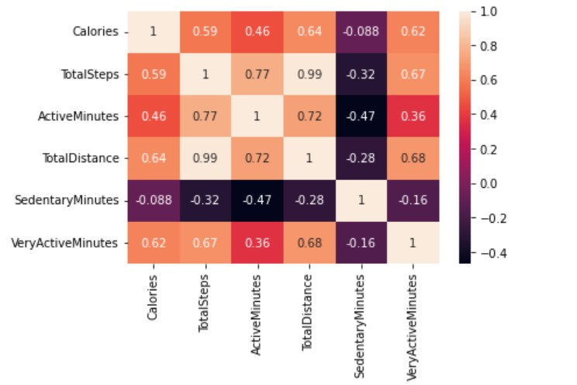
Correlation matrix

Slide 13
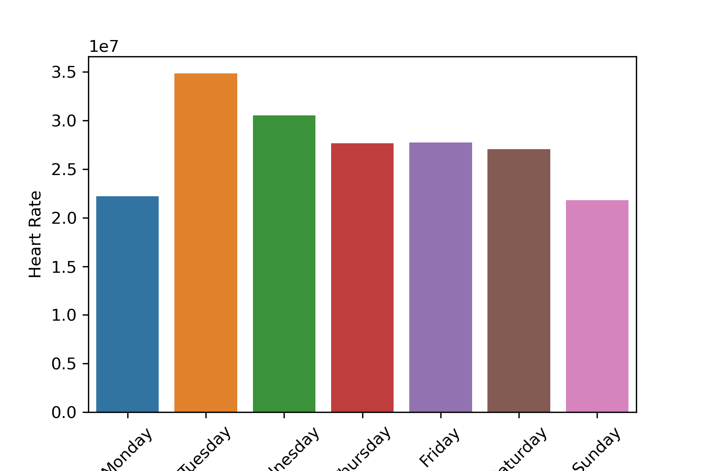
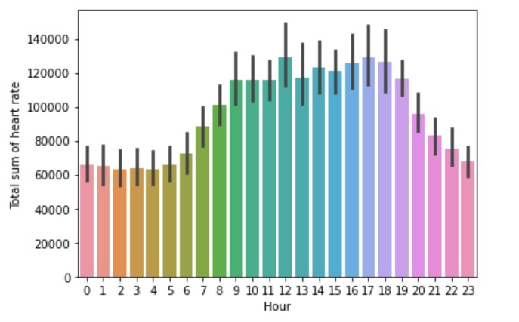
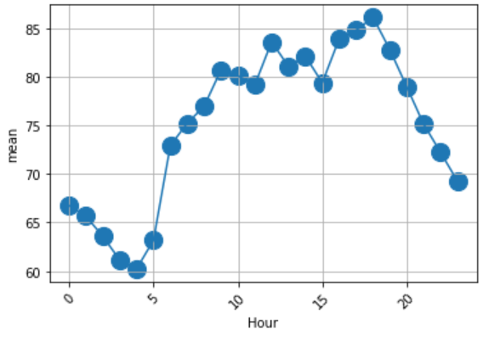
Total sum of heart rate of all customers per hour
Heart rate spread over the weekdays
Mean value of heart rate of all customers
The heart rate grows when people wake up, around lunch time and after the work.
Sunday, Monday are quiet days.
Tuesday is the most active day.

Slide 14
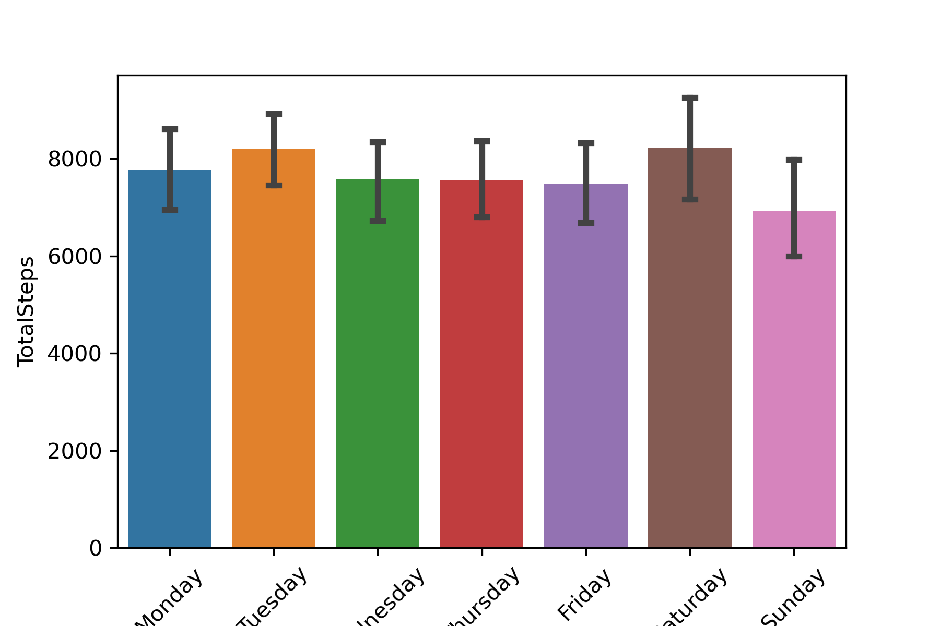
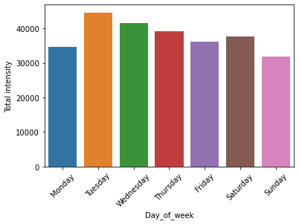
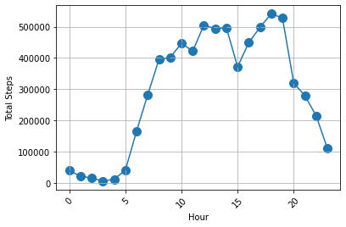
Total sum of intensity of all customers per weekday
Total sum of steps of all customers per weekday
Total Steps per hour
Intensity is the largest on Tuesday
People walk the most on Saturday and Tuesday
Total Steps per day look a lot like heart rate and intenisty minutes.

Slide 15
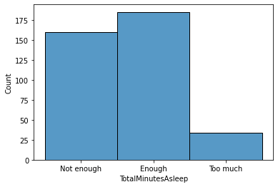
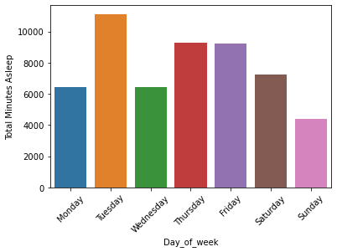
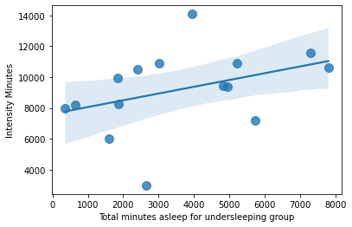
Dividing into 2 groups: sleeping enough and undersleeping
Group that doesn’t sleep enough per weekday
Total minutes of sleep and intensity for undersleeping group
People don’t sleep enough
People most active on Tuesday, sleep the most on Tuesday
When people undersleep – sleeping more allows them to be more active

Slide 16
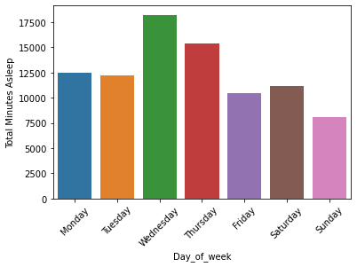
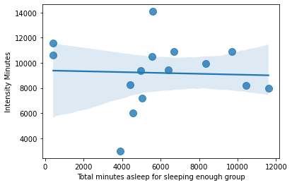
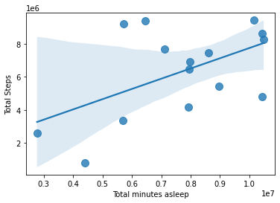
Sleeping enough group, sleeping minutes per weekday
Group that sleeps enough and intensity
Total minutes of sleep and total steps for all customers
People who sleep enough, sleep the most on Wednesday
On Sunday people don’t sleep a lot (over-excited about IronHack on Monday??)
There is a correlation between sleep and total steps
The more you sleep – the more you walk

Slide 17
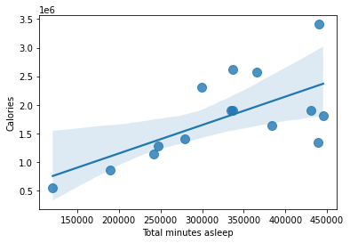
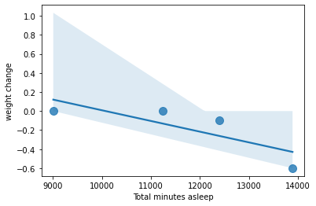
Total minutes asleep and calories
Total minutes of sleep has correlation with the calories!
Total minutes of sleep and weight
Officialy the data of weight has 8 people.
But when counting down, we had only 5 real changes of weight.
I looked at the connection between weight change and total minutes asleep. And it again tells us – sleeping is important.

Slide 18
What are some trends in smart device usage?
We saw the correlation between steps, sleep and calories, we saw the actvity around lunch time and after the end of the working date. We saw more activity on Saturday and Tuesday.
How could these trends apply to Bellabeat customers?
The trends should be relevant to Bellabeat customers as the populations are similar. However, the data analysed was from 2016 and the Coronoa virus pandemic has changed people’s behaviour which may lead to different trends (although minor ones, such as activity levels d during the day).
How could these trends help inﬂuence Bellabeat marketing strategy?
Behaviour drives results and without the measurement of this behaviour it can be harder to achieve results in weight loss / increasing the calories used. So, first of all, get a tracker!
Provide behaviour guidelines to reduce weight (based on the analysis of sleep/activity/etc) for people to follow, increasing engagement with the tracker

