Slide 1
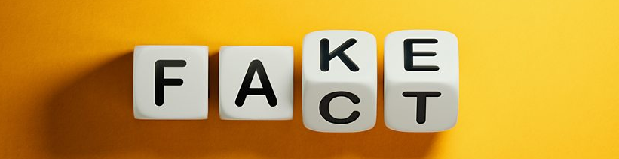
Fake News Detector
Final Bootcamp Project
Tanya Zanina
December 2022

Slide 2

What is fake news?
“Fake news is news, stories or hoaxes created to deliberately misinform or deceive readers.”

Slide 3
Why?
- influence people’s views
- push a political agenda or cause confusion
- click-bait (gain more website visitors and increase advertising revenue for websites)

Slide 4

Different problem – filter bubble
You’re a liberal but have an uncle who won’t stop posting articles touting the brilliance of Donald Trump? Mute him.
You’re conservative and tired of all these pesky Huffington Post articles popping up in your feed? Hide them.

Slide 5
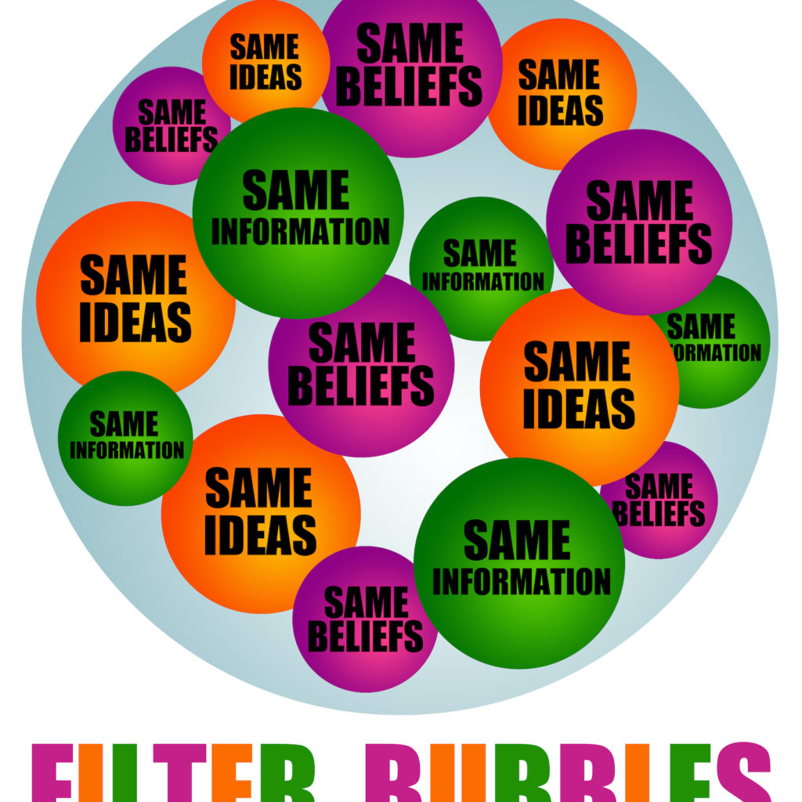
Fake news crisis!
Combine filter bubbles and diversity of voices in our new media frontier
You end up with a great deal of inflammatory and false information circulating among people who want to believe it.
Welcome to the fake news crisis

Slide 6
Data. Models. Predictions.
2 Data sets with true and fake new: https://www.Kaggle.Com/datasets/jainpooja/fake-news-detection
21,417 true news
23,481 fake news
Building models to predict if news true or fake

Slide 7
Data. Models. Predictions
Clean-up from symbols
Train-test split
TFIDF – vectorization (Proportionally increasing the number of times a word appears in the document but is counterbalanced by the number of documents in which it is present. Hence, words like 'this', 'are' etc., That are commonly present in all the documents are not given a very high rank)
Models:
Logistic regression
Passive aggressive classifier
Random forest classifier

Slide 8
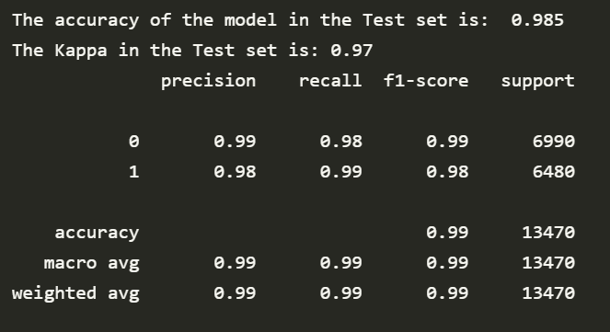
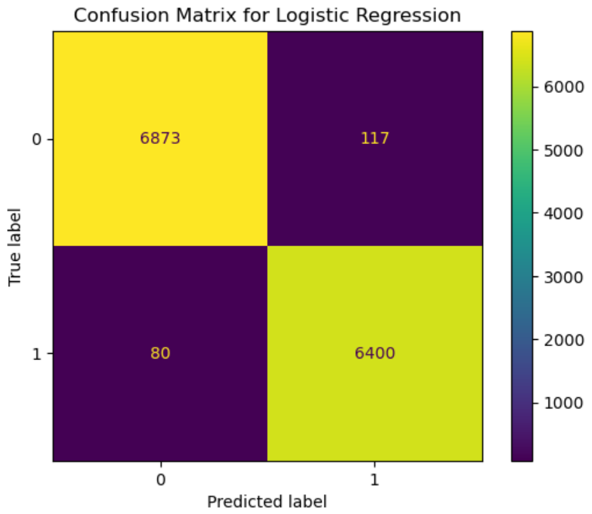
Results for Logistic Regression

Slide 9
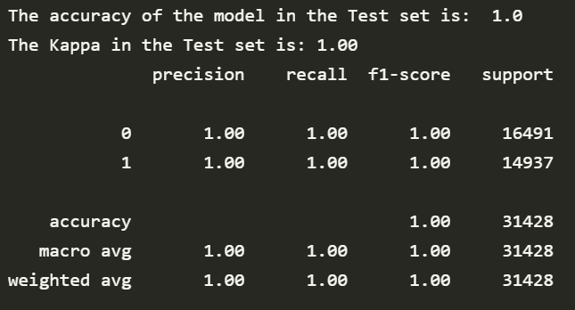
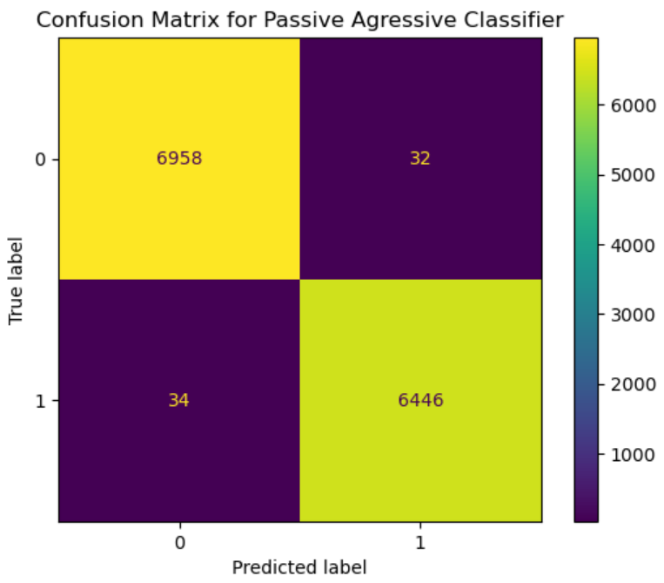
Results for Passive Aggressive Classifier

Slide 10
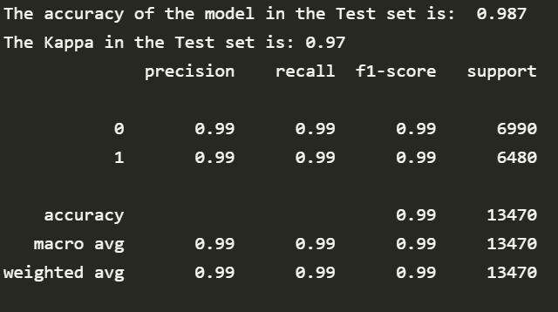

Results for Random Forest Classifier

Slide 11
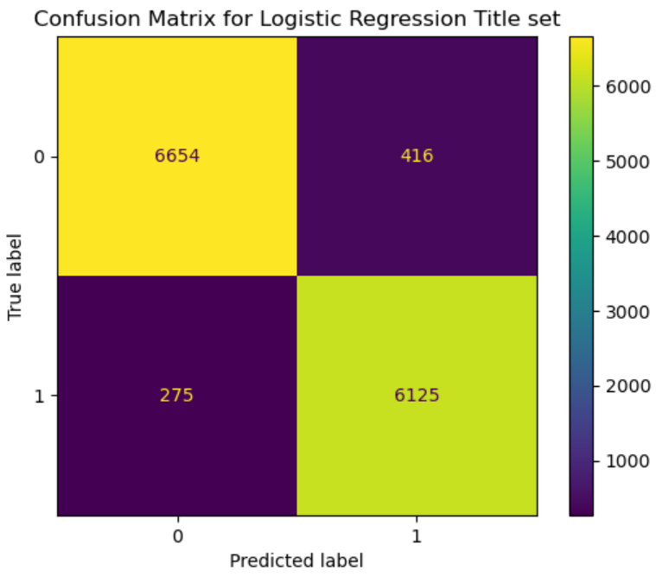
Prediction on titles
Logistic Regression:
The accuracy of the model in the test set: 0.949
The Kappa of the model in the test set: 0.90
Random Forest Classifier:
The accuracy of the model in the test set: 0.944
The Kappa of the model in the test set: 0.89
--------------------------------------------------------
Passive Aggressive Classifier:
The accuracy of the model in the test set: 0.949
The Kappa of the model in the test set: 0.90

Slide 12
Importance Features with hashtags:
[(23.291676503780916, 23.291676503780916, 'burnmymagahat’),
(19.133070044672404, 19.133070044672404, 'gbfufpnl'),
(9.881278574344664, 9.881278574344664, 'cruzed'),
(9.030465396697462, -9.030465396697462, 'kordes'),
(6.256932280644248, 6.256932280644248, 'resgister'),
(6.198761502730006, -6.198761502730006, 'authorityresult’),
(6.1847704413558295, -6.1847704413558295, 'nabra'),
(5.971727369808271, 5.971727369808271, 'thoms'),
(4.823522476308776, -4.823522476308776, 'monza'),
(4.733600251937565, -4.733600251937565, 'jellybeans')]

Slide 13
Importance Features without hashtags:
[(24.97751283666042, 24.97751283666042, 'mprc’)
(12.510115814194476, -12.510115814194476, 'inagurationday’)
(9.235853821406375, 9.235853821406375, 'nouri’)
(7.895692418062816, -7.895692418062816, 'directionally’)
(5.725486664897377, 5.725486664897377, 'delury’)
(5.129240640784158, -5.129240640784158, 'zacaria’)
(5.066415860232255, -5.066415860232255, 'slaughterhouse’)
(4.774985440037104, -4.774985440037104, 'weaknesses’)
(4.762525905073536, 4.762525905073536, 'sry’)
(4.589184652539806, -4.589184652539806, 'arenius')
I couldn’t find connection between the sign of these coefficients and the frequencies of these words.
Probably due to difference in approach. Before running the models I was applying Vectorizers. So it’s more than just frequency of the word in the set

Slide 14
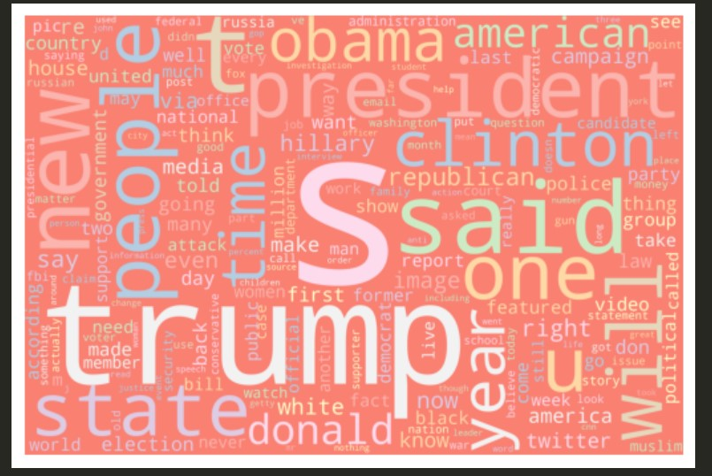
Fake news. Word Cloud.

Slide 15
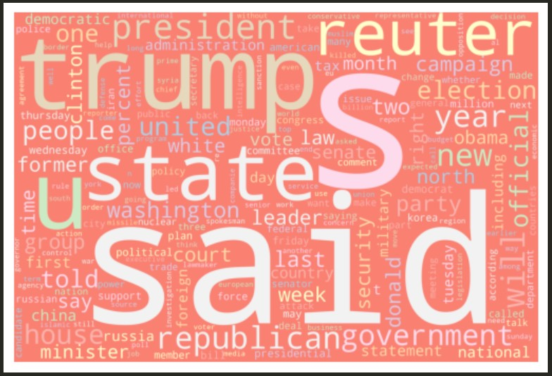
True news. Word Cloud.

Slide 16
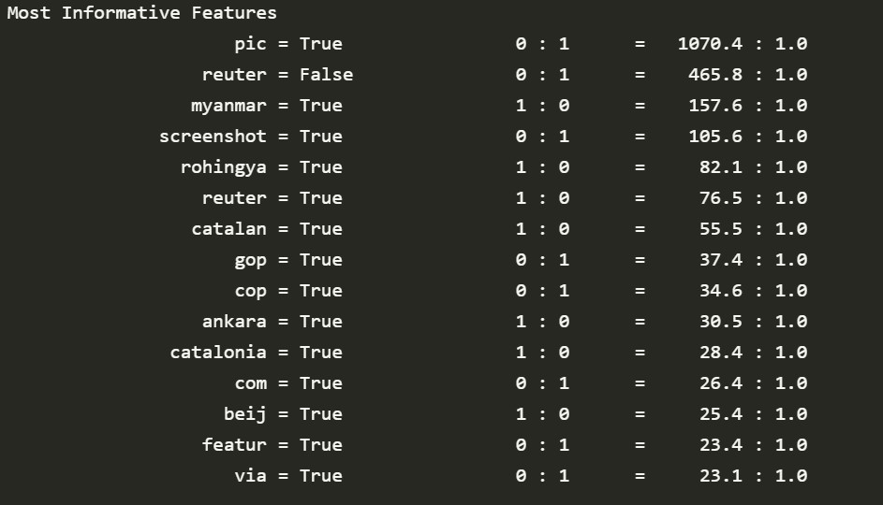
Sentiment Analysis

Slide 17
Examples
Real news example: NATO seeks to buttress Russia's neighbours as Moscow attacks Ukraine “KYIV, Nov 30 (Reuters) - Russia said its forces in eastern Ukraine had edged forward, Kyiv said Moscow was "planning something" in the south and NATO sought on Wednesday to shore up other countries that fear destabilisation from Moscow. Ukraine's General Staff said earlier that its troops had repelled six Russian attacks in 24 hours in the eastern Donbas region, while Russian artillery had relentlessly shelled across the Dnipro River, including at Kherson city, in the south.”
https://www.reuters.com/world/europe/snow-blanket-kyiv-sunday-power-still-short-supply-2022-11-27/
2. Fake news example: FBI Director James Comey’s Clinton Foundation Connection
WASHINGTON, D.C. — A review of FBI Director James Comey’s professional history and relationships shows that the Obama cabinet leader — now under fire for his handling of the investigation of Hillary Clinton — is deeply entrenched in the big-money cronyism culture of Washington, D.C. His personal and professional relationships — all undisclosed as he announced the Bureau would not prosecute Clinton — reinforce bipartisan concerns that he may have politicized the criminal probe. These concerns focus on millions of dollars that Comey accepted from a Clinton Foundation defense contractor, Comey’s former membership on a Clinton Foundation corporate partner’s board, and his surprising financial relationship with his brother Peter Comey, who works at the law firm that does the Clinton Foundation’s taxes. Lockheed Martin When President Obama nominated Comey to become FBI director in 2013, Comey promised the United States Senate that he would recuse himself on all cases involving former employers. But Comey earned $6 million in one year alone from Lockheed Martin. Lockheed Martin became a Clinton Foundation donor that very year. Comey served as deputy attorney general under John Ashcroft for two years of the Bush administration. When he left the Bush administration, he went directly to Lockheed Martin and became vice president, acting as a general counsel. How much money did James Comey make from Lockheed Martin in his last year with the company, which he left in 2010? More than $6 million in compensation. Lockheed Martin is a Clinton Foundation donor. The company admitted to becoming a Clinton Global Initiative member in 2010. According to records, Lockheed Martin is also a member of the American Chamber of Commerce in Egypt, which paid Bill Clinton $250,000 to deliver a speech in 2010. In 2010, Lockheed Martin won 17 approvals for private contracts from the Hillary Clinton State Department.
https://www.breitbart.com/politics/2016/09/10/exposed-fbi-director-james-comeys-clinton-foundation-connection/

Slide 18
Examples
This one also caught my eye – but is it true?!
“BREAKING NEWS - Ignacio has decided that we are his best ever students and has decided to give everyone 100% for their IronHack course!”

Slide 19
Final take-aways
Data (words) analysis algorithms can help and are reliable
Look beyond the headline
Check other sources
Check the facts
Check your biases
Believing something doesn’t make it true (like Ignacio giving 100% to us all!)

Slide 20
THANKS A LOT!

