Slide 1
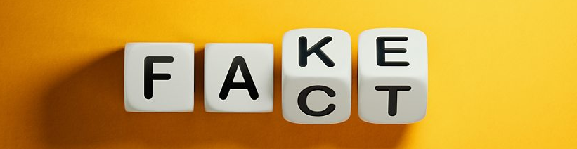
Fake news detector
Final Bootcamp Project
Tanya Zanina
December 2022

Slide 2

What is fake news?
Fake news is news, stories or hoaxes created to deliberately misinform or deceive readers.

Slide 3
Why?
- influence people’s views
- push a political agenda or cause confusion
- gets clicks (gain more website visitors and increase advertising revenue for websites)

Slide 4
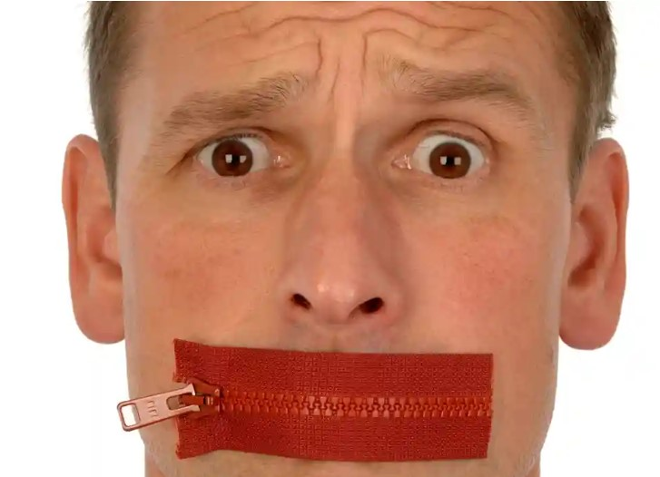
Different problem – filter bubble
You’re a liberal but have an uncle who won’t stop posting articles touting the brilliance of Donald Trump? Mute him.
You’re conservative and tired of all these pesky Huffington Post articles popping up in your feed? Hide them.

Slide 5
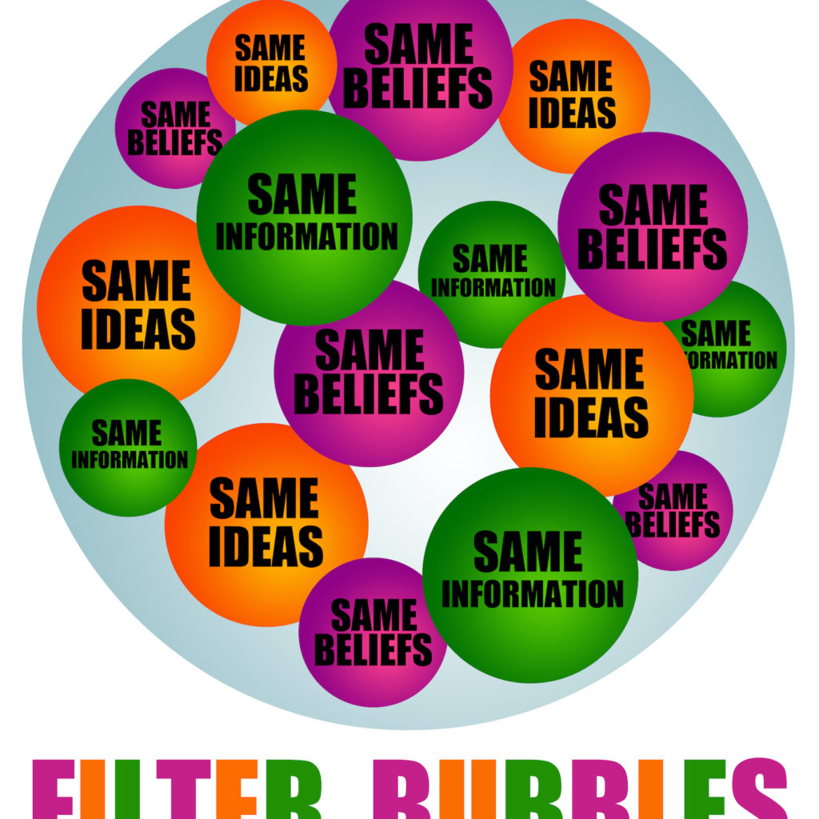
Fake news crisis!
Combine filter bubbles and diversity of voices in our new media frontier
You end up with a great deal of inflammatory and false information circulating among people who want to believe it.
Welcome to the fake news crisis

Slide 6
Data. Models. Predictions.
2 data sets with True and Fake New: https://www.kaggle.com/code/therealsampat/fake-news-detection/data
21417 true news
23481 fake news
Building models to predict if news true or fake

Slide 7
Data. Models. Predictions
Clean-up from symbols
Train-test split
TFIDF – Vectorization (proportionally increasing the number of times a word appears in the document but is counterbalanced by the number of documents in which it is present. Hence, words like 'this', 'are' etc., that are commonly present in all the documents are not given a very high rank)
Models: Logistic Regression
Passive Aggressive Classifier
Random Forest Classifier

Slide 8
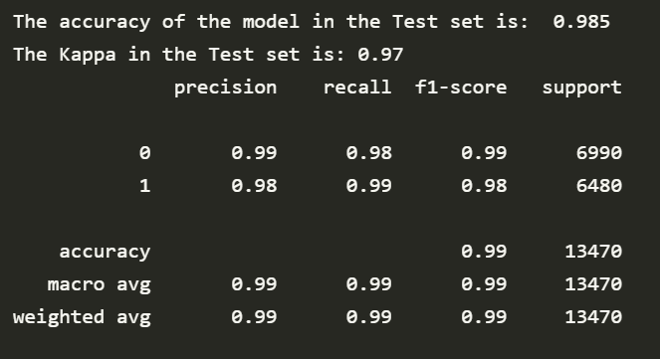
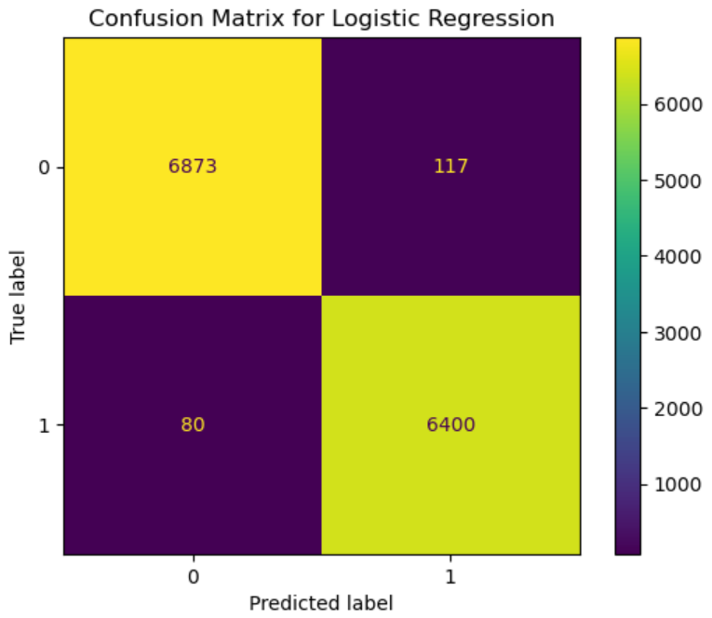
Results for Logistic Regression

Slide 9
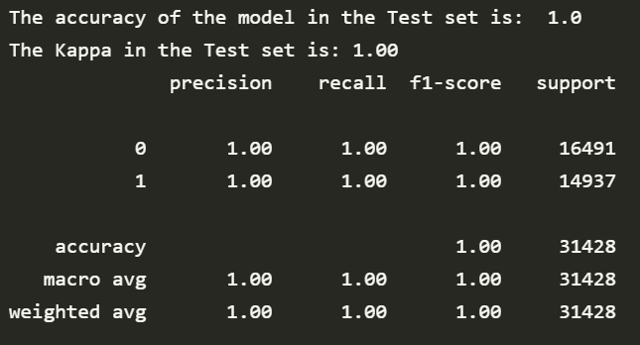
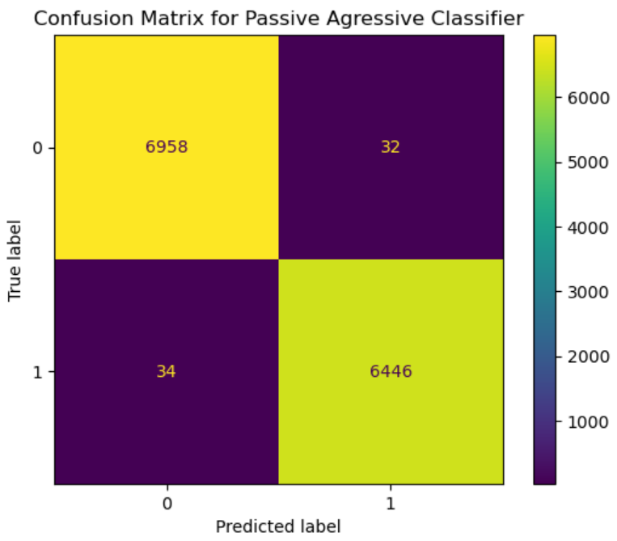
Results for Passive Aggressive Classifier

Slide 10
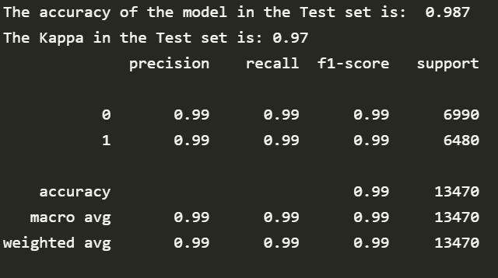

Results for Random Forest Classifier

Slide 11

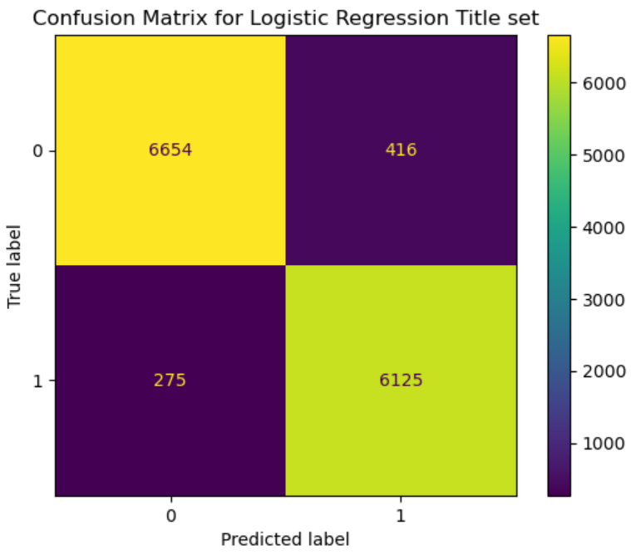
Prediction on titles
Random Forest Classifier:
The accuracy of the model in the test set: 0.944
The Kappa of the model in the test set: 0.89
Passive Aggressive Classifier:
The accuracy of the model in the test set: 0.949
The Kappa of the model in the test set: 0.90

Slide 12
Importance Features with hashtags:
[(23.291676503780916, 23.291676503780916, 'burnmymagahat’),
(19.133070044672404, 19.133070044672404, 'gbfufpnl'),
(9.881278574344664, 9.881278574344664, 'cruzed'),
(9.030465396697462, -9.030465396697462, 'kordes'),
(6.256932280644248, 6.256932280644248, 'resgister'),
(6.198761502730006, -6.198761502730006, 'authorityresult’),
(6.1847704413558295, -6.1847704413558295, 'nabra'),
(5.971727369808271, 5.971727369808271, 'thoms'),
(4.823522476308776, -4.823522476308776, 'monza'),
(4.733600251937565, -4.733600251937565, 'jellybeans')]

Slide 13
Importance Features without hashtags:
[(24.97751283666042, 24.97751283666042, 'mprc’)
(12.510115814194476, -12.510115814194476, 'inagurationday’)
(9.235853821406375, 9.235853821406375, 'nouri’)
(7.895692418062816, -7.895692418062816, 'directionally’)
(5.725486664897377, 5.725486664897377, 'delury’)
(5.129240640784158, -5.129240640784158, 'zacaria’)
(5.066415860232255, -5.066415860232255, 'slaughterhouse’)
(4.774985440037104, -4.774985440037104, 'weaknesses’)
(4.762525905073536, 4.762525905073536, 'sry’)
(4.589184652539806, -4.589184652539806, 'arenius')
I couldn’t find connection between the sign of these coefficients and the frequencies of these words.
Probably due to difference in approach. Before running the models I was applying Vectorizers. So it’smore than just frequency of the word in the set

