Slide 1
Cobify tech challenge
Tanya Zanina, 11-01-2023

Slide 2
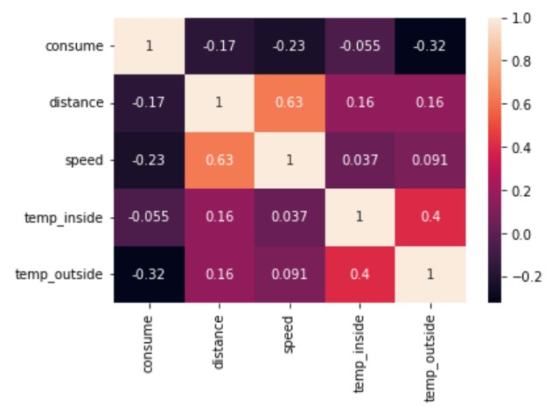
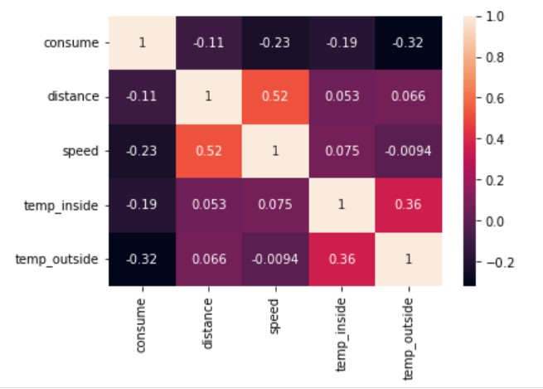
Importance of factors affecting consumption
E10
SP98
In order of importance, the factors affection consumption are: Temp Outside, Speed, Distance and Temp Inside.
Although the correlation of consumption with each variable differs by fuel type, the ranking of these factors is consistent across both fuel types

Slide 3
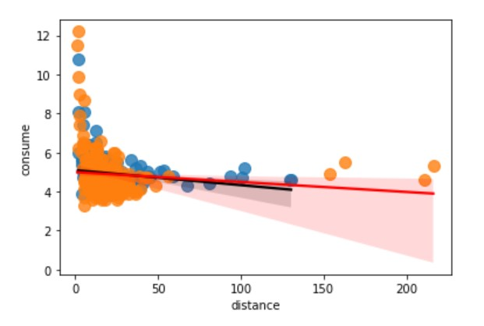
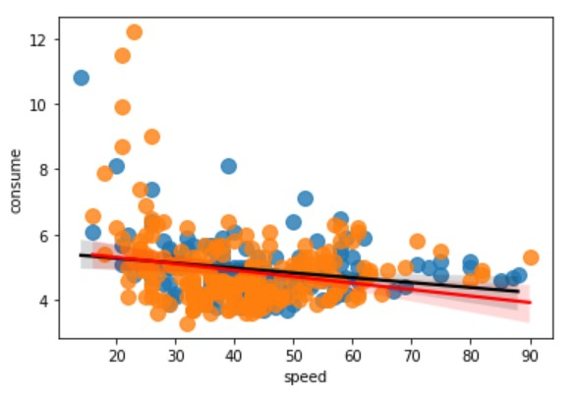
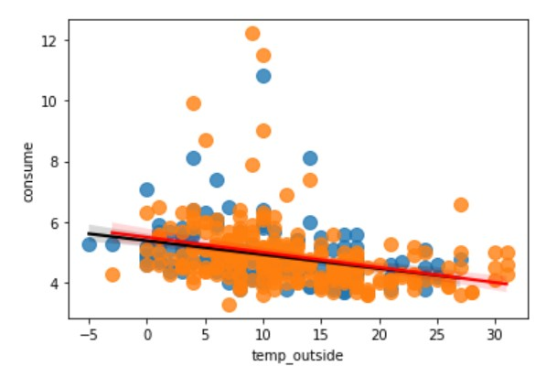
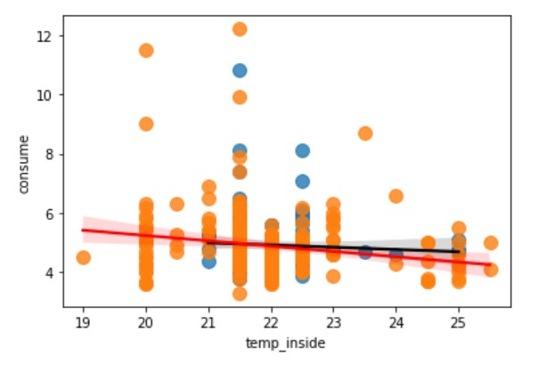
Variation in consumption, per gas type
RED line is SP98, BLACK line is E10
ORANGE dots represent SP98, BLUE is E10 data
Although the Temp outside affects consumption the most, it impacts both fuel types similarly
Cars consume more E10 fuel that SP98 across all speeds above 30km
Cars consume more SP98 than E10 when driving over large distances

