Slide 1
Ethanol Prediction
in Syngas Fermentation
Machine Learning Model Comparison
Ying Tan | CIS 732 / CIS 830
Kansas State University | Spring 2026
Slide 0

Slide 2
Background & Methods
Background: Syngas fermentation produces ethanol from syngas (CO, CO2, H2, N2)
Problem: Need accurate ethanol prediction for real-time process control
Dataset: 176 experimental samples from SyngasMachineLearning repository
Features: time, N2, CO, CO2, H2, flow rate, composition
Models: Linear Regression vs Random Forest (200 trees) vs MLP (64→32)
Metrics: RMSE, MAE, R² | Testing: 30-fold cross-validation + paired statistical tests
Slide 1

Slide 3
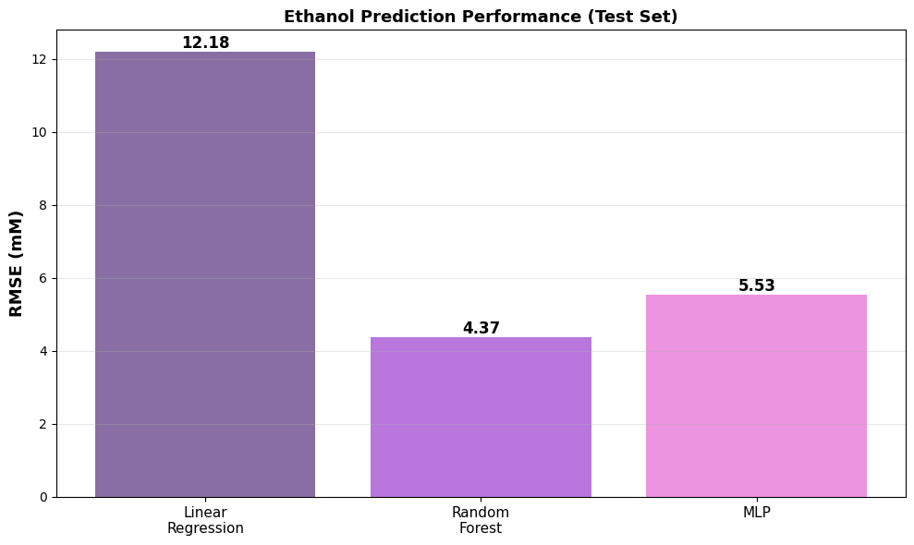
Performance: Test Set Results
Linear Regression (baseline):
RMSE = 12.1832 mM | MAE = 9.2922 | R² = 0.6340
Random Forest (best):
RMSE = 4.3706 mM | MAE = 3.0850 | R² = 0.9529
MLP Regressor:
RMSE = 5.5337 mM | MAE = 4.0084 | R² = 0.9245
Random Forest achieves 65% lower error than Linear Regression
Slide 2

Slide 4
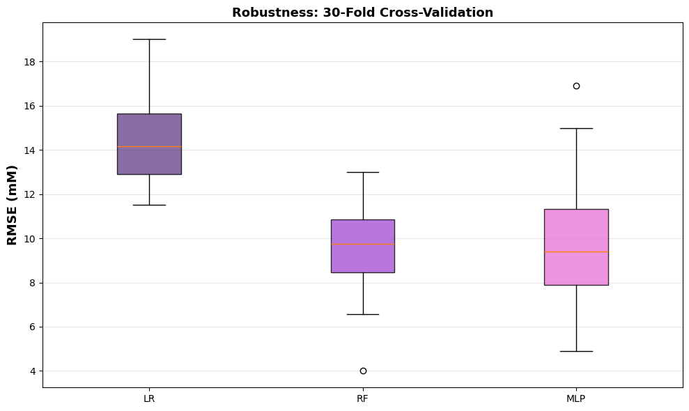
Robustness: 30-Fold Validation
Linear Regression: 14.40 ± 1.78 mM
Random Forest: 9.48 ± 1.80 mM
MLP: 9.73 ± 2.60 mM
Random Forest maintains consistent superior performance across all splits
Statistical Significance:
• Paired t-test p-value: 2.79e-06
• Wilcoxon p-value: 3.02e-06
Both p << 0.05 → RF is statistically proven better than LR
Slide 3

Slide 5
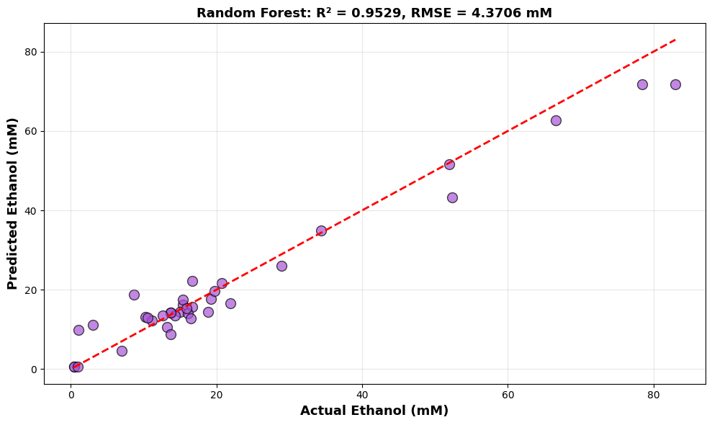
Best Model: Random Forest Analysis
Accuracy Metrics (Test Set, 35 samples):
• R² = 0.9529 → explains 95.3% of ethanol variance
• RMSE = 4.3706 mM → average prediction error
• MAE = 3.0850 mM → mean absolute error
Why Random Forest excels:
• Ensemble of 200 decision trees reduces overfitting
• No feature scaling needed; captures non-linear patterns
• Naturally handles mixed data types (continuous + categorical)
• Robust to outliers and missing value strategies
Slide 4

Slide 6
Key Conclusions
1. Random Forest significantly outperforms Linear Regression (65% error reduction)
2. Statistical tests (p < 3e-6) prove superiority is genuine, not random luck
3. 30-fold robustness testing confirms stable, generalizable performance
4. RF achieves R² = 0.9529, exceeding typical engineering acceptance (R² > 0.90)
5. RECOMMENDATION: Deploy Random Forest for real-time syngas fermentation monitoring
Slide 5

Slide 7
Q1: Most Technically Challenging Aspect
Feature scaling complexity:
• MLP requires StandardScaler; Random Forest does not
• Risk of scaling bias with small dataset (176 samples)
Hyperparameter tuning on limited data:
• Only 35 test samples (20% split) = small validation set
• RF with 200 trees: balancing overfitting vs underfitting
Statistical testing with small N:
• Paired t-test assumes normality; Wilcoxon as non-parametric backup
• Both tests required to ensure robustness of significance claim
Slide 6

Slide 8
Q2: Most Important Learning
Ensemble methods dominate small tabular datasets:
• Why: Random Forest averages 200 trees → reduced overfitting
Statistical significance ≠ empirical performance:
• High R² alone insufficient; need p-value proof
• Our p < 3e-6 provides overwhelming evidence RF is better
Reproducibility through seeds and robustness:
• Fixed seed 42: reproducible baseline for debugging
• 30-fold CV: proves stability across different data splits
• This two-phase approach essential in machine learning
Slide 7

Slide 9
Q3: Future Work Priorities
Feature importance analysis:
• Which gases (CO/CO2/H2) drive ethanol production?
• SHAP values for model explainability
Hyperparameter optimization:
• Grid search: RF tree depth, min_samples_leaf, n_estimators
• Early stopping: prevent MLP convergence warnings
Real-world deployment:
• Validate on out-of-lab fermentation data
• Integrate into SCADA system for live monitoring
• Performance tracking and model retraining schedule
Slide 8

Slide 10
Thank You
Questions?
Code & Data:
https://github.com/garrettroell/SyngasMachineLearning
Slide 9

