Slide 1
支援遞迴資料定義之 XQuery 查詢句轉換系統
Translating XQuery in Recursive Schemas
指導教授：張雅惠教授
研 究 生：吳俊賢
國立台灣海洋大學資訊工程系

Slide 2
大綱
1. 研究動機與目標
2. 相關定義及轉換模組
3. Mapping 及 Skolem Function
4. 正確性分析與轉換結果評估
5. 結論與未來展望

Slide 3

研究動機與目標
XML 資料儲存於各個資料庫
資料庫對資料定義格式不同
目標：建立一個查詢句轉換系統，透過查詢句轉換使得跨資料庫的查詢變得容易。
Target XQuery
Source XQuery
Source XQuery
Target XQuery

Slide 4
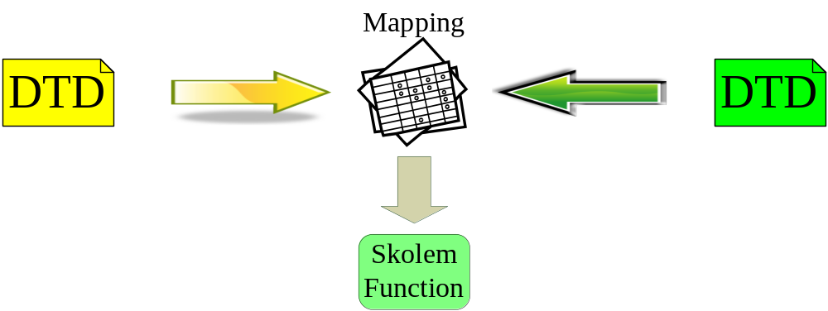
相關定義
Target DTD and Source DTD
Target Query and Source Query
Nested Expression
轉換模組
Mapping & Skolem Function

Slide 5
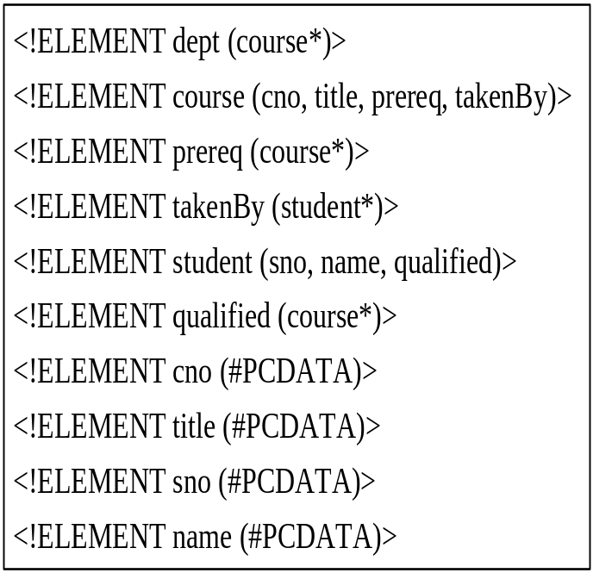
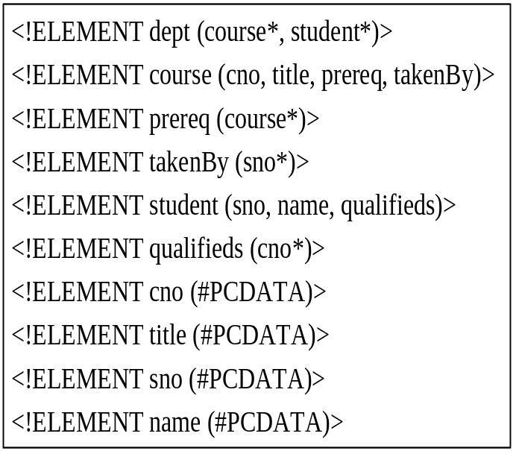

Target DTD and Source DTD (1/2)
Target & Source DTD
Target DTD Source DTD

Slide 6

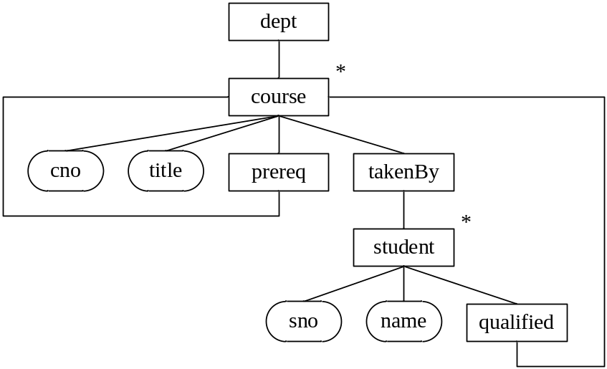
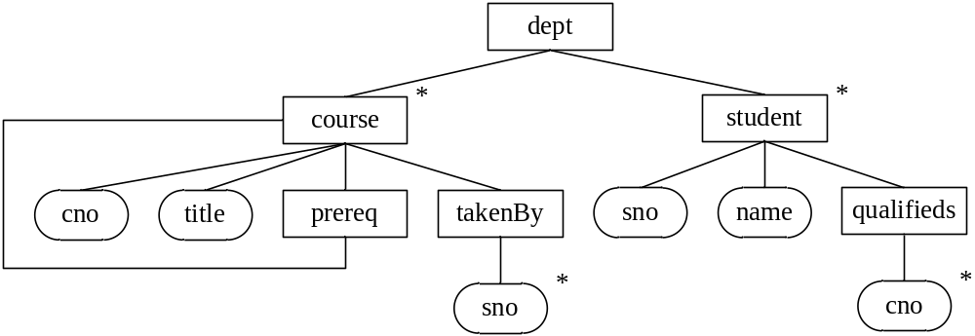


Target DTD and Source DTD (2/2)
Target & Source DTD Graph
Target DTD Graph
Source DTD Graph

Slide 7
Target Query and Source Query
Target Query
  FOR $t0 in /dept/course
  LET $t1 := FOR $t2 in $t0/takenBy/student
  RETURN $t2/name
  WHERE $t0/cno = “C2”
  RETURN $t1
Source Query
  FOR $s0 in /dept/course
  LET $s1 := FOR $s1 in $s0/takenBy,
  $s2 in /dept/student
  WHERE $s1/sno = $s2/sno
  RETURN $s2/name
  WHERE $s0/cno = “C2”
  RETURN $s1

Slide 8
Nested Expression
Nested Expression：
  LET 宣告之變數所對應的查詢句。
  Ex : LET $a := Query
  RETURN 中以 { … } 所定義之查詢句。
  Ex : RETURN <result> { Query } </result>

Slide 9
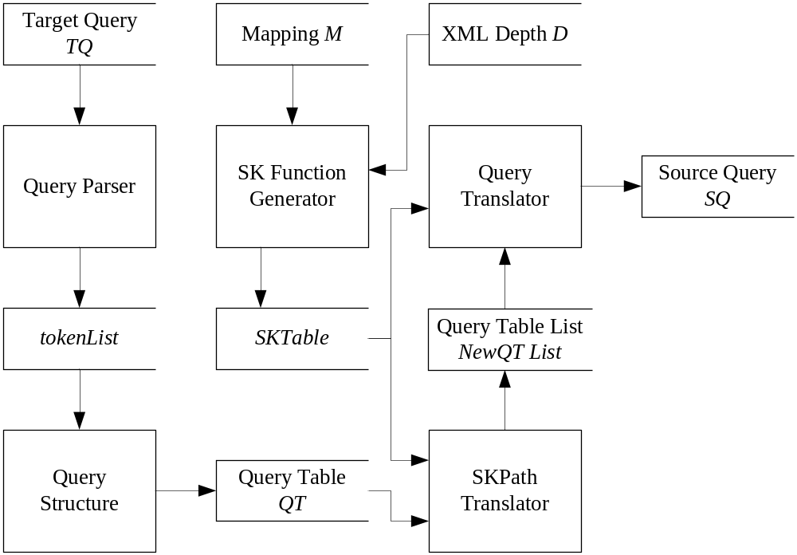
轉換模組

Slide 10
正確性定義
定義：等價的查詢句
若 Target query 和 Source query，其每一個變數指向之元素節點，對應的關係結構相符合，則為一個等價的查詢句轉換

Slide 11
Why Mapping
Mapping 目的：記錄兩個不同 DTD 之 XML，其資料之相互對應關係。
用途：便於產生 Skolme Function

Slide 12
Mapping
Foreach $S0 in /dept/course,
$S1 in $S0/takenBy,
$S2 in /dept/student,
$S3 in $S2/qualifieds/cno,
$S4 in //prereq/course
Where $S1/sno = $S2/sno
Exist $T0 in /dept/course,
$T1 in $T0/prereq/course,
$T2 in $T0/takenBy/student,
$T3 in $T2/qualified/course
With $T0/cno = $S0/cno,
$T0/title = $S0/title,
$T2/sno = $S2/sno,
$T2/name = $S2/name,
$T3/cno = $S3
RR($T1, $T0, $S0, $S4)

Slide 13
Why Skolem Function
目的：將對應資訊結構化的表示，以便利管理者對於資訊的管理與修正。
用途：便利透過 Tracing Skolem Function 取得所有解，以及查詢句轉換時，變數宣告與葉元素對應的取得。

Slide 14
Generate Skolem Function (1/5)
Foreach $S0 in /dept/course,
$S1 in $S0/takenBy,
$S2 in /dept/student,
$S3 in $S2/qualifieds/cno,
$S4 in //prereq/course
Where $S1/sno = $S2/sno
Exist $T0 in /dept/course,
$T1 in $T0//prereq/course,
$T2 in $T0/takenBy/student,
$T3 in $T2/qualified/course
With $T0/cno = $S0/cno,
$T0/title = $S0/title,
$T2/sno = $S2/sno,
$T2/name = $S2/name,
$T3/cno = $S3
RR($T1, $T0, $S0, $S4)
SK0
產生 SK0

Slide 15
Generate Skolem Function (2/5)
Foreach $S0 in /dept/course,
$S1 in $S0/takenBy,
$S2 in /dept/student,
$S3 in $S2/qualifieds/cno,
$S4 in //prereq/course
Where $S1/sno = $S2/sno
Exist $T0 in /dept/course,
$T1 in $T0//prereq/course,
$T2 in $T0/takenBy/student,
$T3 in $T2/qualified/course
With $T0/cno = $S0/cno,
$T0/title = $S0/title,
$T2/sno = $S2/sno,
$T2/name = $S2/name,
$T3/cno = $S3
RR($T1, $T0, $S0, $S4)
SK0
RETURN /cno = $S0/cno,
/title = $S0/title,
/prereq/course = RRSK0.0
/takenBy/student = SK0.0
加入RETURN資訊

Slide 16
Generate Skolem Function (3/5)
Foreach $S0 in /dept/course,
$S1 in $S0/takenBy,
$S2 in /dept/student,
$S3 in $S2/qualifieds/cno,
$S4 in //prereq/course
Where $S1/sno = $S2/sno
Exist $T0 in /dept/course,
$T1 in $T0//prereq/course,
$T2 in $T0/takenBy/student,
$T3 in $T2/qualified/course
With $T0/cno = $S0/cno,
$T0/title = $S0/title,
$T2/sno = $S2/sno,
$T2/name = $S2/name,
$T3/cno = $S3
RR($T1, $T0, $S0, $S4)
SK0
FOR $S0 in /dept/course
RETURN /cno = $S0/cno,
/title = $S0/title,
/prereq/course = RRSK0.0
/takenBy/student = SK0.0
加入 FOR 變數

Slide 17
Generate Skolem Function (4/5)
Foreach $S0 in /dept/course,
$S1 in $S0/takenBy,
$S2 in /dept/student,
$S3 in $S2/qualifieds/cno,
$S4 in //prereq/course
Where $S1/sno = $S2/sno
Exist $T0 in /dept/course,
$T1 in $T0//prereq/course,
$T2 in $T0/takenBy/student,
$T3 in $T2/qualified/course
With $T0/cno = $S0/cno,
$T0/title = $S0/title,
$T2/sno = $S2/sno,
$T2/name = $S2/name,
$T3/cno = $S3
RR($T1, $T0, $S0, $S4)
SK0
FOR $S0 in /dept/course
RETURN /cno = $S0/cno,
/title = $S0/title,
/prereq/course = RRSK0.0
/takenBy/student = SK0.0
判斷是否需要加入 WHERE 條件限制式

Slide 18
Generate Skolem Function (5/5)
Foreach $S0 in /dept/course,
$S1 in $S0/takenBy,
$S2 in /dept/student,
$S3 in $S2/qualifieds/cno,
$S4 in //prereq/course
Where $S1/sno = $S2/sno
Exist $T0 in /dept/course,
$T1 in $T0//prereq/course,
$T2 in $T0/takenBy/student,
$T3 in $T2/qualified/course
With $T0/cno = $S0/cno,
$T0/title = $S0/title,
$T2/sno = $S2/sno,
$T2/name = $S2/name,
$T3/cno = $S3
RR($T1, $T0, $S0, $S4)
SK0
FOR $S0 in /dept/course
RETURN /cno = $S0/cno,
/title = $S0/title,
/prereq/course = RRSK0.0
/takenBy/student = SK0.0
完成 Skolem Function

Slide 19
遞迴資料對應
目的，為了表示遞迴資料的對應資訊
表示方式：RR($T1, $T0, $S0, $S4)
意義：$T1 指向之路徑，遞迴至 $T0 所指向之元素，且此遞迴路徑產生 Skolem Function 時，繼承 $T0 所產生之 Skolem Function 資訊，並將該 Skolem Function 中的變數 $S0 以 $S4 取代。並產生其它相關的 RRSK Function。

Slide 20
Skolem Function 編碼方式
非遞迴資料對應之 Skolem Function，以 Dewey 編碼方式為該元素編碼。編碼依照 Mapping 中所宣告之變數順序及相對位置產生。如$T0無上層變數且為第一個宣告之變數，給予編碼 “0”，$T2為$T0下之第一個非遞迴變數宣告，給予編碼“0.0”，依此類推。
遞迴資料對應之Skolem Function，以定義之遞迴資料順序 N，自 0 開始，於原非遞迴資料對應之 Skolem Function編碼之前，加上 N。

Slide 21
遞迴資料產生 Skolem Function (1/3)
Foreach $S0 in /dept/course,
$S1 in $S0/takenBy,
$S2 in /dept/student,
$S3 in $S2/qualifieds/cno,
$S4 in //prereq/course
Where $S1/sno = $S2/sno
Exist $T0 in /dept/course,
$T1 in $T0/prereq/course,
$T2 in $T0/takenBy/student,
$T3 in $T2/qualified/course
With $T0/cno = $S0/cno,
$T0/title = $S0/title,
$T2/sno = $S2/sno,
$T2/name = $S2/name,
$T3/cno = $S3
RR($T1, $T0, $S0, $S4)
RRSK0.0
FOR $S0 in /dept/course
RETURN /cno = $S0/cno,
/title = $S0/title,
/prereq/course = RRSK0.0
/takenBy/student = SK0.0
繼承 $T0 所產生之 SK0，並更名為 RRSK0.0

Slide 22
遞迴資料產生 Skolem Function (3/3)
Foreach $S0 in /dept/course,
$S1 in $S0/takenBy,
$S2 in /dept/student,
$S3 in $S2/qualifieds/cno,
$S4 in //prereq/course
Where $S1/sno = $S2/sno
Exist $T0 in /dept/course,
$T1 in $T0/prereq/course,
$T2 in $T0/takenBy/student,
$T3 in $T2/qualified/course
With $T0/cno = $S0/cno,
$T0/title = $S0/title,
$T2/sno = $S2/sno,
$T2/name = $S2/name,
$T3/cno = $S3
RR($T1, $T0, $S0, $S4)
RRSK0.0
FOR $S0 in /dept/course
RETURN /cno = $S0/cno,
/title = $S0/title,
/prereq/course = RRSK0.0
/takenBy/student = SK0.0
將 $S0 以 $S4 取代
並對非 RRSK 產生新的 RRSK

Slide 23
遞迴資料產生 Skolem Function (3/3)
Foreach $S0 in /dept/course,
$S1 in $S0/takenBy,
$S2 in /dept/student,
$S3 in $S2/qualifieds/cno,
$S4 in //prereq/course
Where $S1/sno = $S2/sno
Exist $T0 in /dept/course,
$T1 in $T0/prereq/course,
$T2 in $T0/takenBy/student,
$T3 in $T2/qualified/course
With $T0/cno = $S0/cno,
$T0/title = $S0/title,
$T2/sno = $S2/sno,
$T2/name = $S2/name,
$T3/cno = $S3
RR($T1, $T0, $S0, $S4)
RRSK0.0
FOR $S4 in //prereq/course
RETURN /cno = $S4/cno,
/title = $S4/title,
/prereq/course = RRSK0.0
/takenBy/student = RRSK0.0.0
將 $S0 以 $S4 取代，
並對非 RRSK 產生新的 RRSK

Slide 24
Skolem Function (1/3)
SK0 ($T0)
for $S0 in /dept/course
return /cno = $S0/cno,
/title = $S0/title,
/prereq/course = RRSK0.0,
/takenBy/student = SK0.0
SK0.0 ($T2)
for $S0 in /dept/course,
$S1 in $S0/takenBy,
$S2 in /dept/student
where $S1/sno = $S2/sno
return /sno = $S2/sno,
/name = $S2/name,
/qualified/course = SK0.0.0

Slide 25
Skolem Function (2/3)
SK0.0.0 ($T3)
for $S0 in /dept/course,
$S1 in $S0/takenBy,
$S2 in /dept/student,
$S3 in $S2/qualifieds/cno
where $S1/sno = $S2/sno
return /cno = $S3
RRSK0.0 ($T1)
for $S4 in //prereq/course
return /cno = $S4/cno,
/title = $S4/title,
/prereq/course = RRSK0.0,
/takenBy/student = RRSK0.0.0

Slide 26
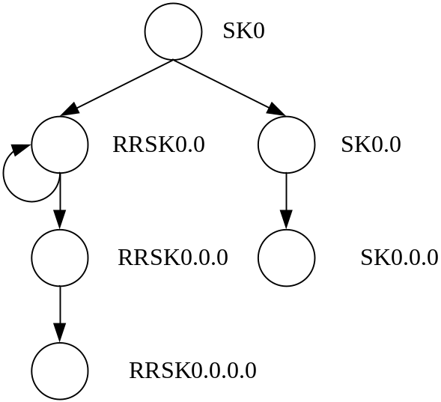
Skolem Function (3/3)
RRSK0.0.0
for $S3 in //prereq/course,
$S1 in $S3/takenBy,
$S2 in /dept/student
where $S1/sno = $S2/sno
return /sno = $S2/sno,
/name = $S2/name,
/qualified/course = RRSK0.0.0.0
RRSK0.0.0.0
for $S3 in //prereq/course,
$S1 in $S3/takenBy,
$S2 in /dept/student,
$S4 in $S2/qualifieds/cno
where $S1/sno = $S2/sno
return /cno = $S4

Slide 27
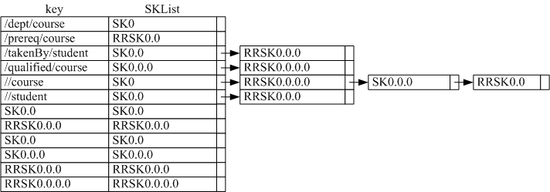
Skolem Function Table：SKTable
key：路徑或 Skolem Function 名稱
value：由 Skolem Function 所組成的串列
用途：將 XQuery 轉換為中間結果與最後結果時使用

Slide 28
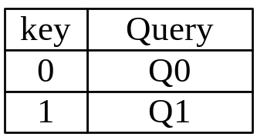
Query Table：QT
key：Query ID
value：Query
用途：將巢狀查詢句以 Nested Expression 為單位切割，給予 ID 並儲存於 QT 中，以便利查詢句轉換。
Query smaple
  Query ID：0 Query ID：1
  FOR $t0 in /dept/course
  LET $t1 := Nested Query 1
  WHERE $t0/cno = “C2”
  RETURN $t1
  FOR $t2 in $t0/takenBy/student
  RETURN $t2/name

Slide 29
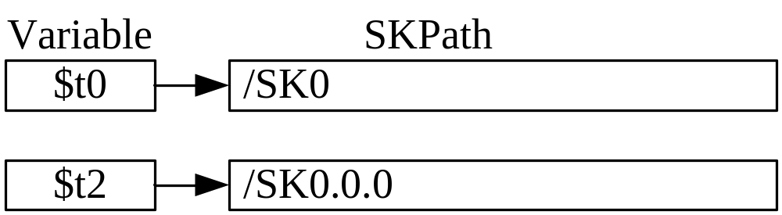
SKPath Translator
SKPath：由 Location Step （/ | //）與 SK 組成
  Ex：/SK0/SK0.0
目的：取得所有可能解
範例：
  $t0 in /dept/course
  $t2 in $t0/takenBy/student
  $t0 in GetSKs(“/dept/course)
  $t2 in GetSKs(“$t0”, “/takenBy/student”)

Slide 30
實驗結果與討論 (1/9)
查詢句轉換範例
參照論文 5.1 節 Target Query M1_Q1
  For $a in /dept/course,
  $b in $a/takenBy/studentlet
  Let $c := For $d in $b/qualified/course,
  $e in /dept/course
  Where $d/cno = $e/cno
  Return <Title> { $e/title } </Title>
  Where $a/title = "DataBase“
  Return <result>
  <CourseNo> { $a/cno } </CourseNo>
  <StudentName> { $b/name } </StudentName>
  <Qualifieds> { $c } </Qualifieds>
  </result>

Slide 31
實驗結果與討論 (2/9)
Nested Query 0：
  For $a in /dept/course,
  $b in $a/takenBy/student
  Let $c := Nested Query 1
  Where $a/title = "DataBase“
  Return <result>
  <CourseNo> { $a/cno } </CourseNo>
  <StudentName> { $b/name } </StudentName>
  <Qualifieds> { $c } </Qualifieds>
  </result>
Nested Query 1：
  For $d in $b/qualified/course,
  $e in /dept/course
  Where $d/cno = $e/cno
  Return <Title> { $e/title } </Title>

Slide 32
實驗結果與討論 (3/9)
Nested Query 0：
  For $a in /dept/course,
  $b in $a/takenBy/student
  Let $c := Nested Query 1
  Where $a/title = "DataBase“
  Return <result>
  <CourseNo> { $a/cno } </CourseNo>
  <StudentName> { $b/name } </StudentName>
  <Qualifieds> { $c } </Qualifieds>
  </result>
Nested Query 1：
  For $d in $b/qualified/course,
  $e in /dept/course
  Where $d/cno = $e/cno
  Return <Title> { $e/title } </Title>

Slide 33
實驗結果與討論 (4/9)
Nested Query 0：
  For $a in GetSKs(“/dept/course”),
  $b in GetSKs(“$a”, “/takenBy/student”)
  Let $c := Nested Query 1
  Where $a/title = "DataBase“
  Return <result>
  <CourseNo> { $a/cno } </CourseNo>
  <StudentName> { $b/name } </StudentName> <Qualifieds> { $c } </Qualifieds>
  </result>
Nested Query 1：
  For $d in GetSKs(“$b”, “/qualified/course”),
  $e in GetSKs(“/dept/course”)
  Where $d/cno = $e/cno
  Return <Title> { $e/title } </Title>

Slide 34
實驗結果與討論 (5/9)
Nested Query 0：
  For $a in /SK0,
  $b in $a/SK0.0
  Let $c := Nested Query 1
  Where $a/title = "DataBase“
  Return <result>
  <CourseNo> { $a/cno } </CourseNo>
  <StudentName> { $b/name } </StudentName>
  <Qualifieds> { $c } </Qualifieds>
  </result>
Nested Query 1：
  For $d in $b/SK0.0.0,
  $e in /SK0
  Where $d/cno = $e/cno
  Return <Title> { $e/title } </Title>

Slide 35
實驗結果與討論 (6/9)
Nested Query 0：
  For $s0_a_0 in /dept/course,
  $s1_b_0 in $s0_a_0/takenBy,
  $s2_b_0 in /dept/sutdent
  Let $c := Nested Query 1
  Where $a/title = "DataBase“ and $s1_b_0/sno = $s2_b_0/sno
  Return <result>
  <CourseNo> { $a/cno } </CourseNo>
  <StudentName> { $b/name } </StudentName>
  <Qualifieds> { $c } </Qualifieds>
  </result>
Nested Query 1：
  For $s3_d_1 in $s2_b_0/qualifieds/cno,
  $s0_e_1 in /dept/course
  Where $d/cno = $e/cno
  Return <Title> { $e/title } </Title>

Slide 36
實驗結果與討論 (7/9)
Nested Query 0：
  For $s0_a_0 in /dept/course,
  $s1_b_0 in $s0_a_0/takenBy,
  $s2_b_0 in /dept/sutdent
  Let $c := Nested Query 1
  Where $a/title = "DataBase“ and $s1_b_0/sno = $s2_b_0/sno
  Return <result>
  <CourseNo> { $a/cno } </CourseNo>
  <StudentName> { $b/name } </StudentName>
  <Qualifieds> { $c } </Qualifieds>
  </result>
Nested Query 1：
  For $s3_d_1 in $s2_b_0/qualifieds/cno,
  $s0_e_1 in /dept/course
  Where $d/cno = $e/cno
  Return <Title> { $e/title } </Title>

Slide 37
實驗結果與討論 (8/9)
Nested Query 0：
  For $s0_a_0 in /dept/course,
  $s1_b_0 in $s0_a_0/takenBy,
  $s2_b_0 in /dept/sutdent
  Let $c := Nested Query 1
  Where $s0_a_0/title = "DataBase“ and $s1_b_0/sno = $s2_b_0/sno
  Return <result>
  <CourseNo> { $s0_a_0/cno } </CourseNo>
  <StudentName> { $s2_b_0/name } </StudentName>
  <Qualifieds> { $c } </Qualifieds>
  </result>
Nested Query 1：
  For $s3_d_1 in $s2_b_0/qualifieds/cno,
  $s0_e_1 in /dept/course
  Where $s3_d_1/cno = $s0_e_1/cno
  Return <Title> { $s0_e_1/title } </Title>

Slide 38
實驗結果與討論 (9/9)
將 Nested Query 0 與 Nested Query 1 合併成轉換結果
  For $s0_a_0 in /dept/course,
  $s1_b_0 in $s0_a_0/takenBy,
  $s2_b_0 in /dept/sutdent
  Let $c := For $s3_d_1 in $s2_b_0/qualifieds/cno,
  $s0_e_1 in /dept/course
  Where $s3_d_1/cno = $s0_e_1/cno
  Return <Title> { $s0_e_1/title } </Title>
  Where $s0_a_0/title = "DataBase“ and $s1_b_0/sno = $s2_b_0/sno
  Return <result>
  <CourseNo> { $s0_a_0/cno } </CourseNo>
  <StudentName> { $s2_b_0/name } </StudentName>
  <Qualifieds> { $c } </Qualifieds>
  </result>
  原查詢句：Link

Slide 39
效能分析
實驗平台：
AMD Athlon Duel Core Processor 3800+
RAM 896MB，2.0GHz
實驗數據差異：
  測試 Tracing Skolem Function 產生 XML 深度 D 的所有解花費之時間
  改變變數個數
  改變 Nested 表示式個數
  改變跳層路徑個數
  改變變數之間的關係，並將前三項一同加入
以下測試均以執行 10000 次後，取得平均時間

Slide 40
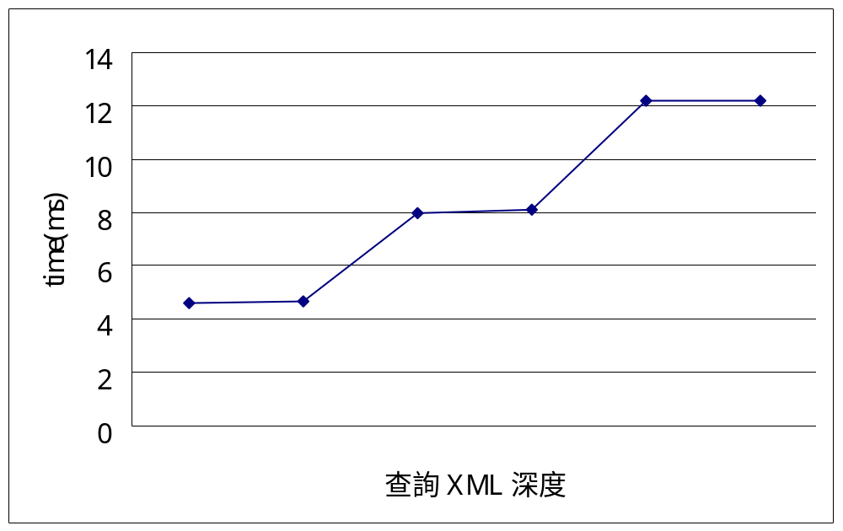
Tracing Skolem Function
以 Mapping 所產生的 Skolem Function 做為測試資料。測試查詢 XML 深度，自 4 ~ 9 的執行時間。

Slide 41
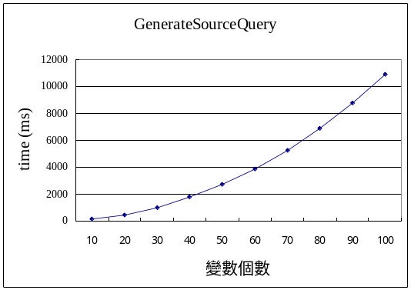
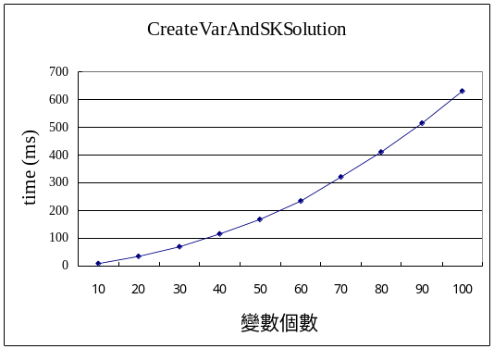
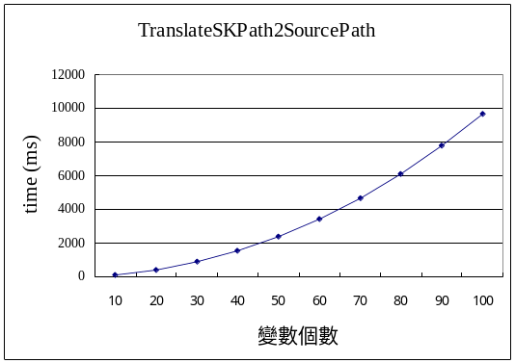
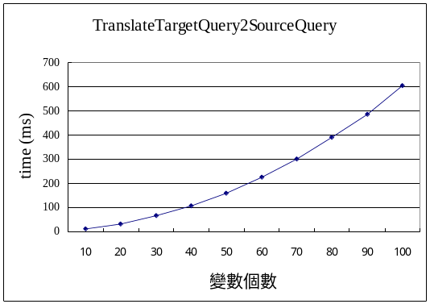
變量：變數個數
測試變數個數自 10 ~ 100 的執行時間

Slide 42
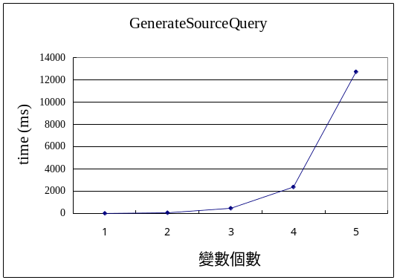
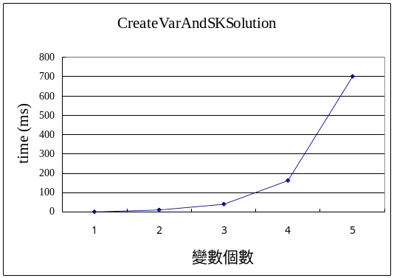
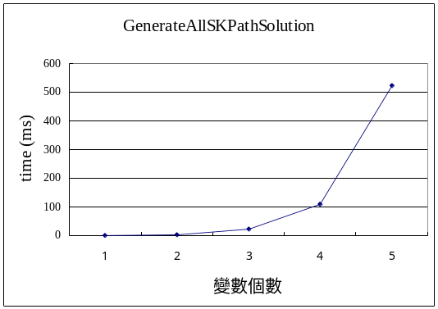
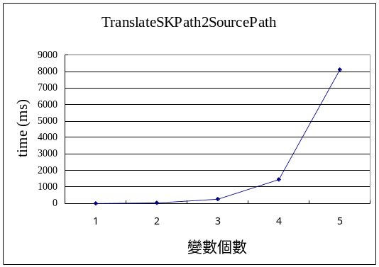
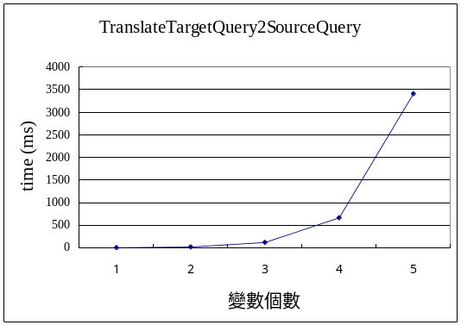
變量：單一跳層路徑
測試單一跳層路徑，變數個數自 1 ~ 5 的執行時間

Slide 43
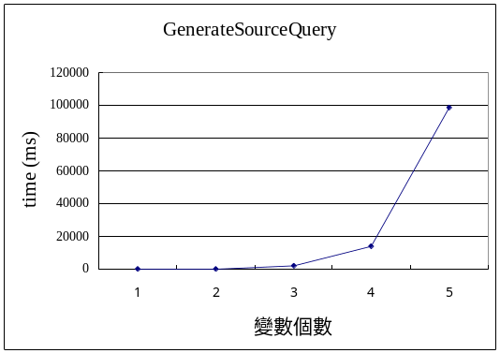
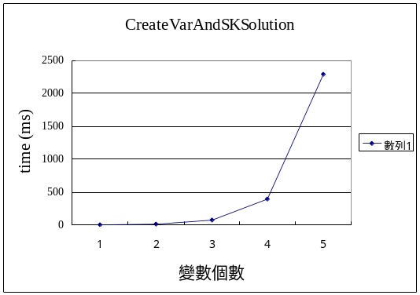
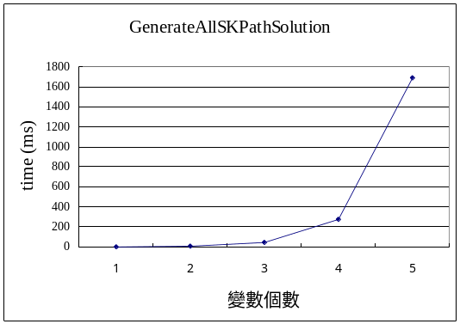
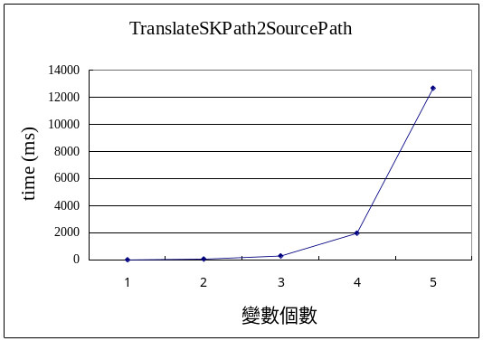
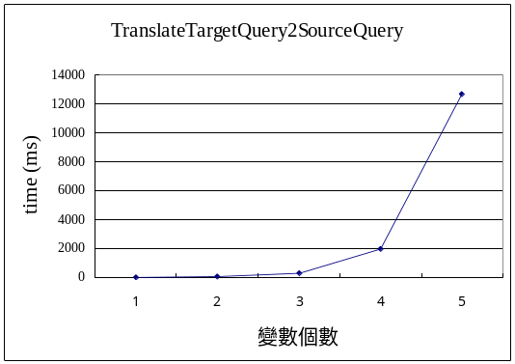
變量：雙跳層路徑
測試雙跳層路徑，變數個數自 1 ~ 5 的執行時間

Slide 44
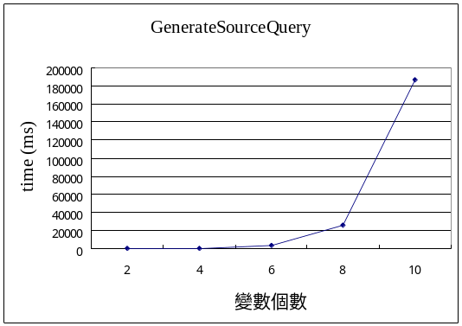
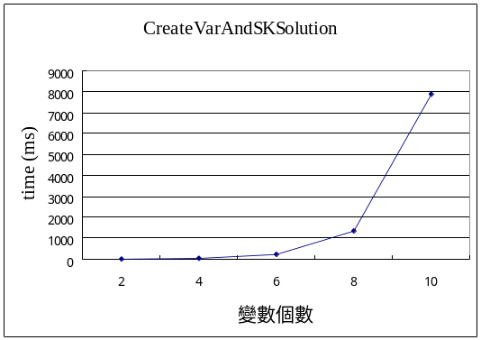
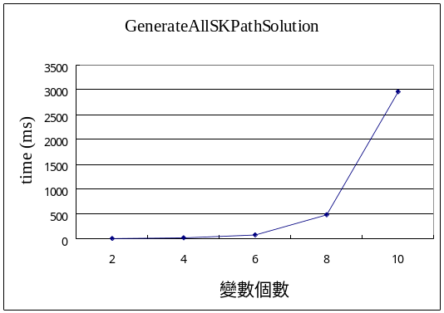
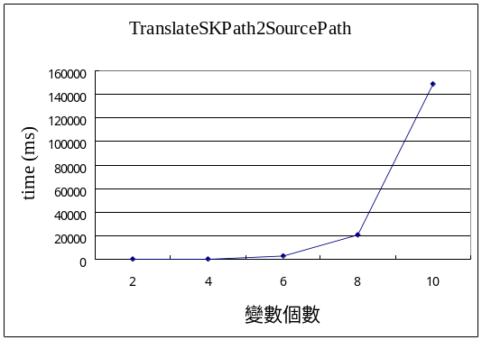
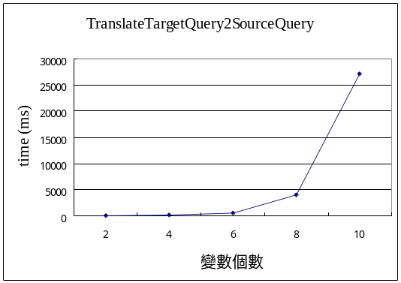
變量：上下層關係之跳層路徑
測試單一跳層路徑，且變數兩兩成對為上下層關係，變數個數自 1 ~ 5 的執行時間

Slide 45
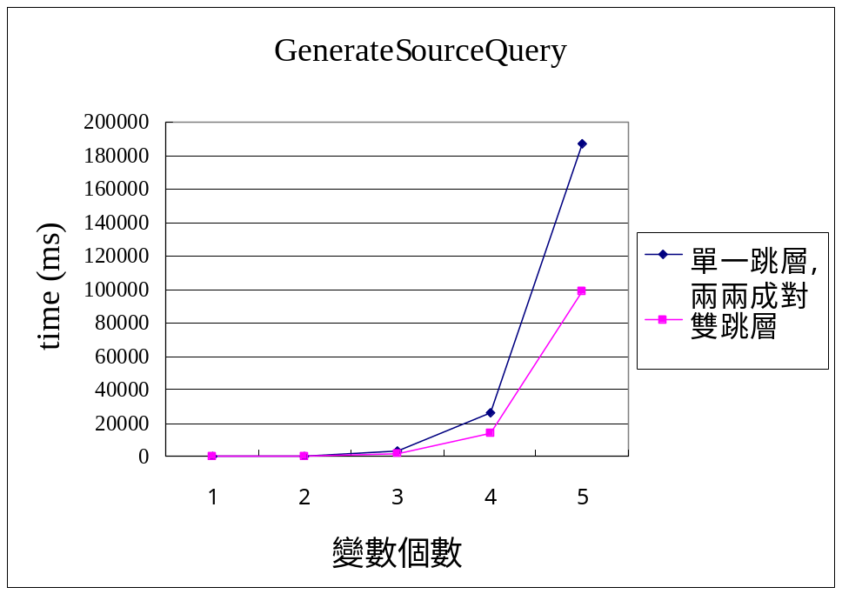
比較變數之間關係之影響
有上下層關係之變數與無上下層關係之變數，其查詢句轉換時間圖如下

Slide 46
複雜測試 (1/2)
將變數分散於三層 Nested 表示式，使變數兩兩之間有 PC 關係，並將路徑皆宣告為跳層路徑
  Ex: For $a in //course
  Return <result>
  { For $b in $a//course
  Return <result>
  { For $c in $b//course
  Return { $c }
  }
  <result> }
  </result>

Slide 47
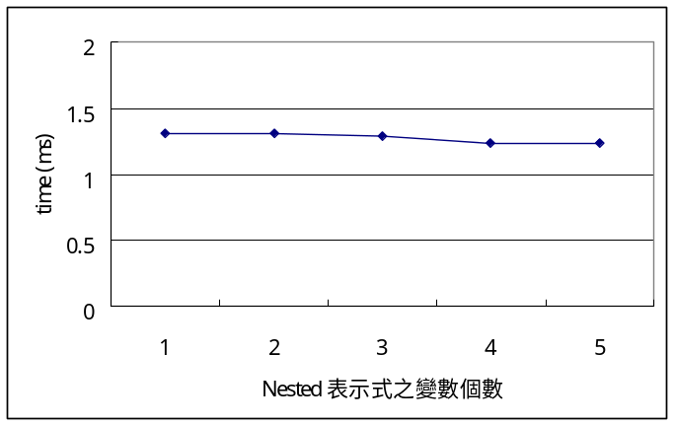
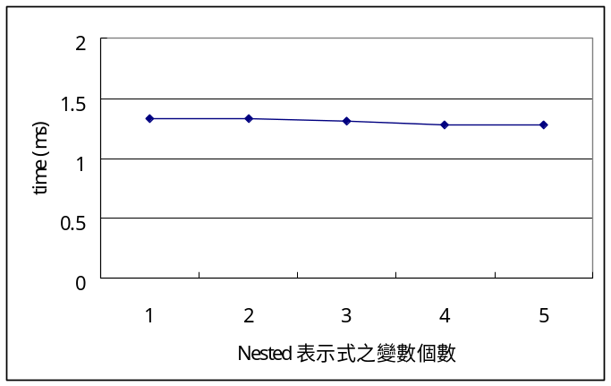
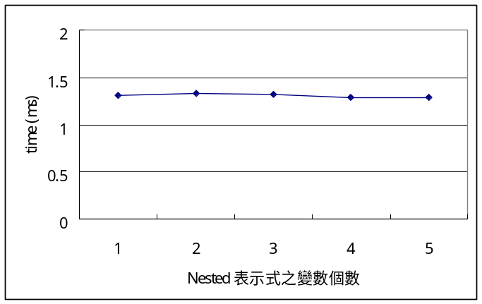
複雜測試 (2/2)
深度 5
深度 15
深度 10

Slide 48
結論
針對遞迴資料設計了新的對應方式。
修改 [YP04] 的 Skolem Function 表示方式，使其更有可讀性，便利管理者管理與後續轉換處理。
利用 Tracing Skolem Function 產生有限深度下的所有解，便利處理跳層路徑。
設計適合的對照表，使得變數能正確的被取代。

Slide 49
未來展望
設計更一般化的 Mapping，使得遞回路徑與非遞迴路徑也能互相轉換。
使 LET 能定義巢狀表示式以外的資訊，並能產生適合的資訊回傳給 LET 定義之變數。
設計更好的資料結構，使得查詢句轉換之效能提升

Slide 50
感謝口試委員陳教授、林教授的指教
與
張老師於生活及學業上的照顧

