Slide 1
Leaf Shape Project (automated species clusterization)
CMPT400, University of Saskatchewan Yuqing Tan (Beatrice)
Supervised by: Prof. Ian Stavness

Slide 2
Guidelines
I. Motivation
II. Problem statement
III. Approaches
IV. Results
V. Conclusions

Slide 3
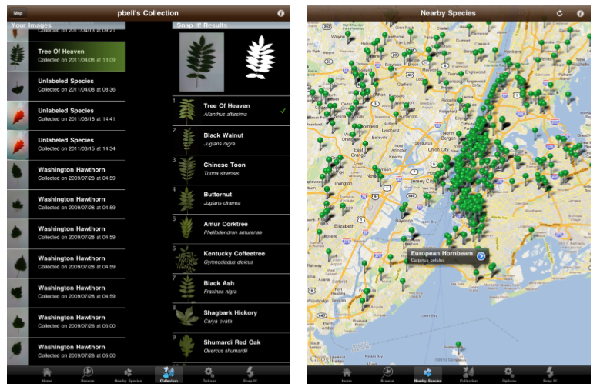
I. Motivation
"Leafsnap: An Electronic Field Guide“ (http://leafsnap.com/)

Slide 4
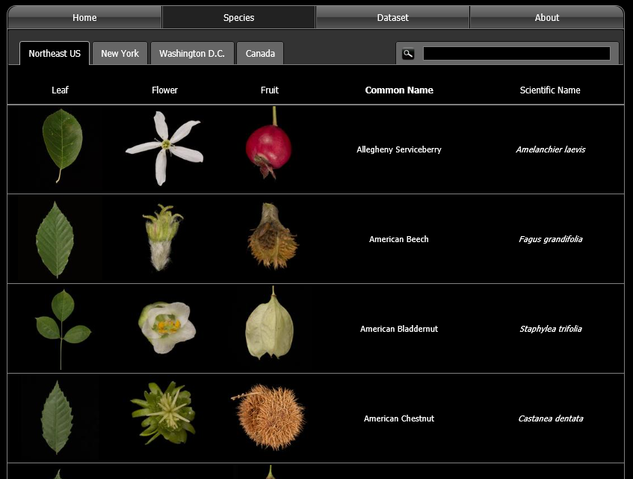

Slide 5
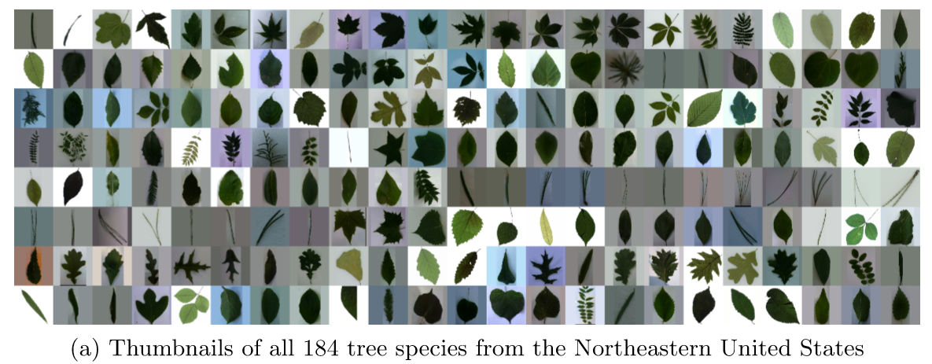

Slide 6
II. Problem statement
My CMPT400 project simulates the shape recognition process of the Leafsnap project, starting with segmented images.
Work flow:
Choose the species
Extract features (using Matlab)
Run clustering algorithm (using Weka)
Measurement criteria:
Grouping
Distinguishing
Time/space complexity

Slide 7
III. Approaches
Choose the species
Download the dataset
Select species (fine segmented, distinguishable)
Extract features (using Matlab)
3 models
Run clustering algorithm (using Weka)
Study how clustering works
Choose an algorithm → K-Means

Slide 8
III. Approaches
Extract features (using Matlab)
1st model: 3-meta-properties model
3 features derived from axis lengths, area and perimeter.
Oblong: (short axis) / (long axis) range: (0,1) value: smaller → bigger shape: more oblong → more round
Fluffiness: area / ( (short axis) * (long axis) ) range: (0,1) value: smaller → bigger shape: more fluffy → more fulfilled
Jaggedness: area * pi * 4 / (perimeter^2) range: (0,1) value: smaller → bigger shape: more jagged → more smooth

Slide 9
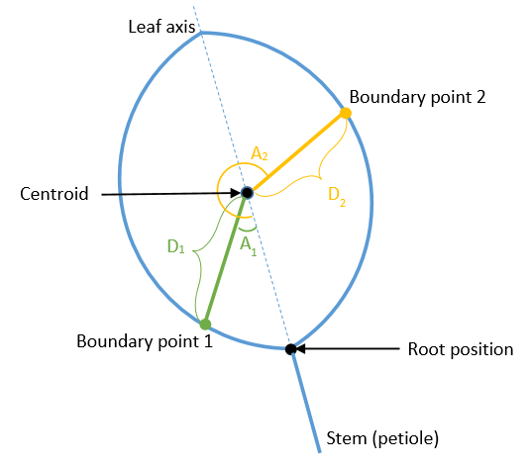
III. Approaches
Extract features (using Matlab)
2nd model: round-scanning model
detecting stem/symmetry and scanning boundary point positions around (one feature with multiple values).
(a) The algorithm to detect stem (as sharp clip shape) if it appears in the picture
(b) The algorithm to find symmetry axis (leaf axis)
(c) Collection of fixed amount of data (D, A) from each image starting from leaf stem
D = the distance from centroid to boundary point (in pixels), divided by average radius (in pixels)
A = the direction relative to leaf axis (in degrees)

Slide 10
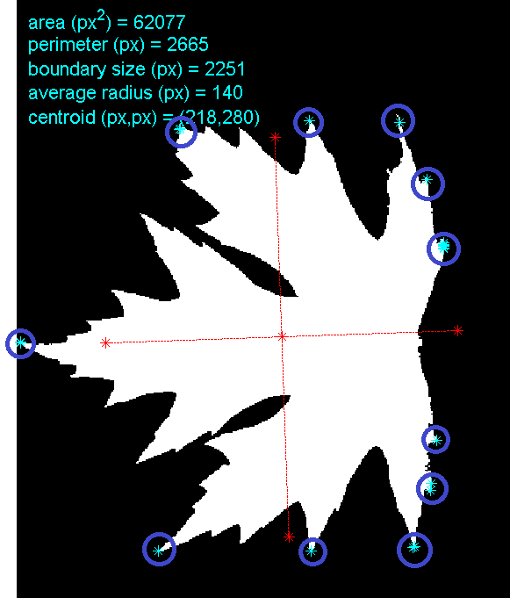
III. Approaches
Extract features (using Matlab)
3rd model: concave-triangle model
10 features from doing arithmetic on concave shapes.
Get the following values between any two adjacent points in convex set.
(a) number of maxima: how many trivial jags it contains
(b) (triangle height) / (average radius of the shape): how deep the jag is
(c) (triangle height) / (triangle bottom): shape of the jag
(d) (curve length) / (triangle bottom): how much the boundary is folded
(e) top angle
(f) average of two side angles
top angle
side angle

Slide 11


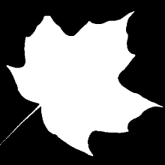



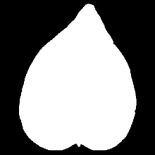
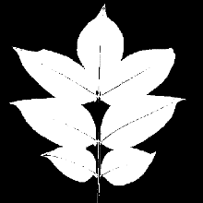


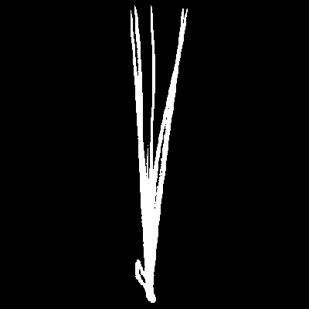
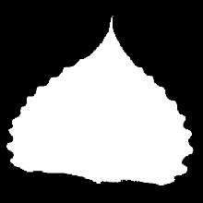
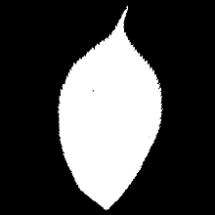

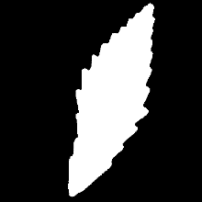
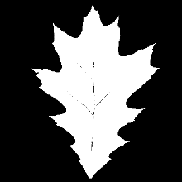
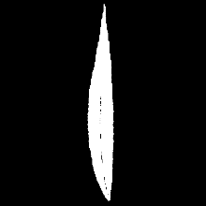

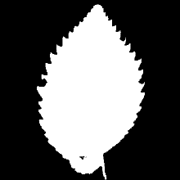
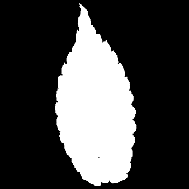
IV. Results
Acer palmatum
(Japanese maple)
Acer saccharinum
(Silver maple)
Acer saccharum
(Sugar maple)
Aesculus flava
(Buckeye)
Ailanthus altissima
(Ailanthus)
Betula nigra
(River birch)
Catalpa speciose
(Catalpa)
Evodia daniellii
(Evodia)
Liquidambar
styraciflua
(Sweetgum)
Metasequoia
glyptostroboides
(Dawn redwood)
Pinus peucea
(Balkan pine)
Populous deltoides
(Cottonwood)
Prunus sargentii
(Sargent's cherry)
Ptelea trifoliate
(Wafer ash)
Quercus montana
(Chestnut oak)
Quercus velutina
(Black oak)
Salix babylonica
(Babylon willow)
Staphylea trifolia
(American bladdernut)
Ulmus Americana
(American elm)
Zelkova serrata
(Japanese elm)

Slide 12

round-
scanning
Model
(1 feature
with 50
data points)
3-meta-
properties
Model
(3 features)
concave-
triangle
Model
(10 features)

Slide 13
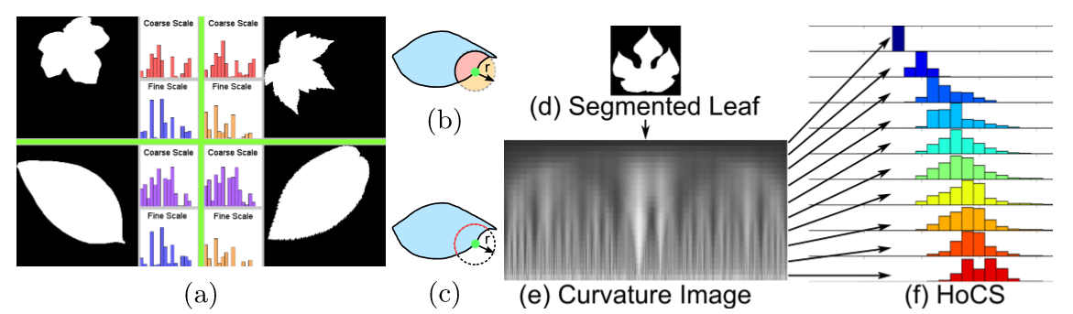
V. Conclusions
Choose the species
Feature extraction
The number is not important
What catches the essence
Possible improvements
Other approaches to try
Clustering
Distance calculation
Design my own algorithm

Slide 14
Leave this page blank for questions

