Slide 1

BREAKING DOWN IMAGES A DEEP DIVE INTO CONVOLUTIONAL NEURAL NETWORKS
TANUJ VERMA-002726506 MS-IS Student Fall’22,Northeastern University verma.tanu@northeastern.edu 002726506

Slide 2
PROBLEM DESCRIPTION
Take the Cifar-10 data set which is a collection of 60,000 32x32 color images in 10 classes, with 6,000 images per class. The dataset is split into 50,000 training images and 10,000 testing images. These images are labeled with the corresponding class from one of the following categories: airplane, automobile, bird, cat, deer, dog, frog, horse, ship, and truck
Build a Convolutional Neural Network (CNN) to classify CIFAR-10 images
Vary the number of convolutional and subsampling layers to find the best model
Use Keras or TensorFlow to implement the CNN
Train the model on a 90/10 split of the CIFAR-10 dataset
Evaluate the performance of the model using accuracy and confusion matrix and ROC curve

Slide 3
TECHINCAL APPROACH
Preprocessing: Reshaping and normalizing the input data using Keras preprocessing tools
Building a baseline CNN model
Varying convolutional and subsampling layers for improved accuracy
Evaluating model performance using a 90/10 split
Visualizing model accuracy and loss curves
Tuning hyperparameters using grid search
Using a confusion matrix to evaluate classification performance
Comparison of different optimization algorithms for training the model

Slide 4
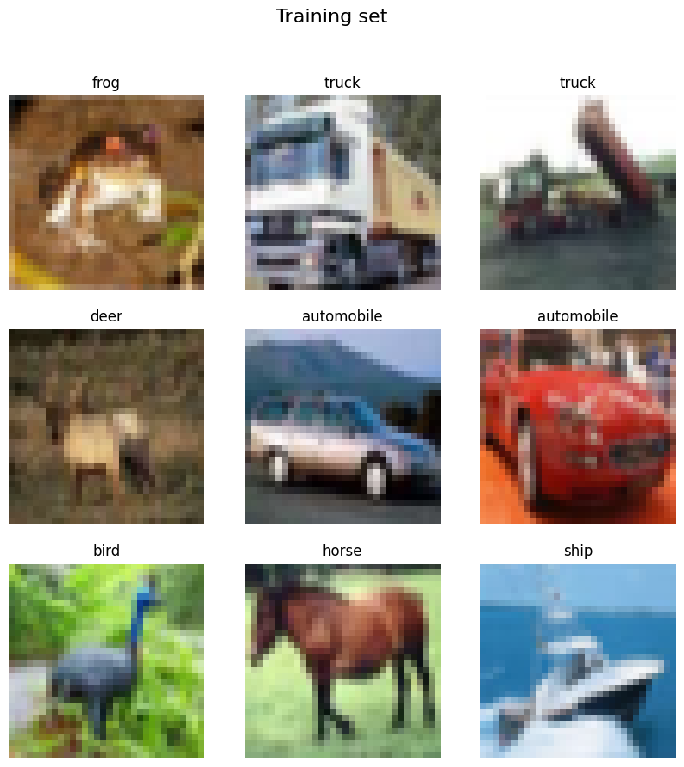
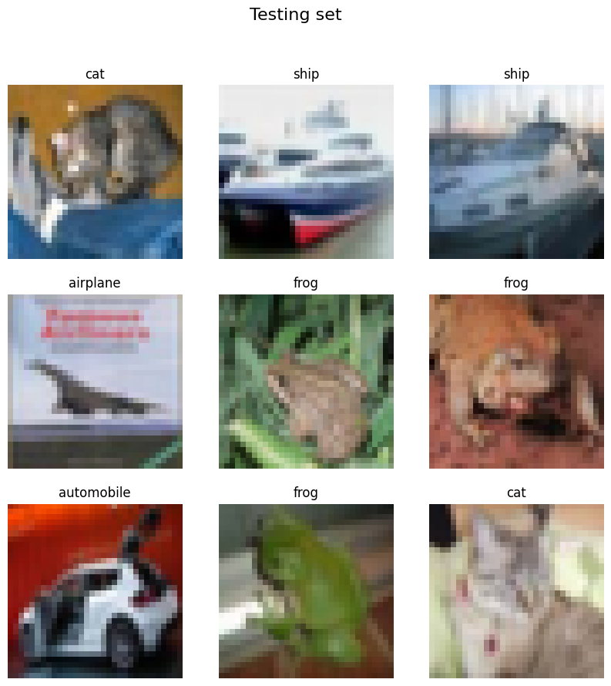
DATASET ANALISYS

Slide 5
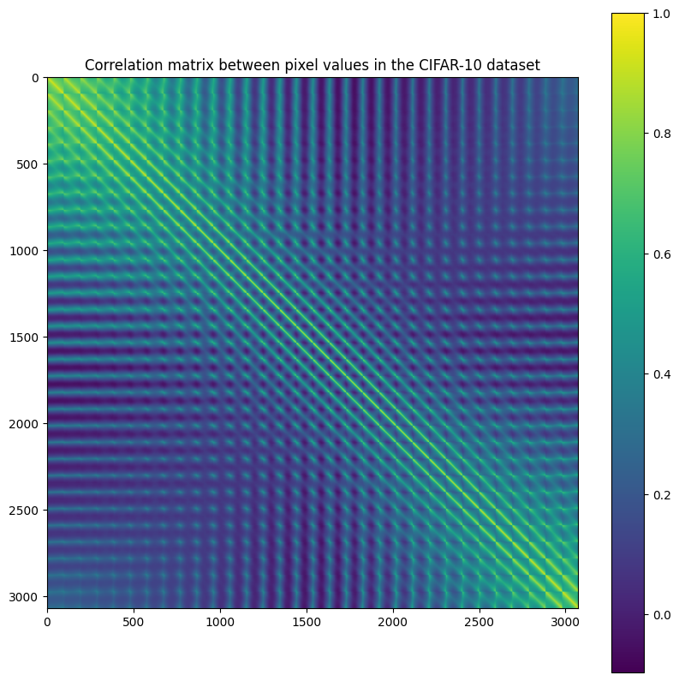
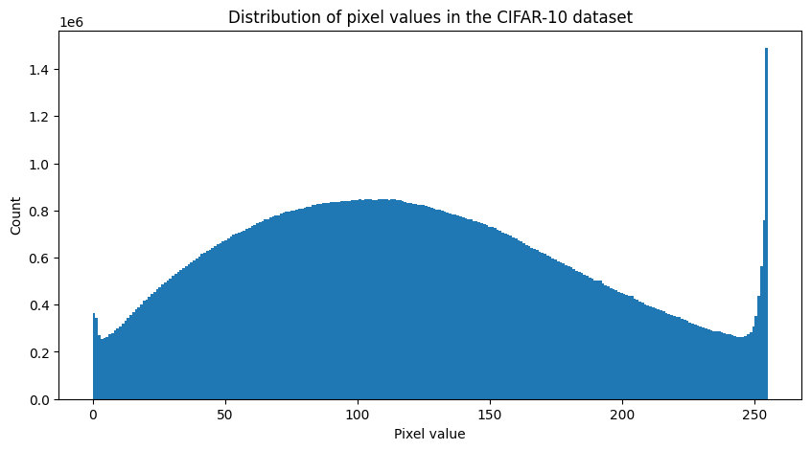
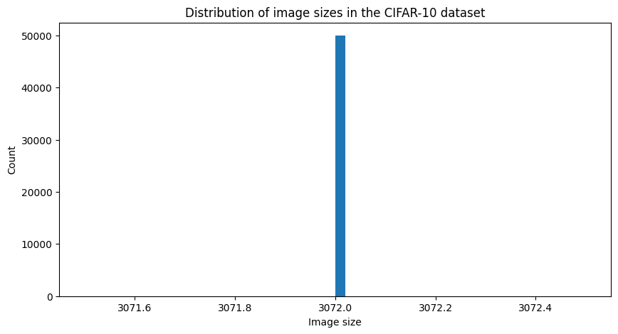
DATASET ANALISYS

Slide 6
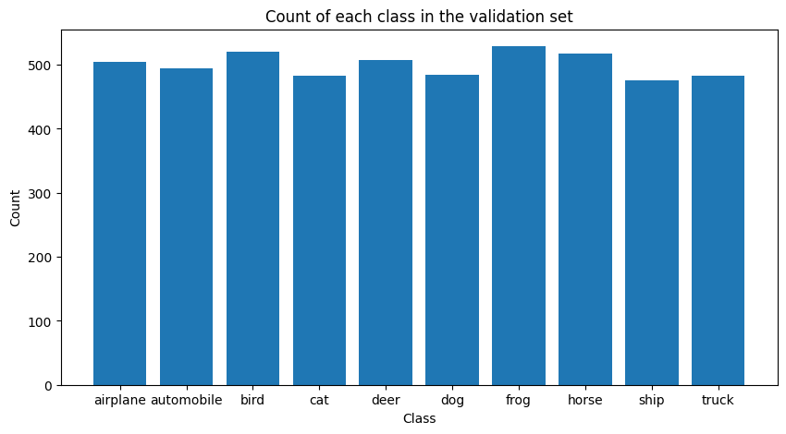
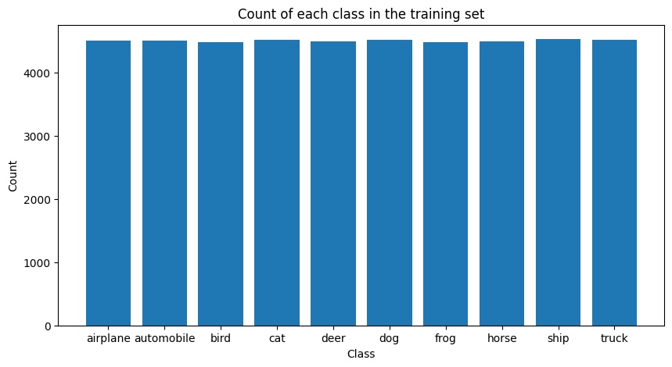
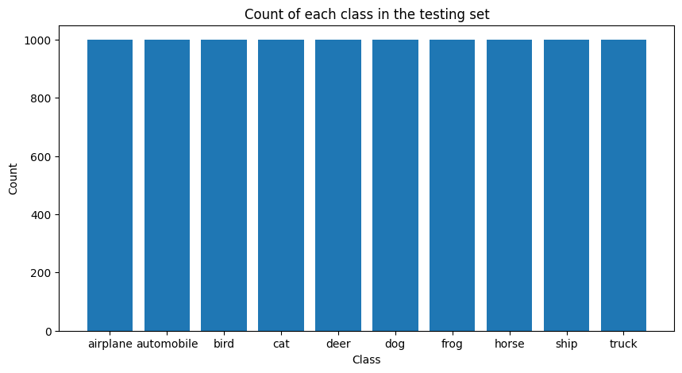
LABLE COUNTS OF DATASET

Slide 7
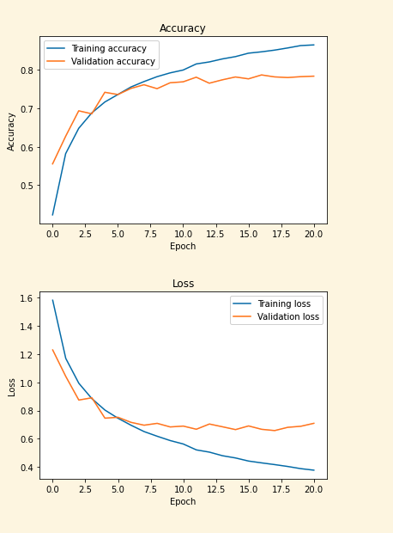

CNN RESULTS MODEL 1
4 convolutional layers with 2 max pooling and dropout,
two dense layers with dropout,
Adam optimizer with categorical cross-entropy
loss and accuracy as the evaluation metrics

Slide 8
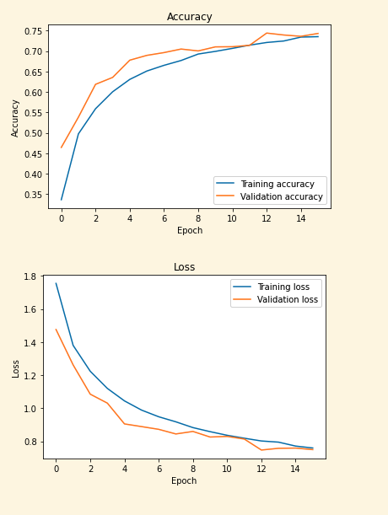

CNN RESULTS MODEL 2
5 convolutional layers with max pooling and dropout,
two dense layers with dropout,
Adam optimizer with categorical cross-entropy
loss and accuracy as the evaluation metrics

Slide 9
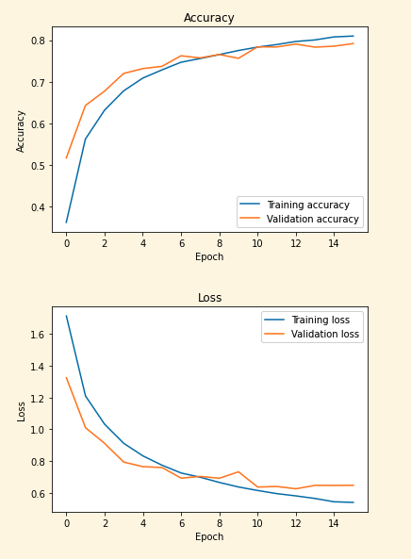

CNN RESULTS MODEL 3
6 convolutional layers with max pooling and dropout,
two dense layers with dropout,
Adam optimizer with categorical cross-entropy
loss and accuracy as the evaluation metrics

Slide 10
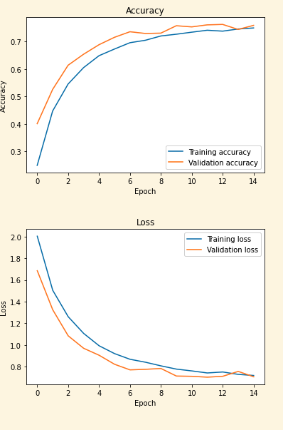

CNN RESULTS MODEL 4
6 convolutional layers with SGD optimizer with max pooling and dropout,
two dense layers with dropout,
Adam optimizer with categorical cross-entropy
loss and accuracy as the evaluation metrics

Slide 11
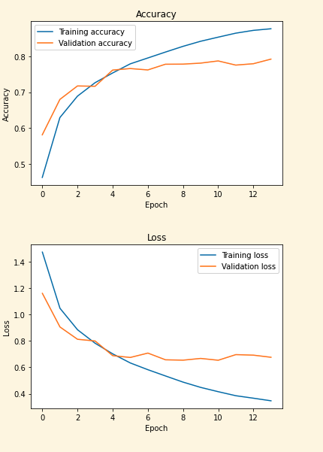

CNN RESULTS MODEL 5
4 convolutional layers with max pooling and dropout,
two dense layers with dropout, with categorical cross-entropy
loss and accuracy as the evaluation metrics and hyperparameter tuning with parameters :
{'batch_size': [32, 64],
'epochs': [10, 20],
'dropout_rate': [0.2, 0.3],
'optimizer': ['adam', 'rmsprop']}

Slide 12
FINAL RESULTS
When we compare all CNN model with different parameters, we found that our model with 4 convolutional layers with max pooling and dropout, two dense layers with dropout, with categorical cross-entropy loss and accuracy as the evaluation metrics and hyperparameter tuning with parameters had the best accuracy

Slide 13
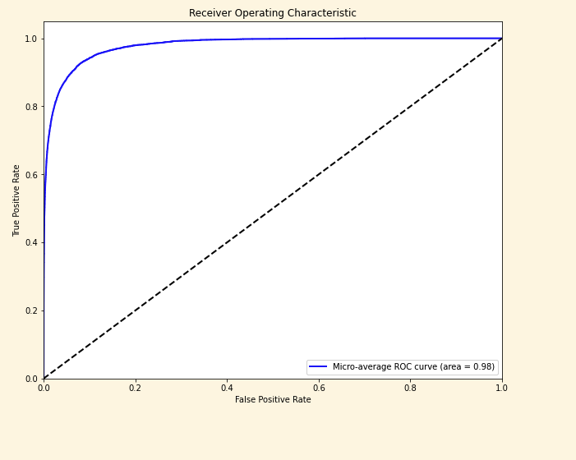
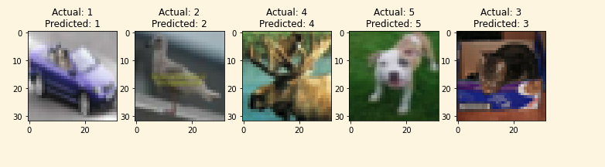
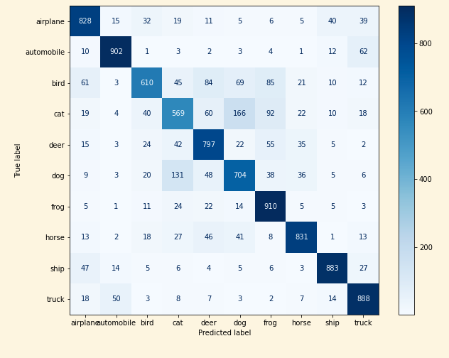
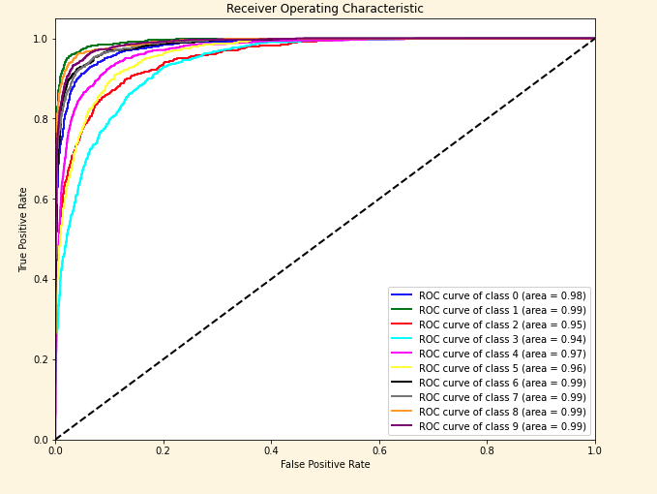
Visualizing Model Performance: Exploring the Confusion Matrix for CIFAR-10 Image Classification "for best model

Slide 14
conclusion
Based on the analysis of the performance of different convolutional neural network (CNN) models with varying number of convolution layers, it can be concluded that:
CNNs are effective in image classification tasks and can be used to achieve high accuracy rates
The number of convolution layers in a CNN affects its performance significantly
Hyperparameter tuning can improve the performance of CNN models. By adjusting the learning rate, number of epochs, and other hyperparameters, it is possible to achieve better accuracy rates
Among the five models tested, the one with four convolution layers and hyperparameter tuning had the best accuracy of 79.22%
Overall, the results of this study demonstrate the potential of CNNs for image classification tasks and highlight the importance of carefully designing and optimizing the architecture of the model

