Slide 1

CAPTION IT! “HARNESSING THE POWER OF CNN/RESNET MODELS AND FLICKR 8K DATASET FOR IMAGE DESCRIPTION”
Tanuj Varma: (002726506)
Shreyas Shetty: (002752852)
Raj Sarode: (002762015)
Mamatha Shetty:(002746925)

Slide 2
AGENDA
Problem Statement
Technical Approach
Data Description
Data Pre-processing
Deep Learning Approaches : VGG16+LSTM and RESNET50 +GRU
Accuracy Comparison via BELU scores
Conclusion

Slide 3
PROBLEM STATEMENT
Our goal is to develop a model that can automatically generate captions for images using the Flickr 8k Dataset and pretrained CNN/ResNet models
To achieve this, we will be exploring two different approaches, CNN+LSTM and ResNet+GRU. The performance of these approaches will be compared using the BLEU score, a widely used metric for evaluating the quality of machine-generated text

Slide 4

TECHNICAL APPROACH
Import required libraries and modules
Load and preprocess the dataset with images and captions
Split the dataset into training and testing subset.
Extract image features using a pre-trained model like VGG16 or ResNet50
Tokenize captions using the Keras tokenizer
Create training data with image features and tokenized captions
Build the caption generation model using extracted image features and captions
Use LSTM or GRU layers for sequential text data processing
Train the caption generation model on the training data
Generate captions for test images using the trained model
Calculate BLEU scores to evaluate the quality of generated captions
Identify and visualize the best predictions based on BLEU scores

Slide 5
DATASET ANALYSIS
Benchmark: 8,000 images, each with 5 captions, from 6 Flickr groups; diverse scenes, no well-known people/locations
Dataset: manually curated, high-quality captions; ideal for image captioning/search model training and evaluation
Dataset: diverse images and captions for various computer vision and NLP model development and testing

Slide 6

EXPLORATORY DATA ANALYSIS

Slide 7
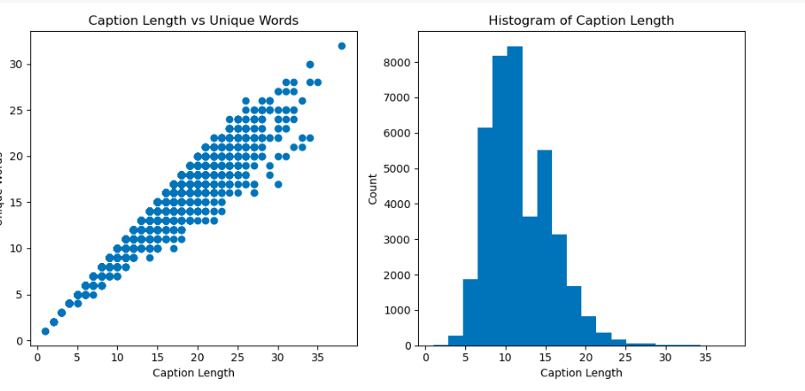
Scatter plot:
X-axis: Caption length
Y-axis: Unique words
Observation: Longer captions tend to have more unique words
Histogram:
X-axis: Caption length range
Y-axis: Caption count in each bin
Observation: Majority of captions have lengths between 0 and 100 characters, peaking around 50 characters

Slide 8
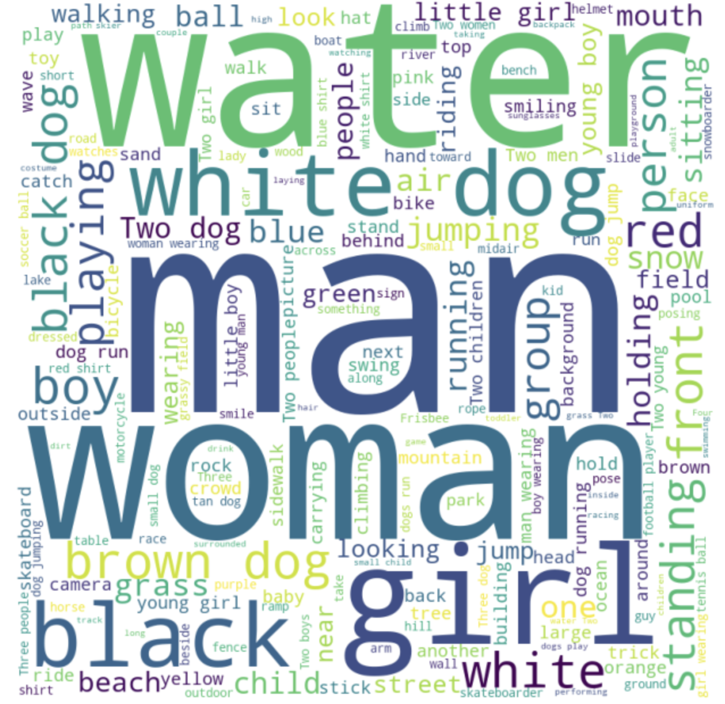
CAPTIONS –WORD CLOUD

Slide 9
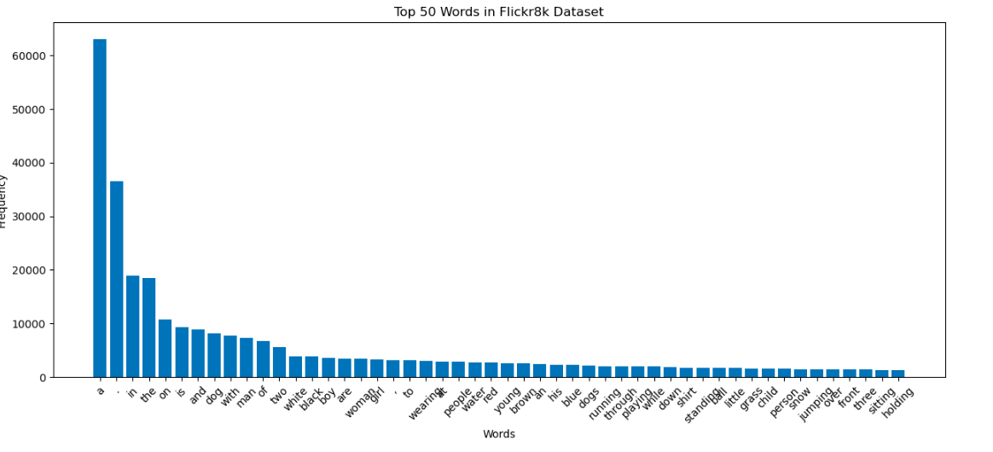
X-axis: 50 most frequent words
Y-axis: Word frequency
Purpose: Understand vocabulary and language patterns in captions
Usage: Illustrate common words and frequency distribution in presentations or reports

Slide 10
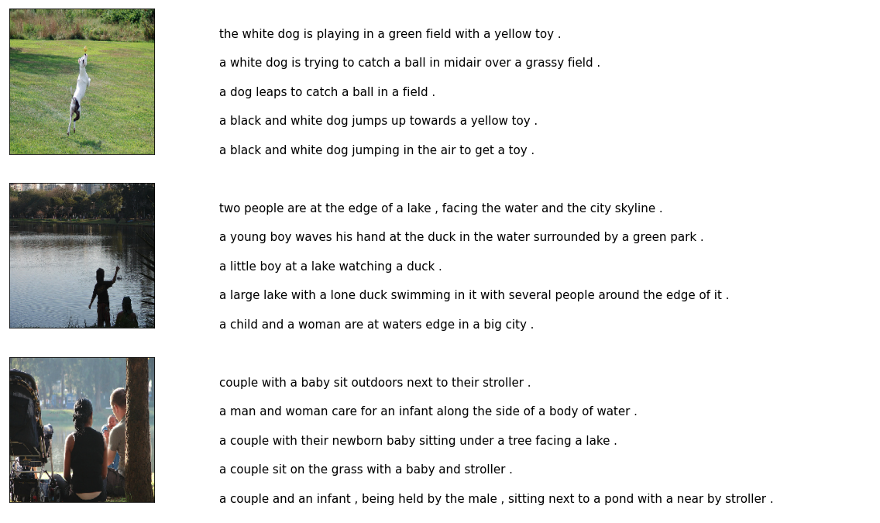
the associated human-annotated captions are displayed alongside, illustrating the natural language descriptions that the image captioning model will be trained to generate.

Slide 11
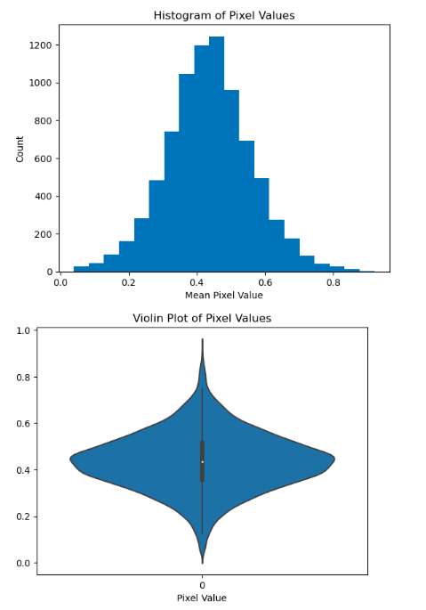
The histogram shows the count of images that have a particular mean pixel value range (x-axis)
The violin plot shows the distribution of the mean pixel values, where the wider areas represent regions with more images having that pixel value

Slide 12
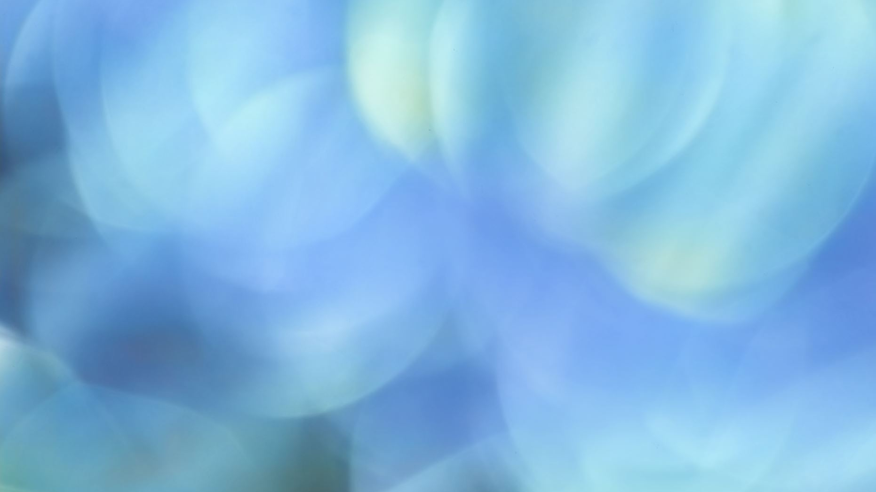
Deep Learning Approaches
To compare the performances of the two deep learning approaches, CNN + LSTM and ResNet + GRU, for generating captions for images using the Flickr 8k Dataset and pretrained models, we can compute their BLEU scores
By comparing the BLEU scores of the two approaches, we can determine which approach performs better at generating captions for images. However, it's worth noting that BLEU scores are just one way to evaluate the performance of a captioning model

Slide 13
APPROACH : VGG16 & LSTM
VGG16: The VGG16 model is a pre-trained convolutional neural network (CNN) designed for image classification
VGG16: 16-layer architecture; 13 for feature extraction, 3 for classification
Trained on ImageNet: 1.2M+ images, 1,000 categories; used for deep learning image classification
LSTM is a recurrent neural network that excels at capturing temporal dependencies via its memory cell, improving predictions in time-series problems

Slide 14
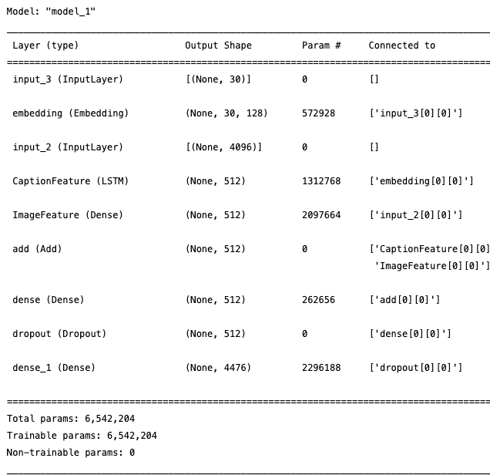
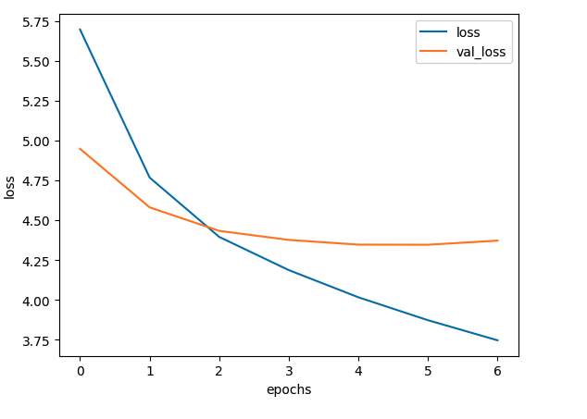
MODEL-VGG16+LSTM

Slide 15
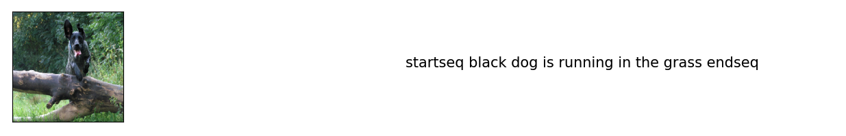
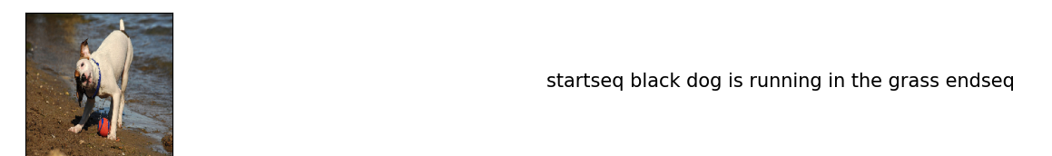
PERFORMANCE EVALUATION

Slide 16
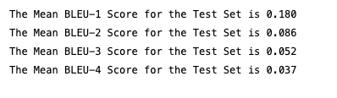
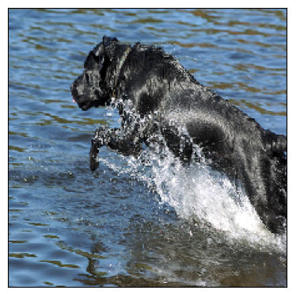



BLEU SCORES

Slide 17
APPROACH : ResNet50 and GRU
ResNet is a widely used deep neural network architecture for image recognition and computer vision tasks, which often uses the pre-training on the ImageNet dataset comprising over 1 million labeled images across 1,000 categories.
ResNet50 is a 50-layer deep residual network with convolutional, max-pooling, and fully connected layers, designed for image recognition tasks.
GRU is a recurrent neural network that efficiently captures temporal relationships using its update and reset gates, enhancing predictions in time-series tasks

Slide 18
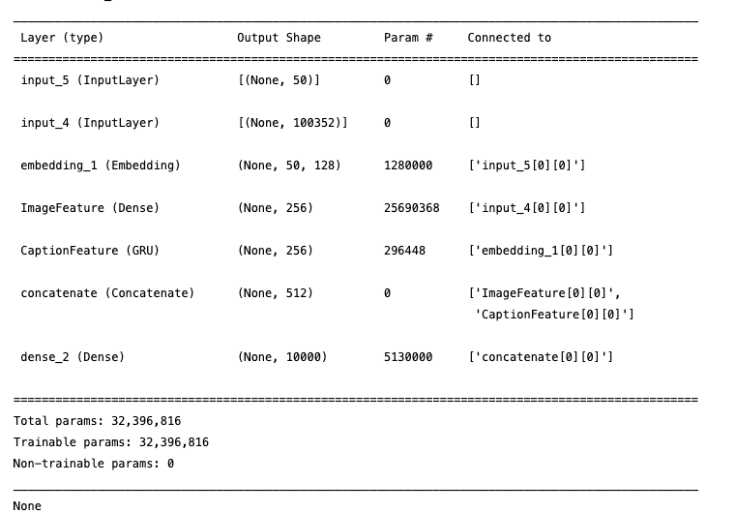
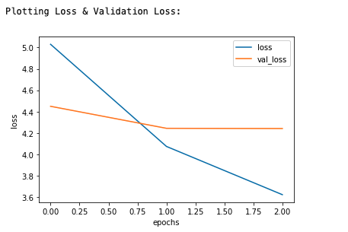
MODEL:RESNET50+GRU

Slide 19
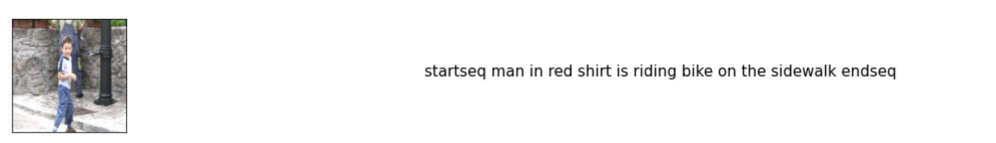
PERFORMANCE EVALUATION

Slide 20
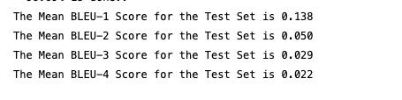
BLEU scores

Slide 21
COMPARISION
VGG16+LSTM
RESNET50+GRU

Slide 22
CONCLUSION
The VGG16 model with LSTM achieved higher BLEU scores across all four metrics compared to the ResNet50 model with GRU, indicating that the VGG16-LSTM combination is more effective at generating accurate and relevant image captions.
The performance difference between the two models suggests that the choice of pre-trained image feature extraction model (VGG16 vs. ResNet50) and the choice of sequence model (LSTM vs. GRU) can significantly impact the quality of generated captions.
Although the VGG16-LSTM model outperforms the ResNet50-GRU model in this comparison, there is still room for improvement in both models. Future work could explore different architectures, optimization techniques, or training strategies to further enhance the performance of image captioning models.

