Slide 1
TANUJ VERMA MS-IS Student Fall’22,Northeastern University verma.tanu@northeastern.edu 002726506
“E-COMMERCE EMOTIONS” ANALYZING REVIEWS TO UNDERSTAND CUSTOMER SENTIMENTS

Slide 2
PROBLEM DESCRIPTION
We were tasked with scraping around 10,000 reviews on a product of our choice and classifying them as positive or negative based on their rating
Our goal was to build a Naive Bayes Classifier that could accurately predict the sentiment of a review based on its text
We decided to use tokenization and stemming to preprocess the textual reviews before feeding them into the classifier
We evaluated the performance of the classifier using an 80/20 split of the scraped data into training and testing sets

Slide 3
TECHNICAL APPROACH
We scraped reviews and ratings of the company Amazon from Trustpilot.com
We labeled each review as positive, neutral or negative based on its rating (1-2 as negative, 3 as neutral, and 4-5 as positive)
We performed tokenization and stemming using the nltk library
We converted the preprocessed reviews into a TF-IDF matrix using TfidfVectorizer from the sklearn.feature_extraction.text module
We built a Naive Bayes Classifier using the MultinomialNB class from sklearn.naive_bayes
We used hyperparameter tuning to optimize the performance of the classifier. Specifically, we used GridSearchCV from sklearn.model_selection to search for the best hyperparameters
We evaluated the performance of the classifier using accuracy, precision, recall, and F1-score. We also visualized the performance of the model by creating a confusion matrix, sentiment plots, recall curves, and feature importance plots

Slide 4
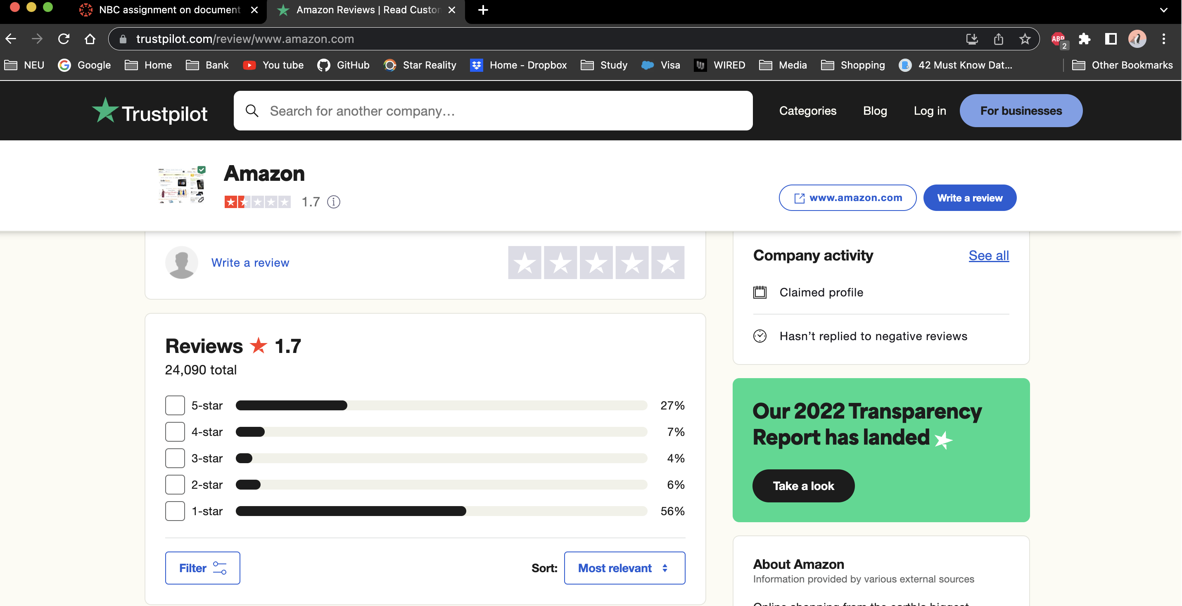
WEB SCRAPING
WEBSITE : https://www.trustpilot.com/review/www.amazon.com
Python and the Beautiful Soup library were utilized to scrape customer reviews from the website Trustpilot for Amazon.com
A loop was used to extract review ratings and review text for each review on a range of Trustpilot pages, Finally, the collected data was converted into a Pandas dataframe

Slide 5
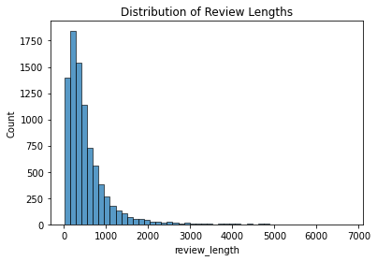
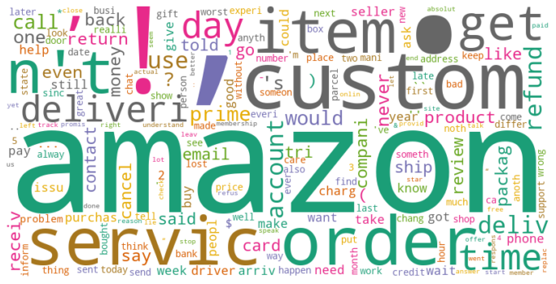
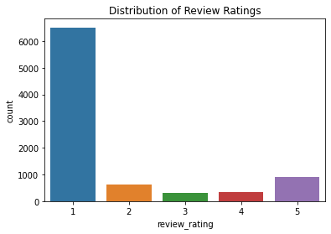
EDA of Dataset
Total Rows : 8920

Slide 6
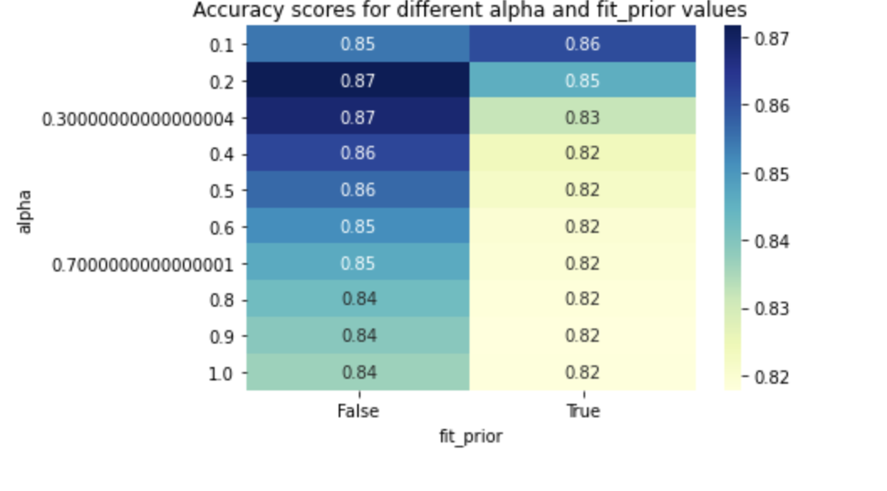
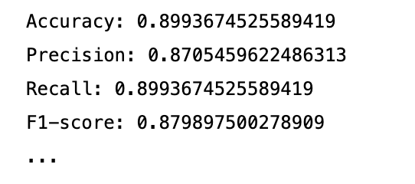
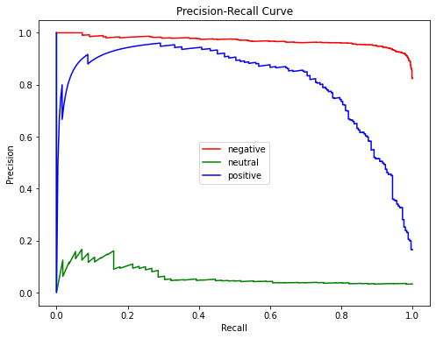
NBC MODELLING
Hyperparamter Tuning
Heatmap for grid results
Precision Recall Curve for 3 sentiments

Slide 7
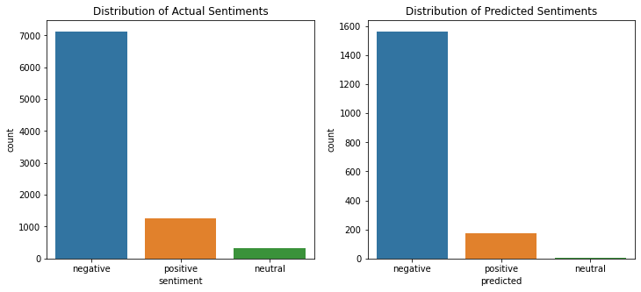
VISUALIZATIONS
SENTIMENT ANALYSIS

Slide 8
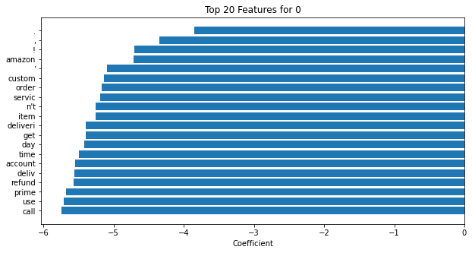
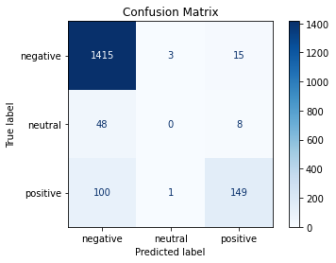
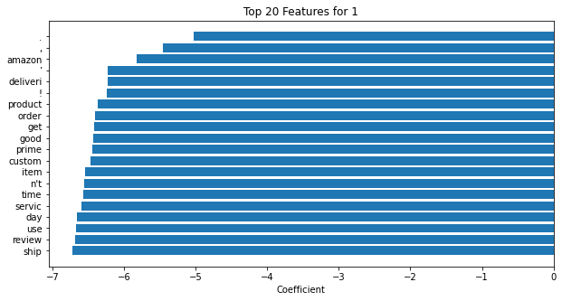
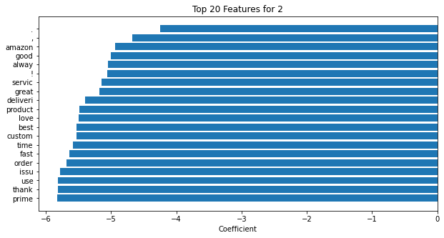
VISUALIZATIONS
NEGATIVE
POSITIVE
NEUTRAL

Slide 9
CONCLUSION
We used web scraping techniques to collect reviews and ratings of Amazon from Trustpilot.com
We classified each review as positive, neutral or negative using its rating, with the help of Python's nltk library
We then converted the preprocessed reviews into a TF-IDF matrix using the TfidfVectorizer from the sklearn.feature_extraction.text module, which allowed us to represent each review as a vector of numerical features
We built a Naive Bayes Classifier using the MultinomialNB class from sklearn.naive_bayes and used hyperparameter tuning to optimize its performance. Specifically, we used GridSearchCV from sklearn.model_selection to search for the best hyperparameters
We evaluated the performance of our classifier using various metrics such as accuracy(89%), precision(87%), recall(89%), and F1-score(87%). We also visualized the performance of the model by creating a confusion matrix, sentiment plots, recall curves, and feature importance plots

