Slide 1

TANUJ VERMA-002726506 MS-IS Student Fall’22,Northeastern University verma.tanu@northeastern.edu 002726506
“BREAKING DOWN BARRIERS WITH NEURAL NETWORKS”
PREDICTING OUTCOMES WITH EASE

Slide 2
PROBLEM DESCRIPTION
Apply simple feed-forward neural network model and evaluate the performance of both data sets based on accuracy

Slide 3
TECHNICAL APPROACH
Implemented a feed-forward neural network with 2/4 hidden layers, trained using binary cross-entropy and mean_squared_error loss with Adam optimizer
Evaluated the model's performance using accuracy, Loss, ROC curve and confusion matrix
Discussed potential improvements such as regularization techniques and hyperparameter tuning

Slide 4
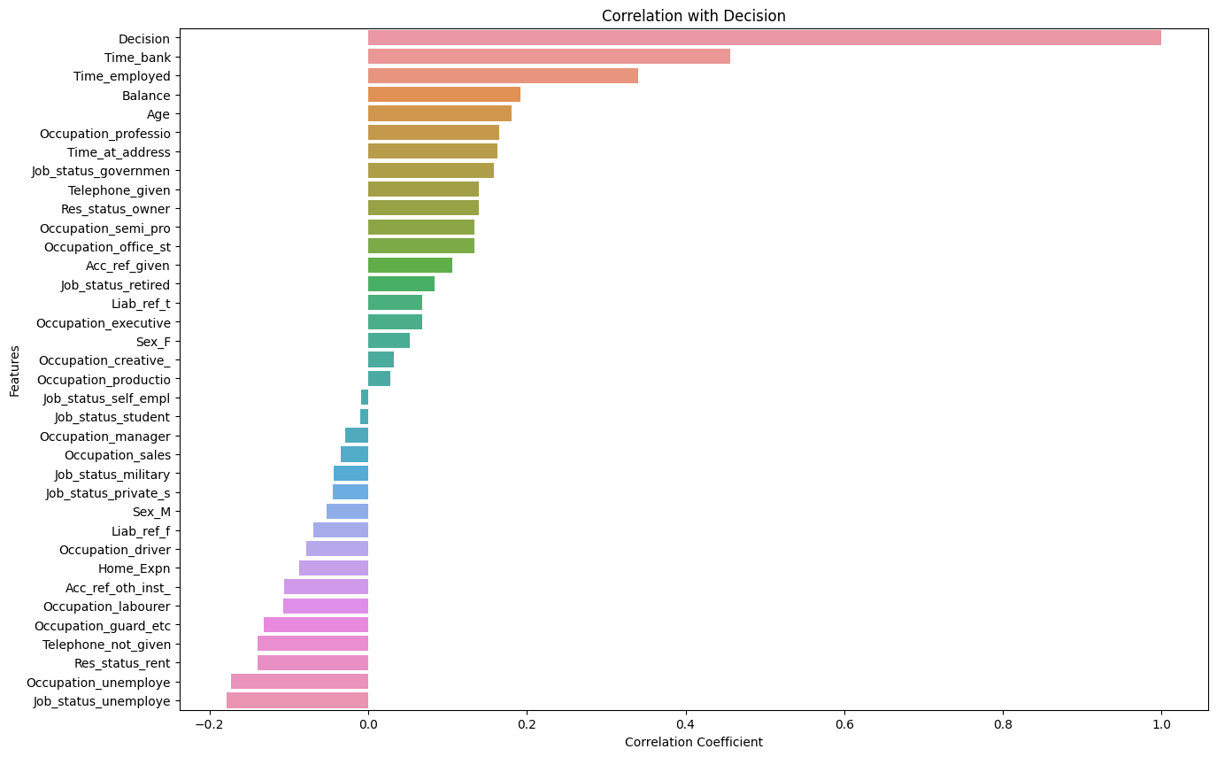
LOAN DATASET

Slide 5
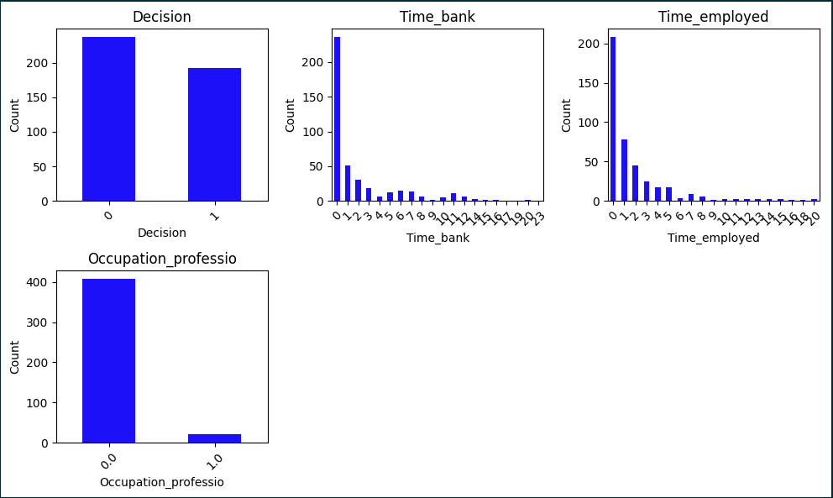
DATA ANALYSIS

Slide 6
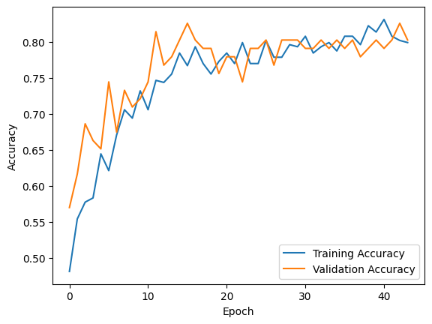

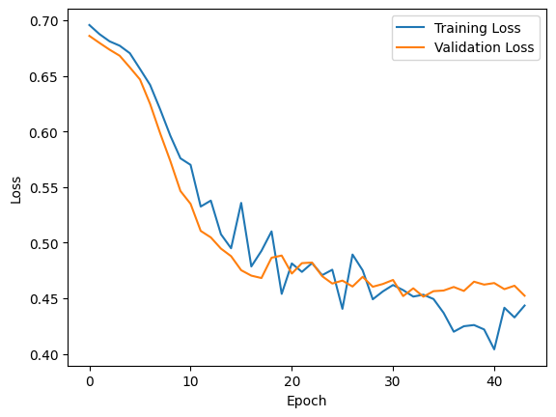
NEURAL NETWORK MODEL WITH REGULARIZATION AND ADAM OPTIMIZER RESULT WITH 4 LAYERS

Slide 7
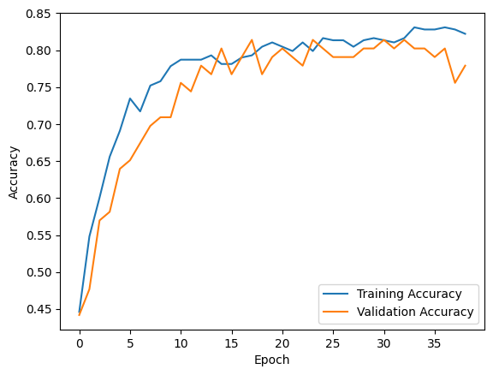
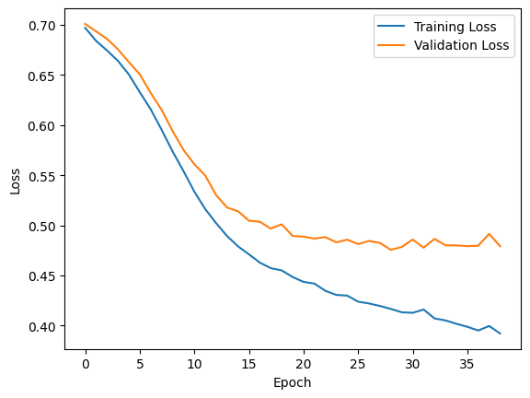
NEURAL NETWORK MODEL WITH REGULARIZATION AND ADAM OPTIMIZER RESULT WITH 2 LAYERS

Slide 8
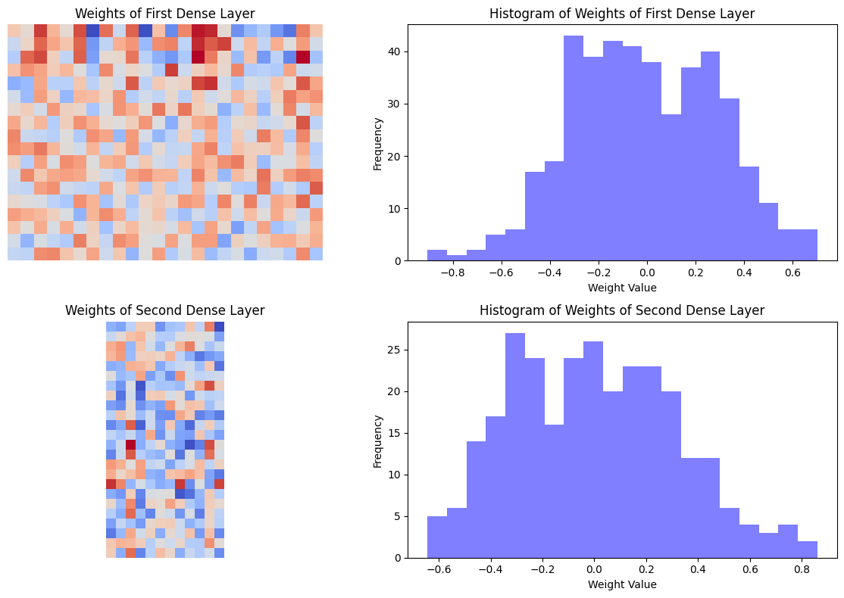
WEIGHTS ANALYSIS

Slide 9
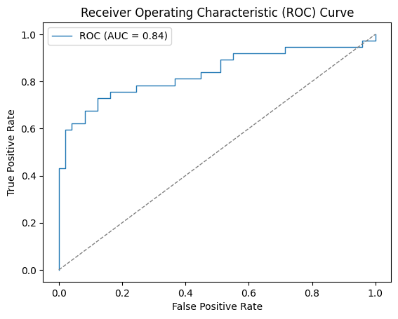
PERFORMANCE EVALUATION

Slide 10
CONCLUSION
Our project involved training neural network models on two datasets: a randomly generated dataset and the Loan dataset
Our neural network model trained on the randomly generated dataset achieved an accuracy of 100% with a loss of 0.03, indicating its ability to accurately classify data
We trained two neural network models on the Loan dataset with four and two hidden layers, respectively. The models achieved accuracies of 79.06% and 80.23%, indicating their ability to classify data with reasonable accuracy
Our visualizations, such as the ROC curve, confusion matrix, and decision boundary plots, provided valuable insights into the models' behavior and performance
Although the accuracy of the models on the Loan dataset was lower than the accuracy achieved on the randomly generated dataset, the results were still promising and demonstrated the models' ability to predict outcomes based on input data
The difference in accuracy between the two models trained on the Loan dataset may indicate the importance of the number of hidden layers and the optimization techniques used in improving the models' performance

