Slide 1

TANUJ VERMA
“CRUNCHING SYMPTOMS”
A COMPARATIVE STUDY OF DISEASE PREDICTION WITH VARIOUS ML ALGORITHMS

Slide 2
PROBLEM DESCRIPTION AND DATA ANALYSIS
Take a Disease prediction dataset and perform 5 different classification techniques
Compare all five techniques using several parameters and find out the best model for prediction

Slide 3
TECHNICAL APPROACH
Performed preprocessing, Univariate Analysis and Exploratory Data Analysis (EDA)on test and train dataset to reveal most relevant columns with “Prognosis” as the dependent variable
Reduce the number of relevant columns using feature reduction RFE
Computed Accuracy and Overfitting score for all models and compared them

Slide 4
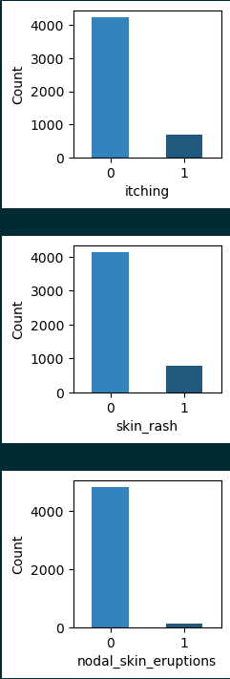
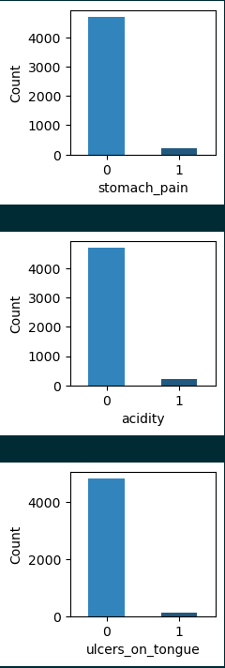
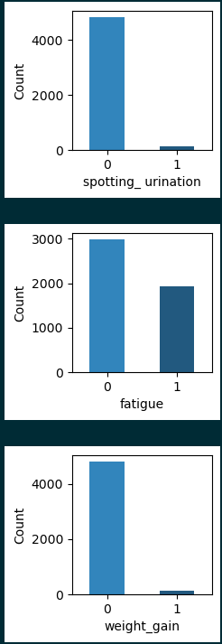
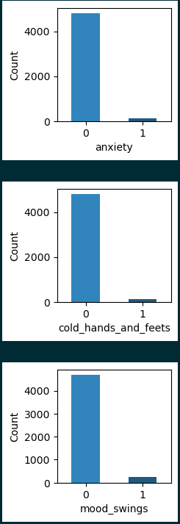
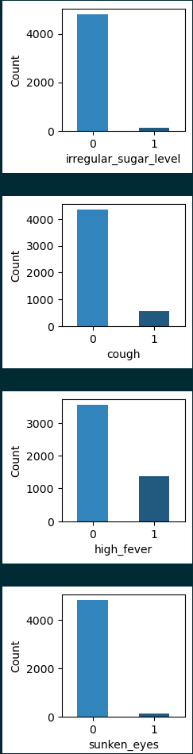
Count of different prognosis in Train Data

Slide 5
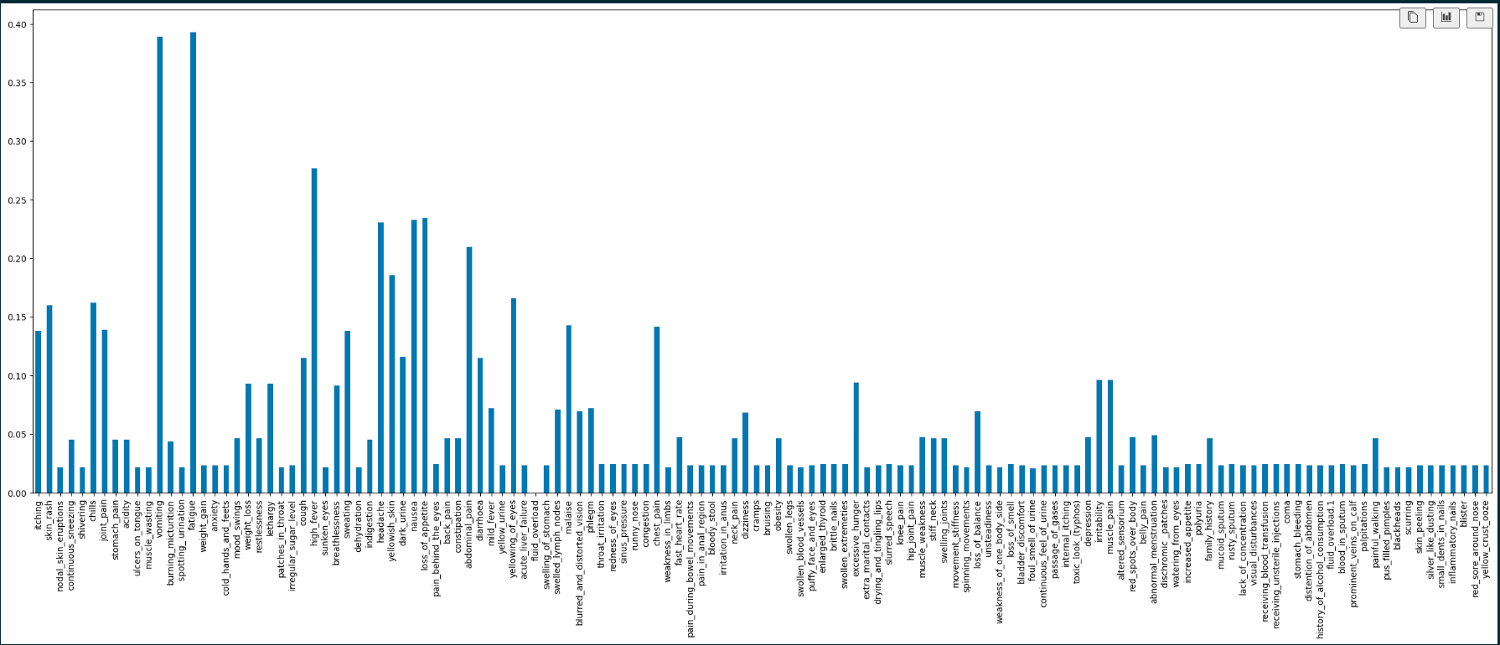
proportion of 1's and 0's for each feature

Slide 6
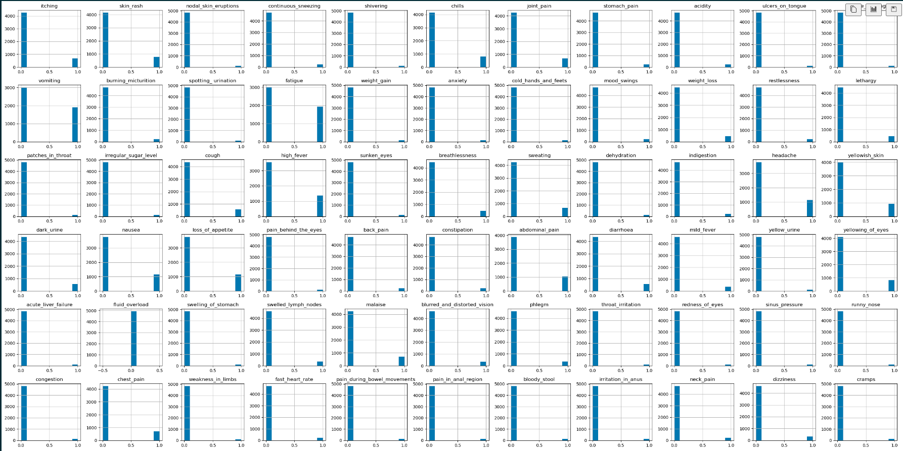
Histograms for each column in the training dataset

Slide 7
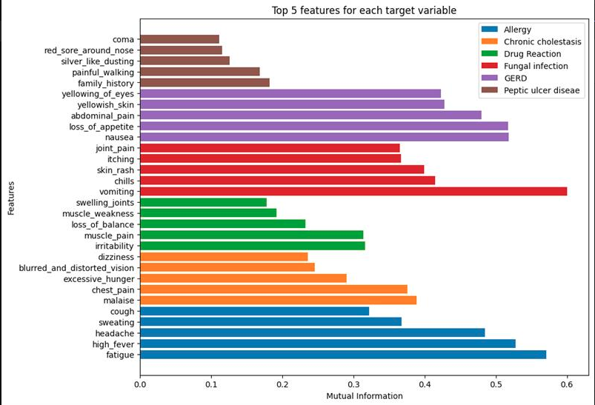

Slide 8
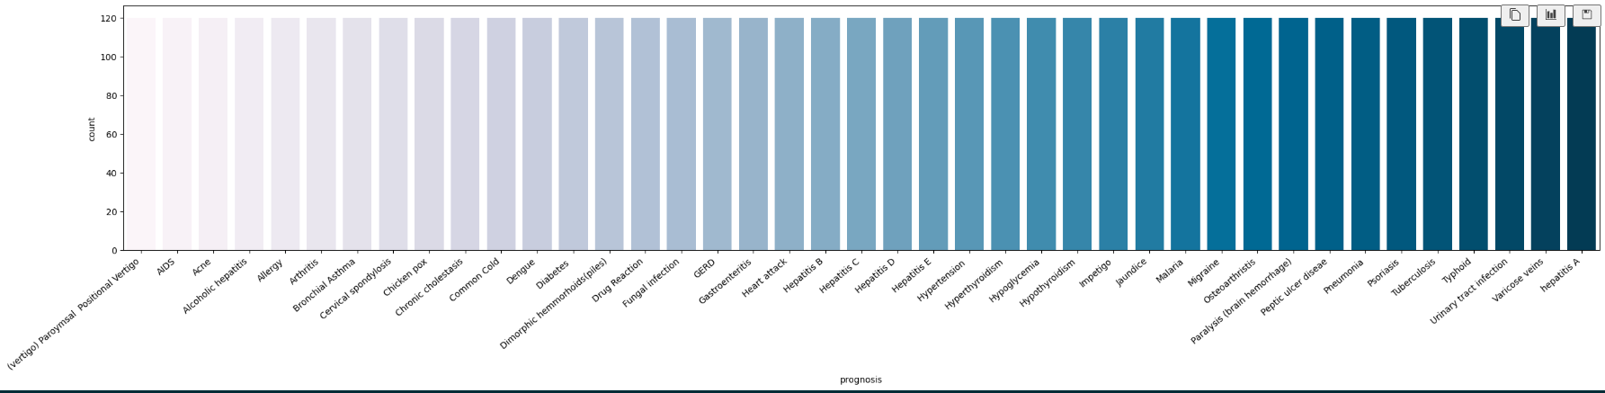
Number of target class variables

Slide 9
INSIGHTS
The top 5 features contributing to target label 'Chronic cholestasis' are: ['malaise' 'chest_pain' 'excessive_hunger' 'dizziness’ 'blurredand distorted_vision’]
The top 5 features contributing to target label 'Drug Reaction' are: ['irritability' 'muscle_pain' 'loss_of_balance' 'swelling_joints’ 'stiff_neck’]
The top 5 features contributing to target label 'Fungal infection' are: ['vomiting' 'chills' 'skin_rash' 'joint_pain' 'itching’]
The top 5 features contributing to target label 'GERD' are: ['nausea' 'loss_of_appetite' 'abdominal_pain' 'yellowing_of_eyes’ 'yellowish_skin’]
The top 5 features contributing to target label 'Peptic ulcer diseae' are: ['family_history' 'painful_walking' 'red_sore_around_nose’ 'stomach_bleeding' 'coma’]
The top 5 features contributing to target label 'Allergy' are: ['fatigue' 'high_fever' 'headache' 'sweating' 'cough']

Slide 10
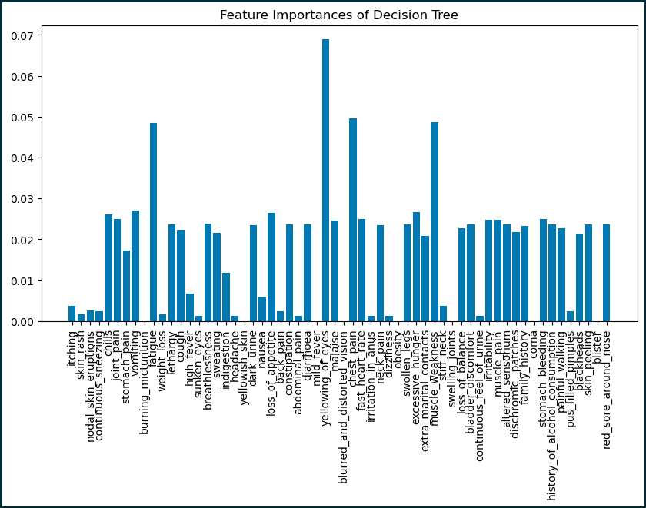

DECISION TREE

Slide 11
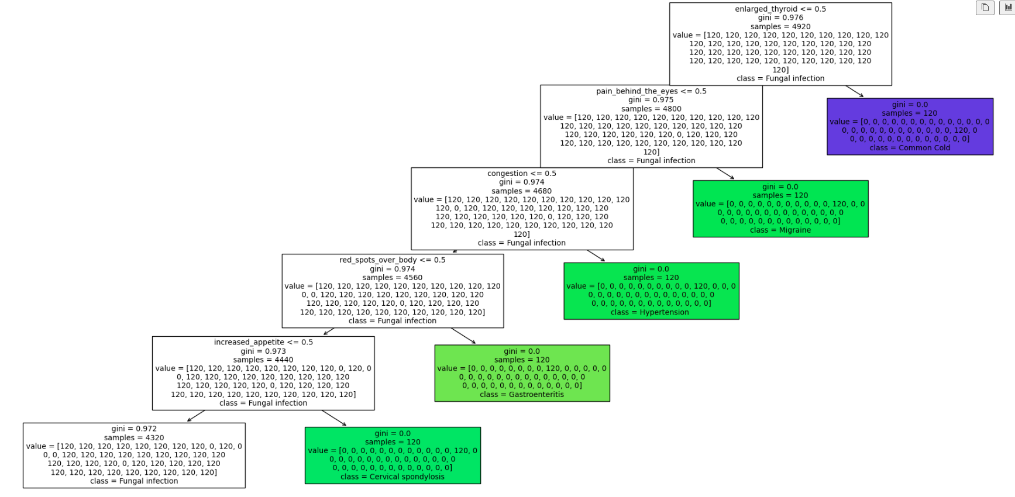
TREE PLOT

Slide 12
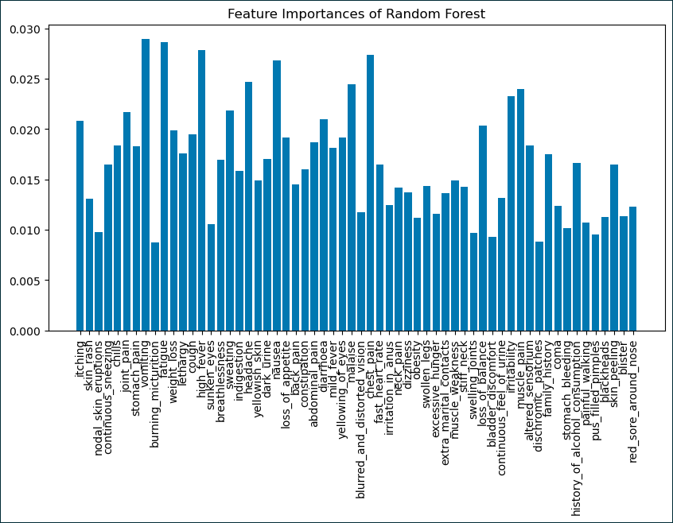

RANDOM FOREST

Slide 13
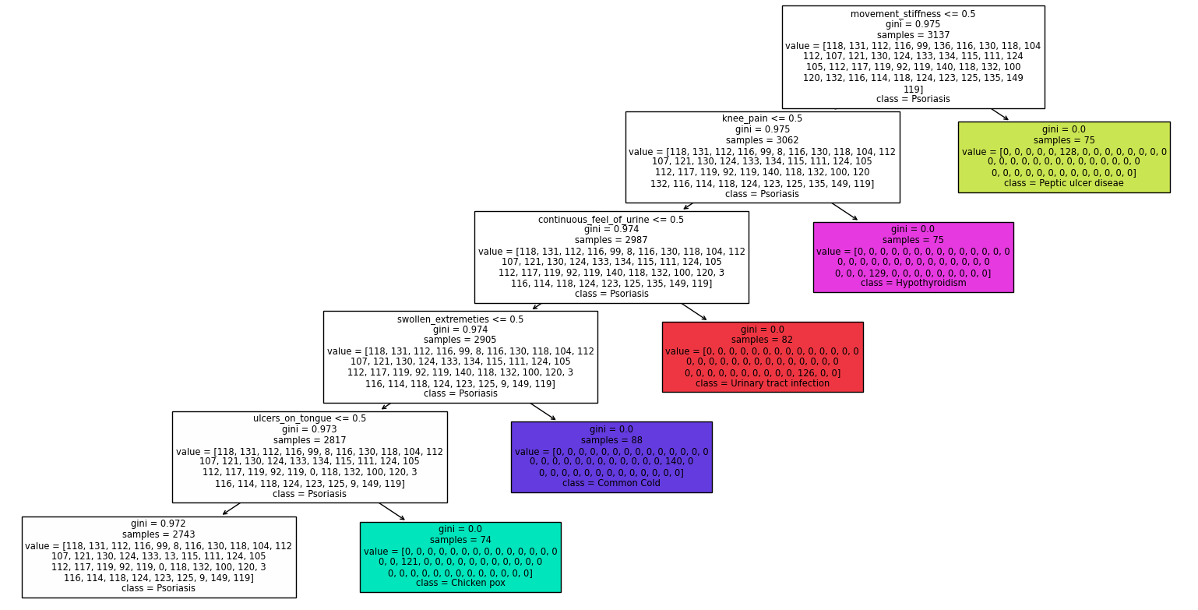
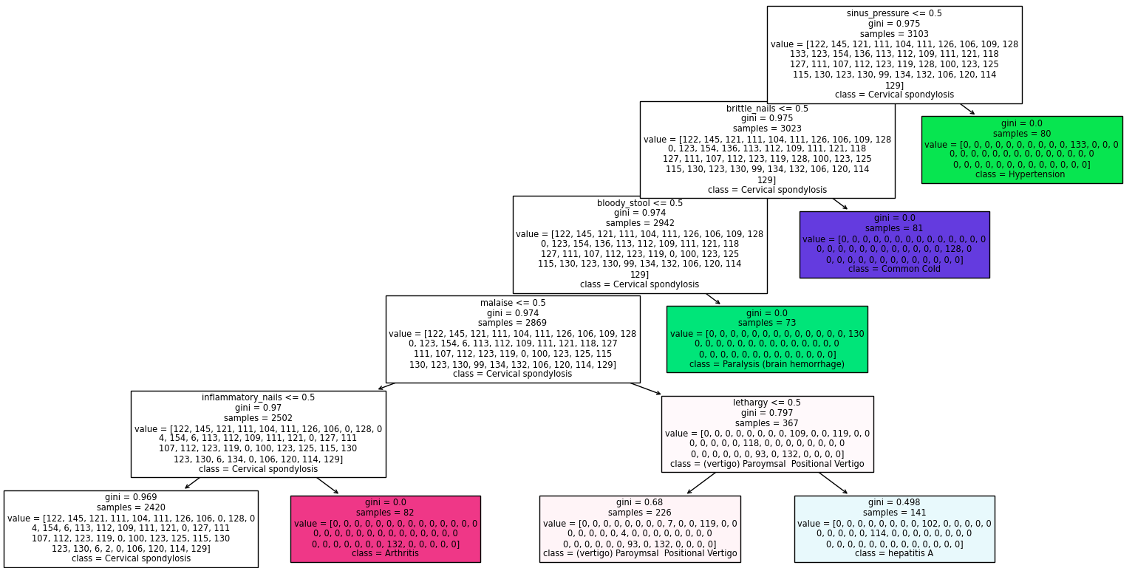
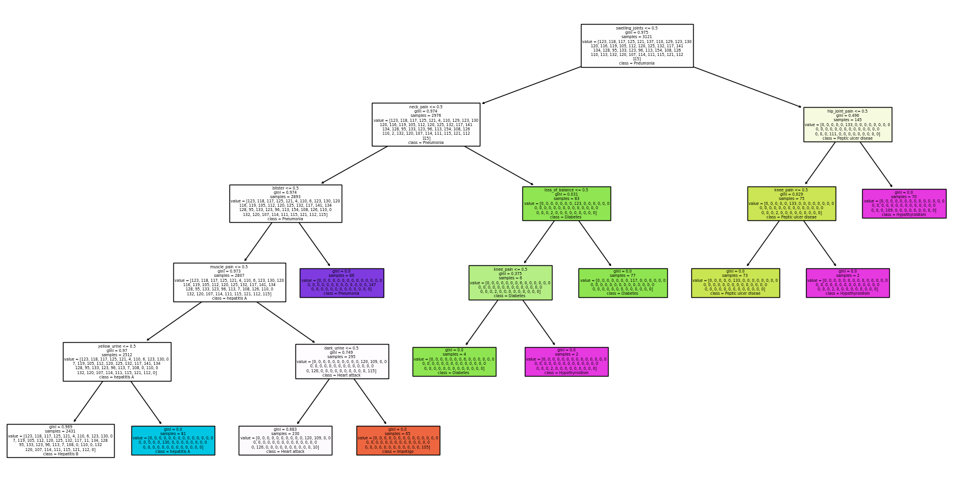
TREE PLOTS

Slide 14
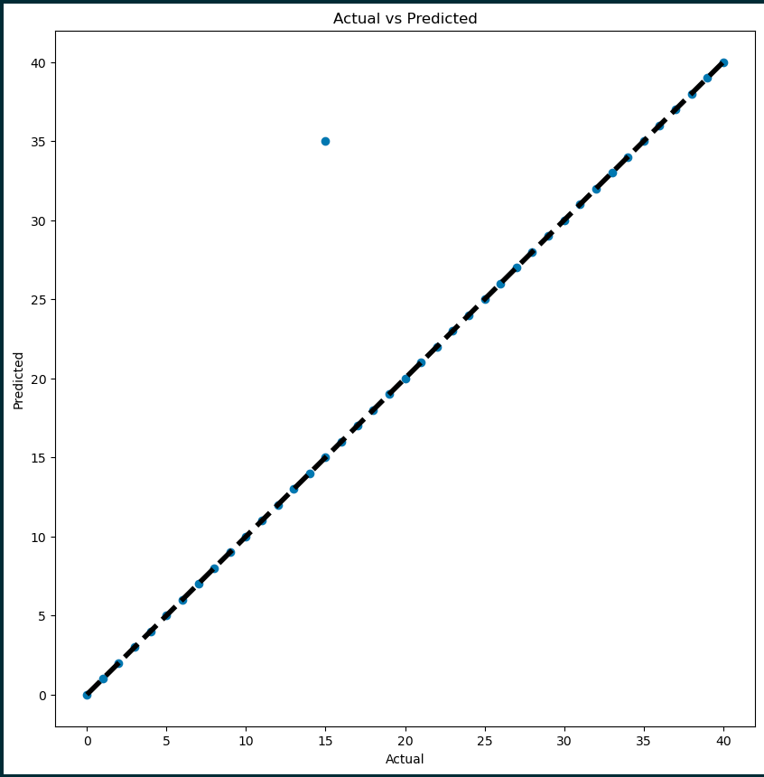
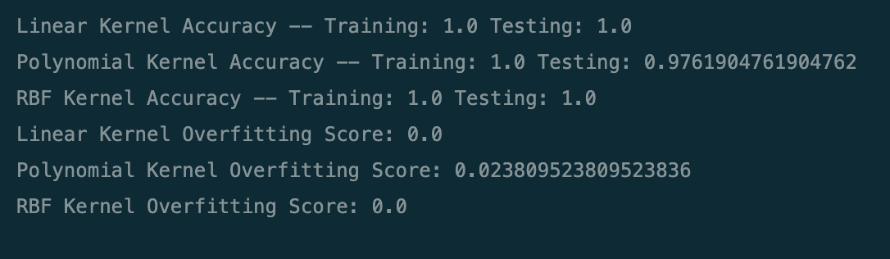
SUPPORT VECTOR MACHINE

Slide 15
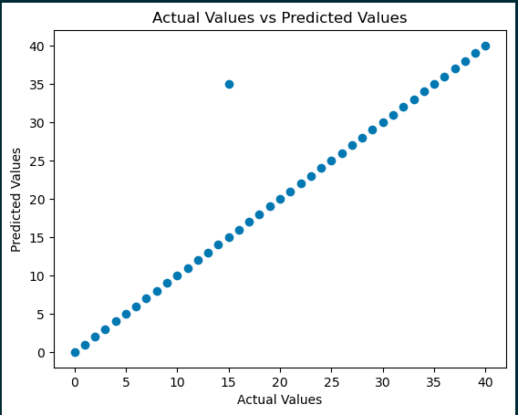
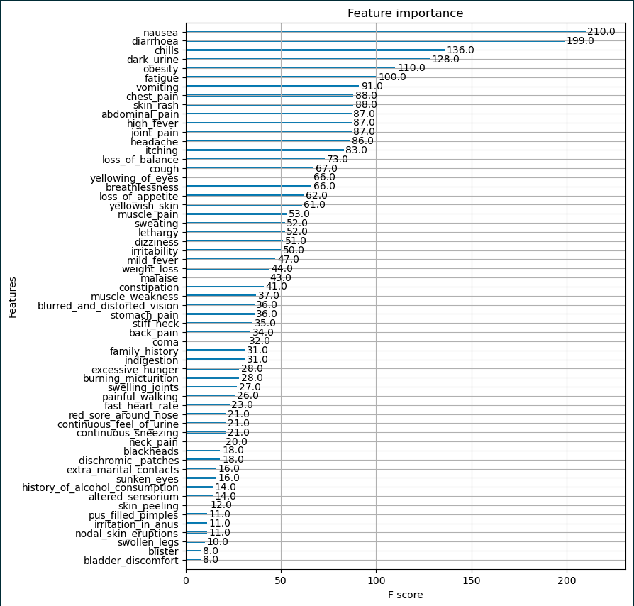


XG BOOST

Slide 16
COMPARISION OF ALL MODELS
DECISION TREE
RANDOM FOREST
SUPPORT VECTOR
MACHINE
XGBOOST

Slide 17
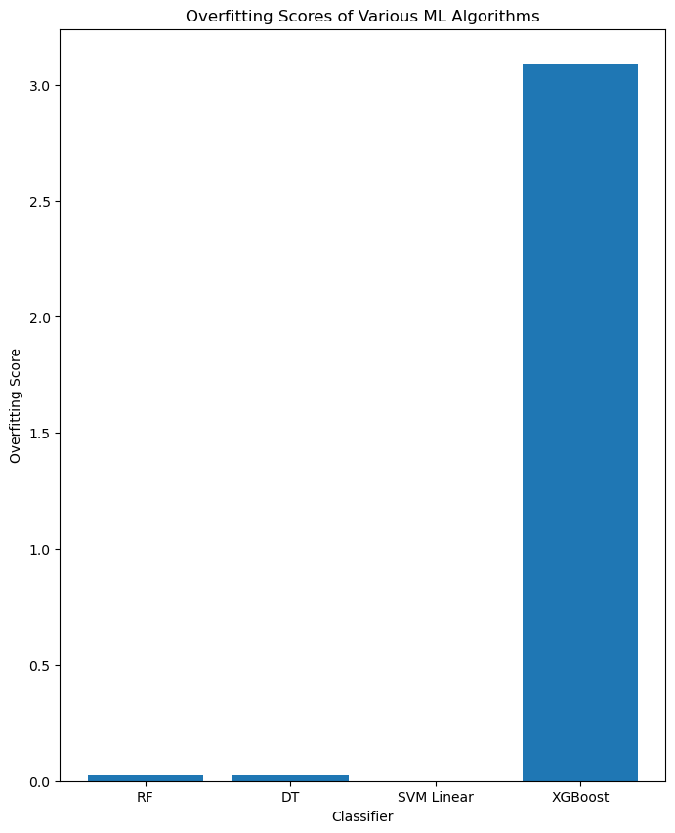
OVERFITTING PLOTS

Slide 18
CONCLUSION
Model performance: All the models, namely DT, RF, SVM Linear, and XGBoost, have the almost same accuracy score of 0.9762
on the test data. This indicates that all models are performing equally well in predicting the target variable
Overfitting: The overfitting score of SVM is lowest, except for XGBoost, which has an overfitting score of 3.086.
This indicates that DT, RF, and SVM Linear models are not overfitting, but XGBoost is severely overfitting
Training accuracy: All models have a training accuracy of 1.0, indicating that they are able to fit the training data perfectly.
However, this does not necessarily mean that the models will perform well on unseen data
Model complexity: The DT model is the simplest model among all the models, whereas RF and XGBoost are more complex
models. SVM Linear falls in between, in terms of model complexity. It is important to strike a balance between model
complexity and performance, as overly complex models can lead to overfitting and poor generalization to unseen data
Model selection: Based on the given data, all models seem to perform equally well in predicting the target variable.
However, XGBoost is severely overfitting and may not generalize well to unseen data. Therefore, it is important to carefully
evaluate the performance of different models using appropriate metrics and techniques before selecting the final model

