Slide 1
Behavioral Design Patterns State and Strategy
Dr. Syed Sajid Hussain

Slide 2
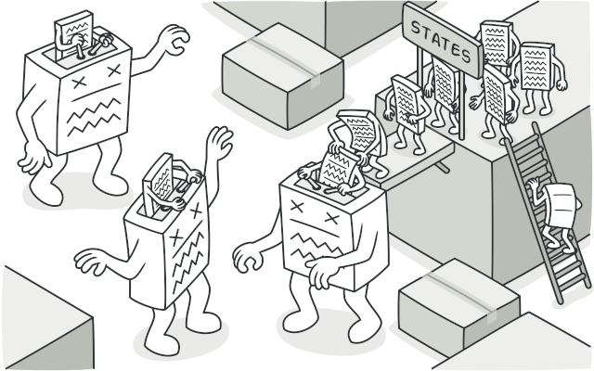
State design pattern
State is a behavioral design pattern that lets an object alter its behavior when its internal state changes. It appears as if the object changed its class.
Notes:
Similar to observer pattern

Slide 3

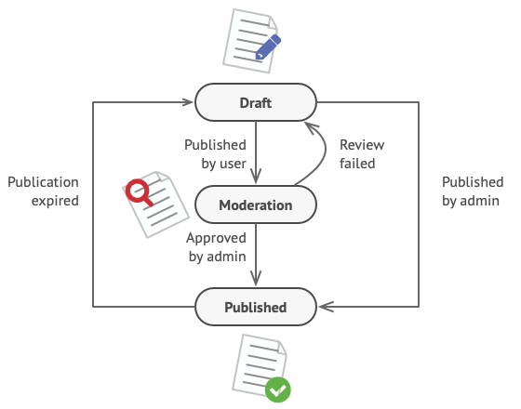
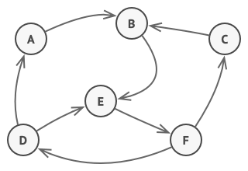
Problem
How to implement this?
List of If conditions, switch?
offline
online
Program – finite states
Each state – different behavior
State transitions
error
paper jam
out of paper
toner empty
Document
Finite-State Machine

Slide 4
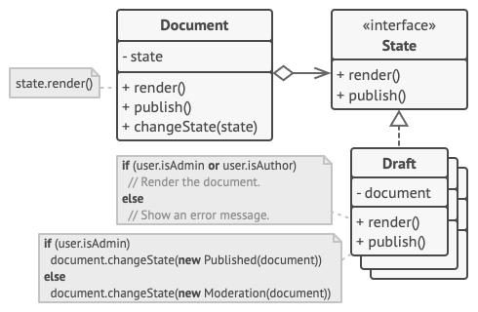
Solution
New class for every state
Extract all state-specific behav.
Transition – replace the state object

Slide 5
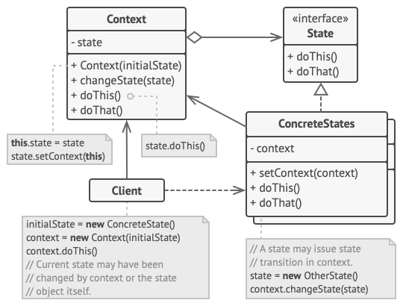
Structure
Context stores a reference to one of the concrete state objects and delegates to it all state-specific work.
The State interface declares the state-specific methods.
Concrete States provide their own implementations for the state-specific methods. (backref.)
Both context and concrete states can set the next state of the context and perform the actual state transition by replacing the state object linked to the context.

Slide 6
State pattern
public class TVBasic {
private String state = "";
public void setState(String state){
this.state=state;
}
public void doAction(){
if(state.equalsIgnoreCase("ON")){
System.out.println("TV is turned ON");
}
else if(state.equalsIgnoreCase("OFF")){
System.out.println("TV is turned OFF");
}
}
public static void main(String args[]){
TVBasic remote = new TVBasic();
remote.setState("ON");
remote.doAction();
remote.setState("OFF");
remote.doAction();
}
}
Client should know the specific values to use for setting the state of TV

Slide 7
State pattern
public interface State {
public void doAction();
}
public class TVOnState implements State {
@Override
public void doAction() {
System.out.println("TV is turned ON");
}
}

Slide 8
State pattern
public class TVContext {
private State tvState;
public void setState(State state) {
this.tvState = state;
}
public State getState() {
return this.tvState;
}
@Override
public void doAction() {
this.tvState.doAction();
}
}

Slide 9
State pattern
public class Demo {
public static void main(String[] args) {
TVContext context = new TVContext();
State tvStartState = new TVOnState();
State tvStopState = new TVOffState();
context.setState(tvStartState);
context.doAction();
context.setState(tvStopState);
context.doAction();
}
}

Slide 10
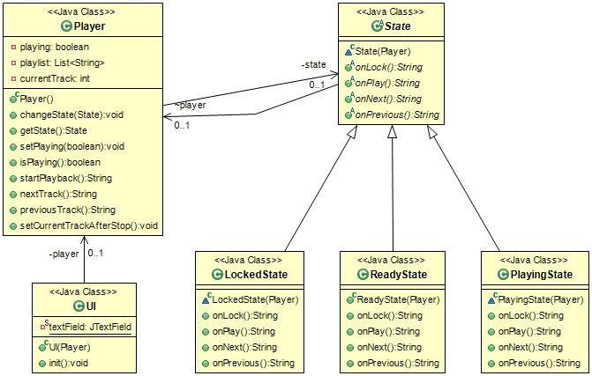
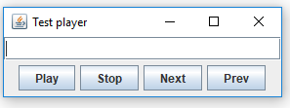

Slide 11
State pattern – when to apply
when the behavior of an object should be influenced by it's state
when complex conditions tie object behavior to it's state

Slide 12

Strategy design pattern
Strategy is a behavioral design pattern that lets you define a family of algorithms, put each of them into a separate class, and make their objects interchangeable.
Notes:
Similar to observer pattern

Slide 13

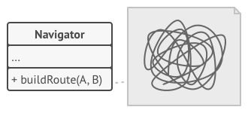
Problem
Navigation app for tourists
Map of the city – navigation
Route planning feature
User enters the destination Address
Fastest route
V1: tourists with cars
Tourists using public transport, bicycles, pedestrians?
Solution: add more code to the Navigator class
Bloated, size of the class, changes, accidental errors, teamwork problems

Slide 14
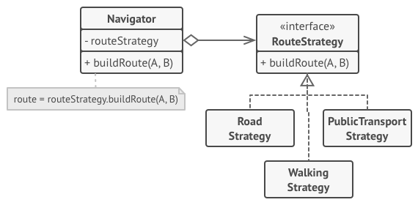
Solution
take a class that does something specific in a lot of different ways
extract all of these algorithms into separate classes called strategies
the original class (context) has a field – reference to current strategy
context delegates the work to a linked strategy object
the client passes the desired strategy to the context

Slide 15
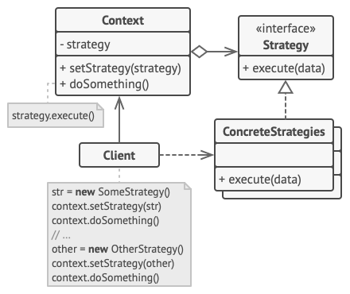
Structure
The Context maintains a reference to one of the concrete strategies and communicates with this object only via the strategy interface.
The Strategy interface declares a method the context uses to execute a strategy.
Concrete Strategies implement different variations of an algorithm the context uses.
The context calls the execution method on the linked strategy object each time it needs to run the algorithm.
The Client creates a specific strategy object and passes it to the context using a setter method.

Slide 16
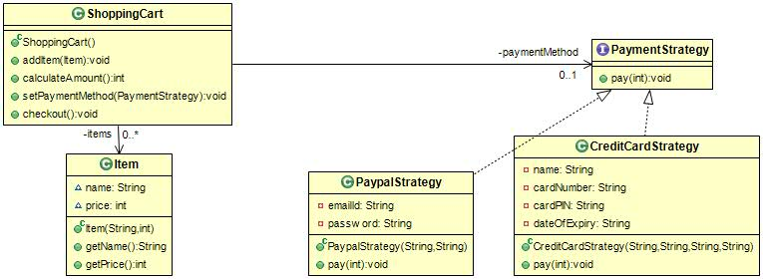
Strategy: code example

Slide 17
Strategy pattern
public interface PaymentStrategy {
public void pay(int amount);
}
public class PaypalStrategy implements PaymentStrategy {
private String emailId;
private String password;
public PaypalStrategy(String email, String pwd){
this.emailId=email;
this.password=pwd;
}
@Override
public void pay(int amount) {
System.out.println(amount + " Rupees paid using Paypal");
}
}

Slide 18
Strategy pattern
public class CreditCardStrategy implements PaymentStrategy {
private String name;
private String cardNumber;
private String cardPIN;
private String dateOfExpiry;
public CreditCardStrategy(String name, String cardNumber, String cardPIN, String expiryDate){
this.name=name;
this.cardNumber=cardNumber;
this.cardPIN = cardPIN;
this.dateOfExpiry=expiryDate;
}
@Override
public void pay(int amount) {
System.out.println(amount +" Rupees paid with card");
}
}

Slide 19
Strategy pattern
public class Item {
String name;
int price;
public Item(String name, int price) {
super();
this.name = name;
this.price = price;
}
public String getName() {
return name;
}
public int getPrice() {
return price;
}
}

Slide 20
Strategy pattern
public class ShoppingCart {
private PaymentStrategy paymentMethod;
private List<Item> items = new ArrayList<Item>();
public void addItem(Item item){
items.add(item);
}
public int calculateAmount(){
int amount = 0;
for(Item it:items){
amount += it.getPrice();
}
return amount;
}
public void setPaymentMethod(PaymentStrategy paymentMethod) {
this.paymentMethod = paymentMethod;
}
public void checkout(){
int amount = calculateAmount();
paymentMethod.pay(amount);
}
}

Slide 21
Strategy pattern
public static void main(String[] args) {
ShoppingCart cart = new ShoppingCart();
Item item1 = new Item("Code complete",120);
Item item2 = new Item("Design patterns in java: a practical tutorial",100);
cart.addItem(item1);
cart.addItem(item2);
cart.setPaymentMethod(new PaypalStrategy("myemail@example.com", "mypwd"));
//pay by paypal
cart.checkout();
//pay by credit card
cart.setPaymentMethod(new CreditCardStrategy("Syed Sajid Hussain", "1234567890123456", "1234", "12/15"));
cart.checkout();
}

Slide 22
Strategy pattern – when to apply
when you want to choose the algorithm to use at runtime
saving files in different formats,
running various sorting algorithms,
or file compression.

Slide 23
Difference between Strategy and State
In the State pattern, the particular states may be aware of each other and initiate transitions from one state to another, whereas strategies almost never know about each other.

Slide 24
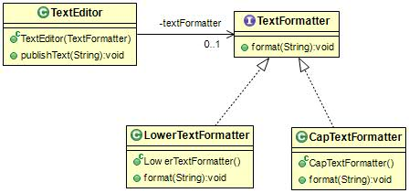
Homework

