Slide 1
HitchHike the Missing Link to IoT
Tanzeela Khan

Slide 2
Outline
Internet of Things
Background
HitchHike
Implementation
Energy Efficiency
Future Development

Slide 3

Internet of Things
Internet of Things (IoT): Devices connecting to each other through the internet.
Missing link: Control all sorts of devices devices wirelessly via the internet
Previously, no two-way radio capable

Slide 4
Background: 802.11b Transmissions
LAN: group of computers that share wireless link to a server
Commodity 802.11b: First wireless LAN adopted by many computers
WiFi hotspots: WiFi available while travelling
When node wants to make transmission, listens for clear channel

Slide 5
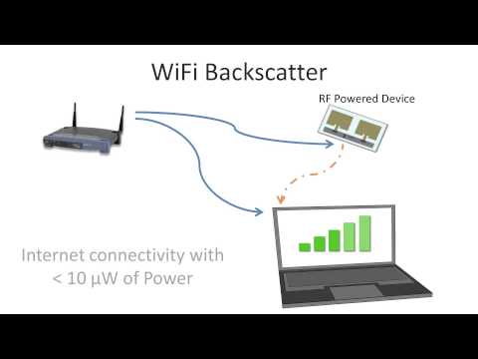
Background: BackScatter Radio
Reflector, bouncing WiFi signals back into atmosphere
Uses RF signals to transmit data without battery/power
Traditional systems require hardware specialization to utilize signals
WiFi Backscatter reduces need

Slide 6
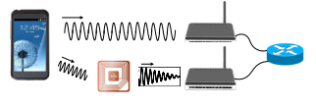
HitchHike Device
Tiny low-energy wireless radio that acts as a self-sufficient WiFi system that enables data transmission
Piggybacks onto incoming radio waves
Reflects existing 802.11b transmissions from surrounding WiFI. Receiver decodes the backscattered signals as a standard data.
Usable as-is with existing wifi
Example of HitchHike in action

Slide 7
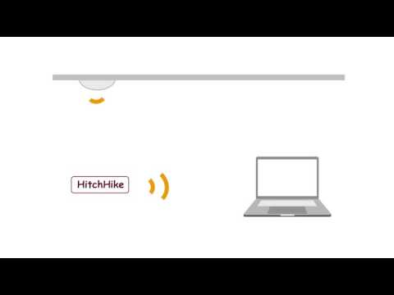
HitchHike

Slide 8
Implementation: CodeWord Translation
WiFi signal is an endless stream of 1s and 0s.
Backscatter Tag - Codeword Translation:
Translating transmitted 802.11b codeword to another 802.11b codeword. Any 802.111b receiver can decode backscattered data.
Tag data 0 = 802.11b data Tag data 1 = 802.11b data × e jπ
Example of codeword translation: 2 codewords
Backscatter bit zero: no translation and reflects original codeword.
Backscatter bit one: translates received codeword by shifting the codeword by 180 degrees

Slide 9

Implementation: XOR Decoder
decoded packet = original data ⊕ backscatter bits
Recovering bits: invert XOR with original data
Example: smartphone can transmit a known packet and any WiFi radio receiving the backscattered packet can XOR with the known 802.11b packet , recovering the backscatter data.

Slide 10
Implementation: Frequency Shifter
Frequency Shifter:
Interference of new data stream or self-interference? Shifts new signal onto another wifi channel
Receiver receives backscattered signal and backscattered transmitter. They share the same frequency band.
Backscattered packet is shifted and transmitted onto a non-overlapping WiFi channel using single band frequency shifting

Slide 11
Energy Efficiency
Self-sufficient: Piggybacks off of existing radio waves, uses almost no power.
Harvests energy of surrounding WiFi’s EMF waves
Consumes 10,000x less power than that the fastest WiFi modem
Transmits 300 kilobits/second

Slide 12
Future Development
Present Work: Hardware Shema
Paper presented on November 16th.
Frequency Problem: Non-overlapping WiFi channel does not imply that no self-interference will be seen, the WiFi transmission emits energy in adjacent channels too, or signal leaking
Premises for IoT: planting multiple HitchHiking devices across the globe.
Eventually: smart cities
3-5 years incorporation

Slide 13
Conclusion
HitchHike: Two-way radio to control all devices through the Internet
IoT: HitchHike is the missing link
Idea: Codebit Translation
Energy efficient
Clever hardware

Slide 14
References
Myers, A. (2016). Miniature WiFi device developed supplies missing link for the Internet of Things | Stanford News. Retrieved from http://news.stanford.edu/2016/11/16/miniature-wifi-device-developed-supplies-missing-link-internet-things/
Zhang, P., Bharadia, D., Joshi, K., & Katti, S. (2016, November 14). HitchHike: Practical Backscatter Using Commodity WiFi [Abstract]. ACM, 0-13. Retrieved from http://web.stanford.edu/~pyzhang/papers/sensys16_back_comm.pdf
Sharma, K. (2016). Tiny WiFi Device Developed By Stanford Engineers Supplies Missing Link For the Internet of Things. Retrieved from http://www.indianweb2.com/2016/11/23/tiny-wifi-device-developed-stanford-engineers-supplies-missing-link-internet-things/
Poole, I. (n.d.). IEEE 802.11b. Retrieved from http://www.radio-electronics.com/info/wireless/wi-fi/ieee-802-11b.php
Zhang, P. (2016, November 14). HitchHike: Practical Backscatter using Commodity WiFi. Retrieved from https://www.youtube.com/watch?v=r6Lh5ftg3C8&feature=youtu.be

