Slide 1

Scent Generator Project: Digitalizing Perfume Recommendations
Welcome to the Scent Generator Project. This presentation outlines a novel approach to perfume selection, moving from traditional, often vague methods to a precise, digital recommendation system.
Contribution & Roles:
Rida Tanzeel: User Entry window and other
Sidra Almas: GUI
Ahmad Khokhar: Database

Slide 2

PROJECT INTRODUCTION
The Scent Generator: A Digital Perfume Recommender
The Scent Generator is an innovative digital perfume recommendation system designed to revolutionize how users discover their ideal fragrance.
It replaces the traditional, often subjective process of manual questioning with a structured, questionnaire-based approach.
By meticulously understanding user preferences, the system generates personalized scent suggestions, ensuring a more accurate and satisfying experience.

Slide 3
UNDERSTANDING THE CHALLENGE
Addressing the Flaws in Traditional Perfume Selection
Manual Questioning
Time-Consuming Process
Reliance on subjective, open-ended questions that lead to inconsistent results.
Users often spend significant time sampling and describing preferences, leading to frustration.
Inaccurate Recommendations
Lack of Personalization
Without structured data, suggestions can miss the mark, resulting in user dissatisfaction.
General advice rather than tailored recommendations based on individual nuances.
There is a clear need for a smart, structured, and digital solution to simplify and enhance the perfume selection journey.

Slide 4





OUR SOLUTION
The Scent Generator System: A Smart Digital Approach
Collects Preferences
Utilizes an intuitive questionnaire to gather detailed user input on scent preferences.
Analyzes Attributes
Evaluates mood, occasion, desired scent type, and intensity for a comprehensive profile.
Generates Formula
Develops a personalized perfume formula tailored to the user's unique profile.
Suggests Digitally
Provides precise perfume recommendations through a user-friendly digital interface.
This solution significantly enhances accuracy, improves user experience, and streamlines decision-making in perfume selection.

Slide 5

PROJECT GOALS
Key Objectives for the Scent Generator Project
Digitize Selection
Transform traditional perfume preference gathering into a streamlined digital process.
Personalized Recommendations
Deliver highly accurate and tailored scent suggestions to each user.
Reduce Manual Effort
Minimize human intervention and eliminate confusion in the selection process.
Apply SE Principles
Implement robust software engineering methodologies throughout development.
Demonstrate MVC
Showcase an effective MVC-based system design for modularity and scalability.

Slide 6

SYSTEM ARCHITECTURE
System Overview: From Input to Personalized Scent
Input
Processing
Output
The Scent Generator meticulously processes user responses to deliver a precise and personalized perfume recommendation, detailing its core components.

Slide 7
METHODOLOGY
The Questionnaire-Based Approach
Our system employs a sophisticated questionnaire to capture nuanced user preferences, ensuring highly relevant and accurate scent suggestions.
User Mood
Usage Occasion
Determining current emotional state to match with suitable aromatic profiles.
Identifying the context (e.g., daily, evening, special event) for optimal scent pairing.
Preferred Scent Family
Perfume Strength
Pinpointing desired fragrance categories (e.g., floral, woody, oriental, fresh).
Gauging desired intensity and longevity of the fragrance.
Each response is strategically mapped to predefined perfume notes, guaranteeing consistent, logical, and highly personalized results.

Slide 8
CORE CAPABILITIES
Functional Requirements of the Scent Generator
User Questionnaire
Allow users to easily complete a comprehensive questionnaire about their scent preferences.
Process Preferences
Efficiently analyze user input to identify key characteristics for scent generation.
Generate Scent Formulas
Create unique and personalized perfume formulas based on processed preferences.
Display Suggestions
Present clear and concise perfume recommendations to the user.
Store Preferences
Securely save user preferences and past results for future reference and improvement.
Update Choices
Provide functionality for users to modify their saved preferences at any time.

Slide 9

QUALITY ASSURANCE
Non-Functional Requirements for a Superior User Experience
Usability: The system must be intuitive and easy for all users to navigate and understand.
Performance: Rapid generation of results to ensure a seamless and responsive user experience.
Scalability: Capable of efficiently handling a growing number of concurrent users without degradation.
Reliability & Accuracy: Consistently provide precise and dependable scent recommendations.
Security: Robust protection for all user data and personal preferences.
Maintainability & Extensibility: Designed for easy updates, maintenance, and future feature expansion.
These requirements ensure the Scent Generator is not only functional but also delivers a high-quality, dependable, and satisfying experience.

Slide 10
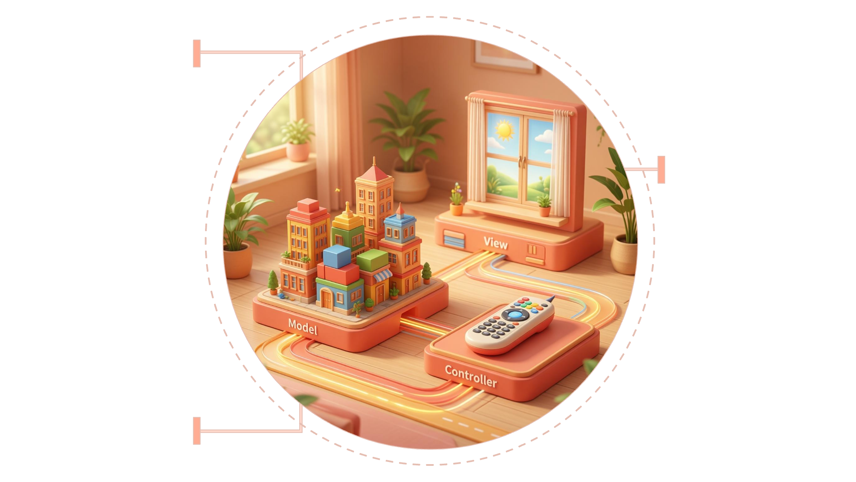
UNDERLYING STRUCTURE
Architectural Model: Leveraging MVC for Robustness
Model
Manages data and business logic
View
Renders the user interface
Controller
Handles input and coordinates components
The Scent Generator project adopts the Model-View-Controller (MVC) architectural pattern, a proven approach for developing flexible and scalable applications.
Model: Manages all data, business logic, rules, and application state.
View: Responsible for displaying data from the Model to the user through the interface.
Controller: Acts as an intermediary, receiving user input from the View and instructing the Model to update its state or the View to update its display.
This separation of concerns significantly enhances modularity, simplifies maintenance, and boosts the overall scalability of the system, making it adaptable for future enhancements.

