Slide 1
Batch 42- MiTH
Tanzeem Nayaz Ahmed

Slide 2
Problem Statement
Predict whether an employee will bill overtime or not which will further be used to optimize resource allocation.
Yes - Employee will bill overtime
No - Employee will not bill overtime
Approaches taken
Logistic regression
Random Forest
XG Boost
Decision Trees

Slide 3
Data Exploration and Visualization
40302 observations of 34 predictor variables, 1 target variable and 1 ID
Target Variable
Yes – Employee will work Extra Time
No – Employee will not work Extra Time
No. of Numeric Attributes - 23
No. of Categorical Attributes - 10
No NA values observed
Variables with no variation in data
- datacollected (Stored as a variable)
- StandardHours
- Over18
- EmployeeCount

Slide 4
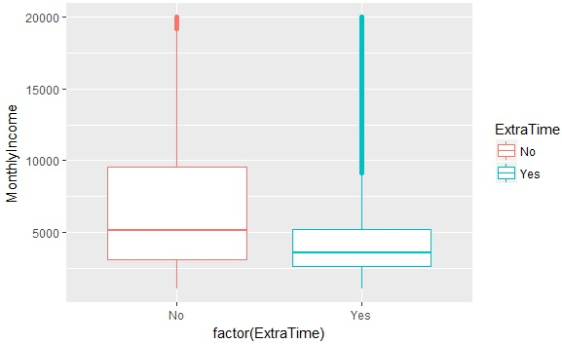
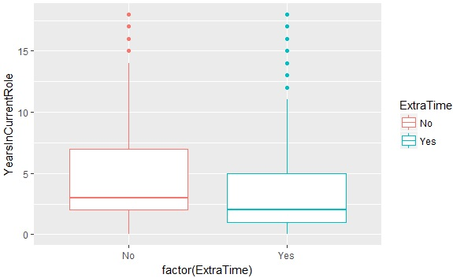
Outliers
Outliers are actually important
People working overtime make more money than average
People with lesser number of years in current role tend to Work overtime.

Slide 5
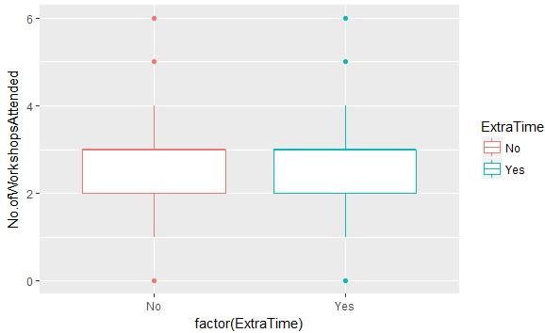
More Visualization and Inferences
No of Workshops attended does not have much impact.

Slide 6
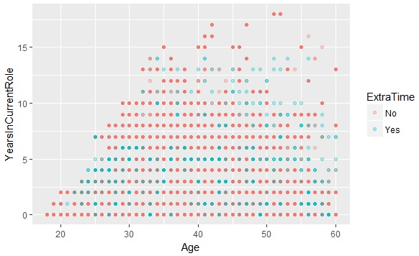
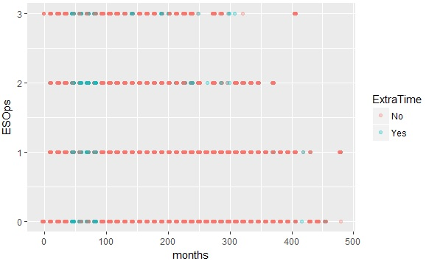
Scatter Plots
Employees with Esops and who are relatively fresh, tend to Work Overtime( Indicating the fire to excel maybe?)
Engineered row based on this fact.

Slide 7
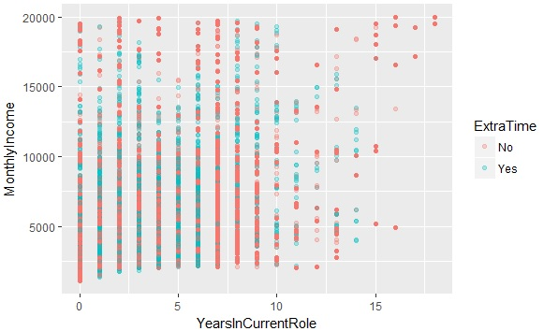
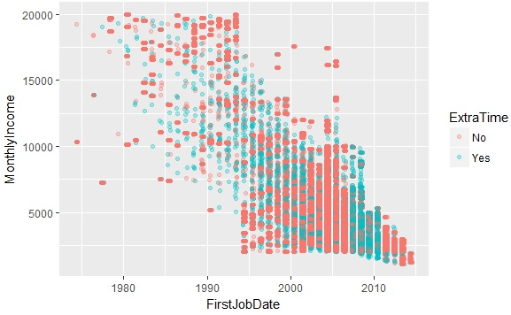
Scatter Plots
Employees less than 5 years in Current Role and having lower income tend to Work Extra Time
Employees with an overall experience between 5-10 year and income less than 10000 tend to Work Extra Time
Due to increased mid age expenses, employees could be putting in extra hours.

Slide 8
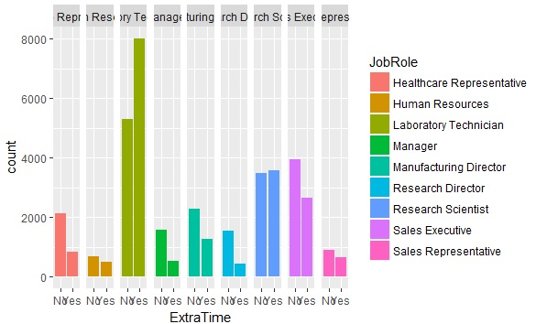
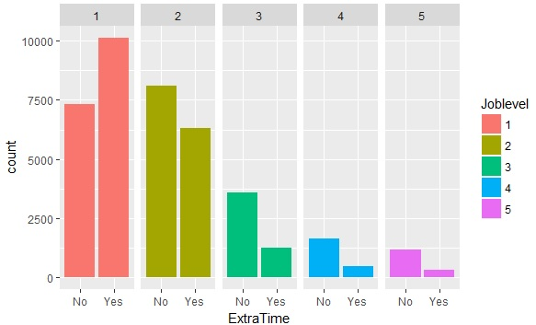
Scatter Plots
Employees at the Directorial Level tend to work lesser Extra Time
Laboratory Technician works relatively more Extra Time
Same can be corroborated from Job Level. Higher the Level, lesser Extra Time

Slide 9
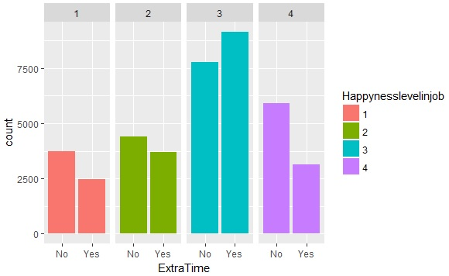
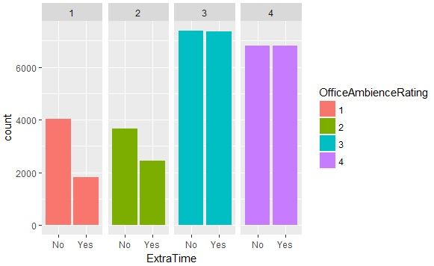
Scatter Plots
Employees who are happy with their job tend to work overtime. But the happiest people are those who are not working overtime.
Lower OfficeAmbienceRating inspires the employees a lot lesser to work OverTime.

Slide 10
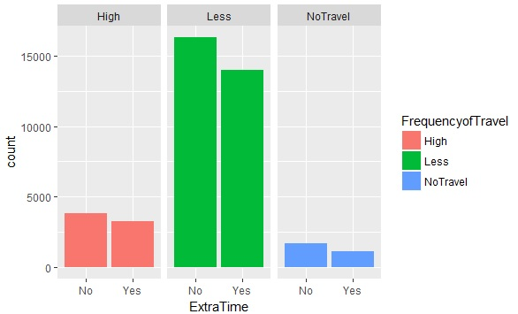
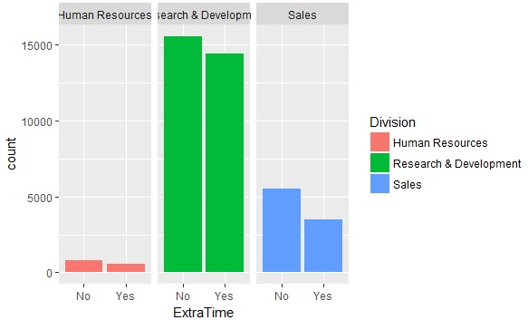
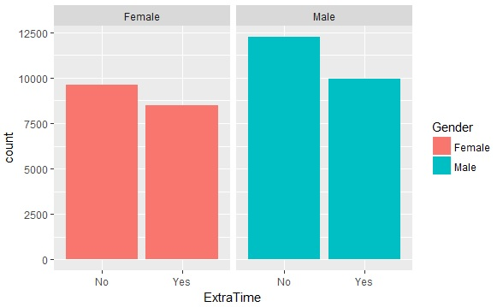

Slide 11
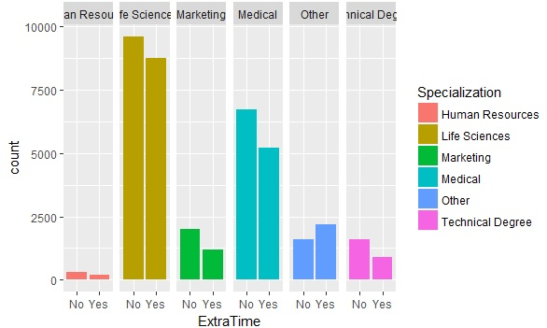
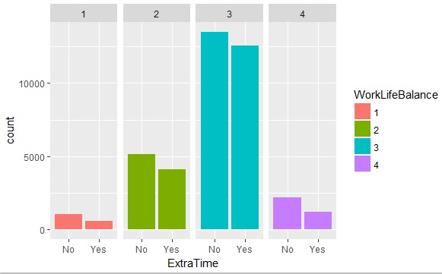
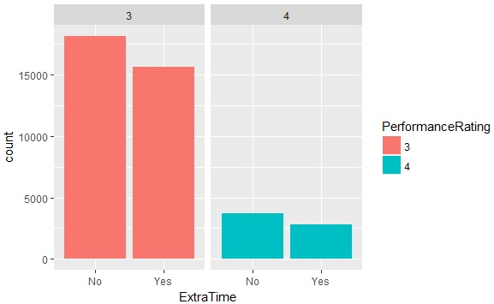

Slide 12
Data Pre-Processing
Removed the variables with no variation
Converted the below Numeric variables to Factor
- Joblevel, OfficeAmbienceRating,
SelfMotivationRating, RelationshipSatisfaction,
WorkLifeBalance, Happynesslevelinjob,
PerformanceRating
Converted the below variables to Date
- FirstJobDate, DateOfjoiningintheCurrentCompany

Slide 13
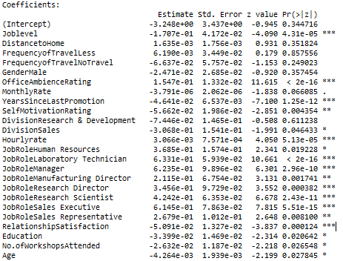
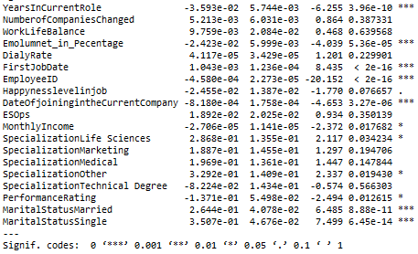
Collinear Attributes(Numeric and Categorical) -
- Built a Logistic Model and then run a VIF to check the
correlation
- Also saw some insignificant variables

Slide 14
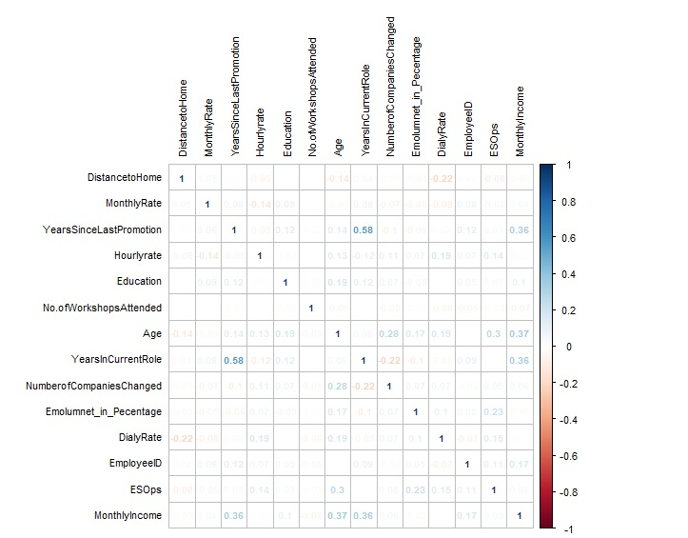
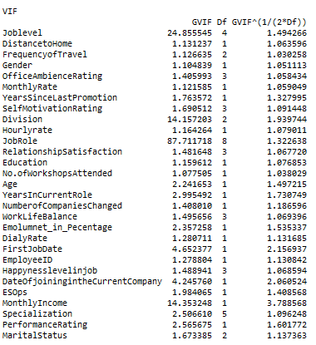

Slide 15

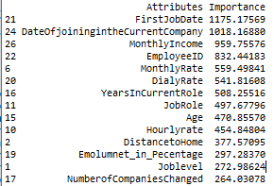
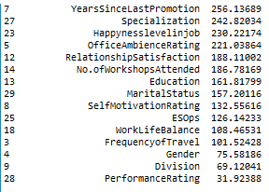
Yearssincelastpromotion and YearsinCurrentRole are slightly correlated - 0.58
Run a Chi square Test between Job Role, Division and Job Level.
Division and Job Role seem Correlated with a high X2 value
Check Importance on Random Forest and remove the correlated variables.

Slide 16
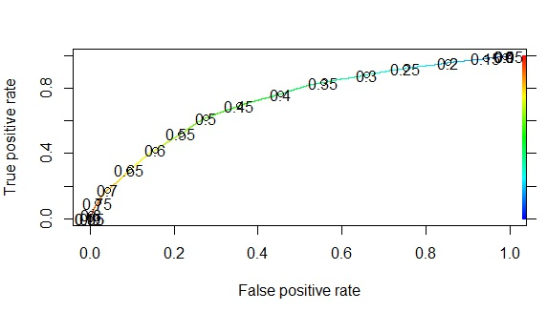
Model Building
Logistic Model ( Model 1)
Split the data into train(70) and validation(30)
Built a base model using Logistic Regression after all the Pre-Processing
AUC - 0.7195307

Slide 17
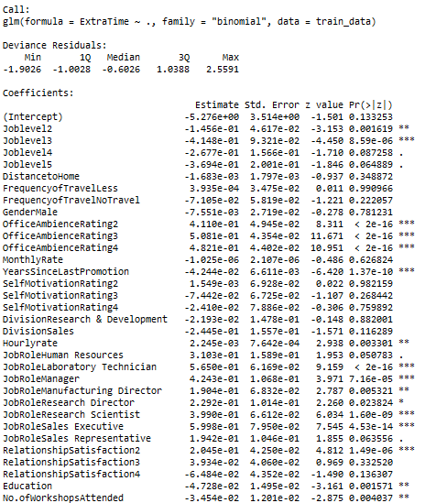
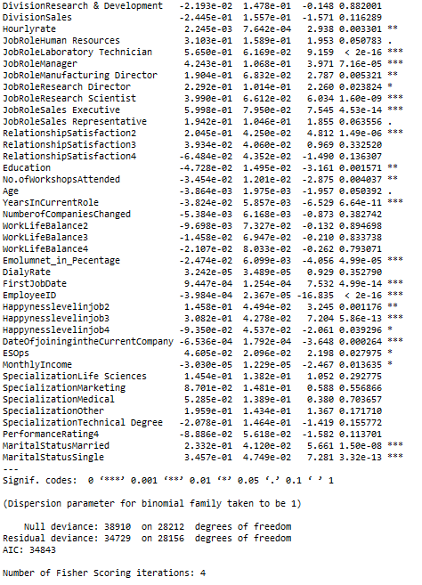

Slide 18
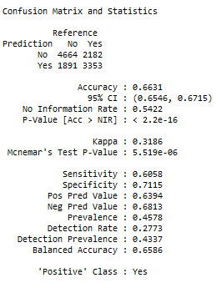
Accuracy – 66.31% and Sensitivity – 60.58%
are relatively low

Slide 19
Feature Engineering
Derived a new column indicating the total number of Months worked - months
Derived a column new_attr ,assigning “1” if Monthly Income less than 10000 and No. of months between 98 and 132 or 0 and 48, else “0”
Derived a new column new_attr2, assigning a status “1” if Gender is Female and Marital Status is Married or “0”
Derived a column new_attr3 and assign “1” if Job role is Health Representative, Manufacturing Director, Research Director and if income is greater than 10000, else “0”
Derived a column new_attr5 and assign “1” if E-Sops is allocated and months is greater than 40 and less than 90,else “0”

Slide 20
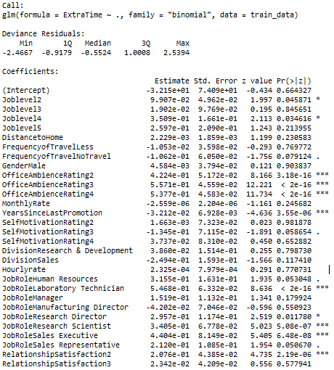
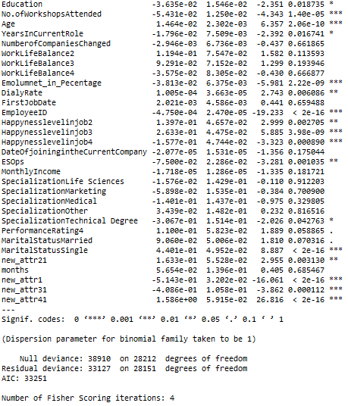
Built the Logistic Model again with new variables and checked Variable Importance and Error Metrics

Slide 21
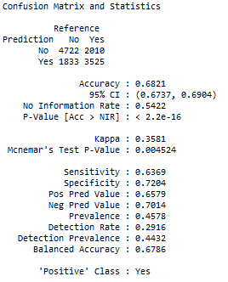
All the new columns were very significant.
AUC - 0.7389634 (Improved slightly)
Accuracy – 68.21% and
the Sensitivity – 63.69%
improved slightly

Slide 22
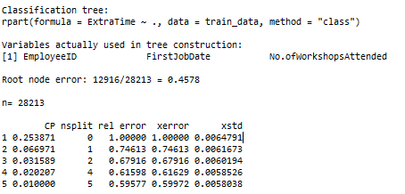
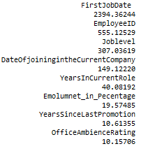
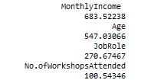
Decision Tree – (Model 2)
Used the train data split earlier to build a CART
Decision Tree.

Slide 23
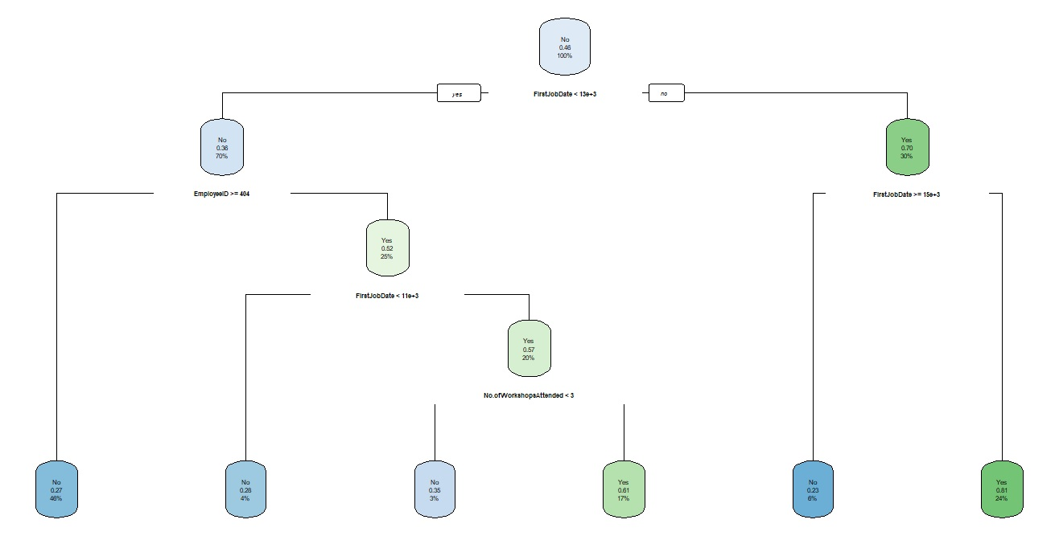

Slide 24
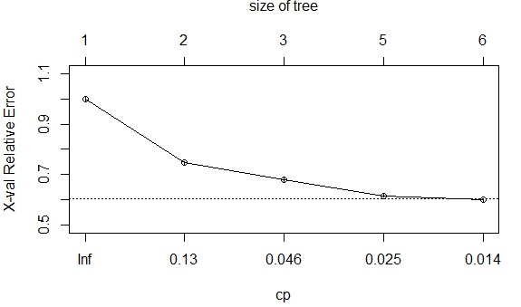
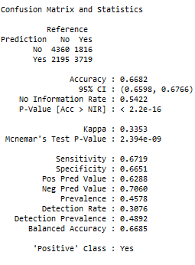
Accuracy - 66.82% and Recall – 67.19% slightly
dropped.

Slide 25
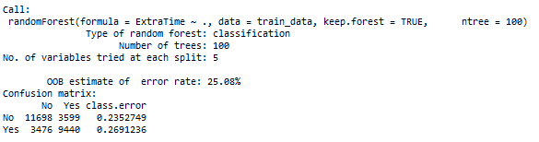
Random Forest – (Model 3)
Used the train data split earlier and with new features to build a Random Forest Model.
Since about 30 predictors were used, sqrt(30)~5 Variables were used at each node for the split.

Slide 26
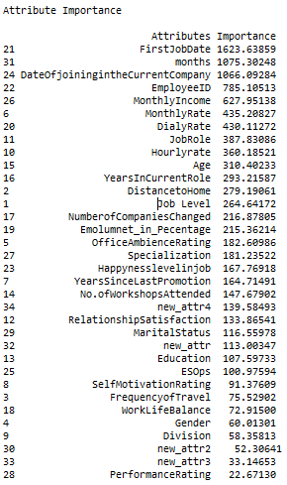
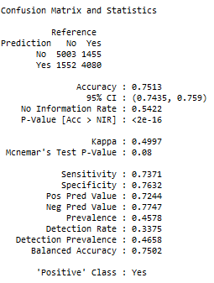
Accuracy-75.13 and Recall-73.71
improved considerably compared
to other models.

Slide 27
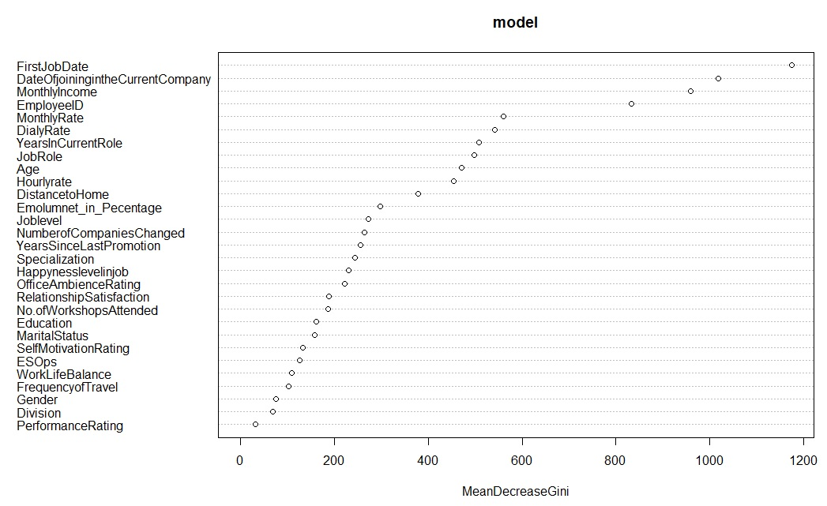

Slide 28

Random Forest – Hyper-parameter Tuned
Tuned the Random Forest for the best value of mtry.
Tried different values of ntreeTry, stepFactor and improve.
Built the model using the best value of mtry chosen based on the maximum decrease in OOB Error.
The best value of mtry was chosen as 4 as opposed to 5 previously

Slide 29
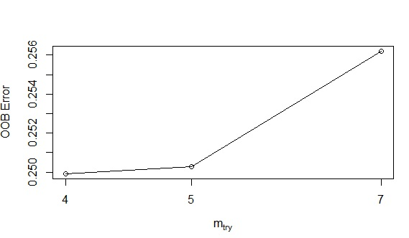
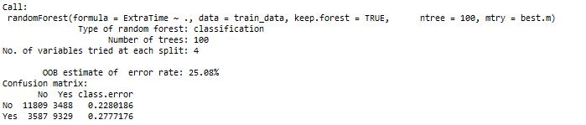
Summary of the Tree

Slide 30
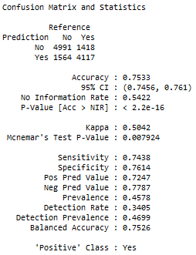
Accuracy-75.33% and Recall-74.38%
improved further to a slight extent

Slide 31
XGBoost with hyperparameter tuning - (Model 4)
Used the train data split earlier and create an Xgb Dmatrix object.
Created a parameter list of objective,eta,early_stopping_rounds,max_depth,colsample_by_tree,subsample,eval_metric
Built an XGBoost model and tried different values of nrounds along with the parameter list

Slide 32
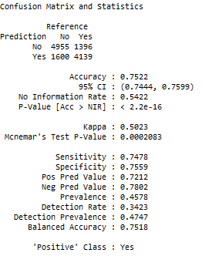
The Accuracy – 75.22% and Recall – 74.78% were comparable to Random Forest results at a cut-off rate of 0.5 but threw an error on Grader.

Slide 33
Different Models with corresponding Error Metrics
 | Validation Data |  | Test Data(Best) Grader
 | Accuracy | Recall | Accuracy | Recall
Logistic-Preprocessed data | 66.31 | 60.58
Logistic-New Rows | 68.21 | 63.69
Decision Trees(CART) | 66.82 | 67.19
Random Forest | 75.13 | 73.71
Random Forest-Tuned | 75.33 | 74.38 | 74.98 | 74.45
XGBoost -Tuned | 75.22 | 74.78

Slide 34
Summary
The Grader submission with the highest accuracy was given by the Tuned Random Forest Model with Feature Engineered Columns. The Final Results are as below :
Accuracy : 74.98% - Recall : 74.45%
The above model can predict whether a person will Extra Time or not with an Accuracy of 74.98% and a Recall of 74.45%

