Slide 1
Batch 42
Tanzeem Nayaz Ahmed

Slide 2
Problem Statement
Classification of target variable into low income (0) a nd high income (1)
Approaches taken
Logistic regression
Naïve Bayes
Knn (not built completely due to difference in levels between train and test data)

Slide 3
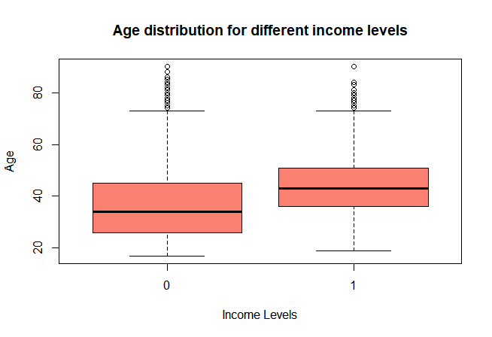
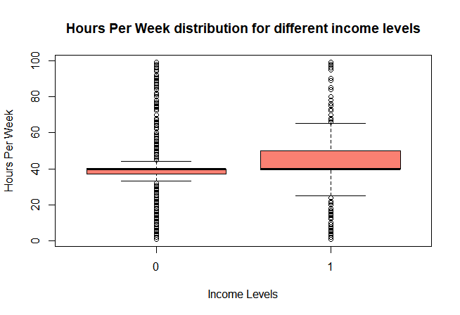
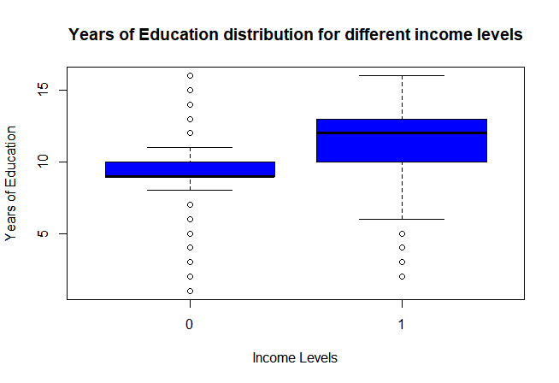
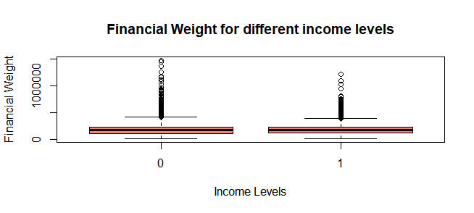
Data Exploration

Slide 4
Preprocessing
Binning
tax_paid
low_tax_paid – tax_paid<6200
high_tax_paid – tax_paid>6200
no_tax_paid
Conversion of variables to appropriate types
Handling missing values
Numerical attributes
tax_paid – 29206
age, financial_weight, gain, loss, working_hours – 2
Knn Imputation using weighted averages
Categorical attributes
working_sector – 1775
occupation – 1782
country – 568
qualification -2
Knn Imputation using median

Slide 5
Logistic Regression
Steps Taken
Split the data into train(70) and validation(30)
Build the model using glm()
Run stepAIC
loan_taken and tax_paid when included seem to give a higher AIC value
Run VIF on both the models
marital_status and relationship seem to strongly correlated
Based on the lowest AIC and VIF observation pick the best model
New model was built eliminating loan_taken, tax_paid and relationship
Predict using the model on validation data
Check ROC and AUC curves
Iterate based on the performance on the validation data at different cutoffs
At the cutoff which gives the highest accuracy predict on the test data

Slide 6
Naïve Bayes
Steps Taken
Split the data into train(70) and validation(30)
Build the model using naivebayes() from e1071 package
Predict on the test data using the model
Build the confusion matrix to check the metrics
Accuracy, sensitivity, specificity

Slide 7
Logistic Regression
Accuracy observed
on validation 83%
On test 84.53%
AUC – 91%
Naïve Bayes
Accuracy observed
on validation 81%
On test 83.48%

Slide 8
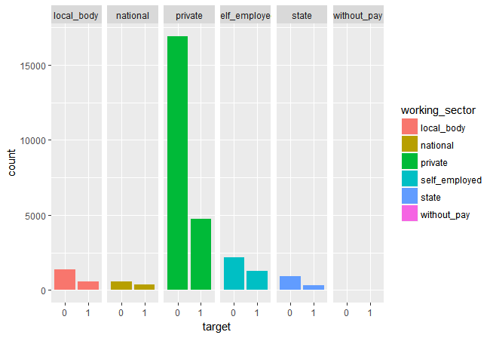
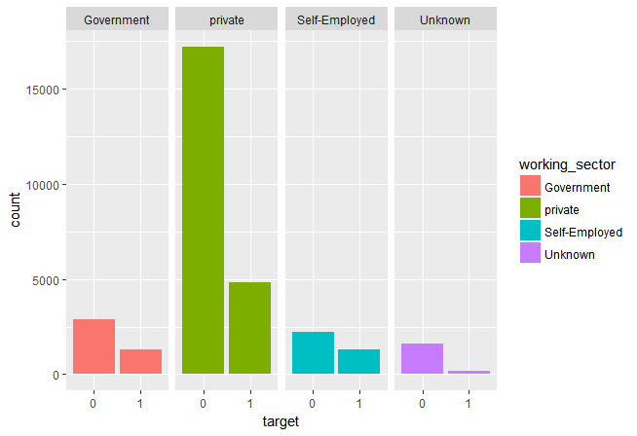
What could have been done

Slide 9
