Slide 1
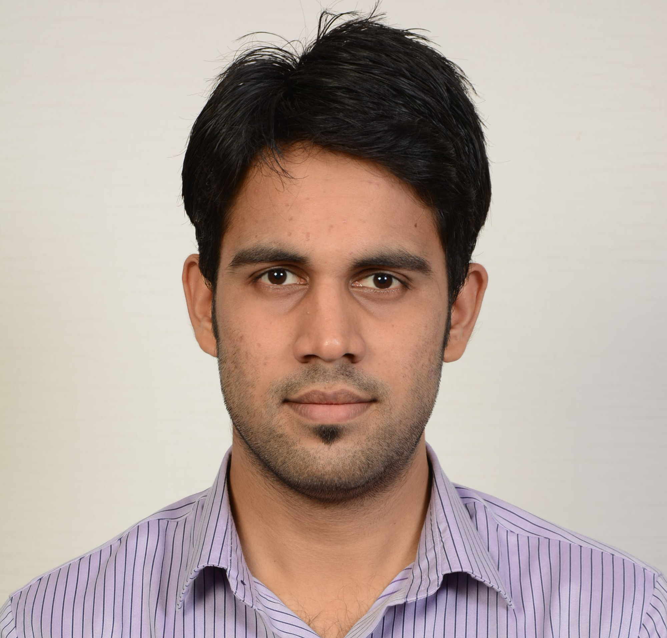



Mazin Arbhaz
Master of Business Information Systems
Skills: Business Analysis, Technical Support, Systems Analysis and Design, Data Warehouse, SQL, SAP ERP, ASP .NET
Abhinesh Kalambakkam Muthukrishnan
Master of Data Science
Skills: Data Analysis,Data Mining, Data Cleaning, Data Architecture Design, Warehouse, SQL, Python , R, Unix
Xilun Mai
Master of Business Information Systems
Skills: Project management, UI design, Business process design and management, Financial analysis.
Zexin Tang
Master of Information Technology
Skills: SQL, MySQL database, python, HTML, CSS, JavaScript, XML, etc.

Slide 2

Team
Raptors

Slide 3

Raptors
One team, One heart , One legacy

