Slide 1
TeamNine
CSC301 Winter
Tom Choi, Ryan Kam, Sangdong Kim,
Sirim Shin, Zhanwen Tan Francis,
Vignesh Ravi, Shivain Thapar

Slide 2






Search Engines Are Awesome

Slide 3
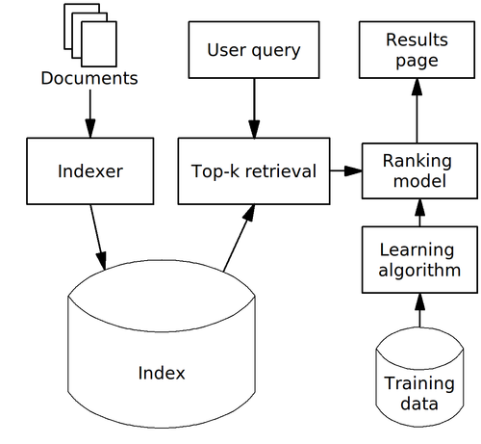

Google vs Bing

Slide 4
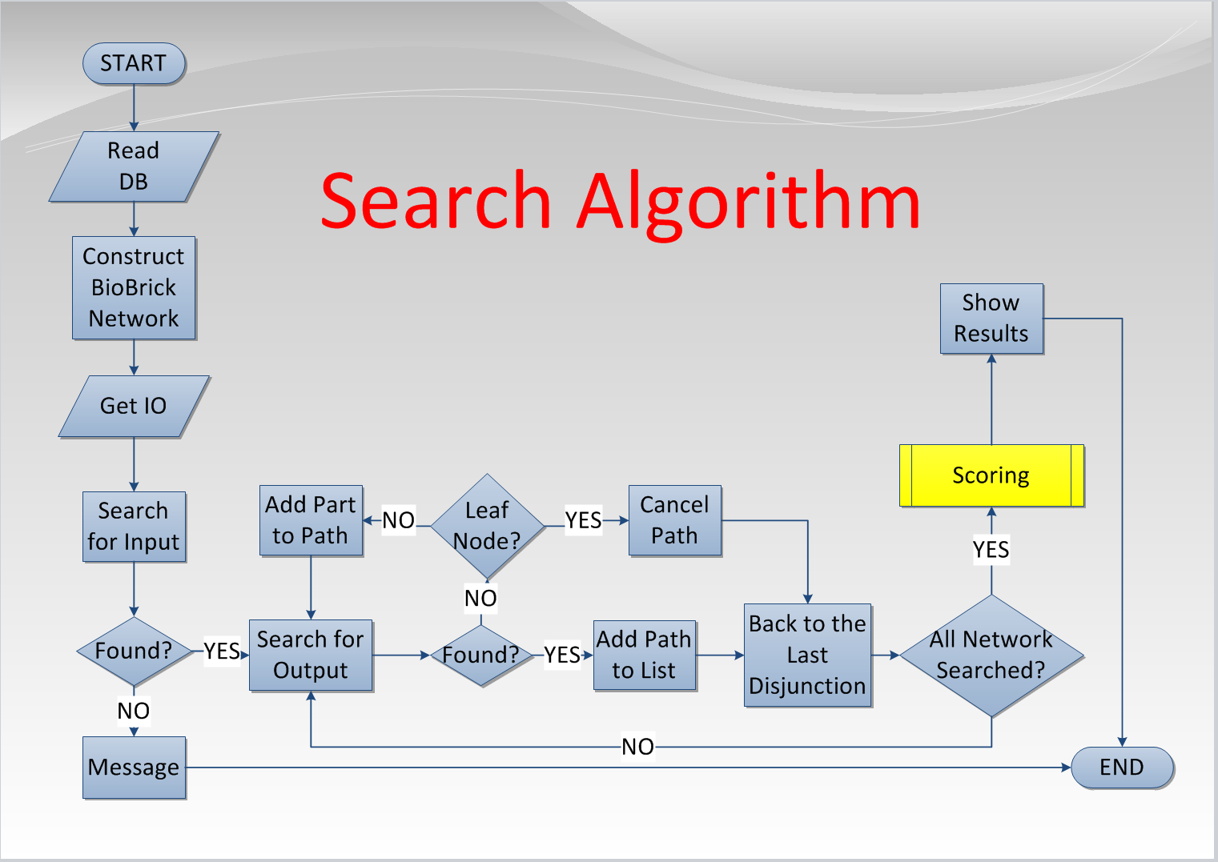
Basic Search Algorithms

Slide 5
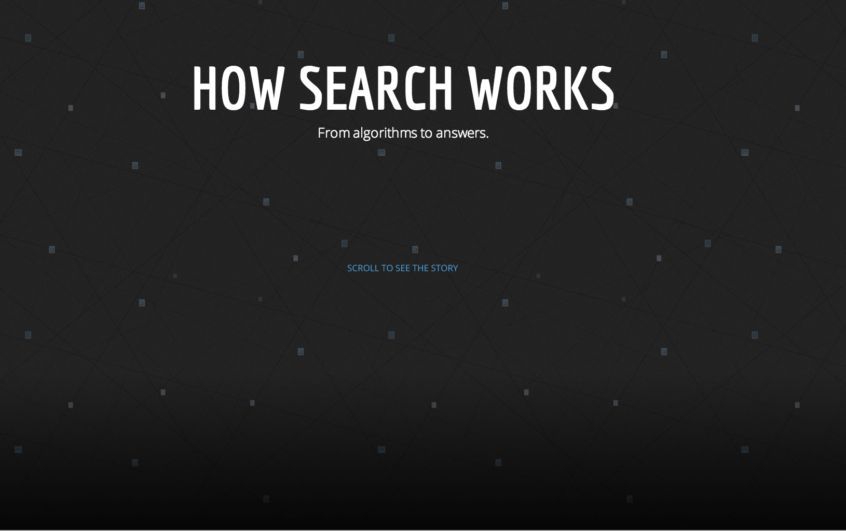
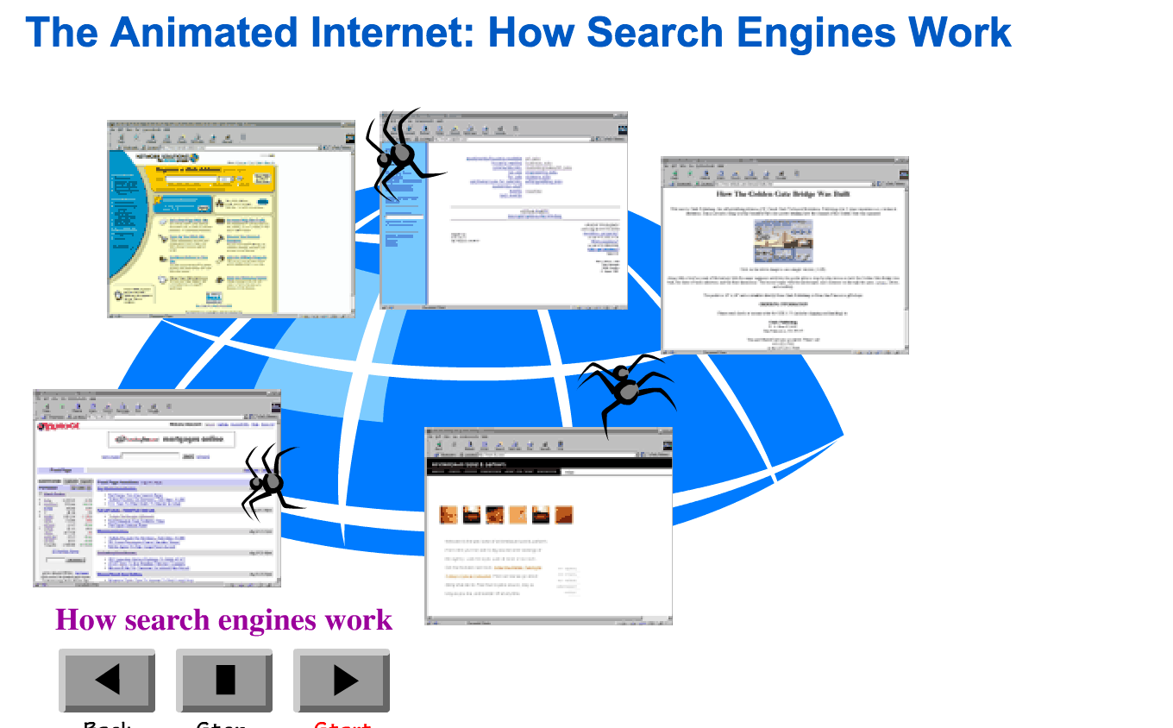
What We Found
https://www.google.com/insidesearch/howsearchworks/thestory/
http://www.learnthenet.com/anima.../how-search-engines-work/

Slide 6
Technologies
Open source web crawlers
scrapy, etc.
Open source search engines
http://www.opensearchserver.com/ (open search server)
http://www.elasticsearch.org/ (elasticsearch)
https://github.com/gigablast/open-source-search-engine
Our own simple engine
Django with interactive/GUI jQuery libraries & html functions

Slide 7


Web Application For…
Students
general audience who wants to visually see & learn how search engines work under the hood.

Slide 8
Work flow
User inputs keywords/ sentences
Step by step display inner processes (depth = level of difficulty)
Paths
different factors that affect the results
optimizations
Aiming to bridge the database and the algorithm concepts
FYI: Its not an actual Search Engine, just an imitation

Slide 9
Thank you!

