Slide 1
Creating web applications using PHP
Introduction to PHP and PHP MVC Frameworks
Telerik Software Academy
http://academy.telerik.com

Slide 2
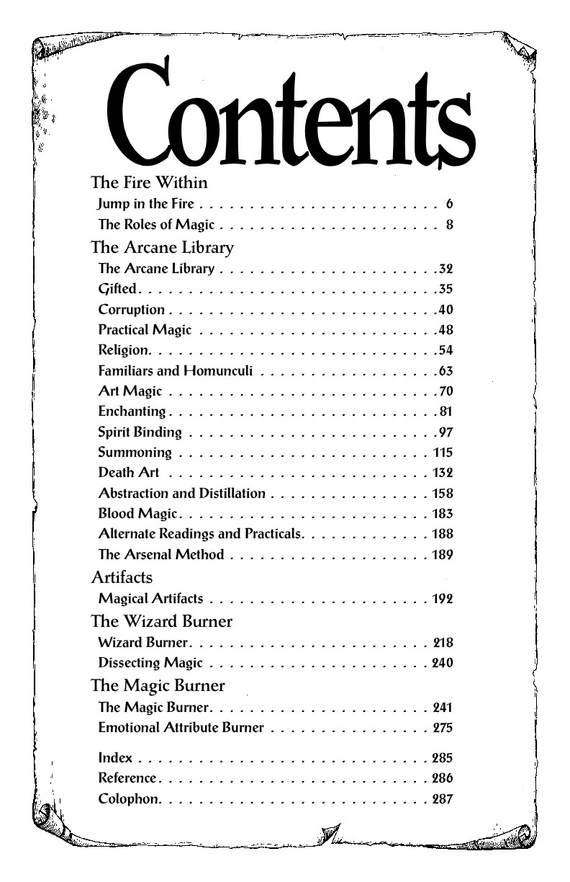
Table of Contents
Introduction t0 PHP
PHP Language Overview
PHP OOP Overview
Writing a native PHP application
Using CodeIgniter MVC
Using Laravel MVC

Slide 3

Introduction to PHP
source:php.net

Slide 4
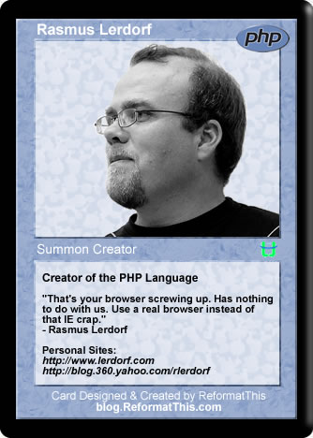

PHP Origins
Created in 1994 by Rasmus Lerdorf
Originally used for tracking visits to his online resume.
Back then PHP meant Personal Home Page.
In June of 1995, Rasmus released an improved version of the PHP Tools to the public

Slide 5

PHP Origins(2)
In April of 1996, PHP/FI (Forms Interpreter) was introduced as version 2.0
It included built-in support for
DBM, mSQL, and Postgres95 databases
cookies
user-defined function support
and much more

Slide 6
PHP Origins(3)
PHP 2.0 went through dramatic changes
By November, 1997, the underlying parsing engine was already entirely rewritten
In 1997 and 1998, PHP/FI had a cult of several thousand users around the world.
A Netcraft survey as of May, 1998, indicated that nearly 60,000 domains reported having headers containing "PHP“ (1% of all domains then)

Slide 7

PHP Origins(4)
Despite these impressive figures, the maturation of PHP/FI was doomed because of its limitations

Slide 8
PHP/FI Code Syntax
Example of PHP/FI Code
<!--include /text/header.html-->
<!--getenv HTTP_USER_AGENT-->
<!--ifsubstr $exec_result Mozilla-->
Hey, you are using Netscape!<p>
<!--endif-->
<!--sql database select * from table where user='$username'-->
<!--ifless $numentries 1-->
Sorry, that record does not exist<p>
<!--endif exit-->
Welcome <!--$user-->!<p>
You have <!--$index:0--> credits left in your account.<p>
<!--include /text/footer.html-->

Slide 9
PHP 3
PHP 3.0 -The first version that closely resembles PHP as it exists today
Andi Gutmans and Zeev Suraski along with Rasmus, began yet another complete rewrite of the underlying parser in 1997.
PHP now evolved as a language
The meaning of PHP changed as a recursive acronym - PHP: Hypertext Preprocessor

Slide 10
PHP 3
Innovations in PHP 3
Strong extensibility
The ease of extending the language itself attracted dozens of developers who submitted a variety of modules
Mature interface for multiple databases, protocols, and APIs
Powerful and consistent language syntax and OOP support

Slide 11
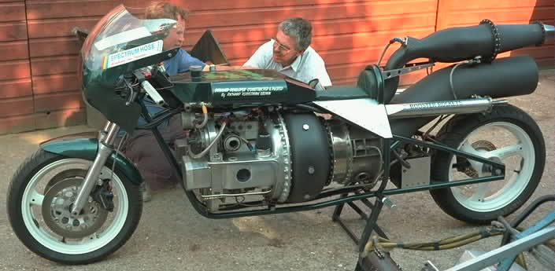
PHP 3
In June, 1998, with many new developers from around the world joining the effort, PHP 3.0 was announced by the new PHP Development Team as the official successor to PHP/FI 2.0.
At its peak, PHP 3.0 was installed on approximately 10% of the web servers on the Internet.

Slide 12
PHP 4
PHP4 was developed with complex applications in mind
The PHP’s Core was again rewriten
The design goals were to improve performance, and improve the modularity of PHP's code base
The new engine, dubbed 'Zend Engine' (comprised of their first names, Zeev and Andi), met these design goals successfully, and was first introduced in mid 1999

Slide 13

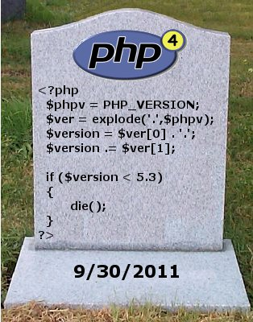
PHP 5
PHP 5 was released in July 2004 after long development and several pre-releases.
driven by the Zend Engine 2.0 with a new object model and dozens of other new features.
It is safe to presume PHP is now installed on tens or even perhaps hundreds of millions of domains around the world.
Current version -5.6.2

Slide 14
Why is PHP used?
Cross Platform
Runs on almost any Web server on several operating system.
Web Servers: Apache, Microsoft IIS, Caudium, Netscape Enterprise Server
One of the strongest features is the wide range of supported database.
Supported Databases: IBM DB2, Informix, Ingres, InterBase, FrontBase, mSQL, Direct MS-SQL, MySQL, ODBC, Oracle (OCI7 and OCI8), Ovrimos, PostgreSQL, SQLite, Solid, Sybase, Velocis,Unix dbm

Slide 15

PHP Language Overview

Slide 16

PHP Language overview
Variables and constants
Data structures and resources
Operators
Statements
Error handling
Linking code files
Core functions

Slide 17
Variables and constants
Declaring variables
$<identifier>=<value>;
Declaring constants
define (<identifier>, <value>[, <case_insensitive>=false] )
<?php
define("GREETING", "Hello.", true);
echo GREETING; // outputs: "Hello."
$age = 20;//int
$ivan="Ivan";//string
$maria='Maria';//also a string
$PI=3.14;//real
$condition=false;//bool
$birthYear = date('Y') - 21;//date()
?>

Slide 18
Variables and constants(2)
Declaring variables can also be done by passing a string variable as the identifier
This feature is very helpful for building objects
Debugging
Can be done using var_dump() function
//cool or not?
$var_name="variable";
$$var_name="value";
$flag=true;
var_dump($flag); // outputs: bool(true)

Slide 19
Data structures
Arrays are mixed
Arrays can contain key-value pairs (Associative arrays)
Key-value pairs are constructed using the => operator
Also, arrays can contain both key-value pairs and simple values at the same time
<key>=><value>
//Arrays
$collections = array (
"fruits" => array("a" => "orange", "b" => "banana", "c" => "apple"),
"numbers" => array(1, 2, 3, 4, 5, 6),
"holes" => array("first", 5 => "second", "third")
);
$collection_length=count($collections[‘numbers’]);//outputs 6

Slide 20
Data structures(2)
Lists
Assign variables to array values
Useful for making array values more readable
Spl data structures
SplDoublyLinkedList, SplStack, SplQueue, SplHeap, SplPriorityQueue, SplFixedArray, SplObjectStorage
$info = array('coffee', 'brown', 'caffeine');
list($drink, $color, $power) = $info;
echo "$drink is $color and $power makes it special.\n";

Slide 21
Resources
A resource is a special variable, holding a reference to an external resource.
Resources are created and used by special functions.
// prints: mysql link
$c = mysql_connect();
echo get_resource_type($c) . "\n";
// prints: stream
$fp = fopen("foo", "w");
echo get_resource_type($fp) . "\n";

Slide 22
Operators
Most of them are like operators in C++ and C#
Exceptions
Strings: “.” (Concatenation)
Logical: “AND”, “OR”, “XOR”
$ivan="Ivan";
$maria='Maria';
$married=$ivan." and ".$maria." are married!";
echo($married);//outputs “Ivan and Maria are married!”
$conditionA=true;
$conditionB=true;
if(($conditionA AND $conditionB) || (!$conditionA OR $conditionB)){…}
else{…}

Slide 23
Operators(2)
PHP Array Operators
The PHP array operators are used to compare arrays
Same as comparison operators, but for arrays
$x = array("a" => "red", "b" => "green");
$y = array("c" => "blue", "d" => "yellow");
$z = $x + $y; // union of $x and $y
var_dump($z);
var_dump($x == $y);
var_dump($x === $y);
var_dump($x != $y);
var_dump($x <> $y);
var_dump($x !== $y);

Slide 24
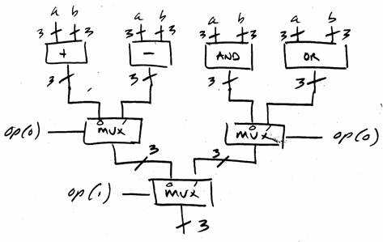
Operators(3)
More info on operators: http://www.w3schools.com/php/php_operators.asp

Slide 25
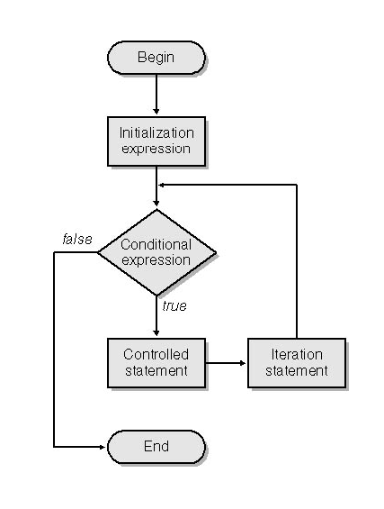
Statements
Like in C++ and C#
If-else statement, switch
for, while, do-while loops
try-catch-finally
Exceptions
foreach
foreach($<collection_ident> as $<key_ident>=>$<value_ident>)
{
//Expressions using $<key> and $<value_ident>...
...
}

Slide 26
Error handling
Simple die() statements
Read more here: http://php.net/manual/en/function.die.php
if(!file_exists("welcome.txt")) {
die("File not found");
} else {
$file=fopen("welcome.txt","r");
}

Slide 27
Error handling(2)
try-catch-finally
Works with \Exception class
try
{
//troll
throw new Exception("Just kidding!");
}
catch(Exception $boom)
{
var_dump($boom);
}
finally
{
echo "That’s all folks! ";
}

Slide 28
Error handling(3)
Error report levels
Assigned with error_reporting() function
error_reporting(E_ALL);
Integer code | Constant | Description
2 | E_WARNING | Non-fatal. Execution of the script is not halted
8 | E_NOTICE | Run-time notices. Potential error.
256 | E_USER_ERROR | Fatal user-generated error. Caused by trigger_error()
512 | E_USER_WARNING | Non-fatal user-generated warning.
1024 | E_USER_NOTICE | User-generated notice.
4096 | E_RECOVERABLE_ERROR | Catchable fatal error. Used with set_error_handler()
8191 | E_ALL | All errors and warnings (PHP 5.4)

Slide 29
Linking code files
The include() function
when you want to include a file within the current process
The include_once() function
exactly the same as the include function except it will limit the file to be used once.
include(<filename>);
include_once(<filename>);

Slide 30
Linking code files(2)
The require() function
used exactly the same as the include() function
The require_once() function
like the include_once() function
It will make sure that the file exists before adding it to the page if it's not there it will throw a fatal error.
require_once(<filename>);

Slide 31


Core functions
PHP has many inbuild functions
this makes the development process easy and fast, but it could be harmful
Read about core functions from here: http://php.net/manual/en/functions.internal.php

Slide 32

DEMO

Slide 33

PHP OOP

Slide 34
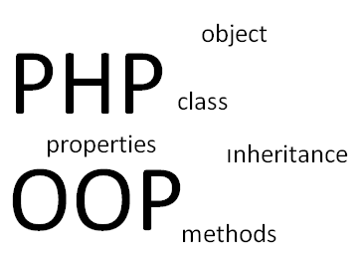
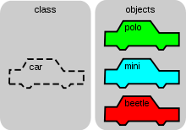
PHP OOP
Creating a “simple” class
Extending classes
Creating objects
Utility classes
Interfaces
Enumeration like abstract classes
Using singleton
Namespaces
Naming conventions

Slide 35
Creating a “simple” class
Example class
class SimpleClass
{
//constructor
public function __construct($field_init_value)
{
$this->field=$field_init_value;
}
// property declaration
private $field = 'a default value';
// method declaration
public function displayField()
{
echo $this->field;
}
}

Slide 36
Extending classes
Using the extend keyword
We can call parent constructor, if needed
class ExtendClass extends SimpleClass
{
...
}
class ExtendClass extends SimpleClass
{
public function __construct($field_init_value)
{
parent::__construct($field_init_value);
//do more stuff here...
}
}

Slide 37
Creating objects
Example code
//instance
$instance = new SimpleClass(10);
$assigned = $instance;
$reference =& $instance;
//some experimentation
$instance->field = '$assigned will have this value';
$instance = null; // $instance and $reference become null
//output results
var_dump($instance);
var_dump($reference);
var_dump($assigned);

Slide 38
Utility classes
Creating static methods
Calling static methods
class Printer
{
public static function printNewLine($line)
{
echo "\n".$line;
}
}
Printer::printNewLine("Hello, Ivan!");
Printer::printNewLine("Hello, Petar!");

Slide 39
Interfaces
Example interface
Implementing interfaces with implements
interface iBattery
{
public function charge($power_input);
public function getCharge();
public function discharge($power_output);
}
abstract class Battery implements iBattery
{
...
}

Slide 40
Enumeration like abstract classes
Example enumeration like class
Usage
abstract class DaysOfWeek
{
const Monday = 1;
const Tuesday = 2;
const Wednesday = 3;
const Thursday = 4;
const Friday = 5;
const Saturday = 6;
const Sunday = 7;
}
$today = DaysOfWeek::Sunday;

Slide 41
Using singleton
Example implementation
class Connection
{
public __construct(){}
public static function create()
{
static $instance = null;
if (null === $instance) {
$instance = new static();
}
return $instance;
}
}

Slide 42
Namespaces
Creating namespaces
Using classes from namespaces
/namespace Classes
{
...
}
use \Exception as Exception;
use Classes\Class as Class;

Slide 43
Naming conventions
Depends on the project
PHP Project | Classes | Methods | Properties | Functions | Variables
CakePHP Framework | PascalCase | camelCase | camelCase | camelCase | camelCase
CodeIgniter Framework | Proper_Case | lower_case | lower_case | lower_case | lower_case
Symfony Framework | PascalCase | camelCase | camelCase | camelCase | camelCase
Zend Framework | PascalCase | camelCase | camelCase | camelCase | camelCase

Slide 44
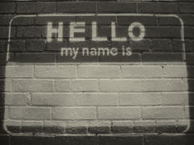
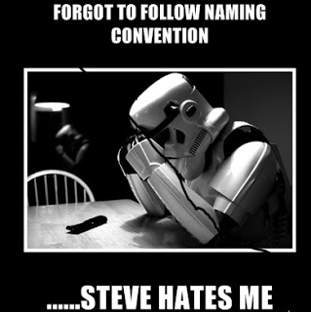
Naming conventions(2)
Go with
ClassName
methodName
propertyName
function_name (meant for global functions)
$variable_name
iInterfaceName

Slide 45
DEMO

Slide 46

Writing a native PHP application

Slide 47


Writing a native PHP application
First PHP script
Fetching data
Generating HTML
Connecting files

Slide 48
First PHP script
Hello world!
Embed php scripts directly in the html code
<!– sample.php -->
<html>
<head>
<META charset=“Utf-8”/>
<title>Hello world!</title>
</head>
<body>
<strong>Hello World!</strong>
<br />
<?php echo “<h2>Hello, World</h2>”; ?>
</body>
</html>

Slide 49
Fetching data
Using core functions for database access
<?php
mysql_connect("localhost","root","");
mysql_select_db("library_db");
$s_term=($_POST[‘search-term’])?$_POST[‘search-term’]:null;
$where=($s_term!=null)?“title LIKE ‘%$s_term%’”:””;
$queryCode="SELECT * books “.$where;
$query=mysql_query($queryCode);
$results=mysql_fetch_assoc($query);
mysql_close();
?>
<form method=“POST”>
<input name=“search-term”/>
<input type=“submit” value=“search”>
</form>
<?php echo var_dump($results);?>

Slide 50
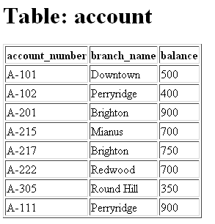
Generating HTML
Generating a table
include “search-form.php”;
<?php if(count($books)>0): ?>
<table>
<thead>
<tr><td>id</td><td>title</td></tr>
</thead>
<tbody>
<?php foreach($books as $book): ?>
<tr>
<td><?php echo $book->id; ?></td>
<td><?php echo $book->title; ?></td>
</tr>
<?php endforeach; ?>
</tbody>
</table>
<?php else: ?>
<strong>No books found!</strong>
<?php endif; ?>

Slide 51
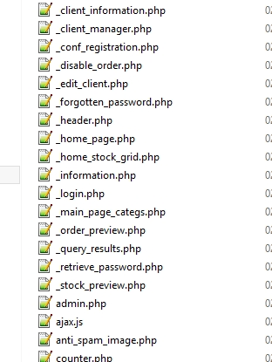
Connecting files
Connecting files
Using the include and require functions
Creating links
<ul>
<li>
<a href=“index.php”>Index</a>
</li>
<li>
<a href=“gallery.php”>Gallery</a>
</li>
<li>
<a href=“upload.php”>Upload</a>
</li>
</ul>

Slide 52
DEMO

Slide 53

Using CodeIgniter MVC

Slide 54

CodeIgniter
Installation & Useful plugins
Configs
Controllers and actions
Views
Models and ActiveRecords
Extending CI controllers and models
DataMapper ORM

Slide 55
Installation & useful plugins
Download CodeIgniter project files
Get CodeIgniter
https://github.com/bcit-ci/CodeIgniter
Get CodeIgniter-restserver(extended with REST)
https://github.com/chriskacerguis/codeigniter-restserver
Create project
By simply copying the downloaded files into a new folder on your web server

Slide 56
Installation & useful plugins(2)
Plugins
DataMapper ORM
http://datamapper.wanwizard.eu/
Provided with the lecture
Messages library
Template library
Less compiler for CodeIgniter
…

Slide 57
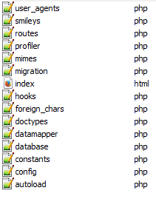
Configs
Located in <project>/application/config folder
config.php
set default application language
set subclass prefix
set application encryption key
autoload.php
Load libraries and helpers
database.php
Configure database connection

Slide 58
Controllers and actions
Basic controller
Extends CI_Controller
Public functions represent actions
<?php
class Blog extends CI_Controller {
public function index()
{
echo 'Hello World!';
}
public function posts($page)
{
echo 'Look at this!';
}
}
?>
action parameters can be passed directly as shown

Slide 59
Views
Basic View
Contains HTML markup and nested PHP code
<html>
<head>
<title><?php echo $title;?></title>
</head>
<body>
<h1><?php echo $heading;?></h1>
<h3>My Todo List</h3>
<ul>
<?php foreach ($todo_list as $item):?>
<li><?php echo $item;?></li>
<?php endforeach;?>
</ul>
</body>
</html>

Slide 60
Views(2)
Displaying views
Passing data as associative array
The key-value pairs are transformed into variables
<?php
class Blog extends CI_Controller {
function index()
{
$data['todo_list'] = array('Clean House', 'Call Mom', 'Run Errands');
$data['title'] = "My Real Title";
$data['heading'] = "My Real Heading";
$this->load->view('blogview', $data);
}
}
?>

Slide 61
Models and ActiveRecords
Basic model
class Model_name extends CI_Model {
var $title = '';
var $content = '';
function __construct() { parent::__construct(); }
function insert_entry()
{
$this->title = $_POST['title']; // please read the below note
$this->content = $_POST['content'];
$this->db->insert('entries', $this);
}
function update_entry()
{
$this->title = $_POST['title'];
$this->content = $_POST['content'];
$this->db->update('entries', $this, array('id' => $_POST['id']));
}
}

Slide 62
Models and ActiveRecords(2)
Using models
The model needs to be loaded before using it
The loading of the model can be done in the __construct() method
It can be loaded right before its usage
class Blog_controller extends CI_Controller {
function blog()
{
$this->load->model('Blog');
$data['query'] = $this->Blog->get_last_ten_entries();
$this->load->view('blog', $data);
}
}

Slide 63
Extending CI controllers and models
config.php
Extended model and controller must be in <project>/application/core folder
Extending these basic classes can be done only on one level
$config['subclass_prefix'] = 'MY_';
<?php
class MY_Controller extends CI_Controller
{
public function __construct() { parent::__construct(); }
...
}

Slide 64
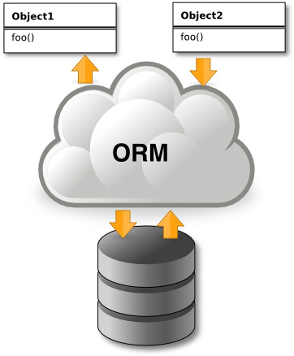

DataMapper ORM
Object relational mapper
Uses “Database first” approach
The database must be predefined
There are specific conventions that need to be followed, in order for the mapper to work
Full documentation at http://datamapper.wanwizard.eu/

Slide 65
DEMO

Slide 66

Using Laravel MVC

Slide 67

Using Laravel MVC
Installation & configs
Migrations & Seeding
Controllers and actions
Views and Blade engine
Routes
Eloquent models
Filters

Slide 68
Installation and configs
Using Composer
https://getcomposer.org/
Laravel installation guide
http://laravel.com/docs/4.2/installation
adding to composer
creating new project
composer global require "laravel/installer=~1.1"
composer create-project laravel/laravel --prefer-dist

Slide 69
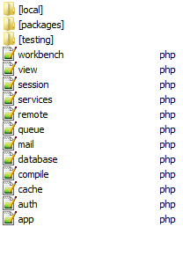
Installation and configs(2)
In <project>/app/config/
app.php
debug mode
language
Providers
…
database.php
set connection strings for different providers
set migrations root

Slide 70
Migrations and seeding
Using Laravel’s Artisan (command-line interface)
Install migrations
Make new migration
This creates a class with up() and down() methods
Running migrations
Rollback last migration
php artisan migrate: install
php artisan migrate: make <name_of_migration>
php artisan migrate
php artisan migrate:rollback

Slide 71
Migrations and seeding(2)
Example Migration class
class CreateNotesTable extends Migration
{
public function up()
{
Schema::create('notes', function(Blueprint $table){
$table->increments('id');
$table->string('title');
$table->text('body');
//how to make a date
$table->timestamps();
$table->engine='InnoDb';
});
}
public function down()
{
Schema::table('notes',function(Blueprint $table){
$table->drop();
});
}
}

Slide 72
Migrations and seeding(3)
Example Seeding migration class
class SeedAuthorsTable extends Migration
{
public function up()
{
DB::table('authors')->insert(array(
'name'=>'Pesho',
'bio'=>'Pesho is a well known author of many books about programming.',
'created_at'=>date('Y-m-d H:m:s'),
'updated_at'=>date('Y-m-d H:m:s'));
}
public function down()
{
DB::table('authors')->whereBetween('name', array('Pesho'))->delete();
}
}

Slide 73
Controllers and actions
Example Controller class
Extends the Controller class
Public functions represent actions
Action parameters can be passed directly
<?php
class HomeController extends Controller
{
public function showWelcome($name)
{
$data=array(
'title'=>'Home page‘,
‘message’=>’Hello, ’.$name
);
$this->RenderView('home.hello',$data);
}
}

Slide 74
Routes
Routes can call anonymous functions
Routes can call controller methods
Routes can have names
Route::get('/login', function()
{
return View::make('auth.loginForm');
});
Route::get(
'/login',
'AuthController@showLoginForm');
Route::get(
'/login',array(‘as’=>’login’,uses=>'AuthController@showLoginForm'));

Slide 75
Views and Blade engine
View using nested PHP code
View using Blade engine
view file has name <name_of_view>.blade.php
<title><?php echo $title;?></title>
<html>
<head>
<title>@yield('page_title')</title>
@yield('css')
@yield('javascript')
</head>
<body>
Some text
@yield('content')
</body>
</html>

Slide 76
Views and Blade engine(2)
Blade syntax
print variable
nest section
define section content
extend layout
{{ $user->name }}
@yield('css')
@section('css')
<link rel="stylesheet" type="text/css" href="mystyle.css" />
@endsection
@extends('layout')

Slide 77
Views and Blade engine(3)
Some control structures
If-else
Unless
@if (...)
...
@elseif ...
@else ...
@endif
@unless (....)
...
@endunless

Slide 78
Views and Blade engine(4)
Loops
for
while
foreach
@for (....)
....
@endfor
@while (....)
....
@endwhile
@foreach (...)
...
@endforeach

Slide 79
Eloquent Models
Example model class
Example queries
class Book extends Eloquent
{
protected $table = 'book';
protected $primaryKey = 'book_id';
public $timestamps = false;
}
Book::all();
Book::find(1);
Book::where('name', '=', 'A brief history of time');

Slide 80
Eloquent Models(2)
Insert
Update
$b = new Book();
$b->title = 'Laravel Basics';
$b->description = 'A very nice book';
$b->save();
$b = Book::find(2);
$b->title = 'Laravel Advanced';
$b->save();

Slide 81
Eloquent Models(3)
Soft delete
In Model class
Delete syntax
Include soft deleted rows
Restore deleted rows
protected $softDelete = true;
Author::where('id','=',$id)->delete();
Book::withTrashed()->get();
$b=Book::onlyTrashed()->get();
$b->restore();

Slide 82
Filters
Filter are defined in <project>/app/filters.php
Example filter
Route::filter('auth', function()
{
if (Auth::guest())
{
if (Request::ajax())
{
return Response::make('Unauthorized', 401);
}
else
{
return Redirect::guest('login');
}
}
});

Slide 83
Filters(2)
Calling filters
Calling filters with parameters
Route::get('user', array('before' => 'old', 'uses' => 'UserController@showProfile'));
Route::filter('age', function($route, $request, $value)
{
//
});
Route::get('user', array('before' => 'age:200', function()
{
return 'Hello World';
}));

Slide 84
Filters(3)
CSRF protection
call predefined ‘csrf’ filter at route
Include token in forms
Route::post('author/edit',array('before'=>'csrf', 'uses'=>'AuthorsController@PostEditAuthor'));
{{Form::token()}}

Slide 85
DEMO

