Slide 1
Creating web applications using PHP
Introduction to PHP and PHP MVC Frameworks
ASP.NET Web Forms
Telerik Software Academy
http://academy.telerik.com

Slide 2
Table of Contents
Introduction t0 PHP
PHP Language Overview
Writing a PHP based Web Application
Using Native PHP
Using CodeIgniter MVC
Using Laravel MVC

Slide 3
Introduction to PHP
source:php.net

Slide 4
PHP Origins
Created in 1994 by Rasmus Lerdorf
Originally used for tracking visits to his online resume.
Back then PHP meant Personal Home Page.
In June of 1995, Rasmus released an improved version of the PHP Tools to the public

Slide 5
PHP Origins(2)
In April of 1996, PHP/FI (Forms Interpreter) was introduced as version 2.0
It included built-in support for
DBM, mSQL, and Postgres95 databases
cookies
user-defined function support
and much more

Slide 6
PHP Origins(3)
PHP 2.0 went through dramatic changes
By November, 1997, the underlying parsing engine was already entirely rewritten
In 1997 and 1998, PHP/FI had a cult of several thousand users around the world.
A Netcraft survey as of May, 1998, indicated that nearly 60,000 domains reported having headers containing "PHP“ (1% of all domains then)

Slide 7
PHP Origins(4)
Despite these impressive figures, the maturation of PHP/FI was doomed because of its limitations

Slide 8
PHP/FI Code Syntax
Example of PHP/FI Code
<!--include /text/header.html-->
<!--getenv HTTP_USER_AGENT-->
<!--ifsubstr $exec_result Mozilla-->
Hey, you are using Netscape!<p>
<!--endif-->
<!--sql database select * from table where user='$username'-->
<!--ifless $numentries 1-->
Sorry, that record does not exist<p>
<!--endif exit-->
Welcome <!--$user-->!<p>
You have <!--$index:0--> credits left in your account.<p>
<!--include /text/footer.html-->

Slide 9
PHP 3
PHP 3.0 -The first version that closely resembles PHP as it exists today
Andi Gutmans and Zeev Suraski along with Rasmus, began yet another complete rewrite of the underlying parser in 1997.
PHP now evolved as a language
The meaning of PHP changed as a recursive acronym - PHP: Hypertext Preprocessor

Slide 10
PHP 3
Innovations in PHP 3
Strong extensibility
The ease of extending the language itself attracted dozens of developers who submitted a variety of modules
Mature interface for multiple databases, protocols, and APIs
Powerful and consistent language syntax and OOP support

Slide 11
PHP 3
In June, 1998, with many new developers from around the world joining the effort, PHP 3.0 was announced by the new PHP Development Team as the official successor to PHP/FI 2.0.
At its peak, PHP 3.0 was installed on approximately 10% of the web servers on the Internet.

Slide 12
PHP 4
PHP4 was developed with complex applications in mind
The PHP’s Core was again rewriten
The design goals were to improve performance, and improve the modularity of PHP's code base
The new engine, dubbed 'Zend Engine' (comprised of their first names, Zeev and Andi), met these design goals successfully, and was first introduced in mid 1999

Slide 13
PHP 5
PHP4 was developed with complex applications in mind
The PHP’s Core was again rewriten
The design goals were to improve performance, and improve the modularity of PHP's code base
The new engine, dubbed 'Zend Engine' (comprised of their first names, Zeev and Andi), met these design goals successfully, and was first introduced in mid 1999

Slide 14
ASP.NET User Controls and Custom Controls
ASP.NET offers two ways of building reusable UI components:
Web User Controls
UI server controls (reusable code snippets), designed in Visual Studio
Consist of .ascx and .ascx.cs files, inherit from UserControl
Web Custom Controls
Plain C# code inheriting from WebControl
No HTML, rendered in C# code

Slide 15


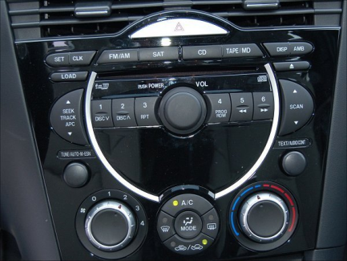


ASP.NET User Controls

Slide 16
User Controls
Web user controls are reusable UI components used in ASP.NET Web Forms applications
User controls derive from UserControl which derive from TemplateControl
Similar to a Web form
Have HTML code and C# code (code behind)
Could have properties and events
Allow developers to create their own controls with own UI and custom behavior

Slide 17
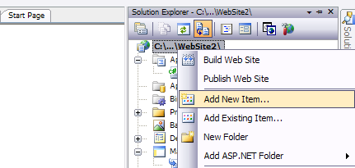
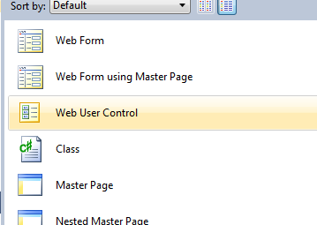
User Controls (2)
Adding a Web User Control from Visual Studio:

Slide 18
User Controls (3)
A Web user control is:
An reusable ASP.NET code snippet that can be nested as part of an ASP.NET page
A server component which offers a user interface and attached logic
Server side logic and lifecycle events (C# code behind)
Client-side logic (JavaScript code)
Shared between the pages of the application
Cannot be displayed directly in the browser

Slide 19
User Controls (4)
Differs from custom server controls
Custom controls are advanced and beyond the scope of the course
Consists of HTML and code
Doesn’t contain <head>, <body> and <form> HTML tags
Uses @Control instead of @Page

Slide 20
User Controls – Advantages
Independent
Use separate namespaces for the variables
Avoid name collisions with the names of methods and properties of the page
Reusable
User controls can be used more than once on a single page
No conflicts with properties and methods
Language neutrality
User controls can be written in a language different of the one used in the page

Slide 21
Sharing of User Controls
User controls can be used throughout an application
Cannot be shared between two Web applications
Except by the copy&paste "approach" ☺
Another approach is to create a Web custom control
Everything is manually written
Notes:
Бележки на автора:
Споделяне на потребителски контроли
Потребителските контроли могат да се споделят между всички страници на уеб приложението. Не могат да се споделят между различни уеб приложения (като изключим copy&paste "технологията" ☺ ).
Друг подход е да се създаде Web custom контрола. Създаването на такава е много по-трудоемко, защото за разлика от потребителските контроли всичко се пише на ръка.

Slide 22
Using User Controls
A user control can be added to each ASP.NET Web form
The form is called "host"
The form adds the control by using the @Register directive
TagName defines the name used by tags that will insert an instance of the control
Src is the path to the user control
<%@ Register TagPrefix="demo" TagName="SomeName"
Src="NumberBox.ascx"%>

Slide 23
Example: Welcome Label
We want to create a "Welcome Label" user control
Like the <asp:Label> control
Has Name and says "Welcome, Name"
Has Color and AlternateColor (on mouse over)
WelcomeLabel.ascx
<%@ Control Language="C#" AutoEventWireup="true"
CodeBehind="WelcomeLabel.ascx.cs"
Inherits="Custom_Controls_Demo.WelcomeLabel" %>
<asp:Label ID="LabelWelcome" runat="server" />
WelcomeLabel.ascx.cs
public partial class WelcomeLabel : System.Web.UI.UserControl
{
…
}

Slide 24


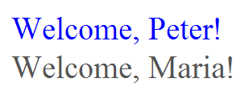
Welcome Label ASCX
Live Demo

Slide 25
Example: Numeric Box
We want to create a "Numeric" user control
Like the <asp:TextBox> control
For integer numbers only
With "+" and "-" buttons
NumericBox.ascx
<%@ Control Language="C#" CodeBehind="NumericBox.ascx.cs" … %>
<asp:TextBox ID="TextBoxNumber" runat="server" … />
<asp:Button ID="ButtonIncrease" runat="server" Text="+" … />
<asp:Button ID="ButtonDecrease" runat="server" Text="-" … />
NumericBox.ascx.cs
public partial class NumericBox : System.Web.UI.UserControl
{
…
}

Slide 26


Numeric Box
Live Demo

Slide 27
ASP.NET Custom Controls

Slide 28
ASP.NET Custom Controls
Web custom controls
Plain C# code inheriting from WebControl
No HTML, rendered in C# code
Attributes [Category("…")] and [Description("…")] serve for interaction with the Visual Studio's Property Designer
The RenderContents method renders the control as HTML code

Slide 29

ASP.NET Custom Control: SEOPlugin
Live Demo

Slide 30
Creating an Error / Success Notification User Control
Create a user control for displaying message boxes: ErrorSuccessNotifier.ascx
Keep all its assets (HTML code, C# code, images, styles and client-side scripts) in its own directory: /Controls/ErrorSuccessNotifier/
Keep a list of messages in the Session object
Message types: Success, Info, Warning, Error
Render the messages dynamically as panels
Include the CSS and client-side scripts on demand through the ClientScriptManager

Slide 31
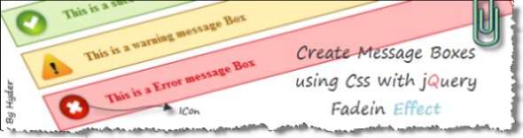
Creating an Error / Success Notification User Control
Live Demo

Slide 32
ASP.NET User Controls
http://academy.telerik.com

Slide 33

Exercises
Create a user control that visualizes a menu of links. The control should have a property to initialize the menu links (a list of items, each containing a title and URL). Use DataList and data binding to visualize the menu links. Implement a property to change the font and the font color. Don’t use the Menu control!
* Create a custom control to display an analog clock based on the HTML 5 canvas (you could take some code from http://randomibis.com/coolclock/). Define a property to change the time zone. All control assets (CSS, images, scripts, etc.) should be loaded dynamically at runtime when the control is rendered.

Slide 34
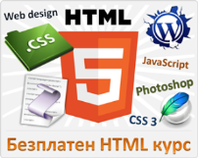



Free Trainings @ Telerik Academy
"Web Design with HTML 5, CSS 3 and JavaScript" course @ Telerik Academy
html5course.telerik.com
Telerik Software Academy
academy.telerik.com
Telerik Academy @ Facebook
facebook.com/TelerikAcademy
Telerik Software Academy Forums
forums.academy.telerik.com

