Slide 1
Simulated Presentation of
Floyd’s Cycle Detection Algorithm

Slide 2
Outline
Key Concepts of Floyd’s Cycle Detection Algorithm
Algorithm Flowchart
Algorithm Pseudo Code
Simulation of the Algorithm
Time and Space Complexity
Code Demonstration in Compiler

Slide 3
1. Key Concepts
Problem Statement
Purpose of Floyd’s Cycle Detection Algorithm
Linked Lists and Nodes
Pointers
Acyclic Linked Lists or Graph
Starting Node in a cycle
1
2
3
7
4
6
5
Fig: An Acylic Graph

Slide 4
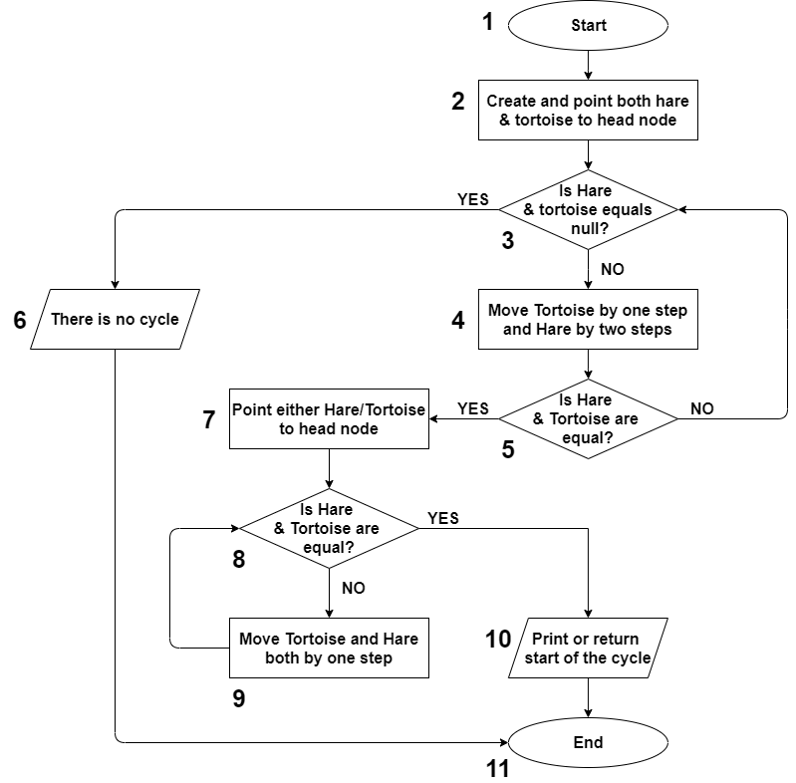
2. The Algorithm (Flow Chart)

Slide 5
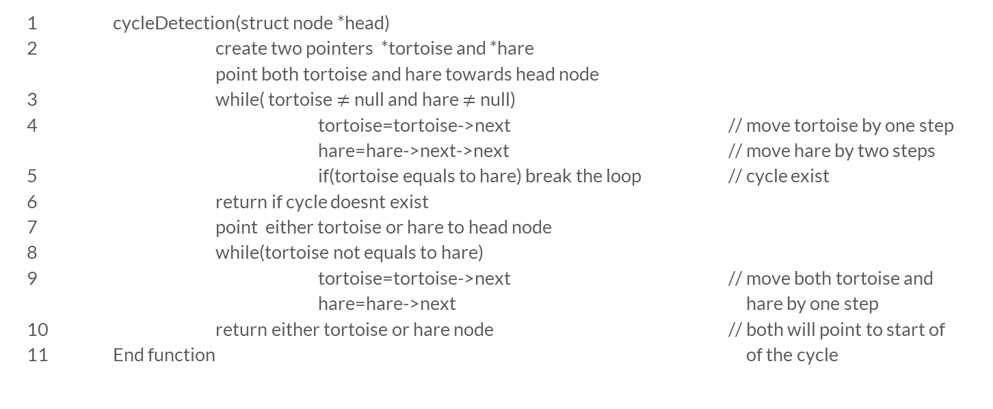
2. The Algorithm (Pseudo Code)
1 cycleDetection(struct node *head)
2 create two pointers *tortoise and *hare
point both tortoise and hare towards head node
3 while( tortoise $≠$null and hare $≠$null)
4 tortoise=tortoise->next // move tortoise by one step
hare=hare->next->next // move hare by two steps
5 if(tortoise equals to hare) break the loop // cycle exist
6 return if cycle doesnt exist
7 point either tortoise or hare to head node
8 while(tortoise not equals to hare)
9 tortoise=tortoise->next // move both tortoise and
hare=hare->next hare by one step
10 return either tortoise or hare node // both will point to start of
11 End function of the cycle

Slide 6


3. Simulation
This will be the starting point of the cycle
Cycle Exist!!
Move Either Tortoise/Hare at the head node and keep other at the same position
Start Tortoise and Hare from head node
Move Tortoise by 1 step and Hare 2 steps until they meet
Move Tortoise and Hare by 1 step until they meet again
15
27
73
41
19
32
11
Head of the Node
66
9
87

Slide 7

4. Time & Space Complexity
1 cycleDetection(struct node *head)
2 create two pointers *tortoise and *hare
point both tortoise and hare towards head node
3 while( tortoise $≠$null and hare $≠$null)
4 tortoise=tortoise->next
hare=hare->next->next
5 if(tortoise equals to hare) break the loop
6 return if cycle doesnt exist
7 point either tortoise or hare to head node
8 while(tortoise not equals to hare)
9 tortoise=tortoise->next
hare=hare->next
10 return either tortoise or hare node
11 End function
Time Complexity
O(1)
O(1)+O(n)+O(n)
=> O(n)
O(n)
O(1)
Space Complexity
O(1)
O(<=n)
O(1)

Slide 8
Time Complexity Explained
Nodes: {0, 1, 2, 3, 4 (starting loop node) , 5, 6, 7, 8, 9}
Tortoise | Hare | Distance
4 | 8 | 2
5 | 4 | 1
6 | 6 | 0
Tortoise | Hare | Distance
4 | 5 | 5
5 | 7 | 4
6 | 9 | 3
7 | 5 | 2
8 | 7 | 1
9 | 9 | 0
Time Complexity for Loop1:
Distance(head→starting loop node)
+ Backward Distance(tortoise→hare)
Always be O(<=n)
Time Complexity for Loop2:
Distance (head→starting loop node)
Always be O(<=n)
Simulated Starting Position in the loop
Max Distance Starting Position

