Slide 1
Study on Dimension Reduction Techniques
Name: Tanzila Akter
Reg. no.: 20190648603
Session: 2018-2019
Dr. Liton Jude Rozario
Professor
Department of CSE
Name: Md Shagor Hossain
Reg. no.: 20190648623
Session: 2018-2019
Tuesday, 28 May, 2024

Slide 2
Outline
Introduction
Objective
Literature Review
Contribution
Problem Definition
Proposed Algorithm
Experimental Results
Conclusion & Future Scope

Slide 3
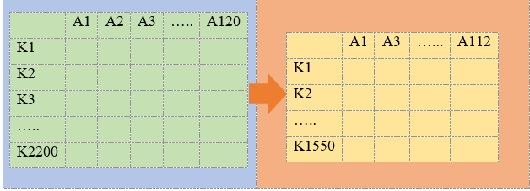
Introduction
In machine learning, having too many features in a dataset can cause problems known as the curse of dimensionality. This happens when the model becomes less efficient and more complex, making it harder to find good solutions
Dimensionality reduction is used during data preprocessing to simplify the dataset before training the model. This process identify relevant feature and remove redundant, irrelevant feature.
Fig 1: Dimension Reduction

Slide 4
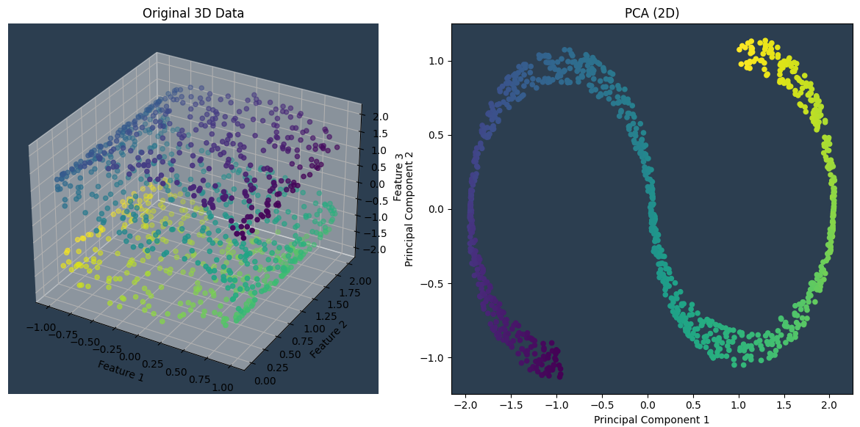
Objective
The primary objective of the project is to undertake a comprehensive examination of various linear dimension reduction methods.
This study focus on evaluating and exploring techniques such as PCA, LDA, and SVD using code and mathematical examples.
Fig 1: Visualize constraints with linear dimension reduction

Slide 5
Literature Review
This literature review explores the extensive research on “dimension reduction” presenting key papers that have significantly enhanced our understanding of the field-
The most recent research in a number of areas, including data visualization, medical condition analysis, network detection of malware, emotion recognition, race identification, genetic classification, text classification, image steganalysis, hyperspectral image classification, and multiple engineering tasks is reviewed by Rizgar R. Zebari et al. in this paper “A Comprehensive Review of Dimensionality Reduction”.
In the "Dimension Reduction” paper P. Cunningham explains dimension reduction has the potential to increase analytical accuracy in addition to being computationally efficient.

Slide 6
Literature Review
Both feature selection and feature extraction approaches as well as techniques applicable to supervised or unsupervised learning can be used to divide the assortment of methods available for reducing size.
Shingchern D. You et al. introduce different methods to simplify the original data by reducing its dimensions. Motion picture expert group (MPEG)-7 audio signature descriptors (ASD) are a particular type of spectral-temporal data that are studied in terms of its dimensionality using three different methods. Among the approaches that have been looked at in this work are factor analysis (FA), ICA, PCA

Slide 7
Literature Review
In the paper "Dimensionality Reduction: A Study," Dr. S. Vijayarani et al. discuss various methodologies, approaches, and computations for dimensionality reduction. The paper also highlights the fields where these reduction techniques have been successfully implemented.
The study "A survey of dimensionality reduction techniques" analyzed how many citations the most relevant papers in each area had gotten during the previous ten years (2003–2012).
Inspired by the low performance of learning models owing to large dimensionality data, this paper “Dimensionality Reduction: Challenges and Solutions” explores five different approaches to dimensionality reduction.

Slide 8
Contribution
Comparative Study:
  Conducted an analysis and comparison of PCA, LDA, and SVD to evaluate their performance and effectiveness.
Practical Application:
  Implemented and validated these dimensionality reduction techniques on a real dataset to demonstrate their practical utility.
Insights:
  Provided insights into the suitability of each method for different scenarios, highlighting their strengths and weaknesses in various contexts.

Slide 9
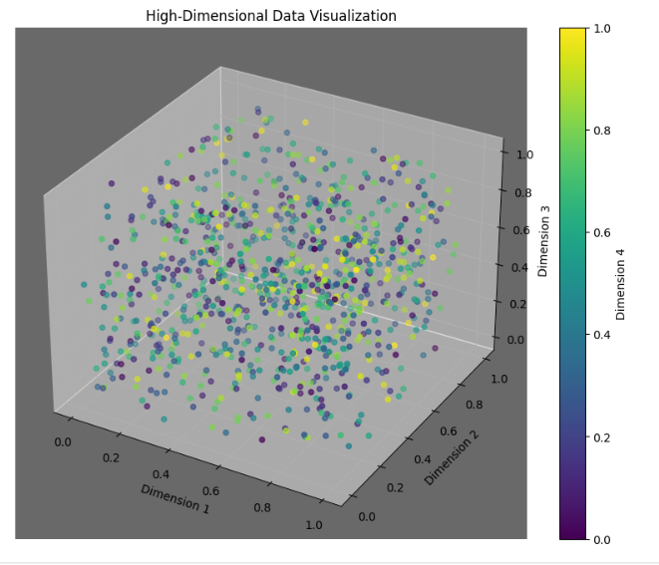
Problem Definition
The analysis of high-dimensional data presents significant challenges in both visualization techniques and the demand for computational resources.
Fig 3: High-dimensional data Visualization

Slide 10
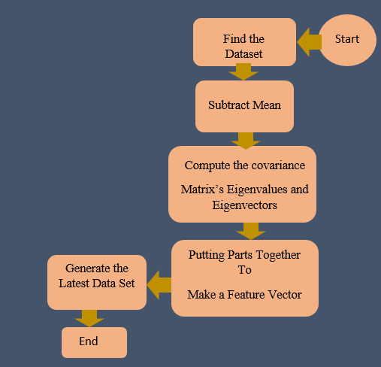

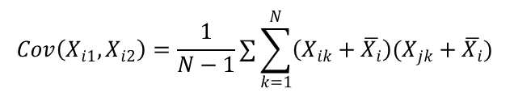


Proposed Algorithm
We utilized PCA, LDA, and SVD among other algorithms for dimension reduction strategies.
PCA reduces data dimensionality by transforming features into a new set of orthogonal variables (principal components)
Formula for PCA-
Fig 4:Flowchart of PCA
The largest eigenvalue is the first principle

Slide 11
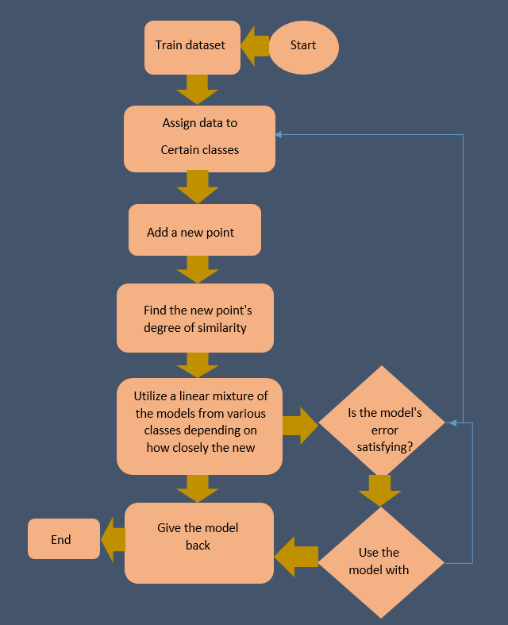

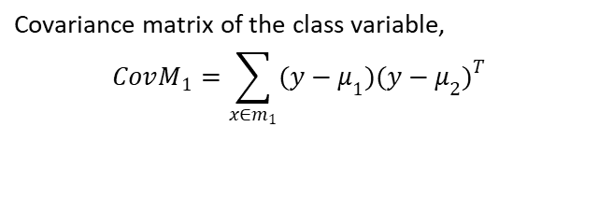

Proposed Algorithm(Conti..)
Linear Discriminant Analysis (LDA) is a supervised technique used for maximizing the separability between multiple classes. LDA reduces the number of dimensions to make computations faster and to prevent overfitting due to having too many features.
Formula for LDA-
Fig 5:Flowchart of LDA

Slide 12
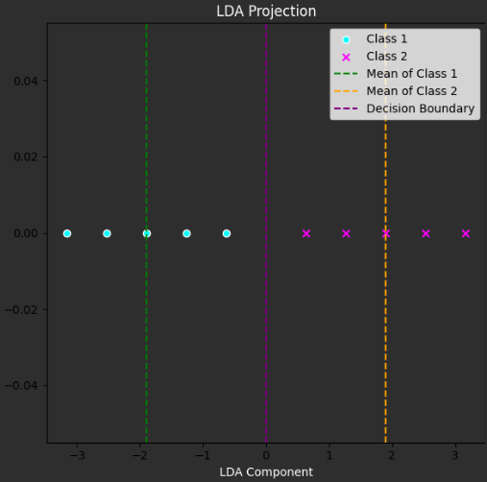
Proposed Algorithm(Conti..)
Two criteria are used by LDA to create a new axis:
-Maximize the distance between means of the two classes
-Minimize the variation within each class
Fig 6: Shown LDA two criteria to create a new axis

Slide 13
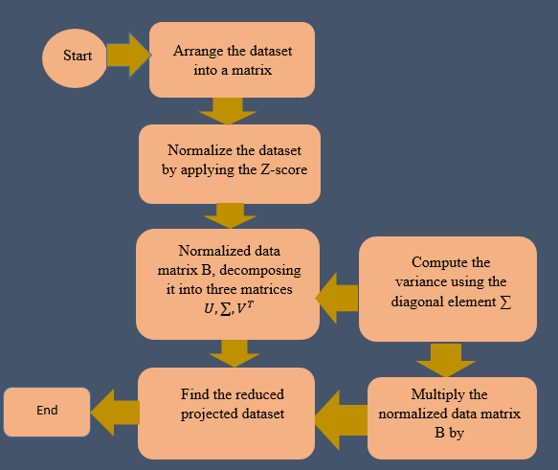
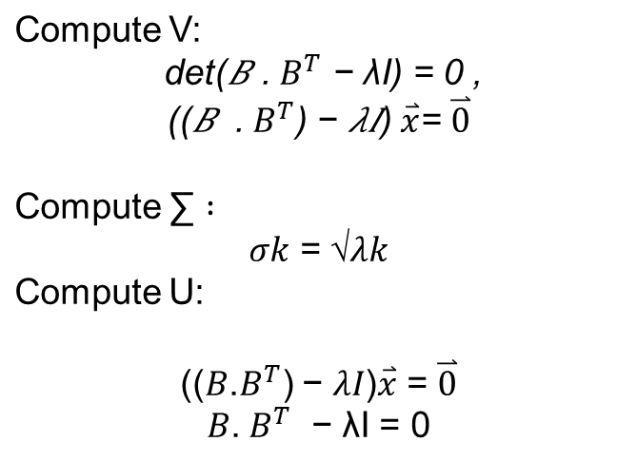
Proposed Algorithm(Conti..)
SVD Factorizes a matrix into three matrices to identify the direction of maximum variance. The diagonal entries of Σ (singular values) represent the amount of variance captured in each dimension. Singular values are ordered by variance captured, from highest to lowest. To reduce dimensions, we choose the top 𝑘 singular values and their corresponding vectors.
Formula for SVD-
Fig 7: Flowchart of SVD

Slide 14
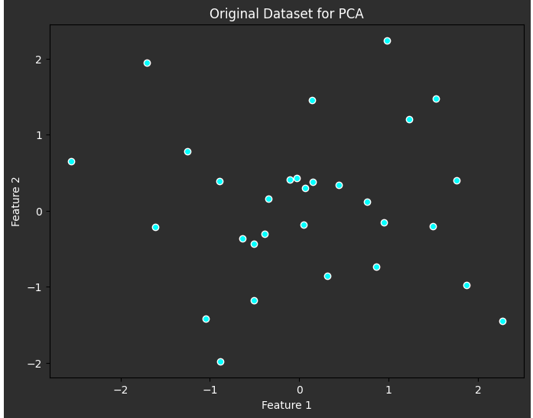
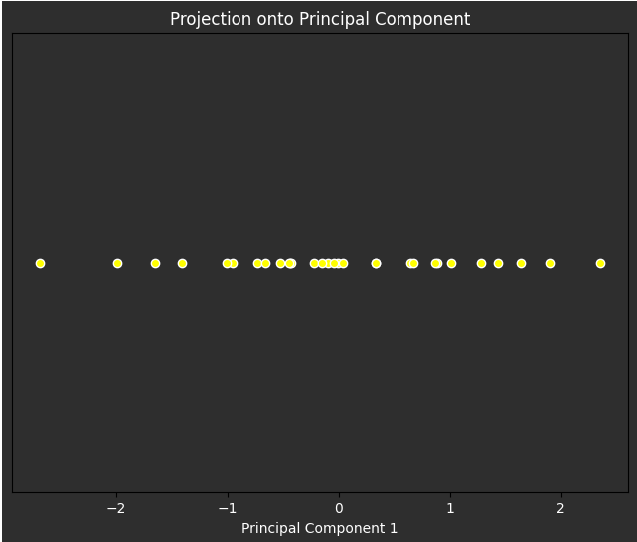
Experimental Results
To understand dimension reduction strategies, all algorithms are executed on a sample dataset using code and mathematical examples of the techniques are solved manually using several tiny datasets and a many large dataset (Digit dataset, irish dataset, diabetes dataset, winequaliy dataset)
Fig 8: show the transformation of 20 sample data points via PCA

Slide 15
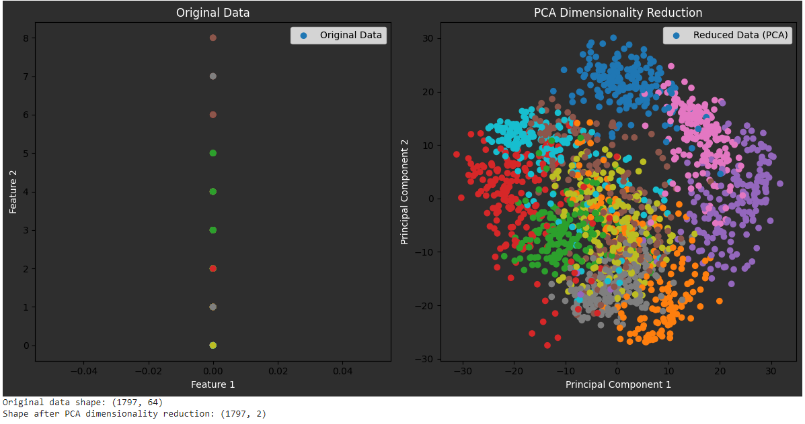
Experimental Results(Conti..)
Visualize the Digit dataset after applying PCA. The original dataset had a dimension of 64, which has been reduced to 2 dimensions with PCA.
Fig 9: PCA dimension reduction on digit dataset

Slide 16
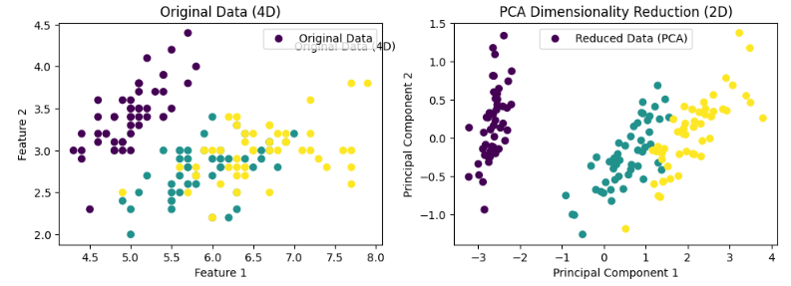
Experimental Results(Conti..)
Visualize the iris dataset after applying PCA. The original dataset had a dimension of 4, which has been reduced to 2 dimensions with PCA.
Fig 10: PCA dimension reduction on Irish dataset

Slide 17
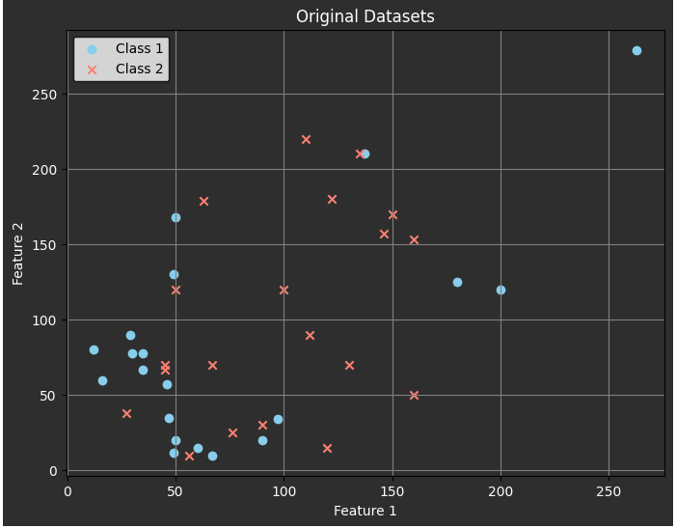
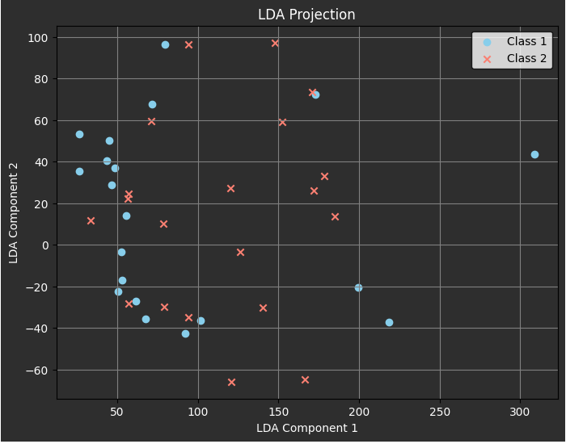
Experimental Results(Conti..)
Visualize the 20 sample data items after applying LDA.
Fig 11: Data reduction visualization on 20 sample data items

Slide 18
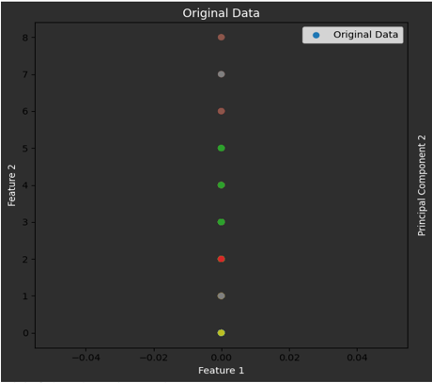
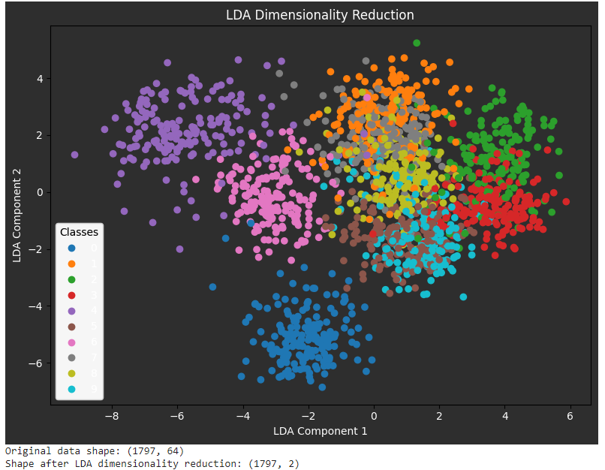
Experimental Results(Conti..)
Visualize the Digit dataset after applying LDA. The original dataset had a dimension of 64, which has been reduced to 2 dimensions with LDA
Fig 12: LDA dimension reduction on digit dataset

Slide 19
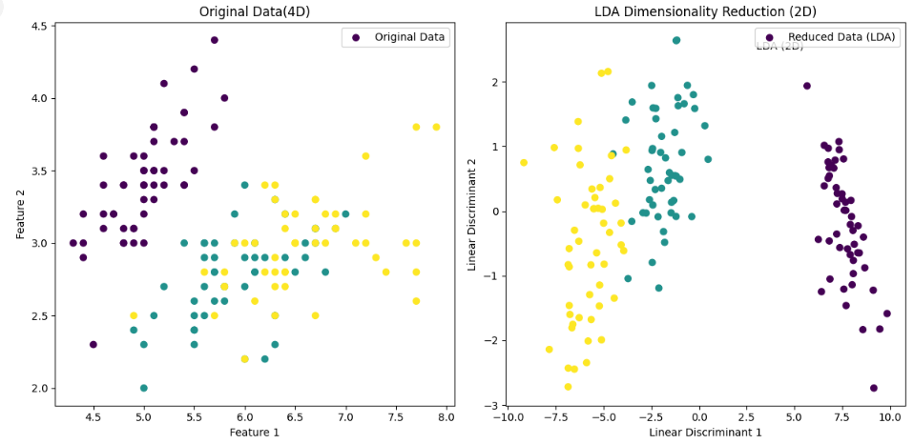
Experimental Results(Conti..)
Visualize the Iris dataset after LDA. Originally 4 dimensions, now reduced to 2 dimensions
Fig 13: LDA dimension reduction on irish dataset

Slide 20
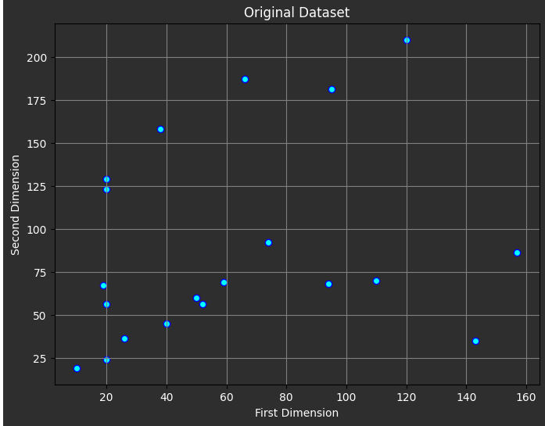
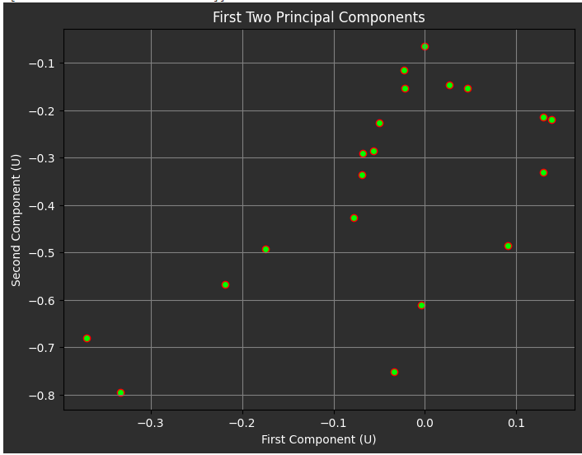
Experimental Results(Conti..)
Visualize the 20 sample data items after applying SVD.
Fig 14: Visualize 20 sample data items reduction using SVD

Slide 21
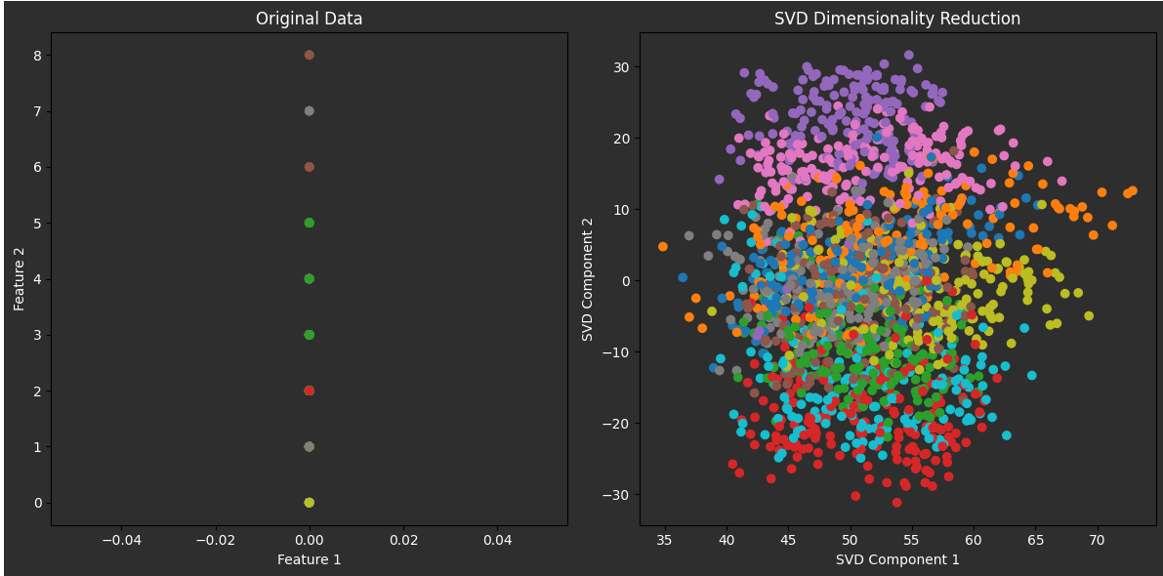
Experimental Results(Conti..)
Visualize the 20 sample data items after applying SVD. The original dataset had a dimension of 64, which has been reduced to 2 dimensions with PCA
Fig 15: SVD dimension reduction on digit dataset

Slide 22
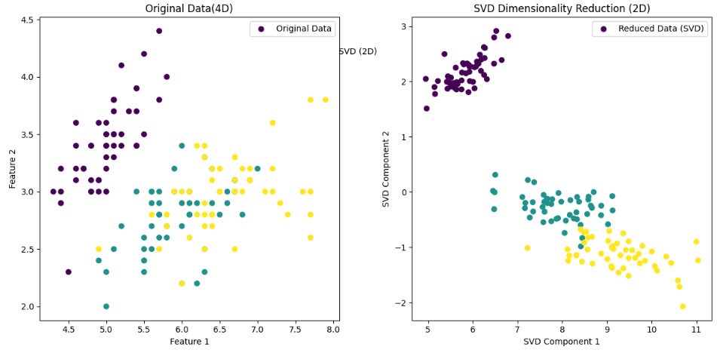
Experimental Results(Conti..)
Visualize the iris dataset after applying SVD. The original dataset had a dimension of 4, which has been reduced to 2 dimensions with SVD
Fig 17: LDA Dimension Reduction on digit dataset

Slide 23
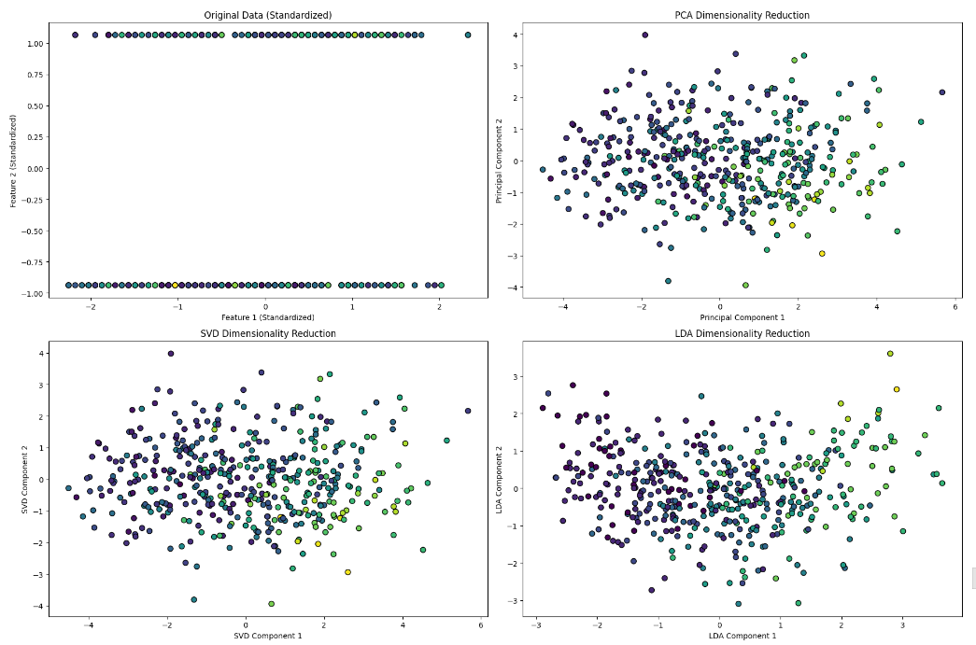
Experimental Results(Conti..)
Visualize the scatterplot after applying PCA, LDA,SVD on diabetes dataset.
Fig 16: PCA, LDA, SVD dimension reduction on diabetes dataset

Slide 24
Conclusion & Future Scope
In this research project, we investigated dimension reduction methods, their applications, and the types of calculations utilized for measurement reduction. We executed these calculations on a test dataset utilizing code. Moreover, we physically solved mathematical illustrations of these strategies utilizing little datasets. We then compared what comes about obtained from manual calculations with those from the code.
After analyzing the results, we found that the outputs from both strategies were steady and delivered the same results.

Slide 25
Conclusion & Future Scope
When we looked at the digit dataset we saw that prior to the application of dimension reduction techniques, it had 64 dimensions. However, the dataset was reduced to just two dimensions after the dimension reduction algorithms were applied. Similarly irish dataset, diabetes dataset dimension reduced by PCA,LDA,SVD.
In future we explore non-linear dimensionality reduction techniques and develop models that apply these methods to larger and more complex datasets.

Slide 26
Thank You

