Slide 1

Detecting Data Drifts in a clinical NLP pipeline
By Mohammad Tanzil Alam

Slide 2
Introduction
Medical data is often present in unstructured form
Manual extraction of data is a tedious and time intense task.
The abstraction pipeline demonstrated a high performance when tested on in-sample test sets, but a lower performance on an unseen test set.
Data drift can be described as a change in the distribution of unseen input data when compared to the data used in training.

Slide 3
Data Pipeline
OCR
Text
Convert into Data Frame
Pre-processing
Calculate Embeddings
Calculate Similarity
Print Result
Analyse

Slide 4
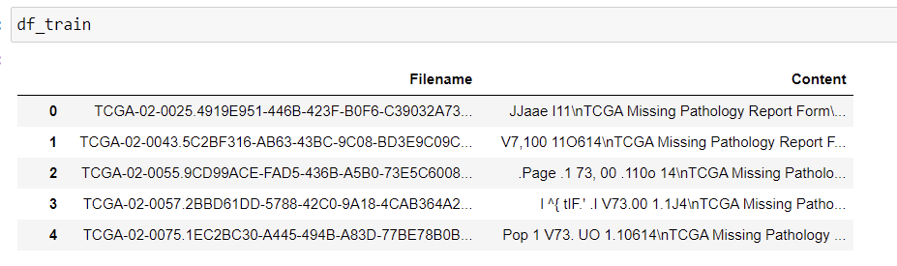
Data Frame

Slide 5
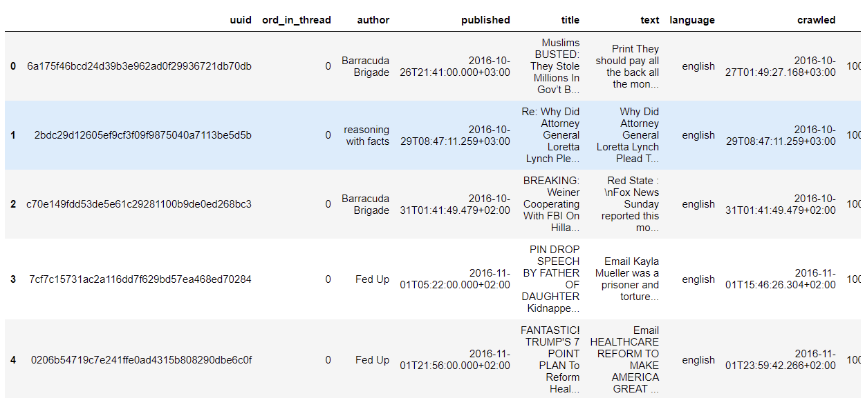
Foreign Dataset
(12999, 20)

Slide 6
Preprocessing
Removal of special characters, punctuations, and numbers.
Converting text into lowercase.
As there were multiple ‘i’s that were occurring, so took a special approach to remove it by limiting multiple occurrences of <=2.
Removed single alphabets as it contains no meaning.
Tokenization: To split the text into words and tokens.
Stopword Removal: Remove stop words that do not hold any special meaning to the text.
Lemmatizing: Reducing the word to its base form.
Removal of mmddyyyy date year format, as it is of no use in finding the data drift.
Removing extra whitespaces.
Finally, join the tokens into a string.

Slide 7
Word Embeddings
TF-IDF (Term Frequency – Inverse Document Frequency)
Word2Vec

Slide 8
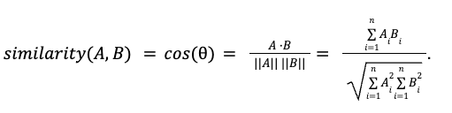
Cosine Similarity
Calculate the dot product between A and B.
Calculate the magnitude of vector A.
Calculate the magnitude of vector B.
Calculate the cosine similarity.

Slide 9
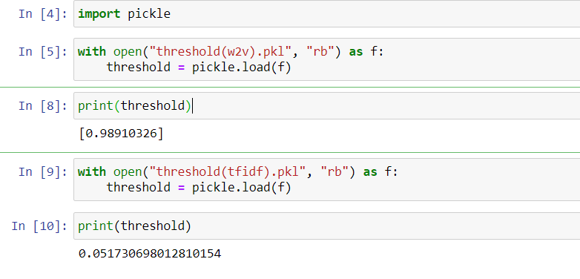
Calculating Threshold

Slide 10
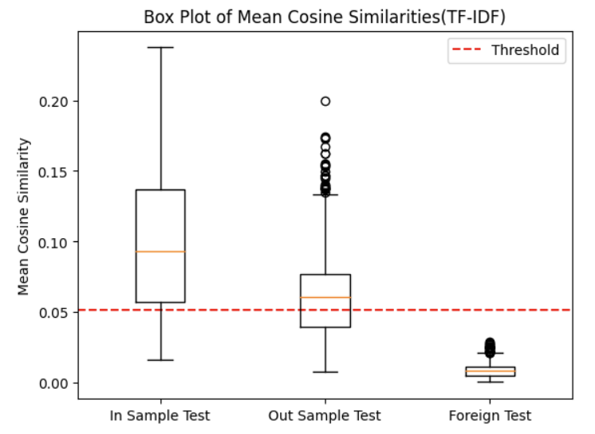
Result
0.051730698012810154

Slide 11
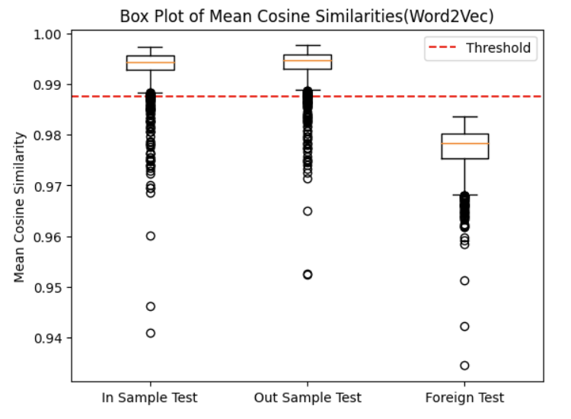
0.98910326

Slide 12
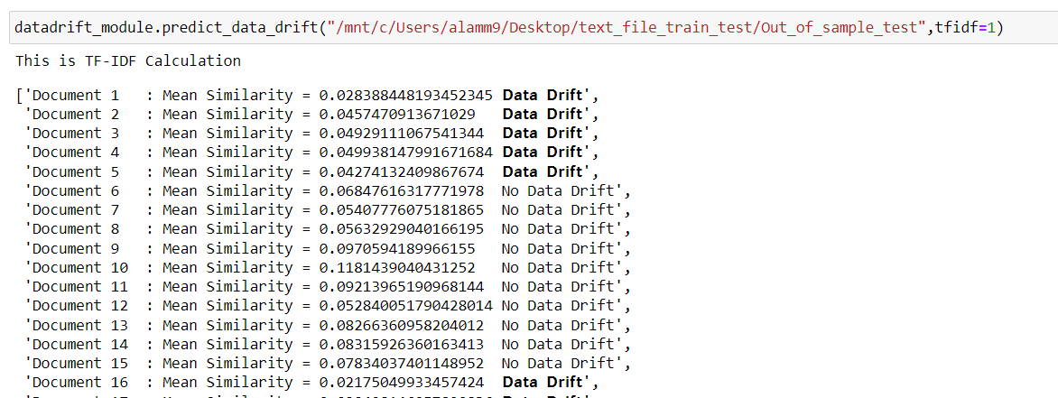

Slide 13
Conclusion
Thesis successfully shows the similarity between different reports.
Reduce manual efforts.
Correctly found the inference from different reports from different departments.
An automated pipeline is constructed which can be integrated into the company production pipeline.

Slide 14
Thank you

