Slide 1


Is it possible to predict Hospitalization

Slide 2
The study we followed
Potentially Avoidable 30-Day Hospital Readmissions in Medical Patients Derivation and Validation of a Prediction Model
Academic medical center in Boston, Massachusetts
(http://jamanetwork.com/journals/jamainternalmedicine/fullarticle/1672282)

Slide 3
The study we followed

Slide 4
A Model to Predict 30-Day Hospital Readmission of Patients in San Francisco General Hospital
USING R
A K M Tanzir HASAN

Slide 5
objective
The objective of the study was to drive a prediction model for 30-day hospital readmission using administrative and clinical data.

Slide 6
What is readmission
Hospital readmission occurs when a patient is admitted to a hospital within a specified time period after being discharged from an earlier hospitalization.

Slide 7
Scope of the Project
Once completed, the model will provide an easy means of identifying patients who may need more intensive transitional care interventions before discharge. Clinicians will be able to target transitional care interventions more efficiently and will be able to help hospitals reduce the readmission rate.

Slide 8
Methodology
For this retrospective cohort study the patients who were discharged from San Francisco General Hospital between December 1, 2015 and November 30, 2016 were followed. The admission from December 1, 2015 to December 31, 2016 were followed for any readmission within 30 days.

Slide 9
Exclusion criteria
The patients who's admission type was Labor & Delivery were excluded from the study.
A case was considered readmission only when the patient was admitted for the same medical condition.
Transfer from one department to another or same day admission were also excluded.

Slide 10
Sample size and character
8786 patients were in the study cohort.
Among the patients 3083 were female and 5703 were male
The age of the patients were between 14 and 100 with mean age of 53
Among the patients 30.6% were White, 24.7% were African American, 25% other race, 16.7% Asian, 1% American Indian, 1.6% Pacific Islander and rest declined to specify their race.

Slide 11
List of variables
Race
Gender
Zip code
Total length of stay
Interval between two admission
Hospital service
Language
Primary discharge diagnosis
Hemoglobin level before discharge
Sodium level before discharge

Slide 12
Modification of variables
The variable Zip code was grouped county wise in 12 groups and a group was made for homeless.
The Zip code "99997”, "99998” and "99999” were codes for homeless.
Depending on the homelessness a new variable was created named homelessness.

Slide 13
Modification of variables
The primary discharge diagnosis were in ICD-9 and ICD-10 codes.
For consistency we converted all ICD-9 codes to ICD-10 codes.
For conversion of the code we used converter available in http://www.icd10data.com
We then grouped the diagnosis depending on the diseases of different body systems.

Slide 14
Results
Among the 8786 patients 2034 (23.15%) readmission case within 30 days of discharge were identified.
The number of unique patient who were admitted once or more with in 30 days were 906 (10%).

Slide 15
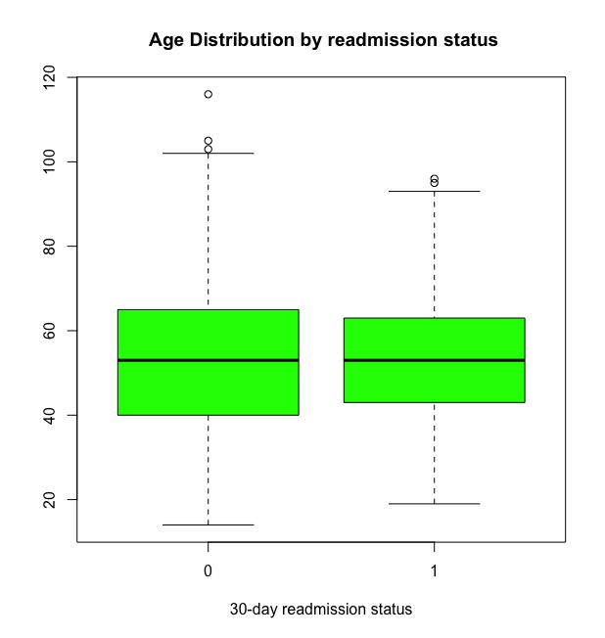
Age distribution is almost similar in both groups

Slide 16
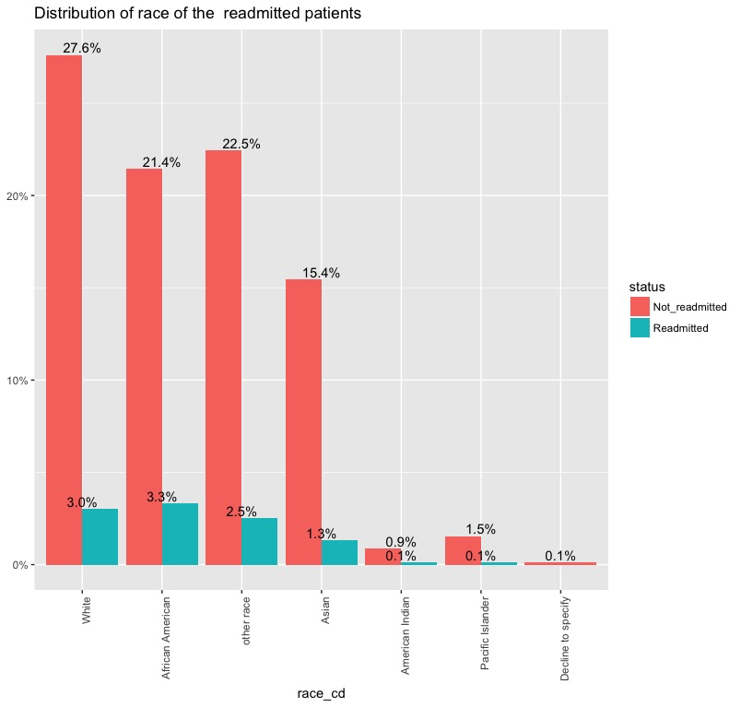
Race

Slide 17
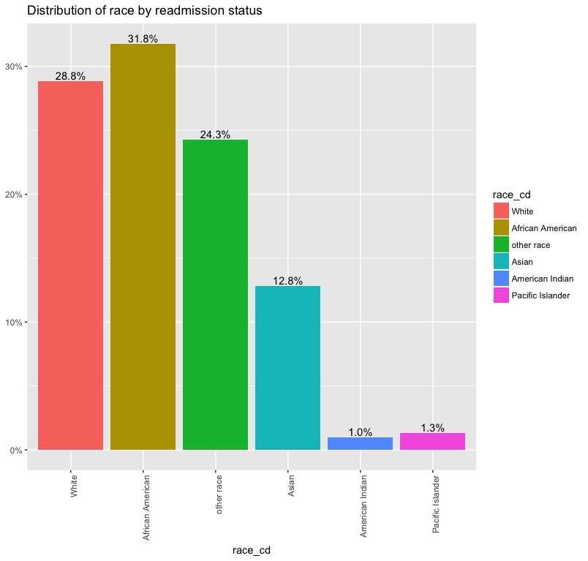
Race
The plot shows that African American race has more within 30-days readmission cases.

Slide 18
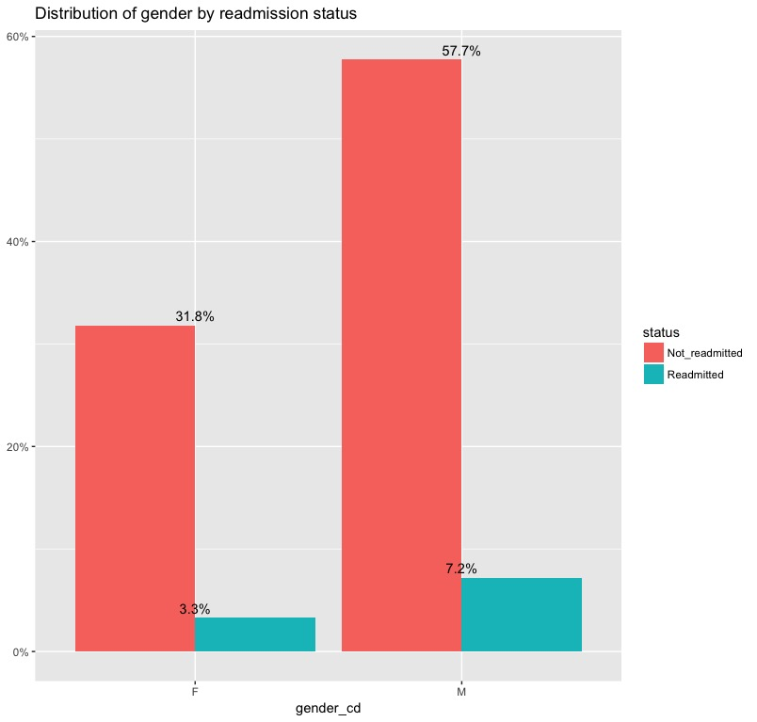
gender
Male patients were readmitted more within 30 days.

Slide 19
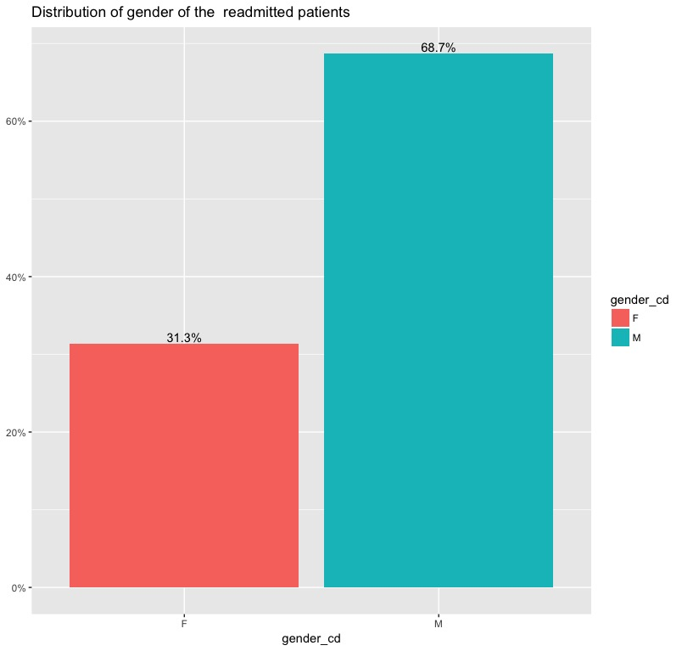
gender

Slide 20
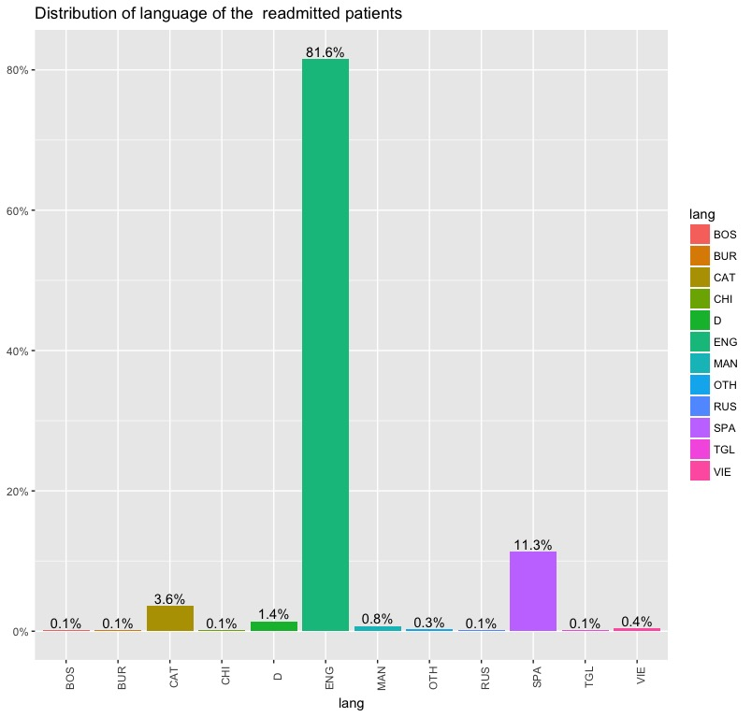
language
About 81% of the readmitted patients first language were English.

Slide 21
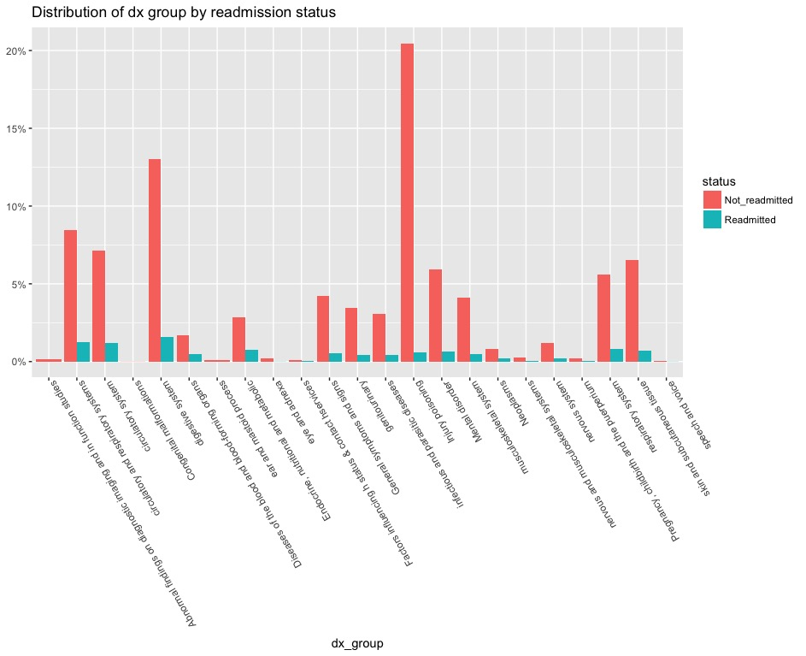
Among the readmitted patients most patient suffered diseases of digestive system.

Slide 22
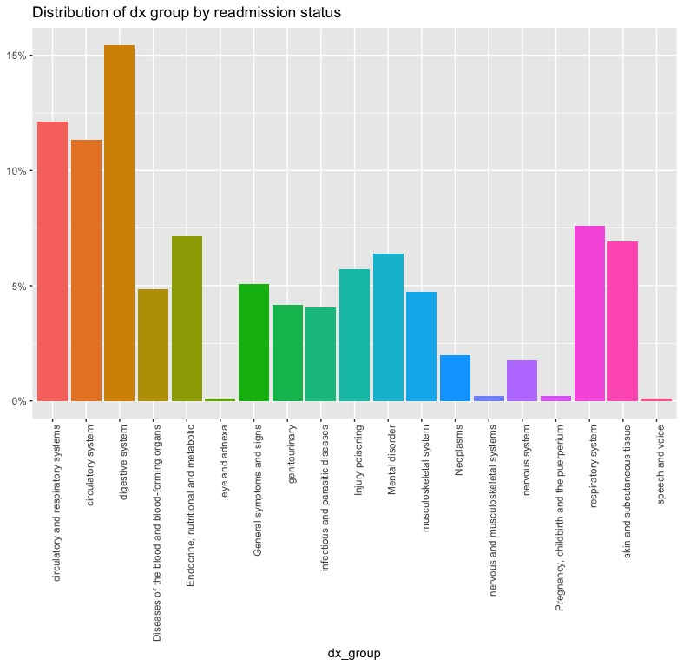
More than 15% patients had digestive system diseases, 12% had circulatory & respiratory system diseases.

Slide 23
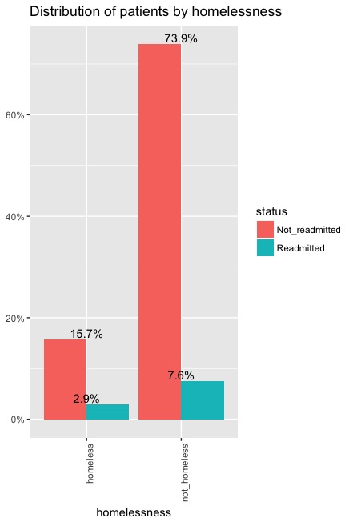
homelessness

Slide 24
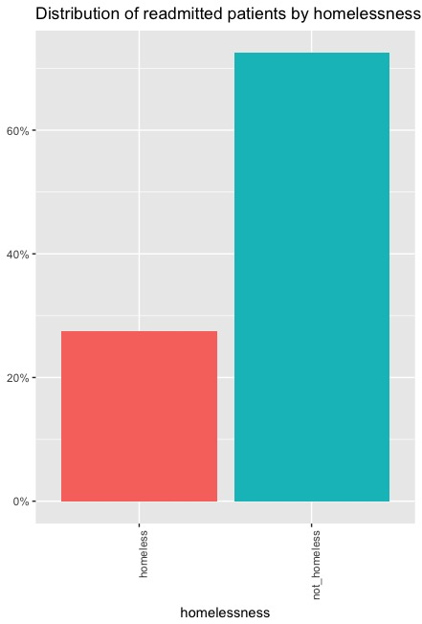
homelessness
Among the readmitted patients more than 25% patients were homeless.

Slide 25
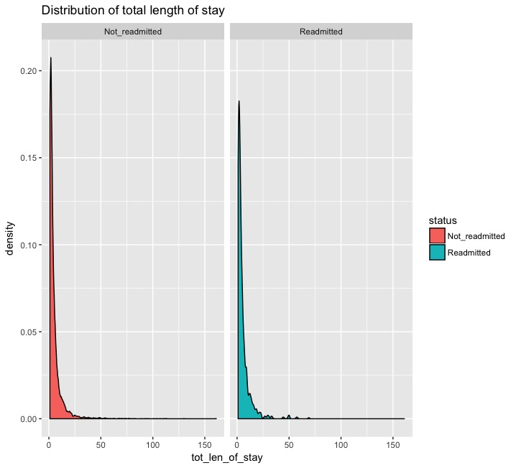
Total length of stay
Mean total length of stay for each admission was 5.4 days, with median of 3 days.
Both the group show almost similar density distribution
(p-value = 0.9651).

Slide 26
Hemoglobin level
Mean Hemoglobin level for the patient was 11.69 g/dl. Median value was 12 g/dl. Minimum level of hemoglobin was 5.3 g/dl and maximum was 19.90 g/dl.

Slide 27
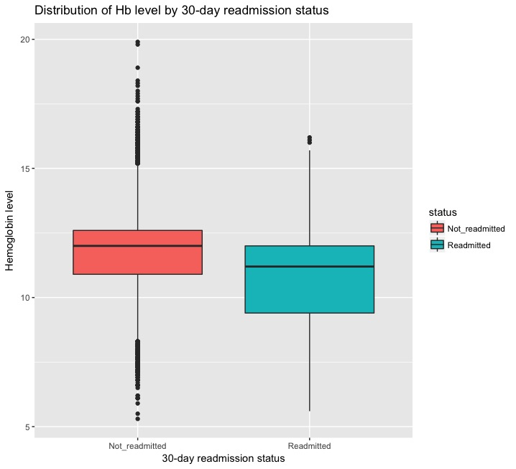
Hemoglobin level
Among the readmitted patients the hemoglobin level was less compared with the not-readmitted patients.
Welch two sample t-test shows significant difference(p-value < 2.2e-16) in hemoglobin level in two groups.

Slide 28
Sodium level
Mean Sodium level was 137.5 mEq/L with minimum of 120 mEq/L and maximum 182mEq/L

Slide 29
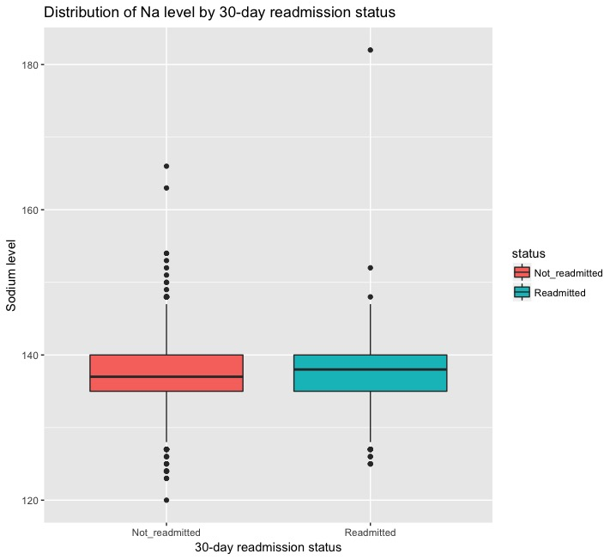
Sodium level
Welch two sample t-test shows there is no significant difference (p-value = 0.3755) in sodium level in two groups

Slide 30
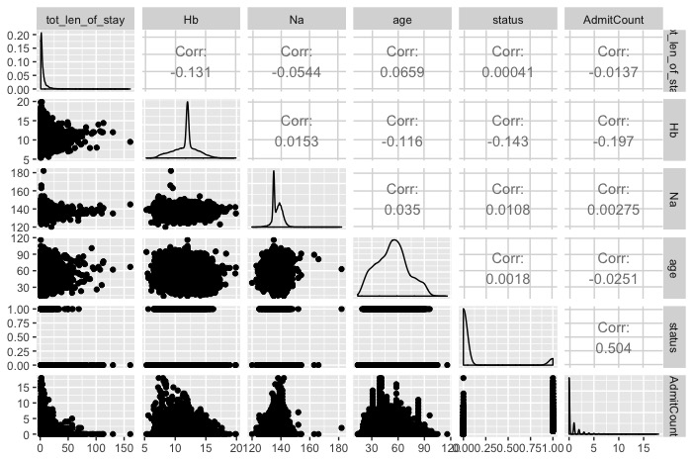
Correlated variable
No significant correlated variables were found in the final data set.

Slide 31
Logistic regression: model fitting
Step function was used to get the best predictors in logistic regression model.
A null model was fitted with only intercept as predictor.
And as main model, all variables were fitted as predictor variable.
Step function returned AdmitCount ,dx_group ,Hb and homelessness as significant predictor with ACI 4292.59 where starting ACI was 5821.63.
Depending on the p value of the Coefficients of the variables dx_group was removed from the model.

Slide 32
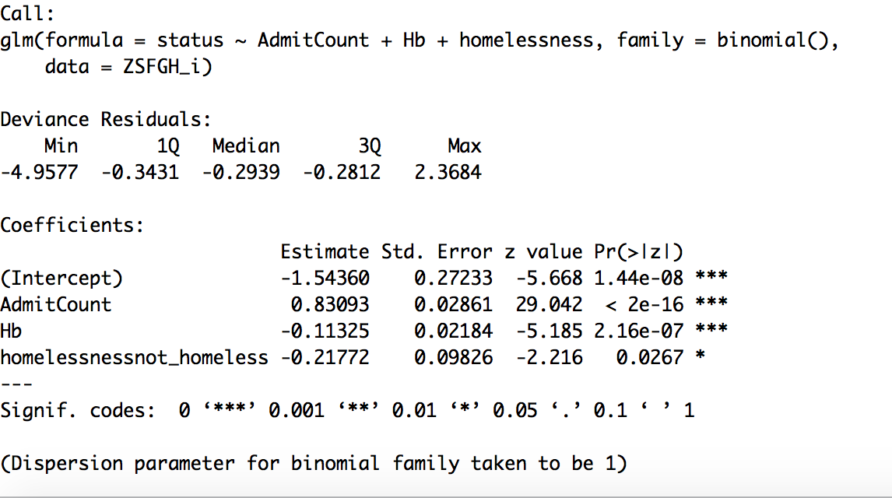

Slide 33
Logistic regression: model fitting
The regression coefficients gave the change in log(odds) in the response for a unit change in the predictor variable, holding other predictor variable constant
Because log(odds) are difficult to interpret, we exponentiate them to put the result on an odds scale
exp(coef(fit_mod)) (Intercept) AdmitCount Hb homelessnessnot_homeless
0.2136110 2.2954460 0.8929313 0.8043495

Slide 34
Logistic regression: model fitting
The training set accuracy of our model was 0.9024278 i.e 90%
In order to test this model's generalizability, we performed k-fold cross-validation
CV-estimated accuracy rate was 93%
This indicates that it is highly unlikely that we are overfitting.

Slide 35
Logistic regression: model fitting
Pseudo R^2 for logistic regression
Hosmer and Lameshow R^2 0.26
Cox and Snell R^2 0.16
Nagelkerke R^2 0.327

Slide 36
Logistic regression: model fitting
The Boston, Massachusetts study that we followed found hemoglobin at discharge, discharge from an oncology service, sodium level at discharge, procedure during the index admission (any ICD-9-CM –coded procedure), index type of admission (non-elective vs elective), number of admissions during the past 12 months, and length of stay

Slide 37
Next step
Explore other variables to get good predictors of readmission.
The result of the multi-variable regression model will then be used to develop a prediction score by using a regression coefficient–based scoring method.
The discriminatory power of the resulting score will be assessed in both the derivation and in validation set by calculating the cross-validated C statistic, which refers to the ability to differentiate between admissions followed and those not followed by a 30-day readmission.

Slide 38
Sample function to get prediction score
riskcalculation <-function(){
risk_score = 0
if (tot_len_of_stay >= 5){
risk_score <- risk_score +2 } else if (dx_group %in% c("digestive system","circulatory system","circulatory and respiratory systems","respiratory system","skin and subcutaneous tissue")){
risk_score = risk_score +2 } else if (Hb < 12) {
risk_score = risk_score +1 } else if (Na < 135){
risk_score = risk_score +1 } else if (homelessness == "homeless"){
risk_score <- risk_score +3 } else if (AdmitCount >5) {
risk_score = risk_score +5 } else if (AdmitCount %in% c(1:4) ){
risk_score = risk_score +2
}
}

Slide 39
Acknowledgement
Patricia Francis Lyon, Assistant Professor, University of San Francisco.
Tina Lee, Director Metrics, Analytics and Data Integration, DPH.
Vijayanand Pawer, IS Business Analyst Principal, DPH.
Carine Rompante, IS Business Analyst Principal, DPH.
Steve Solnit, DPH.

Slide 40
Thank you

