Slide 1

ANALYSIS OF PATIENT-REPORTED SYMPTOMS
WITH RESPECT TO TCS USAGE:
A SELF-IDENTIFIED COHORT OF PATIENTS WITH RSS/TSA/TSW
Tim Berger M.D., Patricia Francis-Lyon Ph.D., Jim Parker M.D., Pamela Friedman MS,
Purvi Sengar MS, Jessica Owens, Arrash Moghadasi, Tanzir Hasan MPH

Slide 2
Red Skin Syndrome/Topical Steroid Addiction/Topical Steroid Withdrawal
Topical corticosteroids (TCS) is mainstay of treatment for inflammatory dermatoses
Reports on social media of RSS/TSA/TSW
National Eczema Association 2016 study concluded that RSS/TSA/TSW is potential adverse effect of TCS
RSS/TSA/TSW is a rare condition
No validated definition
No patient registry
No evidence-based treatment
Notes:
- Potentially - Everywhere that says RSS or “Redskin Syndrome” or just TSA or TSW alone, we should change to RSS/TSA/TSW

Slide 3
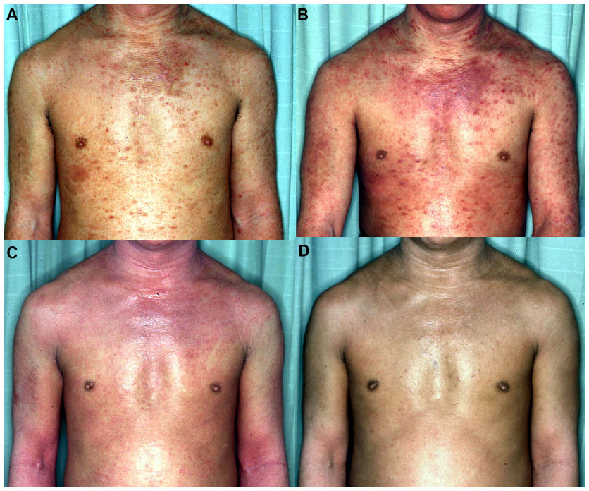
Symptoms of RSS/TSA/TSW
(A) A typical appearance of TSW, with prurigo-like eruption before withdrawal. (B) Appearance just after trial of decreasing the amount of potent topical steroids. The severity of addiction is so intense that the patient cannot safely withdraw by a gradual-decrease method. (C) The rebound erythema is spreading after complete cessation of steroids. (D) The appearance after 1 year. The rebound has almost subsided but hypersensitivity still remains.
Source: Mototsugu Fukaya MD, et al. “Topical Steroid Addiction in Atopic Dermatitis” Drug, Healthcare and Patient Safety, 2014;6: pp.131–138.

Slide 4
Symptoms of RSS/TSA/TSW
Can affect every part of the body - face, armpit, genital area
Rebound eruption can extend to skin where no original lesion existed and no TCS ever applied
Longer periods of application and more potent strength of the TCS more frequently leads to RSS
No statistic regarding prevalence of RSS/TSA/TSW, but a Japanese survey of patients with atopic dermatitis under treatment with TCS estimated ~12% of these adult patients were addicted
Sources:
Furue M, Terao H, Rikihisa W, et al. Clinical dose and adverse effects of topical steroids in daily management of atopic dermatitis. Br J Dermatol. 2003;148(1):128–133.
Hajar, Tamar, Yael A. Leshem, Jon M. Hanifin, Susan T. Nedorost, Peter A. Lio, Amy S. Paller, Julie Block, and Eric L. Simpson. "A Systematic Review of Topical Corticosteroid Withdrawal (âsteroid Addictionâ) in Patients with Atopic Dermatitis and Other Dermatoses." Journal of the American Academy of Dermatology 72.3 (2015): n. pag. Web.

Slide 5
Survey Objective
Survey objective is to increase the understanding of the relationship between TCS usage and RSS/TSA/TSW; and to increase understanding of the causes of RSS/TSA/TSW, its symptoms, severity and duration.

Slide 6
Survey Cohort
Survey posted in social media site dedicated to RSS/TSA/TSW
Respondents are self-identified individuals who visited social media site dedicated to RSS/TSA/TSW
Date range of responses: March 2014 to May 2015
5011 total responses
3840 adults over the age of 18
1171 pediatric responses not presented
2093 of adult respondents started TCS use as children
Notes:
For age 18 - (or did we use over age 16? verify with Patricia)

Slide 7
Survey Methodology
Survey consists of 64 multiple choice, numeric value and open-ended questions including:
Respondent demographics
History of TCS exposure by volume, potency, areas of application, episodes of usage
Elapsed time since stopping TCS
Severity and duration of symptoms after cessation of TCS

Slide 8
Methods
The survey data is analyzed in order to:
Quantify exposure to TCS according to COSTEX (COrticoSTeroid EXposure Index), as a function of volume, potency and areas of application
Assess symptoms by type, severity and duration in relation to elapsed time since stopping TCS

Slide 9
Findings
Severe and prolonged symptoms:
81% reported moderate to severe intense itching
77% reported moderate to severe red burning skin
69% reported moderate to severe raw painful skin
Of 31 respondents who reported having stopped TCS for 5+ years, 26% reported persistent symptoms

Slide 10
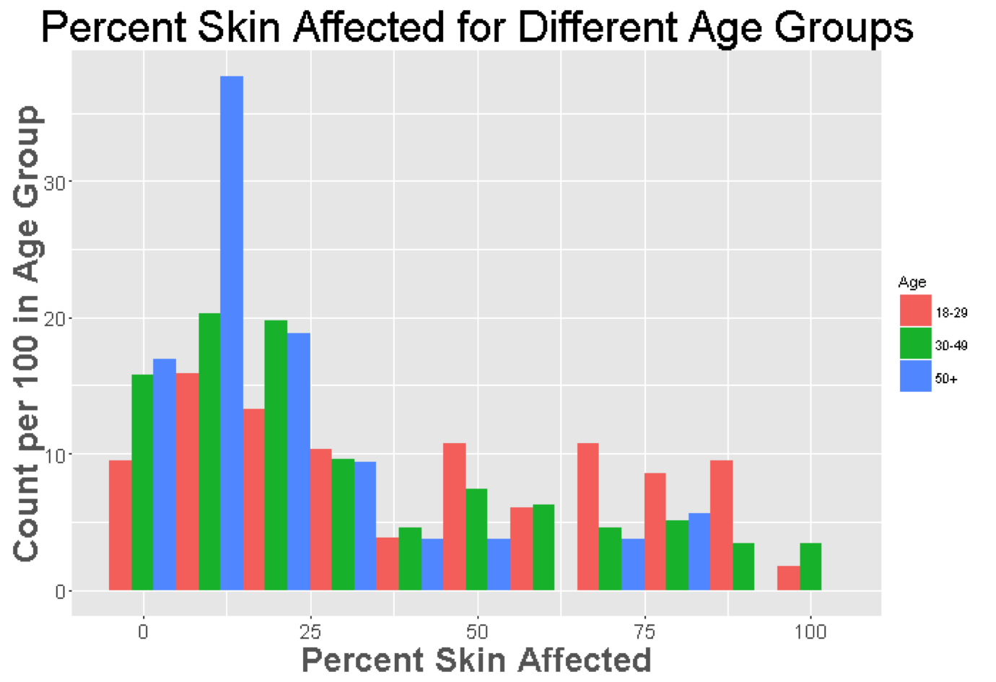

Slide 11
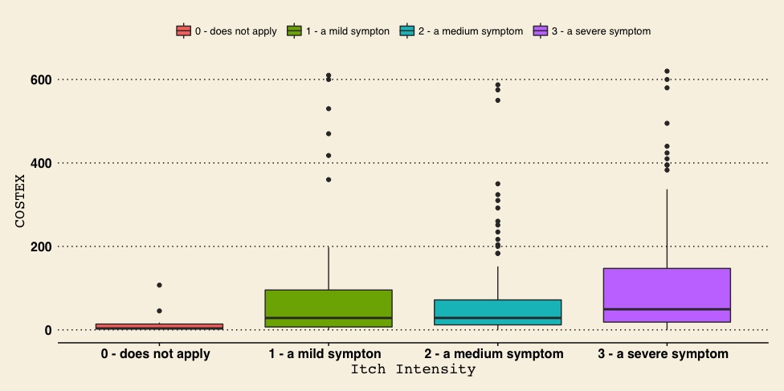
Duration of symptoms is correlated with COSTEX index
(spearman r = 0.27, p < .0005)
Notes:
- Change label name

Slide 12
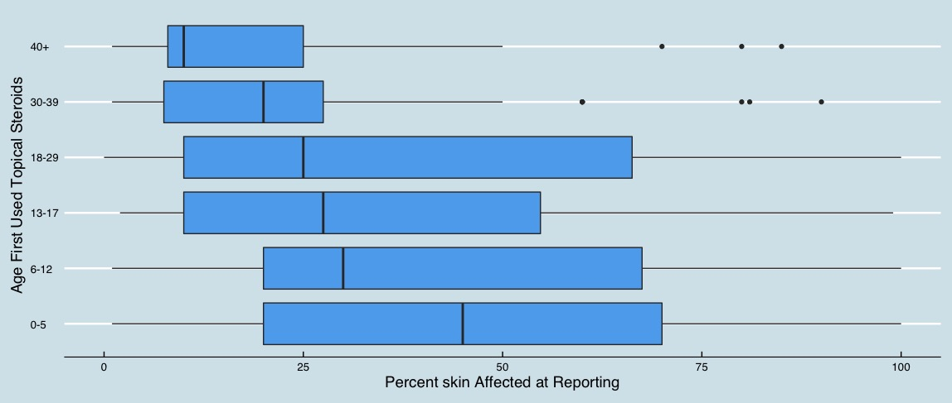
The younger the age of starting TCS, the greater the skin affected
(negative correlation, spearman r = -0.26, p = 1.185e-08)

Slide 13
Results
More severe symptomology for:
Younger age of starting TCS (p=.00006)
Longer duration of TCS exposure (p=5.985e-16)
Greater TCS exposure (COSTEX) (p<2.2e-16)
Higher COSTEX:
Greater percentage of skin affected
Higher itch severity
Correlation (r =.27) between COSTEX and duration of symptoms (p<.0005)

Slide 14
Results
The longer TCS were used, the longer symptoms persisted
A trend was observed that intense pruritis worsened for about 1.5 years after discontinuing TCS before improvement was reported
Prolonged symptomology after stopping TCS

Slide 15
Conclusions
Large numbers of patients who have used TCS believe they have symptoms related to their use
Longer duration and intensity of TCS (higher COSTEX Index) significantly associated with more sever and prolonged symptomatology
Self-reported information in this study is consistent with previous reports

Slide 16
Next Steps
Further study is needed to arrive at an accurate definition, diagnostic criteria, and prevention and treatment strategies for RSS/TSA/TSW

