Slide 1
diceGame
A Python Project

Slide 2
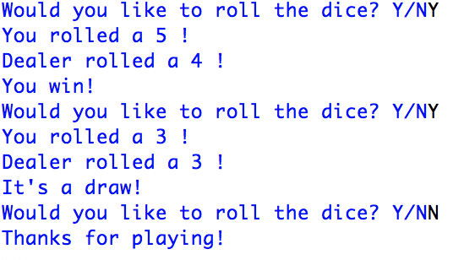
Objective
Create a dice game between User and Dealer (PC)

Slide 3
Algorithm
What is our APPROACH?
What mechanisms do we need?
Loops?
Branching?

Slide 4
Algorithm
“Would you like to roll the dice?”
What is our APPROACH?
Dice Roll
1) User wins
2) User loses
?
Output?
Output?
Output?

Slide 5
Code
To roll the dice, we need to introduce random.randint(min, max)
Returns a random value between min and max
What are the min and max values for a single die?

Slide 6
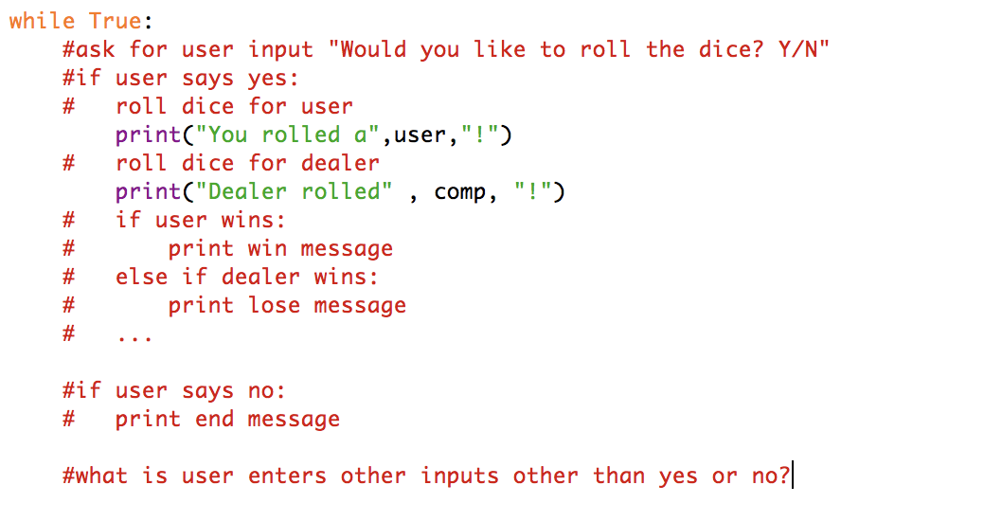
Pseudo-Code

Slide 7
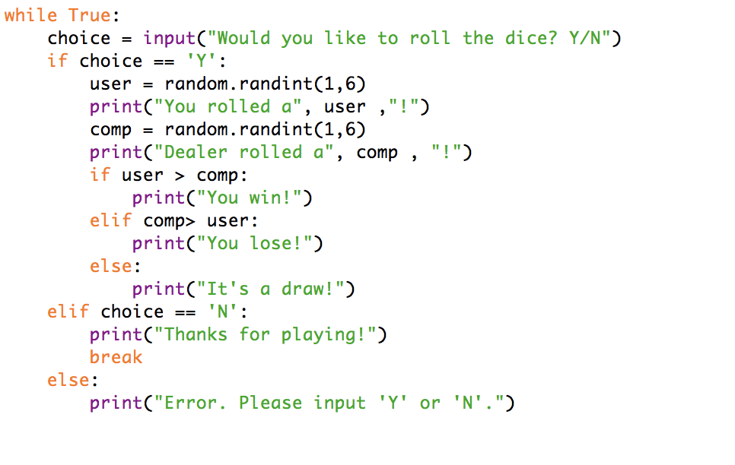
Fill in the blanks

Slide 8
Code

