Slide 1
Several topics in DevOps
Understand DevOps in Deep
MN China Operation & Transformation
May, 2018

Slide 2
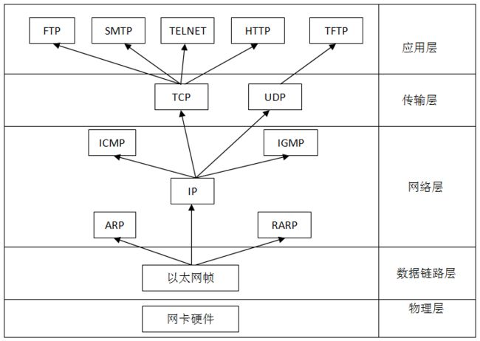

Slide 3
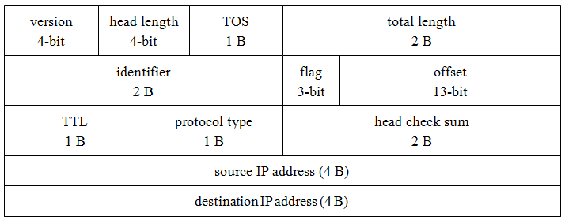

Slide 4

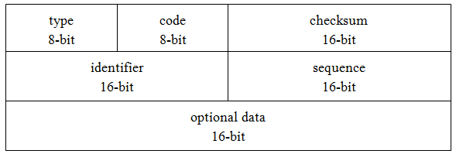

Slide 5


Slide 6
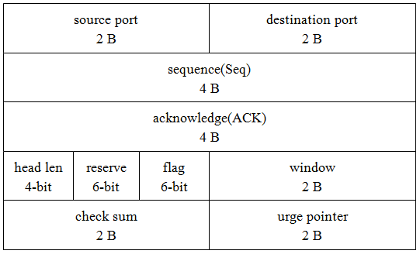

Slide 7
