Slide 2
- private Map<String, Object> getMapByJson(String json) {
- if (StringUtils.isBlank(json)) {
- return new HashMap<>();
- }
- return JsonUtil.fromJson(json, Map.class);
- }
+ private Map<String, Object> getMapByJson(String json) {
+ try {
+ return StringUtils.isBlank(json)
+ ? new HashMap<>()
+ : JsonUtil.fromJson(json, (new TypeToken<Map<String, Object>>() {
+ }).getType());
+ } catch (Exception e) {
+ log.error(e.getMessage());
+ }
+ return null;
+ }

Slide 3
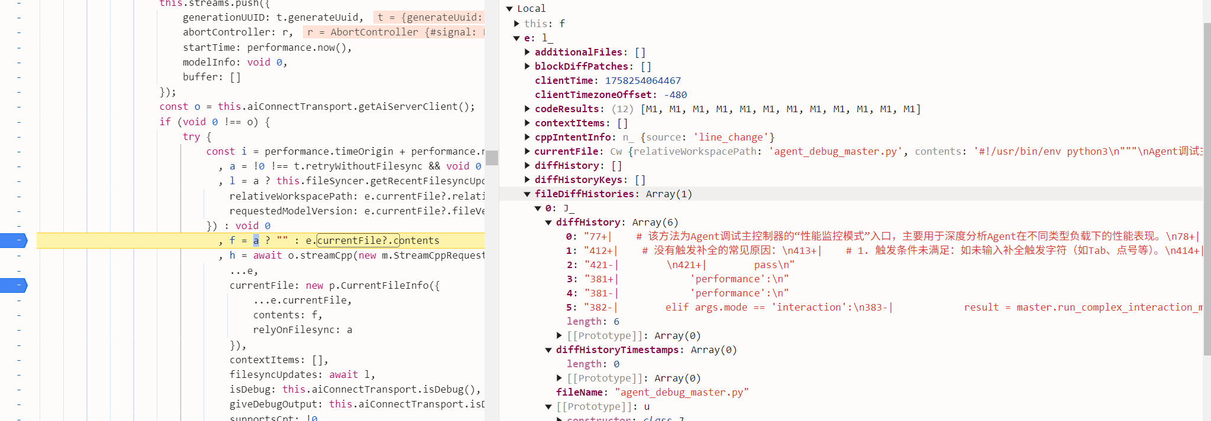
Cursor File Diff History

Slide 4
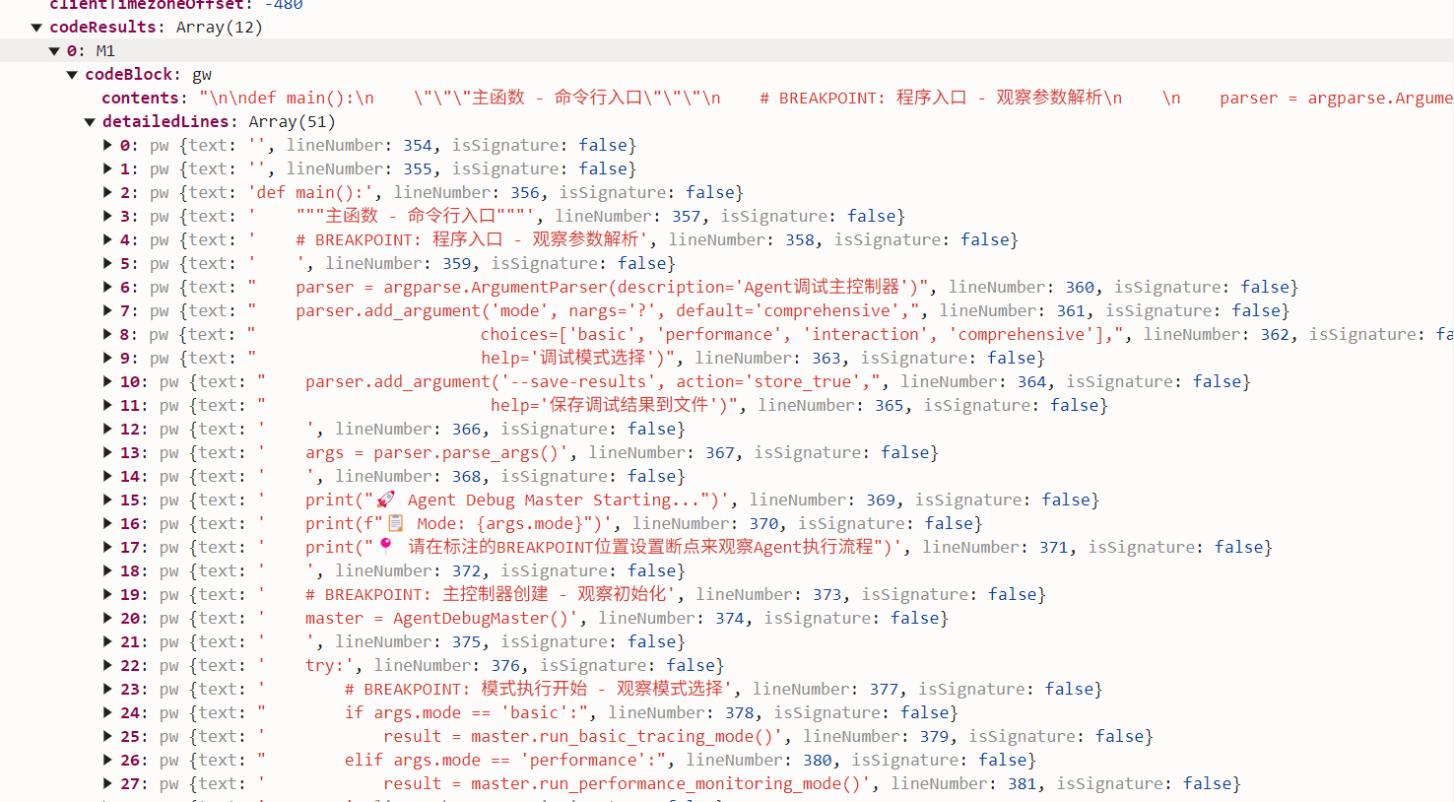

Slide 5
