Slide 1

FINAL YEAR PROJECT · COMPUTER ENGINEERING - HARDWARE & CHIP DESIGN
taoFPGA
Architecture, Implementation, and Evaluation of a Quantized Transformer Processing Core on an Edge FPGA
Eliran Turgeman 316372002 Shay Rask 314951658
Academic supervisor: Dr. Leonid Yavits
Project mentor: David Freud
PROJECT 309
Notes:
Greeting + introductions. We are Eliran Turgeman and Shay Rask, Computer Engineering, hardware & chip design track. Supervisor Dr. Leonid Yavits, mentor David Freud. Project 309: taoFPGA, a quantized INT8 Transformer processing core taken from fixed-point math all the way to real silicon on a $200 Zynq board. 15 minutes; Shay takes background/architecture, Eliran takes verification/results.

Slide 2
WHERE WE ARE GOING
Outline
PROJECT 309
1 Background & motivation - the edge-AI compute dilemma
2 Problem statement, objectives & scope
3 Methodology - a verify-every-layer co-design flow
4 Core hardware architecture (systolic array + fixed-point Softmax/GELU)
5 Technical contribution - a synthesis attribute that silently did nothing
6 Results: kernel speedup, silicon verification, honest workload analysis
7 Planning vs. execution, challenges, budget & roadmap
8 Conclusions & recommendations
taoFPGA · Transformer Accelerator on FPGA · Project 309
02
Notes:
30-second roadmap. Flag slide 5 as the self-contained technical contribution the guidelines ask for - it stands on its own even if you have not read the report.

Slide 3

1 · SIGNIFICANCE & JUSTIFICATION
Background: the edge-AI compute dilemma
PROJECT 309
▸ Transformers are the state of the art in both NLP and computer vision (Vision Transformers, ViT).
▸ Their computational profile is hostile to edge hardware:
- $O(N2)$ self-attention in the sequence length
- large dense matrix multiplications in every encoder layer
- non-linearities (Softmax, GELU) between those matmuls
▸ Edge SoCs are simultaneously short on DRAM bandwidth, on-chip memory and power budget - exactly the resources Transformers stress.
▸ A general-purpose CPU/GPU wastes energy on control and data movement; a dedicated datapath does not - a computer-engineering problem: co-design the arithmetic, the data movement and the silicon together.
Why an FPGA
▸ Custom INT8 datapath, no ISA overhead
▸ Hard DSP + BRAM blocks map matmul directly
▸ Reprogrammable - an academic-scale ASIC proxy
▸ Commodity board: PYNQ-Z2, ~$199
Builds on prior FPGA transformer accelerators (ME-ViT, FTRANS, systolic-array designs) - same design family, embedded-scale device.
taoFPGA · Transformer Accelerator on FPGA · Project 309
03
Notes:
Establish the gap. Every recent FPGA transformer accelerator converges on the same three ideas - systolic/PE matmul, fixed-point quantization, dedicated activation units - because the bottleneck is always the same. Prior art (refs [2]-[5]) targets datacenter FPGAs; we target a 220-DSP embedded Zynq. The engineering interest is the resource pressure: everything is scarce at once.

Slide 4


1 · PRELIMINARIES (SELF-CONTAINED)
Three ideas the rest of the talk builds on
PROJECT 309
Self-attention
INT8 quantization
Systolic array
▸ Every token attends to every other token.
▸ $Q·KT$→ scale → Softmax → weighted sum of V.
▸ Then a position-wise MLP with a GELU.
▸ Cost is $O(N2)$MACs - the quadratic term.
▸ Store each value as a signed 8-bit int + a shared power-of-two scale.
▸ $x ≈ round(x / scale).$
▸ INT8 × INT8 → wide product → round-half-up & saturate to [-128, 127].
▸ ⅓ the memory bandwidth of FP32.
▸ 2D grid of tiny multiply-accumulate PEs.
▸ Operands stream through neighbours only - no global memory, short wires.
▸ Weight-stationary: each PE holds one weight while features stream past.
▸ Matches the Transformer's weight-reuse pattern.
These three primitives are the whole talk: matmul + Softmax + GELU, in INT8, on a systolic array.
taoFPGA · Transformer Accelerator on FPGA · Project 309
04
Notes:
This slide is the glossary so the contribution slides are self-contained. Keep it to ~45s: attention is matmul + Softmax + matmul + GELU; quantization trades precision for bandwidth and logic; a weight-stationary systolic array is how you do the matmul without long wires.

Slide 5
2 · THE CORE ISSUE
Problem statement
PROJECT 309
Run the compute-dominant primitives of a Transformer block - dense matmul plus its Softmax / GELU non-linearities - as a dedicated, numerically-verified INT8 datapath on a commodity 220-DSP edge FPGA, and prove the speed-up is real.
▸ FP32 inference is infeasible on an embedded FPGA - every MAC costs more logic, every value costs 4× the bandwidth.
▸ A correct accelerator is not enough: it has to be verified against a ground-truth model at every layer (RTL, integration, silicon).
▸ And the reported gain must correspond to an operation the hardware can actually perform correctly - not an impressive-looking number that hides a broken computation.
taoFPGA · Transformer Accelerator on FPGA · Project 309
05
Notes:
Three clauses: (1) build the datapath on a small device, (2) verify it end to end, (3) only claim a speed-up that is genuinely true. The third clause becomes a real result later (slide 18).

Slide 6
3 · GENERAL & SPECIFIC
Objectives
PROJECT 309
General Design, implement and quantitatively evaluate a complete hardware accelerator for a Transformer block's dominant primitives on a resource-constrained edge FPGA, and demonstrate measurable latency / throughput / energy gains over a CPU baseline.
O1
INT8 weight-stationary 16×16 systolic matmul core with fused fixed-point Softmax and GELU engines, formalised as exact fixed-point equations.
O2
Tolerance-bounded verification: SystemVerilog testbenches + a bit-faithful Python/NumPy golden model carried to silicon.
O3
Integrate the core as an AXI peripheral on a Zynq-7020 (PYNQ-Z2) SoC and bring it up on real hardware.
O4
Close physical timing at 100 MHz and optimise post-route resource / power at signoff.
O5
Benchmark the hardware kernel against the on-chip ARM Cortex-A9 and characterise the result honestly against real ViT workloads.
taoFPGA · Transformer Accelerator on FPGA · Project 309
06
Notes:
These five specific objectives are the spine of the whole talk and the conclusion returns to each one with a recommendation.

Slide 7
4 · WHAT THIS PROJECT IS AND IS NOT
Scope & boundaries
PROJECT 309
IN SCOPE
OUT OF SCOPE
▸ Fused matmul → Softmax → GELU streaming pipeline
▸ INT8, weight-stationary, 16×16 systolic array (256 MACs)
▸ Xilinx Zynq-7020 / PYNQ-Z2, 100 MHz
▸ RTL flow (SystemVerilog / Verilog), not HLS
▸ Kernel-level benchmark vs. the board's ARM Cortex-A9
▸ Full physical signoff + bitstream + silicon bring-up
▸ End-to-end accelerated ViT inference (fixed pipeline maps to no single ViT sub-block - slide 18)
▸ Batch processing & the full 768-wide ViT-Tiny MLP (64 KB DMA ceiling)
▸ Training / back-propagation
▸ Datacenter-class FPGAs and multi-device scaling
▸ Physically-instrumented power measurement (signoff-grade estimate used)
taoFPGA · Transformer Accelerator on FPGA · Project 309
07
Notes:
Being explicit about the out-of-scope column is itself a result: each exclusion has a concrete, documented reason, not hand-waving. The DMA ceiling and the ViT workload mismatch both come back later.

Slide 8
5 · CO-DESIGN FLOW
Methodology: a verify-every-layer flow
PROJECT 309
Fixed-point math (Eq. 1-2)
RTL + SystemVerilog testbenches (Cadence Xcelium)
Python / NumPy bit-faithful golden model
SoC integration (Vivado IP Integrator)
P&R + physical signoff (timing, power)
Bitstream + hardware platform (.xsa)
PYNQ-Z2 silicon bring-up & benchmark
Governing discipline: every layer is checked against its own reference, never assumed correct because the layer below it passed. The SystemVerilog golden model is re-derived in NumPy and cross-checked against the RTL shifter's exact rounding before it is trusted to validate silicon.
Verification is tolerance-bounded (scale-dependent LSB threshold), not exact-match - to absorb quantization-error compounding across two INT8 boundaries.
taoFPGA · Transformer Accelerator on FPGA · Project 309
08
Notes:
The flow is linear on the slide but was highly iterative in practice (Appendix A). The key methodological choice: a bug at layer N is not diagnosed by trusting layer N-1; each interface is re-derived from the current source of truth. This is what caught the stale driver and the six parameter mismatches.

Slide 9
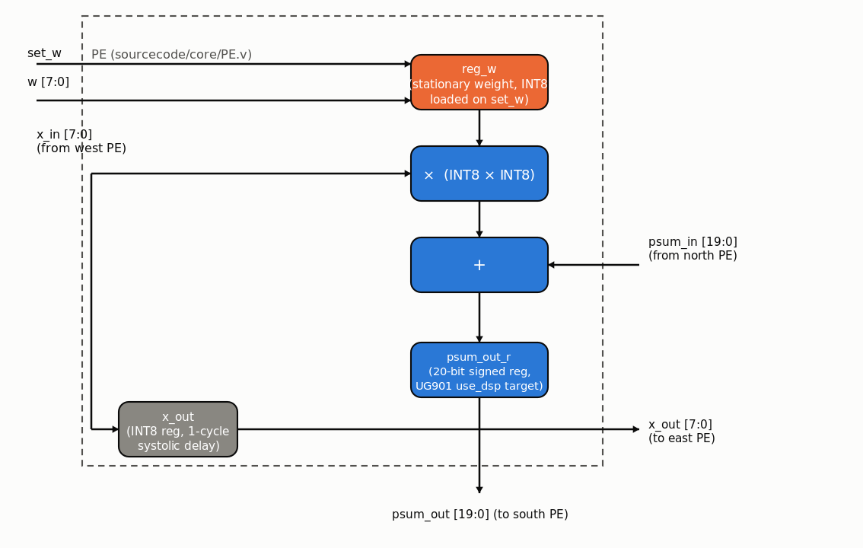

6 · SYSTOLIC MATMUL CORE (MM_ULTRA)
Core architecture - the processing element
PROJECT 309
▸ $16 × 16$grid → 256 INT8 MACs, one MAC / PE / cycle.
▸ Weight-stationary: reg_w loaded once via set_w, held for the whole matmul; x streams west→east, psum north→south.
▸ 20-bit signed accumulator ($2·data_width + log2 m, m = 16$).
▸ Output round-half-up on an arithmetic right shift, then clip to $[−128, 127]$ (Eq. 1, right_shifter.v).
▸ Runtime block-count registers set the contraction / output dims.
taoFPGA · Transformer Accelerator on FPGA · Project 309
09
Notes:
One PE: a held weight, a streamed activation with a registered pass-through, a multiplier, and a 20-bit accumulate register. That psum_out_r register is the exact object the contribution slide is about. Round-half-up-and-saturate is the only place precision is lost, and it is formalised so the golden model can match it exactly.

Slide 10
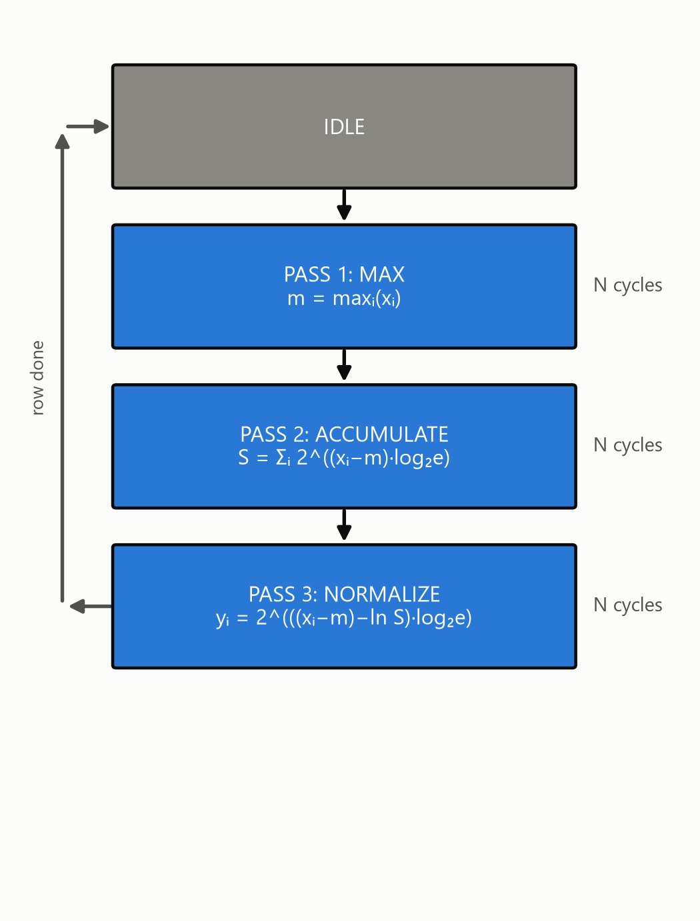
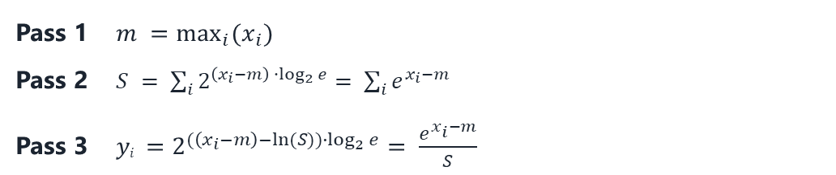
6 · SOFTMAX & GELU
Core architecture - fixed-point non-linear engines
PROJECT 309
▸ Softmax - 3-pass scalar FSM, one buffered row at a time; each pass streams the full row once.
▸ Pass 2/3 use a base-2 exp approximation (log₂ e-scaled); pass 3 avoids a divider with a log-domain term (Ln_module).
▸ GELU - two-segment piecewise-linear: saturate outside a threshold, linear correction (lin.v) inside.
Per-pass equations (exact base-2 restatement of softmax)
Pass 1 $m =\max_{i}{(x_{i})}$
Pass 2 $S = \sum_{i}{2^{\left(x_{i}−m\right)∙\log_{2}{e}}= \sum_{i}{e^{x_{i}−m}}}$
Pass 3 $yi =2^{(\left(x_{i}−m\right)−ln⁡(S))∙\log_{2}{e}}= \frac{e^{x_{i}−m}}{S}$
3N cycles / row, strictly serial → the Softmax throughput bottleneck.
taoFPGA · Transformer Accelerator on FPGA · Project 309
10
Notes:
Softmax is exact softmax re-expressed in the base-2, log-domain form the hardware actually computes - so 'golden' really means identical, not merely close. The 3N-cycle serial structure is a deliberate area choice and a known throughput limit we quantify later.

Slide 11
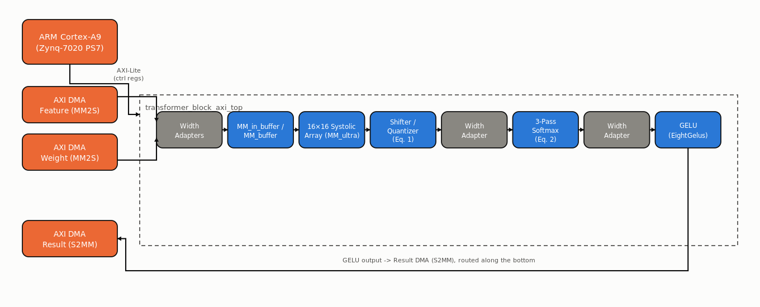
6 · TRANSFORMER_BLOCK_AXI_TOP
SoC integration on the Zynq-7020
PROJECT 309
▸ AXI4-Lite control (7 config regs + 1 status bit) + dual AXI4-Stream in (feature, weight) / single AXI4-Stream out (result).
▸ Three independent AXI DMA engines; PS7 dual-core Cortex-A9 configures and drives the streams; AXI SmartConnect interconnect.
▸ Bespoke AXI-Stream width adapters bridge the parallel array ↔ serial Softmax ↔ GELU datapath widths, plus a purpose-built row-boundary signal.
taoFPGA · Transformer Accelerator on FPGA · Project 309
11
Notes:
Integration surfaced two things worth noting: 40+ async-reset DRC violations on BRAM control logic (fixed across 12 files), and the discovery that the *full* pipeline had never actually been AXI-wrapped - only the standalone matmul. We built the wrapper keeping the RTL's own parameter names to avoid re-introducing an earlier drift bug.

Slide 12
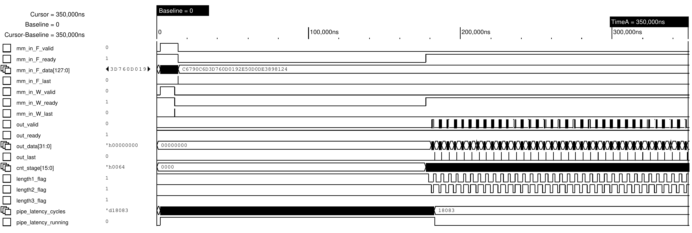
6 · CADENCE XCELIUM SIMULATION
RTL verification - tolerance-bounded, end to end
PROJECT 309
FULL-SCALE RUN · 200 × 96 × 160
0 / 32,000
output elements outside the tolerance bound
3-Pass Softmax Progression
18,083
cycle end-to-end latency, read straight off the counter
18,083 cycles locked
Real SimVision capture (transformer_block_tb): AXI-Stream ingest, 3-pass Softmax flags, streaming output; pipe_latency_cycles locks at 18,083.
4 SystemVerilog testbenches (gelu, Softmax, MM_Ultra, integration), each with a $real golden reference.
taoFPGA · Transformer Accelerator on FPGA · Project 309
12
Notes:
Tolerance is a 6-LSB bound at the shared Softmax/GELU scale, chosen to absorb error compounding across two INT8 boundaries - not a fudge. The 18,083-cycle figure is read off the counter in the waveform, not reconstructed, and it is the same number the silicon run reproduces later.

Slide 13
★ A SYNTHESIS ATTRIBUTE THAT SILENTLY DID NOTHING
Technical contribution - the symptom
PROJECT 309
Post-route, the matmul-dominated accelerator was LUT-bound, not DSP-bound - the exact inverse of what a 256-MAC systolic array should look like.
Resource (post-route, full SoC) | Usage | Reading
DSP48E1 hard multipliers | 13 / 220 (5.9%) | almost idle
Slice LUTs | 30,276 / 53,200 (56.9%) | near the limit
CARRY4 primitives | 4,874 | MACs built from fabric
▸ A 16×16 INT8 multiply-accumulate array is precisely the workload DSP48E1 blocks exist for - yet synthesis was building the multipliers out of general LUT / CARRY4 logic.
▸ First fix attempt: put a (* use_dsp = "yes" *) attribute on the multiply-accumulate always block. Re-synthesis produced byte-identical LUT / DSP / CARRY4 counts - no error, and no effect.
taoFPGA · Transformer Accelerator on FPGA · Project 309
13
Notes:
Frame it as a diagnosis story. 5.9% DSP utilisation on a systolic array is a red flag you only see if you read the utilisation report, not just 'did the build pass'. The obvious pragma did literally nothing, and crucially it did nothing *silently*.

Slide 14
★ ATTRIBUTE PLACEMENT + A BUDGET-SIZED MAPPING
Technical contribution - root cause & fix
PROJECT 309
Per Xilinx UG901, use_dsp must attach to the register declaration that holds the multiply result - an attribute on the always statement is not a recognised attachment point and is dropped during elaboration with no warning.
BEFORE - no-op
AFTER - UG901-correct
(* use_dsp = "yes" *)
always @(posedge clk) begin
psum_out <= psum_in + x_in*reg_w;
end
// attribute on the block: silently ignored
(* use_dsp = "yes" *) reg signed
[2*data_width+log2_array_m-1:0] psum_out_r;
always @(posedge clk)
psum_out_r <= psum_in + x_in*reg_w;
// output reg -> wire, driven by continuous assign
■ keyword ■ (* pragma *) ■ // comment ■ signal / var ■ literal
▸ Fix is cycle-for-cycle behaviour-identical: output reg → wire, an internal register carries the attribute, port driven by a continuous assignment.
▸ All 256 PEs on DSP would exceed the 220-slice budget, so PE_array.v parameterises the split - NUM_DSP_ROWS = 12 of 16 → 192 PEs on DSP48E1, 4 rows (64 PEs) on LUT/CARRY4.
▸ Deliberate, budget-sized partial mapping - not an all-or-nothing switch.
taoFPGA · Transformer Accelerator on FPGA · Project 309
14
Notes:
Two parts: (1) the attribute-attachment rule - wire vs reg, declaration vs block - which is easy to miss from the UG901 text; (2) you cannot just flip every PE to DSP because the chip only has 220 slices, so the mapping is parameterised and sized to the budget. True dual-8-bit DSP packing was considered and rejected as too invasive to the array timing skew.

Slide 15
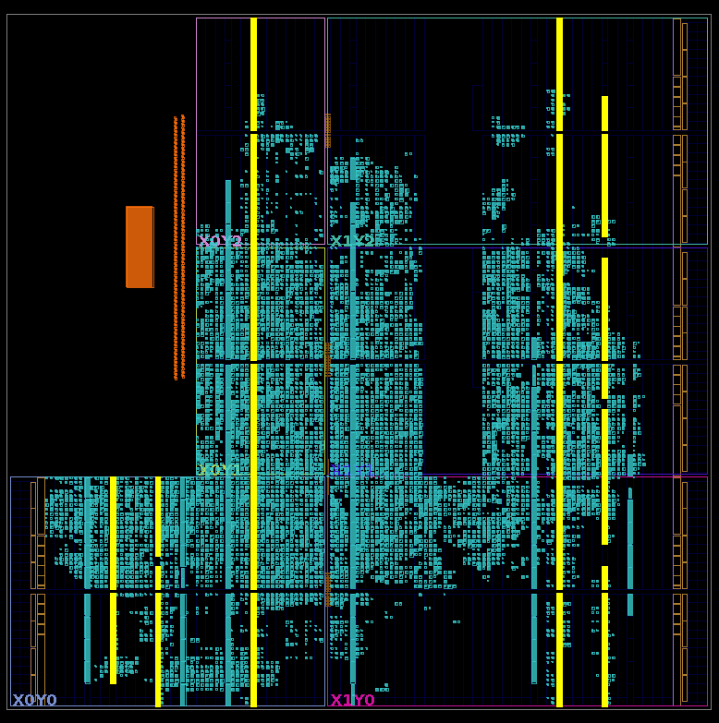
★ ONE RTL-LOCAL CHANGE, MEASURED BEFORE / AFTER
Technical contribution - result at signoff
PROJECT 309
Metric (post-route, full SoC) | Before | After | Δ
Slice LUTs | 30,276 (56.9%) | 15,363 (28.9%) | -49.3%
CARRY4 primitives | 4,874 | 1,862 | -61.8%
DSP48E1 | 13 / 220 (5.9%) | 205 / 220 (93.2%) | +192
WNS @ 100 MHz | +0.361 ns | +0.293 ns | -19% marg.
Total on-chip power | 1.741 W | 1.687 W | -3.1%
205 / 220 DSP48E1 (93.2% DSP column saturation)
+192
DSP48E1 slices
-49.3%
Slice LUTs
-3.1%
on-chip power
Vivado Device view - post-implementation cell placement across the Zynq-7020 fabric; yellow = DSP / BRAM columns.
Lesson a synthesis pragma that raises no error can still do nothing - check utilisation before / after, not just that the build passed.
WNS +0.361 → +0.293 ns: denser DSP column, timing still met - an anticipated trade-off, not a regression.
taoFPGA · Transformer Accelerator on FPGA · Project 309
15
Notes:
This is the headline: a single, behaviour-preserving RTL change cut LUTs in half and dropped power 3%. It stands entirely on its own - no other slide needed to understand it. The lesson generalises to any tool pragma.

Slide 16
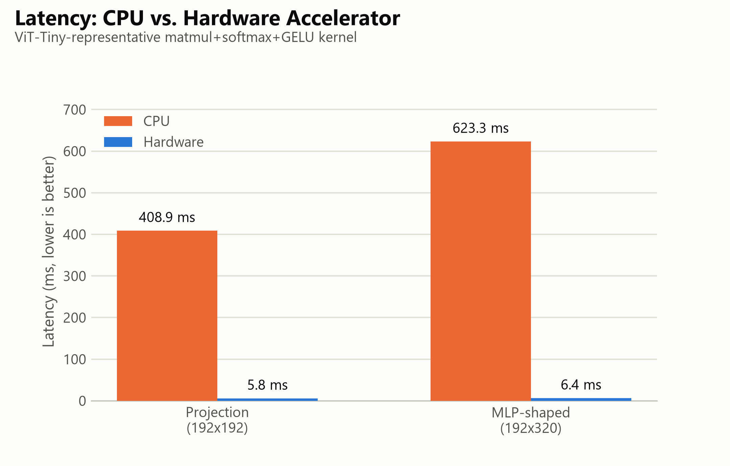
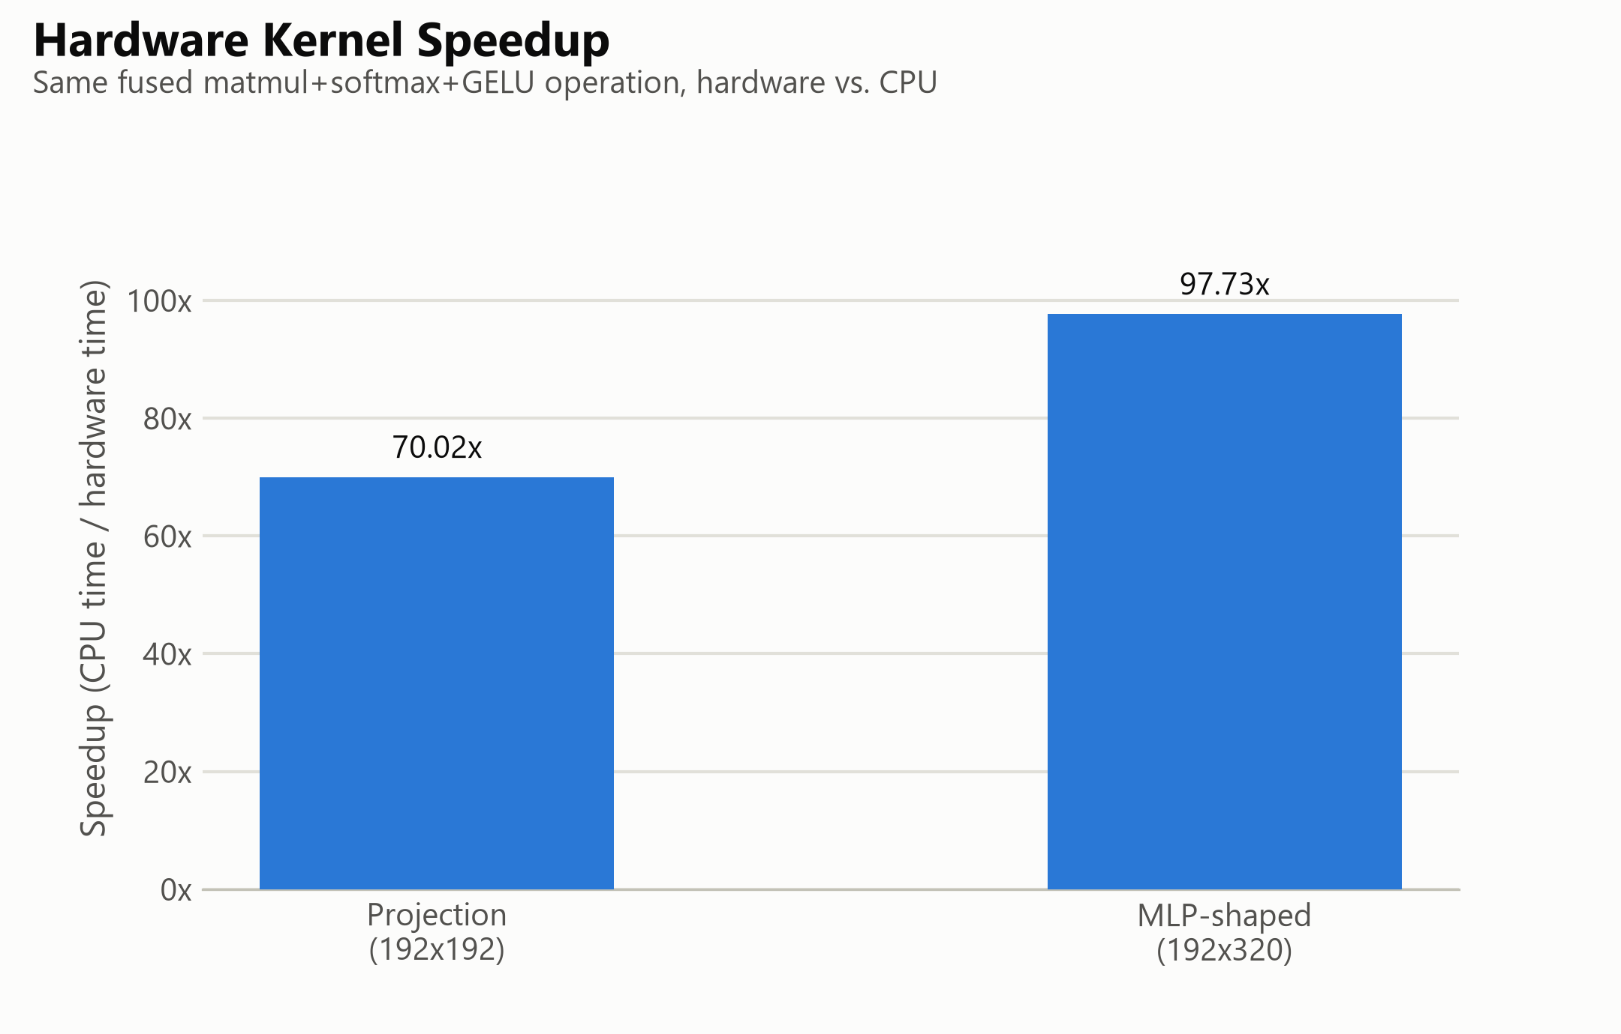

7 · KERNEL BENCHMARK ON PYNQ-Z2
Results - hardware kernel vs. ARM Cortex-A9
PROJECT 309
Shape (fused matmul+Softmax+GELU) | HW | CPU | Speedup
192 × 192 (projection-sized) | 5.84 ms | 408.9 ms | 70.02×
192 × 320 (MLP-shaped) | 6.38 ms | 623.3 ms | 97.73×
70.02× - 97.73×
measured kernel speedup vs. ARM Cortex-A9
2.25 GOPS/W
energy efficiency @ 3.795 GOP/s peak (2.47 dyn.)
$$speedup = \frac{tCPU}{t_{HW}} throughput = 2·\frac{MNK}{tkernel}$$
taoFPGA · Transformer Accelerator on FPGA · Project 309
16
Notes:
Same fused operation on both sides. 70x and 98x measured, live, on the board. Efficiency combines the live throughput with Vivado's post-route activity-based power estimate - a signoff-grade estimate, stated as such, not a wall-plug measurement.

Slide 17
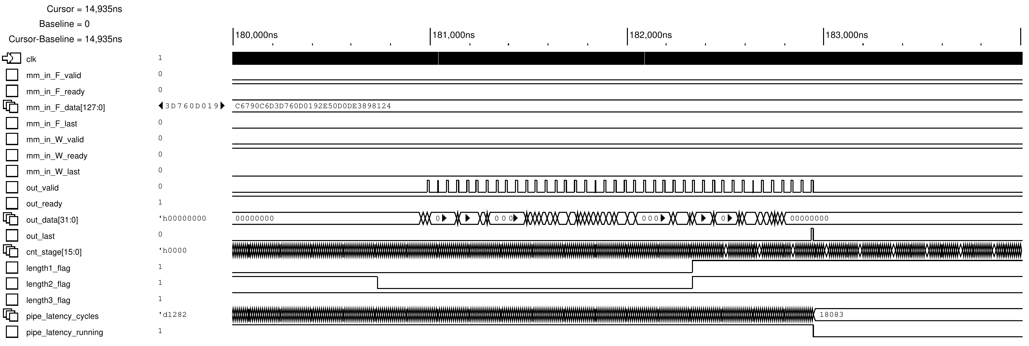

7 · PHYSICAL VERIFICATION AT THE VERIFIED SCALE
Results - simulation ≡ silicon
PROJECT 309
Same shape, real board
$200 × 96 × 160$, on the physical PYNQ-Z2, read back over the PYNQ Python driver:
Continuous 32-bit streaming output
Single-cycle out_last pulse
0 / 32,000
output elements outside the tolerance bound
Behavioural simulation and physical silicon agree at the design's originally verified scale - not a new, more forgiving test.
SimVision zoom: end-of-inference handshake - out_valid / out_data[31:0], single-cycle out_last, counter locking at 18,083.
taoFPGA · Transformer Accelerator on FPGA · Project 309
17
Notes:
The decisive move during bring-up: when small 'smoke-test' shapes failed, we re-ran the *exact* shape simulation had already proven, and it was perfect. That separated 'the design is broken' from 'my quick test exercised an unverified corner' - which is what it was (a single-row address-counter edge case, documented as open).

Slide 18
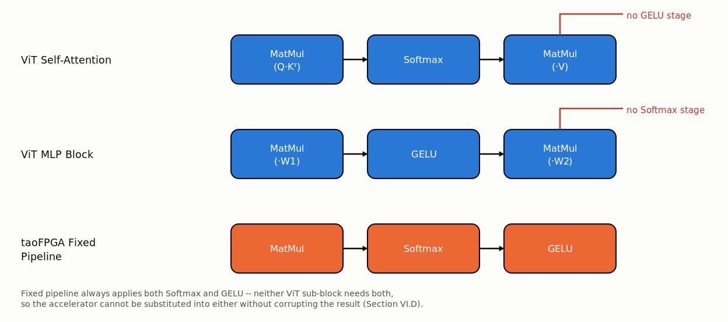
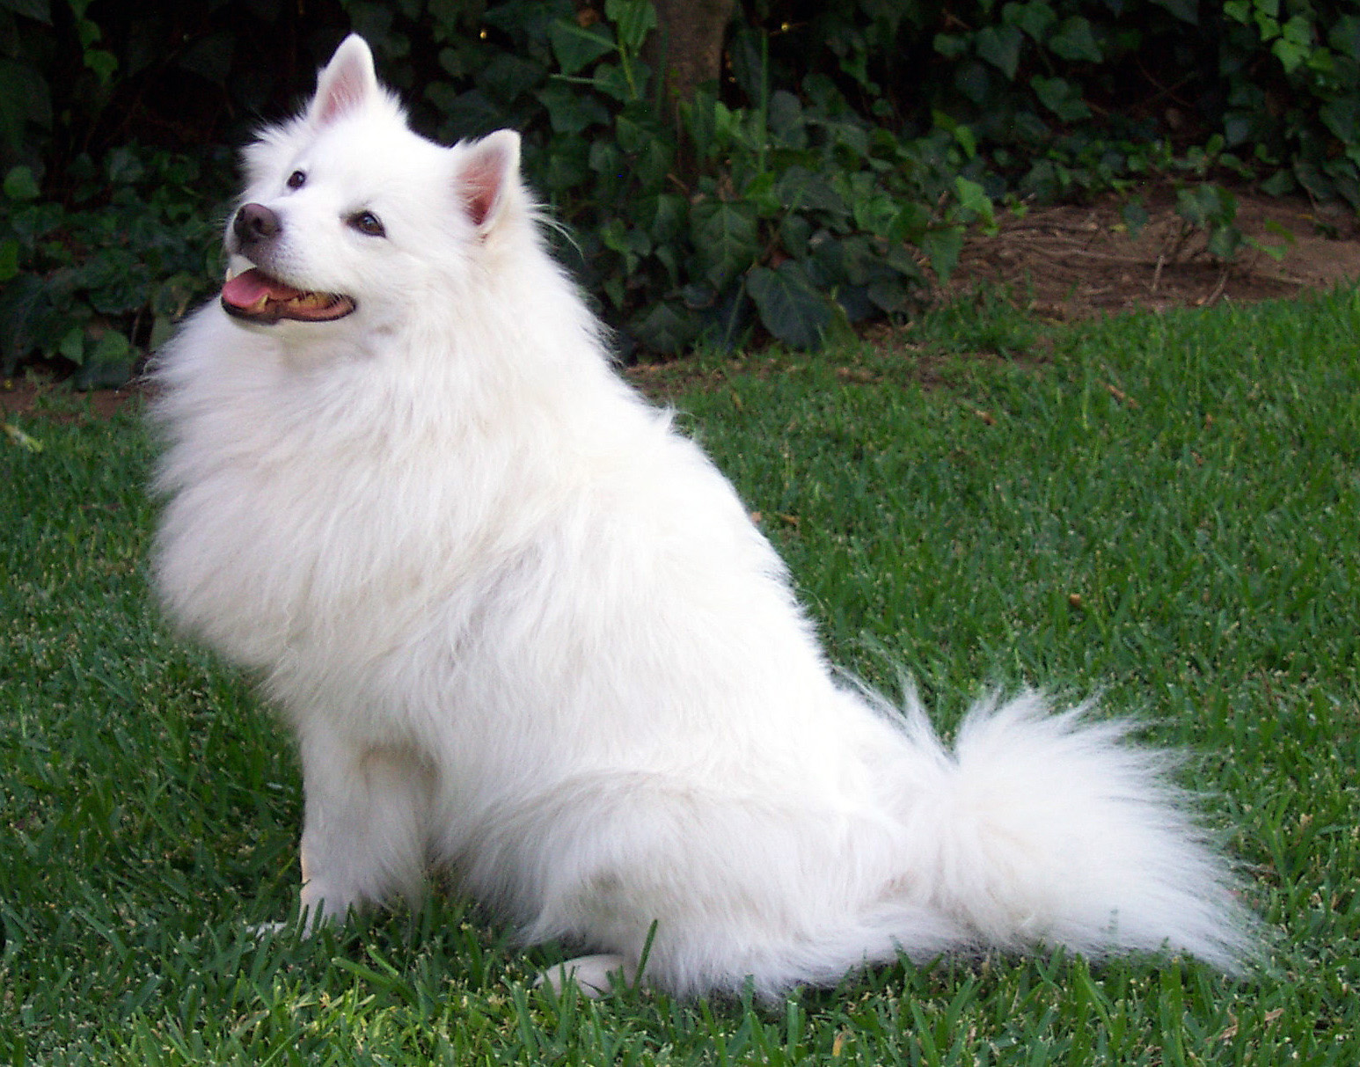

7 · WORKLOAD CHARACTERISATION (A METHODOLOGICAL RESULT)
Results - an honest workload analysis
PROJECT 309
▸ The fixed matmul→Softmax→GELU pipeline maps to no single ViT operation:
- self-attention = matmul-Softmax-matmul, no GELU
- MLP block = matmul-GELU-matmul, no Softmax
▸ Substituting it into either would silently apply an extra normalisation / activation and corrupt the result.
▸ Verified against the RTL, not assumed - so we report a kernel throughput benchmark, never an end-to-end accelerated-ViT claim.
Samoyed · 87.26% confidence
Empirical software-baseline check
From-scratch NumPy ViT-Tiny classifies this sample as Samoyed (87.26% confidence) - identical top-1 to the PyTorch reference,
$$\max\left|Δ_{logit}\right|≤1.0 ×{10}^{−5}$$
$$Δ_{logit}=|z_{NumPy}−z_{PyTorch}|$$
taoFPGA · Transformer Accelerator on FPGA · Project 309
18
Notes:
This is the 'transparency' the guidelines ask for, turned into a contribution. Asked for an end-to-end ViT speed-up, we checked first whether the comparison would even be true - it would not - and reported that instead of a fabricated number. The check before the benchmark mattered more than the benchmark.

Slide 19
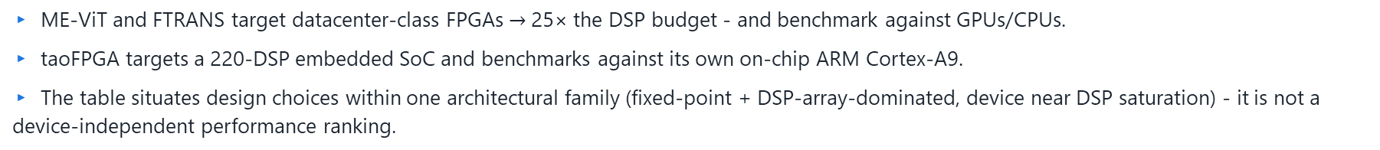
7 · SAME DESIGN FAMILY, DIFFERENT DEVICE CLASS
Comparison with prior FPGA transformer accelerators
PROJECT 309
Design | Target FPGA (total DSPs) | Precision | DSP util. | Reported efficiency
taoFPGA (this work) | Zynq-7020 (220) | INT8 | 205/220 (93%) | 2.25 GOPS/W; 70-98× vs. on-chip ARM
ME-ViT [3] | Alveo U200 (5,867) | n/s | 1,024 (17%) | 4.0× power-eff. vs. GPU
FTRANS [4] | VCU118 (6,840) | 16-bit fixed + BCM | 82-96% | 81× / 8.8× vs. CPU / GPU
▸ ME-ViT and FTRANS target datacenter-class FPGAs $→$25× the DSP budget - and benchmark against GPUs/CPUs.
▸ taoFPGA targets a 220-DSP embedded SoC and benchmarks against its own on-chip ARM Cortex-A9.
▸ The table situates design choices within one architectural family (fixed-point + DSP-array-dominated, device near DSP saturation) - it is not a device-independent performance ranking.
taoFPGA · Transformer Accelerator on FPGA · Project 309
19
Notes:
Same discipline as the ViT slide: a raw GOPS/W ranking across three very different devices would misrepresent the comparison, so we don't make one. All three designs run their device's DSP column near saturation - that's the shared story.

Slide 20
8 · PRE-PROJECT PLAN → WHAT ACTUALLY HAPPENED
Planning vs. execution
PROJECT 309
Phase (pre-project report) | Planned | Actual execution
1 Literature review & theory | Dec 25 · Eliran | Done. Transformer arch, HW quantization, FPGA accel surveyed; 8 refs cited.
2 Architecture & methodology | Jan 26 · Shay | Done. Weight-stationary 16×16 INT8 array + fused fixed-point Softmax/GELU. RTL flow chosen over HLS.
3 Critical component / POC | Feb 26 · Eliran | Done. MM_ultra core built & verified in Cadence Xcelium vs. a SystemVerilog golden model.
4 Full impl. & integration | Apr 26 · Shay | Done, expanded: full pipeline AXI-wrapped from scratch; 60 async-reset blocks fixed / 12 files; 6 stale script params corrected.
5 Performance test & calibration | May 26 · Eliran | Done. PYNQ-Z2 bring-up; full-scale run 0/32,000 errors; 'calibration' became the DSP-inference fix (LUT -49%, power -3%).
6 Results analysis & report | Jun 26 · both | Done. Kernel benchmark vs. on-chip ARM (70-98×). GPU / end-to-end-ViT comparison dropped after workload-mismatch analysis.
Schedule | Final pres. Jun 26 | Final report Sep 22 2026 (~3-month slip): early environment/infrastructure debugging + added integration scope.
taoFPGA · Transformer Accelerator on FPGA · Project 309
20
Notes:
Mandatory slide. Honest read: all six work phases completed, two with more scope than planned (integration, calibration-turned-optimisation). Two deliberate scope changes - RTL instead of HLS, and kernel benchmark instead of GPU/end-to-end-ViT - each for a documented engineering reason. ~3-month calendar slip, mostly from environment/infrastructure problems early on.

Slide 21
8 · WHAT WAS HARD, WHAT IS STILL OPEN
Challenges & engineering discussion
PROJECT 309
STANDING BOTTLENECKS
REPRESENTATIVE DEBUGGING WINS
▸ 64 KB single-transfer DMA ceiling (16-bit length reg). Blocks the 768-wide ViT-Tiny MLP and all batching.
- chunking is unsafe: tlast resets the buffer write-address counter every transfer → chunk 2 overwrites chunk 1
▸ Serial Softmax: parallel 2-D array (A_size results/cycle) feeding a 1-scalar/cycle, 3N-cycle stage - a structural throughput limit.
▸ Async-reset DRC: one root cause chased through 12 files / 3 re-synth rounds → project-wide grep audit.
▸ Elaboration-time memory blow-up from a generate-unrolled test array → on-demand packing functions (5.9 GB → 51 MB).
▸ A comprehensively stale PYNQ driver, rebuilt from the real register map.
▸ Tiny-shape HW mismatch traced to a single-row address-counter edge case - not a design flaw (re-ran the verified shape to confirm).
taoFPGA · Transformer Accelerator on FPGA · Project 309
21
Notes:
Left column = what we would fix next and why it is non-trivial. Right column = four Appendix-A stories that show method: audit the pattern not the symptom; scale test data with an on-demand function; re-derive an interface from its source of truth; and re-run a known-good condition before blaming the design.

Slide 22
8 · NEXT ITERATION
Improvements & architectural roadmap
PROJECT 309
1
Scatter-Gather DMA - Replace direct-register DMA (or re-synthesise with a wider transfer-length register). Per-descriptor frame-boundary control removes the 64 KB ceiling → full-width MLP + batching + a real end-to-end path.
2
Decouple the three stages - Matmul / Softmax / GELU as independent streaming nodes with true backpressure; add the missing GELU skid buffer. Addresses the serial-Softmax bottleneck directly.
3
Parallel / pipelined Softmax - Break the 3N-cycle serial structure - the single largest throughput lever, independent of clock or DSP.
4
Correct PYNQ-Z2 board files - Install the vendor board files and re-apply the DDR3 preset (currently PYNQ-Z1-derived, flagged inline).
taoFPGA · Transformer Accelerator on FPGA · Project 309
22
Notes:
Everything here follows directly from the bottleneck slide. Item 1 is the prerequisite fix - it is what unlocks the out-of-scope column from slide 7.

Slide 23
8 · COST & RESOURCES
Logistics - budget, tooling, references
PROJECT 309
Budget
▸ PYNQ-Z2 board (Zynq-7020) ~ $199
▸ Vivado / Vitis - university / WebPACK license -
▸ Cadence Xcelium - university license -
▸ Python / NumPy / PyTorch (timm) free
Total hardware outlay ≈ $199. No cloud / fabrication cost.
Effort split
▸ Eliran - literature, matmul core & POC, verification, silicon bring-up & benchmarking
▸ Shay - architecture selection, full-system integration, AXI wrapper, physical signoff
▸ Both - results analysis, report & presentations
Key references [1] Vaswani et al., Attention Is All You Need, NeurIPS 2017 · [3] Marino et al., ME-ViT, HiPC 2023 · [4] Li et al., FTRANS, ISLPED 2020 · [6] AMD/Xilinx UG901 (Synthesis) · [7] Dosovitskiy et al., ViT, ICLR 2021
taoFPGA · Transformer Accelerator on FPGA · Project 309
23
Notes:
The project is deliberately cheap: one commodity board, academic tool licenses, open-source Python. The reproducibility cost for anyone else is ~$199 plus the public repo.

Slide 24
9 · ALIGNED WITH THE FIVE SPECIFIC OBJECTIVES
Conclusions - one recommendation per objective
PROJECT 309
 | Delivered | Recommendation
O1 Core + engines | 16×16 INT8 array + fused fixed-point Softmax/GELU, formalised as Eq. 1-2. | Decouple the 3 stages into streaming nodes with backpressure.
O2 Verification | 0 / 32,000 error at the verified scale, sim ≡ silicon. | Extend the golden-model sweep to small / edge shapes (F_length = 1, 2-row).
O3 SoC bring-up | Runs on real PYNQ-Z2 via the PYNQ driver. | Install vendor PYNQ-Z2 board files; re-apply the DDR3 preset.
O4 Physical signoff | Timing met @ 100 MHz; LUT -49.3%, power -3.1% from one RTL-local fix. | Adopt the register-level use_dsp pattern as the project standard.
O5 Evaluation | 70-98× kernel speedup, 2.25 GOPS/W; honest ViT workload analysis. | Scatter-Gather DMA → full-width MLP + batched, end-to-end evaluation.
Governing discipline throughout: verify every layer against its own ground truth, and report every limitation as precisely as the result being claimed.
taoFPGA · Transformer Accelerator on FPGA · Project 309
24
Notes:
Close on the through-line: the numbers matter, but the method - never inherit correctness from an adjacent layer, and never claim more than the hardware can actually do - is the transferable contribution. Thank the supervisor and mentor.

Slide 25
Thank you
Questions & discussion
Eliran Turgeman · Shay Rask · taoFPGA · Project 309
PROJECT 309
Notes:
Anticipated questions: why INT8 power-of-two scales; why 12/16 DSP rows exactly; what the 2-row DMA hang root cause might be; why not HLS; how the golden model handles Softmax rounding; what Scatter-Gather DMA changes in the RTL.

Slide 26
BACKUP · REPRESENTATIVE ISSUES FROM REPORT APPENDIX A
Appendix A - key engineering debugging wins
PROJECT 309
Problem | Root cause | Fix & result
Xcelium session crash at full scale (200×96×160), during native-code generation [A.1] | Testbench x/y/z arrays built with a generate loop - one elaborated hardware object per scalar; memory grew worse than quadratically (59 MB → >5,900 MB at 128³). | Replaced with automatic functions pack_x_word / pack_y_word / unpack_z_word (compute each word on demand). ~51 MB / ~4 s, identical 2,894-cycle latency.
40+ post-synthesis DRC warnings: block-RAM control logic driven by asynchronously-reset registers [A.5] | Async reset on BRAM control can corrupt memory outside STA visibility. The pattern recurred one hierarchy level deeper each re-synth - 3 named files became 12. | Project-wide grep for the anti-pattern, then converted 60 always blocks across 12 files to synchronous reset. Bit-for-bit identical simulation after every round.
Softmax_control scale port (4-bit, 7-12) vs. gelu.v scale port (3-bit, max 7) - could only agree at scale = 7 [A.3] | A known, code-commented limitation. gelu.v had no shift branch for scale > 7, so a plain port-width bump would silently mis-shift values 8-15 as if 7 - a correctness bug. | Widened the scale port through all three modules to 4 bits, added the missing shift-direction branch in gelu.v, extended the GELU testbench range 0-6 → 0-11.
taoFPGA · Transformer Accelerator on FPGA · Project 309
26
Notes:
Three Appendix-A stories that show method: (A.1) a generate loop is an elaboration-time construct - don't use it to hold data; (A.5) a DRC names the nearest offender, not the pattern - audit project-wide; (A.3) a comment saying 'known limitation' is not 'handled' - read the implementation, not just the port width.

Slide 27



BACKUP · EXACT BASE-2, DIVISION-FREE REFORMULATION
Appendix - 3-pass fixed-point Softmax math
PROJECT 309
Textbook$: Softmax{\left(x\right)}_{i}=\frac{\exp\left(xi − m\right)}{S}$→ hardware uses the base-2, log-domain form the exp / Ln units actually compute:
$$m =\max_{i}{{(x}_{i})}$$
Pass 1 - MAX
N cycles - running comparator finds the row maximum.
$$S = \sum_{i}{2^{\left(x_{i}−m\right)∙\log_{2}{e}}}$$
Pass 2 - ACCUMULATE
N cycles - base-2 exp: split x·log₂e into integer + fractional part, linear-interpolate the fractional $2^{x}$ term.
$$yi =2^{(\left(x_{i}−m\right)−\ln{S)}∙\log_{2}{e}}$$
Pass 3 - NORMALIZE
N cycles - second exp unit + Ln_module piecewise log; replaces an explicit hardware divider.
Total 3N cycles / row, sequential. The NumPy golden model uses this identical log₂e-scaled form - 'golden' means bit-faithful, not merely close.
taoFPGA · Transformer Accelerator on FPGA · Project 309
27
Notes:
This is the exact statement from Report §II.B. The point of reformulating softmax into base-2 / log-domain is that it removes an explicit hardware divider (pass 3) and it matches the golden model exactly, so verification is bit-faithful rather than approximate.

Slide 28

BACKUP · WHY 6 LSB, AND ACROSS WHICH BOUNDARIES
Appendix - tolerance-boundary analysis
PROJECT 309
▸ Verification is tolerance-bounded, not exact-match - INT8 requantization and the piecewise exp / log approximations each add sub-LSB error that compounds along the pipeline.
▸ Two INT8 quantization boundaries the error crosses:
- ① matmul accumulator → Softmax input: round-half-up + saturate to $[−128, 127]$(right_shifter.v, Eq. 1)
- ② Softmax output → GELU input: a shared fixed-point scale (softmax_scale_out = gelu_scale) so both stages read the boundary identically
▸ Unit tests use a tighter, scale-dependent LSB threshold per module; the full-pipeline integration test uses a 6-LSB bound at the shared Softmax-output / GELU scale.
▸ 6 LSB absorbs benign quantization compounding while still catching real logic errors - those produce large or structured deviations (e.g. the exact-zero outputs of Appendix A.10), not a uniform ±few-LSB spread.
6 LSB
integration tolerance at the shared Softmax / GELU scale
0 / 32,000
outside tolerance at full scale (200×96×160), 18,083-cycle latency
Same bound is met on real PYNQ-Z2 silicon (Slide 17).
taoFPGA · Transformer Accelerator on FPGA · Project 309
28
Notes:
From Report §III.B and §II.C. The 6-LSB figure is specific to the integration test at the shared Softmax/GELU scale; unit tests are tighter. The rationale: real bugs don't look like uniform small noise, so a modest tolerance separates 'quantization compounding' from 'logic error' cleanly.

