Slide 1
◚◞
Transformer Block
Live Signal Trace — Step by Step
Every calculation, one slide at a time — 21 steps across MatMul → Softmax → GELU.
Advance with a click, arrow key, or space bar to watch each multiply, compare, exponent, and divide happen.
taoFPGA · Project 309 · worked numeric example carried through every slide
Tip: select all slides → Transitions → Morph, for smooth motion between steps in Slide Show mode.

Slide 2
THE PIPELINE
Three Stages, One Streaming Datapath
Every input row flows through the same three hardware stages, back to back.
1 · SYSTOLIC MATMUL
Weight-stationary 4×4 PE array. One multiply-add per cell, per cycle.
2 · SOFTMAX
3 streaming passes: max → exp & sum → normalize.
3 · GELU
4 parallel lanes evaluate the activation function at once.
→
→
This example: x = [3, -2, 4, 1] · a fixed 4×4 weight matrix · softmax scale_in = ÷8 (2^3)

Slide 3
STAGE 1 · WEIGHT-STATIONARY 4×4 PE ARRAY
SYSTOLIC MATMUL
SOFTMAX
GELU
Systolic MatMul
STEP 01 / 21
Cycle 1 — x0 = 3 enters row 0. Every PE in that row multiplies x0 by its own stored weight (one MAC per cell, per cycle).
weights w[i][j] (fixed)
x₀=3
6
-3
0
9
2
-1
0
3
-3
2
1
-2
x₁=-2
—
—
—
—
1
1
-2
2
0
-2
3
1
x₂=4
—
—
—
—
x₃=1
—
—
—
—
matmul output row (Σᵢ xᵢ·wᵢⱼ per column)
—
—
—
—

Slide 4
STAGE 1 · WEIGHT-STATIONARY 4×4 PE ARRAY
SYSTOLIC MATMUL
SOFTMAX
GELU
Systolic MatMul
STEP 02 / 21
Cycle 2 — row 0's partial sums register and flow down to row 1. x₁ = -2 now enters row 1 (it took 1 extra cycles to arrive, staggered on purpose): each cell adds x₁×w to the sum flowing in from above.
weights w[i][j] (fixed)
x₀=3
6
-3
0
9
2
-1
0
3
-3
2
1
-2
x₁=-2
12
-7
-2
13
1
1
-2
2
0
-2
3
1
x₂=4
—
—
—
—
x₃=1
—
—
—
—
matmul output row (Σᵢ xᵢ·wᵢⱼ per column)
—
—
—
—

Slide 5
STAGE 1 · WEIGHT-STATIONARY 4×4 PE ARRAY
SYSTOLIC MATMUL
SOFTMAX
GELU
Systolic MatMul
STEP 03 / 21
Cycle 3 — row 1's partial sums register and flow down to row 2. x₂ = 4 now enters row 2 (it took 2 extra cycles to arrive, staggered on purpose): each cell adds x₂×w to the sum flowing in from above.
weights w[i][j] (fixed)
x₀=3
6
-3
0
9
2
-1
0
3
-3
2
1
-2
x₁=-2
12
-7
-2
13
1
1
-2
2
0
-2
3
1
x₂=4
16
-3
-10
21
x₃=1
—
—
—
—
matmul output row (Σᵢ xᵢ·wᵢⱼ per column)
—
—
—
—

Slide 6
STAGE 1 · WEIGHT-STATIONARY 4×4 PE ARRAY
SYSTOLIC MATMUL
SOFTMAX
GELU
Systolic MatMul
STEP 04 / 21
Cycle 4 — row 2's partial sums register and flow down to row 3. x₃ = 1 now enters row 3 (it took 3 extra cycles to arrive, staggered on purpose): each cell adds x₃×w to the sum flowing in from above.
weights w[i][j] (fixed)
x₀=3
6
-3
0
9
2
-1
0
3
-3
2
1
-2
x₁=-2
12
-7
-2
13
1
1
-2
2
0
-2
3
1
x₂=4
16
-3
-10
21
x₃=1
16
-5
-7
22
matmul output row (Σᵢ xᵢ·wᵢⱼ per column)
—
—
—
—

Slide 7
STAGE 1 · WEIGHT-STATIONARY 4×4 PE ARRAY
SYSTOLIC MATMUL
SOFTMAX
GELU
Systolic MatMul
STEP 05 / 21
Cycle 5 — row 3's multiply-adds register. Column j's total, Σᵢ xᵢ·wᵢⱼ, is complete: this is the matmul's output row, four numbers, one per column.
weights w[i][j] (fixed)
x₀=3
6
-3
0
9
2
-1
0
3
-3
2
1
-2
x₁=-2
12
-7
-2
13
1
1
-2
2
0
-2
3
1
x₂=4
16
-3
-10
21
x₃=1
16
-5
-7
22
matmul output row (Σᵢ xᵢ·wᵢⱼ per column)
16
-5
-7
22

Slide 8
STAGE 2 · 3 STREAMING PASSES
SYSTOLIC MATMUL
SOFTMAX
GELU
Softmax
STEP 06 / 21
Before Softmax can run, each raw integer column-sum is divided by 2^scale_in (here ÷8) — the same shift Softmax_control's scale_in_input register applies to real int8 data, so the exponent stage sees a sane range.
2.750
2.000
-0.875
-0.625
col 0
col 1
col 2
col 3
raw ÷ 2^scale_in (=8) → scaled score

Slide 9
STAGE 2 · 3 STREAMING PASSES
SYSTOLIC MATMUL
SOFTMAX
GELU
Softmax
STEP 07 / 21
Pass 1 of 3 (find the max) — reading element 0: scaled score = 2.000. Running max so far: 2.000.
2.750
2.000
-0.875
-0.625
col 0
col 1
col 2
col 3
running max = 2.000

Slide 10
STAGE 2 · 3 STREAMING PASSES
SYSTOLIC MATMUL
SOFTMAX
GELU
Softmax
STEP 08 / 21
Pass 1 of 3 (find the max) — reading element 1: scaled score = -0.625. Running max so far: 2.000.
2.750
2.000
-0.875
-0.625
col 0
col 1
col 2
col 3
running max = 2.000

Slide 11
STAGE 2 · 3 STREAMING PASSES
SYSTOLIC MATMUL
SOFTMAX
GELU
Softmax
STEP 09 / 21
Pass 1 of 3 (find the max) — reading element 2: scaled score = -0.875. Running max so far: 2.000.
2.750
2.000
-0.875
-0.625
col 0
col 1
col 2
col 3
running max = 2.000

Slide 12
STAGE 2 · 3 STREAMING PASSES
SYSTOLIC MATMUL
SOFTMAX
GELU
Softmax
STEP 10 / 21
Pass 1 of 3 (find the max) — reading element 3: scaled score = 2.750. Running max so far: 2.750.
2.750
2.000
-0.875
-0.625
col 0
col 1
col 2
col 3
running max = 2.750

Slide 13
STAGE 2 · 3 STREAMING PASSES
SYSTOLIC MATMUL
SOFTMAX
GELU
Softmax
STEP 11 / 21
Pass 2 of 3 (exponentiate) — element 0: exp(2.000 − 2.750) = 0.472. Running sum so far: 0.472.
2.750
0.472
-0.875
-0.625
col 0
col 1
col 2
col 3
running max = 2.750 · running sum(exp) = 0.472

Slide 14
STAGE 2 · 3 STREAMING PASSES
SYSTOLIC MATMUL
SOFTMAX
GELU
Softmax
STEP 12 / 21
Pass 2 of 3 (exponentiate) — element 1: exp(-0.625 − 2.750) = 0.034. Running sum so far: 0.507.
2.750
0.472
-0.875
0.034
col 0
col 1
col 2
col 3
running max = 2.750 · running sum(exp) = 0.507

Slide 15
STAGE 2 · 3 STREAMING PASSES
SYSTOLIC MATMUL
SOFTMAX
GELU
Softmax
STEP 13 / 21
Pass 2 of 3 (exponentiate) — element 2: exp(-0.875 − 2.750) = 0.027. Running sum so far: 0.533.
2.750
0.472
0.034
0.027
col 0
col 1
col 2
col 3
running max = 2.750 · running sum(exp) = 0.533

Slide 16
STAGE 2 · 3 STREAMING PASSES
SYSTOLIC MATMUL
SOFTMAX
GELU
Softmax
STEP 14 / 21
Pass 2 of 3 (exponentiate) — element 3: exp(2.750 − 2.750) = 1.000. Running sum so far: 1.533.
1.000
0.472
0.034
0.027
col 0
col 1
col 2
col 3
running max = 2.750 · running sum(exp) = 1.533

Slide 17
STAGE 2 · 3 STREAMING PASSES
SYSTOLIC MATMUL
SOFTMAX
GELU
Softmax
STEP 15 / 21
Pass 3 of 3 (normalize) — element 0: 0.472 ÷ 1.533 = 0.308 (30.8%).
1.000
30.8%
0.034
0.027
col 0
col 1
col 2
col 3
running sum(exp) = 1.533

Slide 18
STAGE 2 · 3 STREAMING PASSES
SYSTOLIC MATMUL
SOFTMAX
GELU
Softmax
STEP 16 / 21
Pass 3 of 3 (normalize) — element 1: 0.034 ÷ 1.533 = 0.022 (2.2%).
1.000
30.8%
2.2%
0.027
col 0
col 1
col 2
col 3
running sum(exp) = 1.533

Slide 19
STAGE 2 · 3 STREAMING PASSES
SYSTOLIC MATMUL
SOFTMAX
GELU
Softmax
STEP 17 / 21
Pass 3 of 3 (normalize) — element 2: 0.027 ÷ 1.533 = 0.017 (1.7%).
1.000
30.8%
2.2%
1.7%
col 0
col 1
col 2
col 3
running sum(exp) = 1.533

Slide 20
STAGE 2 · 3 STREAMING PASSES
SYSTOLIC MATMUL
SOFTMAX
GELU
Softmax
STEP 18 / 21
Pass 3 of 3 (normalize) — element 3: 1.000 ÷ 1.533 = 0.652 (65.2%).
65.2%
30.8%
2.2%
1.7%
col 0
col 1
col 2
col 3
running sum(exp) = 1.533 · Σ probabilities = 1.000

Slide 21
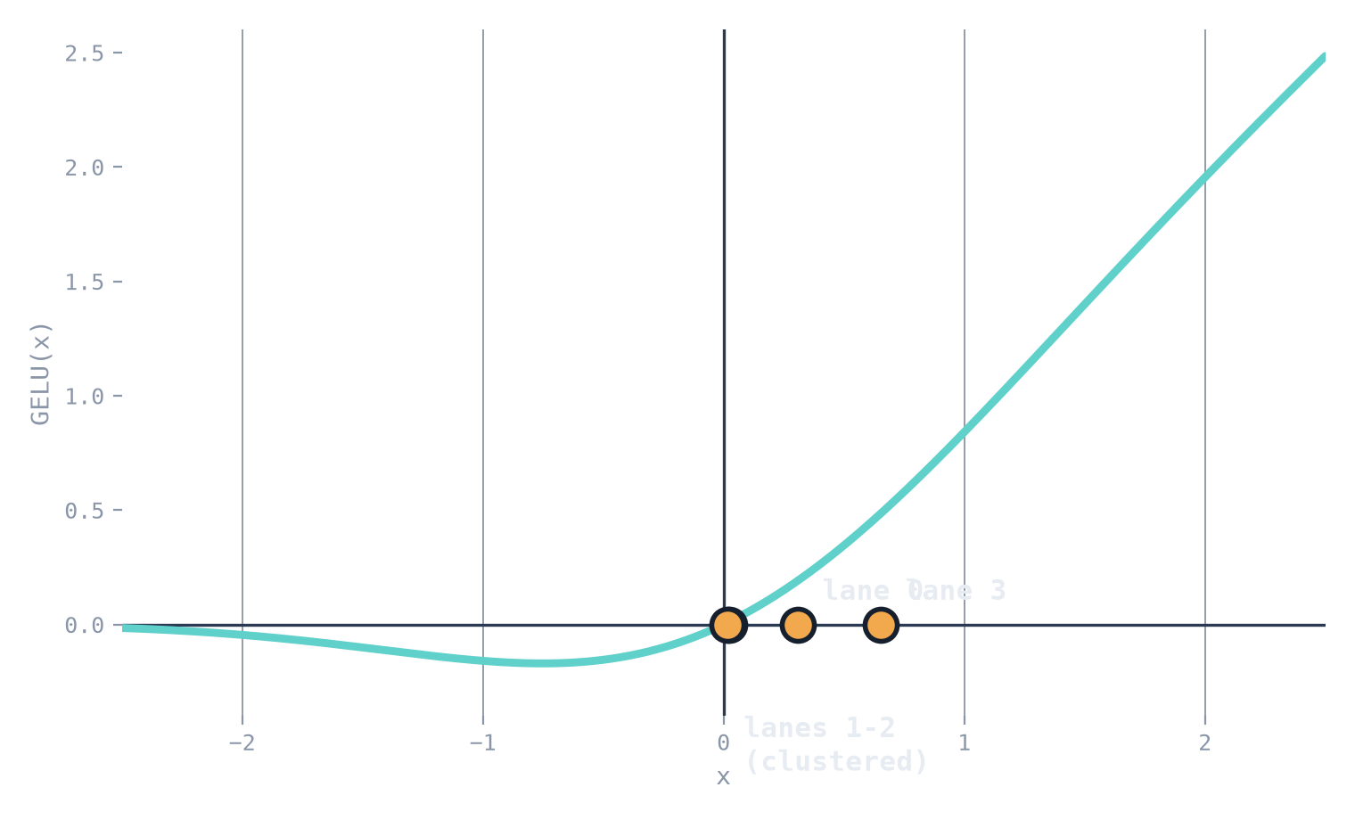
STAGE 3 · 4 PARALLEL LANES
SYSTOLIC MATMUL
SOFTMAX
GELU
GELU
STEP 19 / 21
The four Softmax probabilities become the inputs to four parallel GELU lanes — EightGelus computes num_gelu=4 lanes in the same clock cycles, one per output column.
Lane | Softmax out | GELU out
0 | 0.308 | —
1 | 0.022 | —
2 | 0.017 | —
3 | 0.652 | —
GELU(x) = 0.5·x·(1 + tanh[ √(2/π)·(x + 0.044715x³) ])

Slide 22
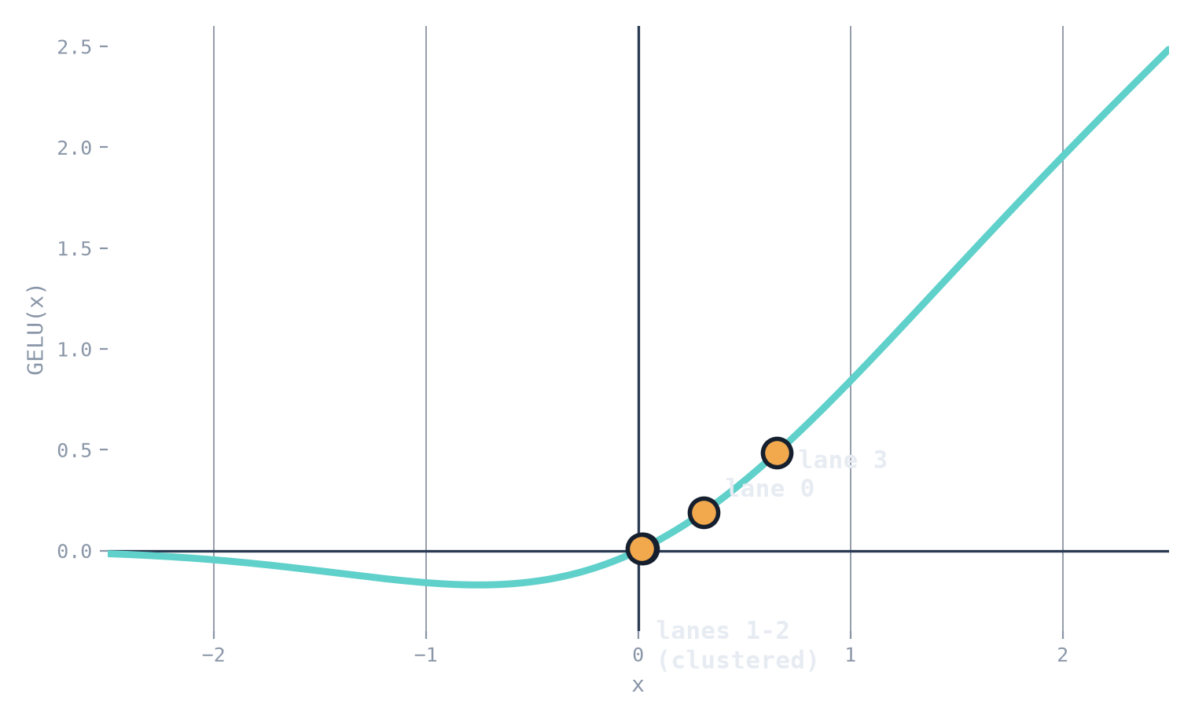
STAGE 3 · 4 PARALLEL LANES
SYSTOLIC MATMUL
SOFTMAX
GELU
GELU
STEP 20 / 21
All four lanes evaluate GELU(x) at once (no data dependency between lanes) — each dot rises to meet the curve at its own output value.
Lane | Softmax out | GELU out
0 | 0.308 | 0.191
1 | 0.022 | 0.011
2 | 0.017 | 0.009
3 | 0.652 | 0.484
GELU(x) = 0.5·x·(1 + tanh[ √(2/π)·(x + 0.044715x³) ])

Slide 23
STAGE 3 · 4 PARALLEL LANES
SYSTOLIC MATMUL
SOFTMAX
GELU
GELU
STEP 21 / 21
Pipeline output — one fully processed row: MatMul → Softmax → GELU, ready to leave this block (or feed the next one).
Lane | Softmax out | GELU out
0 | 0.308 | 0.191
1 | 0.022 | 0.011
2 | 0.017 | 0.009
3 | 0.652 | 0.484
GELU(x) = 0.5·x·(1 + tanh[ √(2/π)·(x + 0.044715x³) ])

Slide 24
PIPELINE OUTPUT
One Row, Fully Processed
MatMul → Softmax → GELU — ready to leave this block, or feed the next one.
out[0]
0.191
out[1]
0.011
out[2]
0.009
out[3]
0.484
WHAT'S REAL VS. SIMPLIFIED HERE
•
Dataflow is exact: weight-stationary systolic accumulation, the 3-pass streaming Softmax, and the piecewise GELU all match your RTL's actual structure.
•
Simplified for this deck: plain decimals stand in for the real 8-bit fixed-point / Q-format registers, and the array shown is 4×4 rather than the default 16×16.
•
Wiring note: GELU runs after Softmax here, matching transformer_block_top.v's real wiring — this is not a complete attention block (no Q·Kᵀ, no multi-head, no residual / LayerNorm yet).

