Slide 1
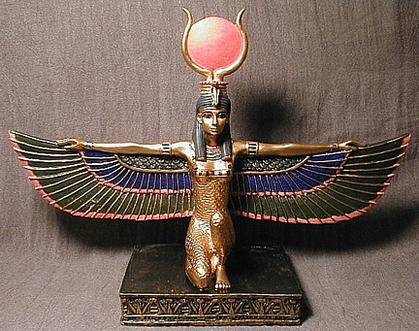
Your First Isis2 Group
Cornell University
Ken Birman

Slide 2
Let’s implement “Hello World”
We can start with the example from the “Intro” module you saw previously
Let’s look at it first, and then we’ll modify it into a real application

Slide 3
Isis2 System
“join myGroup”
update
update
state transfer
myGroup
A library to which your application is linked
Core functionality: groups of objects
… fault-tolerance, speed (parallelism), coordination
Intended for use in very large-scale settings
The local object instance functions as a gateway
Read-only operations performed on local state
Update operations update all the replicas

Slide 4
Isis² fragment from the Intro module
Group g = new Group(“myGroup”);
Dictionary<string,double> Values = new Dictionary<string,double>();
g.ViewHandlers += delegate(View v) {
Console.Title = “myGroup members: “+v.members;
};
g.Handlers[UPDATE] += delegate(string s, double v) {
Values[s] = v;
};
g.Handlers[LOOKUP] += delegate(string s) {
g.Reply(Values[s]);
};
g.Join();
g.OrderedSend(UPDATE, “Harry”, 20.75);
List<double> resultlist = new List<double>();
nr = g.OrderedQuery(ALL, LOOKUP, “Harry”, EOL, resultlist);
First sets up group
Join makes this entity a member. State transfer isn’t shown
Then can multicast, query. Runtime callbacks to the “delegates” as events arrive
Easy to request security (g.SetSecure), persistence
“Consistency” model dictates the ordering aseen for event upcalls and the assumptions user can make

Slide 5
Concept: A “multi-query”
Our lookup is
Multicast to the group
All members respond
The chance for parallelism
Each can do part of the job: e.g. search 1/n^{th} of a database
Reduces response delays
I forgot that guy’s name but I need to find him! He lives in Ithaca and has Harry in his name. I think.
Front end
Names with Harry in them: ....
With n replicas... ... we get an n times speedup!

Slide 6
Code for full program
using System;
using System.Collections.Generic;
using System.Linq;
using System.Text;
using Isis;
using System.Threading;
namespace ConsoleApplication3
{
public class tuple
{
public int rank;
public int value;
public tuple(int r, int v)
{
rank = r; value = v;
}
}
class Program
{
static List<tuple> database = new List<tuple>();
public const int UPDATE = 0;
public const int LOOKUP = 1;
static Semaphore go = new Semaphore(0, 1), dbFull = new Semaphore(0, 1);
static void Main(string[] args)
{
IsisSystem.Start();
Group g = new Group("foo");
int myRank = 0;
bool go = false, dbfull = false; ;
g.ViewHandlers += (ViewHandler)delegate(View v)
{
Console.WriteLine("New View: " + v);
myRank = v.GetMyRank();
if (v.members.Length == 3)
go.Release(1);
};
g.Handlers[UPDATE] += (Action<int,int>)delegate(int rank, int n)
{
database.Add(new tuple(n, rank));
Console.WriteLine("New tuple: " + rank + "/" + n);
if (database.Count() == 15)
dbfull.Release(1);
};
g.Handlers[LOOKUP] += (Action<int>)delegate(int arg)
{
Console.WriteLine("=== Query for arg=" + arg);
List<int> answer = new List<int>();
int index = 0;
foreach (tuple tp in database)
if (index++ % 3 == myRank)
{
Console.WriteLine("Looking at " + tp.rank + "/" + tp.value);
if (tp.rank == arg)
{
Console.WriteLine("Including " + tp.rank + "/" + tp.value);
answer.Add(tp.value);
}
}
g.Reply(answer);
};
g.Join();
go.WaitOne();
for (int n = 0; n < 5; n++)
g.OrderedSend(UPDATE, myRank, n);
dbFull.WaitOne();
if(myRank == 1)
for (int n = 0; n < 3; n++)
{
List<List<int>> results = new List<List<int>>();
g.OrderedQuery(Group.ALL, LOOKUP, n, new Isis.EOLMarker(), results);
Console.WriteLine("\r\nAnswers for Query rank=" + n);
foreach (List<int> list in results)
foreach (int value in list)
Console.Write(value + " ");
}
IsisSystem.WaitForever();
}
}
}

Slide 7
State Transfer: Initialize new member
By registering a checkpoint creation and loading method, we enable state transfer in our group
The state is in the Values Dictionary object.
Isis² doesn’t automatically marshal the Dictionary type, so we’ll send it as a List of KeyValuePair objects
g.MakeChkpt += (Isis.ChkptMaker)delegate(View nv)
{
g.SendChkpt(Values.ToList<KeyValuePair<string,double>>()); // Send the Values Dictionary as a list
g.EndOfChkpt(); // Finished making the checkpoint
};
g.LoadChkpt += (Action<List<KeyValuePair<string,double>>>)delegate(List<KeyValuePair<string,double>> incoming)
{
foreach(KeyValuePair<string,double> item in incoming)
Values[item.Key] = item.Value;
};
g.Join(); // This new code goes BEFORE the g.Join() call!

Slide 8
What happens when it finishes?
Our programs linger doing nothing, but with the main threads all in IsisSystem.WaitForever();
You will need to kill them one by one.
Challenge: Add code so that the rank 0 member will “terminate” the group after 30 seconds
It will need to call g.terminate()
The new view handlers would call IsisSystem.Shutdown();
IsisSystem.WaitForever() will return! (And then your main thread can simply exit).

Slide 9
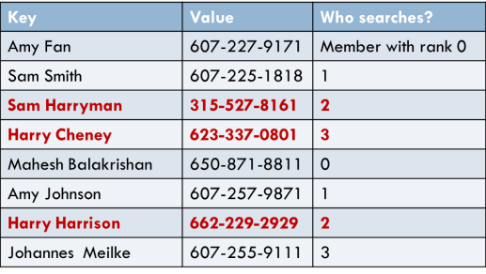
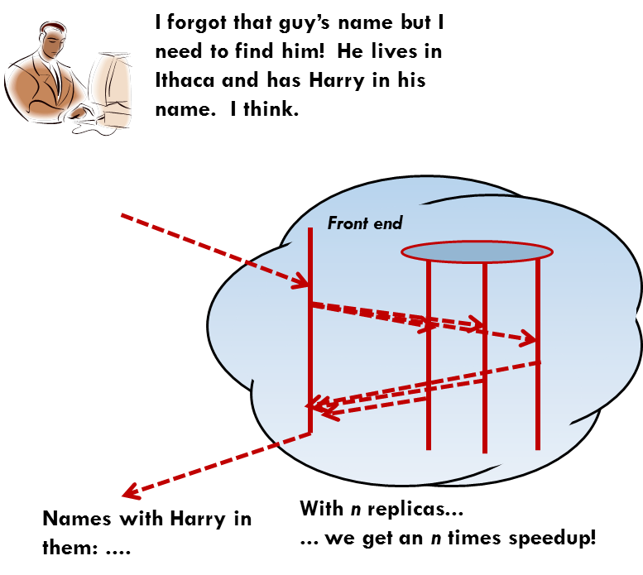
Summary
“join myGroup”
update
update
state transfer
myGroup
We created a group. Members join it and state is transferred to them. All have identical state. Updates are applied in order.
We saw how to use the group for a parallel search of the key-value list.
Homework: Modify the program to store phone-book data. Have the Query look up every person in Ithaca with Harry somewhere in their name, and form a list of names and numbers.

