Slide 1
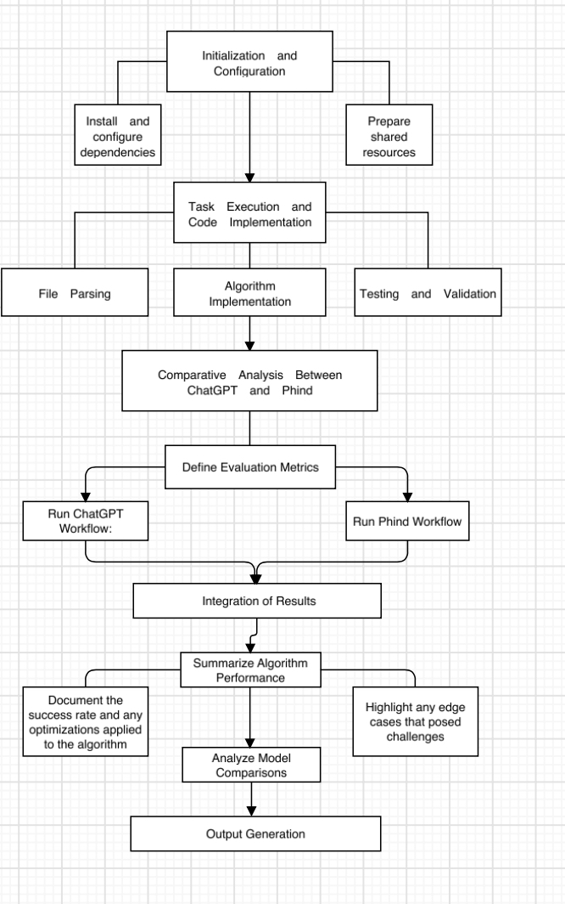

Slide 2
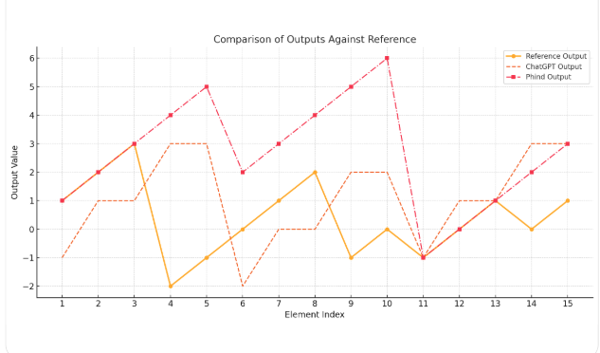
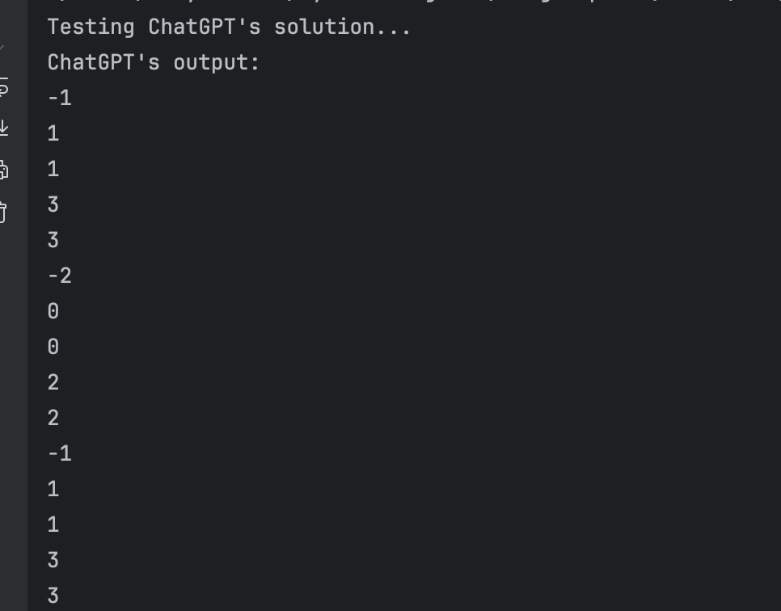
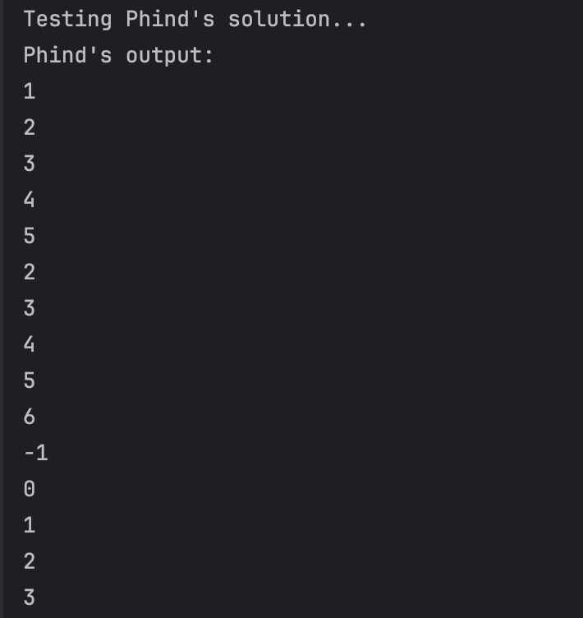
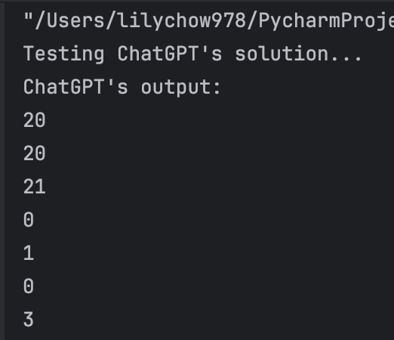
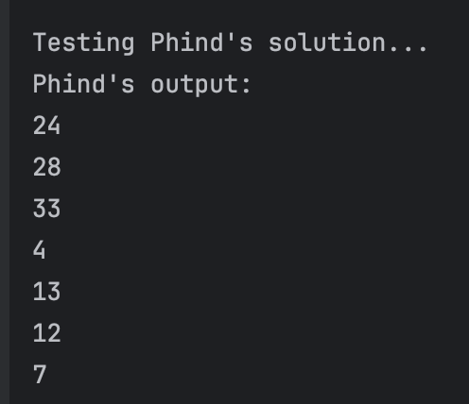
The Accuracy for Running Results of two AI Agents
The comparison of Outputs Against References
The outputs of Chat GPT
The outputs of Phind
The chart compares the outputs of ChatGPT and Phind against the Reference Output (SAMPLE OUTPUT) across multiple elements.
For ChatGPT Output: Deviates significantly from the reference output in most elements. Only matches the reference output for 2 out of 15 elements, resulting in an accuracy of 13.33%.
For Phind Output: Matches the reference output for 6 out of 15 elements, resulting in an accuracy of 40.00%.
Both agents still require optimization to fully replicate the reference output's pattern and variability.
Data Source: USA Computing Olympiad. https://usaco.org/index.php?page=viewproblem2&cpid=1429

Slide 3
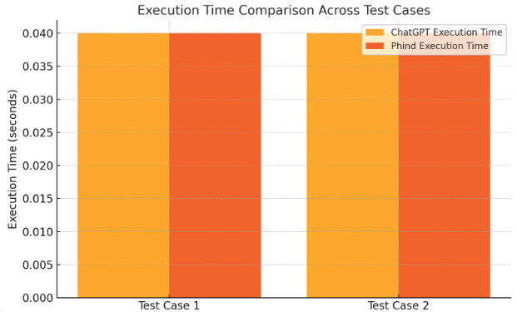
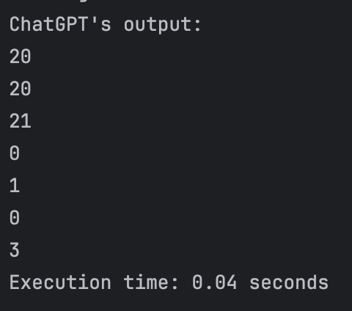
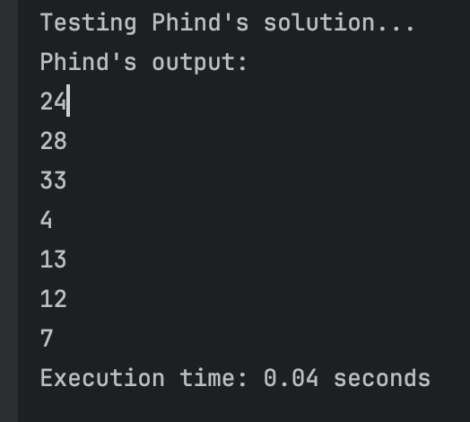
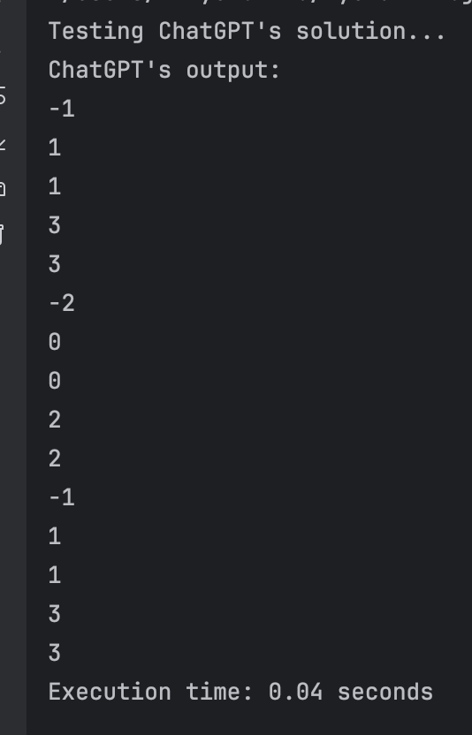
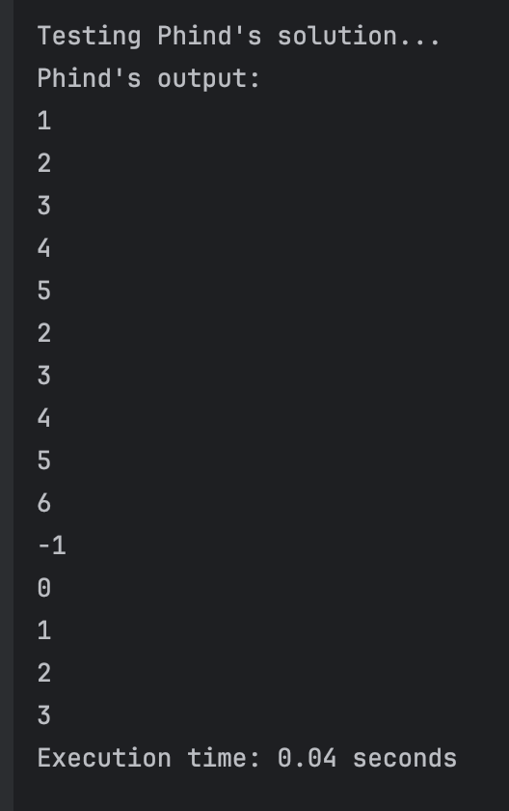
The Running Time of two AI Agents
The chart above visually compares the execution times of ChatGPT and Phind across two test cases:
Both agents show identical execution times of 0.04 seconds in both tests.
The comparison highlights that there is no significant difference in computational performance between the two agents under these conditions.
The Running time of Chat GPT
The Running time of Phind

