Slide 1
MYSQL
陈琪
2016/5/26

Slide 2
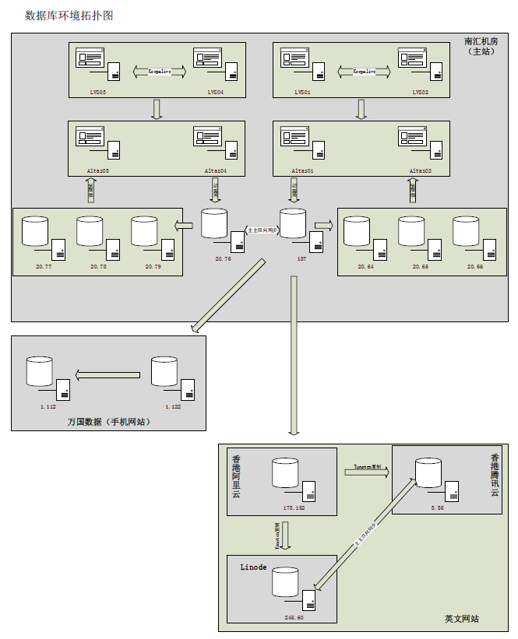

Slide 3
ATLAS
https://github.com/Qihoo360/Atlas/releases

Slide 4
数据拆分
垂直拆分
水平拆分
XA事务

Slide 5
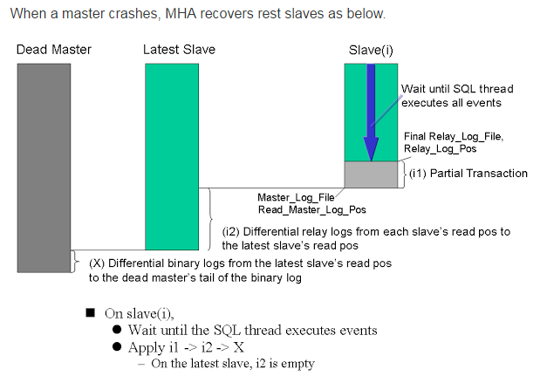
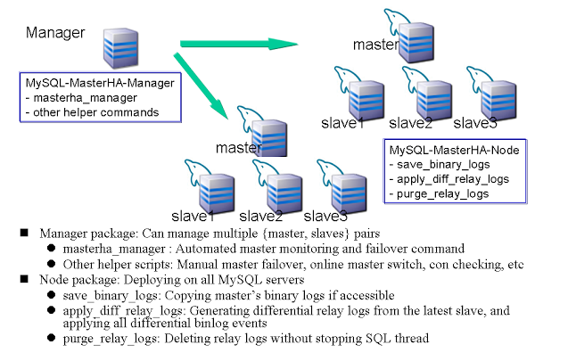
MHA
http://www.2cto.com/database/201412/363712.html
https://github.com/yoshinorim/mha4mysql-manager/wiki

Slide 6
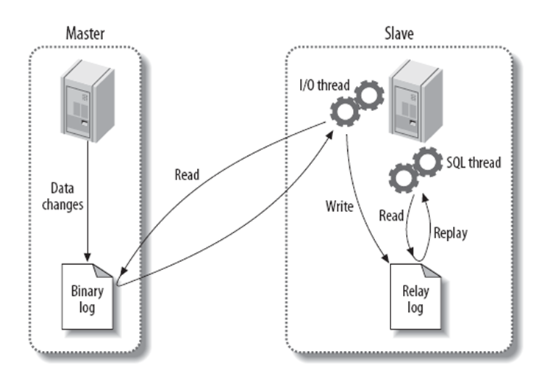
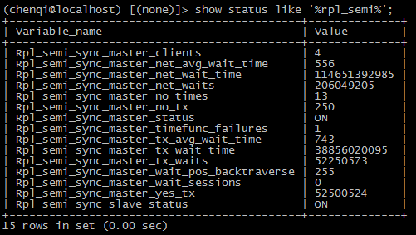
SEMI replication
INSTALL PLUGIN rpl_semi_sync_master SONAME 'semisync_master.so';
INSTALL PLUGIN rpl_semi_sync_slave SONAME 'semisync_slave.so';

Slide 7
tmpfs
MYSQL5.7版本之前适用
sort_buffer_size
mount tmpfs /RamDisk -t tmpfs -o size=2G

Slide 8
Tungsten
https://github.com/vmware/tungsten-replicator

Slide 9
Backup&recovery
Mysqldump
Mydumper
Xtrabackup

Slide 10
Delay replication
http://dev.mysql.com/doc/refman/5.7/en/replication-delayed.html

Slide 11
FLUSHBACK
http://www.cnblogs.com/youge-OneSQL/p/5249736.html

Slide 12
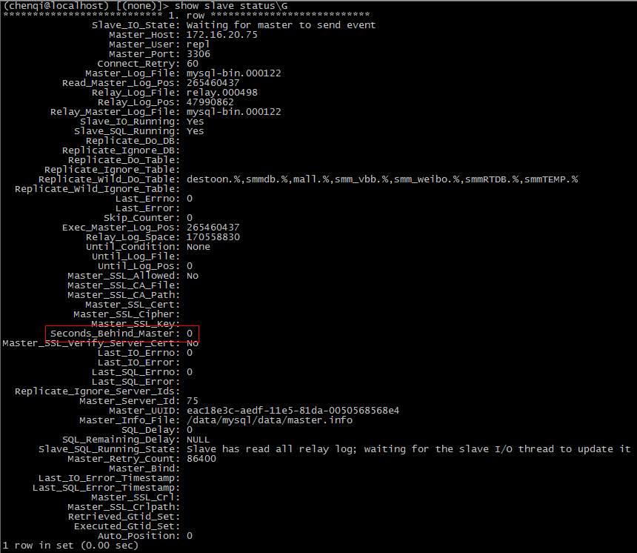
复制延迟
pt-heartbeat

Slide 13
MYSQL开发管理工具推荐
MYSQL命令行
MYSQL WORKBENCH
NAVICAT

