Slide 1
citibike
File created on: 7/19/19 9:55:03 PM GMT-07:00

Slide 2
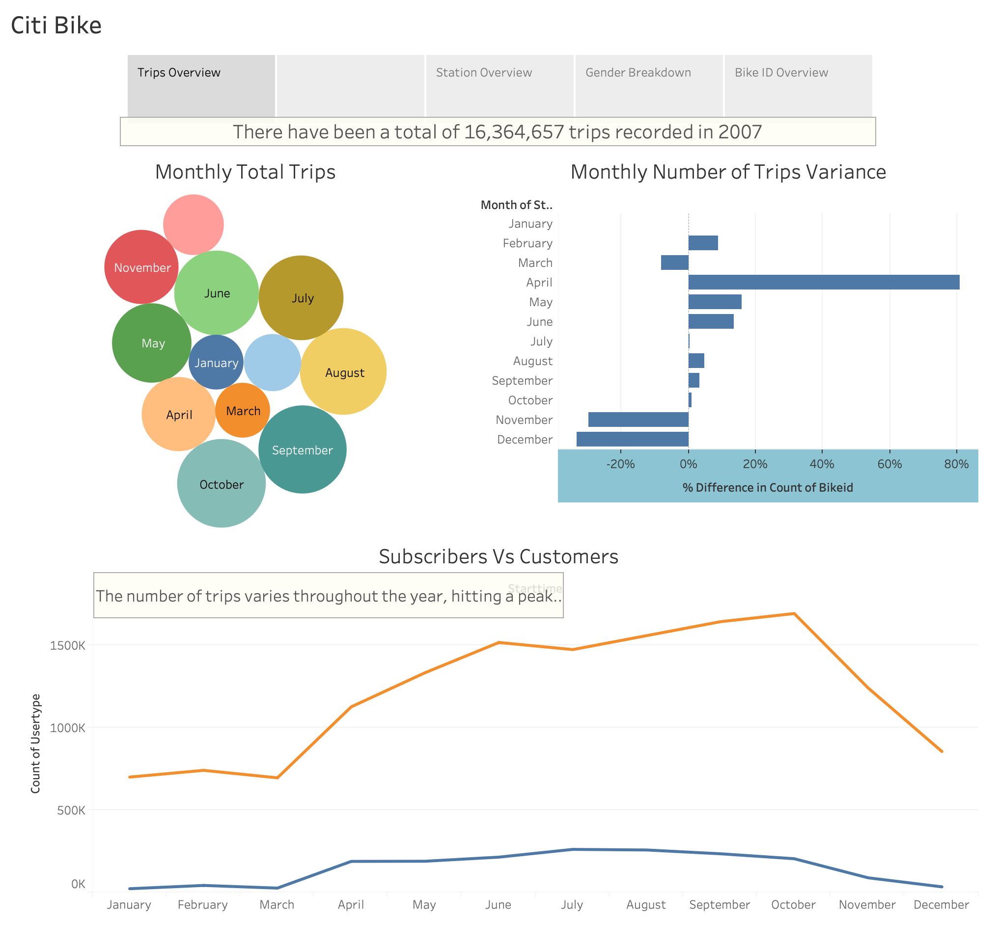

Slide 3
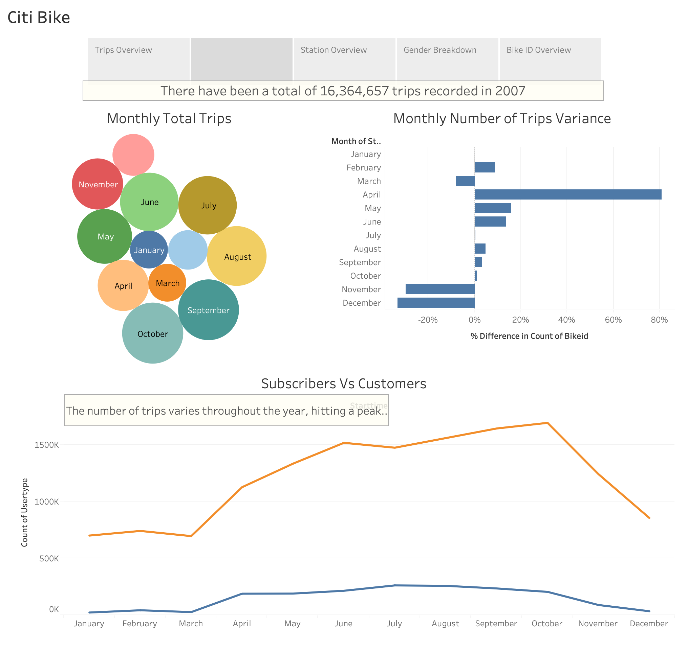

Slide 4
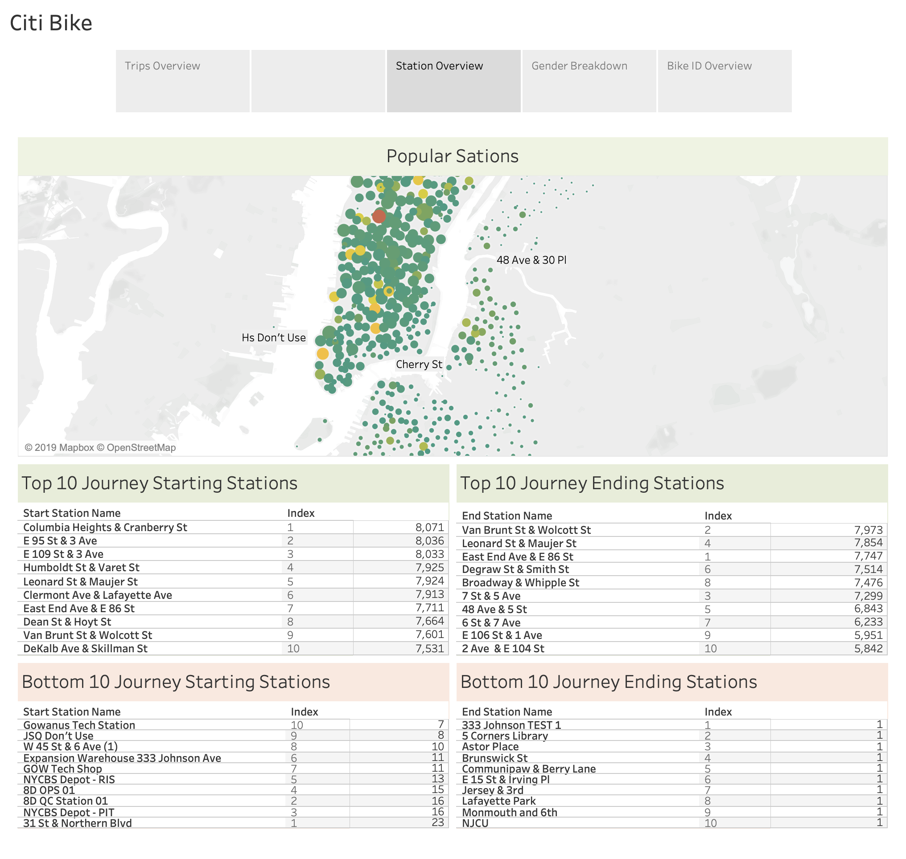

Slide 5
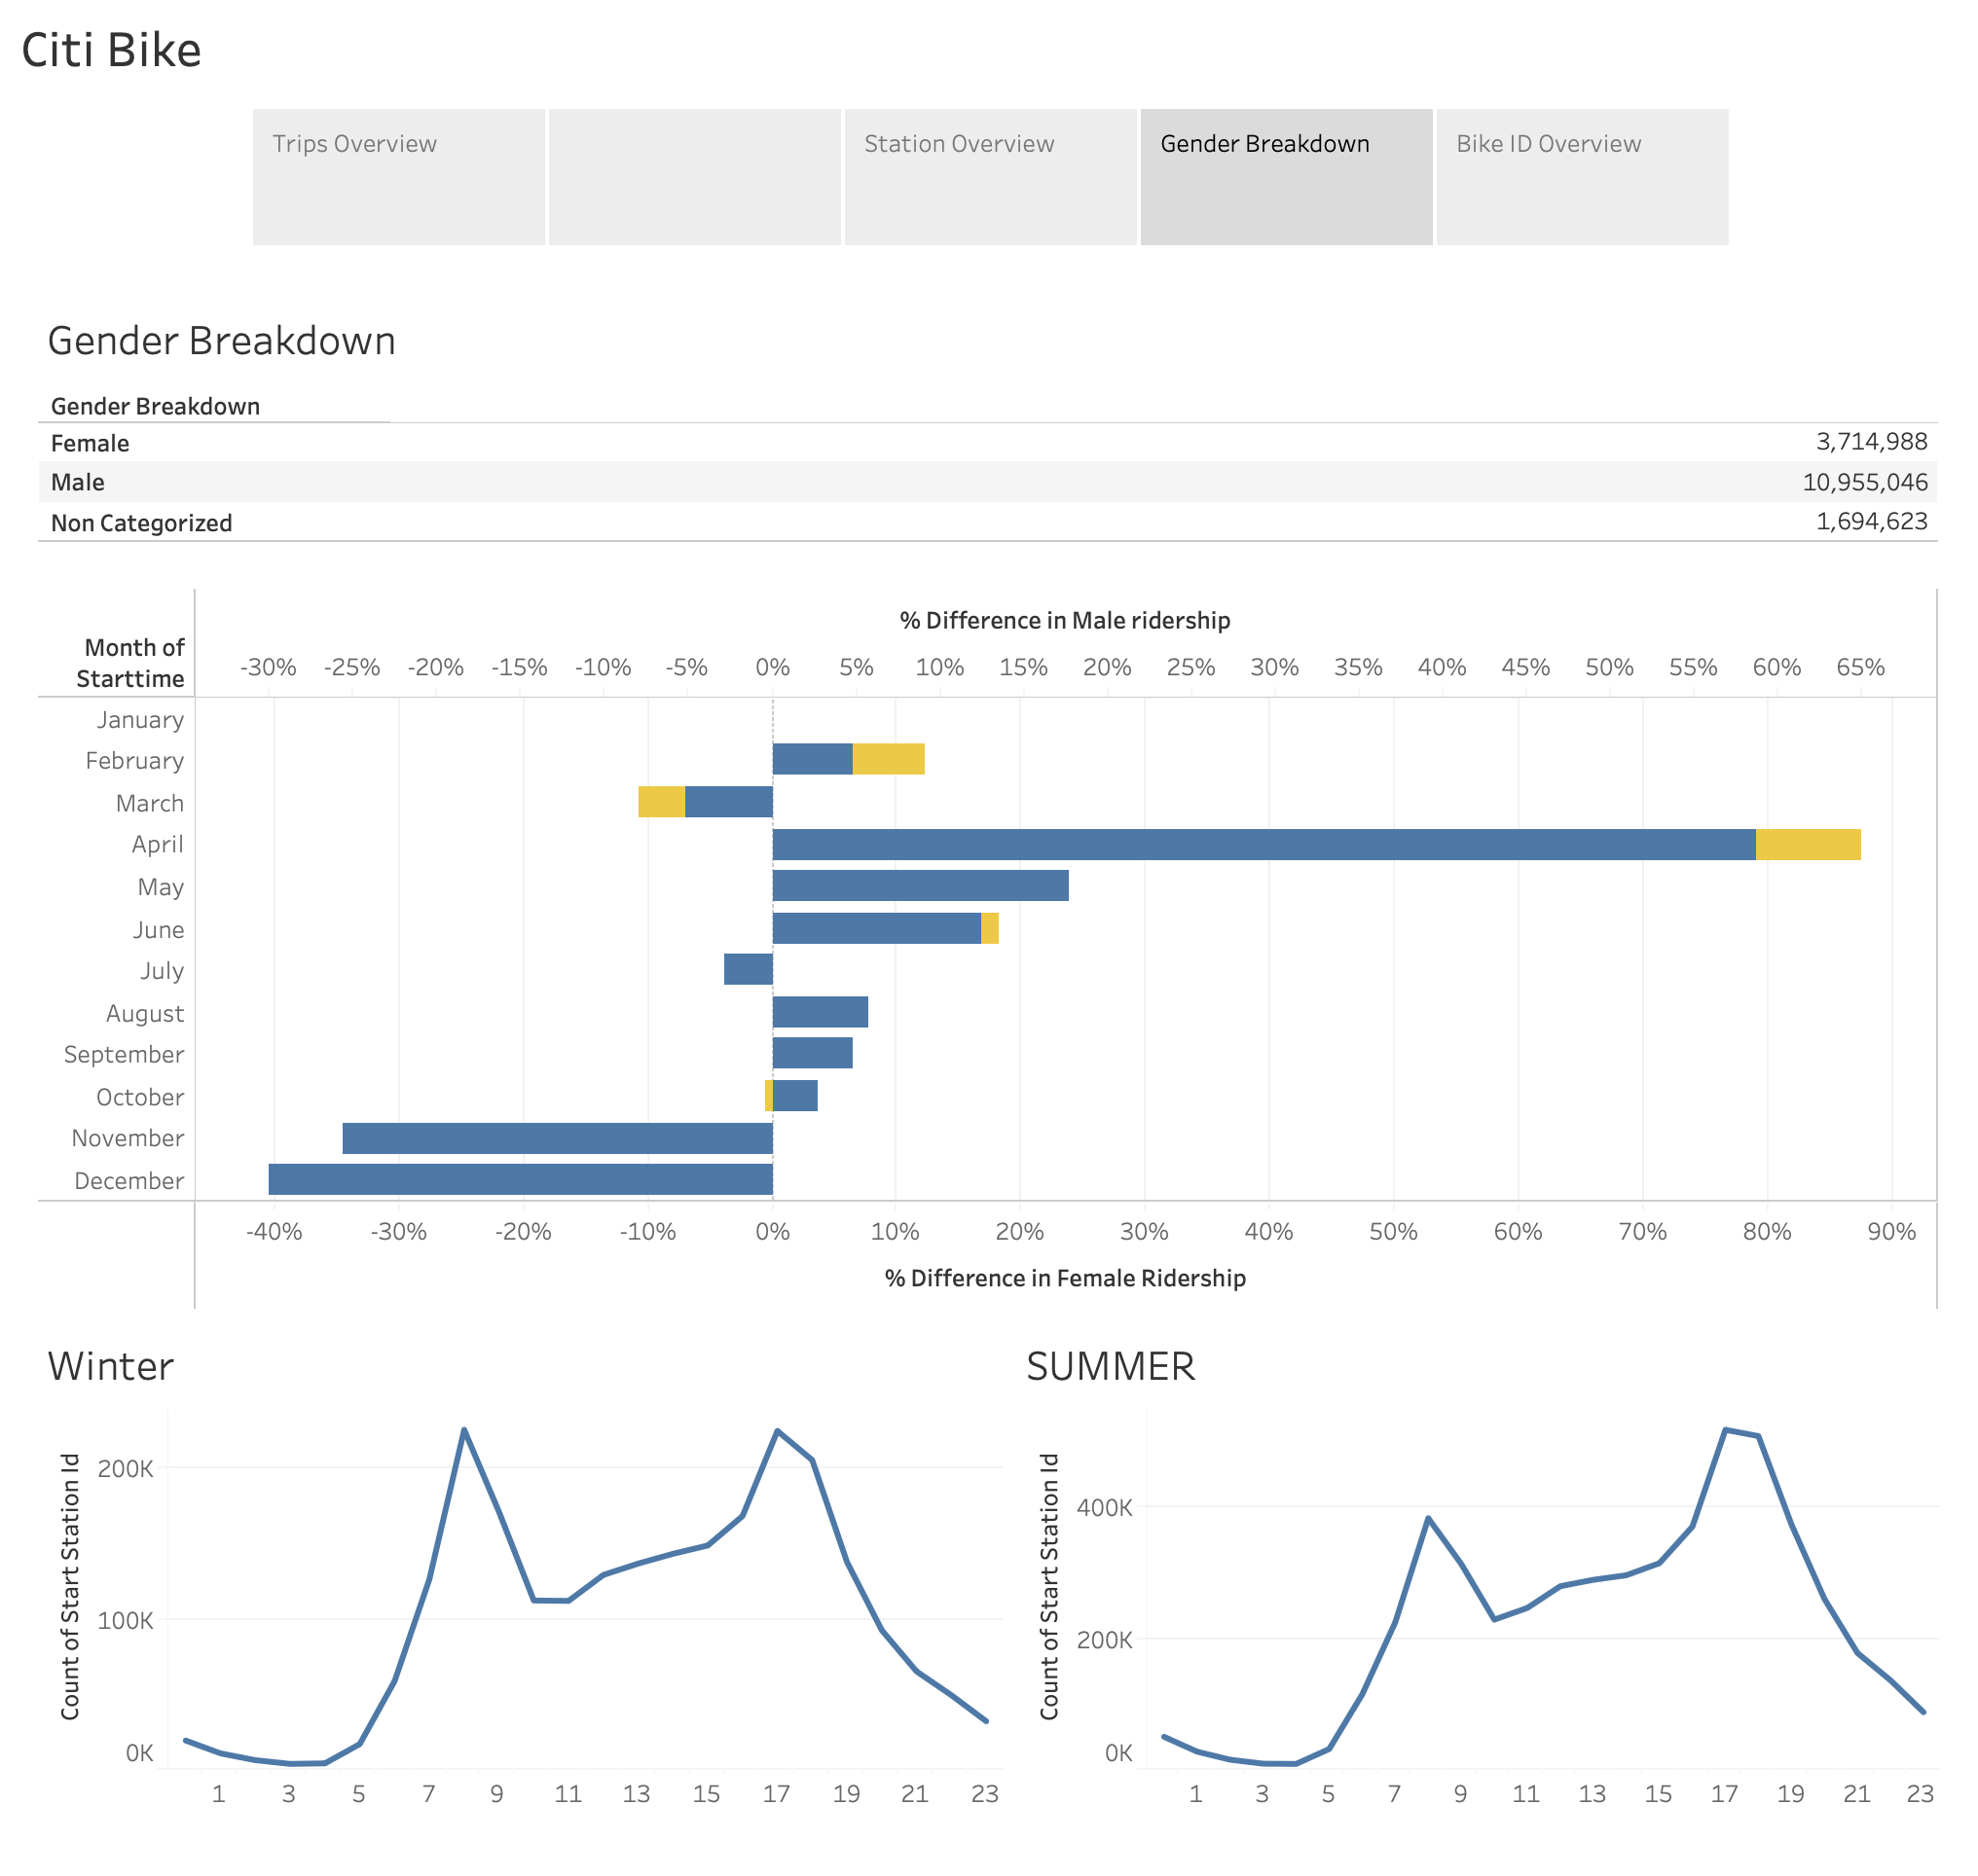

Slide 6
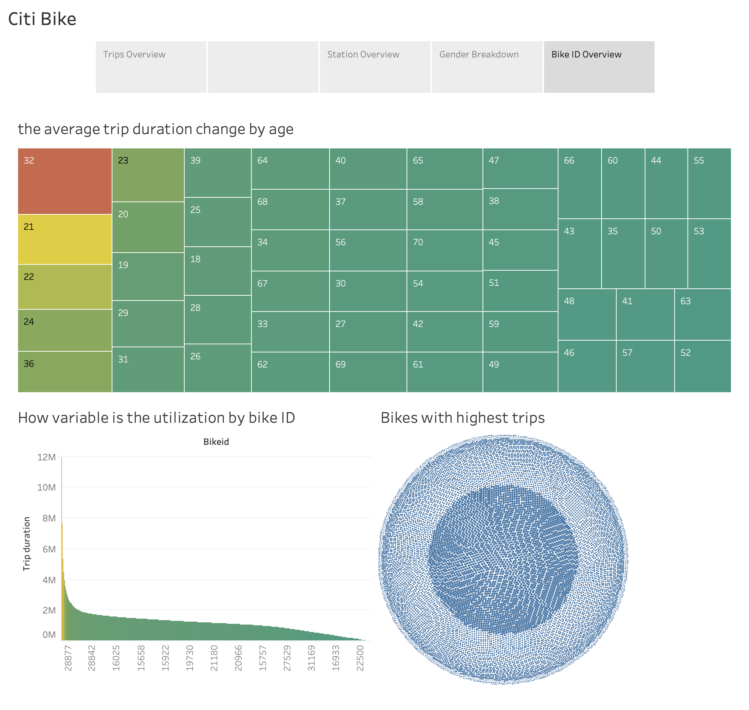

Slide 7


Slide 8
