Slide 1
Lecture 3: CNN & RNN
Presenters: Colby Wang & Dongfu Jiang

Slide 2
What we will cover
Basics of recurrent neural networks.
LSTM, GRU and other variants of RNN.
How the RNNs have been used in different downstream applications.
Basics of convolutional neural networks.
ConvNext, ResNet, ResNext, DenseNet, UNet, MobileNet, etc.
How does CNNs have been used in different downstream applications.

Slide 3
Basics of Recurrent Neural Networks

Slide 4
Basics of Recurrent Neural Network
First let us look at a simple diagram of Recurrent Neural Network (RNN):
h
h^{t-1}
h^{t}
h^{t+1}
f
f
f
f
Unfold
x
x^{t-1}
x^{t}
x^{t+1}

Slide 5
Mathematical Formulations for RNN
Now let us look at the mathematical formulations for RNN:
h^{t} = tanh(W_{hh} h^{t-1} + W_{xh}x^{t} + b), where
h^{t-1} represents the information at the previous step in the sequence. It's a vector that stores the learned information up to that point.
x^{t} represents the new input data at current time step
h^{t} represents the next hidden state calculated based on a weighted sum of h^{t-1} and x^{t}.

Slide 6
Problems of Vanilla RNNs
Gradient Vanishing and Explosion: These issues arise due to the multiplication of gradients through the many layers of an RNN during backpropagation. Vanishing gradients make it hard for the model to learn, as updates to the weights become insignificantly small. Exploding gradients can cause the weights to oscillate or diverge wildly.

Slide 7
Problems of RNN Cont’d
Long Range Memory: RNNs ideally should remember information from early in the sequence to use much later, which is crucial for tasks like text translation or sentiment analysis. However, with vanishing gradients, the network tends to forget this early information.
Prediction Drift: Over long sequences, small errors can accumulate in each timestep of prediction, causing the RNN to drift off course. This drift makes it challenging to maintain accurate predictions in tasks like time-series forecasting or text generation as the sequence progresses (since current input is based on previous input)

Slide 8
RNN Variant I: Long Short-Term Memory
(LSTM)

Slide 9
Long Short-Term Memory (LSTM)
Special gated structure to control memorization and forgetting in RNNs
Mitigate gradient vanishing
Facilitate long term memory
A simple diagram looks like the following:
These gates are essentially different neural networks with sigmoid activation functions (outputting values between 0 and 1). They are trained to selectively allow information to pass through, which helps in retaining the important information over longer periods and hence, mitigating the vanishing gradient problem

Slide 10
LSTM Diagram
Out₁
Output Gate
x
h₀
h₁
x
Forget Gate
x
Input Gate
x₁

Slide 11
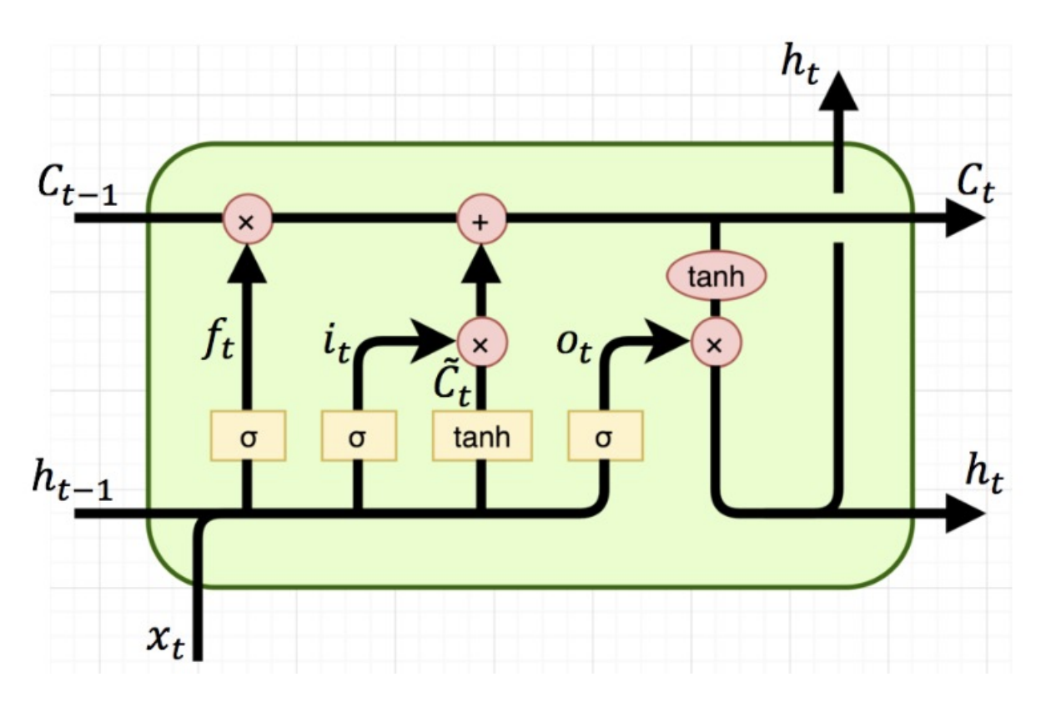
Practical Implementation

Slide 12
Mathematical Formulations
Hidden state h_{t} called cell state c_{t}
Output y_{t} called hidden state h_{t}
Update Equations:
Input Gate i_{t} = σ(W^{(ii)}x_{t}+W^{(hi)}h_{t-1})
Forget Gate: f_{t} = σ(W^{(if)}x_{t}+W^{(hf)}h_{t-1})
Output Gate: o_{t} = σ(W^{(io)}x_{t}+W^{(ho)}h_{t-1})
Process Input: c_tilda = tanh(W^{(ic_tilda)}x_{t}+W^{(hc_tilda)}h_{t-1})
Cell Update: c_{t} = f_{t} * c_{t-1} + i_{t} * c_tilda
Output: y_{t} = h_{t} = o_{t} * tanh(c_{t})

Slide 13
Roles of Different Gates in LSTM
Input Gate (it): Controls the extent to which a new value flows into the cell state.
Forget Gate (ft): Determines the information to be discarded from the cell state.
Output Gate (ot): Regulates the amount of information to output from the cell state.
Process Input (c̃): Creates a vector of new candidate values that could be added to the cell state.

Slide 14
Roles of Different Gates in LSTM Cont’d
Cell Update (ct): Updates the cell state by combining the old state (influenced by the forget gate) and the new candidate values (modulated by the input gate). (memory)
Output (yt = ht): Determines the next hidden state based on the cell state and output gate.
The network can selectively remember or forget information, aiding in preserving long-term dependencies.

Slide 15
Variants II of RNN: Highway Networks Inspired by LSTM

Slide 16
Highway Networks
Designed to mitigate issues associated with training deep neural networks such as gradient vanishing
Accomplished through the use of a learned gating mechanism for regulating information flow which is inspired by Long Short Term Memory recurrent neural networks
Information either flows without attenuation, or flows using neural network weights

Slide 17
Mathematical Formulations for Highway
Networks
y = H(x, W_{H})· T(x, W_{x}) + x · C(x, W_{C})
Here T is called a transform gate, and C is called a carry gate. For simplicity we can set C = 1 - T. Then:
y = H(x, W_{H})· T(x, W_{x}) + x · (1 - T(x, W_{x}))
Here T is defined as T(x) = σ(W^{T}_{T} x+b_{T}), where σ(x) = 1 / (1 - e^{-x})

Slide 18
Advantages of Highway Networks
A highway layer can smoothly vary its behavior between that of a plain layer and that of a layer which simply passes its inputs through.
A simple initialization scheme which is independent of the nature of H: b_{T} can be initialized with a negative value (e.g. -1, -3 etc.) such that the network is initially biased towards carry behavior.
Note:
A highway network consists of multiple blocks such that the i th block computes a block state Hi(x) and transform gate output Ti(x). Finally, it produces the block output y_{i} = H_{i}(x) ∗ T_{i}(x) + x_{i} ∗ (1 - T_{i}(x)), which is connected to the next layer.

Slide 19
Experiments
Compared the optimization of deep plain networks and highway networks using the MNIST dataset.
Networks with varying depths (10, 20, 50, and 100 layers) was trained to observe optimization performance.

Slide 20
Experiments Cont’d
Highway networks displayed consistent performance across all depths, contrary to plain networks whose performance degraded with increased depth. Notably, a 100-layer highway network significantly outperformed a 10-layer version.
The study also included a preliminary test on a 900-layer highway network on CIFAR-100, which showed promising results without optimization difficulties.

Slide 21
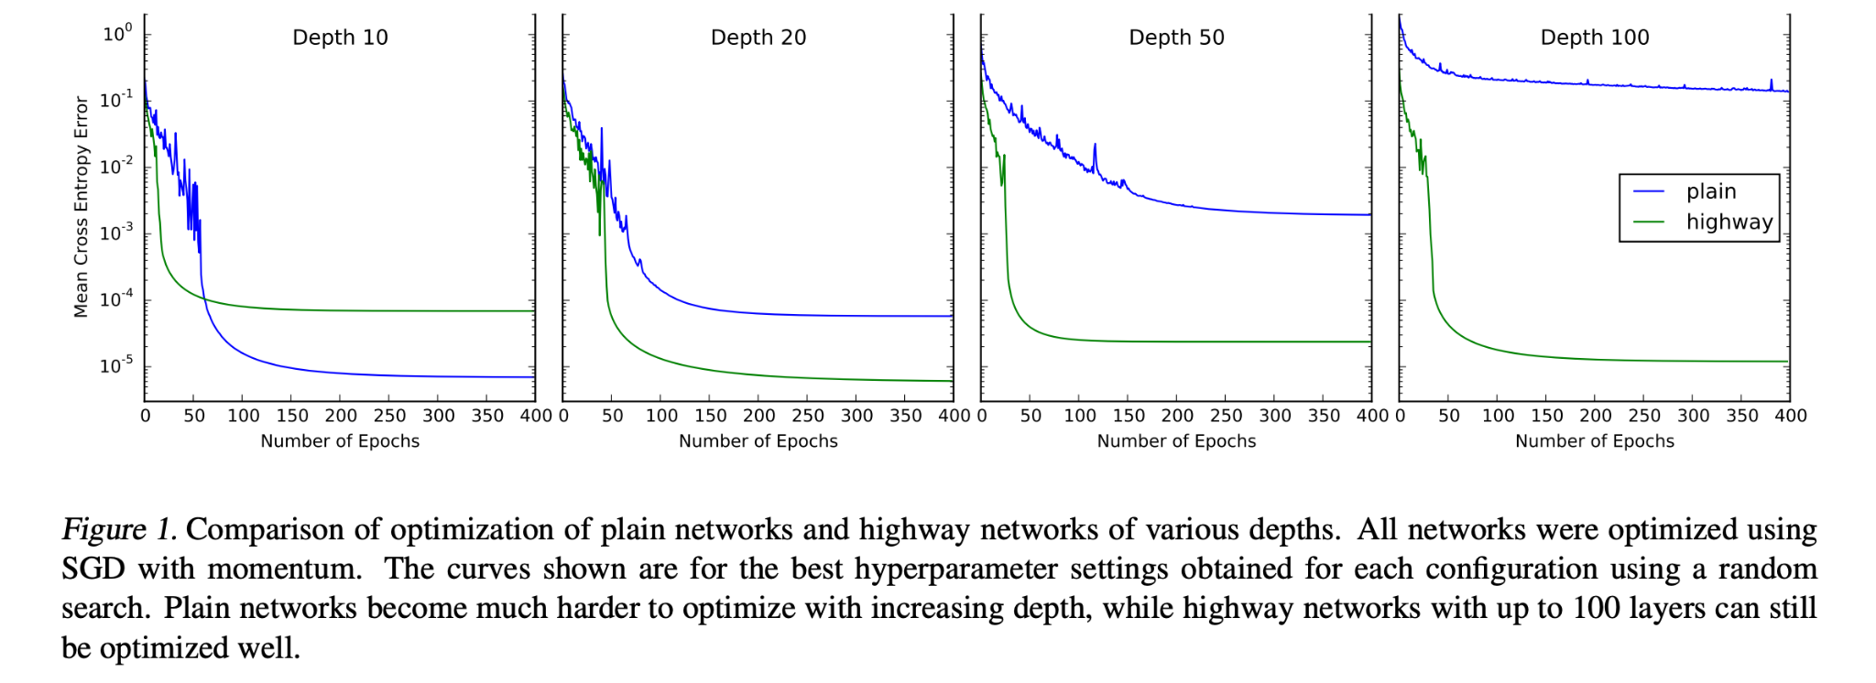
Results

Slide 22
More experiments
The study compared highway networks to Fitnets on CIFAR-10 for evaluating generalization in supervised learning.
Fitnets required complex training procedures (using a teacher network) for networks deeper than 5 layers with a limited number of parameters and operations.
Highway networks were easily trained with parameters and operations similar to Fitnets, using straightforward backpropagation.
This approach to training highway networks proved effective even for deeper and thinner network architectures.

Slide 23
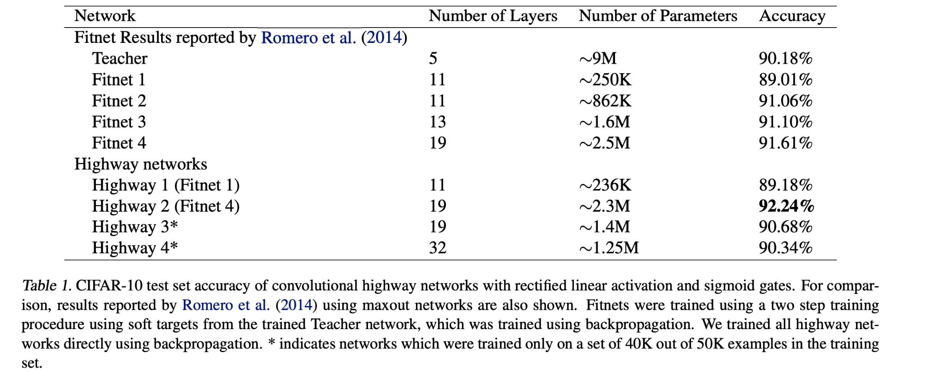
Results

Slide 24
Variant III: Gated Recurrent Unit for
Simplifying LSTM

Slide 25
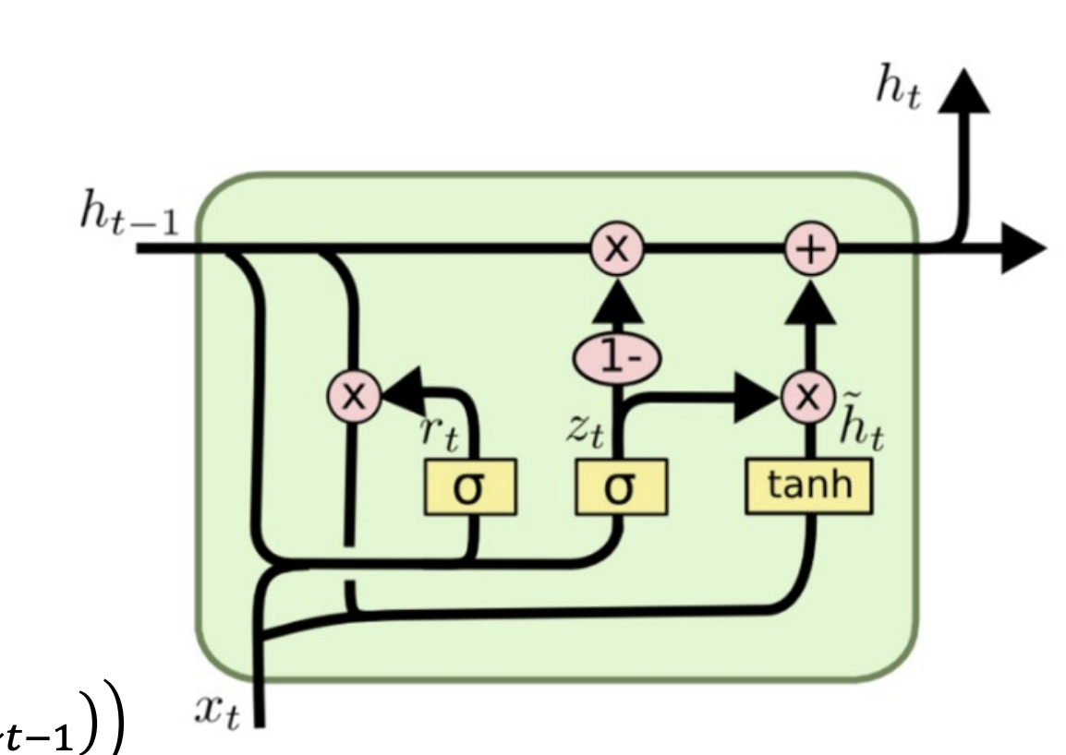
Gated Recurrent Unit (GRU)
No cell state
Two gates (instead of three)
Fewer weights
Update Equations (update = input + forget):
Reset Gate r_{t} = σ(W^{(ir)}x_{t}+W^{(hr)}h_{t-1})
Update Gate: z_{t} = σ(W^{(iz)}x_{t}+W^{(hz)}h_{t-1}) (how much input to pass)
Process Input: h_tilda_{t} = tanh(W^{(ih_tilda)}x_{t}+r_{t} * W^{(hh_tilda)}h_{t-1})
Hidden State Update: (1 - z_{t}) * h_{t-1} + z_{t} * h_tilda_{t}
Output: y_{t} = h_{t}
Notes:
Reset gate controls short term dependencies

Slide 26
Roles of Gates in GRU
Reset Gate (rt): Determines how much past information to forget, allowing the model to drop irrelevant information from the past.
Update Gate (zt): Balances between the new input and the past memory, controlling how much of the past state to retain versus the new input.

Slide 27
Roles of GRU Cont’d
Process Input (h̃t): Generates candidate values for the new hidden state, influenced by the reset gate.
Hidden State Update: Combines the old hidden state (modulated by 1−zt) and the new candidate values (weighted by zt) to form the new hidden state.
Output (yt = ht): The updated hidden state serves as the output, representing the current memory of the network.

Slide 28
Compare LSTM with GRU
Complexity: LSTMs are more complex with three gates (input, forget, output), while GRUs have two gates (reset, update).
Memory Usage: LSTMs generally require more memory due to their complexity.
Training Time: GRUs, being simpler, often train faster than LSTMs.

Slide 29
Compare GRU with LSTM Cont’d
Performance: GRUs might perform better on smaller datasets, while LSTMs often excel on datasets with longer sequences.
Parameters: LSTMs have more parameters, making them more flexible but also more prone to overfitting on smaller datasets.
State Update Mechanism: LSTMs have separate cell and hidden states, whereas GRUs have a single hidden state.
Choice of Model: The choice between GRU and LSTM depends on the specific application and dataset characteristics.

Slide 30
Advantages of GRU
Faster Training: Due to fewer parameters, GRUs can be faster to train, making them more efficient for smaller datasets or when computational resources are limited.
Efficient on Smaller Datasets: GRUs may perform better than LSTMs when the amount of data is not large, as they can capture dependencies without the need for extensive data.
Flexibility in Memory Management: GRUs are capable of adapting to the use of short-term memory through their update and reset gates, potentially capturing information across various time steps efficiently.

Slide 31
Comparing Vanilla RNN with LSTM and GRU

Slide 32
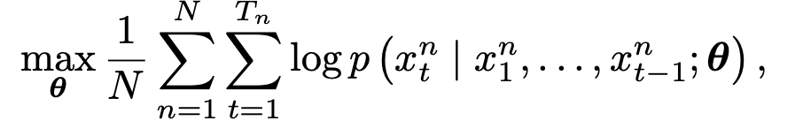
Experiments: Sequence Modeling
maximizing the log-likelihood of a model given a set of training sequences (theta is a set of model parameters)
Evaluate these units in the tasks of polyphonic music modeling and speech signal modeling.

Slide 33
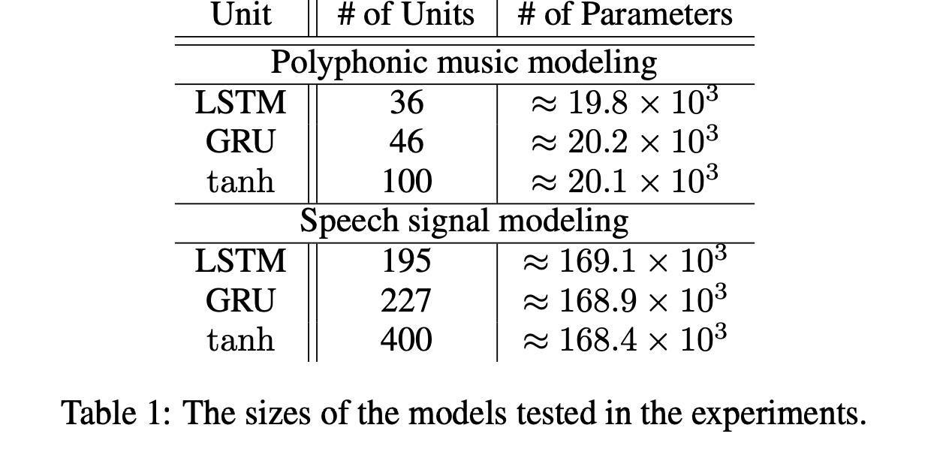
Results

Slide 34
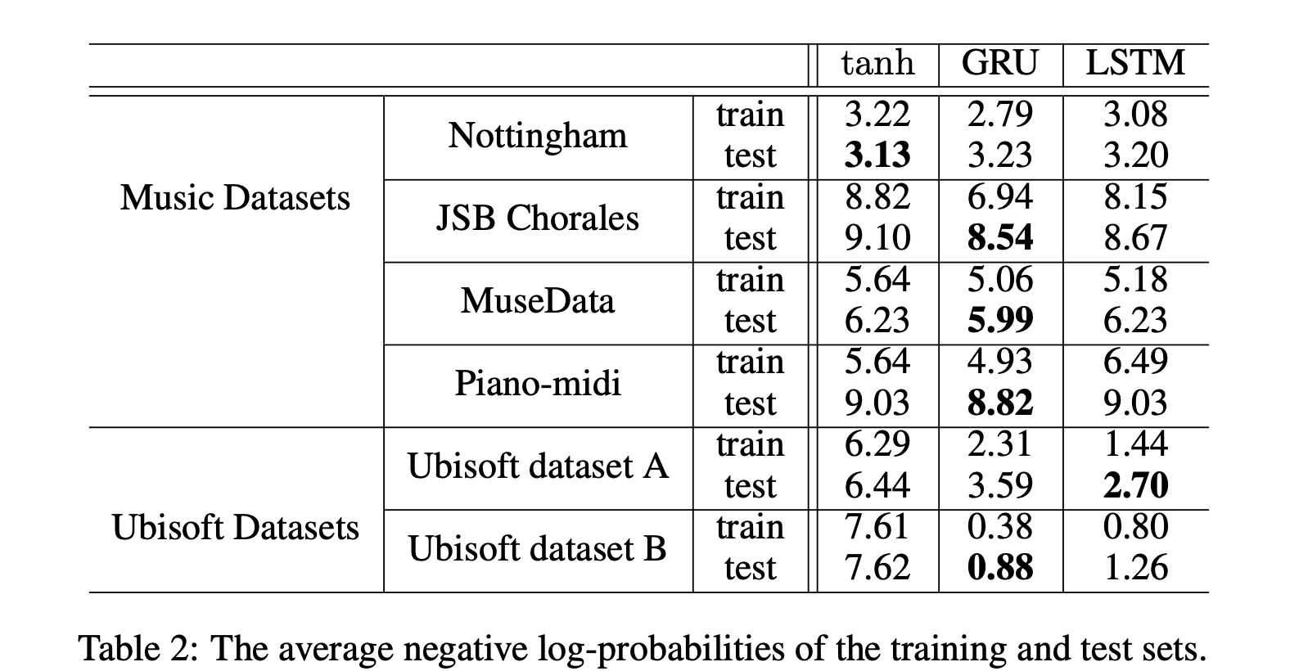
Results Cont’d

Slide 35
Simple Analysis
RNN with gating units outperform the one without gating unit, on the task of speech recognition.
Over the music dataset the performances are similar

Slide 36
Downstream Applications of RNN: Machine Translation

Slide 37
Attention
Mechanism for alignment in machine translation, image captioning, etc.
Attention in machine translation: align each output word with relevant input words by computing a softmax of the inputs
context vector c_{i =} ∑_{j}a_{ij}h_{j}
a_{ij} is called an alignment weight between input encoding and h_{j} and output encoding s_{i}. This is computed as follows:
a_{ij}= exp(alignment(s_{i-1}, h_{j})) / ∑_{j’}exp(alignment(s_{i-1}, h_{j’}) [softmax]

Slide 38
Attention Diagram
y₁
y₂
y₃
Decoder
s₁
s₂
s₃
……
+
a₃₁
a_{3t}
a₃₂
a₃₃
h₁
h₂
h₃
……
h_{t}
Encoder
x₁
x₂
x₃
x_{t}

Slide 39
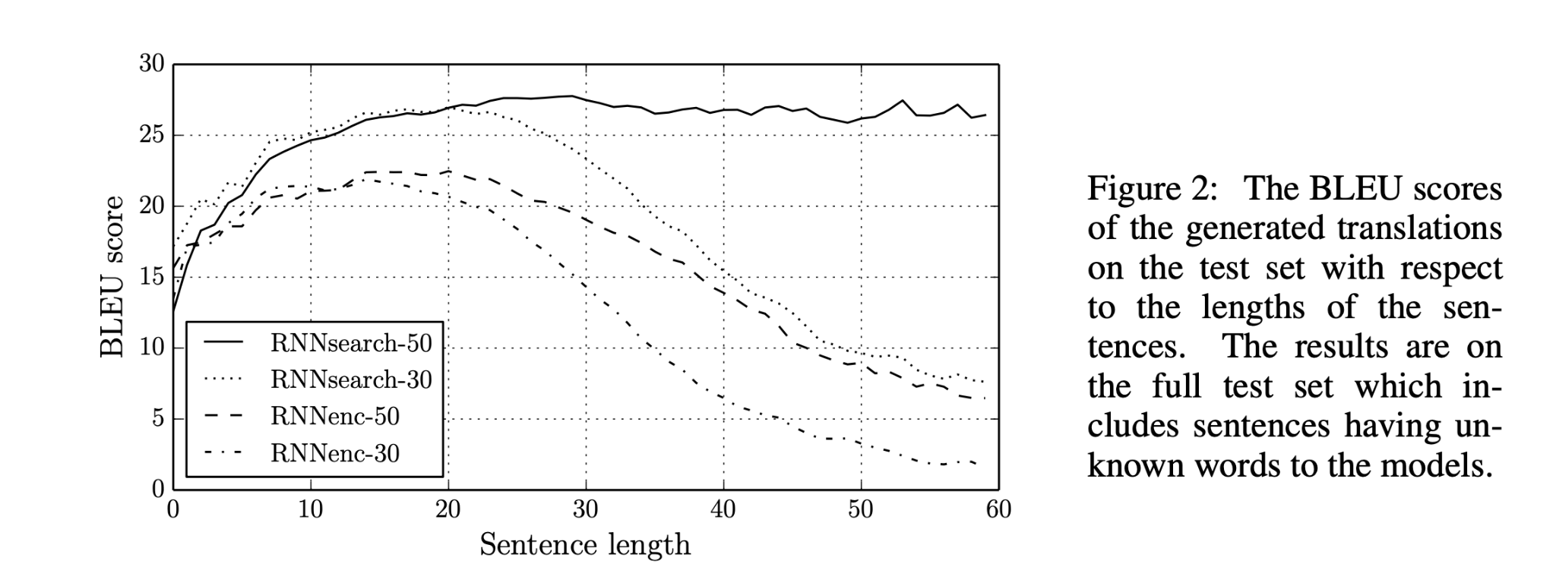
Machine Translation with Bidirectional
RNNs, LSTM units and attention
Bahdanau, Cho, Bengio (ICLR-2015)
Bleu: BiLingual Evaluation Understudy: Percentage of translated words that appear in ground truth

Slide 40
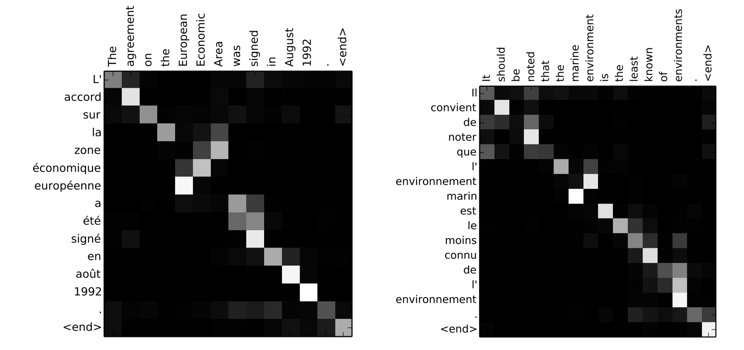
Alignment example

Slide 41
Local Attention
Previously we are discussing a form of global attention, where all source tokens are attended to. Now we look at 2 forms of local attention:
Monotonic Alignment (Local M): assume source and target sequences are monotonically aligned, and the align vector is computed as discussed on a previous slide
Predictive Alignment (Local P): predicts an aligned position as follows:
p_{t}=S*sigmoid(v_{p}^{T} tanh(W_{p}h_{t}))
W_{p} and v_{p} are learned model parameters, and S is the source sentence length
We will use the aligned position to form a window length 2*D (we are only attending to this window) [p_{t}-D, p_{t}+D]

Slide 42
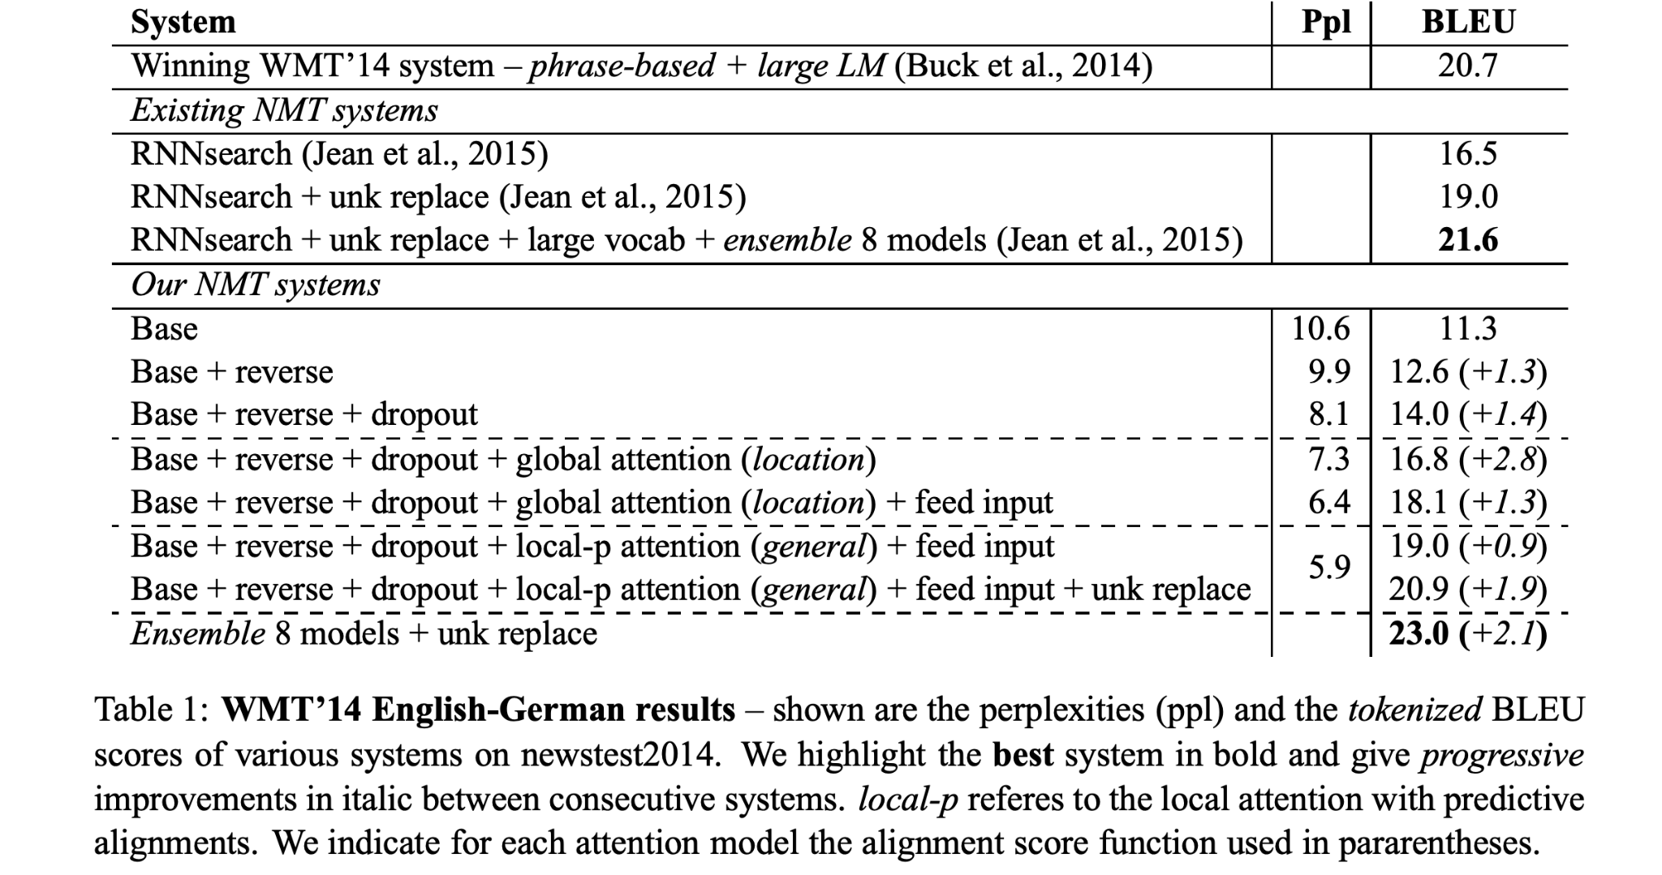
More Results
Translating between English and German:

Slide 43
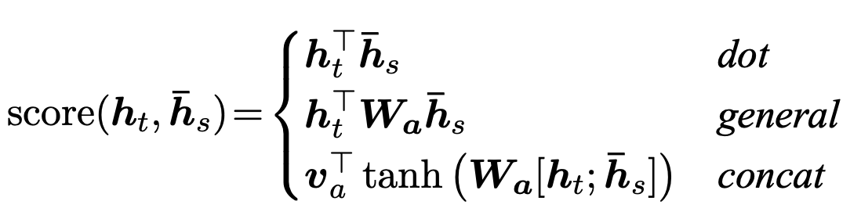
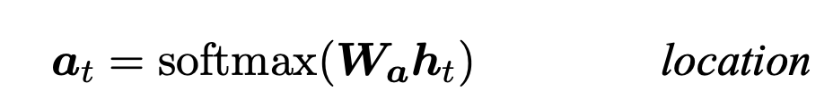
Some Notes on Previous Table

Slide 44
Input feeding means attentional vectors h˜_{t} are concatenated with inputs at the next time steps.
We limit our vocabularies to be the top 50K most frequent words for both languages. Words not in these shortlisted vocabularies are converted into a universal token <unk>.

Slide 45
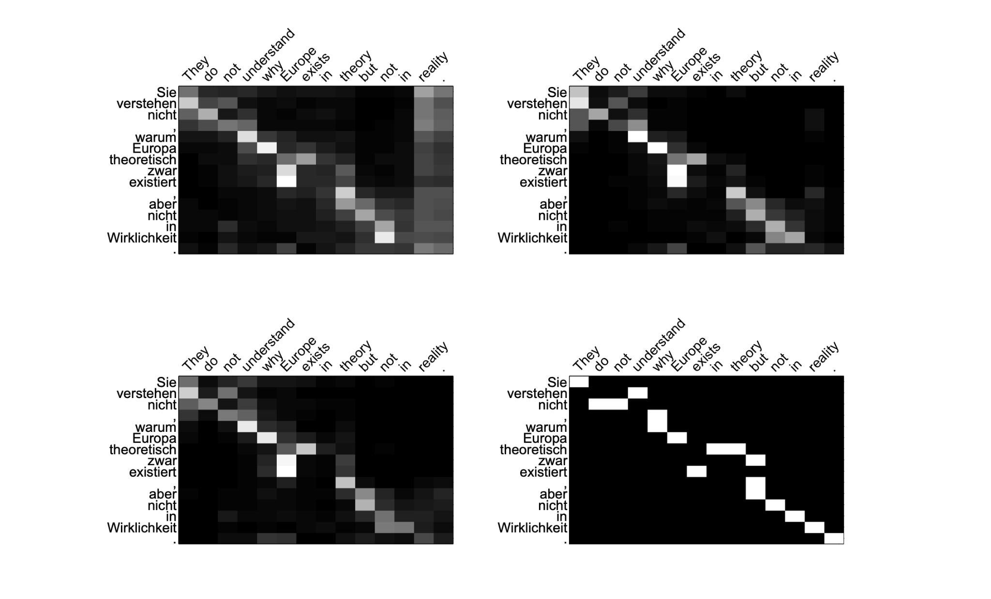
More Alignment Illustration
(Global, Local M & Local P, Gold Alignment)

Slide 46
Convolutional Neural Networks

Slide 47


Basics of CNN
CNN operation
Pooling operation
0
0
7
7
8
0
4
2
5
1
7
7
8
1
2
1
46
1
6
1
3
1
2
5
1
0
2
1
46
1
4
5
9
0
1
3
1
2
1
1
1
2
7
8
5
0
0
7
7
8
0
4
2
5
1
7
7
8
8
1
6
1
3
1
2
5
1
8
1
4
5
9
0
1
3
1
MaxPooling
1
2
7
8
5
Notes:
7*1 +

Slide 48
Basics of CNN
CNN operation
Pooling operation
0
0
7
7
8
0
4
2
5
1
7
7
8
1
2
1
46
1
6
1
3
1
2
5
1
0
2
1
46
1
4
5
9
0
1
3
1
2
1
1
1
2
7
8
5
0
0
7
7
8
0
4
2
5
1
7
7
8
8
1
6
1
3
1
2
5
1
8
1
4
5
9
0
1
3
1
MaxPooling
1
2
7
8
5
Notes:
7*1 +

Slide 49
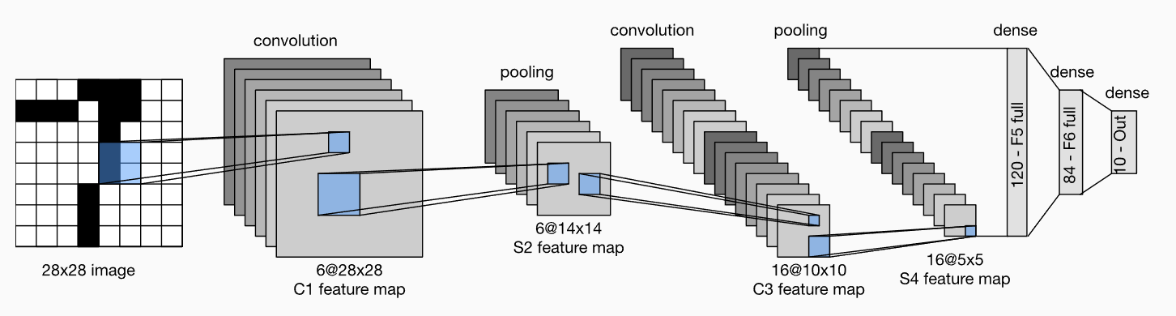
LeNet-5
Sigmoid activation after each convolution operation
Using average pooling
Notes:
Using sigmoid
Average pooling
2 convs + 3 fully connected

Slide 50
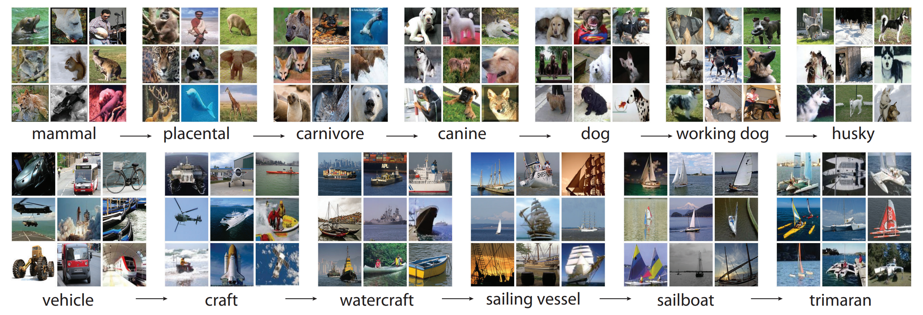
ImageNet
ImageNet is a dataset with over 15 million labeled high-resolution images belonging to roughly 22,000 categories.

Slide 51
AlexNet (2012)
Can we train larger deep convolutional neural network using GPU?
Issues and solutions:
  Larger Training Dataset -> ImageNet
  Computation resources -> Implementation of AlexNet on GPU.
It’s the first work that uses GPU to train a deep neural network
Notes:
Using max pooling
Using relu
Using LRN
Use GPU to train and inference
Deeper and wider
Using dropout on fully dense layer

Slide 52
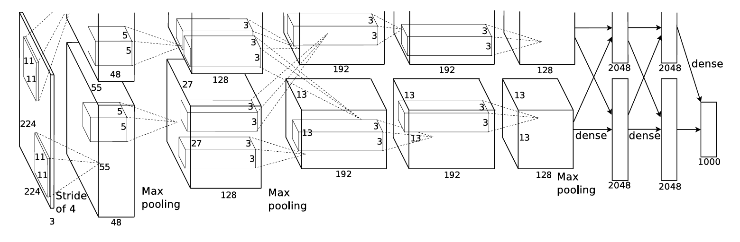
AlexNet (2012)
Technical details
  5 convolutional layers and 3 fully connected layers
  Using ReLU + LRN after each convolutional layer
  3 Max pooling layer
  Dropout = 0.5 for the 2 hidden fully connected layers.
Notes:
Using max pooling
Using relu
Using LRN
Use GPU to train and inference
Deeper and wider
Using dropout on fully dense layer

Slide 53
VGGNet (2014)
What’s the effects of increasing depths of deep CNN network?
Main contributions:
  Design a VGG CNN block that can easily increase the depth by stacking blocks.
…
Conv(3x3)-64
…
…
Conv(3x3)-64
…
RELU
maxpool(2x2), stride 2
Fully connected layers
VGG Block
VGGNet
Notes:
- CNN block design, CNN + relu + maxpooling

Slide 54
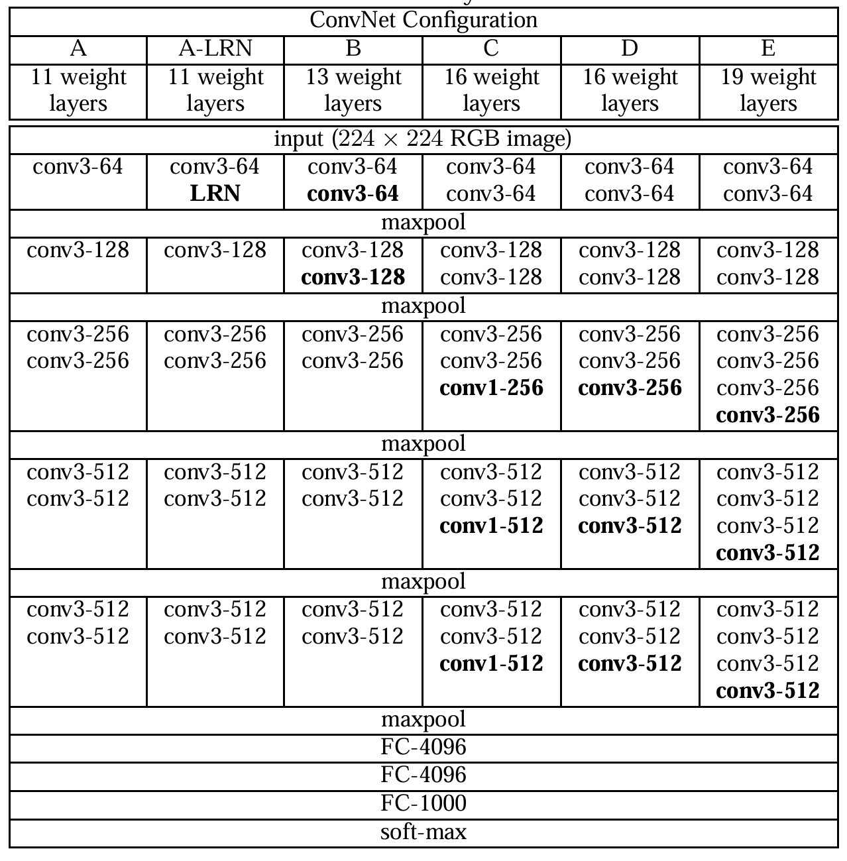
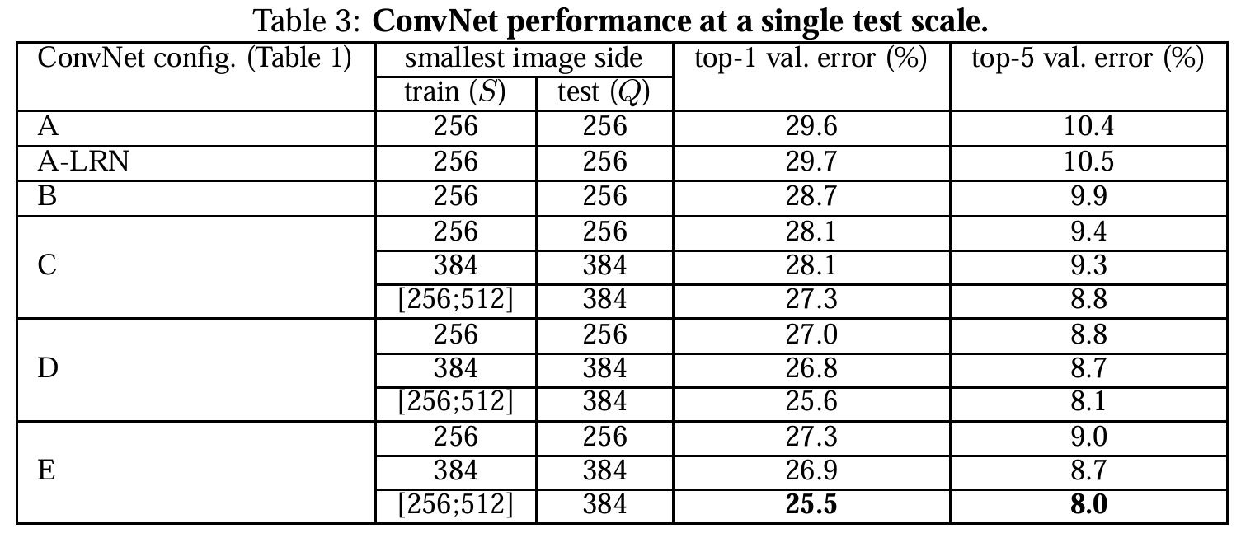
VGGNet (2014)
Conclusion: Deeper is better.
Notes:
- CNN block design, CNN + relu + maxpooling

Slide 55
ResNet (2015)
Is learning better networks as easy as stacking more layers?
Issues:
  Vanishing/exploding gradients -> Well addressed by BatchNorm
  Performance degeneration on deeper networks -> Open Problem
Assumption:
  There exists an Identity mapping from deeper to shallower
  Easier to learn the residual mapping instead of the identify mapping.
Solution:
  Add residual connection to the CNN network.
Notes:
What will happen if network goes deeper and deeper?
-

Slide 56
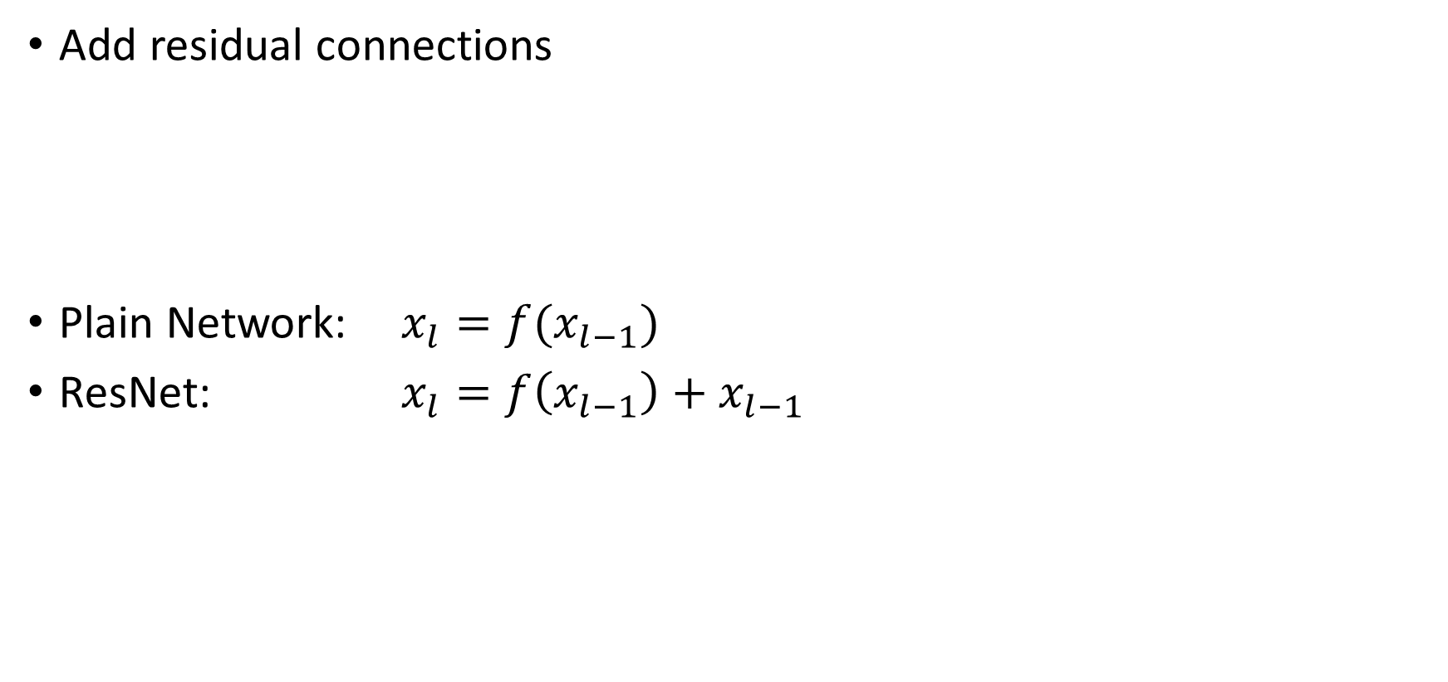




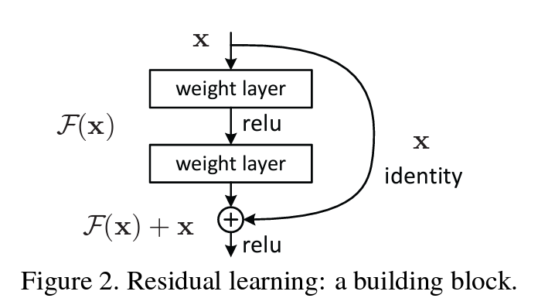
ResNet (2015)
Plain Network
ResNet
Notes:
What will happen if network goes deeper and deeper?
-

Slide 57
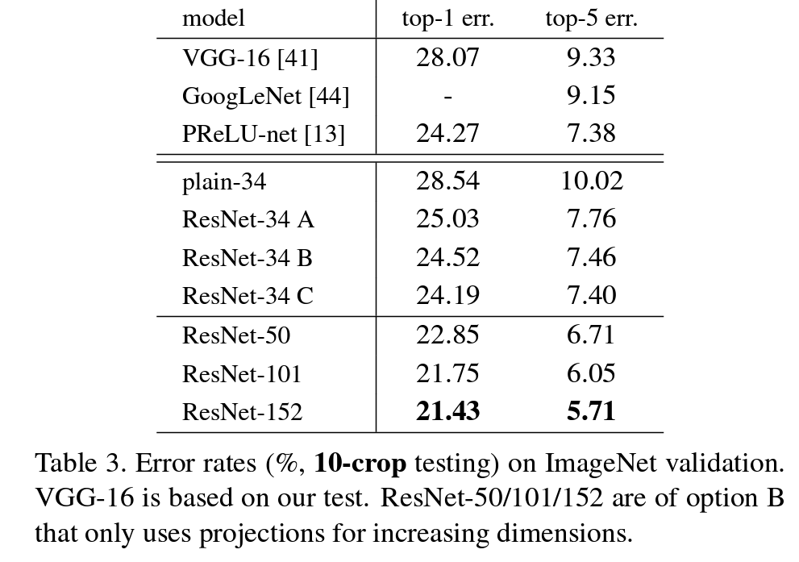
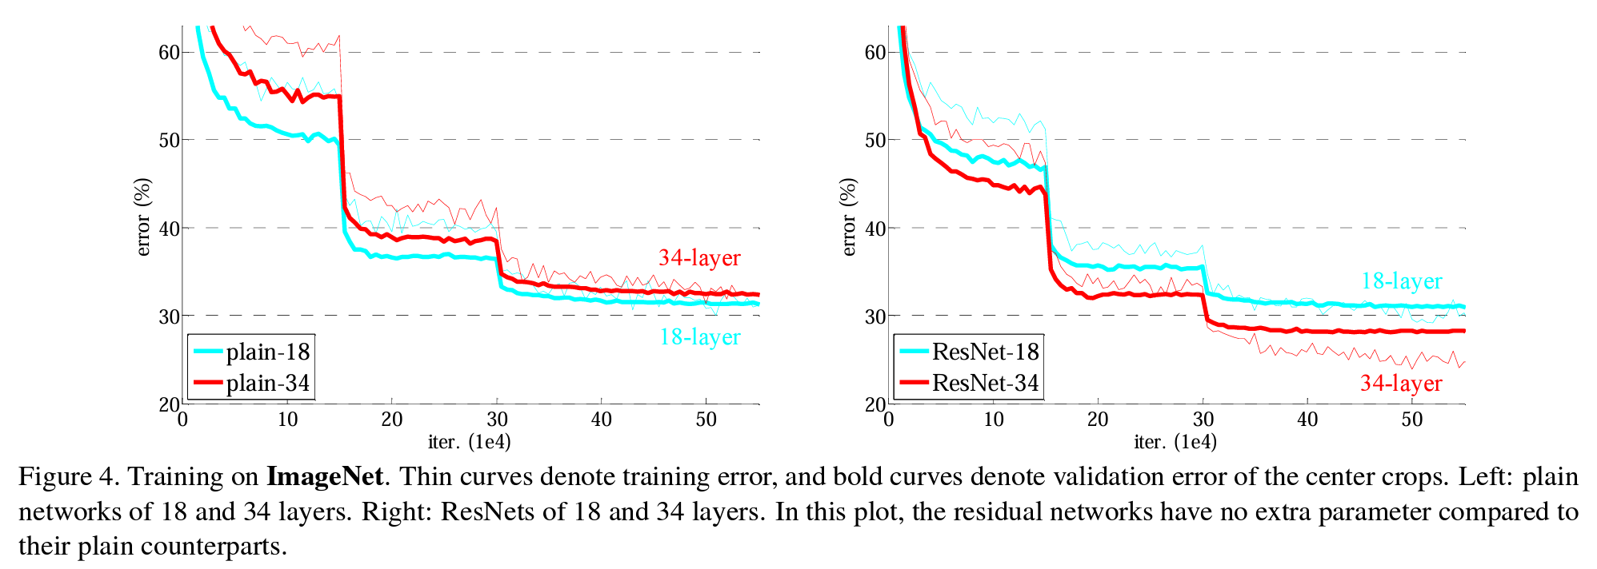
ResNet (2015)
Results:
  The performance degeneration for deeper network is gone.
  Deeper Resnet comes with better performance
Notes:
What will happen if network goes deeper and deeper?
-

Slide 58
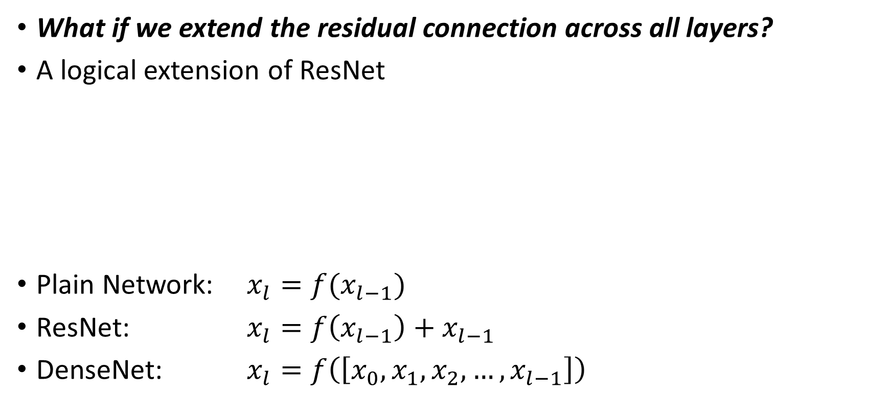




DenseNet (2016)
ResNet
DenseNet

Slide 59
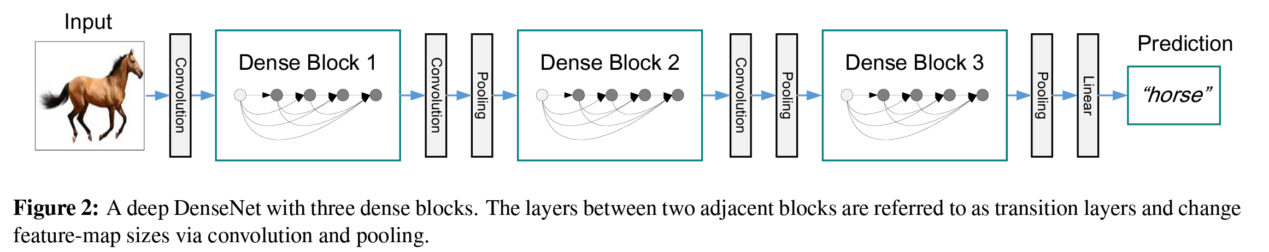
DenseNet (2016)
DenseBlock:
  BN-ReLU-Conv(1x1)-BN-ReLu-Conv(3x3) as basic block
  Introducing Conv(1x1) as Bottleneck layer to reduce the number of inputs
Transition Layer:
  Conv(1x1)-AvgPool(2x2)
  Introducing Conv(1x1) to Half the number of input features.
Transition layer
Transition layer
Transition layer

Slide 60
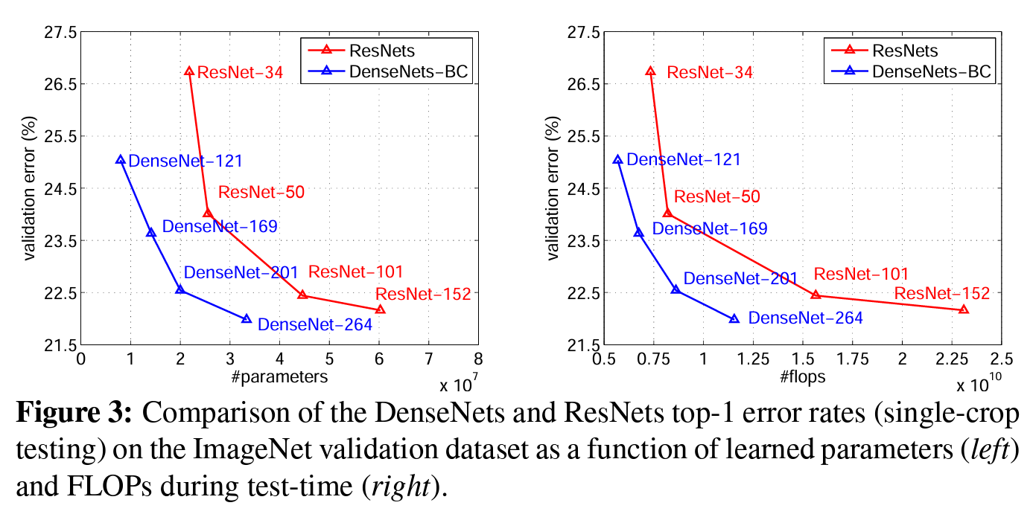
DenseNet (2016)
Results:
DenseNet get the same or better error rate compared to ResNet,
But with:
  Fewer parameters.
  Fewer computation resources (flops)

Slide 61
GoogLeNet/Inception (2014)
What if we make the CNN network wider instead of deeper?
  Larger model -> better performance, higher computation cost
  Fully connected architecture (deeper) -> sparsely connected architecture (wider)
  What is the optimal local sparse structure of the CNN block (kernel size, pooling, etc)?
Solution: Let model learn.
Filter concatenation
1x1 convolutions
3x3 convolutions
5x5 convolutions
3x3 max pooling
Previous layer
Notes:
Find out the optimal local sparse structure in a CNN network.
How to decide the kernel size?
Pooling or not?

Slide 62
GoogleNet/Inception (2014)
To reduce cost:
  Add Conv(1x1) layer before the highly-cost Conv(3x3) and Conv(5x5) to reduce the computation cost.
  Dubbed as “split-transformation-merge” strategy.
Filter concatenation
1x1 convolutions
3x3 convolutions
5x5 convolutions
1x1 convolutions
1x1 convolutions
1x1 convolutions
3x3 max pooling
Previous layer
Notes:
Find out the optimal local sparse structure in a CNN network.
How to decide the kernel size?
Pooling or not?

Slide 63
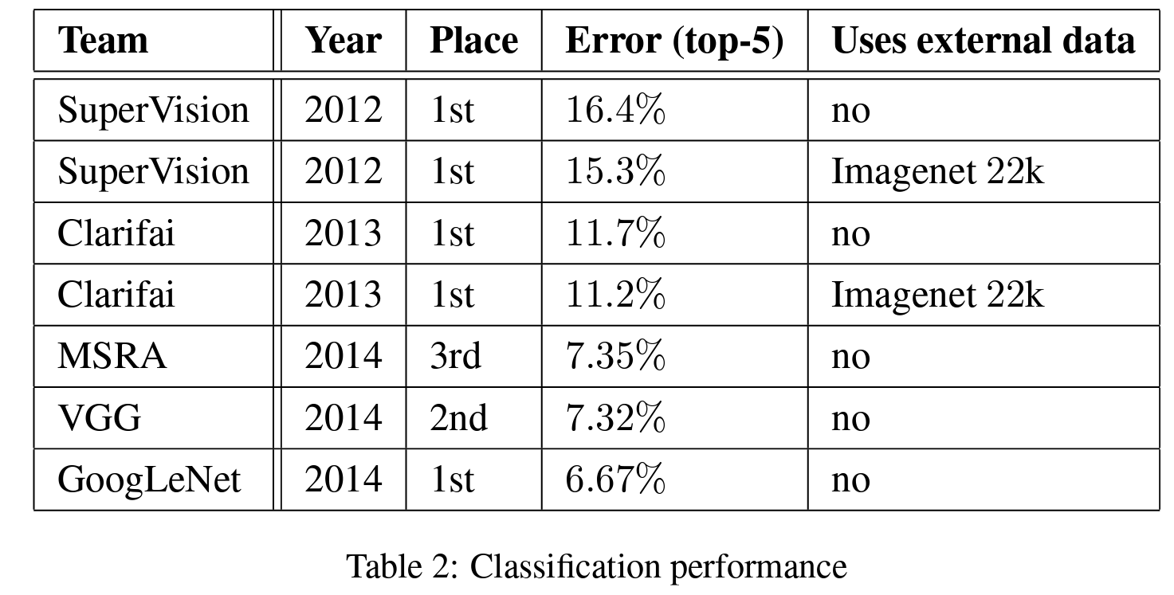
GoogleNet/Inception (2014)
Results:
  Better performance on ImageNet
Notes:
Find out the optimal local sparse structure in a CNN network.
How to decide the kernel size?
Pooling or not?

Slide 64
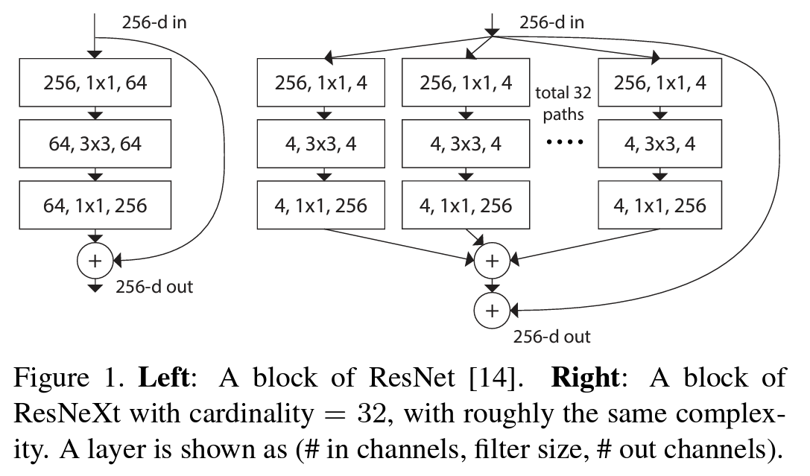
ResNeXt (2016)
Can we develop a wider ResNet?
  Apply “split-transformation-merge” strategy with the same topological branch
  (VGG-style repeating layers)
  Apply residual connection between each block

Slide 65
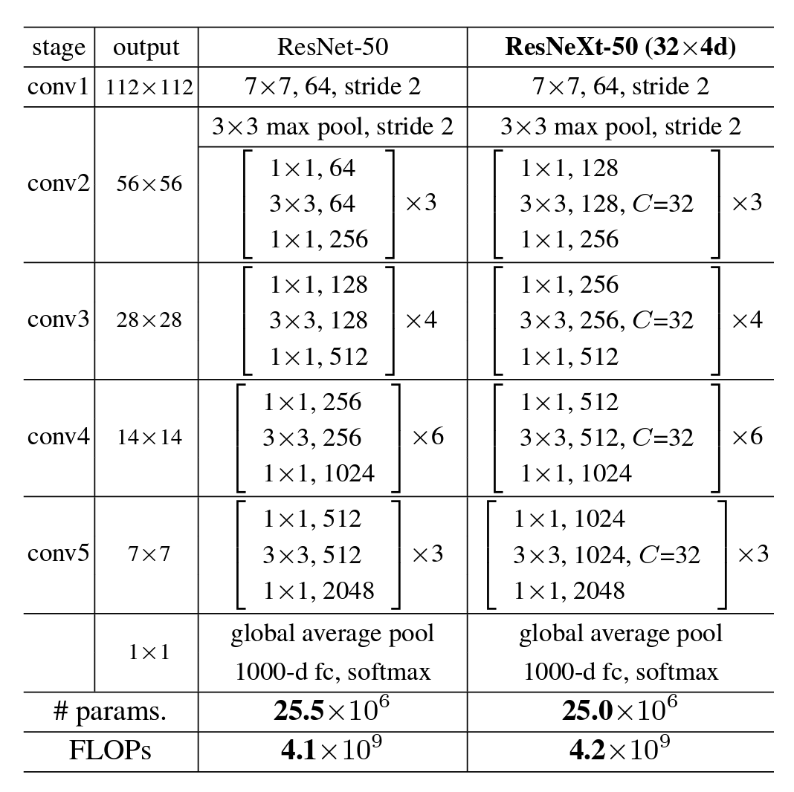
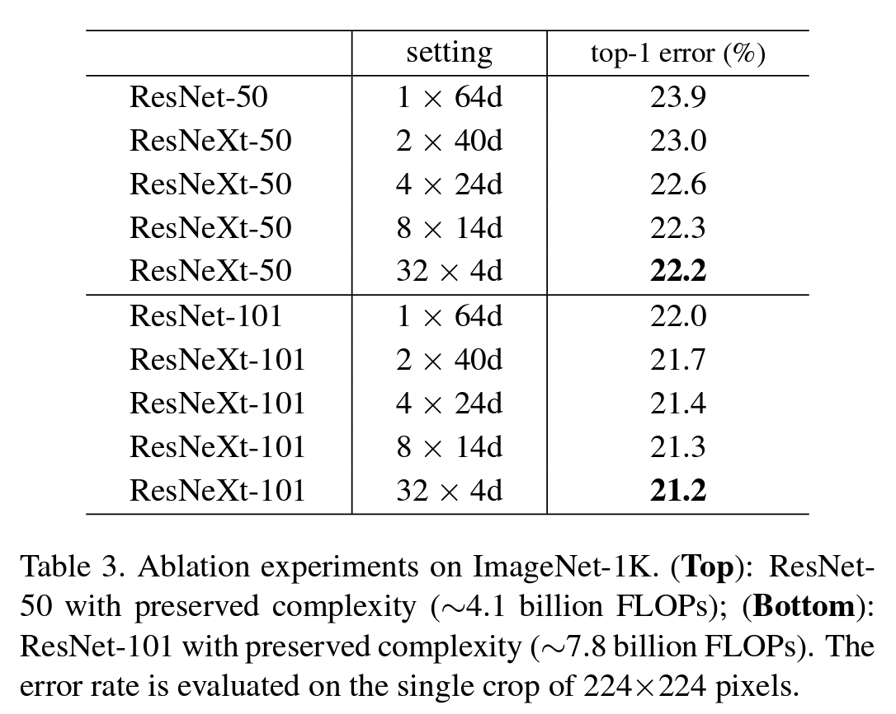
ResNeXt (2016)
Results:
  Lower error rate with the same number of parameters

Slide 66
ConvNeXt (2022)
To bridge the gap between the Conv Nets and ViT
  ViT, Swin Transformer has been the SOTA visual model backbone
  Is convolutional networks really not as good as transformer models?
Investigation
  The author start with ResNet-50 and reimplement the CNN networks with modern designs
  The results showing that ConvNeXt achieves beat the ViT models, again.

Slide 67
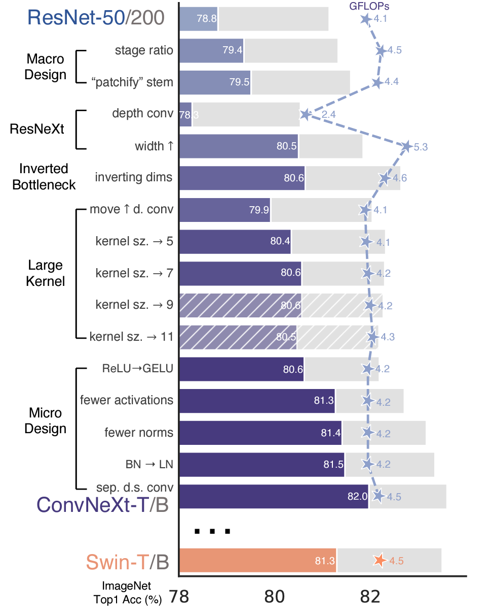
ConvNeXt (2022)
Modern designs added:
Use ResNeXt
Apply Inverted Bottleneck
Use larger kernel size
Training strategy:
  90 epochs -> 300 epochs
  AdamW optimizer
  Data augmentation like Mixup, CutMix
  Regularization Schemes like label smoothing
  …

Slide 68
ConvNeXt (2022)
Modern designs added:
Macro Design
  Changing stage compute ratio
  Changing stem to “patchify”
Micro Design
  ReLU -> GELU
  Fewer activation functions
  Fewer normalization layers
  BatchNorm -> LayerNorm
  Separate downsampling layers

Slide 69
CNN for downstream applications
Downstream tasks
  Image-segmentation: U-Net
  Object Detection: Yolo
  …
CNNs that more cost-effective
  MobileNet
  SqueezeNet
  …

Slide 70
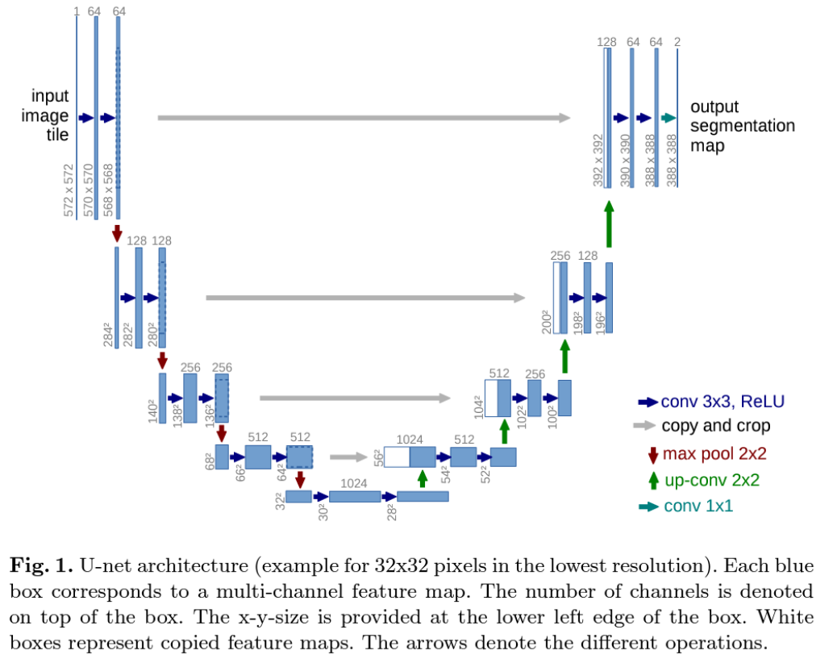
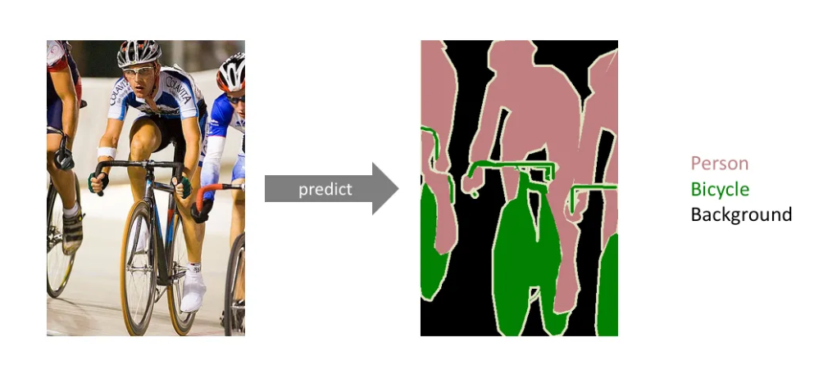
U-Net (2015)
Fully convolutional network for image segmentation
Output is 2 segmentation map
representing the probabilities of
each pixel belongs to either background or the object.

Slide 71
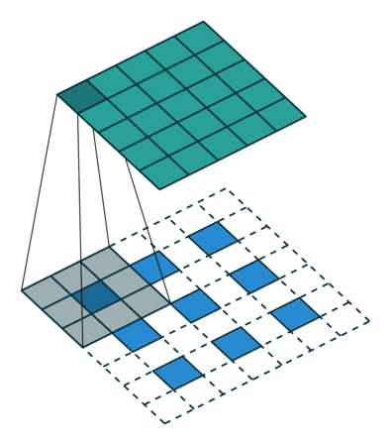
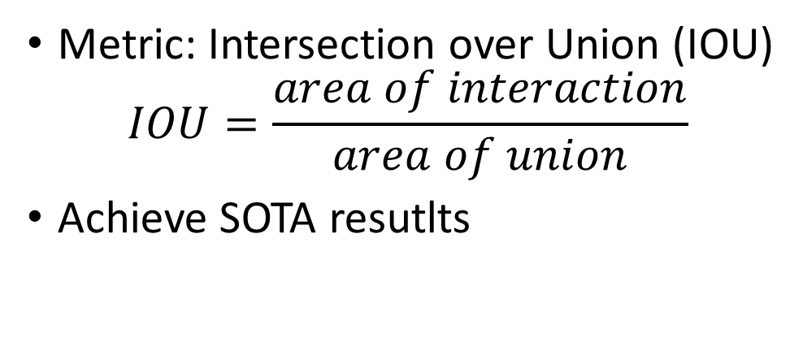
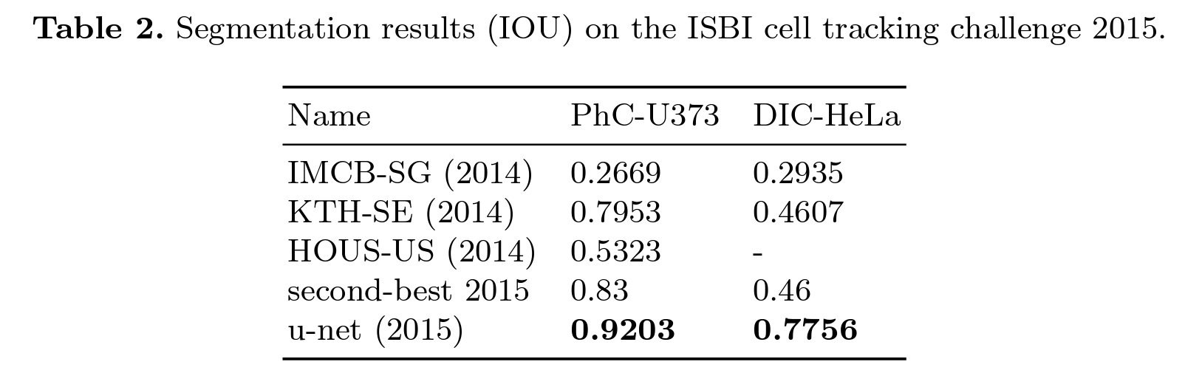
U-Net (2015)
Up-convolution
  Vanila convolution reduce the size of feature map
  Up convolution increase the size of feature map

Slide 72
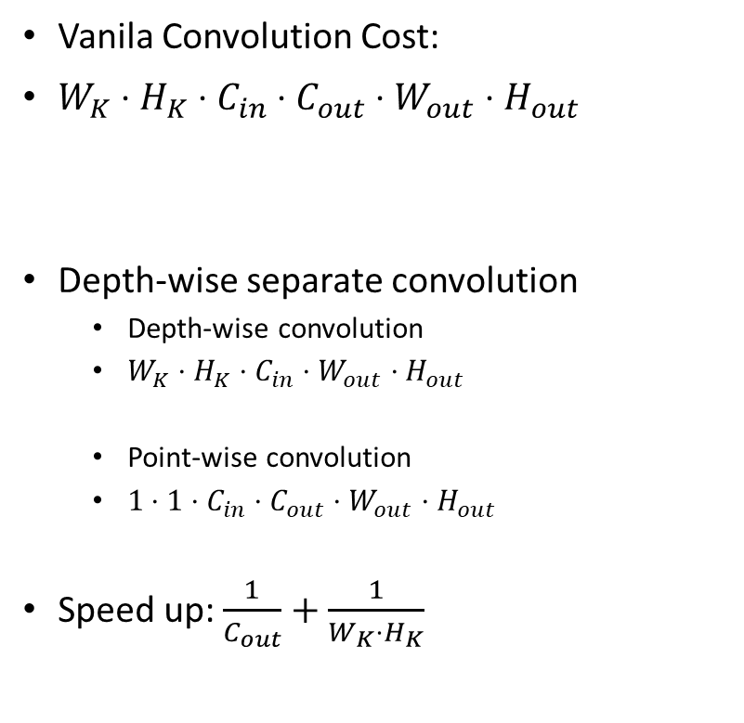
MobileNet (2017)
Efficient Network with depth-wise separate convolution
Kernel Size
# Kernels
Output feature size
Vanilla Convolution
Depth-wise
convolution
Point-wise
convolution
Depth-wise separate convolution

Slide 73
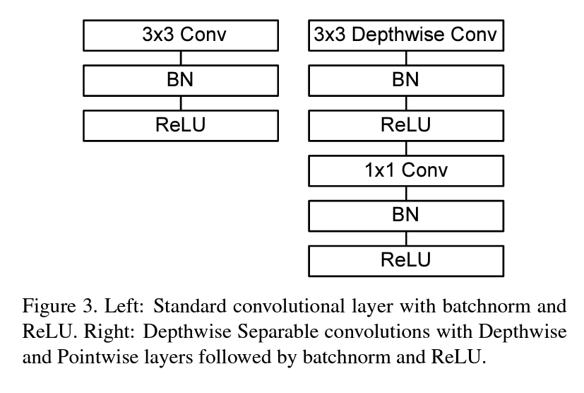
MobileNet (2017)
Vanilla Convolution
Depth-wise
convolution
Point-wise
convolution
Depth-wise separate convolution

Slide 74
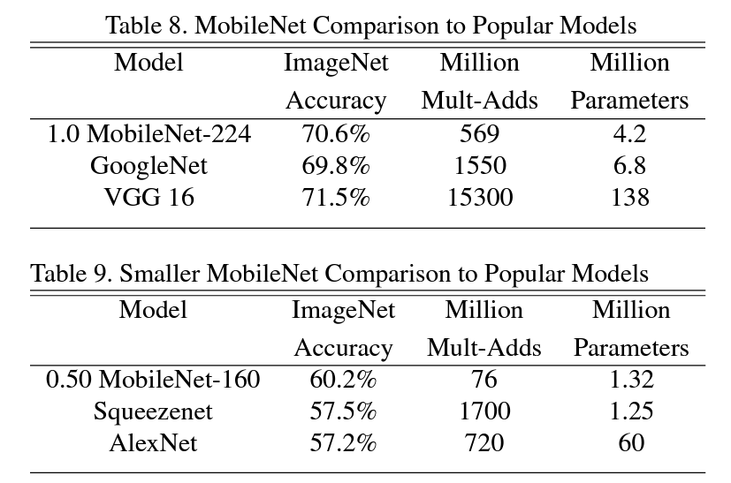
MobileNet (2017)
Results:

Slide 75
Summary of CNN part
LeNet-5: First CNN network
AlexNet: First CNN network on GPU.
VGGNet: Increasing model depth via repeating blocks
ResNet: Residual connection enable deeper network
DenseNet: Residual connection across all layers
GoogLeNet/Inception: Wider network via “split-transformation-merge”
ResNeXt: ResNet with VGG-style “split-transformation-merge”
ConNeXt: CNN network with modern design techniques.
U-Net: CNN network for image segmentation
MobileNet: More cost-effective CNN network via depth-separate CNN.

Slide 76
Summary of CNN part
Before 2012
2012
2014
2015
2016
2020
LeNet-5
AlexNet
VGGNet
ResNet
DenseNet
Towards deeper network
ConvNeXt
GoogLeNet
ResNeXt
Towards wider network
Downstream Applications
U-Net
MobileNet
Yolo
SqueezeNet
…
Image
segmentation
More
Efficient
Object
Detection
Smaller
Size
Other
Downstream Tasks

