Slide 1
Lecture 9: Large Language Models
Presenters: Ayinde Yakubu & Jerry Gu
Notes:
Introduce myself and allow Jerry to introduce himself

Slide 2
Agenda
Language Model
T5
In-context Learning
GPT-3
Codex
Llama-2
Mixtral of Experts
PaLM
Q&A Session
Notes:
Our session today is on Language Models. This is a part of deep learning that is focused on Natural Language Processing (NLP) tasks. We will talk about various types of Language Models such as T5, GPT-3, Codex, Llama-2, Chincilla, and PaLM. We will also talk about unsupervised learning and compare them to other types of learning. Please feel free to stop us anytime and ask questions. We have a set of discussion questions at the end of our session.

Slide 3
What is Large Language Model (LLM)?¹
Language models are computational models that have the capability to understand and generate human language.
Deep learning algorithm that can perform various NLP tasks
Are trained on massive datasets that allow them to recognise, translate, predict, or generate text or other content
Unsupervised multi-task learners
Chang, Y., Wang, X., Wang, J., Wu, Y., Zhu, K., Chen, H., Yang, L., Yi, X., Wang, C., Wang, Y., Ye, W., Zhang, Y., Chang, Y., Yu, P.S., Yang, Q., & Xie, X. (2023). A Survey on Evaluation of Large Language Models. ArXiv, abs/2307.03109.
Slides created for CS886 at UWaterloo
Notes:
Language models are computational models that have the capability to understand and generate human language
LMs have the transformative ability to predict the likelihood of word sequences or generate new text based on a given input
N-grams models, estimate word probabilities based on the preceding text
They are trained on massive amount of publicly available data
LMs have the transformative ability to predict the likelihood of word sequences or generate new text based on a given input
LLMs are advanced language models with massive parameter sizes and exceptional learning capabilities
Self-attention module in Transformer serves as the fundamental building block for language modelling tasks
Transformers have revolutionized the field of NLP with their ability to handle sequential data efficiently, allowing for parallelization and capturing long-range dependencies in text
One key feature of LLMs is in-context learning which we will talk about later

Slide 4
Large Language Model (LLM) Comparison
Comparison | Traditional ML | Deep Learning | LLMs
Training Data Size | Large | Large | Very Large
Feature Engineering | Manual | Automatic | Automatic
Model Complexity | Limited | Complex | Complex
Interpretability | Good | Poor | Poorer
Performance | Moderate | High | Highest
Hardware Requirements | Low | High | Very High
Slides created for CS886 at UWaterloo
Notes:
Compared to other types of artificial intelligence, Large Language Models have
Very large amount of training data set - we are talking about billions of input tokens
Do not need to manual control what features to focus on
Are very complex model
May be harder to interpret their conclusions. This is an area that we will talk about later in this session
Have very high performance
Require massive amount of compute powers in order to run. We are talking in order of Peta FLOPS/s per day.

Slide 5
Natural Language Processing Tasks
Natural Language Understanding
  Sentiment Analysis: This is a classification task. It analyzes and interprets text to determine their emotional inclination. The result is usually a binary (positive and negative) or triple (positive, neutral or negative)
  Text Classification: This is related to sentiment analysis though encompasses more.
  Natural language Inference (NLI): determination of whether a given “hypothesis” logically follows from a given “premise”. ChatGPT does very well on NLI tasks.
  Semantic Understanding: Interpretation and comprehension of words, phrases, sentences and the relationships between them.
Reasoning
  Models must comprehend provided information and utilize reasoning and influence to deduce answers when explicit responses are absent.
Natural Language Generation
  Summarization: ability to create a concise abstract for a given sentence or paragraph.
  Question answering: Creating answers to specific questions
Slides created for CS886 at UWaterloo
Notes:
We understand words and sentences by the context in which they are used. This is especially true for new words that we are not used to.

Slide 6
T5 Framework²
Unified (text) approach to tasks
2. Raffel, C., Shazeer, N., Roberts, A., Lee, K., Narang, S., Matena, M., ... & Liu, P. J. (2020). Exploring the limits of transfer learning with a unified text-to-text transformer. The Journal of Machine Learning Research, 21(1), 5485-5551.
Translate English to German: That is good
Das is gut
cola sentence: The course is jumping well.
T5
Not acceptable
Stsb (similarity score 1-5)
Sentence 1: The rhino grazed on the grass, sentence 2: A rhino is grazing in a field
3.8
Summarize: state authorities dispatched emergency crews tuesday to survey the damage after an onslaught of severe weather in Mississippi
Six people hospitalized after a storm in attala county
Slides created for CS886 at UWaterloo
Notes:
T5 stands for Text-to-Text Transfer Transformer (T5)
It can perform tasks such as:
Translation:
Question Answering
Classification
Similarity Score
Summarization
Unified approach ensure that tasks all are cast text-to-text inputting text and generating some target text. This allows us to use the same model, loss function, hyperparameters, layers, etc. across a diverse set of tasks.
Treats every text processing problem as a “text-to-text” problem
Use of word vectors to map word identities to a continuous representation
Common Crawl project produces about 20TB of text data extracted from web pages each month
Model is first pre-trained on a data-rich task before being fine-tuned on a downstream task
Primary building block is self-attention
Prefix LM in the input e.g. “translate English to German: That is good. target:”

Slide 7
T5: Transformer Architecture
Uses word2vec to generate numeric representation vector for each token in the input sequence
Input
Input Embedding
Positional Encoding
Decoding Component
Decoder
Encoding Component
Encoder
Decoder
Encoder
Decoder
Encoder
Linear
Softmax
Output
Slides created for CS886 at UWaterloo
Notes:
Transformers were first introduced in a 2017 paper called “Attention is all you need” by Vaswani and others.
A groundbreaking architecture that uses attention to add context to data
The Encoding component of a transformer accepts an input sequence and maps it into an abstract continuous representation that holds all the learned information about the input.
The Decoding component then takes the continuous representation and sequentially generates output while also being fed its previous outputs.
The encoding component accepts all vectors in the input sequence at the same time. It performs positional encoding to retain the order of the input within the sequence by adding extra vector to each input embedding vector
For every odd, add a vector created by cosine function, and sine for every even embedding
The output is generated via
The linear layer is neural network that projects the vector produced by the decoding component into a much larger vector called a logits vector whose size is determined by the number of unique words in the model’s vocabulary
The job of the softmax layer is to convert the logits score into probabilities. The word with the highest probability in the model’s vocabulary is chosen and is predicted as the output during this time step.
This output is then fed back to the decoding component to help inform or provide context to its prediction in the next time step. This is known as autoregression.
Note that as data flows from one encoder, it flows to the next encoder in the stack
The same thing happens with the stack of decoders

Slide 8
Transformer Architecture
Encoding Component
Decoding Component
Decoder
Encoder
Self-Attention
Self-Attention
Encoder-Decoder Attention
Feed-Forward
Feed-Forward
Decoder
Encoder
Linear
Softmax
Output
Slides created for CS886 at UWaterloo
Notes:
Self-attention - This mechanism enables words to interact with each other (self) so they can figure out which other words they should pay more attention to (attention)
Encoder-Decoder Attention: The goal of this layer is to help the model align the words in the input sequence with the words in the output sequence
The linear layer is neural network that projects the vector produced by the decoding component into a much larger vector called a logits vector whose size is determined by the number of unique words in the model’s vocabulary
The job of the softmax layer is to convert the logits score into probabilities. The word with the highest probability in the model’s vocabulary is chosen and is predicted as the output during this time step.
This output is then fed back to the decoding component to help inform or provide context to its prediction in the next time step. This is known as autoregression.

Slide 9
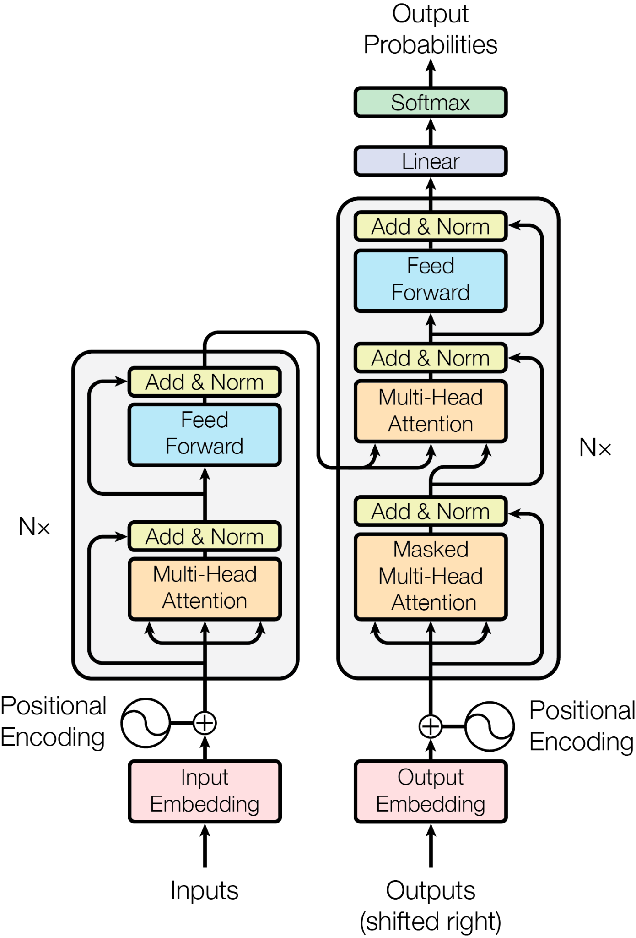
T5 Transformer Model Architecture
Encoder/decoder blocks similar in sizes
Each block comprises self-attention, optional encoder-attention, and a feed-forward network
Slides created for CS886 at UWaterloo
Notes:
Transformer architecture is something we have all seen in earlier lectures so wont go into a lot of details here. Points to note:
Consisted of an encoder-decoder architecture
The encoder and decoder are each similar in size and configuration. Each consists of 12 blocks each. Each block comprising self-attention, optional encoder-decoder attention, and a feed-forward network.
The feed-forward networks in each block consist of a dense layer with an output dimensionality of dff = 3072 followed by a Rectified Linear Unit (ReLU) which converts linear combination inputs into non-linear outputs
The “key” and “value” matrices of all attention mechanisms have a dimensionality of dkv = 64 and all attention mechanisms have 12 heads. All other sub-layers and embeddings have a dimensionality of model = 768
In total, this results in a model of about 220 million parameters
Primary building block is self-attention
Variant of attention (sometimes called intra-attention)
Processes a sequence by replacing each element by a weighted average of the rest of the sequence
Relating different positions of a single sequence in order to compute a representation of the sequence
Maps an input sequence of symbols representations to (x1,..,xn) to a sequence of continuous representations z = (z1,..,zn)
Given z, the decoder then generates an output sequence (y1,..,ym) of symbols one element at a time
At each step, the model is auto-regressive, consuming the previously generated symbols as additional input when generating the next.
Encoder - self-attention - tokens look at each other. Queries, keys, values are computed from encoder states
Feed-forward network: after taking information from other tokens, take a moment to think and process this information
Decoder-encoder attention: target token looks at the source: queries - from decoder states; keys and values from encoder states
Decoder self-attention (masked): tokens look at the previous tokens - queries, keys, values re computed from decoder states

Slide 10
T5 Transformer Attention³
Encoder-decoder attention
  Queries come from the previous decoder layer
  The memory keys and values come from the output of the encoder
  Allows every position in the decoder to attend to all positions in the input sequence
  Helps the model align words in the input sequence with the words in the output sequence
Encoder contains self-attention
  All of the keys, values and queries come from the same place, the output of the previous layer in the encoder
  Each position in the encoder can attend to all positions in the previous layer of the encoder
Masked self-attention in the decoder
  Allows each position in the decoder to attend to all positions in the decoder up to and including that position
  Prevents leftward information flow in the decoder via a scaled dot-product attention by masking out ( setting to -∞) all values
3. A. Vaswani et al., “Attention is All you Need,” in Advances in Neural Information Processing Systems (NeurIPS), 2017.
Slides created for CS886 at UWaterloo
Notes:
In self-attention, the model processes each token in the input sequence and assigns different attention scores to other tokens in the same sequence. These scores determine the importance of each token's contribution
to the model's understanding of the context.

Slide 11
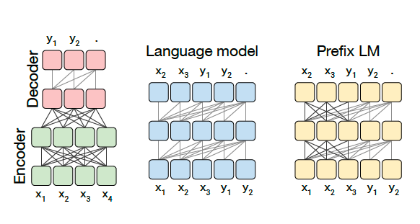
T5 Architecture variants
A major distinguishing factor is the “mask” used by different attention mechanisms in the mode
Blocks represent elements of sequence, lines attention visibility
Dark grey lines correspond to fully-visible masking and light grey lines correspond to causal masking
Slides created for CS886 at UWaterloo
Notes:
Schematics of the Transformer architecture variants we considered. In this diagram, blocks represent elements of a sequence and lines represent attention visibility.
Different colored groups of blocks indicate different Transformer layer stacks. Dark grey lines correspond to fully-visible masking and light grey lines correspond to causal masking.
We use “.” to denote a special end-of-sequence token that represents the end of a prediction.
The input and output sequences are represented as x and y respectively.
Left: A standard encoder-decoder architecture uses fully visible masking in the encoder and the encoder-decoder attention, with causal masking in the decoder.
Middle: A language model consists of a single Transformer layer stack and is fed the concatenation of the input and target, using a causal mask throughout.
Right: Adding a prefix to a language model corresponds to allowing fully-visible masking over the input.

Slide 12
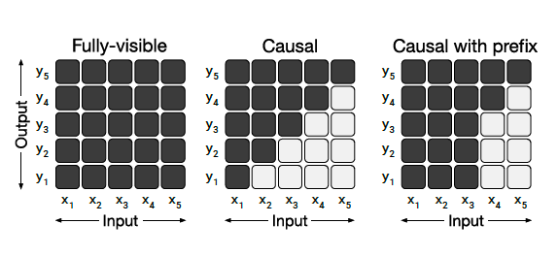
T5 Attention Mask Patterns
Slides created for CS886 at UWaterloo
Notes:
An attention mask is a crucial component in large language models (LLMs). It serves as a mechanism to control which parts of the input sequence the model should pay attention to during the training or inference process.
Types of Attention Masks
Full Attention: In some models, every token is allowed to attend to every other token in the input sequence. This is known as full attention and is often used in smaller models.
Scaled Dot-Product Attention: To make computations more efficient, large models typically use scaled dot-product attention. This means that tokens only attend to other tokens within a certain distance, determined by a window size or a fixed context length.
Masked Attention: In cases where the model should not attend to future tokens (to avoid data leakage during training), a triangular attention mask is applied. This mask ensures that each token can only attend to previous tokens in the sequence.
Attention Heads: Large language models like GPT-3.5 employ multiple attention heads. Each head learns different attention patterns, allowing the model to capture various relationships within the data. Attention heads can focus on different aspects like syntax, semantics, or sentiment.
The matrices in this diagram represent different attention mask patterns. The input and output of the self-attention mechanism are denoted x and y respectively.
A dark cell at row i and column j indicates that the self-attention mechanism is allowed to attend to input element j at output timestep i. For example, it attends to input x1 at output y1.
A light cell indicates that the self-attention mechanism is not allowed to attend to the corresponding i and j combination.
Left: A fully-visible mask allows the self-attention mechanism to attend to the full input at every output timestep.
Middle: A causal mask prevents the ith output element from depending on any input elements from “the future”.
Right: Causal masking with a prefix allows the self-attention mechanism to use fully-visible masking on a portion of the input sequence.

Slide 13
T5 Performance of architecture variants
Architecture | Objective | Params | Cost | GLUE | CNNDM | SQuAD | SGLUE | EnDe | EnFr | EnRo
*Encoder-decoder | Denoising | 2P | M | 83.28 | 19.24 | 80.88 | 71.36 | 26.98 | 39.82 | 27.65
Enc-dec, shared | Denoising | P | M | 82.81 | 18.78 | 80.63 | 70.73 | 26.72 | 39.03 | 27.46
Enc-dec, 6 layers | Denoising | P | M/2 | 80.88 | 18.97 | 77.59 | 68.42 | 26.38 | 38.40 | 26.95
Language model | Denoising | P | M | 74.70 | 17.93 | 61.14 | 55.02 | 25.09 | 35.28 | 25.86
Prefix LM | Denoising | P | M | 81.82 | 18.61 | 78.94 | 68.11 | 26.43 | 37.98 | 27.39
Encoder-decoder | LM | 2P | M | 79.56 | 18.59 | 76.02 | 64.29 | 26.27 | 39.17 | 26.86
Enc-dec, shared | LM | P | M | 79.60 | 18.13 | 76.35 | 63.50 | 26.62 | 39.17 | 27.05
Enc-dec, 6 layers | LM | P | M/2 | 78.67 | 18.26 | 75.32 | 64.06 | 26.13 | 38.42 | 26.89
Language model | LM | P | M | 73.78 | 17.54 | 53.81 | 56.51 | 25.23 | 34.31 | 25.38
Prefix LM | LM | P | M | 79.68 | 17.84 | 76.87 | 64.86 | 26.28 | 37.51 | 26.76
Slides created for CS886 at UWaterloo
Notes:
Performance of the different architectural variants described earlier. P refers to the number of parameters in a 12-layer base Transformer layer stack and M to refer to the FLOPs required to process a sequence using the encoder decoder model. We evaluate each architectural variant using a denoising objective and an autoregressive objective (as is commonly used
to train language models).
We can see that the encoder-decoder architecture with denoising (reducing randomness and corruption in input data) has the best performance. Noise refers to random or unpredictable fluctuations in data that disrupt the ability to identify target patterns or relationships. The result is reduced accuracy or reliability of a model’s predictions or output.

Slide 14
T5 Input - Colossal Clean Crawled Corpus
20TB of text data extracted from web pages each month
Needed to be cleaned up
Heuristics for cleaning up
  Remove boilerplate texts
  Remove duplicates
  Retained lines containing at least 5 words
Slides created for CS886 at UWaterloo
Notes:
Retained only lines that ended in terminal punctuation mark (i.e. a period, exclamation mark, question mark, or end quotation mark)
Discarded any page fewer than 3 sentences.
Only retained lines that contained at least 5 words
Removed any page that contained any word on the “List of Dirty, Naughty, Obscene or Otherwise Bad Words”
Removed boilerplate policy notices
Deduplicate the data set

Slide 15
T5: Downstream Tasks
Measure general language learning abilities
Sentence acceptability judgement
Sentiment analysis
Paraphrasing/sentence similarity
Natural language inference
Coreference resolution
Sentence completion
Word sense disambiguation
Question answering
Slides created for CS886 at UWaterloo
Notes:
These are the downstreams tasks that T5 model can be used for

Slide 16
T5: Training the model
All tasks are formulated as text-to-text tasks
Pre-train each model for 2¹⁹ = 524,288 steps
Use a maximum sequence of 512 and a batch size of 128 sequences
Pack multiple sequences into each of batch 2¹⁶ or 65,536 tokens
Pre-training batch size X number of steps 2³⁵≈ 34B tokens
2³⁵ tokens only covers a fraction of the entire C4 data set
Learning rate is inverse square root schedule: 1 / √max(n,k) where n is the current training iteration and k is the number of warm-up steps (set to 10⁴)
Sets the learning rate of 0.01 for the first 10⁴ steps, then exponentially decays the learning rate until pre-training is over.
Learning rate of 0.001 when fine-tuning
Slides created for CS886 at UWaterloo

Slide 17


T5 - Unsupervised Objectives
Provides mechanism through which the model gains general-purpose knowledge to apply to downstream tasks
Ingest a sequence of token IDs corresponding to a span of text from input unlabelled text data set
Original Text
Thank you for inviting me to your party last week.
Inputs
Thank you <X> me to your party <Y> week.
Targets
<X> for inviting <Y> last <Z>
Slides created for CS886 at UWaterloo
Notes:
Central importance as it provides mechanism through which the model gains general-purpose knowledge to apply to downstream tasks
Ingest a sequence of token IDs corresponding to tokenized span of text from our unlabelled text data set
The token sequence is processed to produce both a (corrupted) input sequence and a corresponding target.
Used SentencePiece to encode text as WordPiece tokens
Leveraging unlabelled data to pre-train our model necessitates an objective that does not require labels
The words “for”, “inviting” and “last” (marked with an X) are randomly chosen for corruption
Each consecutive span of corrupted tokens is replaced by a sentinel token (shown as <X> and <Y> that is unique over the example
Since “for” and “inviting” occur consecutively, they are replaced by a single sentinel <X>
The output sentinel then consists of the dropped-out spans, delimited by the sentinel tokens used to replace them in the input plus final sentinel token <Z>

Slide 18
T5 - Pre-training Data set
High-level approaches
Corruption strategies
Corruption rate
Corrupted span length
Mask
10%
2
Language Modelling
Replace spans
15%
3
BERT-style
Drop
25%
5
Deshuffling
50%
10
Slides created for CS886 at UWaterloo
Notes:
Similar in importance to unsupervised objectives, the pre-training data set itself is a crucial component of the transfer learning pipeline
Unlike objectives and benchmarks, new pre-training data sets are usually not treated as significant contributions on their own
A few disparate approaches were considered - language modeling, BERT-style denoising, and deshuffling

Slide 19
T5 - Performance Results
Data set | Size | GLUE | CNNDM | SQuAD | SGLUE | EnDe | EnFr | EnRo
*C4 | 745GB | 83.28 | 19.24 | 80.88 | 71.36 | 26.98 | 39.82 | 27.65
C4, unfiltered | 6.1TB | 81.46 | 19.14 | 78.78 | 68.04 | 26.55 | 39.34 | 27.21
RealNews-like | 35GB | 83.83 | 19.23 | 80.39 | 72.38 | 26.75 | 39.90 | 27.48
WebText-like | 17GB | 84.03 | 19.31 | 81.42 | 71.40 | 26.80 | 39.74 | 27.59
Wikipedia | 16GB | 81.85 | 19.31 | 81.29 | 68.01 | 26.94 | 39.69 | 27.67
Wikipedia +TBC | 20GB | 83.65 | 19.28 | 82.08 | 73.24 | 26.77 | 39.63 | 27.57
Slides created for CS886 at UWaterloo
Notes:
Performance resulting from pre-training on different data sets. The first four variants are based on our new C4 data set.
The best performance came from RealNews-like dataset even though it was not the largest

Slide 20
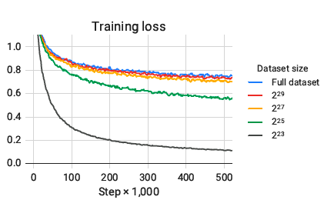
T5 - Pre-training Loss
Slides created for CS886 at UWaterloo
Notes:
Pre-training loss for our original C4 data set as well as 4 artificially truncated versions. The sizes listed refer to the number of tokens in each data set.
The four sizes considered correspond to repeating the data set between 64 and 4,096 times over the course of pre-training.
Using a smaller data set size results in smaller training loss values, which may suggest some memorization of the unlabeled dataset.

Slide 21
T5 Scaling
Increasing compute power results in better performance
Baseline model has 220M parameters, is pre-trained and fine tuned for 2¹⁹ and 2¹⁸ steps respectively
Increasing training time and/or model size
Increasing baseline model size
Undertake longer training to improve performance
Scale up model sizes
Slides created for CS886 at UWaterloo
Notes:
The bitter lesson of machine learning research is that general methods that can leverage additional computation ultimately win out against methods that rely on human expertise to scale up.
With Neural Networks as much as with military ‘God is usually on the side of big battalions - according to Voltaire (1694 - 1778). The more computing power you have, the better
Two models are considered equivalent if they either have the same number of parameters or they require the roughly the same amount of computation to process a given (input-sequence, target-sequence) pair.
Microsoft invested about $13B USD in OpenAI, the makers of ChatGPT. A large portion of that fund was for cloud compute purchases instead of direct cash injection. That is compute extensive deep learning is!

Slide 22
Reflections on T5
-Text-to-text
  provides a simple way to train a single model on a wide variety of tasks using the same loss function and decoding procedure
  Successfully applied to abstractive summarization, classification tasks like natural language inference, and regression task like STS-B
  Comparable performance to task-specific architectures
Architectures
  Original encoder-decoder form worked best
  Uses twice as many parameters as “encoder-only” (e.g. BERT)
Unsupervised objectives:
  “Denoising” objectives train the model to reconstruct randomly corrupted text performs well
Data sets - Used the (Colossal Clean Crawled Corpus) C4 data set
Training strategies
  Updating all of pre-trained model’s parameters
Scaling
Slides created for CS886 at UWaterloo
Notes:
Let’s recap some of our findings for the T5 model.
Scaling
Compared various strategies for taking advantage of additional compute, including increasing training data, larger model

Slide 23
In-Context Learning
Need for a large dataset for every task limits applicability of language models - its not practical
Potential to exploit spurious correlations in training data grows with the expressiveness of the model and narrowness of the training distribution Language models are few-shot learners
Humans do not require large supervised datasets to learn most language tasks - a brief directive is sufficient
Meta-learning or zero-shot transfer allows the model to develop a broad set of skills and pattern recognition abilities at training time
Not as performant as reinforcement learning from human feedback (RLHF)
Slides created for CS886 at UWaterloo
Notes:
The LLM learns a new task from a small set of examples presented within the context (the prompt) at inference time.
The key idea is to learn from analogy

Slide 24
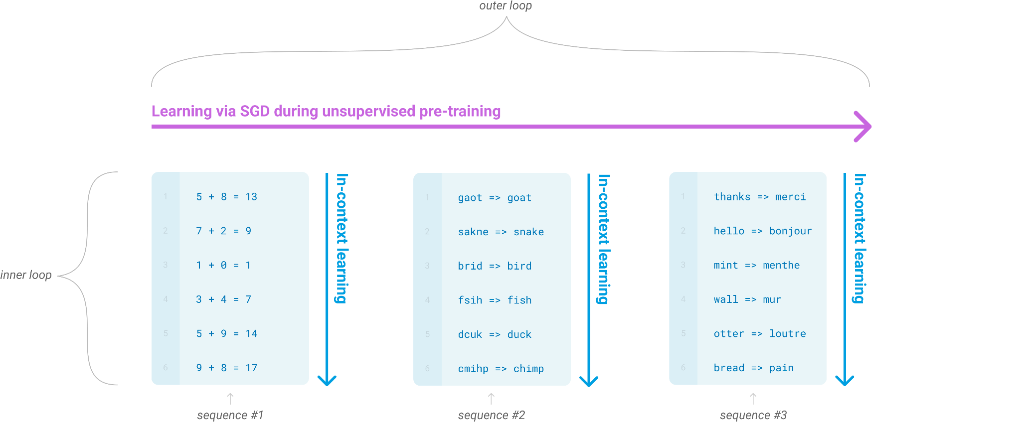
Language model meta-learning⁴
Language model develops a broad set of skills and pattern recognition abilities during training
Slides created for CS886 at UWaterloo
4. Brown, T., Mann, B., Ryder, N., Subbiah, M., Kaplan, J. D., Dhariwal, P., ... & Amodei, D. (2020). Language models are few-shot learners. Advances in neural information processing systems, 33, 1877-1901.
Notes:
During unsupervised pre-training, a language model develops a broad set of skills and pattern recognition abilities.
It then uses these abilities at inference time to rapidly adapt or recognize the desired task,
The term ‘in-context’ learning refers to the inner loop of this process. It occurs within the forward-pass upon each sequence

Slide 25
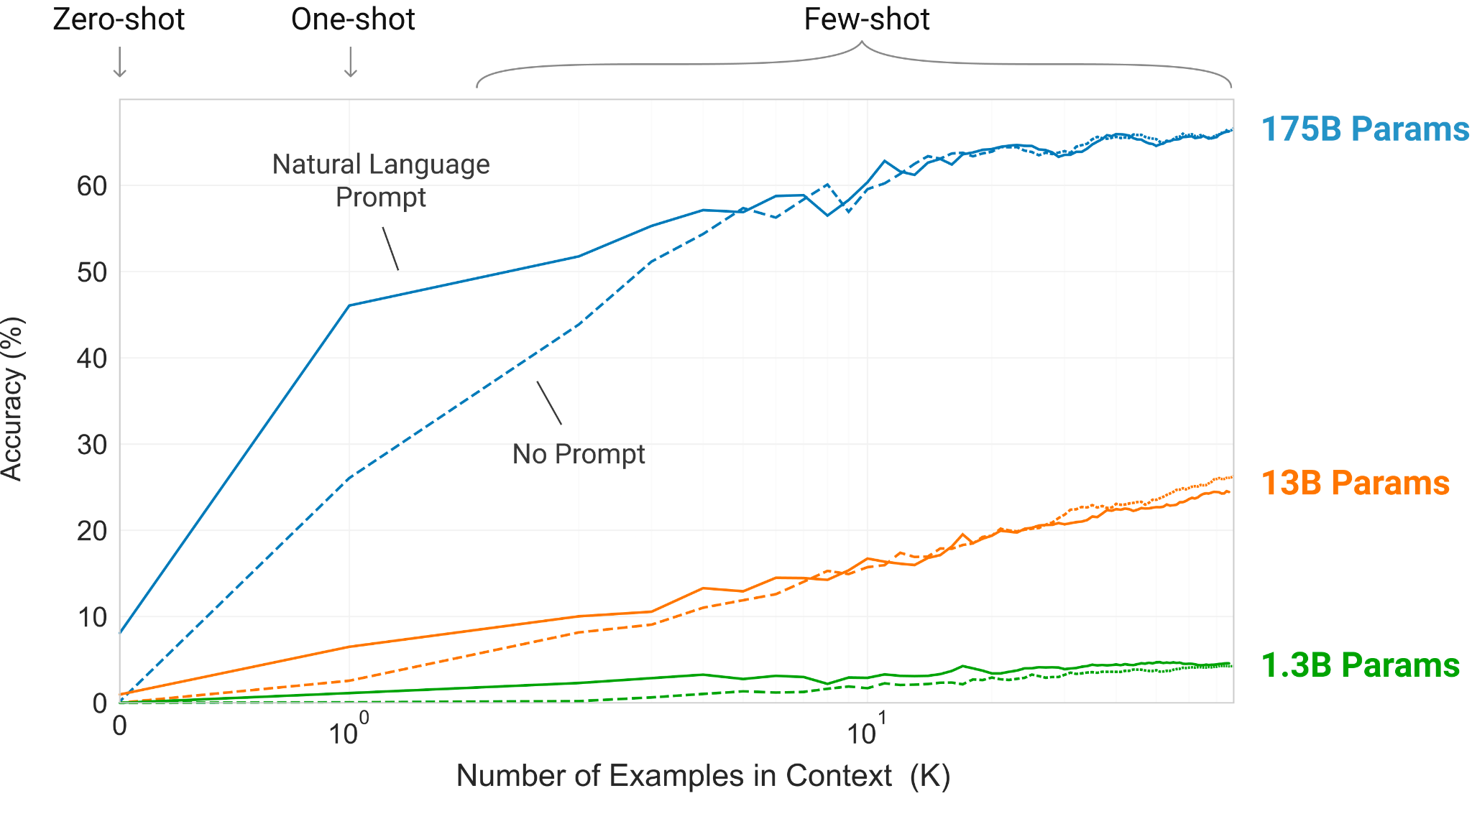
Language model meta-learning
Task: Remove random symbols from a word
Larger models make increasingly efficient use of in-context info
Params: weights + biases
Eval: GPT-3
Slides created for CS886 at UWaterloo
Notes:
Larger models make increasingly efficient use of in-context information
The steeper “in-context learning curves” for large models demonstrate improved ability to learn a task from contextual information

Slide 26
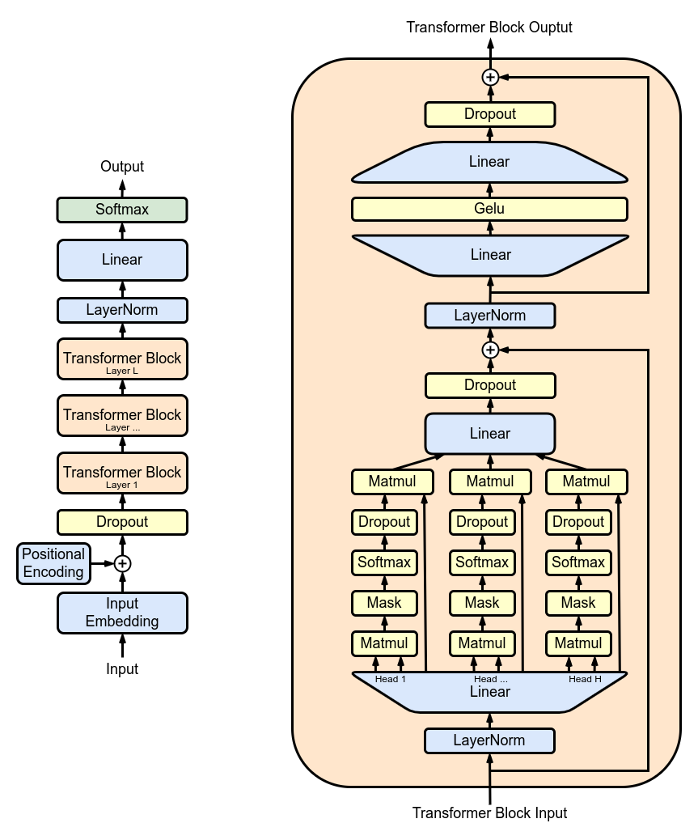
GPT-3 Architecture
Slides created for CS886 at UWaterloo
Notes:
Even though GPT-3 is based on Transformer architecture, note that its a decoder-only neural network.
It does have to embedding the input and pass all of it into the network but it does not have an encoder neural network layer.
The goal is to predict the next text given all previous text
Very large autoregressive language model can be used for few-shot prediction (training only very few data)

Slide 27
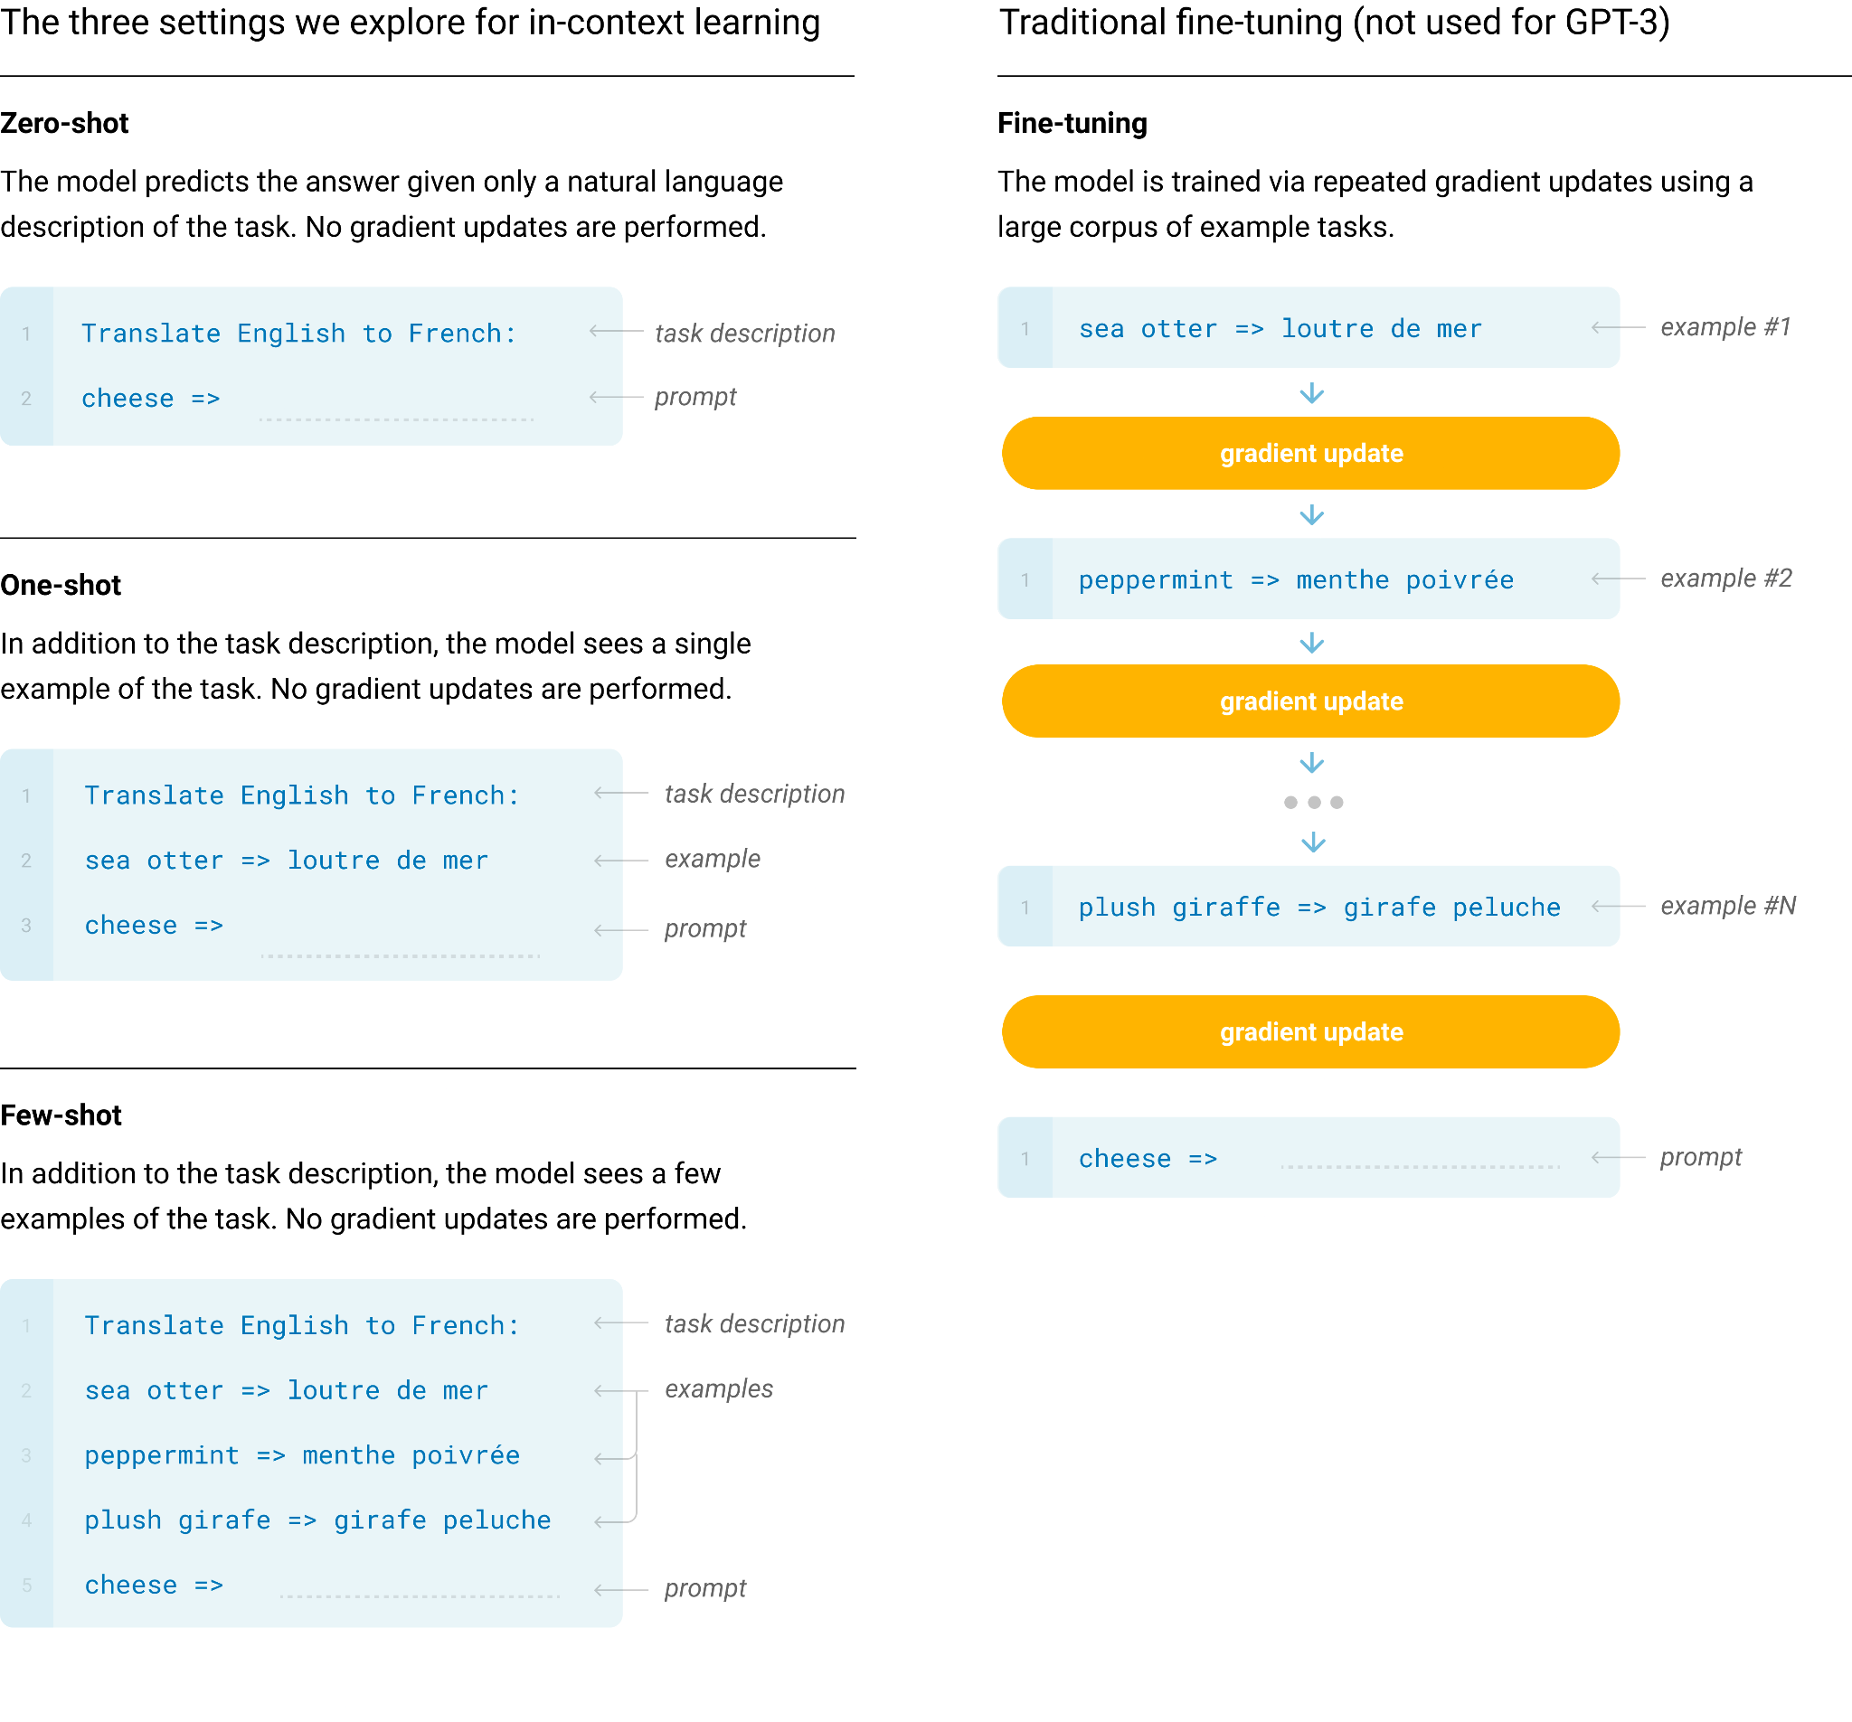
GPT-3 Training Approaches
Slides created for CS886 at UWaterloo
Notes:
Fine-Tuning (FT)
Most common approach, involves updating weights of a pre-trained model by training on a supervised dataset specific to the desired task
Uses thousands of labelled examples
Not used for GPT-3
Advantage - Strong performance on benchmarks
Disadvantage - Need new dataset for every task, potential for poor generalization
Few-Shot (FS)
Model given a few demonstration of the task at inference time
No weight updates are allowed
One-Shot (1S)

Slide 28
GPT-3 - Training dataset
Based on raw Common Crawl dataset of up to 1T words
Cleaned up original datasets by:
  Filtered Common Crawl based on similarity to a range of high-quality reference corpora
  Performed fuzzy deduplication at the document level
  Added known high-quality reference corpora to the training mix
Used final cleaned up data in training
Slides created for CS886 at UWaterloo

Slide 29
GPT-3 - Training dataset
Sizes, architectures, and learning hyper-parameters (batch size in tokens and learning rate) of the models trained
All models were trained for a total of 300 billion tokens
Model Name | n_{params} | n_{layers} | d_{model} | n_{heads} | d_{head} | BatchSize | Learning Rate
GPT-3 Small | 125M | 12 | 768 | 12 | 64 | 0.5M | 6.0 x 10⁻⁴
GPT-3 Medium | 350M | 24 | 1024 | 16 | 64 | 0.5M | 3.0 x 10⁻⁴
GPT-3 Large | 760M | 24 | 1536 | 16 | 196 | 0.5M | 2.5 x 10⁻⁴
GPT-3 XL | 1.3GB | 24 | 2048 | 24 | 128 | 1M | 2.0 x 10⁻⁴
GPT-3 2.7B | 2.7GB | 32 | 2560 | 32 | 80 | 1M | 1.6 x 10⁻⁴
GPT-3 6.7B | 6.7GB | 32 | 4096 | 32 | 128 | 2M | 1.2 x 10⁻⁴
GPT-3 13B | 13.0B | 40 | 5144 | 40 | 128 | 2M | 1.0 x 10⁻⁴
GPT-3 175B or “GPT-3” | 175.0B | 96 | 12288 | 96 | 128 | 3.2M | 0.6 x 10⁻⁴
Slides created for CS886 at UWaterloo
Notes:
Major difference is ipn

Slide 30
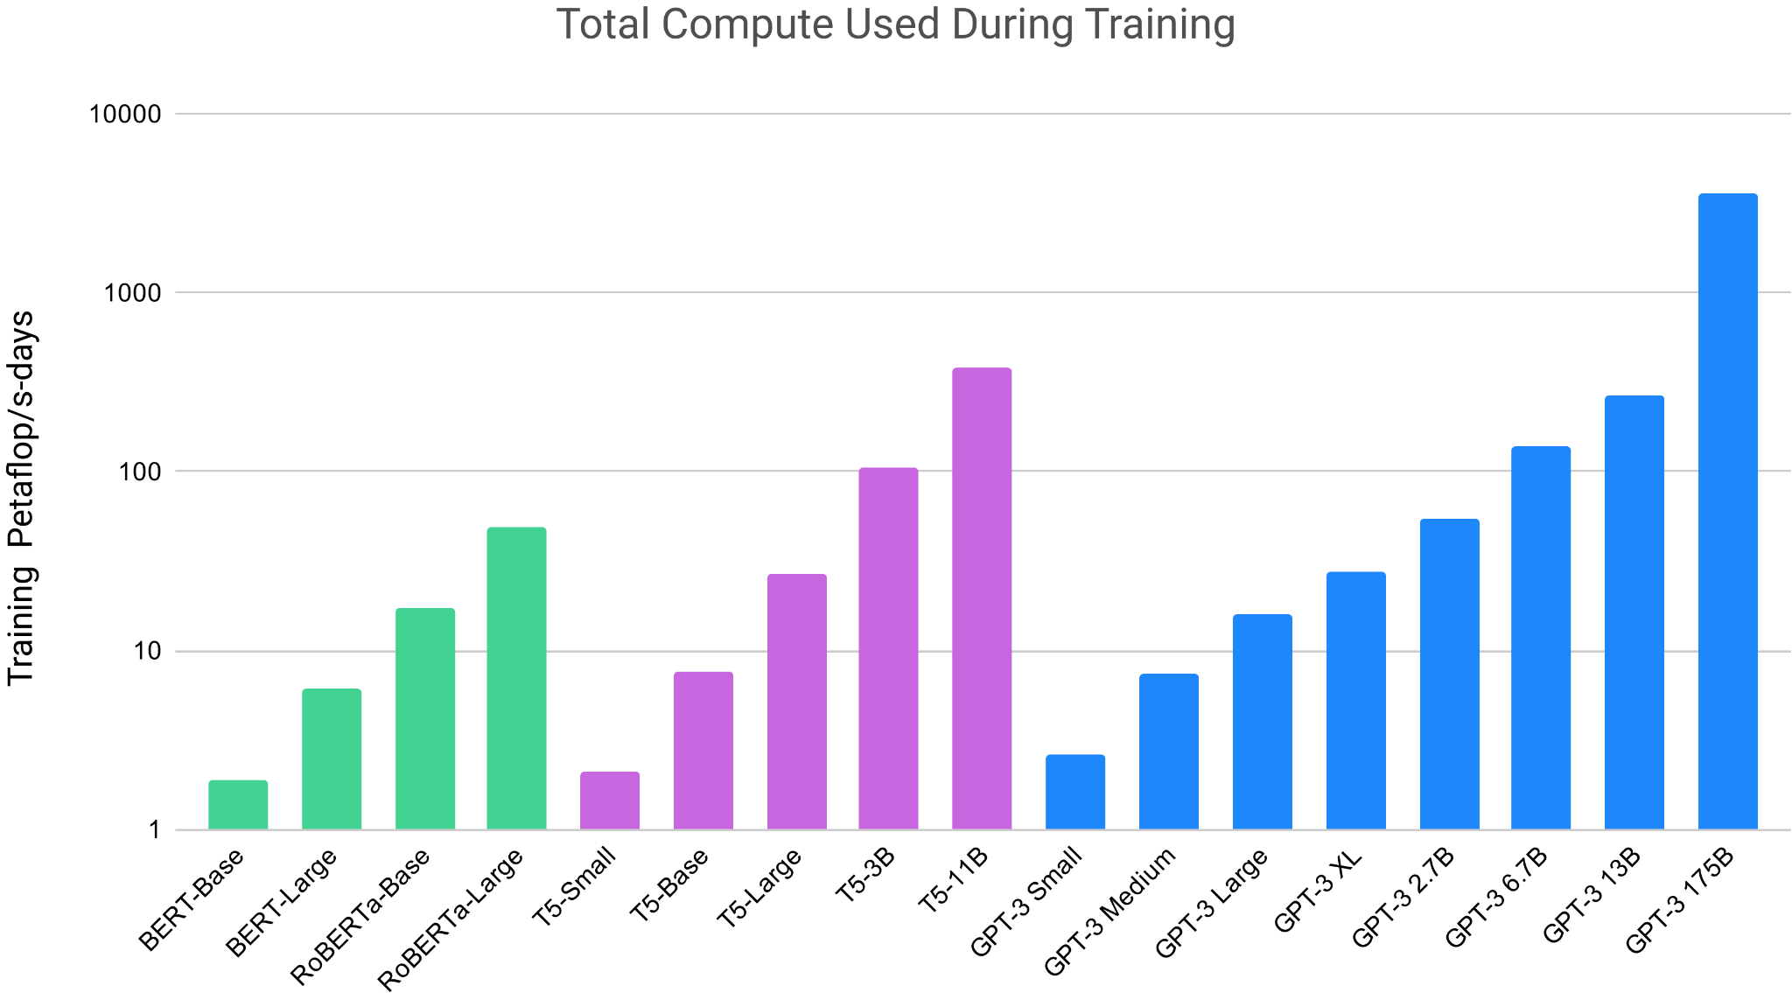
GPT-3 Compute Consumption
Slides created for CS886 at UWaterloo
Notes:
Based on the analysis in Scaling Laws for Nueral Language for Neutral model, trains much larger models on many fewer tokens than is typical. As a consequence, although GPT-3 3B is almost 10x larger than RoBERTa-Large (355M params), both models took roughly 50 petaflops/s-days of compute during pre-training.
petaflops/s-days :==> The total number of compute operations if you had a computer with throughput 1 PetaFLOP/s working on a problem for a full day (so it would be 10^15 FLOP/s * 3600 s/hr * 24 hr/day)
10 Petaflops/s => Equivalent of 10 days compute power running 1 PetaFLOP per second
Y axis - exponential value - order of magnitude

Slide 31
GPT-3 Limitations
Limitations in text synthesis
Structural and algorithmic limitations
Poor sample efficiency during pre-training
Lack of interpretability
Can perpetuate and amplify existing biases and unfairness in society
Multilingualism - majority language model researches are done in English
Slides created for CS886 at UWaterloo
Notes:
As advanced and as wonderful as GPT-3 is, it still has its limitations:
Text synthesis -
Though overall quality is high.
It sometimes repeat itself semantically at the document level,
It can lose coherence over sufficiently long passages
It can contradict itself
Occasionally contain non-sequitur sentences or paragraphs e.g. The sky is blue, and the sun is shining. The kid did not drink his milk.
Lack of interpretability
Its decisions are not easily understood or interpreted. It may not work well in novel inputs. It retains the biases of the data it has been trained on. This can lead to stereotyped or prejudiced contents. This is of special concern from a societal perspective
Need to be careful about relying too much on GPT-3 without thinking
Work continue on improving GPT, so some of these issues may no longer be there
I now hand over to Jerry to continue

Slide 32
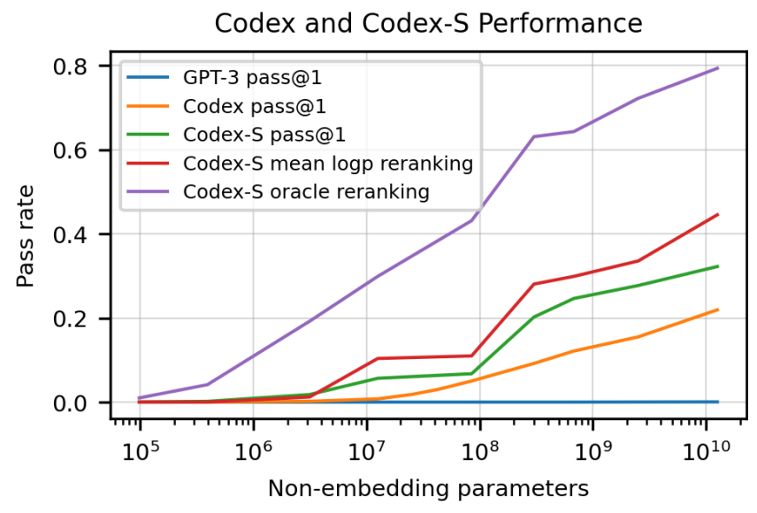
CodeX introduction
Recently, there has been progress in generating programs from language models
Surprisingly, GPT3 could generate programs, even though it was never explicitly trained on code
CodeX is a specialized GPT model trained on code
Slides created for CS886 at UWaterloo

Slide 33
CodeX evaluation
While the performance of generative models are usually evaluated using match-based metrics by comparing output to a reference solution, there may be too many different possible output programs that are functionally equivalent to the reference solution for this metric to account for; indeed, it was found that one such metric called the BLEU score is unreliable
An alternative method is to use functional correctness instead, which runs the output code on test cases to measure performance; it is preferable similar to how humans judge code
Slides created for CS886 at UWaterloo
Notes:
-as functionally equivalent code may use different methods to solve the problem (e.x. Sorting algorithms)
-e.x. Code is evaluated based on test cases passed instead of comparing to solution code

Slide 34
CodeX evaluation
Can evaluate functional correctness using the pass@k metric, which calculates the fraction of problems such that at least one of k sample codes generated passed (all test cases) for that problem; pass@k = 1-(1-pass@1)^{k}
Can be interpreted as the result of evaluating the best of k samples
Directly calculating the pass@k results in high variance; instead, n>=k sample codes are generated, the # of passed codes c is counted and the estimator 1-(_{n-c}C_{k} / _{n}C_{k}) is calculated for each problem and averaged
That estimator is unbiased, unlike directly plugging in the empirical estimate of pass@1 into pass@k, which underestimates pass@k
A set of 164 problems called HumanEval was created (each containing a function signature, docstring, body, and average of 7.7 unit tests), hand-written to avoid training on potential solutions
Slides created for CS886 at UWaterloo
Notes:
(1-pass@1) is probability of an output code failing (atleast one test case)
c is distributed by Binom(n,pass@1), (n-c)Ck/nCk= #ways to pick all failed codes/#ways to pick codes
Take expectation over c and expand it to a sum and solve; Distributions are skewed more right when taken exponent k>1, but its mode is ^k so mean is more than ^k

Slide 35
CodeX training
Fine-tuned GPT models up to 12B parameters on code
Trained on 159GB dataset of unique Python files on GitHub
Used the same learning rate as the corresponding GPT model, with a 175 step linear warmup and cosine learning rate decay. Trained on a total of 100 billion tokens, using the Adam optimizer with a weight decay coefficient of 0.1.
Slides created for CS886 at UWaterloo

Slide 36
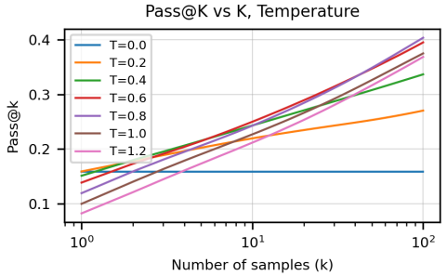
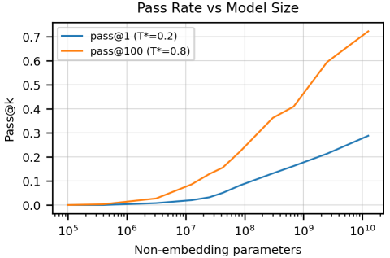
CodeX results
It was found that the cross-entropy test loss on a held-out validation set follows a power law of (N/5.92x10⁷)^{-0.13}, where N=# non-embedding params
When only one sample can be evaluated, it was found that compared to randomly choosing a sample to evaluate, choosing the one with the highest mean log probability performs better, but with the highest sum log probability performs slightly worse.
Notes:
-(for the plots) The sampling temperature that maximizes pass@k increases with number of samples k; this result makes sense since pass@k only cares about if one sample passes, and sampling temperature controls randomness when sampling, which (in the context of generative models) generates the next token from a distribution of softmax(x/T), where x is the logits (i.e. unnormalized scores of tokens)

Slide 37
CodeX comparison
Model | pass@1 | pass@10 | pass@100
GPT-NEO 125M | 0.75% | 1.88% | 2.97%
GPT-NEO 1.3B | 4.79% | 7.47% | 16.30%
GPT-NEO 2.7B | 6.41% | 11.27% | 21.37%
GPT-J 6B | 11.62% | 15.74% | 27.74%
TABNINE | 2.58% | 4.35% | 7.59%
CODEX-12M | 2.00% | 3.62% | 8.58%
CODEX-25M | 3.21% | 7.1% | 12.89%
CODEX-42M | 5.06% | 8.8% | 15.55%
CODEX-85M | 8.22% | 12.81% | 22.4%
CODEX-300M | 13.17% | 20.37% | 36.27%
CODEX-679M | 16.22% | 25.7% | 40.95%
CODEX-2.5B | 21.36% | 35.42% | 59.5%
CODEX-12B | 28.81% | 46.81% | 72.31%
GPT models and the largest free model from Tabnine were evaluated on HumanEval (with temperatures of 0.2, 0.4, or 0.8)
GPT-Neo and GPT-J are models similar to CodeX, trained on The Pile dataset which has 8% GitHub code, and are the only GPT models with pass rates not close to 0
Slides created for CS886 at UWaterloo
Notes:
-temperatures used: best of 0.2, 0.4, 0.8 for NEO, 0.2 and 0.8 for J

Slide 38
CodeX-S
There may be code unrelated to translating natural language to code, which may lower performance
A set of training problems from relevant code was obtained from competitive programming websites and repositories with continuous integration
CodeX-S is a version of CodeX with this supervised fine-tuning and it has improved performance
Slides created for CS886 at UWaterloo

Slide 39
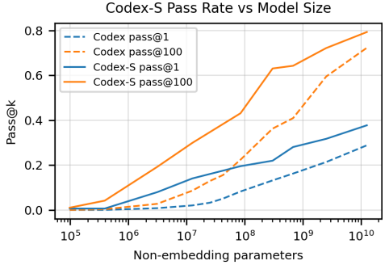
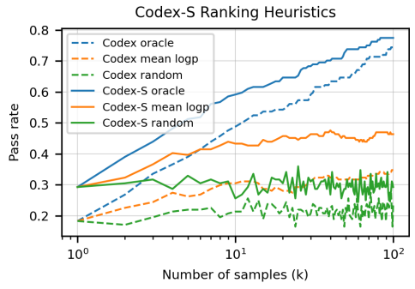
CodeX-S results
Prefers slightly higher sampling temperatures than CodeX, possibly due to a narrower distribution
Outperforms CodeX by 6.5% on pass@1 and 15.1% on pass@100
Slides created for CS886 at UWaterloo

Slide 40
CodeX-D
So far we have discussed how CodeX generates code from docstrings, but what about the other way around?
CodeX-D is a version of CodeX that generates docstrings from code
Each training problem contains the function signature, the reference solution, and docstring
No way to measure functional correctness for docstrings
  graded only 10 samples for each of 1640 problems by hand manually
  pass@1 and pass@10 are 20.3% and 46.5% respectively (which is slightly lower than that for CodeX-S: 32.2% and 59.5% respectively)
Slides created for CS886 at UWaterloo

Slide 41
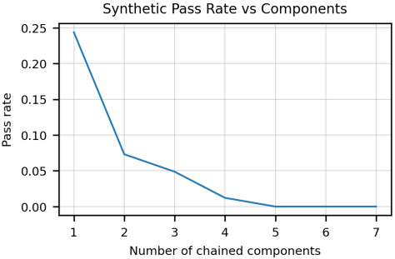
CodeX Limitations
Not sample efficient to train, as the training data totaled hundreds of millions of lines of code
Performance decreases exponentially in docstring length
Can make mistakes binding variables to operations, especially when there are a lot of them
Slides created for CS886 at UWaterloo
Notes:
Synthetic problems created from assembling 13 building blocks that deterministically modify string input (e.x. “Convert to lowercase” or “remove every 3rd char”)

Slide 42
Llama-2 introduction
-Family of pretrained and fine-tuned LLMs with billions of parameters
-Can outperform other open-source LLMs and be on par with close-sourced LLMs
Slides created for CS886 at UWaterloo
Slides created for CS886 at UWaterloo

Slide 43
Llama-2 pretraining
Most of the pretraining, architecture, and hyperparameters were adopted from Llama-1:
  Standard transformer architecture
  pre-normalization (normalized the input of each sub-layer instead of the output to improve training stability, like in GPT3)
  SwiGLU activation function (allows more flexibility and expressiveness in the feed-forward layers to improve performance of transformer models compared to using standard activations like ReLU)
  Instead of absolute positional embeddings, used rotary positional embeddings which use a rotation matrix which shows relative positions of tokens and allows the model to capture their dependencies; can improve performance because changing positions of words in a sentence can change its meaning.
Slides created for CS886 at UWaterloo

Slide 44
Llama-2 pretraining
7, 13, 34, and 70 billion parameters, with context length (i.e. amount of text that can be processed at a time) of 4k (doubled from Llama-1)
Learning rate of 0.0003 for smaller models, 0.00015 for larger models with grouped query attention
Trained using AdamW optimizer with a cosine learning rate schedule, on 2T tokens of data (40% more than Llama-1)
Slides created for CS886 at UWaterloo

Slide 45
Llama-2 pretraining evaluation
Llama-1 and 2 base models, along with other open-sourced models MosaicML Pretrained Transformer (MPT) and Falcon, were evaluated on several benchmarks for comparison
  For code, the average pass@1 score on HumanEval and MBPP is reported
  For commonsense reasoning, world knowledge, reading comprehension, and math, the average of scores from 8, 2, 3, and 2 different methods is reported, respectively
  Massive multitask language understanding (MMLU), Big Bench Hard (BBH), and Artificial General Intelligence evaluation (AGIEval) on English tasks are also reported.
Slides created for CS886 at UWaterloo
Notes:
-MMLU evaluates a wide variety of tasks, BBH evaluates a subset of Big Bench tasks (which evaluates a wide variety of tasks) that were found to be beyond the capabilities of current language models, AGIEval evaluates models based on their performance on human-centric standardized exams

Slide 46
Llama-2 pre-training evaluation
 | Size | Code | Commonsense Reasoning | World Knowledge | Reading Comprehension | Math | MMLU | BBH | AGI Eval
MPT | 7B 30B | 20.5 28.9 | 57.4 64.9 | 41.0 50.0 | 57.5 64.7 | 4.9 9.1 | 26.8 46.9 | 31.0 38.0 | 23.5 33.8
Falcon | 7B 40B | 5.6 15.2 | 56.1 69.2 | 42.8 56.7 | 36.0 65.7 | 4.6 12.6 | 26.2 55.4 | 28.0 37.1 | 21.2 37.0
Llama-1 | 7B 13B | 14.1 18.9 | 60.8 66.1 | 46.2 52.6 | 58.5 62.3 | 6.95 10.9 | 35.1 46.9 | 30.3 37.0 | 23.9 33.9
Llama-1 | 33B 65B | 26.0 30.7 | 70.0 70.7 | 58.4 60.5 | 67.6 68.6 | 21.4 30.8 | 57.8 63.4 | 39.8 43.5 | 41.7 47.6
Llama-2 | 7B 13B | 16.8 24.5 | 63.9 66.9 | 48.9 55.4 | 61.3 65.8 | 14.6 28.7 | 45.3 54.8 | 32.6 39.4 | 29.3 39.1
Llama-2 | 34B 70B | 27.8 37.5 | 69.9 71.9 | 58.7 63.6 | 68.0 69.4 | 24.2 35.2 | 62.6 68.9 | 44.1 51.2 | 43.4 54.2
Slides created for CS886 at UWaterloo

Slide 47
Llama 2-Chat
Llama 2-Chat is a version of Llama-2 with supervised fine-tuning through alignment techniques
Supervised fine tuning with publicly available instruction fine-tuning data
  it was found that using less (thousands instead of millions) but higher quality examples improved results
Reinforcement learning with human feedback (RLHF) is applied after fine-tuning so the model can understand the user intentions to further align the model with human preferences
Slides created for CS886 at UWaterloo

Slide 48
Llama 2-Chat Human Preference Data Collection
Data of human preferences obtained from human feedback
For more diversity of collected prompts, binary comparison protocol was used to collect feedback
  Annotators write prompts for the model, then for each prompt they choose one of 2 responses from different variants of the model (e.x. With different temperature) based on provided criteria (helpfulness or safety), and rank how much better their chosen response is on a scale of 4 points
  Preference was given to helpfulness and safety
  This data was received in batches over time (so the reward model improved over time)
Slides created for CS886 at UWaterloo

Slide 49
Llama 2-Chat Reward Modeling
Human preference data was used to train reward model (RM) so that patterns in the preferences can be learned, by changing internal text distribution of the base model
The RM outputs a score based on prediction of the quality of the model (based on human preference) given a prompt and model response
These scores were used as rewards for RLHF
Initialized from pretrained model to avoid situations where the models would end up favouring hallucinations, with the same architecture and hyperparameters but with a regression head for outputting rewards
2 RMs: for helpfulness and for safety
Slides created for CS886 at UWaterloo

Slide 50
Llama 2-Chat Reward Modeling
Used a binary ranking loss with a margin component: L_{ranking} = −log(σ(r_{θ}(x, y_{c}) − r_{θ}(x, y_{r}) − m(r))), where r_{θ} is the reward model with model weights θ that takes (prompt, response) as input, y_{c} is the chosen response and y_{r} is the rejected response
  The margin component m(r) is a function of the preference rating (different for each reward model), which helps the RM give more distinct scores for more different responses
The preference data was increased by combining with open-sourced ones
Trained with same parameters as base model, but only ran 1 epoch (as it may overfit otherwise) and slightly lower learning rate
Slides created for CS886 at UWaterloo

Slide 51
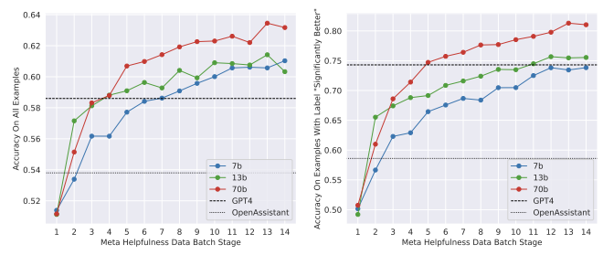
Llama 2-Chat Reward Modeling
These reward models outperform SteamSHP-XL, Open Assistant, and GPT4 on several human preference benchmarks
  The helpfulness RM and safety RM each performed best on their own domain (e.x. Helpfulness performed best on Meta Helpful data, etc) as they may sometimes have conflicts
  Optimizing one RM with both objectives would’ve confused the model and not perform well
Slides created for CS886 at UWaterloo

Slide 52
Llama 2-Chat Iterative Fine-tuning
Successive versions of RLHF were trained as more batches of human preference data were received; labelled -V1 to -V5
RLHF fine-tuning explored with 2 algorithms:
Rejection sampling fine-tuning
  At each iteration, K samples generated from model, and best one was selected using reward model; these best samples were used for a gradient update to tune the model for the next iteration
  Applied to the 70B model, with smaller models fine-tuned on rejection sampled data from 70B model
  Later versions include best samples from all previous models and not just the preceding one since, for example, V3 was trained using only samples from V2 but its performance worsened in certain tasks
  Sampling temperature was adjusted for each iteration, as its optimal value significantly changes

Slide 53
Llama 2-Chat Iterative Fine-tuning
A standard method in reinforcement learningProximal policy optimization (PPO)
  A standard method in reinforcement learning
  Uses the reward model as an estimate of the reward function, and the (language) model as the policy to optimize
  Policy iteratively improved by sampling prompts from dataset and generations from policy and apply PPO

Slide 54
Llama 2-Chat Ghost Attention (GAtt)
GAtt is a new technique from this model that helps control dialogue flow over multiple turns
Initially the RLHF models sometimes forgets instructions in a dialogue after a few turns; this can be fixed with GAtt, and was applied after RLHF-V3
The method works by synthetically concatenating the instruction to user messages once it’s defined
GAtt is consistent up to 20+ turns up to the context length
Slides created for CS886 at UWaterloo

Slide 55
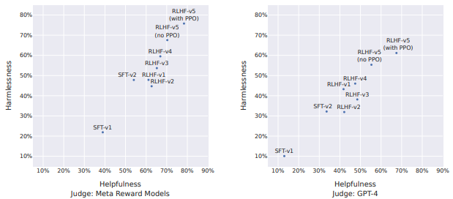
Llama 2-Chat RLHF model-based evaluation
For each prompt in a test set of helpfulness and safety, 3 annotators judge the quality on a 7 point scale
The figure below shows the win rate % against GPT-4 for different versions of Llama 2-Chat during SFT and RLHF

Slide 56
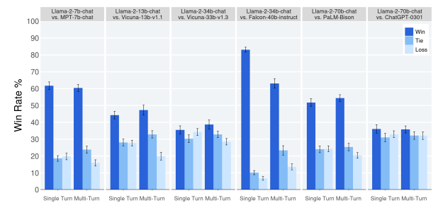
Llama 2-Chat RLHF human evaluation
Llama 2-Chat was compared with MPT-7B-chat, Vicuna-13B-v1.1 an 33B-v1.3, Falcon-40B-instruct, PaLM-Bison, and ChatGPT-0301 on human evaluation with over 4000 diverse prompts, with multi-turn prompts generated by Llama 2-Chat and/or ChatGPT
For each prompt, 3 human annotators rate how much better/worse one model is than the other on a 7 point scale

Slide 57
Llama-2 Safety
Harmful data filtered out during pretraining and fine-tuning
Compared to before fine-tuning, Llama 2-chat showed great improvement in truthfulness and toxicity
  50.18% to 64.14% on TruthfulQA and 24.60 to 0.01% ToxiGen, respectively, for the 70B model
  Also, lowered bias, as the BOLD scores increased overall
To test robustness against attackers, red teaming was performed
  Over 350 diverse people, including experts in various fields, probed the models in various unsafe situations with simulated prompts
  These insights were used for fine-tuning and feedback training to lower the rate of violating responses; for the 7B model, this rate was lowered by 4x

Slide 58
Llama-2 Safety
Overall outperforms many other models in helpfulness and safety (Falcon, Vicuna, PaLM, ChatGPT) based on human raters judging
While these safety tuning approaches fixed most safety issues, it goes too far in some instances, which can cause the model to be overly cautious and have false refusals, although only happens 0.05% of the time on the helpfulness data

Slide 59
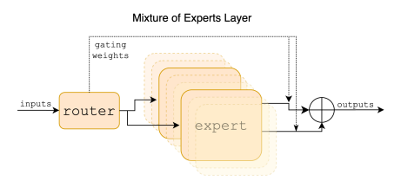
Mixtral of Experts (MoE) introduction
Mixtral 8x7B is a sparse mixtral of experts (SMoE) model that can outperform Llama-2 70B and GPT3.5 on most benchmarks (math, code generation, multilingual tasks)
Uses a subset of parameters for every token, can change the size to make inference faster or higher throughput
Slides created for CS886 at UWaterloo

Slide 60
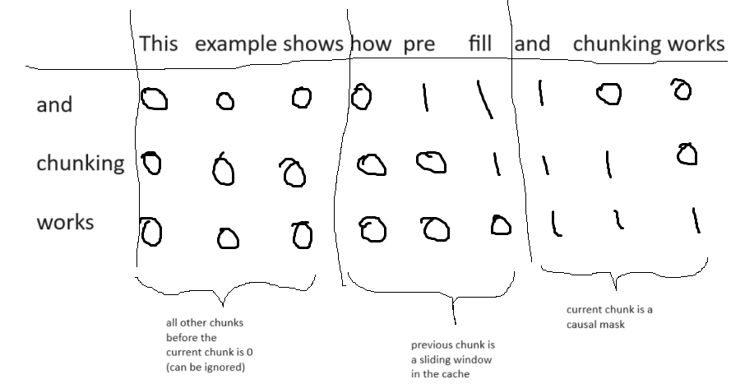
Mistral architecture
Mistral 7B is an earlier version of Mixtral
Similar architecture to Llama, but also with:
  Sliding Window Attention (SWA) limits the amount of tokens each token can attend to by window size W, to save computation and memory
  Rolling Buffer Cache was then used to limit cache size to W, and the keys and values at the i-th step are stored at the (i mod W)-th position of the cache
  Pre-fill and chunking: can pre-fill cache with prompt, or split and pre-fill with each chunk if prompt is large; then, to compute the attention for each chunk, only that of the current chunk and the previous (which is in the cache) is needed
Slides created for CS886 at UWaterloo

Slide 61
Sparse Mixtral of Experts
Mixtral has the same architecture and its parameters as Mistral, except the context length is 32k (quadrupled from Mistral), and feed-forward blocks are replaced by 8 MoE layers
Experts are individual feed-forward networks
Generally, MoE’s output is the sum of the dot products of the expert E(x)_{i} and its gating network G(x)_{i}, over each expert i
  Mixtral uses the softmax of top k logits of linear layer: G(x)=Softmax(TopK(x⋅W_{g})), where TopK is identity for top K logits and -inf otherwise
  Then, the total (sparse) parameter count can grow with n while the active parameter count (used for processing a token) only grows with k
  For mixtral, E=SwiGLU and K=2
Slides created for CS886 at UWaterloo
Notes:
-G(x) in mistral takes the softmax of top k logits of linear layer

Slide 62
Mixtral results
Mixtral was compared to Llama by evaluating them on several benchmarks similar to Llama-2’s paper
Model | Active params | MMLU | Hellaswag | Winogander | PIQA | ARC-Easy | ARC-Challenge | NaturalQuestions | TriviaQA | HumanEval | MBPP | MATH | GSM8K
Llama-2 | 7B | 44.4% | 77.1% | 69.5% | 77.9% | 68.7% | 43.2% | 17.5% | 56.6% | 11.6% | 26.1% | 3.9% | 16.0%
Llama-2 | 13B | 55.6% | 80.7% | 72.9% | 80.8% | 75.2% | 48.8% | 16.7% | 64.0% | 18.9% | 35.4% | 6.0% | 34.3%
Llama-1 | 33B | 56.8% | 83.7% | 76.2% | 82.2% | 79.6% | 54.4% | 24.1% | 68.5% | 25.0% | 40.9% | 8.4% | 44.1%
Llama-2 | 70B | 69.9% | 85.4% | 80.4% | 82.6% | 79.9% | 56.5% | 25.4% | 73.0% | 29.3% | 49.8% | 13.8% | 69.6%
Mistral | 7B | 62.5% | 81.0% | 74.2% | 82.2% | 80.5% | 54.9% | 23.2% | 62.5% | 26.2% | 50.2% | 12.7% | 50.0%
Mixtral | 13B | 70.6% | 84.4% | 77.2% | 83.6% | 83.1% | 59.7% | 30.6% | 71.5% | 40.2% | 60.7% | 28.4% | 74.4%
Slides created for CS886 at UWaterloo
Notes:
Hella to ARC = commonsense reasoning, next pairs = world knowledge, code, math

Slide 63
Mixtral results
Compared to Mistral, multilingual data was significantly upsampled, allowing it to perform well on multilingual benchmarks
For each language, ARC-Challenge, Hellaswag, and MMLU are reported
Model | French | German | Spanish | Italian
Llama-1 33B | 39.3% 68.1% 49.9% | 41.1% 63.3% 48.7% | 45.7% 69.8% 52.3% | 42.9% 65.4% 49.0%
Llama-2 70B | 49.9% 72.5% 64.3% | 47.3% 68.7% 64.2% | 50.5% 74.5% 66.0% | 49.4% 70.9% 65.1%
Mixtral 8x7B | 58.2% 77.4% 70.9% | 54.3% 73.0% 71.5% | 55.4% 77.6% 72.5% | 52.8% 75.1% 70.9%
Slides created for CS886 at UWaterloo

Slide 64
Mixtral results
Long range performance
  100% retrieval accuracy of the passkey retrieval task which measures the ability of models to retrieve a passkey randomly inserted in a long prompt
  Perplexity decreases as context length increases
Bias benchmarks
  Mixtral outperforms Llama-2 70B on Bias Benchmark for QA (BBQ) (56.0% vs 51.5%)
  On Bias in Open-Ended Language Generation Dataset (BOLD), Mixtral has higher scores overall compared to Llama-2, which represents less social bias
Slides created for CS886 at UWaterloo

Slide 65
Mixtral-Instruct
Mixtral-Instruct is a version of Mixtral with supervised fine-tuning on an instruction dataset followed by Direct Performance Optimization (DPO)
In the Large Model Systems (LMSYS) Chatbot Arena as of December 2023, Mixtral-Instruct outperforms other open-weight models on MT-Bench (a set of challenging multi-turn questions) and is ranked 6th in the arena elo (based on 200,000 human preference votes)

Slide 66
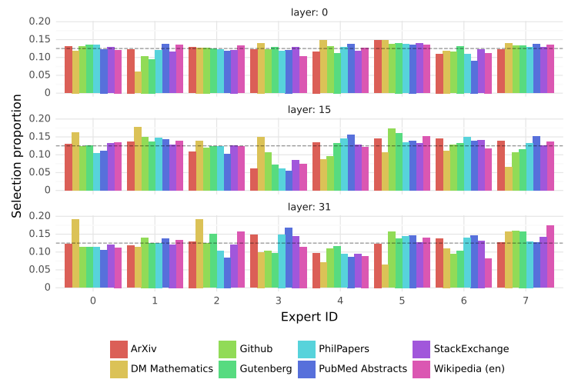
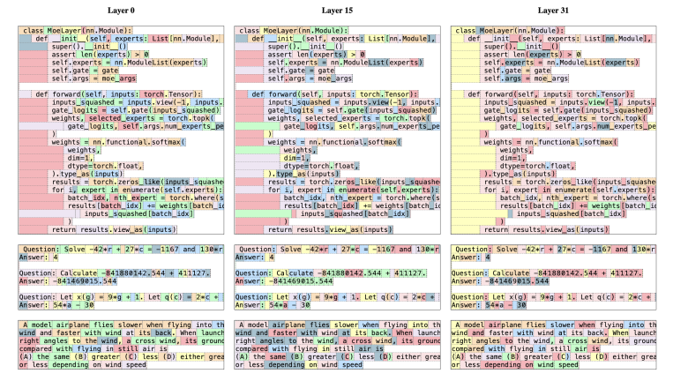
Mixtral routing analysis
The distribution of selected experts using The Pile datasets was measured and reported for first, middle, and last layers
Only DM Mathematics had significantly different distributions, possibly due to limited coverage of natural language
Its distribution at the first and last layer is very similar to the input and output embeddings, respectively
This suggests the router has structured syntactic behavior

Slide 67
PaLM: Pathways Language Model⁵
Trained as a 540-billion parameter, densely activated, Transformer Language model
Trained on a Google 6144 Tensor Processing Units (TPU) v4 chips
  Efficient Scaling - Scaled very well across thousands or tens of thousands of accelerator chips in a highly efficient manner
  Continued improvements from scaling - Continuous growth in improvement on device as its TPU are scaled up
  Breakthrough capabilities - It can perform reasoning tasks via multi-step mathematics
  Discontinuous improvements - Scaling behaviour where improvements in performance not linear e.g. scaling from 62b to 540b parameters result in dramatic jump in accuracy compared to scaling from 8B to 62B. New capabilities emerge when the model achieves sufficient scale.
  Multilingual Understanding - More thorough work than earlier models including translation
  Bias and toxicity - Accuracy improved on gender and occupation bias. The model still has an issue with race/religion/gender bias being very much affected by the style of prompt provided. It still associated Muslims with terrorism, extremism and violence. This is work in progress.
5. Chowdhery, A., Narang, S., Devlin, J., Bosma, M., Mishra, G., Roberts, A., ... & Fiedel, N. (2023). Palm: Scaling language modeling with pathways. Journal of Machine Learning Research, 24(240), 1-113.
Slides created for CS886 at UWaterloo

Slide 68
PaLM: Model Architecture
Uses a standard Transformer Model architecture in a decoder-only setup. Each timestep can only attend to itself and past timesteps
SwiGLU Activation -
Parallel Layers - each transformer block is in parallel. The standard formulation is written as:
y = x + MLP(LayerNorm(x + Attention(LayerNorm(x)))
whereas the parallel formulation can be written as:
y = x + MLP(LayerNorm(x)) + Attention(LayerNorm(x))
Slides created for CS886 at UWaterloo
Notes:
MLP (Multilayer Perceptron) - designed to perform multiple layers of non-linear transformations on the input and its output serves as the attention weights.
The neurons in the MLP are trained with the back propagation learning algorithm.
MLP are designed to approximate any continuous function and can solve problems which are not nearly separable.
The major uses cases of MLP are pattern classification, recognition, prediction and approximation.
Notice the x in the regular formulation, the addition of the input into the mix.
LayerNorm refers to layer normalization. It computes the mean and standard deviation across each individual observation instead rather than across the batch.

Slide 69
PaLM: Model Scale Hyperparameters
Compared three different model scales: 540B parameters, 62B parameter, and 8B parameters
Number of FLOPs per token is approx equal to number of parameters
Model | Layers | # of Heads | d_{model} | # of Parameters (in billions) | BatchSize
PaLM 8B | 32 | 16 | 4096 | 8.63 | 256 -> 512
PaLM 62B | 64 | 32 | 8192 | 62.50 | 512 -> 1024
PaLM 540B | 118 | 48 | 18432 | 540.35 | 512 -> 1024 -> 2048
Slides created for CS886 at UWaterloo
Notes:
Models are all trained identically except batch size using the same data and vocabulary
Number of layers, dimension of the model which refers to the number of neurons in each layer of the network
For example, we have 8B parameter model with 32 layers, 16 attention heads and 4,096 neuron per layer,

Slide 70
PaLM: Training Dataset
Consists of high-quality corpus of 780 billion tokens representing a wide range of natural language use cases
Based on datasets used to train LaMDA
Total dataset size = 780 billion tokens
Data source | Proportion of data
Social media conversations (multilingual) | 50%
Filtered webpages (multilingual) | 27%
Books (English) | 13%
GitHub (code) | 5%
Wikipedia (multilingual) | 4%
News (English) | 1%
Slides created for CS886 at UWaterloo
Notes:
Proportion of data from each source in the training set. The multilingual corpus contains text from over 100 languages. If you ever published your code on GitHub, the authors of neural networks will like to thank you as you have contributed to the training of several models.

Slide 71
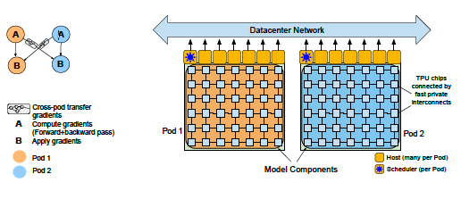
PaLM: Training Infrastructure
All models trained on TPU v4 Pods
Slides created for CS886 at UWaterloo
Notes:
Training and evaluation codebase is based on JAX and T5X
All models are trained on TPU v4 Pods
PaLM 540B is trained over 2 TPU v4 Pods over data centre network (DCN) using a combination of model and data parallelism
Use 3072 TPU v4 chips in each Pod attached to 768 hosts

Slide 72
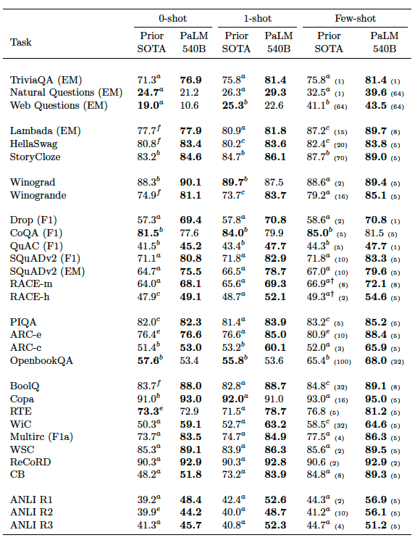
PaLM: Results
PaLM 540B across 29 NLP benchmarks
Slides created for CS886 at UWaterloo
Notes:
Results obtained by the PaLM 540B model across 29 benchmarks
For the few-shot results, the number of shots for each task are mentioned in parenthesis
Prior SOTA – Prior state-of-art

Slide 73
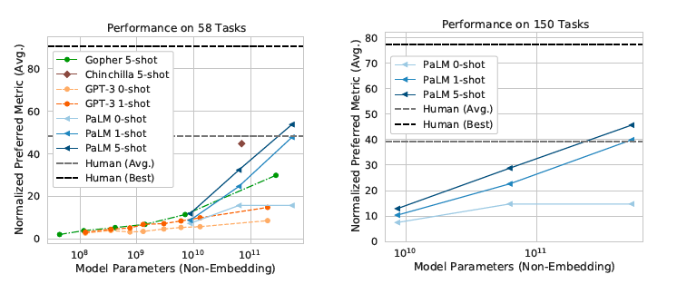
PaLM: BIG-bench
BIG-bench is a collaborative benchmark aimed at producing challenging tasks for LLM.
Slides created for CS886 at UWaterloo
Notes:
Over 150 tasks that cover a variety of language modeling tasks including logical reasoning, translation, question answering, mathematics, etc.
Evaluation of PaLM, GPT-3, Gopher, and Chinchilla
Average human metric is around 50 while the best humans do around 100. PaLM 5-shot (shown 5 examples in training) performs better than average human at about 10^11 model parameter

Slide 74
PaLM: Evaluating Reasoning
Arithmetic reasoning - often grade-school level natural language math problems which require multi-step logical inference. The math itself is trivial. The difficult part is transforming the natural language into mathematical equations.
Input: Q: Roger has 5 tennis balls. He buys 2 more cans of tennis balls. Each can has 3 tennis balls. How many
tennis balls does he have now?
Answer: The answer is 11.
Commonsense reasoning - Question answering tasks which require strong world knowledge but are not simply factual question answering. They require chaining multiple logical inferences about the world
  Input: Q: Sean was in a rush to get home, but the light turned yellow and he was
  forced to do what? Answer Choices: (a) take time (b) dawdle (c) go slowly (d) ocean (e) slow down
  Answer: The answer is (e) slow down.
Slides created for CS886 at UWaterloo

Slide 75
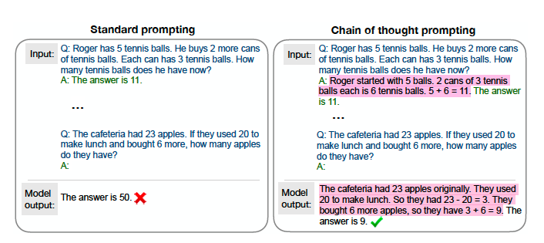
PaLM: Chain-of-thought prompting
Slides created for CS886 at UWaterloo
Notes:
LLM can achieve significant accuracy improvements by generating intermediate reasoning steps before generating the final steps
In few-shot setting, these intermediate reasoning steps are manually written for the few-shot examples
The model will then generate its own chain-of-thoughts for the test examples.
Only final answer is used for evaluation, although these generated chain-of-thoughts can be useful for error analysis and model interpretability (Interpretability being one of the major drawbacks of LLMs)
Chain of thought prompting allows language models to better perform multi-step reasoning tasks such as math word problems.
In the example above, PaLM is able to show its intermediate steps and how it arrived at accurate results
I

Slide 76
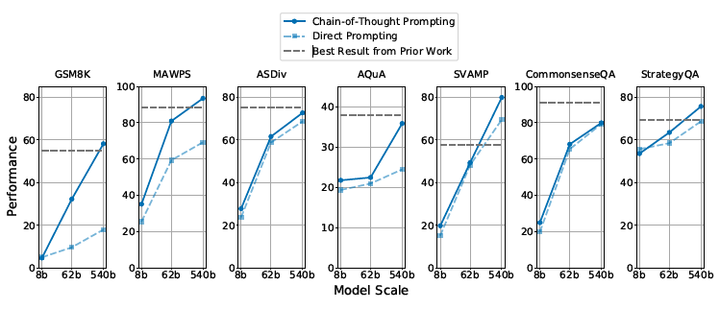
PaLM: Chain-of-thought Results
Slides created for CS886 at UWaterloo
Notes:
Via chain of thought prompting, PaLM achieves strong performance on a range of arithmetic and common sense reasoning tasks.

Slide 77
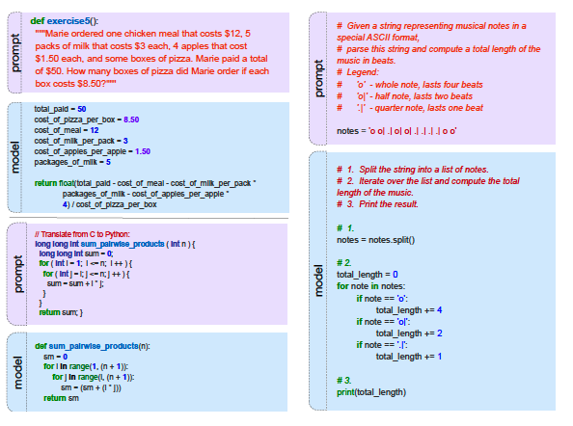
PaLM: Code Tasks
Text-to-code - task is to write code given a natural language description.
Code-to-code - task is to translate C or C++ programs to Python
Major risks:
  Generated code may be wrong
  Presence of subtle bugs
Slides created for CS886 at UWaterloo
Notes:
PaLM can be used for 2 main types of code work - generating code from natural language description and translation work.
The current level of expertise is the generation of a Python function from description. An entire program cannot be generated, yet
This is a very promising research area
TransCoder data is downloaded from GitHub
Provide few-shot examples to provide training to the PaLM model
Examples from the PaLM-Coder 540B model. (top left) GSM8K-Python question converted from the OpenAI GSM8K math dataset. (bottom left) TransCoder example translating a simple function from
C++ to Python. (right) Converted HumanEval example.
PaLM included GitHub code in its training set. A total of 39B code tokens were used in the pre-training dataset.
PaLM supports additional languages such as Java, HTML, Javascript, Python, C, PHP, C# and C++
A key risk for using

Slide 78
PaLM: Translation
Rewrite one human language into another one while preserving the content, semantics and style of the input
English-centric language pairs
  Traditional focus of past models
  English as source or target language e.g. English -> French, English->German, etc.
Direct language pairs
  Directly translate between any pair of languages without involving English. For example French->German instead of French->English->German
Extremely-low resource language pairs
  In some cases, one of the languages have little monolingual data such as Kazakh. E.g. French and German have about 24 and 26 billion tokens in training set while Kazakh has around 134 million tokens.
Slides created for CS886 at UWaterloo
Notes:
PaLM

Slide 79
PaLM: Translation
 |  | 0-Shot |  | 1-Shot |  | Few-shot |  | Supervised
Source | Target | Prior SOTA | PaLM 540B | Prior SOTA | PaLM 540B | Prior SOTA | PaLM 540B | Finetuned SOTA
en | fr | 2P | 38.5 | 28.3 | 37.5 | 33.9 | 44.0 | 45.6
en | de | P | 31.8 | 26.2 | 31.8 | 26.8 | 37.4 | 41.2
en | ro | P | 24.2 | 20.6 | 28.2 | 20.5 | 28.7 | 33.4
fr | en | P | 41.1 | 33.7 | 37.2 | 38.0 | 42.8 | 45.4
de | en | P | 43.8 | 30.4 | 43.9 | 40.6 | 47.5 | 41.2
ro | en | 2P | 39.9 | 38.6 | 42.1 | 37.3 | 43.8 | 39.1
Slides created for CS886 at UWaterloo
Notes:
Translation BLEU scores on traditional WMT language pairs. Superscripts denote results from past work: aFLAN(Wei et al., 2022a); bGPT-3 175B (Brown et al., 2020); c(Edunov et al., 2018); d(Wang et al., 2019b); e(Caswell et al., 2019); f Lin et al. (2020); g(Wang et al., 2019b); h(Song et al., 2019). For PaLM, we use 5 shots in the few-shot setting. We bold the best zero/few-shot results, and underline the best results overall.
Few-shot evaluation corresponds to 5 shots for PaLM. Note that 0-shot prompt includes the source and target language names in the prompt, while 1-shot and few-shot don't (languages must be
inferred from the exemplars), which may explain the strong 0-shot performance in some language pair
Translation quality is better when translating into English rather than out of English
Prompts can deliver even more value than a single example
Generalist models relying solely on self-supervision can match specialized models at smaller scale.

Slide 80
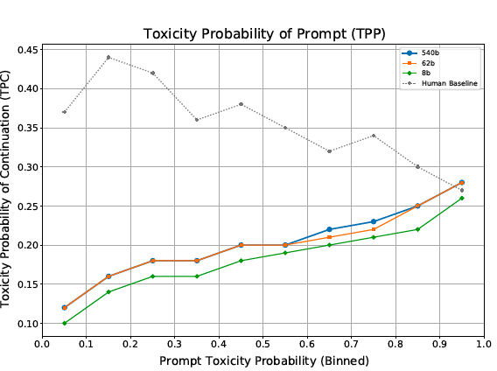
PaLM: Limitations
Contain and amplify biases in underlying data
Gender and occupation bias
Toxicity and bias
Slides created for CS886 at UWaterloo
Notes:
Note that this limitation is not unique to PaLM but to other LLMs in general
Words such as Islam are associated with highly charged terms and stereotypes such as terrorist, violent and radical
Toxicity probability of the continuation (TPC) as a function of the Toxicity probability of the prompt (TPP). The human baseline represents the toxicity probability of the original sentence continuation. Model
TPC is more consistent with the TPP than the human TPC, suggesting that the model is strongly influenced by the prompt-style and is likely to respond like-to-like. Note that the PaLM 62B and 540B models have very similar toxicity proles.

Slide 81
LLMs Comparison
Model Name | n_{params} | n_{layers} | d_{model} | n_{heads} | d_{head} | Learning Rate | Context length | Architecture
T5 | 125M | 12 | 768 | 12 | 64 | 1.0 x 10⁻³ |  | Transformer – Encoder-Decoder
GPT-3 175B or “GPT-3” | 175.0B | 96 | 12288 | 96 | 128 | 0.6 x 10⁻⁴ |  | Transformer – Decoder
CodeX 12B | 12B | N/A |  |  |  | 0.6 x 10⁻⁴ | 4k | Transformer - Decoder
Llama-2 70B | 70B | N/A |  | 1 |  | 1.5 x 10⁻⁴ | 4k | Transformer with Pre-Normalization, SwiGLU activation, RoPE, GQA
Mixtral 8x7B | 13B active, 47B sparse | 32 | 14436 | 32 | 128 |  | 32k | Transformer with Pre-Normalization, SwiGLU activation, RoPE, SWA, and Mixture of Experts instead of feed-forward layer
PaLM | 540B | 118 | 18432 | 48 |  | 5 x10⁻⁵ |  | Transformer – Encoder- Decoder
Notes:
These are data for the typical versions of the LLMs we reviewed in this session.
Each of the LLMs have multiple versions/settings, we just picked the most typical or sometimes largest.
We could not select all of them as that would not fit the page.

Slide 82
Questions/discussions
Which is preferable, unsupervised learning or reinforcement learning with human feedback?
What makes a large language model large?
Can language models be used maliciously?
How can we reduce societal harm due to misuse of language models?
How do we remove societal implicit biases from becoming part of foundation models?
What lead to emergent abilities observed in LLMs?
Slides created for CS886 at UWaterloo

Slide 83
References
Chang, Y., Wang, X., Wang, J., Wu, Y., Zhu, K., Chen, H., Yang, L., Yi, X., Wang, C., Wang, Y., Ye, W., Zhang, Y., Chang, Y., Yu, P.S., Yang, Q., & Xie, X. (2023). A Survey on Evaluation of Large Language Models. ArXiv, abs/2307.03109
Raffel, C., Shazeer, N., Roberts, A., Lee, K., Narang, S., Matena, M., ... & Liu, P. J. (2020). Exploring the limits of transfer learning with a unified text-to-text transformer. The Journal of Machine Learning Research, 21(1), 5485-5551.
A. Vaswani et al., “Attention is All you Need,” in Advances in Neural Information Processing Systems (NeurIPS), 2017.
Brown, T., Mann, B., Ryder, N., Subbiah, M., Kaplan, J. D., Dhariwal, P., ... & Amodei, D. (2020). Language models are few-shot learners. Advances in neural information processing systems, 33, 1877-1901.
Chowdhery, A., Narang, S., Devlin, J., Bosma, M., Mishra, G., Roberts, A., ... & Fiedel, N. (2023). Palm: Scaling language modeling with pathways. Journal of Machine Learning Research, 24(240), 1-113.
Chen, Mark, et al. Evaluating Large Language Models Trained on Code. arXiv:2107.03374, arXiv, 14 July 2021. arXiv.org, https://doi.org/10.48550/arXiv.2107.03374.
Touvron, Hugo, et al. Llama 2: Open Foundation and Fine-Tuned Chat Models. arXiv:2307.09288, arXiv, 19 July 2023. arXiv.org, https://doi.org/10.48550/arXiv.2307.09288.
Jiang, Albert Q., et al. Mixtral of Experts. arXiv:2401.04088, arXiv, 8 Jan. 2024. arXiv.org, https://doi.org/10.48550/arXiv.2401.04088.
Slides created for CS886 at UWaterloo

