Slide 1
Roadmap
The whole tutorial in a nutshell (only pictures and intuitions)
Quick probability warmup (Bayes, MLE, EM)
  Bayes
  Maximum likelihood estimation (MLE)
  Expectation maximization (EM)
Latent variable models: AE, VAE and visualization
Hierarchical VAE to Diffusion
Diffusion take 2: Score based models
GAN
Normalizing flows
Wrap up
30m
30m
45m
60m
30m
15m
15m
10m
~ 4 hours

Slide 2
Balls and Bins and Bayes
B1
B2
What is p( ball is red if the ball is picked from B1)?
p( X = red | B = 1) =

Slide 3
Balls and Bins and Bayes
B1
B2
What is p( ball is red if the ball is picked from B1)?
p( X = red | B = 1) =
What is p ( bin is B1 if the ball you picked is red )?
p( B = 1 | X = red ) =

Slide 4
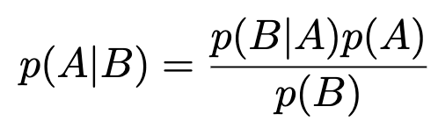
Balls and Bins and Bayes
B1
B2
What is p( ball is red if the ball is picked from B1)?
p( X = red | B = 1) =
Likelihood → you know this
distribution, so easy to calculate
What is p ( bin is B1 if the ball you picked is red )?
p( B = 1 | X = red ) =
Posterior → the opposite is a known
distribution, but this is a bit harder.

Slide 5
Balls and Bins and Bayes
B1
B2
p( Illinois resident | Harris voter )
Likelihood → you know this
distribution, so easy to calculate
p( Harris voter | Illinois resident )
Posterior → the opposite is a known
distribution, but this is a bit harder.

Slide 6
Balls and Bins and Bayes
B1 = Illinois
B2 = Texas
B2 = California
p( Illinois resident | Harris voter )
Likelihood → you know this
distribution, so easy to calculate
p( Harris voter | Illinois resident )
Posterior → the opposite is a known
distribution, but this is a bit harder.

Slide 7


Balls and Bins and Bayes
p( Illinois resident | Harris voter )
Likelihood → you know this
distribution, so easy to calculate
p( Harris voter | Illinois resident )
Posterior → the opposite is a known
distribution, but this is a bit harder.
Likelihood | p(data | distribution parameters ) | Tractable, well defined
Posterior | p (distribution parameters | data ) | Typical goal, tricky, try Bayes
Prior | p( distribution parameters ) | Domain knowledge
Evidence | p(data ) | Approximate with large data

Slide 8
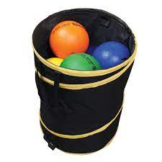
Maximum likelihood (MLE)
Draw balls from one opaque bin and put back.
i.i.d outcomes = { B, R, R, G, G, B, R, R, B, B}
Estimate parameter
where = probability of drawing red ball

Slide 9

Maximum likelihood (MLE)
Draw balls from one opaque bin and put back.
i.i.d outcomes = { B, R, R, G, G, B, R, R, B, B}
Estimate parameter
where = probability of drawing red ball

Slide 10
Multivariate
Satellites see bee locations on earth … wants to estimate bee hive location.
Given data = {L1, L2, L3, … L10}
Estimate parameter
where = bee hive location
What would you do?

Slide 11
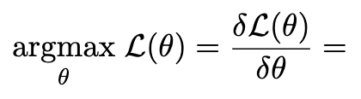
Multivariate
Satellites see bee locations on earth … wants to estimate bee hive location.
Given data = {L1, L2, L3, … L10}
Estimate parameter
where = bee hive location
What would you do?

Slide 12
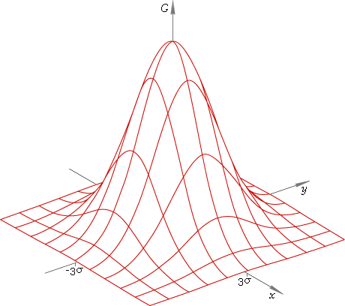
Multivariate
Slide the bell curve towards
the position that maximizes
the probability of all data points.

Slide 13

Multivariate
under the Gaussian
model
Slide the bell curve towards
the position that maximizes
the probability of all data points.

Slide 14
Multivariate
Say satellite sees red and blue bees. Possible to find two bee hive locations?

Slide 15
Multivariate
Say satellite sees red and blue bees. Possible to find two bee hive locations?
Of course, possible.

Slide 16
Multivariate
Now, satellite cannot see the bee colors.
Possible to still color each bee and find the 2 bee hive locations?

Slide 17

Multivariate
Now, satellite cannot see the bee colors.
Possible to still color each bee and find the 2 bee hive locations?
Do you see the chicken
and egg problem here?

Slide 18
Multivariate
Now, satellite cannot see the bee colors.
Possible to still color each bee and find the 2 bee hive locations?
Do you see the chicken
and egg problem here?
Motivates the popular
EM algorithm

Slide 19


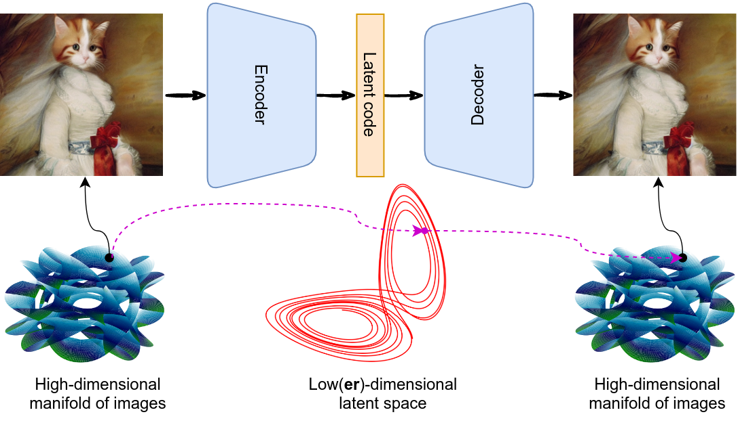
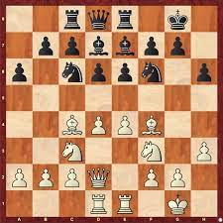
What’s the chicken and egg
Problem in VAE?
EM:
VAE:
=

Slide 20
Questions

Slide 21
Multivariate
Now, satellite cannot see the bee colors.
Possible to still color each bee and find the 2 bee hive locations?
Do you see the chicken
and egg problem here?
Motivates the popular
EM algorithm

Slide 22
Multivariate
Now, satellite cannot see the bee colors. Possible to still find 2 bee hive locations?
Brute force?
K-means → then MLE?
Other ideas?

Slide 23





Expectation Maximization (EM)
Given: Bee locations
Estimate: bee colors and bee hives
But we can estimate if we know locations of both hives

Slide 24
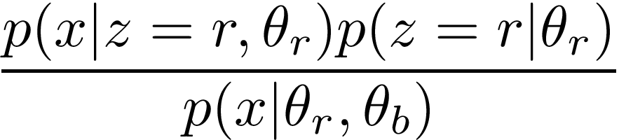

Expectation Maximization (EM)
Given: Bee locations
Estimate: bee colors and bee hives
But we can estimate if we know locations of both hives

Slide 25
Expectation Maximization (EM)
Given: Bee locations
Estimate: bee colors and bee hives
But we can estimate if we know locations of both hives
How likely a red bee is here
How likely a bee is here

Slide 26
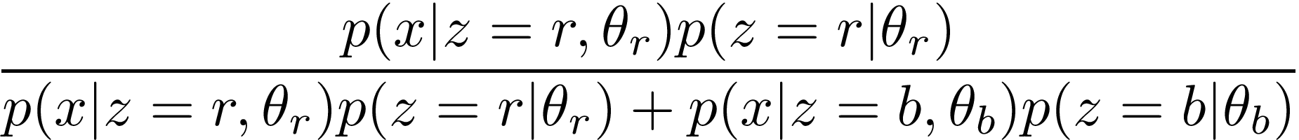
Expectation Maximization (EM)
Given: Bee locations
Estimate: bee colors and bee hives
But we can estimate if we know locations of both hives
Red bee distribution
Size of the red hive
Red bee likelihood
Blue bee likelihood

Slide 27

Expectation Maximization (EM)
Given: Bee locations
Estimate: bee colors and bee hives
But we can estimate if we know locations of both hives
Red bee distribution
Size of the red hive
Red bee likelihood
Blue bee likelihood
How do we know hive locations? We start with a guess
That’s our first “chicken”!

Slide 28

Expectation Maximization (EM)
Basic idea:
1. Initialize with arbitrary values
2. Write out the likelihood function
→ Somehow need to get

Slide 29

Expectation Maximization (EM)
Basic idea:
1. Initialize with arbitrary values
2. Write out the likelihood function
→ Somehow need to get
3. Treat as a random variable and compute it’s distribution
How? Compute the posterior
(i.e., probability of bin given ball color, probability of bee type given bee location)
4. Treat likelihood as a function of . Then, what is average likelihood?

Slide 30

Expectation Maximization (EM)
Basic idea:
1. Initialize with arbitrary values
2. Write out the likelihood function
→ Somehow need to get
3. Treat as a random variable and compute it’s distribution
How? Compute the posterior
(i.e., probability of bin given ball color, probability of bee type given bee location)
4. Treat likelihood as a function of . Then, what is average likelihood?
5. Maximize expected likelihood to get new
6. Return to step #1 until convergence
7. Return

Slide 31
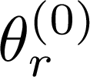
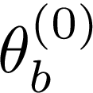


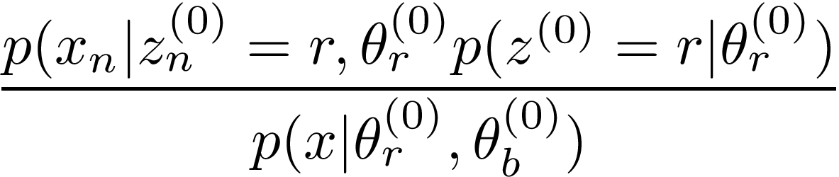
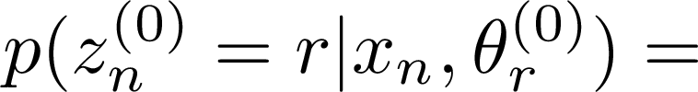
Expectation Maximization (EM) Steps
E-Step : Given estimated hive locations, Calculate bee color
Given , estimate

Slide 32
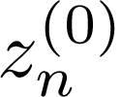
Expectation Maximization (EM) Steps
E-Step : Given estimated hive locations, Calculate bee color
Given , estimate

Slide 33

Expectation Maximization (EM) Steps
E-Step : Given estimated hive locations, Calculate bee color
Given , estimate
M-Step : Given estimated bee color, Calculate hive locations
Given , estimate

Slide 34
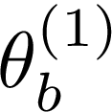
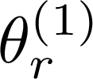
Expectation Maximization (EM) Steps
E-Step : Given estimated hive locations, Calculate bee color
Given , estimate
M-Step : Given estimated bee color, Calculate hive locations
Given , estimate

Slide 35
Expectation Maximization (EM) Steps
E-Step : Given estimated hive locations, Calculate bee color
Given , estimate
M-Step : Given estimated bee color, Calculate hive locations
Given , estimate

Slide 36
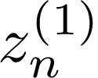
Expectation Maximization (EM) Steps
E-Step : Given estimated hive locations, Calculate bee color
Given , estimate
M-Step : Given estimated bee color, Calculate hive locations
Given , estimate

Slide 37
Flashback and looking forward …
EM:
VAE:

Slide 38
Questions

