Slide 1
Roadmap
The whole tutorial in a nutshell (only pictures and intuitions)
Quick probability warmup (Bayes, MLE, EM)
  Bayes
  Maximum likelihood estimation (MLE)
  Expectation maximization (EM)
Latent variable models: AE, VAE and visualization
Hierarchical VAE to Diffusion
Diffusion take 2: Score based models
GAN
Normalizing flows
Wrap up
30m
30m
45m
60m
30m
15m
15m
10m
~ 4 hours

Slide 2


Data Compression
Goal: Represent high dimensional data with lower dimensions
Recall – Principal Component Analysis (PCA)

Slide 3


Data Compression
Goal: Represent high dimensional data with lower dimensions
Recall – Principal Component Analysis (PCA)

Slide 4


Data Compression
Goal: Represent high dimensional data with lower dimensions
Recall – Principal Component Analysis (PCA)
Compress: Linear projection
De-compress: Linear projection

Slide 5


Data Compression
Goal: Represent high dimensional data with lower dimensions
Recall – Principal Component Analysis (PCA)
Encoder
Decoder

Slide 6
Data Compression
Goal: Represent high dimensional data with lower dimensions
Recall – Principal Component Analysis (PCA)
Encoder
Decoder
Can we do better than linear compression?
Yes! Make encoder/ decoder non-linear

Slide 7


Auto Encoder (AE)
PCA
Encoder
Decoder
AE
Encoder/ Decoder learns a low dimensional manifold
Map data to points on the manifold
Encoder
Decoder

Slide 8
Auto Encoder (AE)
AE
Encoder/ Decoder learns a low dimensional manifold
Map data to points on the manifold
Encoder
Decoder
! AE can do ANY mapping if the reconstruction is good!

Slide 9
Auto Encoder (AE)
AE
Encoder/ Decoder learns a low dimensional manifold
Map data to points on the manifold
Encoder
Decoder
! AE can do ANY mapping if the reconstruction is good!

Slide 10


Auto Encoder (AE)
AE
Encoder/ Decoder learns a low dimensional manifold
Map data to points on the manifold
Encoder
Decoder
! AE can do ANY mapping if the reconstruction is good!
Good for compression, but bad for if we want new samples - Generation
Ideally… if ,we want
We can call generated data… But AE does not guarantee this!

Slide 11







Auto Encoder (AE) Visualization
Example: Encode moon phases of different dates to
A
B
C
D
E
$$Z_{A}$$
$$Z_{B}$$
$$Z_{C}$$
$$Z_{D}$$
$$Z_{E}$$

Slide 12
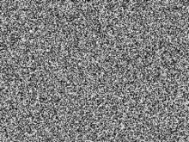
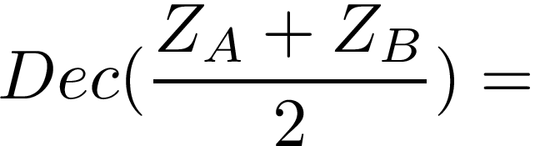



Auto Encoder (AE) Visualization
Example: Encode moon phases of different dates to
A
B
C
D
E
$$Z_{A}$$
$$Z_{B}$$
$$Z_{C}$$
$$Z_{D}$$
$$Z_{E}$$
Random can generate any images
Does not affect reconstruction loss!

Slide 13

Auto Encoder (AE) Visualization
Ideal case
A
B
C
D
E
$$Z_{A}$$
$$Z_{B}$$
$$Z_{C}$$
$$Z_{D}$$
$$Z_{E}$$
Latent dimensions keep semantic meaning
Motivate Variational Auto Encoder (VAE)
How can you make the latent semantically meaningful/ continuous?

Slide 14

Variational Auto Encoder (VAE)
AE + Probabilistic (pictures and intuitions)
EM + NN (equation)
Encoder outputs a distribution
Distribution overlap $→$ Continuous semantics

Slide 15



VAE – Variational AE
AE + Probabilistic (pictures and intuitions)
Encoder outputs a distribution
For example, if is a Gaussian
VAE Loss
Distribution overlap $→$ Continuous semantics

Slide 16




VAE – Variational AE
AE + Probabilistic (pictures and intuitions)
Encoder outputs a distribution
C
D
For example, if is a Gaussian
VAE Loss
Distribution overlap $→$ Continuous semantics
If falls in the overlap between and
and

Slide 17
VAE – Variational AE
AE + Probabilistic (pictures and intuitions)
Encoder outputs a distribution
C
D
! But overlapping hurts reconstruction!
Distribution overlap $→$ Continuous semantics
If falls in the overlap between and
and

Slide 18
VAE – Variational AE
AE + Probabilistic (pictures and intuitions)
Encoder outputs a distribution
C
D
! But overlapping hurts reconstruction!
Encoder may avoid overlapping
Distribution overlap $→$ Continuous semantics
If falls in the overlap between and
and

Slide 19
VAE – Variational AE
AE + Probabilistic (pictures and intuitions)
Encoder outputs a distribution
C
D
! But overlapping hurts reconstruction!
Encoder may avoid overlapping
Distribution overlap $→$ Continuous semantics
If falls in the overlap between and
and
How do we guarantee overlap?

Slide 20


VAE Prior and KL Loss
How do we guarantee overlap?
Match these distribution to a Gaussian
Prior

Slide 21


VAE Prior and KL Loss
How do we guarantee overlap?
Match these distribution to a Gaussian
Minimizing the KL-divergence between and

Slide 22


VAE Prior and KL Loss
How do we guarantee overlap?
Match these distribution to a Gaussian
Minimizing the KL-divergence between and
Introduce overlap between distributions and
Latent space keep semantic meaning

Slide 23




VAE Prior and KL Loss
How do we guarantee overlap?
Match these distribution to a Gaussian
Minimizing the KL-divergence between and
Introduce overlap between distributions and
Latent space keep semantic meaning
Make follows a pre-defined distribution
We can sample and generate new data

Slide 24
VAE vs AE
AE is projecting input into any low dim. vector
Encoder
Decoder

Slide 25
VAE vs AE
AE is projecting input into any low dim. vector
VAE is projecting input into a fixed low dim. prior
Like doing “Packing problem”
Encoder
Decoder
Encoder
Decoder

Slide 26
VAE vs AE
VAE is projecting input into a fixed low dim. prior
Like doing “Packing problem”
Reconstruct: Sampling from posterior
Encoder
Decoder

Slide 27
VAE vs AE
VAE is projecting input into a fixed low dim. prior
Like doing “Packing problem”
Reconstruct: Sampling from posterior
Generate: Sampling from prior
Encoder
Decoder
Encoder
Decoder

Slide 28

Variational Auto Encoder (VAE)
AE + Probabilistic (pictures and intuitions)
EM + NN (equation)
Latent: vector to distribution
Latent: NN estimating
continuous and overlapped

Slide 29
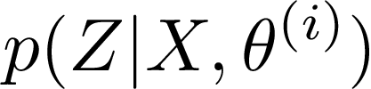
VAE – Network on EM
EM + NN (equation)
EM equation
Posterior
Likelihood

Slide 30
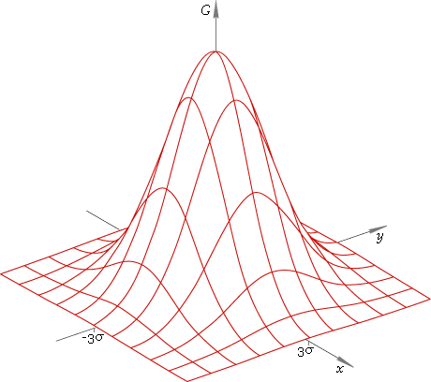

VAE – Network on EM
EM + NN (equation)
EM equation
Posterior
Likelihood
EM
Hive locations
Bee colors

Slide 31

VAE – Network on EM
EM + NN (equation)
EM equation
Posterior
Likelihood
EM
VAE
Encoder
Decoder
Hive locations
Bee colors

Slide 32

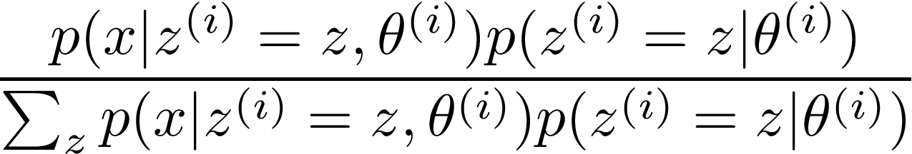

VAE – Network on EM
EM + NN (equation)
EM equation
Posterior
Likelihood
EM
Posterior
Bayes
Likelihood
MLE

Slide 33


VAE – Network on EM
EM + NN (equation)
EM equation
Posterior
Likelihood
Can we estimate Posterior and Likelihood with NN?
EM
VAE
Posterior
Bayes
Likelihood
MLE

Slide 34
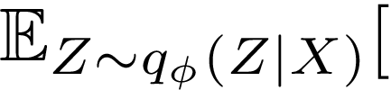
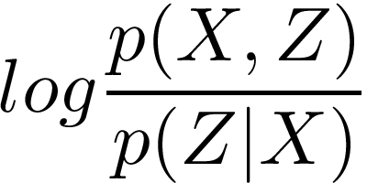


VAE – Network on EM
EM + NN (equation)
To maximize the likelihood

Slide 35
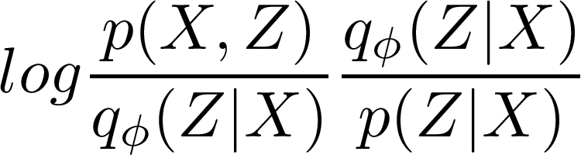
VAE – Network on EM
EM + NN (equation)
To maximize the likelihood

Slide 36
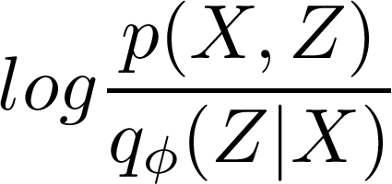
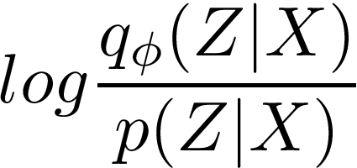

VAE – Network on EM
EM + NN (equation)
To maximize the likelihood

Slide 37


VAE – Network on EM
EM + NN (equation)
To maximize the likelihood
Evidence Lower BOund (ELBO)
Intractable since we don’t know

Slide 38
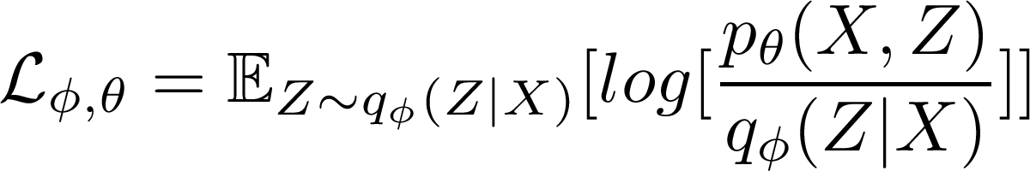
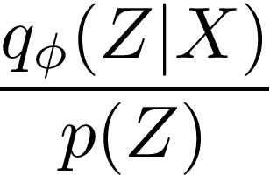

VAE – Evidence Lower BOund (ELBO)
EM + NN (equation)
ELBO is the bound to optimize for VAE
ELBO

Slide 39


VAE – Evidence Lower BOund (ELBO)
EM + NN (equation)
ELBO is the bound to optimize for VAE
ELBO
Reconstruction loss
Prior matching loss

Slide 40
VAE – Evidence Lower BOund (ELBO)
EM + NN (equation)
ELBO is the bound to optimize for VAE
ELBO
Reconstruction loss
Prior matching loss
Take-away: VAE optimize for

Slide 41
Questions

Slide 43

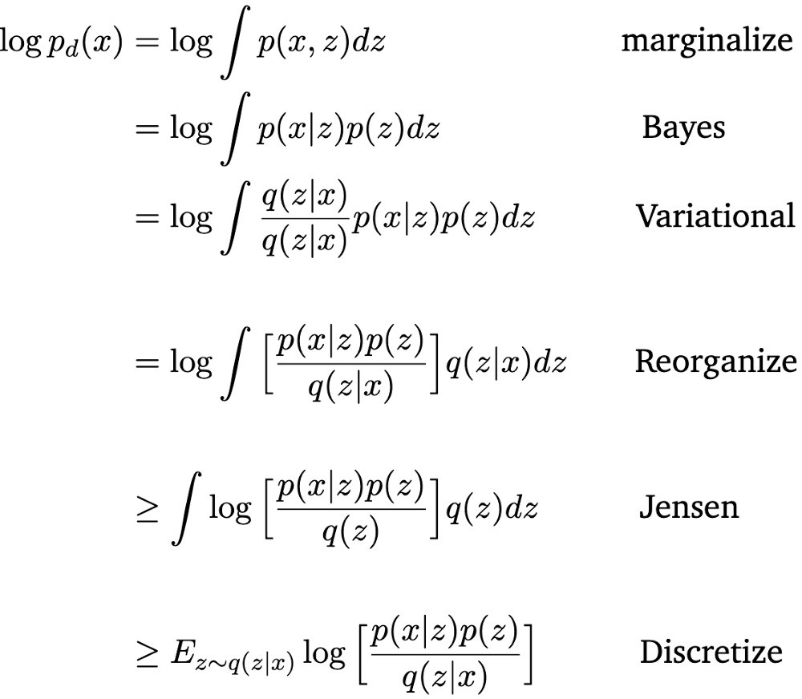
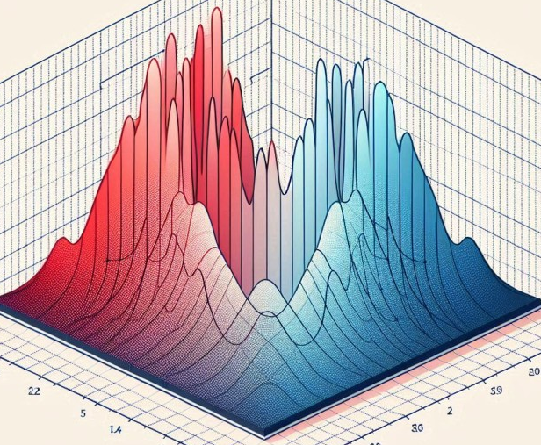
True but
unknown
Encoder
Decoder
Z space

Slide 44

True but
unknown
Encoder
Decoder
Z space
Importance
sampling from
posterior
Encoder
Decoder
Z space

Slide 45

True but
unknown
Encoder
Decoder
Z space
Importance
sampling from
posterior
Encoder
Decoder
Z space

Slide 46
True but
unknown
Encoder
Decoder
Z space
Importance
sampling from
posterior
Encoder
Decoder
Z space
Samples from the posterior

Slide 47
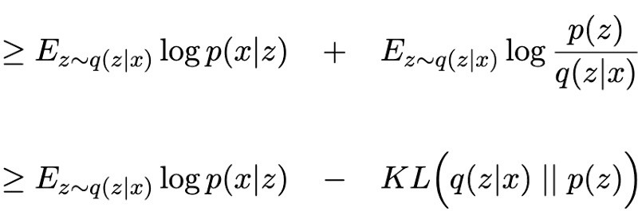
True but
unknown
Encoder
Decoder
Z space
Importance
sampling from
posterior
Encoder
Decoder
Z space

Slide 48

True but
unknown
Encoder
Decoder
Z space
Importance
sampling from
posterior
Encoder
Decoder
Evidence Lower Bound (ELBO)
Z space

Slide 49





True but
unknown
Encoder
Decoder
Z space
Importance
sampling from
posterior
Evidence Lower Bound (ELBO)
VAE learns the posterior and
likelihood function parameters: and
Encoder
Decoder
Z space

Slide 50
True but
unknown
Encoder
Decoder
Z space
False but known
Evidence Lower Bound (ELBO)
VAE learns the posterior and
likelihood function parameters: and
Encoder
Decoder
Z space

Slide 51

True but
unknown
Evidence Lower Bound (ELBO)
Encoder
Decoder
VAE learns the posterior and
likelihood function parameters: and
Z space
Maximize Expected ELBO over all data points
Encoder
Decoder
Z space

Slide 52
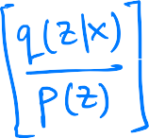





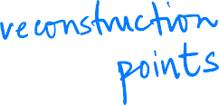





Maximize Expected ELBO over all data points
Encoder
Decoder
Z space
KL = Cross entropy – entropy

Slide 53
Maximize Expected ELBO over all data points
Encoder
Decoder
Z space
KL = Cross entropy – entropy
Reconstruction
Cross Entropy
Entropy
-
+

Slide 54
VAE is trying to find the
equilibrium between 3 forces
acting on latent space
Encoder
Decoder
Z space
Push out away from center
Pull into Gaussian dome
Flatten each mountain
Reconstruction
Cross Entropy
Entropy
-
+

Slide 55
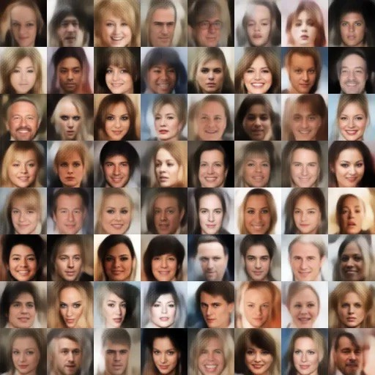
VAE is trying to find the
equilibrium between 3 forces
acting on latent space
Once VAE converges:
Sample from and feed
Decoder → Get new images
Encoder
Decoder
Z space
Push out away from center
Pull into Gaussian dome
Flatten each mountain
Reconstruction
Cross Entropy
Entropy
-
+

Slide 56
Problems Remain
Guesses?
Z space

Slide 57
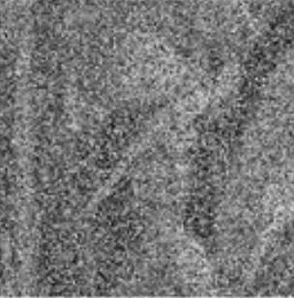
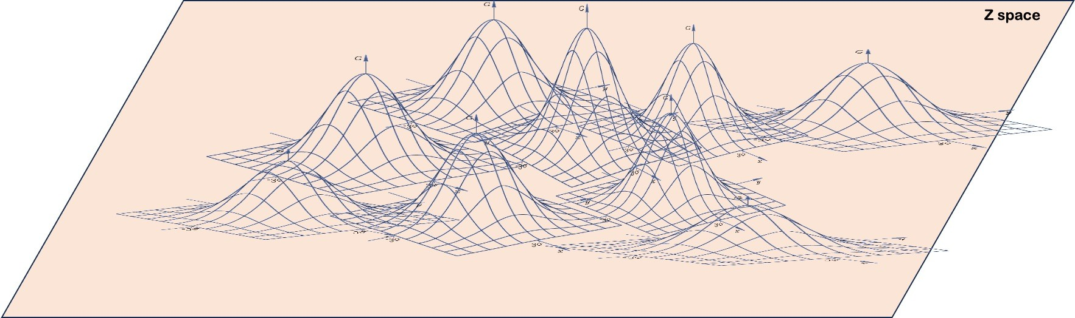
1. Prior Hole: Samples from may not have probability in . Results in poor samples on Decoding
De
Research: Why ? Learn flexible priors that match → Energy Based Models (EBM)
+ MCMC sampling

Slide 58
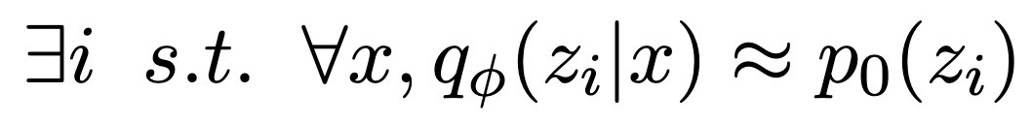
2. Posterior Collapse: If Decoder is powerful (autoregressive), then some Z dimensions are redundant
K out of L dimensions of posterior can match
Gaussian → reduces KL
Decoder decodes from remaining (L – K) dimensions

Slide 59
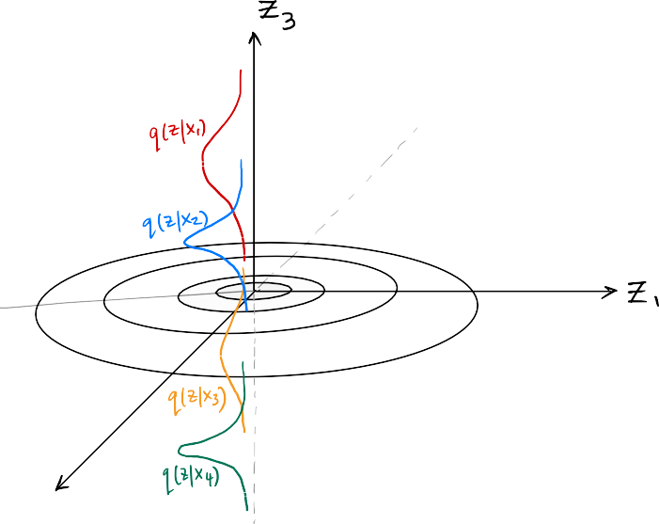
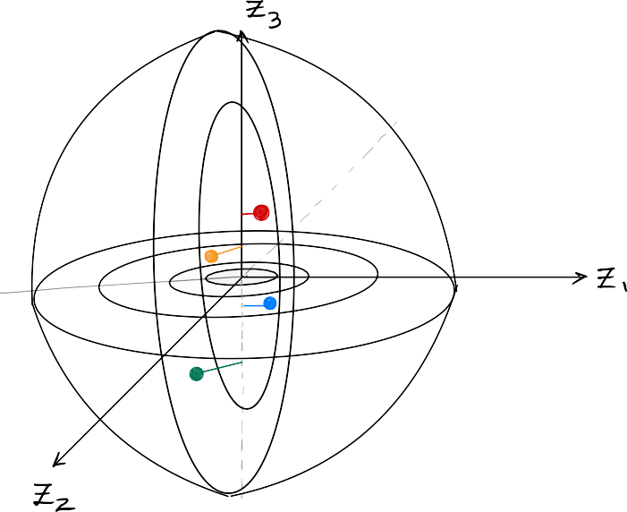
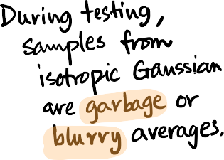

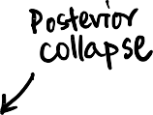

2. Posterior Collapse: If Decoder is powerful (autoregressive), then some Z dimensions are redundant
K out of L dimensions of posterior can match
Gaussian → reduces KL
Decoder decodes from remaining (L – K) dimensions

Slide 60
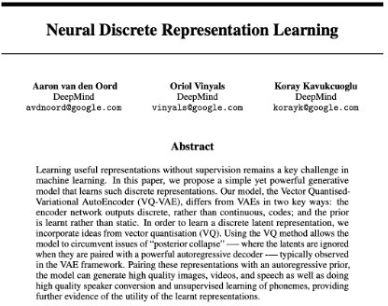
Research: Vector Quantized VAE (VQ VAE)

Slide 61
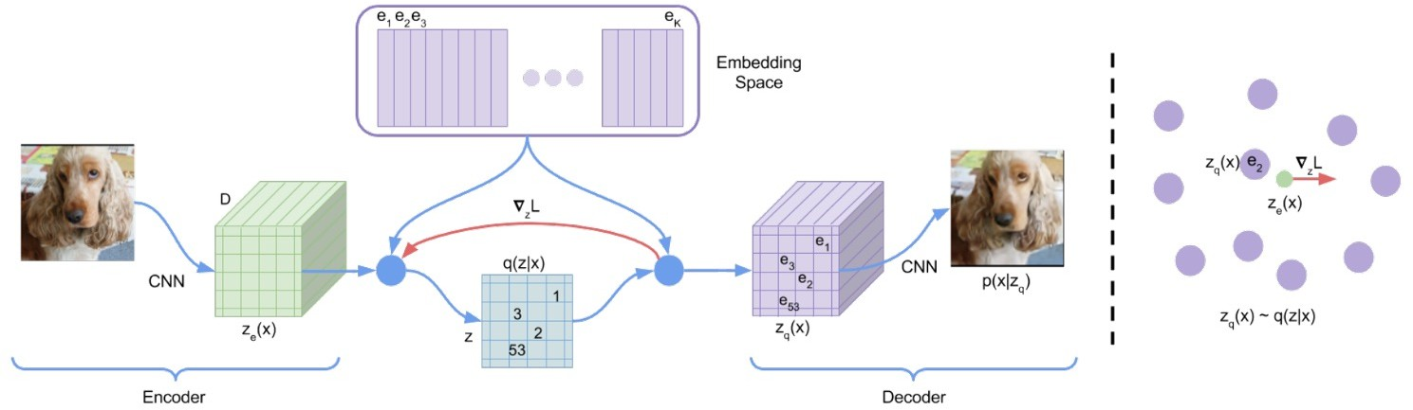
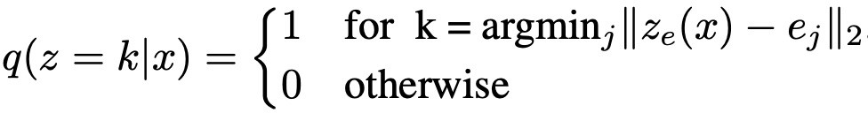
VQ-VAE: Let the latent space be discrete, i.e., composed of a dictionary of embeddings.

Slide 63
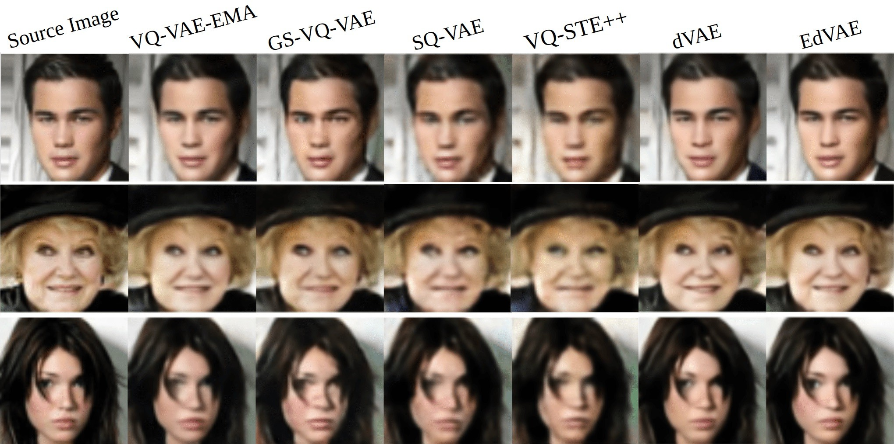
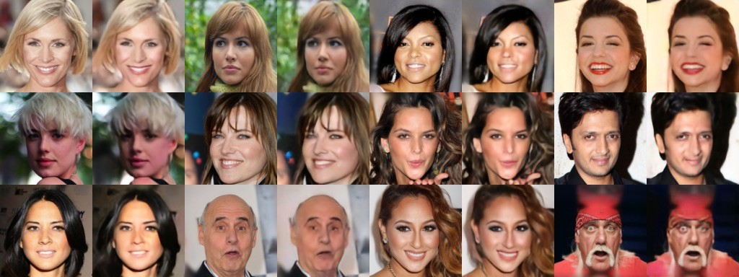

Slide 64
Questions

